Slide 1
Special Olympics Lions Clubs International Opening Eyes Introduces: Eye-Connect: Looking into our Eyes Series

Slide 2
Agenda: Diabetes and My Eyes? Eye-Connect: Looking into our Eyes Series
Does diabetes affect my vision and eye health?
What should I do to protect my eyes if I am diabetic?
Is the Opening Eyes program that same as an eye exam?

Slide 3
Why did we create Eye-Connect: Looking into our Eyes Series?
COVID-19 pandemic has affected all of us!
COVID-19 pandemic has been shown us that we can continue to work with Special Olympics athletes. We just need to maintain our distance so we can protect each other from the virus.

Slide 4
Let’s Get Started – What is diabetes?
Diabetes is a disease that occurs when your blood sugar (also called blood glucose) is too high.
Blood glucose is what gives your energy. You get this from the foods that you eat.

Slide 5
Let’s Get Started – What is diabetes?

Slide 6
What is diabetes?
Insulin is a hormone made by the pancreas (part of your body). Insulin helps your body convert the glucose you get from the foods you eat get into cells. That is where it changes the glucose to energy.
If insulin is not doing its job right, you end up with more glucose in your blood. That is when you are told you have diabetes.

Slide 7
What are the types of diabetes ?
There are three kinds of diabetes:
Type 1 diabetes – this is the kind that is found in children and young adults.
Type 2 diabetes – this is seen in adults and is the most common type.
Diabetes can be seen in some women when they are pregnant.

Slide 8
What puts me at risk for developing diabetes?
It is more common in people when:
they are over 45 years of age
there is a family history of diabetes
you are overweight, high BMI
you are physically inactive – you do not move or exercise
factors that put you at high risk include your race or other health problems such as high blood pressure, high cholesterol, or kidney disease

Slide 9
How do I know if I have diabetes?
Many people do not know that they are.

Slide 10
How do I know if I have diabetes?
The doctor will do a blood test to find out if you have diabetes or prediabetes.

Slide 11
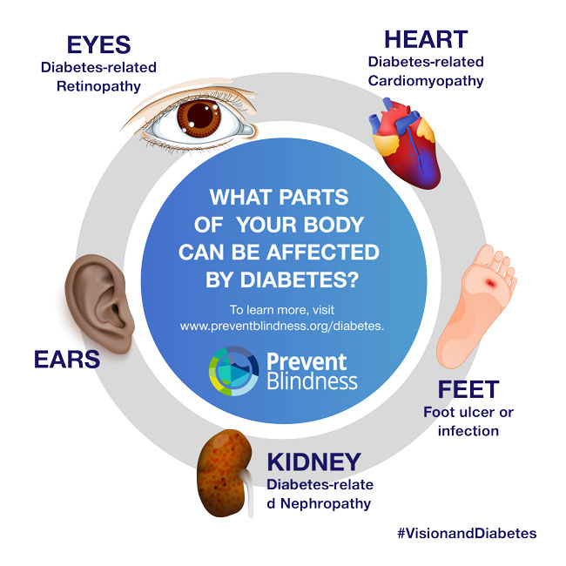
If I have diabetes, what other kinds of health problems can happen?
Heart problems
Nerve damage
Foot problems
Mouth / dental health problems
Kidney problems
Sexual and bladder problems
Vision and eye health problems
Ears

Slide 12
What vision problems occur with diabetes?
There are other eye health problems caused by diabetes:
Diabetic retinopathy – most common problem
Diabetic macular edema
Cataracts
Glaucoma
Notes:
https://www.nei.nih.gov/learn-about-eye-health/eye-conditions-and-diseases/diabetic-retinopathy
Diabetic Retinopathy
On this page:
Types Symptoms Risk Causes Diagnosis Prevention Treatment Research Resources
At a glance: Diabetic Retinopathy
Early Symptoms:
None
Later Symptoms:
Blurry vision, floating spots in your vision, blindness
Diagnosis:
Dilated eye exam
Treatment:
Medicine, laser treatment, surgery
What is diabetic retinopathy?
Diabetic retinopathy is an eye condition that can cause vision loss and blindness in people who have diabetes. It affects blood vessels in the retina (the light-sensitive layer of tissue in the back of your eye).
If you have diabetes, it’s important for you to get a comprehensive dilated eye exam at least once a year. Diabetic retinopathy may not have any symptoms at first — but finding it early can help you take steps to protect your vision.
Managing your diabetes — by staying physically active, eating healthy, and taking your medicine — can also help you prevent or delay vision loss.
Other types of diabetic eye disease
Diabetic retinopathy is the most common cause of vision loss for people with diabetes. But diabetes can also make you more likely to develop several other eye conditions:
Cataracts. Having diabetes makes you 2 to 5 times more likely to develop cataracts. It also makes you more likely to get them at a younger age. Learn more about cataracts.
Open-angle glaucoma. Having diabetes nearly doubles your risk of developing a type of glaucoma called open-angle glaucoma. Learn more about glaucoma.
What are the symptoms of diabetic retinopathy?
The early stages of diabetic retinopathy usually don’t have any symptoms. Some people notice changes in their vision, like trouble reading or seeing faraway objects. These changes may come and go.
In later stages of the disease, blood vessels in the retina start to bleed into the vitreous (gel-like fluid in the center of the eye). If this happens, you may see dark, floating spots or streaks that look like cobwebs. Sometimes, the spots clear up on their own — but it’s important to get treatment right away. Without treatment, the bleeding can happen again, get worse, or cause scarring.
What other problems can diabetic retinopathy cause?
Diabetic retinopathy can lead to other serious eye conditions:
Diabetic macular edema (DME). Over time, about half of people with diabetic retinopathy will develop DME. DME happens when blood vessels in the retina leak fluid, causing swelling in the macula (a part of the retina). If you have DME, your vision will become blurry because of the extra fluid in your macula.
Neovascular glaucoma. Diabetic retinopathy can cause abnormal blood vessels to grow out of the retina and block fluid from draining out of the eye. This causes a type of glaucoma.
Learn more about types of glaucoma
Retinal detachment. Diabetic retinopathy can cause scars to form in the back of your eye. When the scars pull your retina away from the back of your eye, it’s called tractional retinal detachment.
Learn more about types of retinal detachment
Am I at risk for diabetic retinopathy?
Anyone with any kind of diabetes can get diabetic retinopathy — including people with type 1, type 2, and gestational diabetes (diabetes that can develop during pregnancy).
Your risk increases the longer you have diabetes. More than 2 in 5 Americans with diabetes have some stage of diabetic retinopathy. The good news is that you can lower your risk of developing diabetic retinopathy by controlling your diabetes.
Women with diabetes who become pregnant — or women who develop gestational diabetes — are at high risk for getting diabetic retinopathy. If you have diabetes and are pregnant, have a comprehensive dilated eye exam as soon as possible. Ask your doctor if you’ll need additional eye exams during your pregnancy.
What causes diabetic retinopathy?
Diabetic retinopathy is caused by high blood sugar due to diabetes. Over time, having too much sugar in your blood can damage your retina — the part of your eye that detects light and sends signals to your brain through a nerve in the back of your eye (optic nerve).
Diabetes damages blood vessels all over the body. The damage to your eyes starts when sugar blocks the tiny blood vessels that go to your retina, causing them to leak fluid or bleed. To make up for these blocked blood vessels, your eyes then grow new blood vessels that don’t work well. These new blood vessels can leak or bleed easily.
How will my eye doctor check for diabetic retinopathy?
Eye doctors can check for diabetic retinopathy as part of a dilated eye exam. The exam is simple and painless — your doctor will give you some eye drops to dilate (widen) your pupil and then check your eyes for diabetic retinopathy and other eye problems.
Learn what to expect from a dilated eye exam
If you have diabetes, it’s very important to get regular eye exams. If you do develop diabetic retinopathy, early treatment can stop the damage and prevent blindness.
If your eye doctor thinks you may have severe diabetic retinopathy or DME, they may do a test called a fluorescein angiogram. This test lets the doctor see pictures of the blood vessels in your retina.
What can I do to prevent diabetic retinopathy?
Managing your diabetes is the best way to lower your risk of diabetic retinopathy. That means keeping your blood sugar levels as close to normal as possible. You can do this by getting regular physical activity, eating healthy, and carefully following your doctor’s instructions for your insulin or other diabetes medicines.
To help control your blood sugar, you’ll need a special test called an A1c test. This test shows your average blood sugar level over a 3-month period. Talk with your doctor about lowering your A1c level to help prevent or manage diabetic retinopathy.
Learn more about the A1c test
Having high blood pressure or high cholesterol along with diabetes increases your risk for diabetic retinopathy. So controlling your blood pressure and cholesterol can also help lower your risk for vision loss.
What’s the treatment for diabetic retinopathy and DME?
In the early stages of diabetic retinopathy, your eye doctor will probably just keep track of how your eyes are doing. Some people with diabetic retinopathy may need a comprehensive dilated eye exam as often as every 2 to 4 months.
In later stages, it’s important to start treatment right away — especially if you experience changes in your vision. While it won’t undo any damage to your vision, treatment can stop your vision from getting worse. It’s also important to take steps to control your diabetes, blood pressure, and cholesterol.
Injections. Medicines called anti-VEGF drugs can slow down or reverse diabetic retinopathy. Other medicines, called corticosteroids, can also help.
Learn more about injections to treat diabetic retinopathy
Laser treatment. To reduce swelling in your retina, eye doctors can use lasers to make the blood vessels shrink and stop leaking.
Learn more about laser treatment for diabetic retinopathy
Eye surgery. If your retina is bleeding a lot or you have a lot of scars in your eye, your eye doctor may recommend a type of surgery called a vitrectomy.
Learn more about vitrectomy
What is the latest research on diabetic retinopathy and DME?
Scientists are studying better ways to find, treat, and prevent vision loss in people with diabetes.
Get the latest news on NEI-supported diabetic eye disease research
Diabetic Eye Disease Resources
Find statistics and data on diabetic retinopathy in the United States
Check out our library of diabetic eye disease videos
See our materials for community health educators
Get flyers, booklets, and other resources about diabetic eye disease
Last updated: August 3, 2019

Slide 13
How will I know if I have a vision problem from my diabetes?

Slide 14
What can I do to protect my vision and eye health?

Slide 15
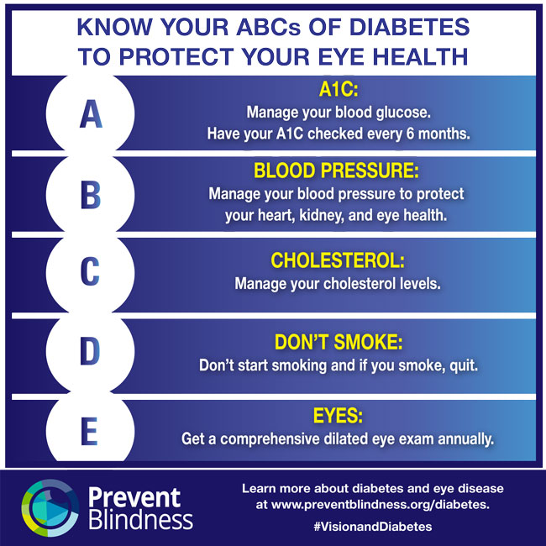
What can I do to protect my vision and eye health?

Slide 16
What if I suspect an eye health problem?
If you think that you have any of the problems just described, you need to go for a complete eye exam.
Make sure you tell the eye doctor all the problems that you have observed or are worried about.

Slide 17
One last point! The 20-20-20 Rule
With COVID-19, many young (and old) people are spending too much time on their devices. This can lead to visual fatigue. We recommend that they follow the 20-20-20 Rule:
For every 20 minutes that the person looks at a book or screen, they should look at something at least 20 feet (6 meters) always for 20 seconds to prevent and relief digital eye strain. You can also close the eyes for 20 seconds or blink for a few seconds in addition to prevent dry eyes.

Slide 18
The 20-20-20 Rule

Slide 19
Take care of their eyes!
Early identification and treatment of vision problems can often lead to good vision.
Remember that the Opening Eyes Program doesn’t replace eyecare with your personal eye doctor.

Slide 20
Best wishes for a long life of good vision!
Special Olympics Lions Clubs International Opening Eyes

