Slide 1
overall_0_132499602025518819 columns_1_132499602025518819
The mark “CDC” is owned by the US Dept. of Health and Human Services and is used with permission. Use of this logo is not an endorsement by HHS or CDC of any particular product, service, or enterprise.

Slide 3
The Reality of Health For Children with ID:
6x more likely to be hospitalized
16-20 years shorter life expectancy
7x higher mortality
Poorer health status in children/youth than other ages
Notes:
People with intellectual disabilities die 20 years prematurely and often from preventable causes of death.
Stigma faced by people with intellectual disabilities (ID) compromises the quality of care they receive & limits their access to professional care leading to a cascade of disparities.
Despite severe need and higher health risks, people with ID lack access to quality health care and prevention programming.

Slide 4
Untreated Health Conditions Exist…
Children in the US (age 8-19 years) from 2015 to present.
Notes:
Where does the cascade begin? In our studies over 2 decades in countries all over the world, we have found that it's lack of preventive care. In the US, on a team of 10 Special Olympics children ages 8 to 19, over 20% have untreated tooth decay—active dental caries--and 1 in 10 need an urgent dental care; 40% need a new prescription for eye glasses—they are coming to the field and they can't see, 1 in 10 has never had an eye exam. Almost 20% fail our hearing tests—they can't hear. Half are overweight or obese and most have flexibility, strength or balance issues that put them at risk for injury.

Slide 5
Multiple Causes of Health Disparities:
Limited accessible prevention programming
Lack of access to healthcare including insurance, lack of preventive screenings, delayed specialty care and no coordination
Lack of trained providers skills and resources for providers
Prohibitively complex health systems that people with intellectual disabilities cannot navigate

Slide 6
Their doctors aren't confident … and aren't getting trained
80%
41%
80%
Of doctors believe their patients with IDD have worse quality of life
Of physicians felt confident about their ability to provide the same quality of care
Of health professionals have not been trained on IDD
Notes:
Well, physicians aren't that comfortable or confident taking care of children and adults with ID. I don't know about you, but sometimes I have to get my real game face on and try to get through some of these complex visits. I admit, I sometimes feel bad for these families—and I'm not alone. 4 of 5 doctors believe their patients with ID have worse quality of life—that's an underlying assumption that is maybe ingrained in our culture. But wow, take a pause on that bias.
And sometimes I feel like I can't do that much to help or I don't know how. Less than half of physicians felt confident about their ability to provide the same quality of care to those with ID as without.
Finally, 80% have never been trained on ID. I am sure it's different here, but when I went to medical school and residency, I got about 2 hours total on IDD.

Slide 7
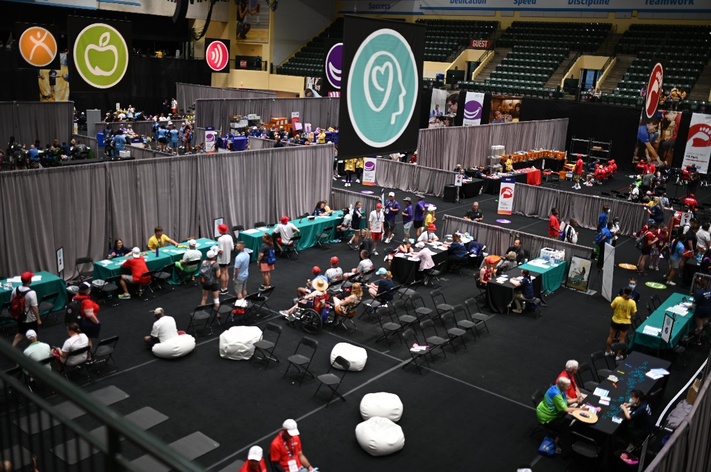
Healthy Athletes: A Program to Address Health Disparities
Special Olympics created Healthy Athletes to provide a comprehensive screening program for people with intellectual disabilities
Aims to identify, treat, and provide referrals for health conditions that are common in people with ID
Provided over 2 million screenings to date
9 Screening Disciplines:
Audiology
Dentistry
Mental Health
Optometry
Pediatrics
Physical Therapy
Podiatry
Prevention & Nutrition
Sports Physicals

Slide 8
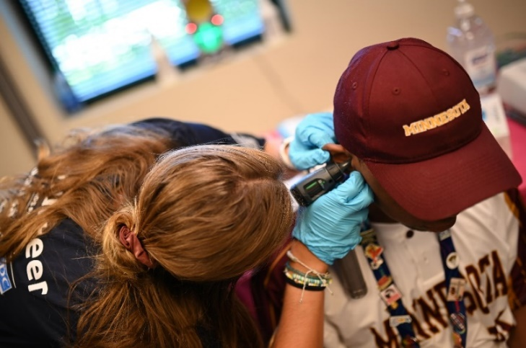
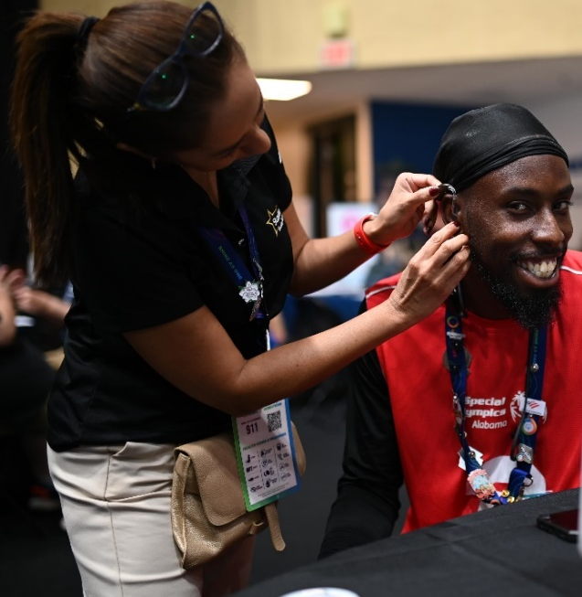
Healthy Hearing:
Increase access to hearing care for athletes
Identify permanent hearing loss and medical issues causing hearing loss and provide referral for follow-up care
Raise audiologists’ awareness of the hearing concerns of people with special needs
Provide educational and clinical opportunities for students training in of Speech Language Pathology and Audiology
Provide a list of regional audiologists and ear, nose and throat specialists who care for people with special needs
Educate athletes about ways to prevent hearing loss from noise exposure
20% of Special Olympics athletes fail hearing tests

Slide 9
Healthy Hearing Volunteers:
For additional information please visit the Healthy Hearing Resource Page
Volunteer Manual: Volunteer Manual

Slide 10
Volunteer Responsibilities:
Interacting with athletes
Possible limited verbal expression
and comprehension
Possible undiagnosed hearing or vision loss
Possible language/dialect barriers
Possible greater sensitivity to
non-verbal communication
Possible use of communication devices
Helping with flow
Conducting screenings
Educating athletes
5. Escorting an athlete through stations
6. Setting up/Cleaning up
7. Data collection
Accurate and thorough documentation is important
Used to improve screenings and follow-up care, strengthen prevention programming, inform improvements in health system
8. Data recording

Slide 11
Healthy Hearing Introductory Video:

Slide 12
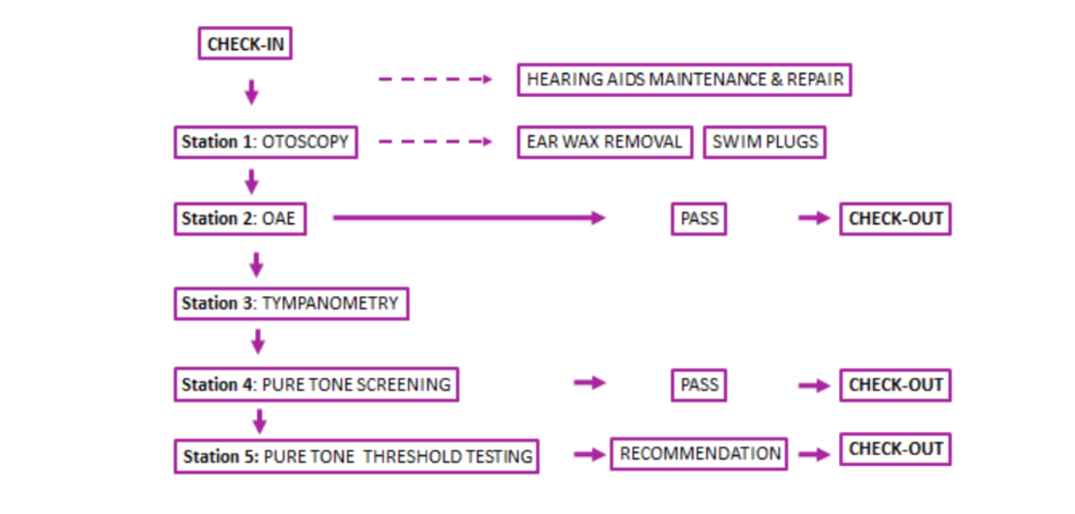
Healthy Hearing Stations:

Slide 13
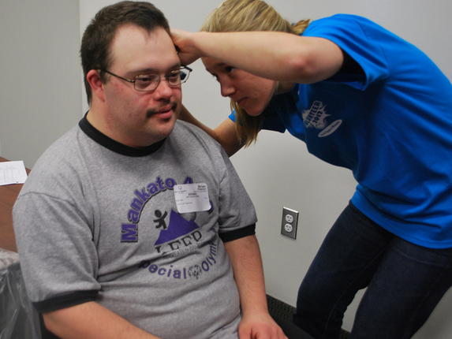
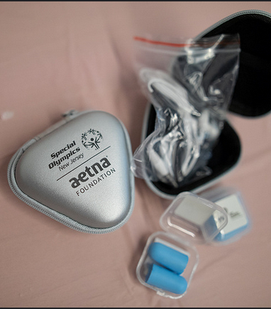
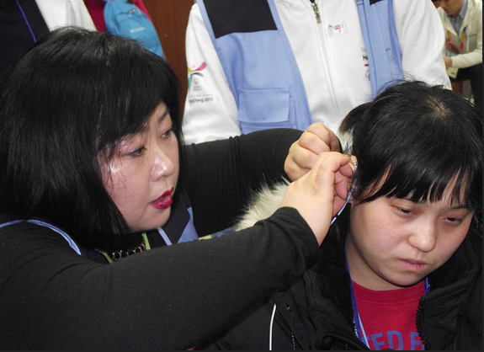
Optional Stations:
Ear Wax Removal
Swim Plugs
Hearing Aid Maintenance/Repair
Check-In, Stations 1-5, Check-Out, will always be available at screening event
Healthy Hearing has a new partnership with Starkey Cares where they will provide cerumen removal and hearing aid services onsite at event when activated by the Program

Slide 14
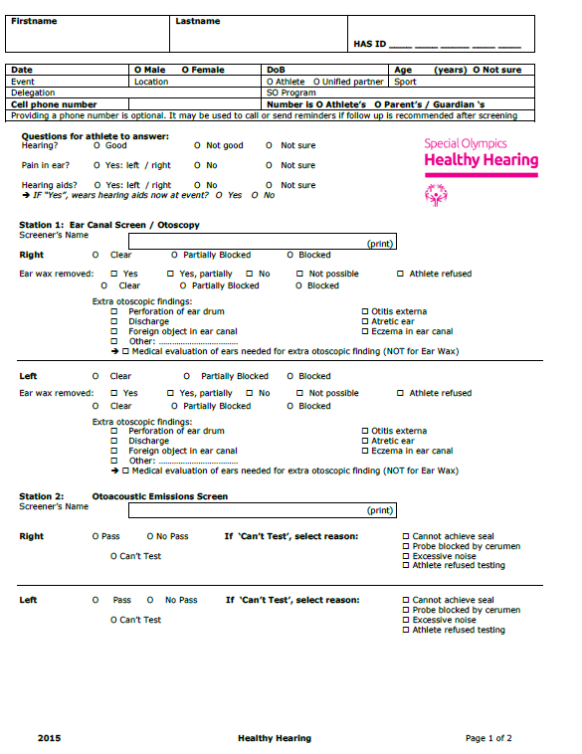
Healthy Athletes Systems (HAS) Form and Screening:
The HAS form is the method you will use to document every athlete who is screened at a Healthy Hearing event
Link to form: HAS Form

Slide 15
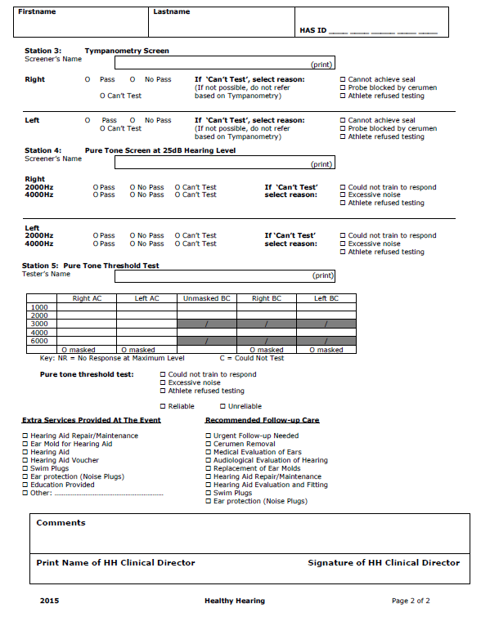
Healthy Athletes Systems (HAS) Form and Screening:
The data helps improve screenings and follow-up care and strengthen prevention programming that improve the health of individuals with intellectual disabilities worldwide
Link to form: HAS Form

Slide 16
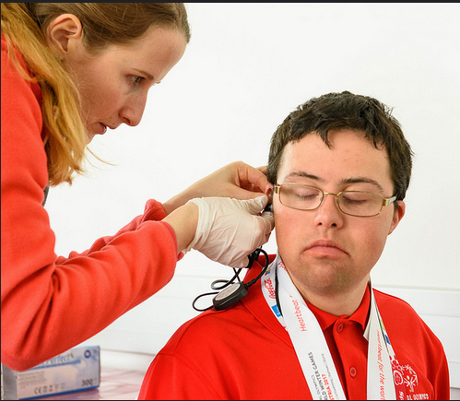
Supplies Needed for Each Healthy Hearing Station:
Office Supplies
Clipboards
Pens
Trash bags
Tables
Table coverings
Chairs
General Supplies
Otoscopes + specula
Disinfectant supplies
Electrical adaptors and converters for events outside of the US
Batteries for equipment
Extension cords
Power strips/power boards
Water and snacks for volunteers
Hand sanitizer
Non-latex gloves
Other Supplies
T-shirts
Decorations
Athlete giveaways
Link to list: Equipment List
Notes:
Link to list
Healthy-Hearing-Healthy-Athletes-Equipment-and-Supply-List-22.pdf (specialolympics.org)

Slide 17
Equipment Needed for Each Healthy Hearing Screening Event:
Clinical Screening Equipment
OAEs screening units and tips
Tympanometers and reusable tips
Pure Tone Audiometers with Air Conduction (AC) and Bone Conduction (BC)
Link to list: Equipment List
Notes:
Link to list→Healthy-Hearing-Healthy-Athletes-Equipment-and-Supply-List-22.pdf (specialolympics.org)

Slide 18
Next, we will discuss what occurs during each Healthy Hearing Screening Station

Slide 19
Check-in: Completing the first section on the HAS form
Sit facing the athlete
Acquire the athlete’s general information
Ask the athlete hearing-related questions, not the coach/parent

Slide 20
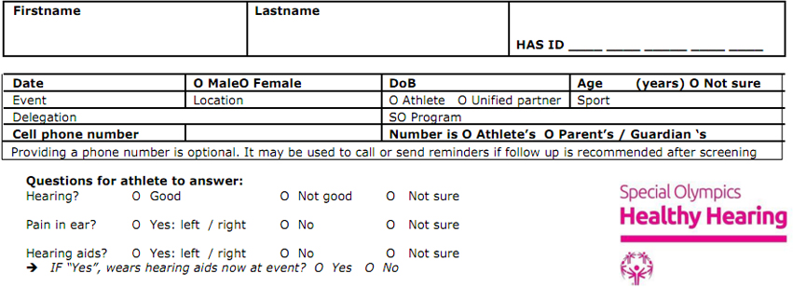
Check-in: Completing the first section on the HAS form
If the athlete has a hearing aid with them at the screening, one clinical volunteer can check and do maintenance, while another screens the athlete

Slide 21
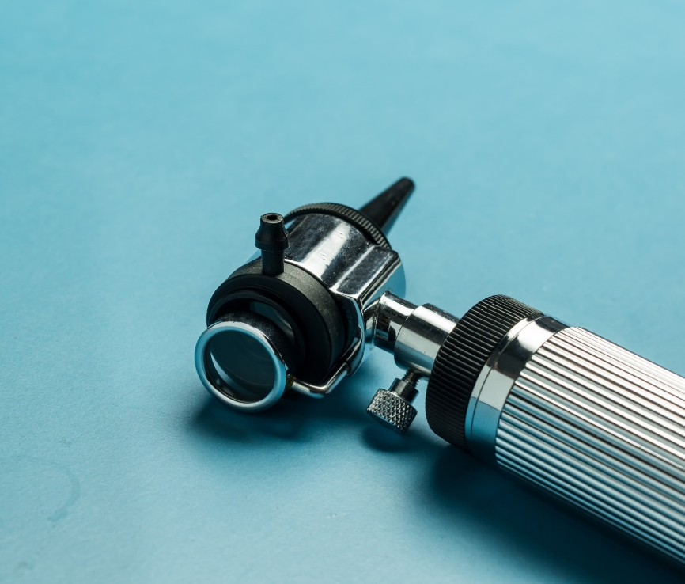
Station 1: Otoscopy
Explain to the athlete what you will be doing
Show them the tools you will be using
Ask if it is okay to continue
With the athlete sitting comfortably and you standing next to him/her, conduct the screening

Slide 22
Station 1: Otoscopy
Cerumen blockage
If an ear canal is partially blocked or blocked with ear wax then refer to ear wax removal, as it will be difficult to obtain an accurate assessment due to blockage
Discharge from ear(s)
If detected, do not perform any exam in that specific ear - the other ear can be screened and on the HAS form indicate that you could not test and explain why

Slide 23
Station 2: Otoacoustic Emissions (OAEs)
Explain to the athlete what you are going to be doing
Show them the tools you will be using
Ask if it is okay to continue
With the athlete sitting comfortably and you standing next to him/her, conduct the screening

Slide 24
Station 2: OAEs Troubleshooting and Results
The most common problem to solve within Station 2 is related to power and electricity
Regarding the screening itself, there are a few suggestions to keep in mind to help avoid any Station 2 screening challenges
If suddenly all OAE units stop working, it may be because of an electrical overload. This can be solved by unplugging the OAE units and relying on their battery supply
Clip probe cable to credentials or clothes of athletes; do not hold the probe cable while screening
Make sure the correct size of foam ear tip is chosen
Retry the OAEs after repositioning the probe in the ear canal
If there is a “pass” for each ear, athlete moves to check-out station

Slide 25
Station 3: Tympanometry
Explain to the athlete what you are going to be doing
Show them the tools you will be using
Ask if it is okay to continue
With the athlete sitting comfortably and you standing next to him/her, conduct the screening

Slide 26
Station 3: Tympanometry Results
For standardization, the following normative data for tympanometry (“The Rule of 2”) need to be used
✓ “Pass” =
admittance between 0.20 and 2 mmho
middle ear pressure between +20 and -200daPa
ear canal volume between 0.60 and 2 ml
✓ “No Pass” =
type B (= flat)
type C (= under pressure) with middle ear pressure more positive than +20 daPa or more negative than -200 daPa
type As with admittance < 0,20 mmho
type AD with admittance > 2 mmho
ear canal volume < 0.60 ml or > 2 ml
If you “can’t test” try to problem solve the reason why the testing is not possible - for instance, clean probe of ear wax, ask a colleague to try to obtain a seal, etc., and then retry

Slide 27
Station 4: Pure Tone Screening
Clean the headphones and bone conductor, with a disinfectant wipe
Explain to the athlete what you are going to be doing
Ask if it is okay to continue
With the athlete sitting comfortably and you standing next to him/her, conduct the screening
Sit in a way you can see the athlete’s face for observation of facial expressions and body language, but the athlete cannot see the controls, other athletes or surrounding activity

Slide 28
Station 4: Pure Tone Screening Results
If there is a “pass” for each ear for 2000 and 4000Hz, athlete moves to check-out station
Record your findings on the HAS form for both the right and left ear - both ears should be tested in Station 4 and 5, not only the ear with the result of “no pass” on the OAEs

Slide 29
Station 5: Pure Tone Thresholds
Clean the headphones and bone conductor, with a disinfectant wipe
Explain to the athlete what you are going to be doing
Ask if it is okay to continue
With the athlete sitting comfortably and you standing next to him/her, conduct the screening
Sit in a way you can see the athlete’s face for observation of facial expressions and body language, but the athlete cannot see the controls, other athletes or surrounding activity

Slide 30
Station 5: Pure Tone Thresholds Results
As soon as a “no pass” on 1 of the 2 test frequencies is obtained in Station 4, the volunteer can stop screening and start the pure tone threshold testing" in station 5
Record your findings on the HAS form for both the right and left ear
Both ears should be tested in Station 4 and 5, not only the ear with the result of “no pass” on the OAEs
Please take your time to check the box indicating if the test was reliable or unreliable

Slide 31
Check-out:
This role is most important, as you are responsible for quality control - your role here is crucial as you are tying all the stations together and ensuring appropriate referral and education
Clinical Director or a lead Audiologist volunteer will
Check the HAS form to make sure the athlete went to all necessary stations
Check the HAS form to make sure it was completed correctly
Review all “no pass” stations for each athlete and decide on appropriate recommendations and referral
Give athlete a “pass” or “no pass” form depending on results
Notes:
Pass Form - https://media.specialolympics.org/resources/health/disciplines/healthy-hearing/HealthyHearing_PASS_RecommendationForm.pdf?_ga=2.85539870.609422274.1679493233-1634640219.1679329663
No Pass Form - https://media.specialolympics.org/resources/health/disciplines/healthy-hearing/HH_NO-PASS-RecommendationForm_ENGLISH.pdf?_ga=2.85539870.609422274.1679493233-1634640219.1679329663

Slide 32
Check-out: Pass and No Pass Forms
Pass Form - Pass Form
No Pass Form - No Pass Form
Notes:
Pass Form - https://media.specialolympics.org/resources/health/disciplines/healthy-hearing/HealthyHearing_PASS_RecommendationForm.pdf?_ga=2.85539870.609422274.1679493233-1634640219.1679329663
No Pass Form - https://media.specialolympics.org/resources/health/disciplines/healthy-hearing/HH_NO-PASS-RecommendationForm_ENGLISH.pdf?_ga=2.85539870.609422274.1679493233-1634640219.1679329663

Slide 33
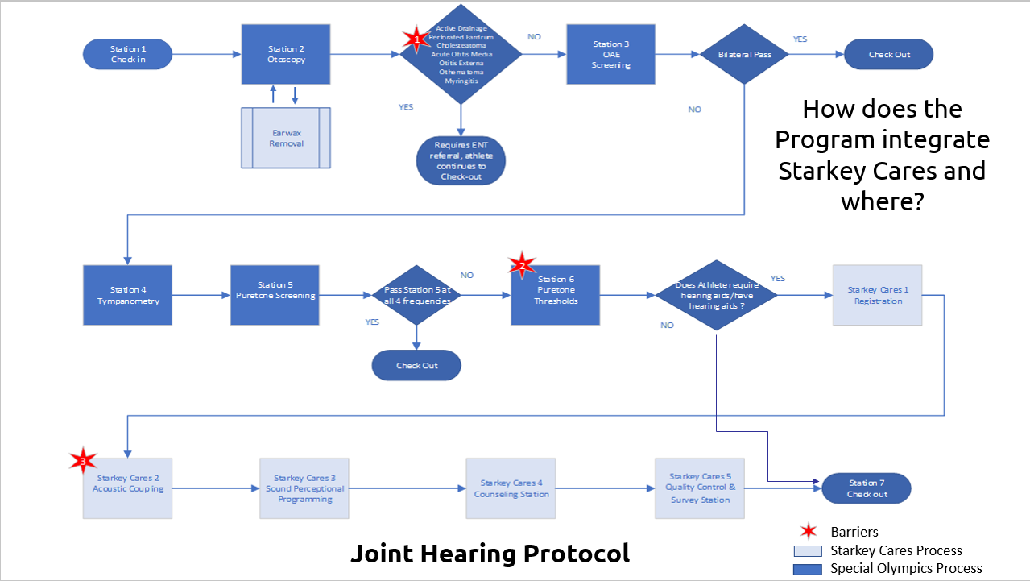

Slide 34
Guidelines for Follow-up Care Recommendations:
Otoscopy: “Partially Blocked” or “Blocked” ear canals in one or both ears→ referral ear wax removal = “Cerumen Removal”
Otoscopy: “Medical evaluation of ears needed for extra otoscopic findings” checked by Healthy Hearing Clinical Director / Medical Doctor in one or both ears (after visualization of an acute problem in the ear canal or at the ear drum) → referral for possible ear problem = “Medical Evaluation of Ears”
OAE: “No Pass” in one or both ears → no referral → recommendation will depend on results on pure tone audiometry
Tympanometry: “No Pass” in one or both ears (no normal type A-tympanogram OR abnormal small or abnormal big ear canal volume OR type B-tympanogram) → referral for possible middle ear problems (unless no other referral is necessary) = “Medical Evaluation of Ears”
Pure Tone Audiometry: “No Pass” on pure tone audiometry in one or both ears (response > 25dBHL at 2000 and/or 4000Hz) → referral to rule out hearing loss = “Audiological Evaluation of Hearing”
BUT, to avoid over-referral: ✓ If the only “No Pass” is on tympanometry, no referral is made, unless the Lead Audiologist or Medical Doctor decides that it is necessary. ✓ If there is a “No Pass” on pure tone audiometry for 1 or 2 test frequencies at 30dBHL (instead of 25dBHL), no referral for possible hearing loss is needed, unless the Lead Audiologist decides it is necessary

Slide 35
General Advice on Regular Ear and Hearing Screening:
Goal: Every athlete will receive general advice, which is:
✓ Have your ears checked by a medical doctor for ear wax 1 / 2* times a year
✓ Have a hearing evaluation by an audiologist / ENT-specialist every 1 / 3 / 5* year(s)
* strike out as appropriate Guidelines for general advice
• An athlete, without Down syndrome, without hearing aid(s):
✓ Ear wax: once a year
✓ Hearing evaluation: every 5 years
• An athlete with Down syndrome, without hearing aid(s):
✓ Ear wax: twice a year
✓ Hearing evaluation: every 3 years ≤ 35 years of age // every year > 35 years of age
• Athlete with hearing aid(s):
✓ Ear wax: Twice a year
✓ Hearing evaluation: every year
The individual results as well as the specific recommendations need to be explained to the athlete as well as to the coach, carer and/or family

Slide 36
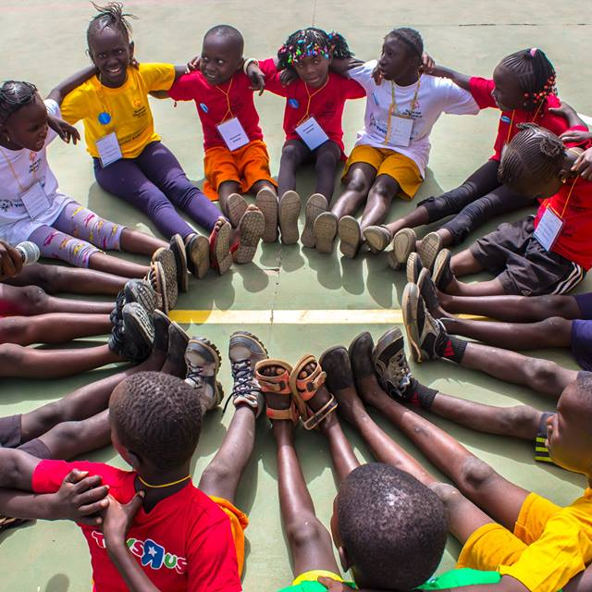
overall_1_132499605790186937 columns_1_132499605790186937
THANK YOU!

