Slide 1
Healthy Hearing 2.0 Training Webinar
Denise Cardona, AuD, CCC/A
Sr. Clinical Program Manager
Notes:
Hi everyone. I appreciate you being here for the healthy hearing 2.0 training webinar.
Following this call, please address any specific inquiries regarding HAS 2.0 to Brittany Routh at healthyathletes@specialolympics.org, and direct any Healthy Hearing related questions to healthyhearing@specialolympics.org. This session is being recorded and will be posted on the web after the completion of all healthy athletes discipline training

Slide 2
Outline
Introduction
Healthy Athletes 2.0
HAS 2.0 Clinical Director Training
Referral Guidelines
Pass/No Pass forms
HAS Form
Q&A

Slide 3
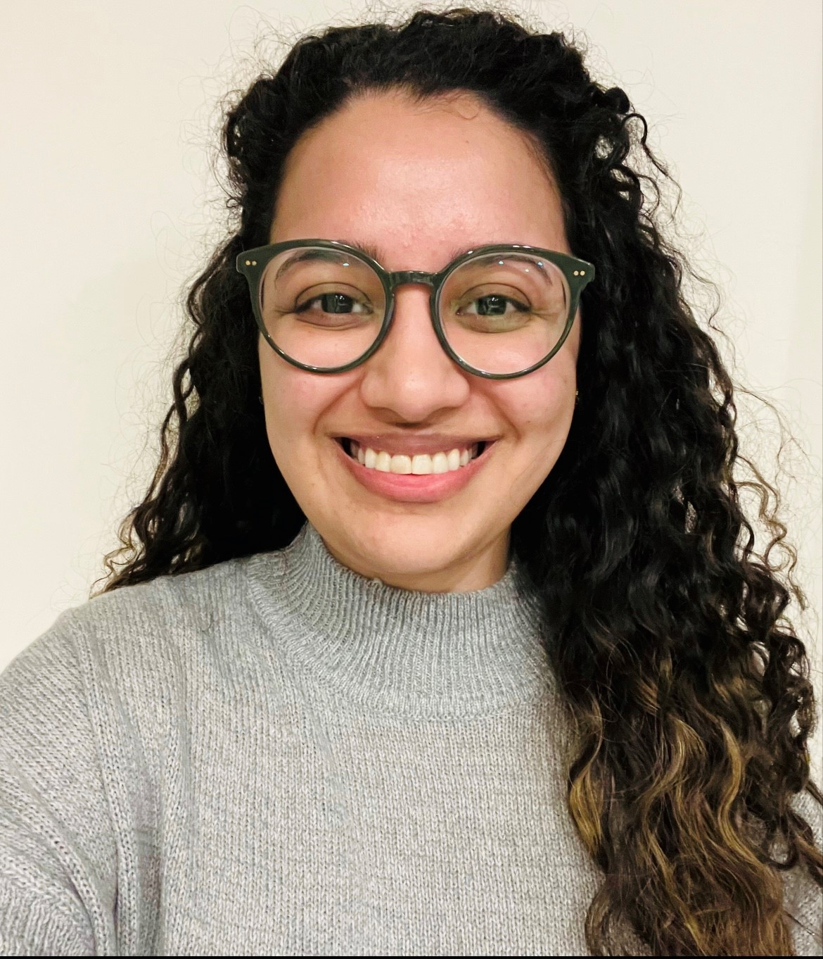
Introduction
Denise Cardona
Discipline Manager of Healthy Hearing
Licensed Audiologist
Based remotely in Arizona (PST/MST)
Email: healthyhearing@specialolympics.org

Slide 4
Healthy Athletes 2.0

Slide 5
Healthy Athletes System (HAS)
Enables the capture of screening data across the Healthy Athletes disciplines. To better support Special Olympics athletes, Programs, and clinical volunteers, HAS features have been:
Streamlined with consistent formatting between disciplines
Designed to reduce errors in data entry and improve clinical efficiency
Reviewed and updated HAS forms, resources and content
*Resource documents will be sent directly to Programs hosting early events, otherwise they will be added to the resource page within the month.
Notes:
This initiative is now referred to as HAS 2.0.

Slide 6
HAS 2.0 Clinical Director Training

Slide 7
Clinical Director Training Modules
The updated Clinical Director (CD) training for Healthy Athletes 2.0 (HAS 2.0) is live on the Learning Management System (LMS) https://elearn.specialolympics.org/health
New and future approved clinical directors will be assigned the HAS 2.0 online training modules
Current CDs trained on Healthy Hearing 1.0 will need to complete this training prior to implementing Healthy Hearing 2.0
Can be accessed in the currently assigned courses on the LMS. Please note that while it may appear that the course has already been completed, you can restart/retake it at any time
Contact Kelsey Sparks for LMS assistance (ksparks@specialolympics.org)

Slide 8
Referral Guidelines

Slide 9
Referral Guidelines
Provider directory needs to be developed in conjunction with Program Health Staff and CDs​
For local events – should be specific to the local area​
For larger events – will need to have broader, wide-reaching resources​
If athlete lives in remote area where the Program Health Staff and CD are unable to identify local providers, refer to PCP
Ultimately, however, all follow-up recommendations/referrals are determined at the discretion of the clinical director, in accordance with referral guidelines
Notes:
Healthy Hearing Referral guidelines and provider directory should be developed collaboratively by Program Health Staff and CDs. For local events, resources need to be tailored specifically to that area, while larger events require more comprehensive, widely accessible options. If an athlete resides in a remote location and local providers cannot be identified by the Program Health Staff or CD, they should be referred to their primary care provider (PCP).

Slide 10
Pass / No Pass Forms

Slide 11
Pass / No Pass Forms
The revised pass and no pass forms remain accessible on the Healthy Hearing resource page following minor formatting adjustments. Programs are encouraged to utilize these forms in conjunction with “passport” books, where applicable
https://resources.specialolympics.org/health/healthy-hearing

Slide 12
HAS Form Updates

Slide 13
General Form Filling Information
Make sure to fill out the form correctly
Circle = choose one answer only
Square = select all that apply
Consider “if yes/no” sub questions
Tips for ensuring accurate post-event digitization
Confirm all registration information is completed fully
Confirm the form is completed in its entirety

Slide 14
Healthy Hearing Stations
Check in (general volunteer)
Otoscopy (audiologist/ent)
OAEs (audiologist/clinical volunteer with training)
Tympanometry (audiologist/clinical volunteer with training)
Pure Tone Screening (audiologist)
Pure tone thresholds (audiologist)
Check Out which now includes a referral section (clinical director/audiologist)
*Additionally, the equipment requirements for these stations have not changed.
*
Notes:
For our stations, which have not changed, we have Check in, Otoscopy, OAEs, Tympanometry, Pure Tone Screening, Pure tone thresholds and Check Out which now includes a referral section. Additionally, the equipment requirements for these stations have not changed. Now let’s get into the actual form. Y

Slide 15
Station 1: Check In
Check In is now officially recognized as our first station, whereas previously it was not assigned a number. At the top, you'll find athlete identifiers, and it's crucial to fill out this section accurately to ensure proper post-event digitization. The primary update in this section is the shift to full questions, whereas previously, the initial question was just "hearing loss?" Now, complete sentences are listed, such as: "Do you think you have a hearing loss?"

Slide 16
Station 2: Otoscopy
Always ensure the Screener’s name is clearly identified.
The main update is that you can now specify if a foreign body is present, which is different from indicating earwax. Both options have their own sub questions. You'll also need to note whether the ear canal is minimally, partially, or completely blocked, and whether you were able to remove the blockage fully or only partially. Again, it's important to carefully read each question and ignore any sub questions that don't apply. We will also continue to record any additional otoscopic findings in either ear.
Notes:
Also, during otoscopy, if you encounter any licensure or liability concerns with removing cerumen and are unable to remove it, your best approach is to document that the athlete has earwax, specify how much is present, and note that removal was not possible.

Slide 17
Station 3: OAEs
Always ensure the Screener’s name is clearly identified.
The third station is designated for OAE screening, with the same options available. You will indicate if the athlete passed, failed, or was unable to be tested, and if testing could not be completed for either ear, you must provide a reason. If the athlete passes in both ears and the otoscopy is clear, they move directly to check out, skipping the remaining stations.
Equipment requirements remain unchanged.

Slide 18
Station 4: Tympanometry
Always ensure the Screener’s name is clearly identified.
Like the OAE screening, for tympanometry screening, you will mark whether the athlete passed, did not pass, or unable to test, and you must select a reason if testing was not possible for each ear.
Equipment requirements remain unchanged.

Slide 19
Station 5: Puretone Screening – 2000 & 4000Hz
Always ensure the Screener’s name is clearly identified.
Puretone screening at 25dB remains unchanged at the fifth station. We test both ears at 2000 and 4000Hz; results are recorded as pass, did not pass, or unable to test, with a required reason if testing isn't possible for either ear. If the athlete passes both frequencies in both ears, they proceed to check out and bypass the remaining stations.
Equipment requirements remain unchanged.

Slide 20
Station 6: Puretone threshold testing
Always ensure the Screener’s name is clearly identified.
Puretone threshold testing has significant updates. Now, testing is split into right and left air conduction testing ranging from 250 to 8000 Hz, as well as right and left bone conduction testing from 250 to 4000 Hz. For each test, you indicate whether a response was obtained, not obtained at limits of audiometer, or if the test could not be performed; then, you record the dB HL and specify if masking was used. After completing the table, you'll be asked to assess the reliability of the thresholds. If they aren't reliable, you'll need to select a reason why.
Equipment requirements remain unchanged.

Slide 21
Station 7: Check Out
Always ensure the Screener’s name is clearly identified.
The final station, Station 7, is the Check Out area. Here, you will indicate whether the screening was successfully completed or, if not, provide an explanation for any incomplete screenings. You will also select any additional services provided on site. The earwax removal and hearing aid fitting sections are now available, allowing you to choose between right ear, left ear, or both options.

Slide 22
Station 7: Follow- up Recommendations
If a follow-up appointment is recommended, you can choose the appropriate provider and specify whether the referral is urgent or non-urgent, as well as select the reason for referral from several prepopulated choices. If none of these options fit, you may enter your own reason for referral in the “other” section. For example, a non-urgent ENT referral may be indicated if an athlete does not pass tympanometry in both ears, or a non-urgent audiologist referral may be made if athlete fails pure tone thresholds etc. Ultimately, however, all follow-up recommendations are determined at the discretion of the clinical director, in accordance with referral guidelines.

Slide 23
For any Healthy Hearing 2.0 questions, please contact: Healthyhearing@specialolympics.org

Slide 24
For any HAS 2.0 questions, please contact: Healthyathletes@specialolympics.org

