Slide 1

overall_0_132499602025518819 columns_1_132499602025518819

Slide 2


Slide 3




Reality of Health For Individuals with IDD:
98.7% have 2 or more co-morbidities
6x more likely to be hospitalized
16-20 years
shorter life expectancy
7x higher
mortality rate
Poorer health status in children/youth than any other ages
2x times as likely to have asthma and cardiovascular disease
3
Photo Credit: Special Olympics
Notes:
And so, as a truly special population of competitive athletes, we need to understand what the reality of health is for this population & ensure that we can best serve their unique health needs. Unfortunately, this group experiences significant health inequities and disparities compared to the general population and are (READ BULLETS)

Slide 4
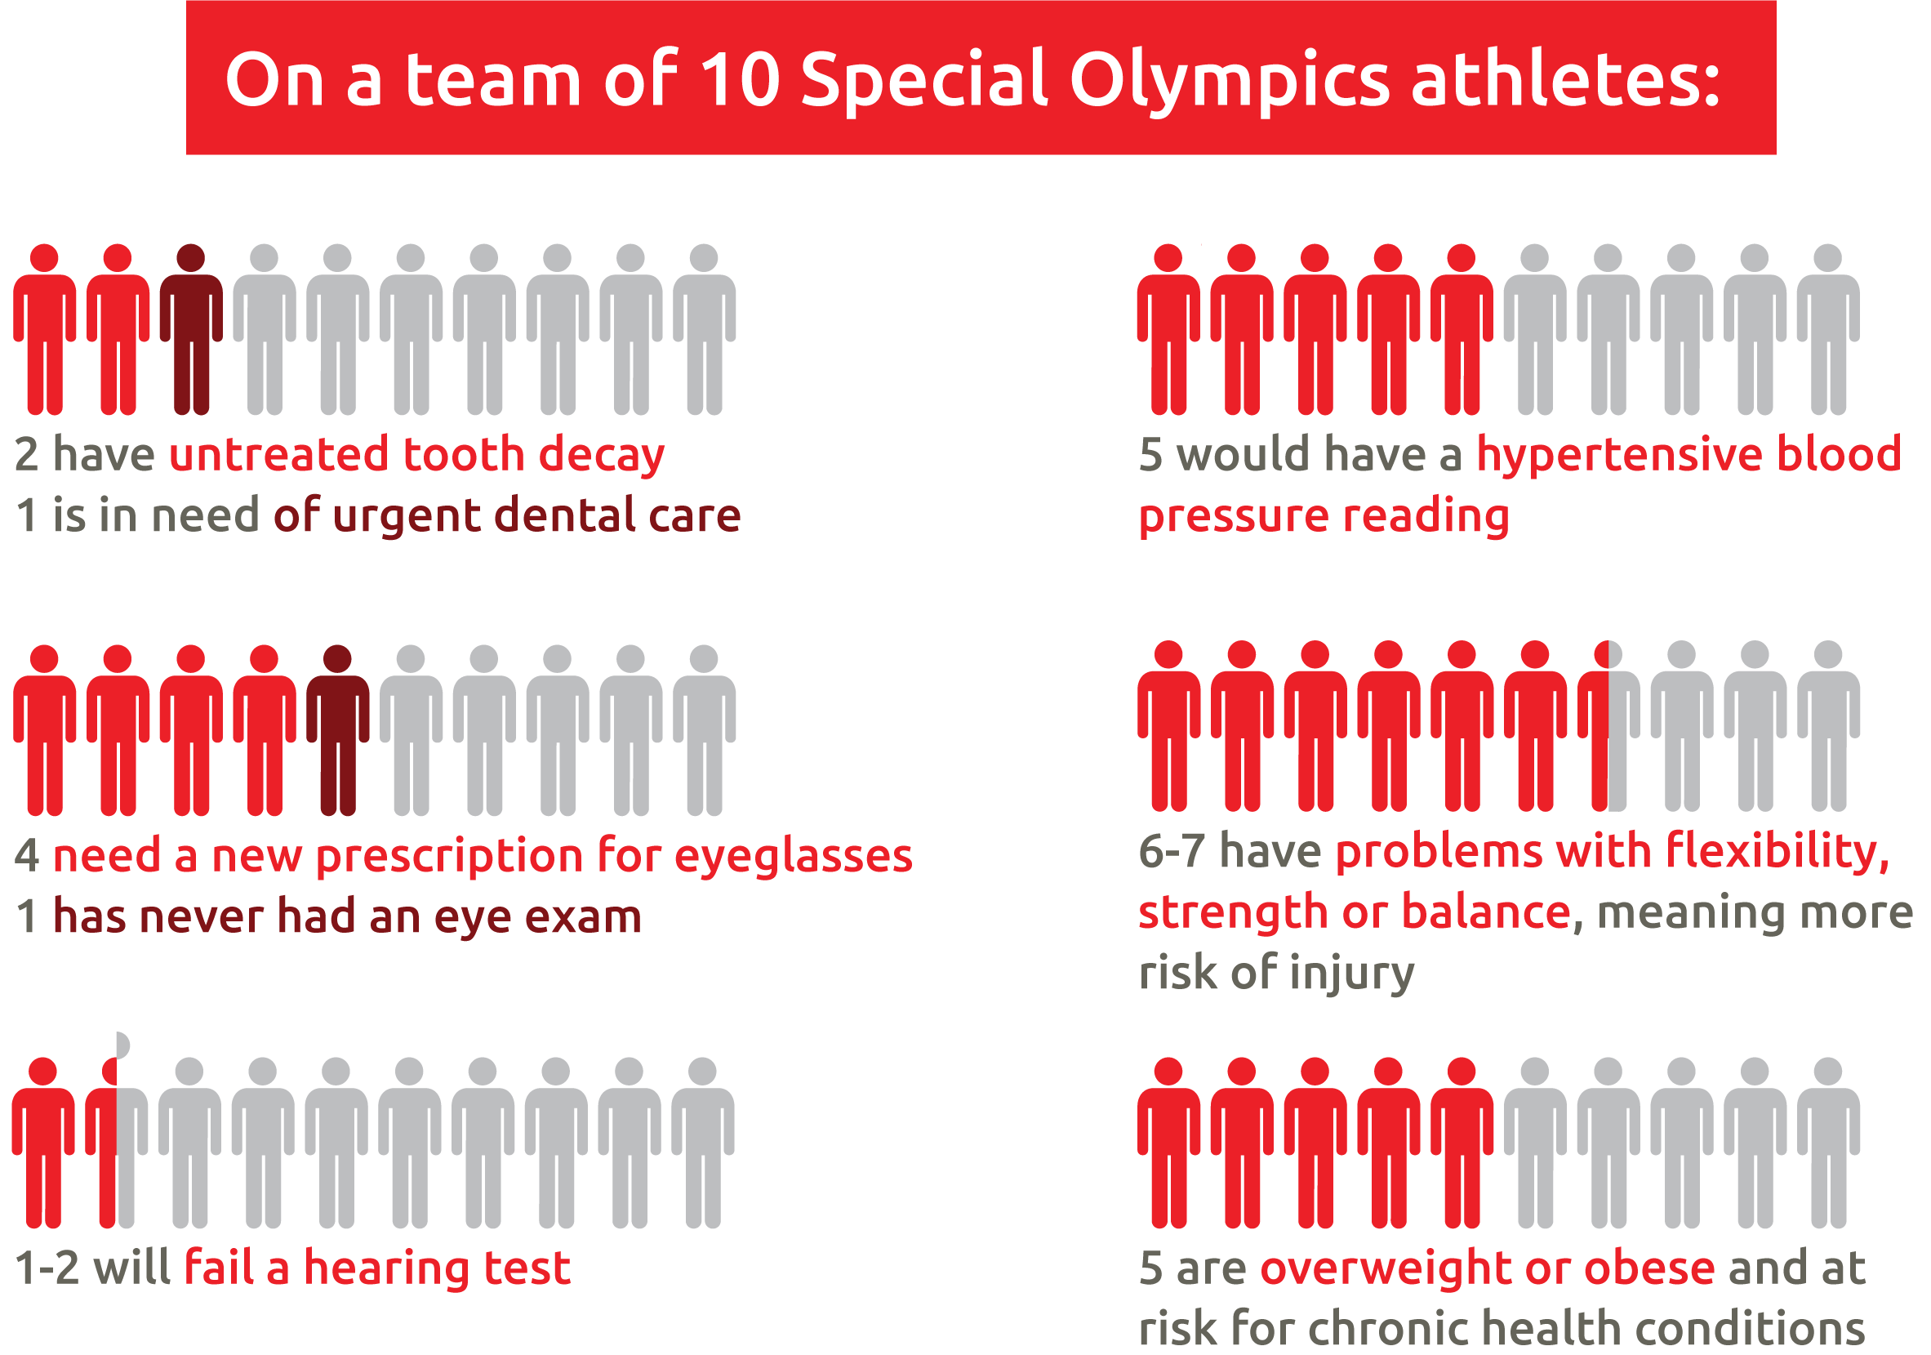
Untreated Health Conditions Exist…
Children in the US (age 8-19 years) from 2015 to present.
Notes:
Where does the cascade begin? In our studies over 2 decades in countries all over the world, we have found that it's lack of preventive care. In the US, on a team of 10 Special Olympics children ages 8 to 19, over 20% have untreated tooth decay—active dental caries--and 1 in 10 need an urgent dental care; 40% need a new prescription for eye glasses—they are coming to the field and they can't see, 1 in 10 has never had an eye exam. Almost 20% fail our hearing tests—they can't hear. Half are overweight or obese and most have flexibility, strength or balance issues that put them at risk for injury.

Slide 5
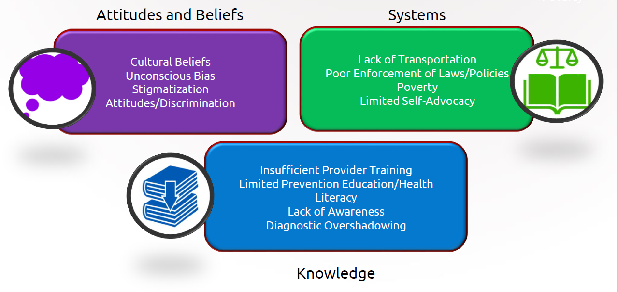
Multiple Causes of Health Disparities:
Notes:
So why are we seeing these health disparities in this population? The misconception that the poor health of these individuals is unavoidable because it’s due to their disability is one of the biggest issues. Most of the time, disparities & inequities faced by these individuals are a result of a breakdown in attitudes and believes, systems, and knowledge that can and should be addressed.
Let's talk about some of them
Poverty - Individuals with disabilities are more likely to be poor, representing one in five of the world's poorest people. United Nations Development Program estimates that 80 percent of all individuals with IDD live in low-income countries. And are more likely to be unemployed (United Nations, 2016a and 2015c; ILO, 2014a)
Insufficient provider training - In a survey conducted by Special Olympics, which explored the training of health care professionals, 52% of medical school deans and 56% of students reported that graduates were “not competent” to treat people with intellectual disabilities. Another study showed that more than 80% of U.S. medical school students reported receiving no clinical training regarding individuals with IDD. Because of this, communities and healthcare providers can be slow to detect certain things, such as hearing loss. Due to the lack of training in caring for these individuals, clinicians may have difficulty incorporating this population into conventional practices. (2005 and 2009)
Additionally is the lack of awareness. Despite higher health risks and need for medical care, individuals with IDD as we saw in the previous slides are missing services. The relationship between disadvantage and disability often becomes a vicious cycle. We have an important role to play in breaking that cycle and promoting the inclusion of individuals with IDD by providing them with the means to access services and devices needed to create an enabling environment.

Slide 6

Special Olympics Healthy Athletes®:
A Program to Address Health Disparities
Identify risk factors or signs of preventable health conditions
Provide access to health services through partnerships
Athlete and caregiver education
Referrals to community-based follow-up care
Educate and train healthcare professionals and students
Audiology
Dentistry
General Medicine
Mental Health
Physiotherapy
Pediatrics
Podiatry
Preventative Medicine
Vision Care
Notes:
Under Special Olympics Health, Healthy Athletes, which is a free screening program to address health disparities, was created to
Part of what we do at the Healthy athletes program is to address the insufficient training of healthcare providers so we bring professionals and students to events and provide them education and practical training on how to provide services to individuals with IDD. We also offer free inclusive health training.
Today HA includes 9 different disciplines that athletes can engage with at local, national and global level events including….. Each of these disciplines are supported by volunteer health professionals in the respective fields to complete the required tests and measures to provide athletes care from head to toe.

Slide 7

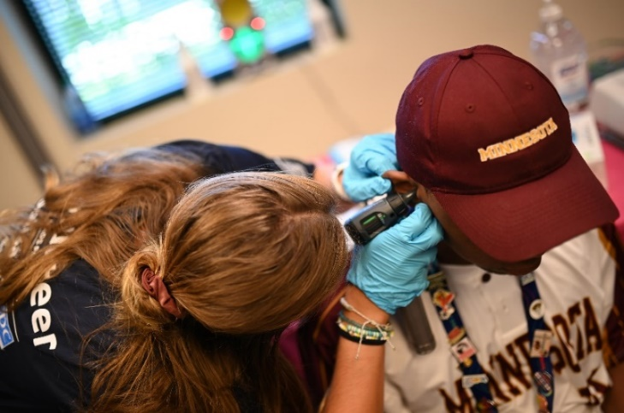
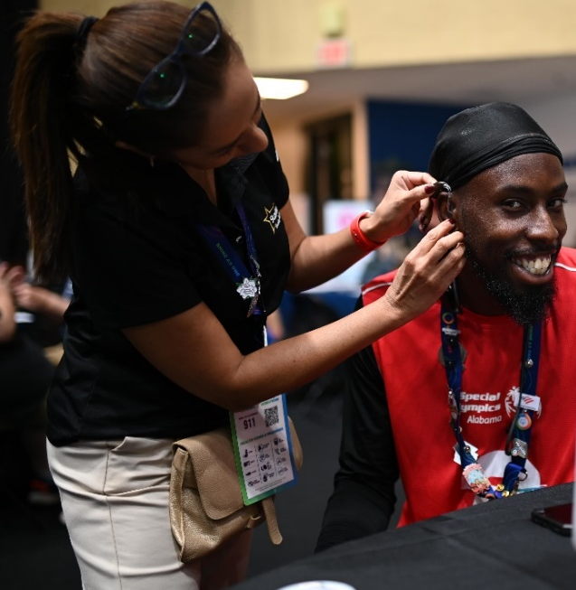
Healthy Hearing:
Increase access to hearing care for athletes
Identify permanent hearing loss and medical issues causing hearing loss and provide referral for follow-up care
Raise audiologists’ awareness of the hearing concerns of people with special needs
Provide educational and clinical opportunities for students training in of Speech Language Pathology and Audiology
Provide a list of regional audiologists and ear, nose and throat specialists who care for people with special needs
Educate athletes about ways to prevent hearing loss from noise exposure

Slide 8
Healthy Hearing Volunteers:
For additional information please visit the Healthy Hearing Resource Page
Volunteer Manual: Volunteer Manual

Slide 9
Volunteer Responsibilities:
Interacting with athletes
    Possible limited verbal expression
    and comprehension
    Possible undiagnosed hearing or vision loss
    Possible language/dialect barriers
    Possible greater sensitivity to
    non-verbal communication
    Possible use of communication devices
Helping with flow
Conducting screenings
Educating athletes
5. Escorting an athlete through stations
6. Setting up/Cleaning up
7. Data collection
    Accurate and thorough documentation is important
    Used to improve screenings and follow-up care, strengthen prevention programming, inform improvements in health system
8. Data recording

Slide 10
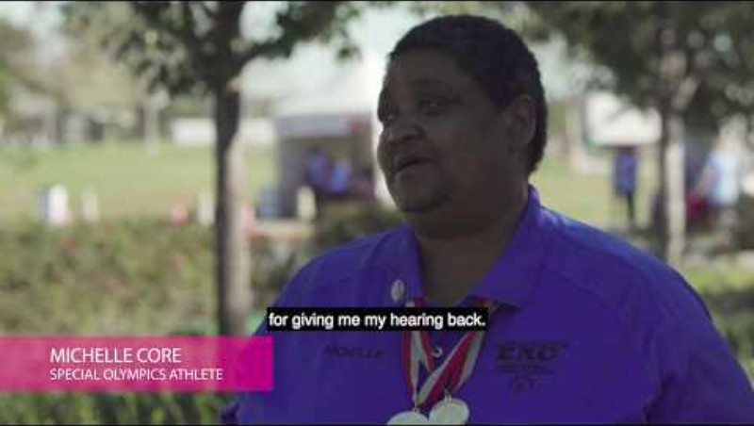
Healthy Hearing Introductory Video:

Slide 11
Healthy Hearing Stations:
Check In (general volunteer)
Otoscopy (audiologist/ent)
OAEs (audiologist/clinical volunteer with training)
Tympanometry (audiologist/clinical volunteer with training)
Pure Tone Screening (audiologist)
Pure tone thresholds (audiologist)
Check Out which now includes a referral section (clinical director/audiologist)

Slide 12
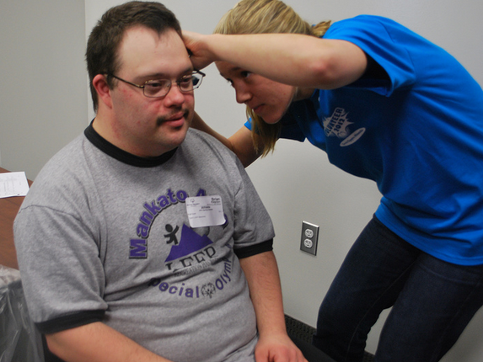
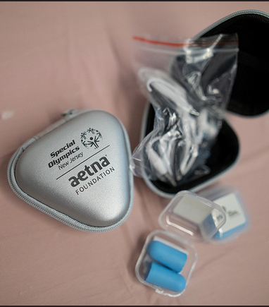
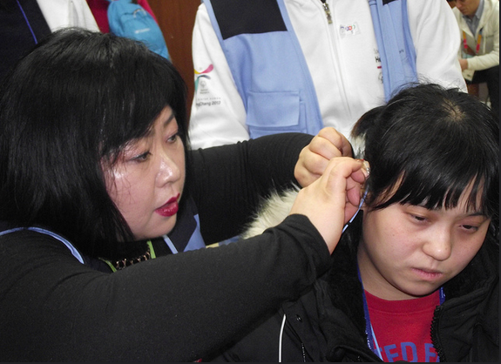
Optional Stations:
Ear Wax Removal
Swim Plugs
Hearing Aid Maintenance/Repair
All other 7 stations will always be available at screening event

Slide 13
Healthy Athletes Systems (HAS) Form and Screening:
The Healthy Athletes System enables the electronic capture of screening data across the Healthy Athletes disciplines.
Goals:
Identify risk factors of chronic health conditions
Evaluate the need for a referral for follow-up
Connect athletes to care in their communities
Provide restorative health services
Educate athletes on basic preventive health behaviors
Refer & connect athletes to tailored quality care
To better support Special Olympics athletes, Programs, and clinical volunteers, HAS 2.0 features have been:
Streamlined with consistent formatting between disciplines
Designed to reduce errors in data entry and improve clinical efficiency
Formatted for consistent and reliable referrals
Notes:
https://resources.specialolympics.org/health/healthy-athletes-system

Slide 14
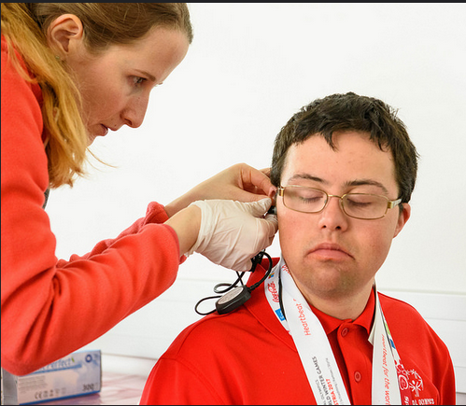
Supplies Needed for Each Healthy Hearing Station:
Office Supplies
Clipboards
Pens
Trash bags
Tables
Table coverings
Chairs
General Supplies
Otoscopes + specula
Disinfectant supplies
Electrical adaptors and converters for events outside of the US
Batteries for equipment
Extension cords
Power strips/power boards
Water and snacks for volunteers
Hand sanitizer
Non-latex gloves
Other Supplies
T-shirts
Decorations
Athlete giveaways
Equipment list can be found on the Healthy Hearing resource page

Slide 15
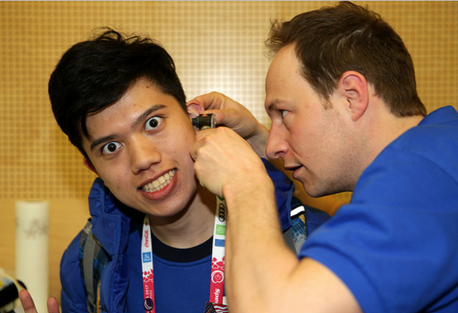
Equipment Needed for Screening Event:
Clinical Screening Equipment
OAEs screening units and tips
Tympanometers and reusable tips
Pure Tone Audiometers with Air Conduction (AC) and Bone Conduction (BC)
Equipment list can be found on the Healthy Hearing resource page

Slide 16
Next, we will discuss what occurs during each Healthy Hearing Screening Station

Slide 17
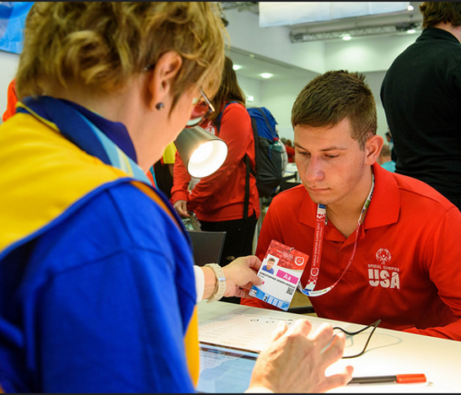
Station 1: Check In
Completing the first section on the HAS form
Sit facing the athlete
Acquire the athlete’s general information
Ask the athlete hearing-related questions, not the coach/parent

Slide 18
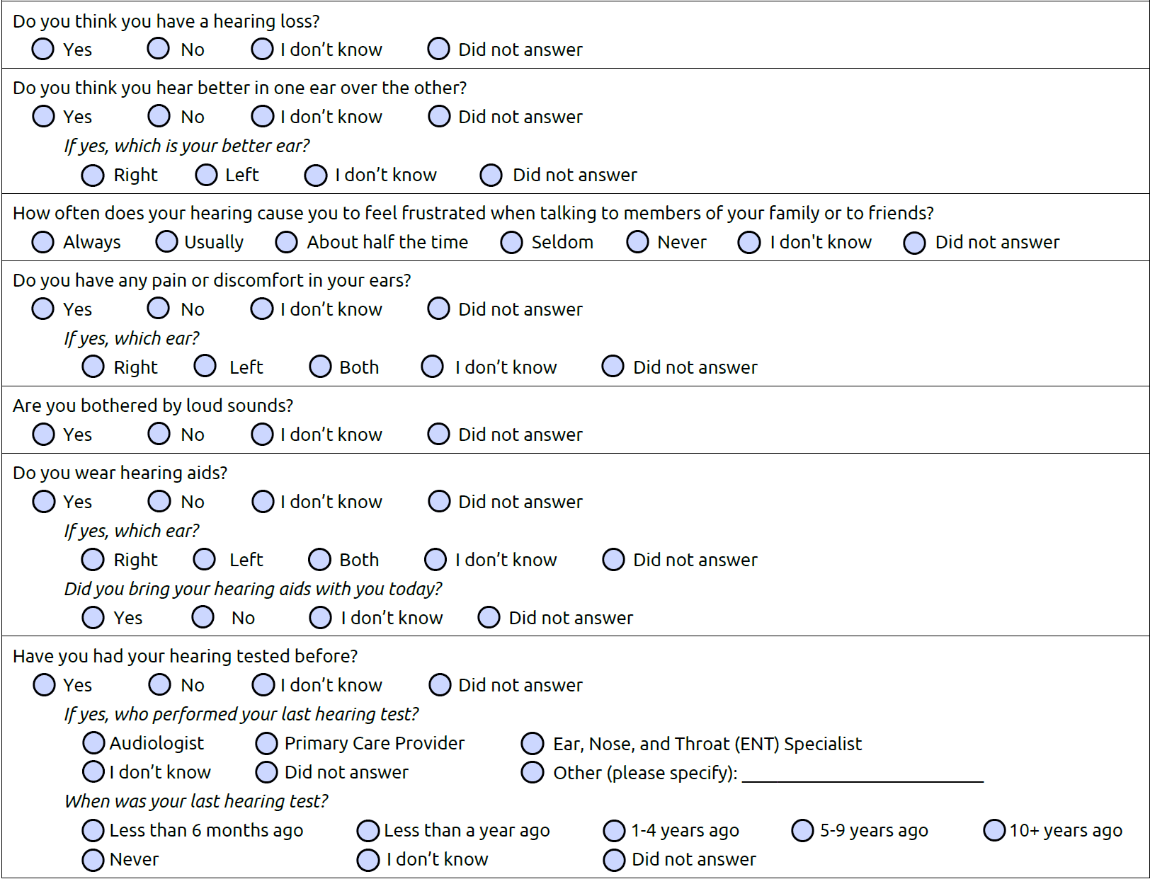
Station 1: Check In
Completing the first section on the HAS form

Slide 19
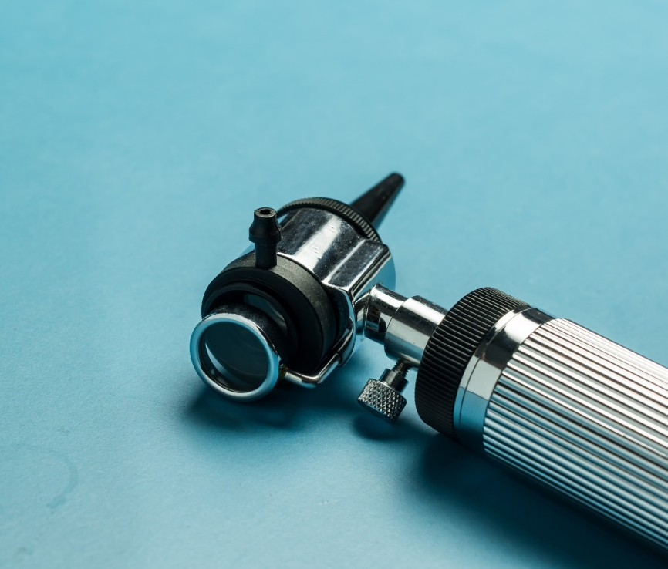
Station 2: Otoscopy
Explain to the athlete what you will be doing
Show them the tools you will be using
Ask if it is okay to continue
With the athlete sitting comfortably and you standing next to him/her, conduct the screening

Slide 20
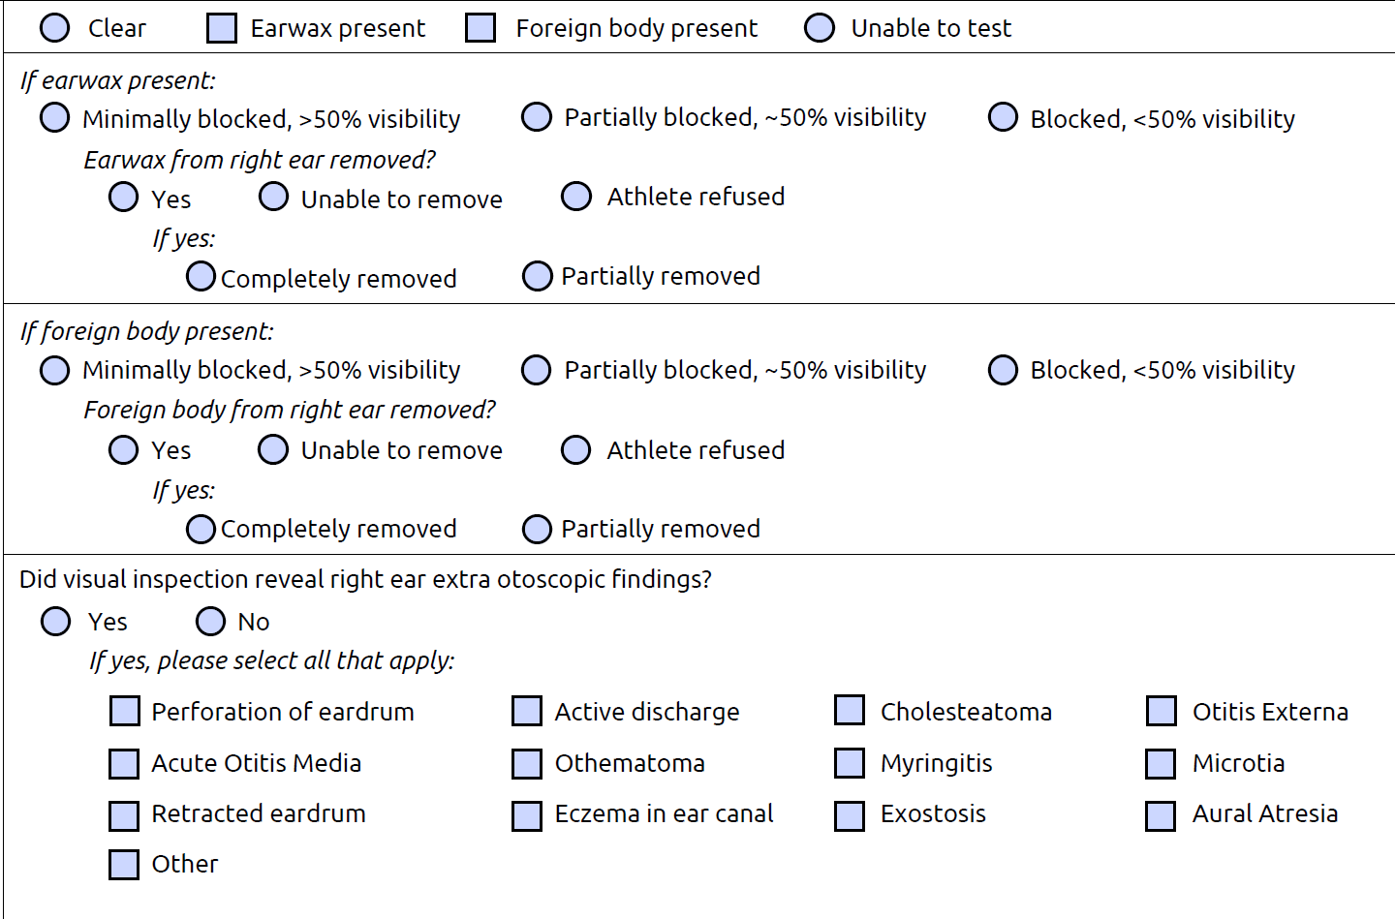
Station 2: Otoscopy
Cerumen blockage
If an ear canal is partially blocked or blocked with earwax then refer for ear wax removal, as it will be difficult to obtain an accurate assessment due to blockage
Foreign body
If an ear canal is partially blocked or blocked with foreign body then refer for removal, as it will be difficult to obtain an accurate assessment

Slide 21
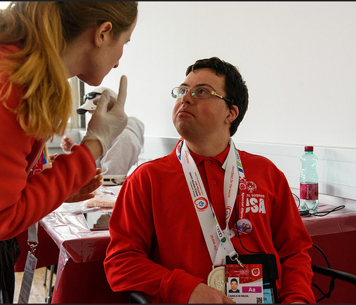
Station 3: Otoacoustic Emissions (OAEs)
Explain to the athlete what you are going to be doing
Show them the tools you will be using
Ask if it is okay to continue
With the athlete sitting comfortably and you standing next to him/her, conduct the screening

Slide 22
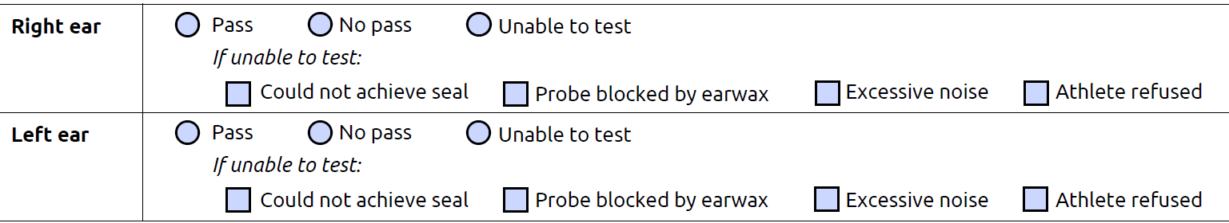
Station 3: OAEs Troubleshooting and Results
The most common problem to solve within Station 3 is related to power and electricity
Regarding the screening itself, there are a few suggestions to keep in mind to help avoid any Station 3 screening challenges
If suddenly all OAE units stop working, it may be because of an electrical overload. This can be solved by unplugging the OAE units and relying on their battery supply
Clip probe cable to credentials or clothes of athletes; do not hold the probe cable while screening
Make sure the correct size of foam ear tip is chosen
Retry the OAEs after repositioning the probe in the ear canal
If there is a “pass” for each ear, athlete moves to check-out station

Slide 23
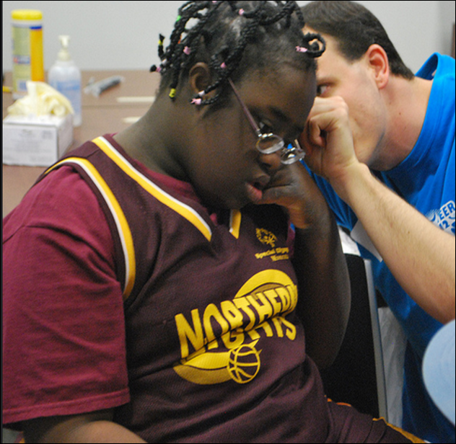
Station 4: Tympanometry
Explain to the athlete what you are going to be doing
Show them the tools you will be using
Ask if it is okay to continue
With the athlete sitting comfortably and you standing next to him/her, conduct the screening

Slide 24
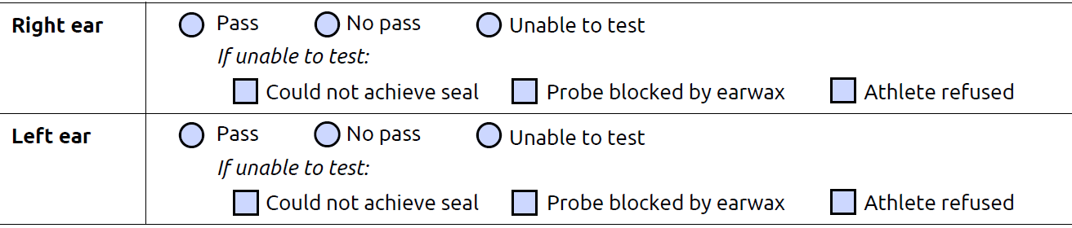
Station 4: Tympanometry Results
For standardization, the following normative data for tympanometry (“The Rule of 2”) need to be used
✓ “Pass” =
admittance between 0.20 and 2 mmho
middle ear pressure between +20 and -200daPa
ear canal volume between 0.60 and 2 ml
✓ “No Pass” =
type B (= flat)
type C (= under pressure) with middle ear pressure more positive than +20 daPa or more negative than -200 daPa
type As with admittance < 0,20 mmho
type AD with admittance > 2 mmho
ear canal volume < 0.60 ml or > 2 ml
If you are “unable to test” try to problem solve the reason why the testing is not possible - for instance, clean probe of earwax, ask a colleague to try to obtain a seal, etc., and then retry

Slide 25
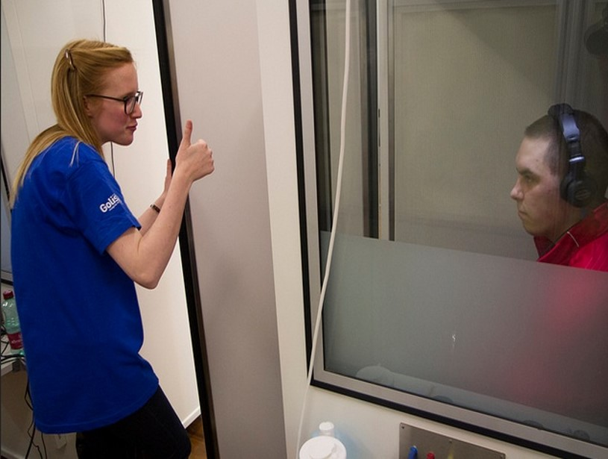
Station 5: Pure Tone Screening @ 25dB HL
Clean the headphones and bone conductor, with a disinfectant wipe
Explain to the athlete what you are going to be doing
Ask if it is okay to continue
With the athlete sitting comfortably and you standing next to him/her, conduct the screening
Sit in a way you can see the athlete’s face for observation of facial expressions and body language, but the athlete cannot see the controls, other athletes or surrounding activity

Slide 26
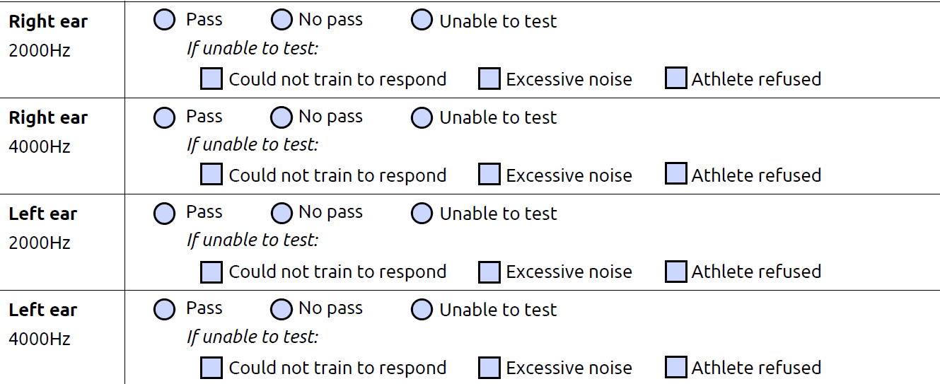
Station 5: Pure Tone Screening @ 25dB Results
If there is a “pass” for each ear for 2000 and 4000Hz, athlete moves to check-out station
As soon as a “no pass” on 1 of the 2 test frequencies is obtained in Station 5, the volunteer can stop screening and start the pure tone threshold testing in station 6
Record your findings on the HAS form for both the right and left ear - both ears should be tested in Station 5 not only the ear with the result of “no pass” on the OAEs

Slide 27
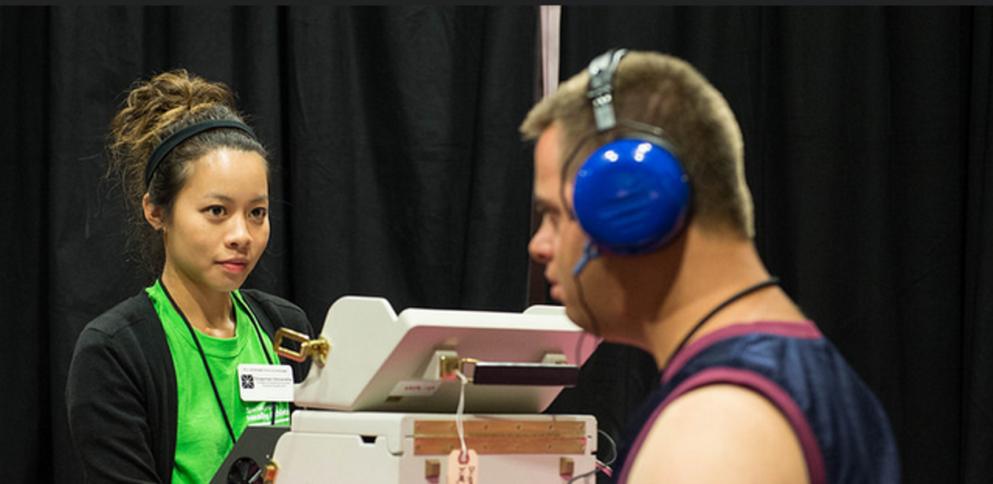
Station 6: Pure Tone Thresholds
Clean the headphones and bone conductor, with a disinfectant wipe
Explain to the athlete what you are going to be doing
Ask if it is okay to continue
With the athlete sitting comfortably and you standing next to him/her, conduct the screening
Sit in a way you can see the athlete’s face for observation of facial expressions and body language, but the athlete cannot see the controls, other athletes or surrounding activity

Slide 28
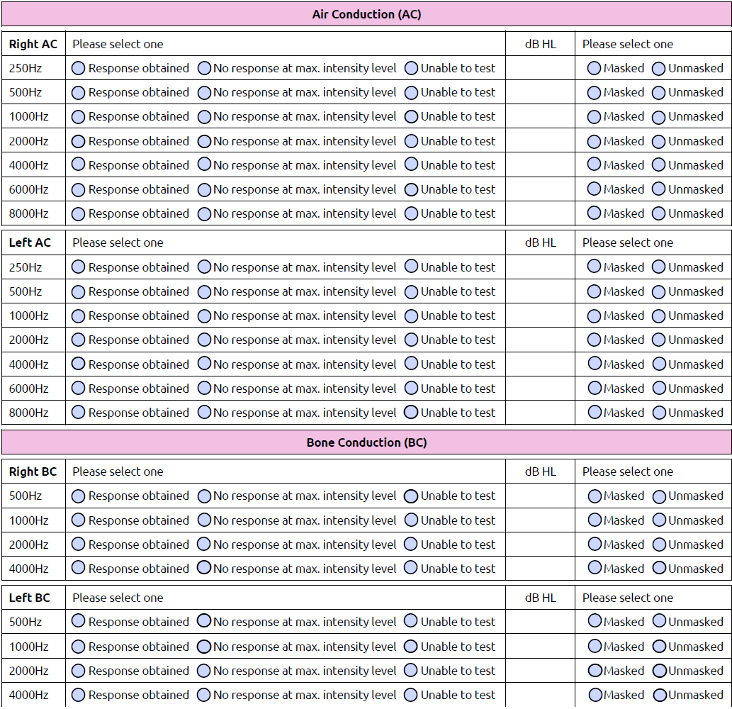
Station 6: Pure Tone Thresholds Results
Record your findings on the HAS form for both the right and left ear air for air and bone conduction
Please take your time to check the box indicating if the test was reliable or unreliable

Slide 29
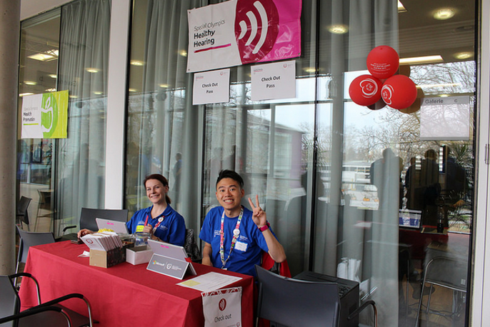
Station 7: Check Out
This role is most important, as you are responsible for quality control - your role here is crucial as you are tying all the stations together and ensuring appropriate referral and education
Clinical Director or a lead Audiologist volunteer will
Check the HAS form to make sure the athlete went to all necessary stations
Check the HAS form to make sure it was completed correctly
Review all “no pass” stations for each athlete and decide on appropriate recommendations and referral
Give athlete a “pass” or “no pass” form depending on results

Slide 30
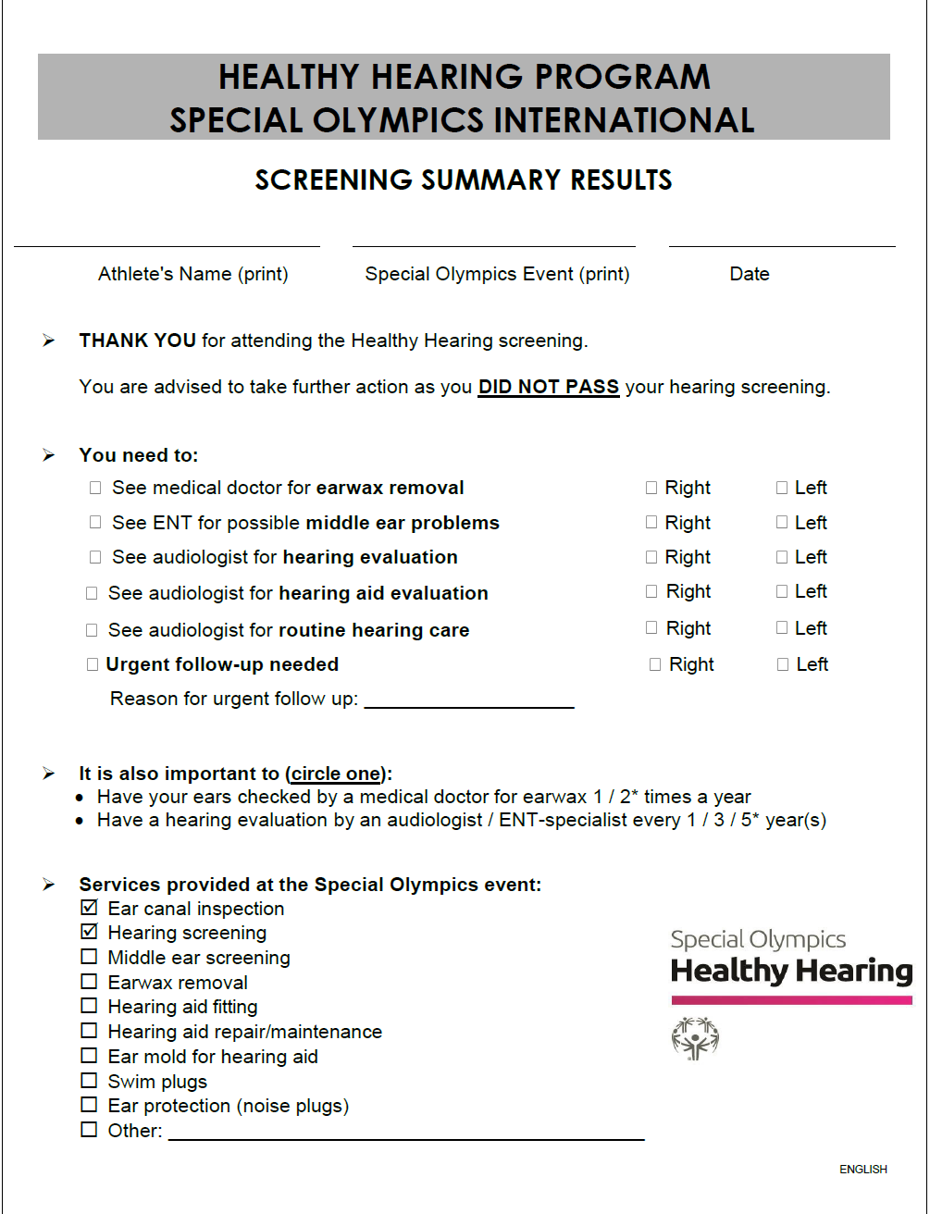
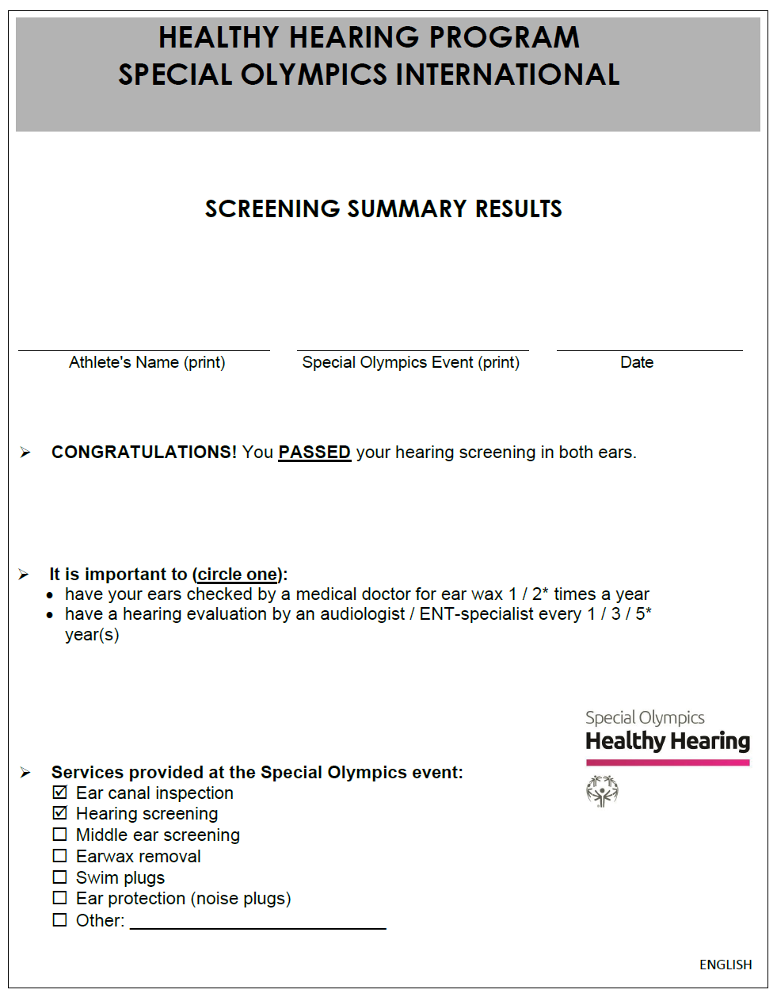
Station 7 Check Out: Pass and No Pass Forms
Forms are available on the Healthy Hearing resource page

Slide 31
Guidelines for Follow-up Care Recommendations:
Otoscopy: “Partially Blocked” or “Blocked” ear canals in one or both ears that was unable to be removed → referral to Audiologist OR ENT, Non-Urgent Referral, Earwax removal
Otoscopy: If selecting Yes for “Visual inspection revealed right/left ear extra otoscopic findings”, depending on selections: →referral to ENT, Non-Urgent Referral, Medical evaluation of ears OR →referral to ENT or Audiologist, Urgent Referral, Contraindications noted during Otoscopic screening
OAE: “No Pass” in one or both ears → no referral → recommendation will depend on results on pure tone audiometry
Tympanometry: “No Pass” in one or both ears (no normal type A-tympanogram OR abnormal small or abnormal big ear canal volume OR type B-tympanogram) → referral to ENT, Non-Urgent Referral, Medical evaluation of ears
Pure Tone Screening at 25db HL: “No Pass” on pure tone audiometry in one or both ears (response > 25dBHL at 2000 and/or 4000Hz) → referral to Audiologist, Non-Urgent Referral, Requires Audiological Evaluation and/or Hearing aid fitting
Pure Tone Thresholds: Unreliable AND [cannot condition to test, OR non-measurable thresholds, OR athlete refused] → referral to Audiologist, Non-Urgent Referral, Requires Audiological Evaluation
Pure Tone Thresholds: For either ear, 3 or more frequencies >25dB HL → referral to Audiologist, Non-Urgent Referral, Requires Audiological Evaluation and/or Hearing aid fitting
To avoid over-referral: If the only “No Pass” is on tympanometry, no referral is made, unless the Clinical Director decides that it is necessary. If there is a “No Pass” on pure tone audiometry for 1 or 2 test frequencies at 30dBHL (instead of 25dBHL), no referral for possible hearing loss is needed, unless the Clinical Director decides it is necessary.

Slide 32
General Advice on Regular Ear and Hearing Screening:
Goal: Every athlete will receive general advice, which is:
✓ Have your ears checked by a medical doctor for ear wax 1 / 2* times a year
✓ Have a hearing evaluation by an audiologist / ENT-specialist every 1 / 3 / 5* year(s)
* strike out as appropriate Guidelines for general advice
• An athlete, without Down syndrome, without hearing aid(s):
✓ Ear wax: once a year
✓ Hearing evaluation: every 5 years
• An athlete with Down syndrome, without hearing aid(s):
✓ Ear wax: twice a year
✓ Hearing evaluation: every 3 years ≤ 35 years of age // every year > 35 years of age
• Athlete with hearing aid(s):
✓ Ear wax: Twice a year
✓ Hearing evaluation: every year
The individual results as well as the specific recommendations need to be explained to the athlete as well as to the coach, carer and/or family

Slide 33

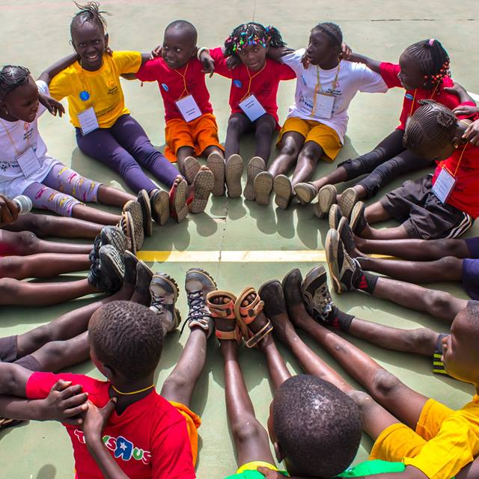
overall_1_132499605790186937 columns_1_132499605790186937
THANK YOU!

