Slide 1

Special Olympics
Healthy Hearing
Hearing Education 101

Slide 2
Welcome
Thank you for attending and participating in this Healthy Hearing event!
This will be an interactive session where you’ll have the opportunity to ask and answer questions about your hearing.
The questions will be at the end.
We will go through the questions together.
Are you ready?
Let’s begin!

Slide 3
Introduction
____________
Audiologist
Healthy Hearing Clinical Director Special Olympics (State/Country)

Slide 4
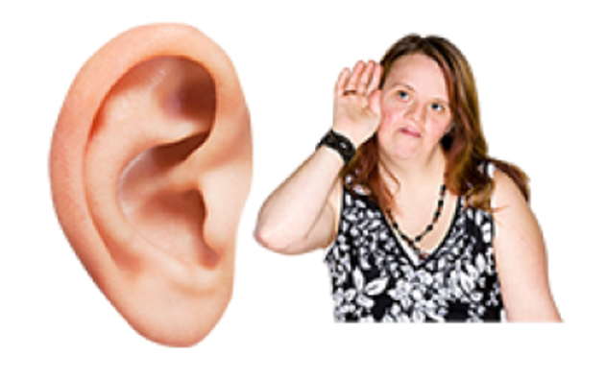
What is Hearing loss?
Hearing loss means finding it hard to hear or not being able to hear at all.

Slide 5

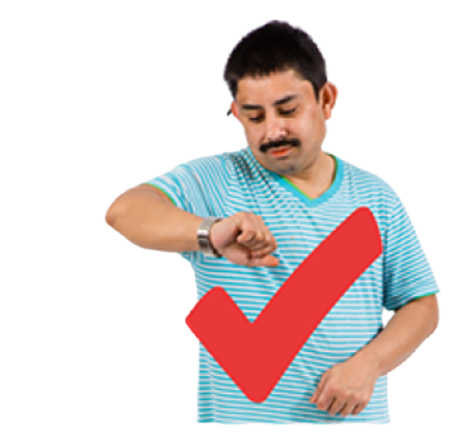

When does hearing loss happen?
Hearing loss can happen suddenly.
Or, your hearing may slowly get worse over time.

Slide 6




How long does hearing loss last?
Hearing loss can last for a short amount of time.
Or, it might last for the rest of your life.
Monday
Tuesday
Wednesday
Thursday
Friday
Saturday
Sunday

Slide 7
What causes hearing loss?
Hearing loss can be caused by different things like:

Slide 8
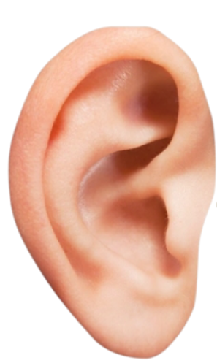
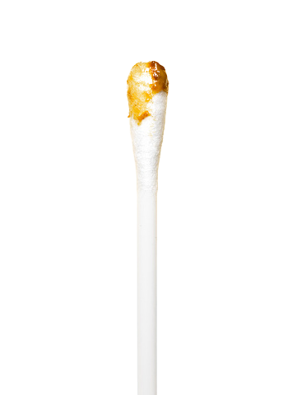
Ear Wax
Hearing loss can be caused by different things like:
Ear wax

Slide 9

Ear Infection

Slide 10

Something inside the ear like fluid

Slide 11
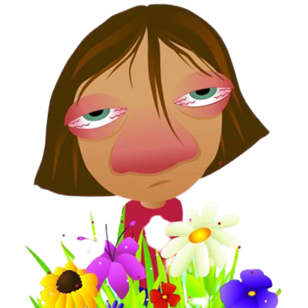
Allergies

Slide 12
A burst ear drum – a hole in the ear drum

Slide 13

Damage from very loud noise

Slide 14

Getting older

Slide 15
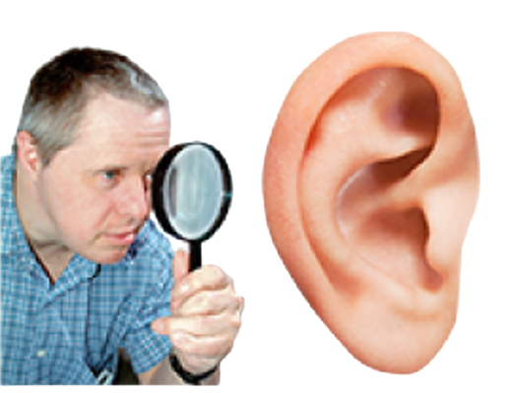
These are some different signs you may have a hearing loss.

Slide 16

Not being able to hear other people clearly

Slide 17





Not being able to hear clearly if there is noise in the background

Slide 18


Able to hear sounds but not understand the words clearly
?
OR

Slide 19
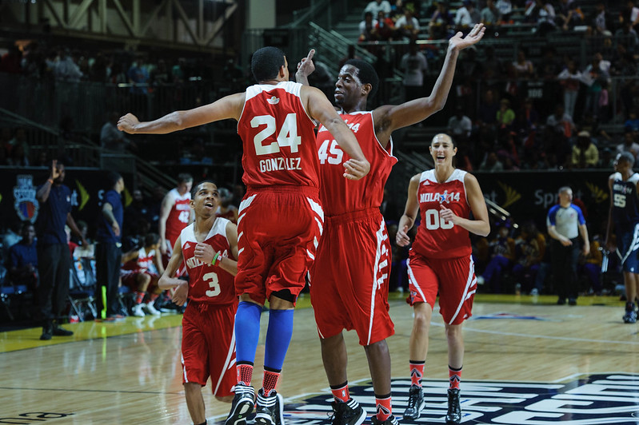
Have trouble hearing your coaches or teammates

Slide 20

Having to have music or the tv on very loud

Slide 21

Feeling tired when you talk to people because you have to work hard to hear or feeling left out

Slide 22
Earache or drainage from your ear

Slide 23


Noises in your ears like ringing or buzzing

Slide 24

Feeling like you are spinning

Slide 25
If you suddenly have trouble hearing in one or both your ears.

Slide 26

If you have any of these signs:
Tell someone – parents, coach, team mate
Don’t Wait!
There is help!

Slide 27
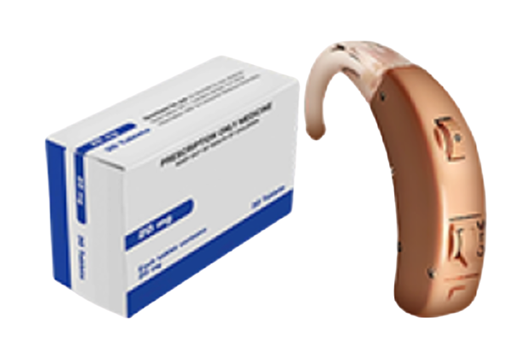
There are lots of different treatments for hearing loss

Slide 28
Can hearing loss improve?
Some hearing loss happens for a short amount of time. It sometimes gets better on its own, or can be treated easily.

Slide 29

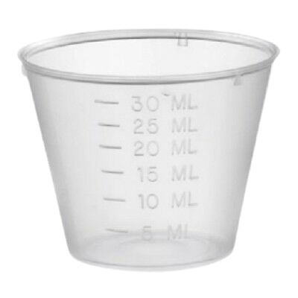
Treatment
Medicine

Slide 30
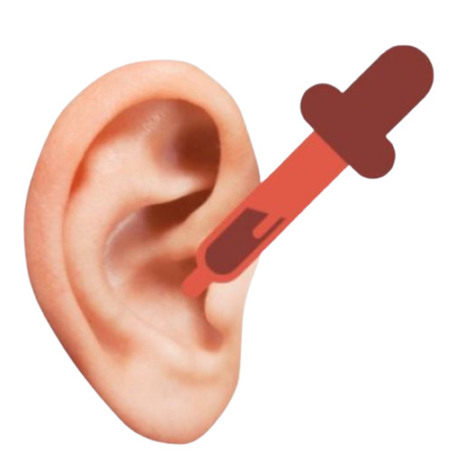
Treatment
Some simple treatment like drops that go in your ear to soften earwax
One brand is Debrox

Slide 31
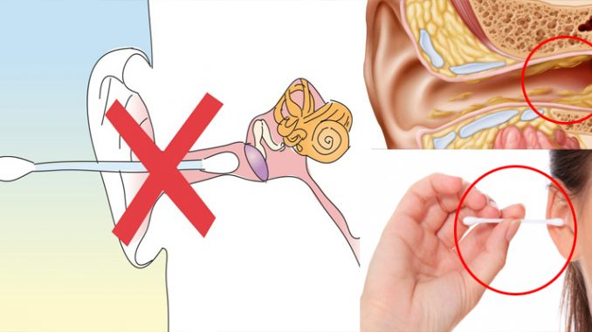
Q-Tips
Q-Tips can make it worse, so do not use those.

Slide 32
Some hearing loss lasts for the rest of your life
There are things that can help you live with your hearing loss.

Slide 33
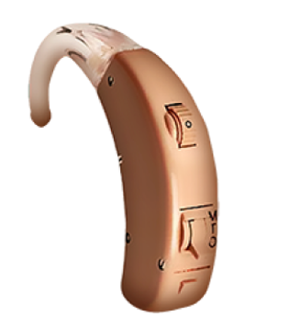
Hearing Aid
A hearing aid can help you to hear better and clearer.
Hearing aids are small devices worn in you ear.
They make sounds louder and clearer.
There are many different types of hearing aids.
The most common type goes around the top and back of your ear.

Slide 34
Questions

Slide 35
Question 1
How old are you?
Please select your age:
5 to 10 years old
11-18 years old
19-30 years old
31-50 years old
Over 51 years old

Slide 36
Question 2
Are you-
An athlete
Unified Partner
Coach
Clinical Director/Volunteer
Parent/Family Member

Slide 37
Question 3
Hearing loss: Do you have trouble hearing?
Yes
No
Not Sure

Slide 38
Question 4
Hearing loss:
If yes, sudden hearing loss:
Yes
No
Not Sure

Slide 39
Question 5
Have you ever had a hearing test?
Yes
No
Don't remember

Slide 40
Question 6
What were the results of the hearing test?
No hearing loss
Hearing loss
Not sure

Slide 41
Question 7
If you have a hearing loss, do you wear hearing aids?
No hearing loss
Yes, I wear hearing aids
Yes, I wore hearing aids but not now
Yes, I have hearing loss but never wore hearing aids

Slide 42
Question 8
Do you have pain in your ears?
Yes
No
Don’t know
Left ear? Right ear?
Yes A. Yes
No B. No
Don’t know C. Don’t know

Slide 43
Question 9
Do you have a draining ear (blood, pus, …):
Yes
No
Not sure

Slide 44
Question 10
Did you ever have ear surgery?
Yes
No
Don’t know/remember

Slide 45
Question 11
Did you learn something new today?
Yes
No
Maybe

Slide 46
Advice

Slide 47
It is important to:
Have your ears checked by a medical doctor for ear wax:
Every year
More than 1 time a year if you wear hearing aids or have a lot of ear wax

Slide 48
It is important to:
Have a hearing evaluation by an Audiologist or an ENT-specialist, when you are:
Younger than 18 years: every 3 years
Between 18 and 50 years: every 5 years
Older than 50 years: every 3 years

Slide 49
It is important to:
When you wear hearing aids, your hearing needs to be checked every year by an Audiologist or an ENT-specialist.

Slide 50
Thank you for your attention!

Slide 51
What else would you like to know about your hearing? If you have any questions, please contact healthyhearing@specialolympics.org

