Slide 1
Healthy Hearing 2.0 Training Webinar
Denise Cardona, AuD, CCC/A
Sr. Clinical Program Manager

Slide 2
Outline
Introduction
Healthy Athletes 2.0
Clinical Director Training
Referral Guidelines
Pass and No Pass forms
HAS Form Updates
Q&A

Slide 3
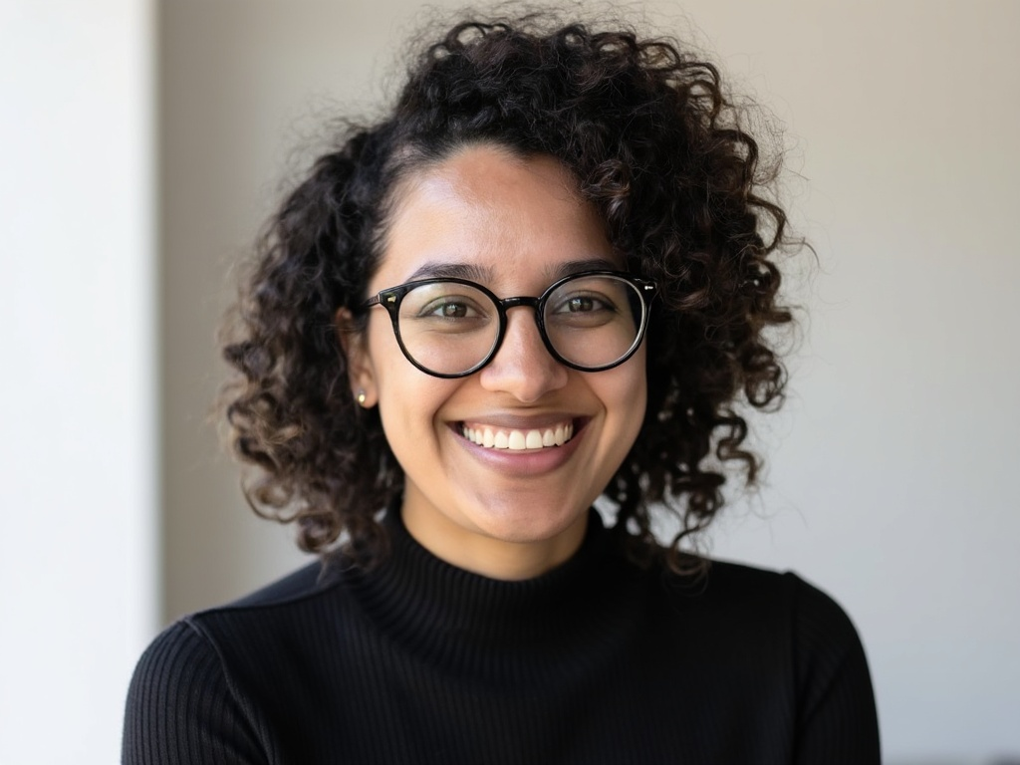
Introduction
Denise Cardona
Licensed Audiologist
Discipline Manager of Healthy Hearing
Previous SONV HH CD
Based remotely in Arizona (PST/MST)
Email: healthyhearing@specialolympics.org
Office Hours: held on the third Wednesday of each month from 9:00 to 10:00 AM Eastern Time

Slide 4
Healthy Athletes 2.0

Slide 5
Healthy Athletes 2.0
Enables the capture of screening data across all Healthy Athletes disciplines. To better support Special Olympics athletes, Programs, and clinical volunteers, HAS features have been:
Streamlined with consistent formatting between disciplines
Designed to reduce errors in data entry and improve clinical efficiency
Reviewed and updated HAS forms, resources and content
2.0 Forms, PPT, and recordings can be found on the Healthy Athletes System website: https://resources.specialolympics.org/health/healthy-athletes-system
Healthy Hearing 2.0 documents have been added to the Healthy Hearing resource page: https://resources.specialolympics.org/health/healthy-hearing
Notes:
Right now, 2.0 is only available on paper. We are working on a digital system, however, release date is yet to be determined. Once a specific date is established, Brittany Routh, Director of Healthy Athletes, will communicate this information to programs via your regional health managers

Slide 6
Clinical Director Training

Slide 7
Clinical Director Training Modules
Healthy Hearing 2.0 CD Training Module is live on the Learning Management System (LMS) https://elearn.specialolympics.org/health
Current CDs trained on 1.0 will need to complete this training prior to implementing 2.0
New and future approved clinical directors will be assigned the 2.0 online training modules
Can be accessed in the currently assigned courses on the LMS. Please note that while it may appear that the course has already been completed, you can restart/retake it at any time
For LMS assistance contact learning@specialolympics.help

Slide 8
Referral Guidelines

Slide 9
Referral Guidelines & Provider Directory
Provider directory should be developed in conjunction with Program Health Staff and CDs​
For local events – should be specific to the local area​
For larger events – will need to have broader, wide-reaching resources​
If athlete lives in remote area where the Program Health Staff and CD are unable to identify local providers, refer to PCP
Ultimately, however, all follow-up recommendations/referrals are determined at the discretion of the clinical director, in accordance with referral guidelines

Slide 10
Pass and No Pass Forms

Slide 11
Pass and No Pass Forms
Athletes receive a Pass form after a screening if he or she passes
Athletes receives a No Pass form after a screening if he or she needs follow-up attention.
The revised pass and no pass forms remain accessible on the Healthy Hearing resource page following minor adjustments. Programs are still encouraged to utilize these forms during each Healthy Hearing screening event
Healthy Hearing resource page: https://resources.specialolympics.org/health/healthy-hearing

Slide 12
Healthy Hearing 2.0 Form Updates

Slide 13
General Form Filling Information
Selection Fields
Circle = choose one answer only
Square = select all that apply
Consider “if yes/no” sub questions
Tips for ensuring accurate post-event digitization
Confirm all registration information is completed fully
Confirm the form is completed in its entirety
Notes:
First update is how to fill out the form. Now you will see different types of selection fields. So a circle option means you can only choose one answer and a square means you can select more than one option. Also, sub questions may now appear depending on how the athlete or caregiver responds to a question. On paper forms, sub questions are italicized. In the upcoming digital system (release date TBD), they show or hide automatically depending on the response. Therefore, when completing the paper version, it's important to carefully read each question and ignore any sub questions that don't apply.

Slide 14
Healthy Hearing 2.0 Stations
Station 1: Check In
Station 2: Otoscopy
Station 3: Otoacoustic Emissions (OAEs)
Station 4: Tympanometry
Station 5: Pure Tone Screening @ 25dB HL
Station 6: Pure tone thresholds
Station 7: Check Out which now includes a robust referral section
*Additionally, the equipment requirements for these stations have not changed.
*
Notes:
Let’s now talk about the Healthy Hearing stations, which have remained unchanged from Healthy Hearing 1.0. We have Station 1:Check in, Station 2: Otoscopy….. Additionally, the equipment requirements for these stations have not changed, depending on your SO Region, you will still need to request audiometers, tympanometers, and OAES through the product needs form located on the healthy hearing resource page. The main form updates have occurred during check in, otoscopy, pure tone thresholds and check out which are highlighted above and will be reviewed in more detail shortly.
Previously, I indicated that Program Health Staff and Clinical Directors should collaborate to develop referral guidelines and establish a provider directory. A more comprehensive referral section is now available at the check-out station, and a guideline for follow-up recommendations has been created and added to the healthy hearing resource page for reference. I want to emphasize that these guidelines are intended to support clinical directors while still respecting their professional judgment.

Slide 15
Accessibility During 2.0 Form Review
If you require closed captioning services during the form review portion of our webinar, please do the following:
Click the "More" button with three dots at the top of your Teams screen
Select "Language and Speech" drop down
Select "Show Live Captions"
To turn off, click the "X" in the caption text box

Slide 16
Station 1: Check In
Check In is now officially recognized as our first station, whereas previously it was not assigned a number. At the top, you'll find athlete identifiers, and it's crucial to fill out this section accurately to ensure proper post-event digitization. The primary update in this section is the shift to full questions, whereas previously, the initial question was just "hearing loss?" Now, complete sentences are listed, such as: "Do you think you have a hearing loss?"

Slide 17
Station 2: Otoscopy
Always ensure the Screener’s name is clearly identified.
The main update is that you can now specify if a foreign body is present, which is different from indicating earwax. Both options have their own sub questions. You'll also need to note whether the ear canal is minimally, partially, or completely blocked, and whether you were able to remove the blockage fully or only partially. Again, it's important to carefully read each question and ignore any sub questions that don't apply. We will also continue to record any additional otoscopic findings in either ear.
Notes:
Also, during otoscopy, if you encounter any licensure or liability concerns with removing cerumen and are unable to remove it, your best approach is to document that the athlete has earwax, specify how much is present, and note that removal was not possible.

Slide 18
Station 3: OAEs
Always ensure the Screener’s name is clearly identified.
The third station is designated for OAE screening, with the same options available. You will indicate if the athlete passed, failed, or was unable to be tested, and if testing could not be completed for either ear, you must provide a reason. If the athlete passes in both ears and the otoscopy is clear, they move directly to check out, skipping the remaining stations.
Equipment requirements remain unchanged.

Slide 19
Station 4: Tympanometry
Always ensure the Screener’s name is clearly identified.
Like the OAE screening, for tympanometry screening, you will mark whether the athlete passed, did not pass, or unable to test, and you must select a reason if testing was not possible for each ear.
Equipment requirements remain unchanged.

Slide 20
Station 5: Puretone Screening – 2000 & 4000Hz
Always ensure the Screener’s name is clearly identified.
Puretone screening at 25dB remains unchanged at the fifth station. We test both ears at 2000 and 4000Hz; results are recorded as pass, did not pass, or unable to test, with a required reason if testing isn't possible for either ear. If the athlete passes both frequencies in both ears, they proceed to check out and bypass the remaining stations.
Equipment requirements remain unchanged.

Slide 21
Station 6: Puretone threshold testing
Always ensure the Screener’s name is clearly identified.
Puretone threshold testing has significant updates. Now, testing is split into right and left air conduction testing ranging from 250 to 8000 Hz, as well as right and left bone conduction testing from 250 to 4000 Hz. For each test, you indicate whether a response was obtained, not obtained at limits of audiometer, or if the test could not be performed; then, you record the dB HL and specify if masking was used. After completing the table, you'll be asked to assess the reliability of the thresholds. If they aren't reliable, you'll need to select a reason why.
Equipment requirements remain unchanged.

Slide 22
Station 7: Check Out
Always ensure the Screener’s name is clearly identified.
The final station, Station 7, is the Check Out area. Here, you will indicate whether the screening was successfully completed or, if not, provide an explanation for any incomplete screenings. You will also select any additional services provided on site. The earwax removal and hearing aid fitting sections are now available, allowing you to choose between right ear, left ear, or both options.

Slide 23
Station 7: Follow- up Recommendations
If a follow-up appointment is recommended, you can choose the appropriate provider and specify whether the referral is urgent or non-urgent, as well as select the reason for referral from several prepopulated choices. If none of these options fit, you may enter your own reason for referral in the “other” section. For example, a non-urgent ENT referral may be indicated if an athlete does not pass tympanometry in both ears, or a non-urgent audiologist referral may be made if athlete fails pure tone thresholds etc. Ultimately, however, all follow-up recommendations are determined at the discretion of the clinical director, in accordance with referral guidelines.

Slide 24
For any Healthy Hearing 2.0 questions, please contact: Healthyhearing@specialolympics.org

