Slide 1
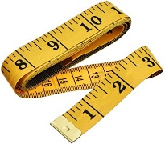
How to measure your waist and height
What will you need?
A flexible tape measure
A box or book to help measure how tall you are
If possible, a camera phone to take a photo of your waist measurement
tape measure
book
camera phone
Mary Pittaway and Alice Lenihan
September 2020
Notes:
Slide 1
This short presentation will explain the correct way to measure your waist size. The waist measurement is important because it can give us information about your health risks. So, let’s get started!
The tools you need to measure your waist and height are a flexible tape measure, a box or book to help check your height and a smart phone to take a picture of your measurement.
These instructions are available to print as well.

Slide 2
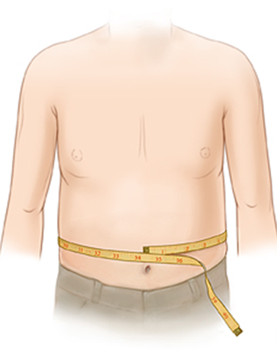
Why it’s good to know your waist to height ratio
Body Mass Index or BMI is the common way to see if a person's weight is healthy.
Comparing your waist with your height shows if your waist size is healthy or not.
Notes:
Slide 2
To learn if your weight affects your health, we want to measure your waist, and compare it to your height. We will now describe the correct way to measure your waist and height.
We suggest that you find someone to help make measuring easier and more accurate.

Slide 3
How to measure your height and weight
1. Use a flexible tape measure
2. Measure your waist
3. Measure your height if you’re not sure how tall you are
4. Record the measurements
5. Share a photo of your waist being measured and the result
Notes:
Slide 3
Gather your flexible tape measure and your box or book to get a correct height measurement. Also, if you have a camera phone, please take a photo of the tape measure correctly wrapped around your waist, so the reading is showing. You will be asked to upload the photo when you complete the Health Promotion Health Habits Assessment Survey.
This will help us know if our directions are clear and useful.

Slide 4
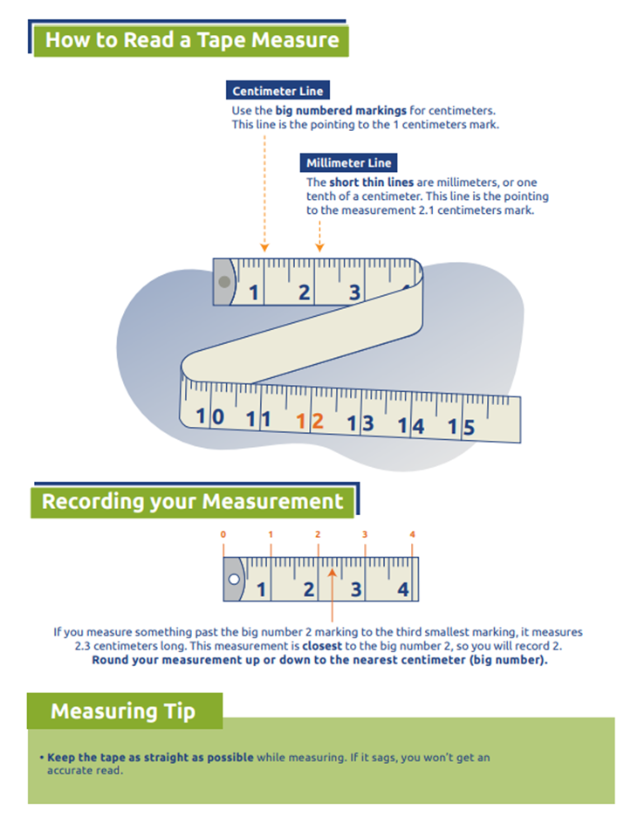
Using a Tape Measure
Measuring Tips
The centimeter lines extend across the tape measure. There’s a big bold number at each centimeter.
The half- centimeter mark is in-between the full centimeter marks.
Now we will see where to place the tape for your waist measurement.
Notes:
Slide 4
Your waist and height will be measured in centimeters
The centimeter marks extend across the tape measure and there’s a big bold number at each inch.
The half centimeter mark is the next longest line between the full centimeter marks.
Now we will show you where to place the tape for your waist measurement.

Slide 5
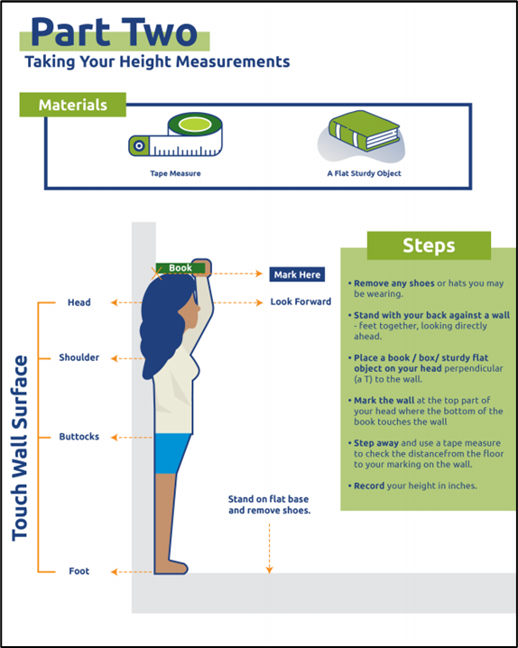
Measure Your Height
Remove shoes
Stand with back to a wall, feet together, looking straight ahead.
Have heels, seat and head touch wall
Place a book or box on your head against the wall (see picture)
Mark wall at the top of your head where the book touches the wall.
Measure distance from floor to the mark.
Record height in inches or centimeters.
Have someone help measure your height.
Notes:
Slide 6
Now we will discuss how to measure height.
It’s easier if you have another person help measure your height
Take off your shoes
Stand with your back against a wall, feet together, looking straight ahead.
Make sure your heels, seat and head touch the wall.
Place a book or box on your head against the wall (see picture)
Mark the wall at the top of your head where the book touches the wall.
Use a tape measure to check the distance from the floor to the mark.
Record your height in centimeters on your data sheet.

Slide 6
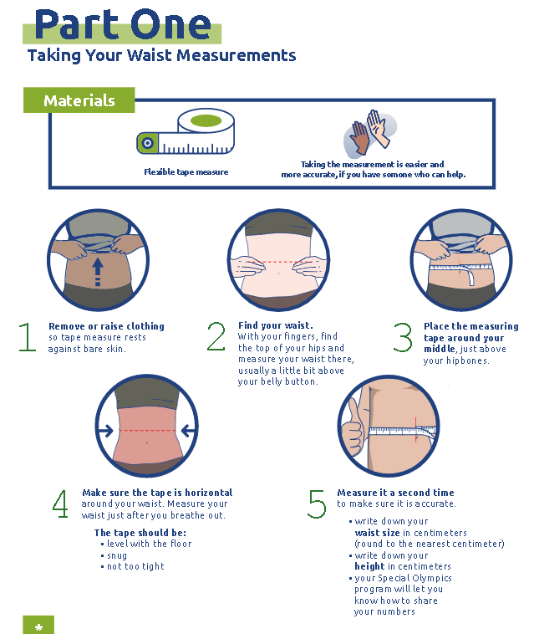
Measure Your Waist
Learn to correctly measure your waist so you can check it from time to time.
Its another good way to monitor your health.
Notes:
To correctly measure waist circumference
Stand and place a tape measure around your middle, just above the top of your hip bones. This is usually level with your belly button.
Make sure the tape is horizontal around the ways and not drooping.
Make sure it's not too tight and that it's straight, even at the back. Don't hold your breath while measuring.
Check the number on the tape measure right after you breathe out.
If you have a smart phone, take a photo of the tape around your waist, so result is also in the photo. Upload the photo on your data sheet.
Record your waist measurement in centimeters on your data sheet.

Slide 7
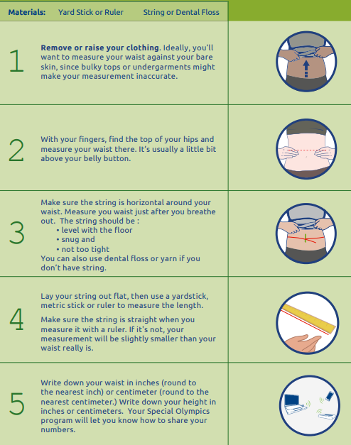
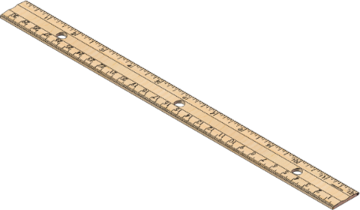
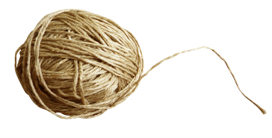
Measure Your Waist a String
You’ll need string and a measure stick
Have someone else help the with measurement
We recommend you have someone help you take the measurement to ensure the string is correctly placed
Notes:
If you don’t have a flexible tape measure, you can
measure your waist size using a piece of string and a measuring stick.
If possible, please take a photo of the string wrapped around your waist so we can see if our instructions are clear and useful. Upload your photo according to directions from your Special Olympics program.

Slide 8
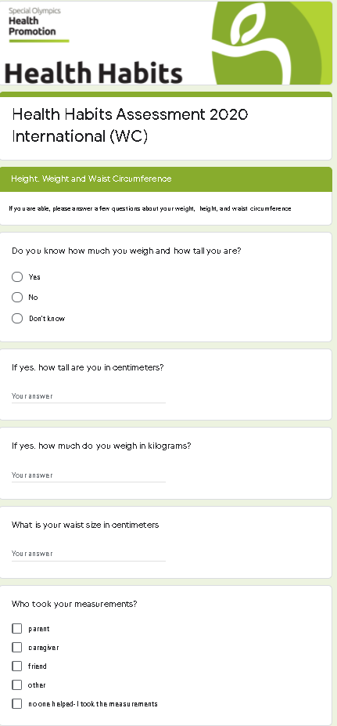
Record Your Measurements
On the Health Habits Survey, you’ll enter
your height, weight and waist size
information on who helped you with measurements
a photo of your waist measurement
Notes:
Slide 7
Make sure you record your measurements!
Please upload the photo of your waist measurement, if possible.

Slide 9
Keep your waist less than half your height
Record your waist size and divide by your height in centimeters.
For example, if you are 165 centimeters tall, keep your waist at 83 centimeters.
If your waist to height ratio is more than .5, your risk of high blood pressure, type 2 diabetes, heart disease and other health conditions rises.
Notes:
Slide 8
Comparing your waist size with your height is called the Waist Height Ratio. This calculates your body fat distribution and results over .5 can be an early sign for risk of diabetes, heart disease, stroke and other non-communicable diseases.

Slide 10
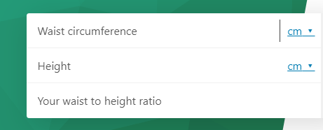
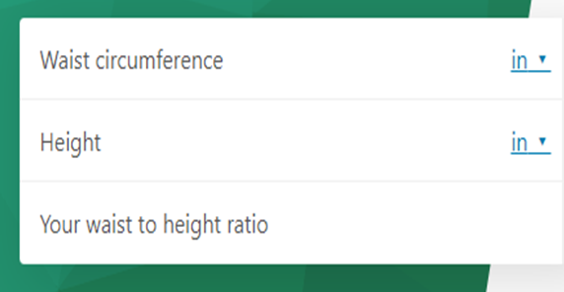
Use an online WHtR calculator to see if your waist is half your height. Here is an example
Enter waist and height measurements into calculator to get you waist to height ratio (WHtR).
Or
Divide waist measurement, by height measurement. A healthy result is .5 or less.
Click on this link to go to an online calculator
https://www.omnicalculator.com/health/Waist_Height
Notes:
To find out what your waist to height ratio is, divide your waist measurement in centimeters , by your height in centimeters .
You can use this information to direct you on a path towards better health.
Waist-to-height ratio cannot necessarily tell you that you are overweight or underweight or even give you a specific amount of weight to lose. However, it does give you information about how much excess fat you have around your mid-section.
Increased levels of abdominal fat, increases your risk for diabetes, heart disease and other illnesses.

Slide 11
What do the WHtR numbers mean?
References
Waist to height ratio is a better screening tool than waist circumference and BMI for adult cardiometabolic risk factors
How long is A Piece of String? Less than Half your Height Five Steps from Science to Screening This reference explains how you can monitor your waist size with string! Your active lifestyle and healthy food choices can help you keep your waist a healthy size.
Notes:
Waist-height ratio is considered a simpler and more predictive method to determine ‘early heath risks’ associated with central obesity.
The rule of thumb for a healthy body and for supporting life expectancy is to aim keeping the waist circumference to less than half of the height, so the WHtR at less than 0.5
Use this chart to see how your waist size relates to your health classification. If your waist to height ratio is over .5, remember, even small decreases in waist size can have a large impact on your health.
This reference explains how you how an active lifestyle and healthy food choices can help you keep a healthy weight size. How long is A Piece of String? Less than Half your Height. Five Steps from Science to Screening: A Mini Review

