Slide 1
Health Promotion Virtual Healthy Athletes
Overview of program resources for Regional and Program Health Managers and Health Promotion Clinical Directors

Slide 2
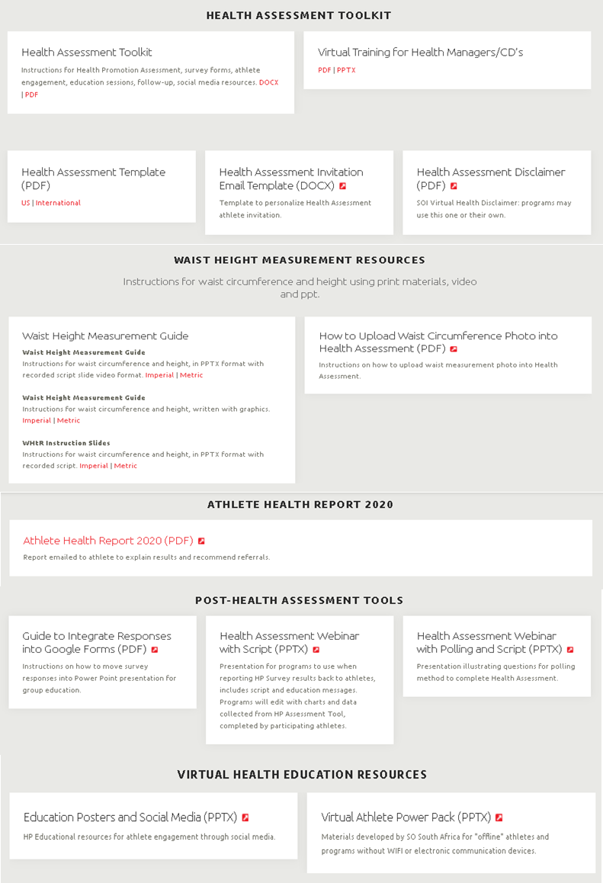
Check out the materials on the Virtual Health Promotion Webpage
Health Assessment Toolkit
Instructions for the Health Assessment, survey forms, athlete engagement, education sessions, follow-up, social media resources. DOCX | PDF
Health Assessment Invitation Email Template (DOCX)
Waist Height Measurement Guide (PDF)
Waist Height Instruction Slides with audio (PPTX)
Health Assessment Template US (PDF)
Health Assessment Template International (PDF)
Health Assessment Disclaimer (PDF)
Guide to Integrate Responses into Google Forms (PDF)
Health Assessment Webinar with Script (PPTX)
Notes:
The materials and guidance for delivery of the Health Assessment are posted on the Health Promotion Resources website under Virtual Health Promotion. They are organized to help programs easily incorporate the event into ongoing athlete services.
You’ll find templates, athlete guidance taking their own height and waist measurements, suggestions on how to adapt the materials to your unique program needs. Also included are tools needed by your Clinical Director or clinical volunteer to deliver the health promotion education session, and guidance on post event documentation and follow-up. Documents are also listed and linked on this slide for your later reference.
We have found this program to be fun and relevant to athletes, families and caregivers. Program staff have been impressed with the athletes participation and level of engagement. We hope you will too!

Slide 3
Steps to Planning for the Health Assessment
Program Health Staff | Clinical Director or Volunteer
Share overview of the Virtual Health Promotion program with Clinical Director and decide on date(s). | Review the waist measurement instruction and the Health Assessment Webinar with Script.
Provide Health Messengers with an overview of the program, discuss dates and their role. | Discuss the overall program and resources with Program Health staff and Health Messengers.
Send the invitation with Health Assessment survey link and disclaimer form to athletes. | Assist with resource development for the Education Webinar.
Prepare athlete survey results (charts and/or graphs) and embed into the Education Webinar slides. | Assist Health Messengers to create their Health Assessment promotional messaging.
Test the system with a trial run, to ensure delivery success. | Deliver the Education Webinar.
Set your goal for the number of athletes you hope to engage in the Health Assessment. Plan the number of sessions needed to serve your athlete population. Consider mailing the Health Assessment to athletes who can’t participate online. Decide if you will post an archive of the webinar for future viewing. | Based on athlete interest in topics discussed during the webinar, chat entries, and screening results, determine ideas for follow-up education sessions.
Determine what incentives you will use to reinforce participation.
Follow-up on athlete referrals according to referral protocols.
Notes:
As with any new program, people want to know who is responsible for what . This chart lays out suggested roles for Program staff, clinical directors and volunteers.
Careful planning and trial runs can help your ensure success in the delivery of Health Assessment. Some may wish to use these steps as a checklist when planning for delivery of the Health Assessment .

Slide 4
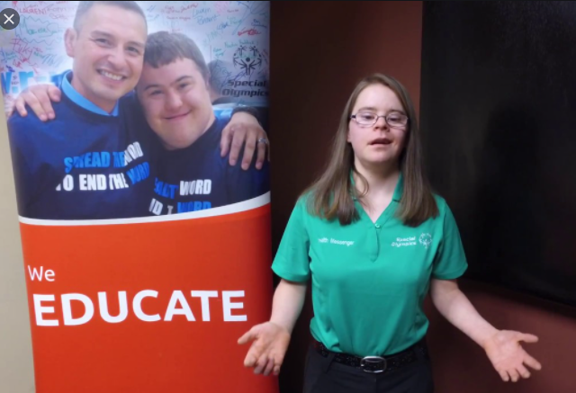
Enhance your Education Session with Health Messengers
Sponsor and promote the Health Assessment activities.
Send a personal message and invitation to athletes and post on Facebook and other social media.
Challenge fellow athletes to register and attend the session.
Act as co-host for session, deliver speaker introductions and help moderate.
Present scripted messages on healthy habits during the webinar.
Thank athletes and presenter.
Follow-up with recap and thanks in social media after the webinar.
Notes:
Health Messengers and Athlete leaders can play an important role in promoting the program with athletes via Social Media. They may help host the session, introduce speakers, pose questions to the audience during the session and present scripted health education on health habits during the webinar.
They may also help wrap up the session by congratulating the athletes and challenging them to continue to embrace healthy lifestyles .
.

Slide 5
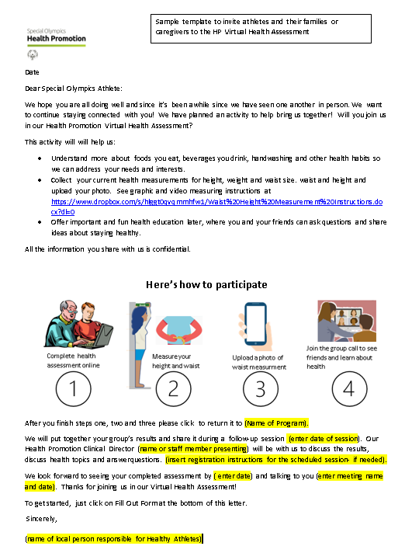
Athletes Register
Invitation Template
Use the invitation template which includes a link to the athlete Health Assessment.
The template is designed for Google Forms.
Athletes are invited to register and sign the disclaimer *and
Follow the guidance on measuring their waist and height.
Once registered, the online assessment form is shared with the athlete to be completed and uploaded.
* The Virtual Health Assessment Disclaimer may be attached to the registration form or to the Health Assessment Template
Notes:
So how do athletes actually register for the event? The invitation template, designed for Google Forms:
explains the planned activities
includes a link for the athlete to register for the event and sign the Virtual Health Assessment disclaimer and
provides a link to guidance on measuring their waist size and height.
Once registered, the online assessment form is shared with the athlete, to be completed and uploaded.
Unified partners, coaches, staff and volunteers are also invited to participate in the Virtual Health Assessment

Slide 6
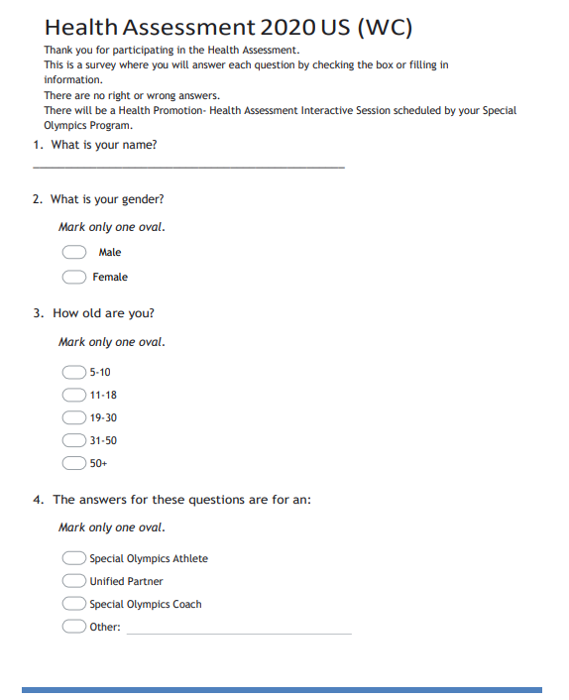
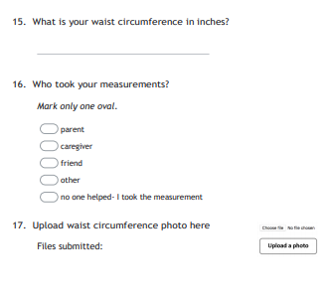
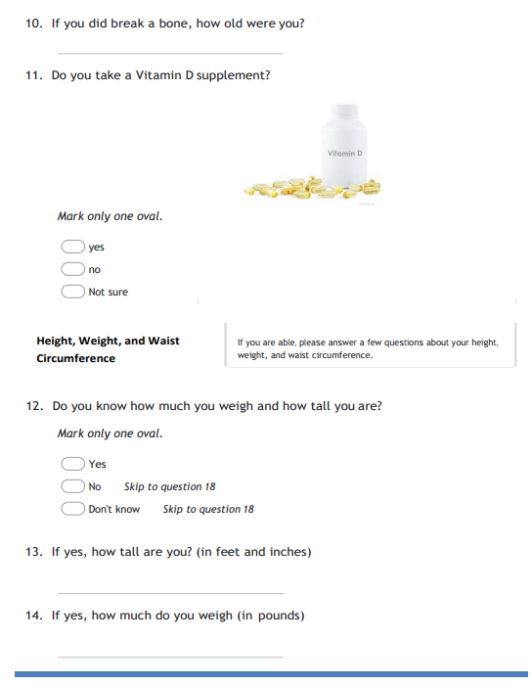
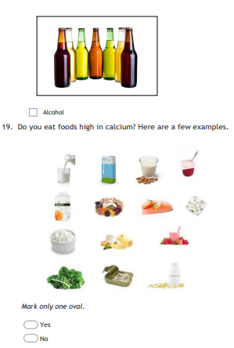
Athletes Follow The Link To Access The Online Health Assessment Tool
The Health Assessment template includes
Athlete demographics
Height, weight and waist circumference
Self-reported nutrition and health habits
Notes:
The three components of the Health Assessment tool that athletes complete include
Demographics
clinical measures: self-reported weight, self-measurement of waist and
self-reported health behaviors.
We anticipate that athletes will have help from family or caregivers while responding to the questions and to measure their waist and height and upload the photo.
Athletes are asked to follow instructions to measure height and weight for the Waist to Height Ratio or WHtR.

Slide 7
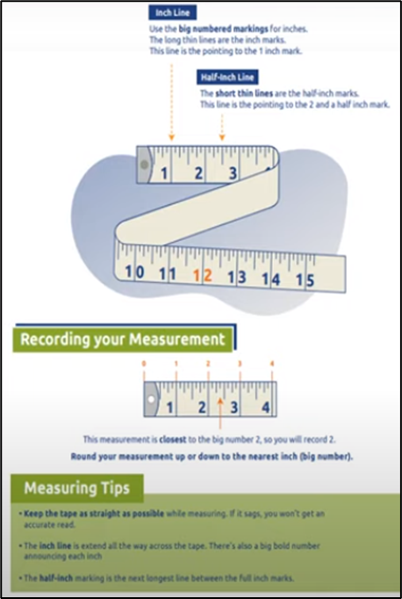
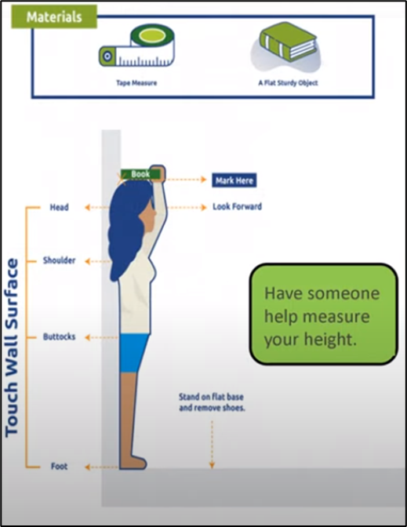
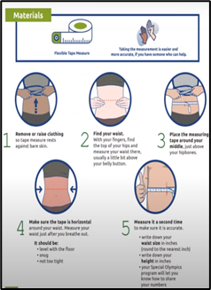
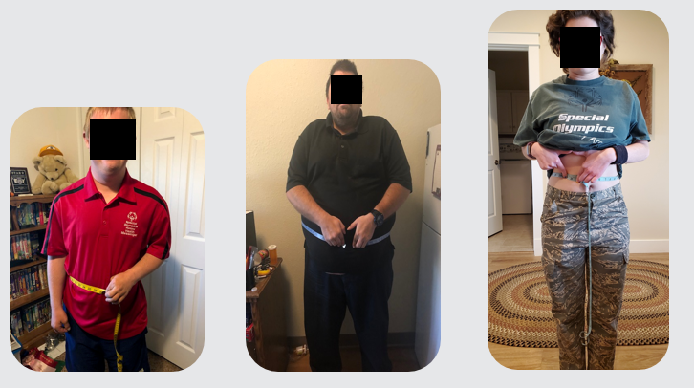
Instructions To Measure Waist and Height Are Found on the Virtual Health Promotion web page.
WHtR Training materials
Athletes measure their waist and upload a photo of their waist measurement.
Scripted slides with and without narration are posted on web page
Graphic guides for measurement techniques are available for athletes
Notes:
Comparing waist size with height is a new and important screening in Health Promotion, called the Waist to Height Ratio or WHtR
The graphic instructions and short slide presentation show correct placement of the measuring tape, how to read the tape and record the waist and height measurements. After measuring their waist, athletes are asked to upload a photo of the waist measurement. The referral criteria for the Waist to height ratio will be explained later.

Slide 8
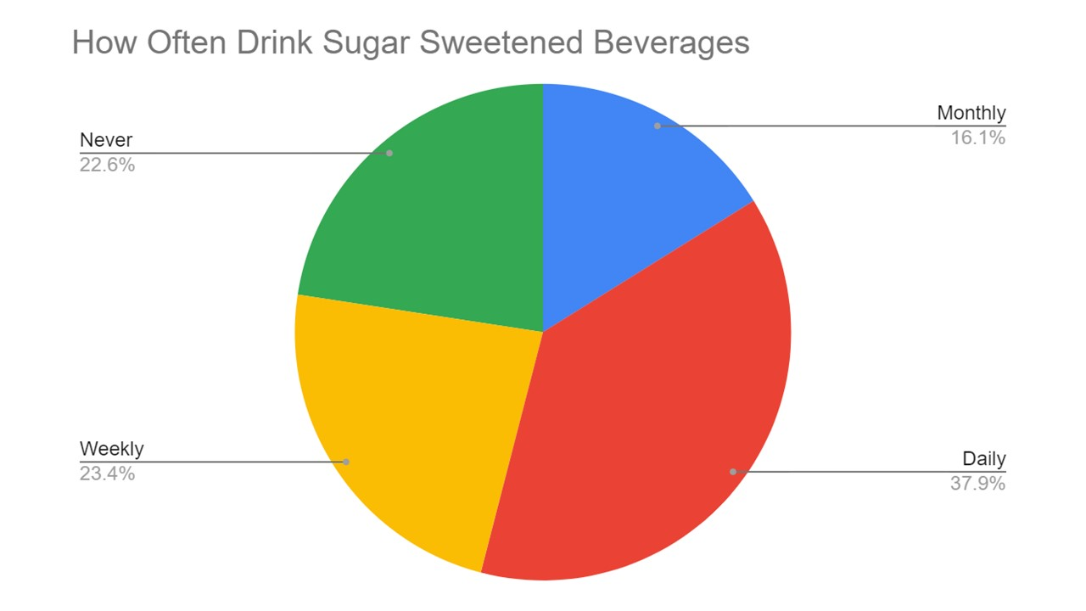
Health Assessment Webinar
Athlete weight, height, waist and health habits responses go into Google sheets file. These can be saved in Excel for transfer of screening results into HAS.
Charts and graphs can be developed from Google sheets or Excel.
Survey results and key education messages can be discussed with athletes during the educational webinar.
A Clinical Director or clinical volunteer may present the webinar.
Scripted education is found on the HP Resources Virtual Health Promotion web page.
Time for questions and answers should be included in webinar.
Notes:
Athlete newly measured height and waist size, and self-reported weight and health habits responses are reported back to the program in a Google sheets file. This can be saved as an excel file so screening results and be entered later into HAS. Charts and graphs can be developed from Google sheets or Excel. The resulting graphs may be added to the slides in the webinar template, found on the HP Virtual Health Promotion web page. Survey results and key education messages should be discussed with athletes during the educational webinar
The webinar may be presented by the HPCD or a clinical volunteer with help from a HM. Scripted education content for the webinar is also found at the VHP web page. When time for Q and A is included in the webinar, athletes can share thoughts and interest in further discussion of the topics covered.

Slide 9
Additional Information on Webinar
Athletes engaged in the Health Assessment education webinar.
Aggregated athlete responses presented on spread sheet.
Example of an aggregated response converted to pie-chart for webinar slides.
Notes:
Athlete responses for weight, height, waist size and health habits responses are seen in the Google sheets file, it can be saved as an excel file for later transfer into HAS.
Charts and graphs can be developed from Google sheets or Excel
Survey results and key education messages should be discussed with athletes during the educational webinar. A Clinical Director or clinical volunteer may present the webinar. A scripted PowerPoint presentation is found on the HP Resources web page. Time for questions and answers should be included in webinar.

Slide 10
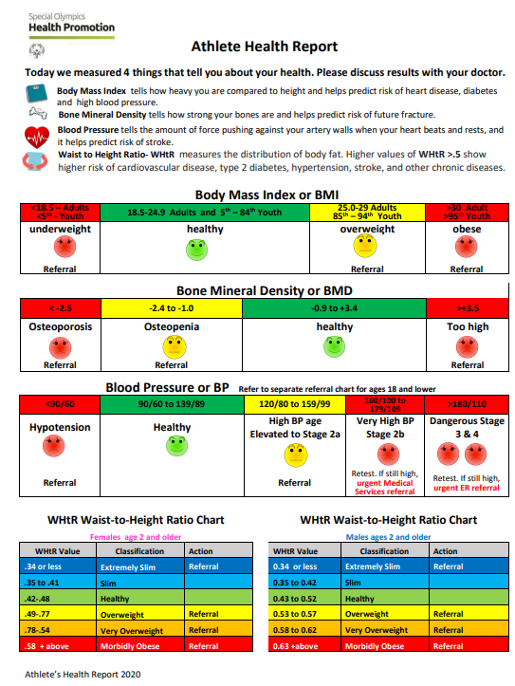
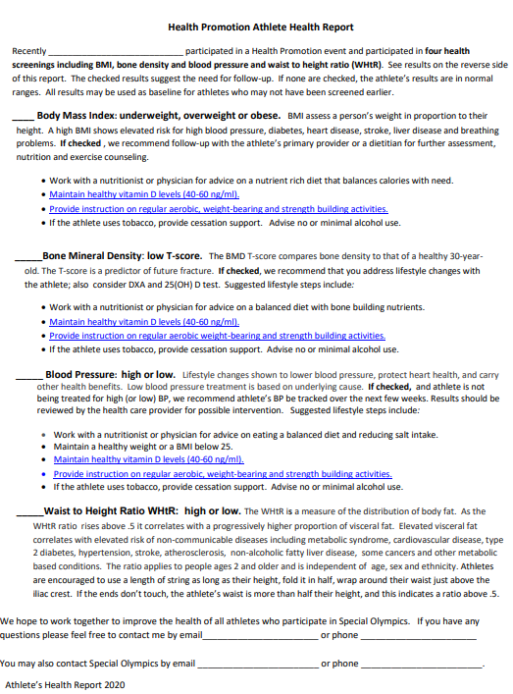
Follow-up Referrals and Evaluation
Athlete Health Report 2020
If either the BMI or waist to height ratio (WHtR) meets our referral criteria, the Health Promotion referral and follow-up process is followed.
Refer to the updated Athlete Health Report 2020 for WHtR referral guidelines.
Be sure to include fitness opportunities like Fit 5, SO Fit, Unified Fitness Club and others, offered through the Program as a referral option.
SOMT Health Director Bill Salonen following-up with athlete referral
Notes:
If the BMI or waist to height ratio (WHtR) meet referral criteria shown on the Athlete Health Report, the HP referral and follow-up process should be followed. Remember to include your fitness programming as a referral source for athletes.

Slide 11
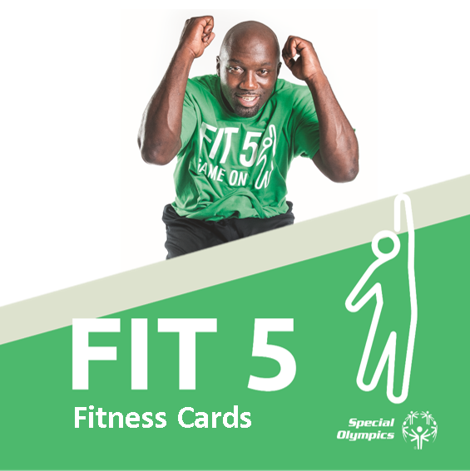
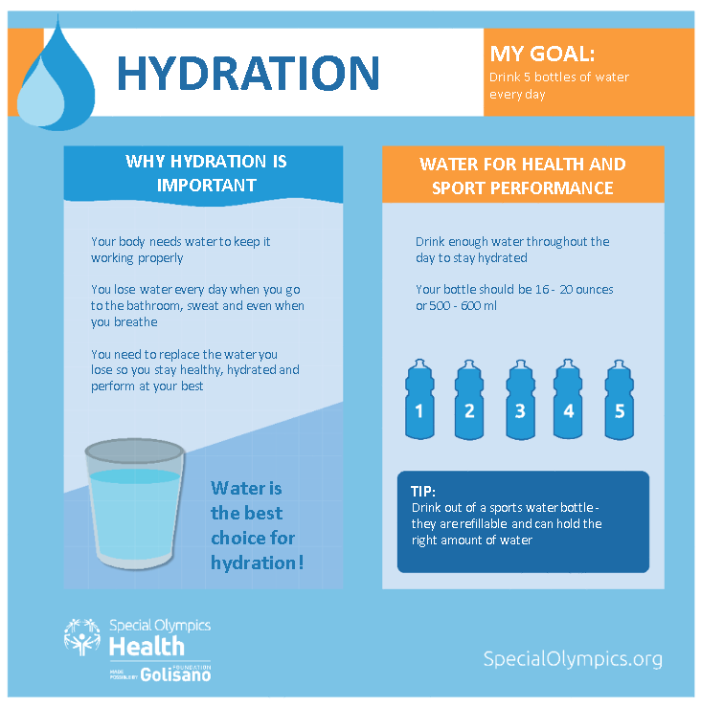
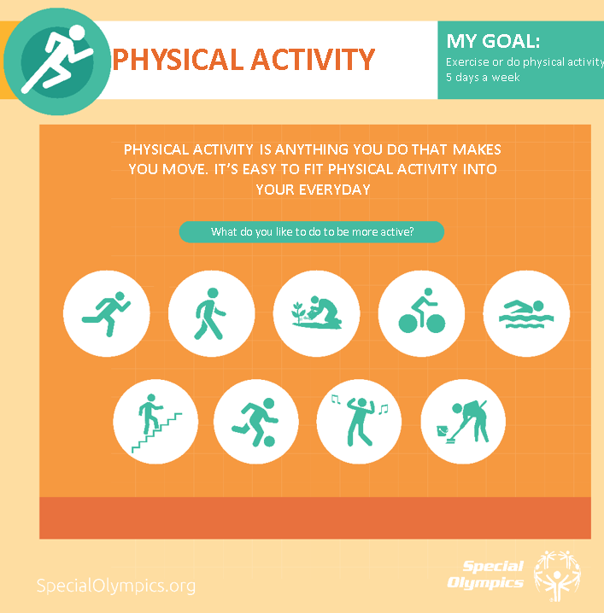
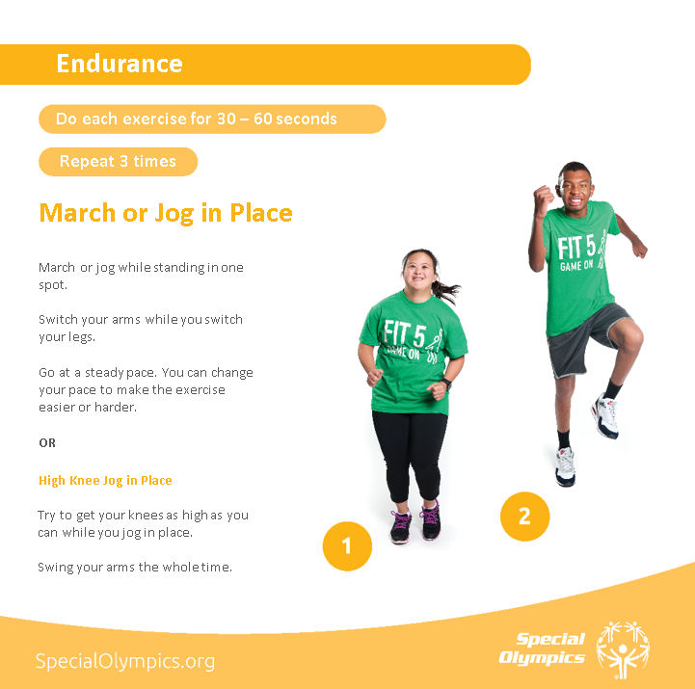
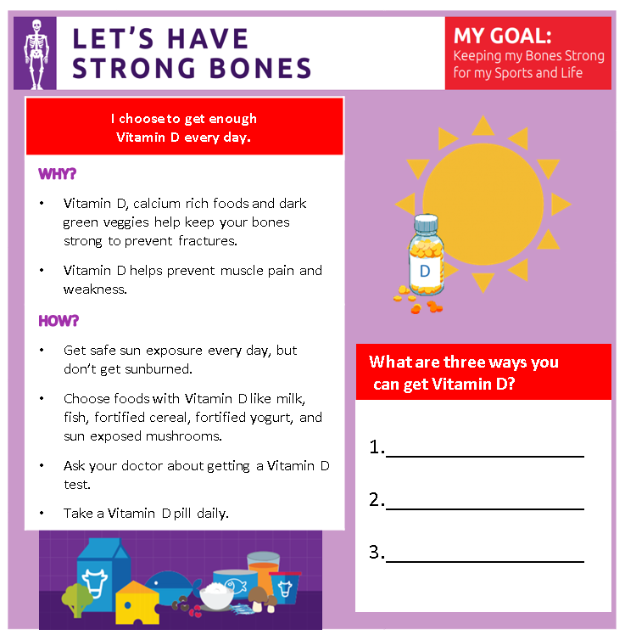
Health Promotion and Fitness Resources for Social Media Use
Virtual Athlete Power Pack
Materials developed by SO South Africa for offline athletes and programs without WIFI or electronic communication devices.
Education Posters and Social Media
Examples of Health Promotion resources for athlete engagement through social media.
Notes:
Additional resources for ongoing virtual health promotion and fitness messaging, are available on the Virtual Health Promotion webpage

Slide 12
Additional Social Media Resources and Content
As Programs and Regions share resources, they will be posted on Virtual Health Promotion web page. See examples below.
Perfect Food Portions: From SO Connecticut, a ready to use nutrition education presentation from SOCT, with athlete challenges and polling built into presentations. (Request approval from SOCT to join Facebook group.)
Snacks vs. Treats: View Special Olympics Iowa Health Promotion Clinical Director, Judy Fitzgibbons showing the difference between treats and healthy snacks.
Fit 5 and Fitness Cards and Videos: Resources for Programs looking to expand their fitness programming and initiatives.
School of Strength: Introducing a new way to exercise. Work out with these videos five times a week to help you stay fit and reach your athletic goals.
Proper Hand Washing Techniques: Special Olympics athletes have skills and abilities beyond sports. In a new Expert Tip video series, athletes share their know-how on a range of helpful and popular topics.
COVID Handwashing poster from SONH.
Notes:
Additional virtual health promotion resources shared by other programs will be posted as updates are submitted. Here are examples of short cooking classes and interactive nutrition education classes.

Slide 13
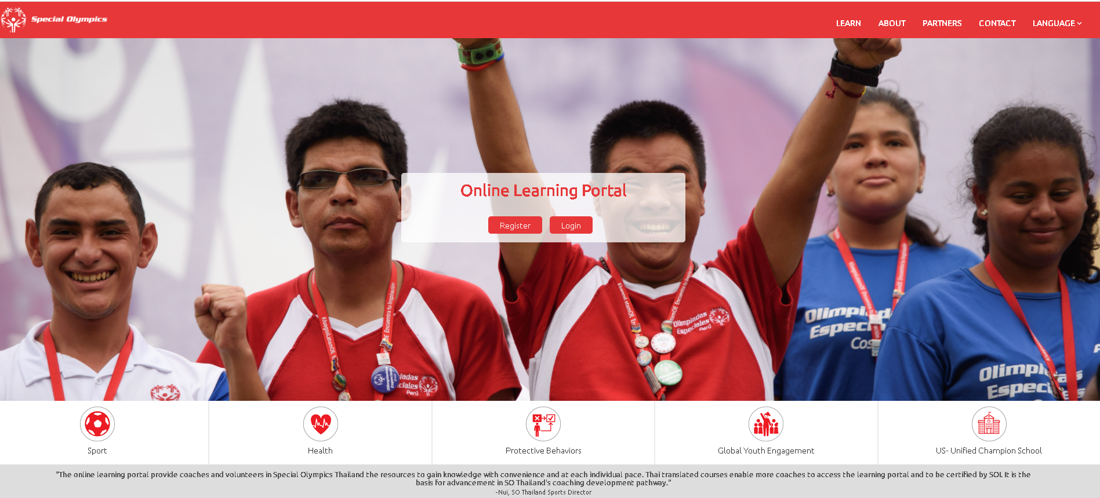
SOI Online Health Promotion TTT
In recent years, Health Promotion has incorporated changes into screening, education and referral protocols. Check out the updated resources below.
Clinical Directors and volunteers are invited to complete the Health Promotion Clinical Director Online TTT Modules.
The revised Clinical Director Manual content coincides changes included in the Online TTT.
Notes:
Over the years, Health Promotion has incorporated changes into screening protocols, we added the waist to height ratio . Our health habits interview has evolved to include additional relevant. We have new education resources and ways to discuss health education topics with athletes. Our referral protocols have been expanded to include Special Olympics fitness programming and community-based services and programs.
These changes are reflected in our Online Health Promotion Train the Trainer modules and we encourage previously trained Clinical Directors to enroll in the course to learn of these important changes.
We also ask Clinical Directors to review the updated Health Promotion Clinical Director Manual for changes, and to see additional resources to enhance your program.

Slide 14
Thanks for viewing the Overview of the Health Promotion Virtual Health Assessment
The materials referenced in this presentation can be found at the Virtual Healthy Promotion link on the Special Olympics website.
Our thanks go to all the Special Olympics Health Managers, Clinical Directors, Health Messengers and volunteers who help make Virtual Healthy Athletes fun, engaging and effective.
And remember……………………….
Athletes will enjoy participating in the Health Promotion Health Assessment!
Notes:
Thanks for your time and interest in the Health Promotion Virtual Health Assessment overview. The materials referenced are found at the Health Promotion Virtual Healthy Athletes link on the Special Olympics website.
And our sincere thanks go to all the Special Olympics Health Managers, Health Promotion Clinical Directors , Health Messengers, and volunteers who help make Virtual Healthy Athletes fun, engaging and effective.
And remember……………………….

Slide 15
You Can Do It. We Can Help.
Alice Lenihan, MPH, RD, LDN
Global Clinical Advisor
Special Olympics International
lenihanaj@aol.com
Mary Pittaway, MA, RDN, LDN
Global Clinical Advisor
Special Olympics International
Mpitt59802@aol.com
Health Promotion Senior Manager
Special Olympics International
healthpromotion@specialolympics.org
Notes:
You can do it, and we can help. Best wishes and great success in your future Health Promotion Programming.

