Slide 1
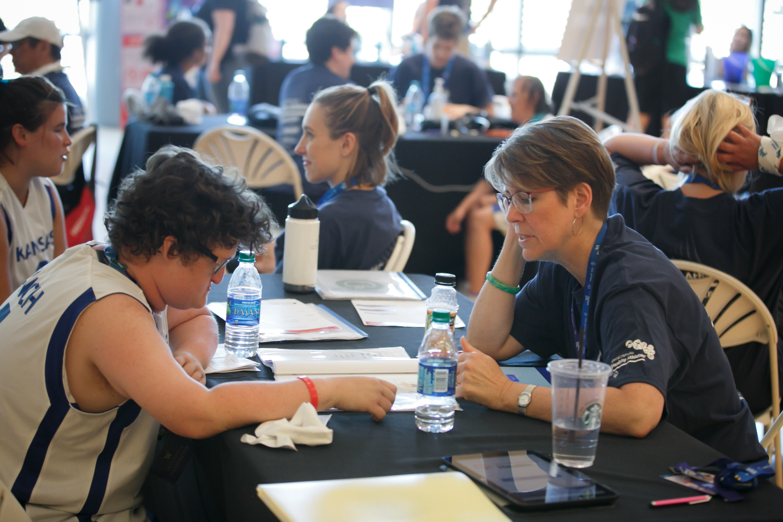

Health Promotion Health Assessment
Notes:
Welcome to Special Olympics Health Promotion. My name is (insert name) and I am a Clinical Director (or other title, dietitian, nurse, etc.) for the (insert state or local) Special Olympics Program. Today we are talk about the results of the Health Assessment you completed.

Slide 2
How Does this Work?
Thank you for participating in the Health Assessment
Today, we are going to share the results from the surveys you completed.
There were no right or wrong answers, after each question, we will share some health recommendations about the question.
Please raise your hand if you have a question.
You can request a meeting with a Health Promotion Clinical Advisor if you want to discuss a question or health concern you have.
Notes:
During our session today, we are going to discuss your responses to the Health Assessment survey. The results are for the group, we will not be talking about any one person’s answers.
I want to thank each of you for answering the survey. Your answers helps us to better plan activities and health education topics for our athletes. Your input is important to us,
At the end we will ask if you want to talk to a Health Promotion Clinical Advisor about questions you may have or other health concerns.

Slide 3
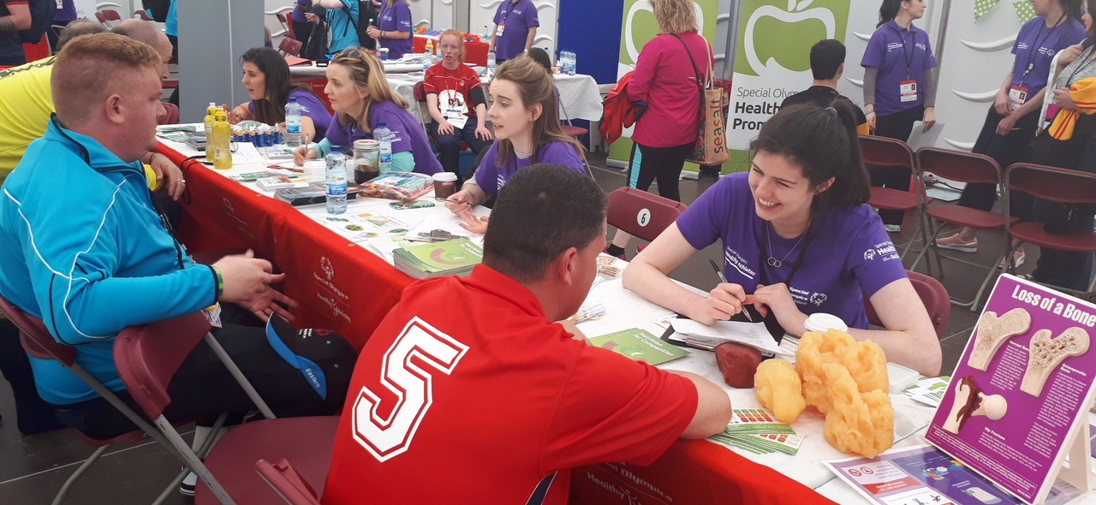
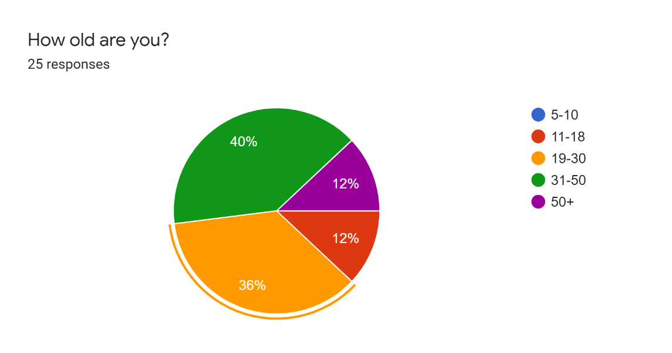
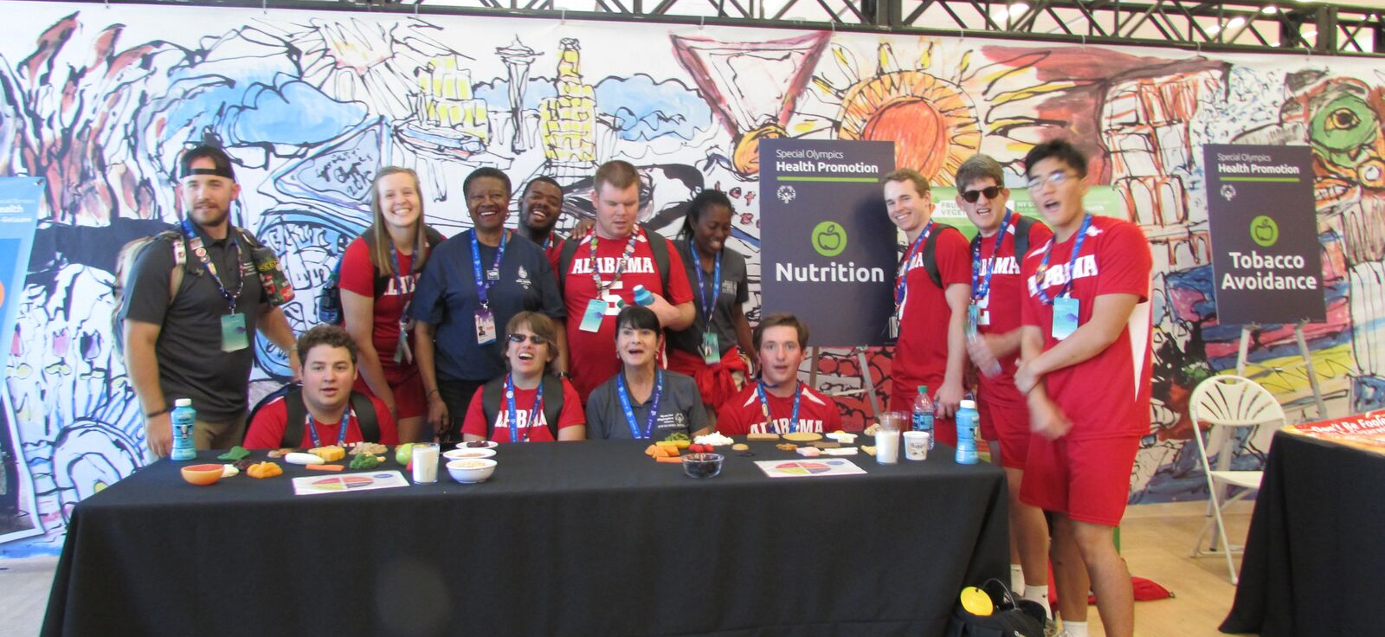
Notes:
The majority of those who responded were between 19-50 years of age.

Slide 4
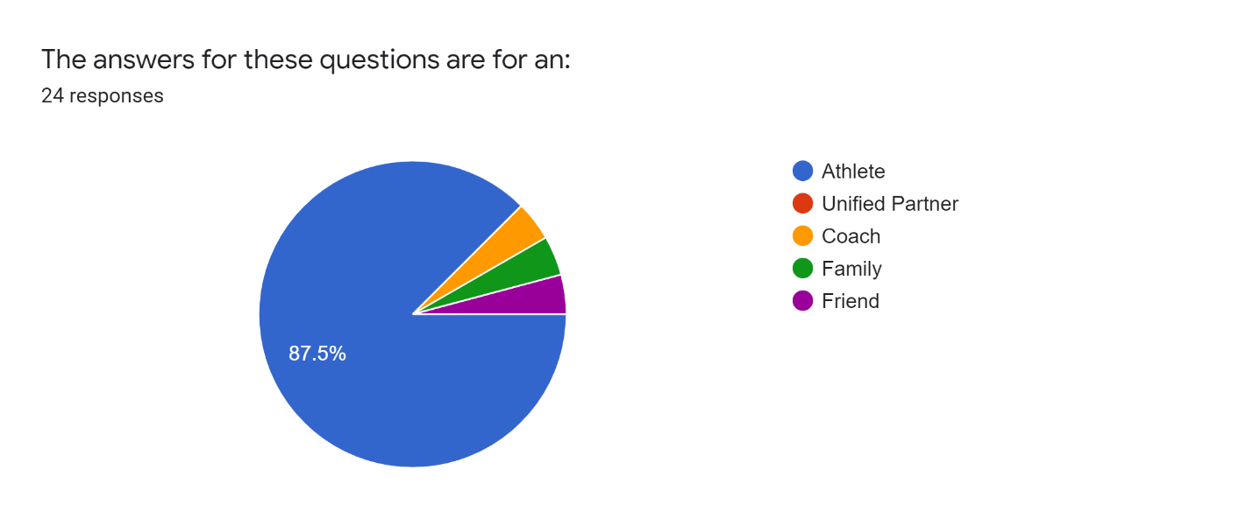
The responses for these questions is for an:
Athlete
Unified Partner
Coach
Family
Friend
Notes:
87% of the responses were for an athlete. There also was a coach, family member and friend.

Slide 5
Medical Care and Health
Questions
Do you have a doctor?
Yes
No
Not sure
When was the last time you went to the doctor?
  3 months ago
  3 to 6 months ago
  6- 12 months ago
  more than 12 months ago
Do you take any medicine for your blood pressure?
Yes
No
Do you have any concerns about your weight?
Yes
No
Responses
100% had a doctor
60% doctor visit 3 months ago
12% doctor visit 3-6 months ago
16 % doctor visit 6-12 months ago
12% doctor visit more than 12 months ago
16% take medicine for blood pressure
52% have concerns about their weight
Notes:
Good job, everyone has a doctor. 60% have seen their doctor in the past 3 months and others have had visits in the past year. A few of you (12%) have not seen your doctor in the past year. You might want to think about checking in with your doctor for an annual visit.

Slide 6
Bone Health
Question
Response
Have you ever broken a bone?
Yes
No
Not sure
If yes, how old were you?
_________
32% had broken a bone at various ages
Notes:
Almost 1/3 or 32% of you have broken a bone.

Slide 7
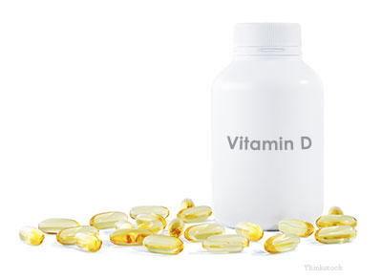
Question
Do you take a Vitamin D Supplement?
Response
Yes
No
Not sure
Good job!
68% take a Vitamin D Supplement
Notes:
Good job 68% of you take a vitamin D supplement

Slide 8


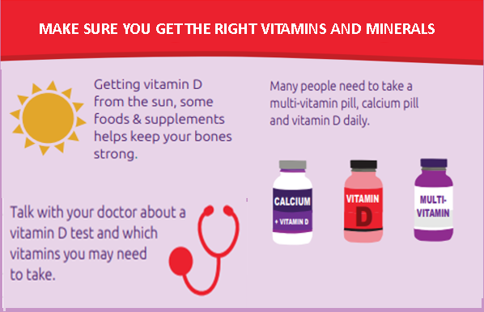
Notes:
There are many things you can do to be sure you have strong bones; a vitamin D supplement is just one. You can also get vitamin D from the sun and foods. We will talk about foods with calcium and vitamin D in a few minutes.

Slide 9
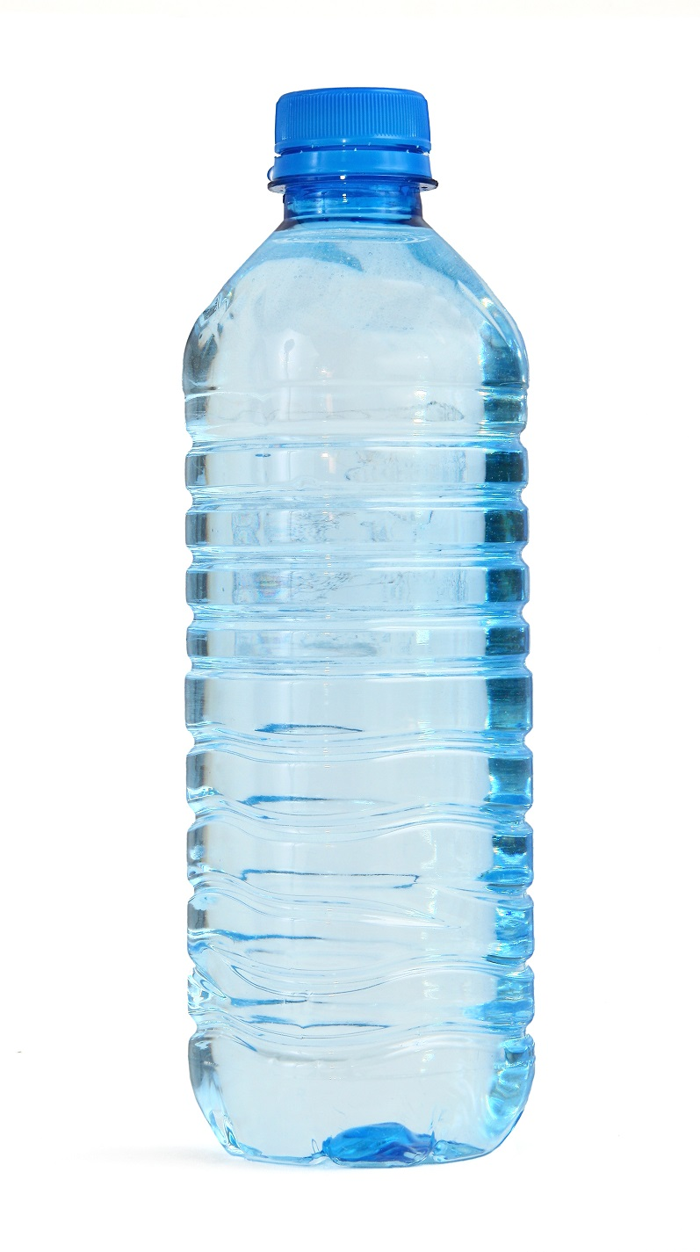
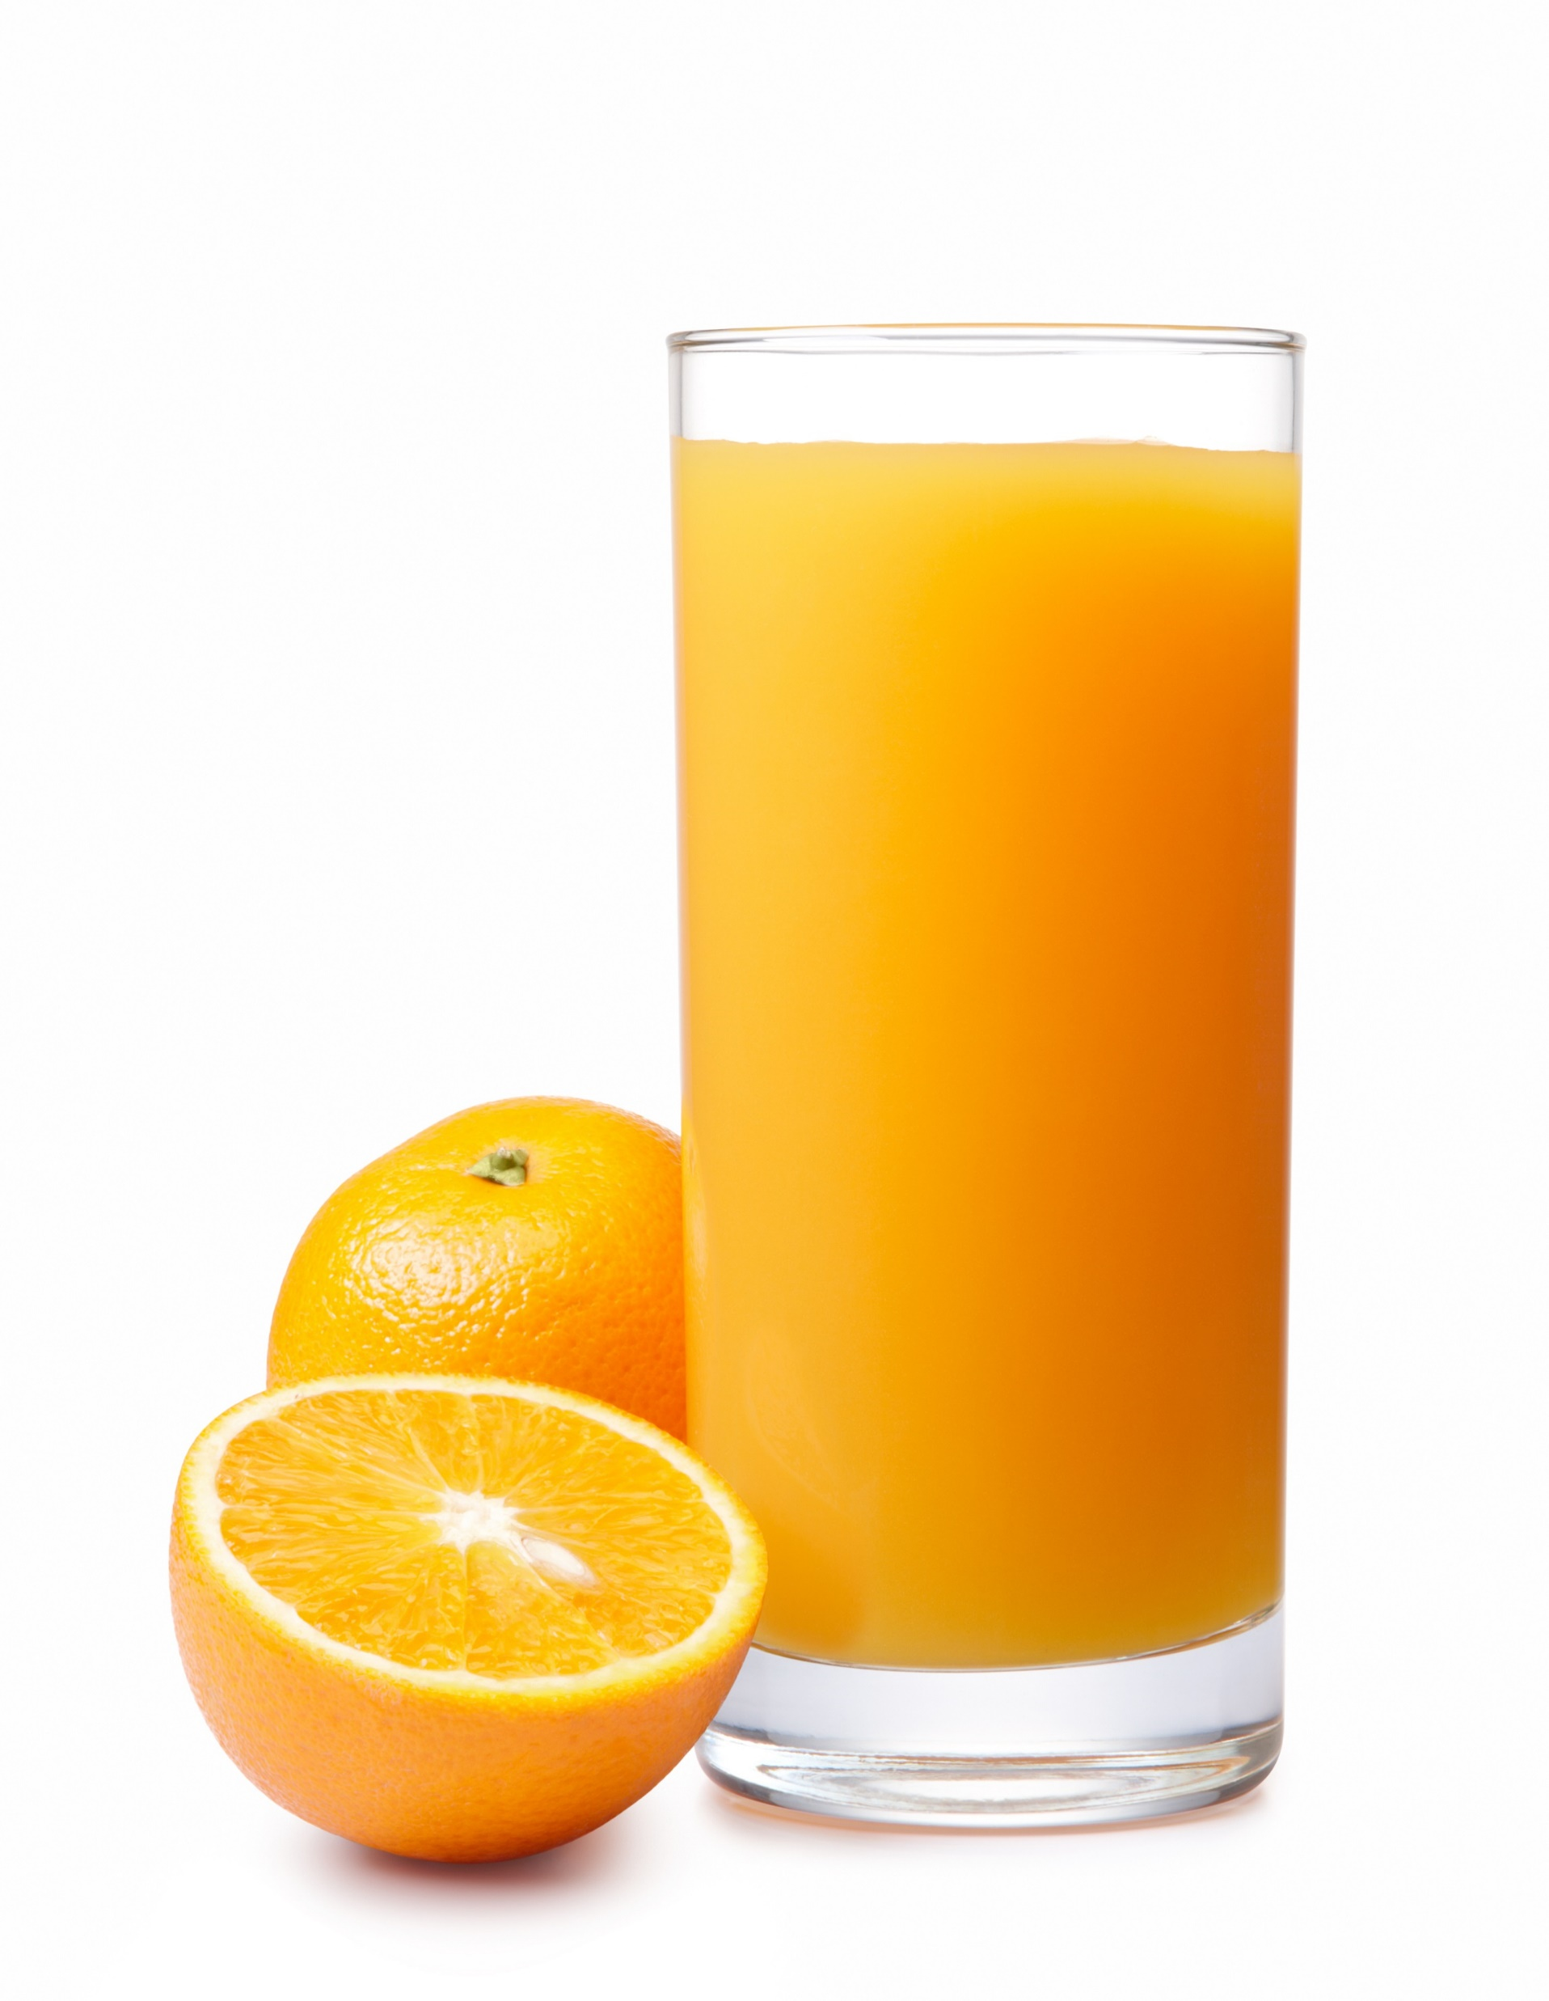

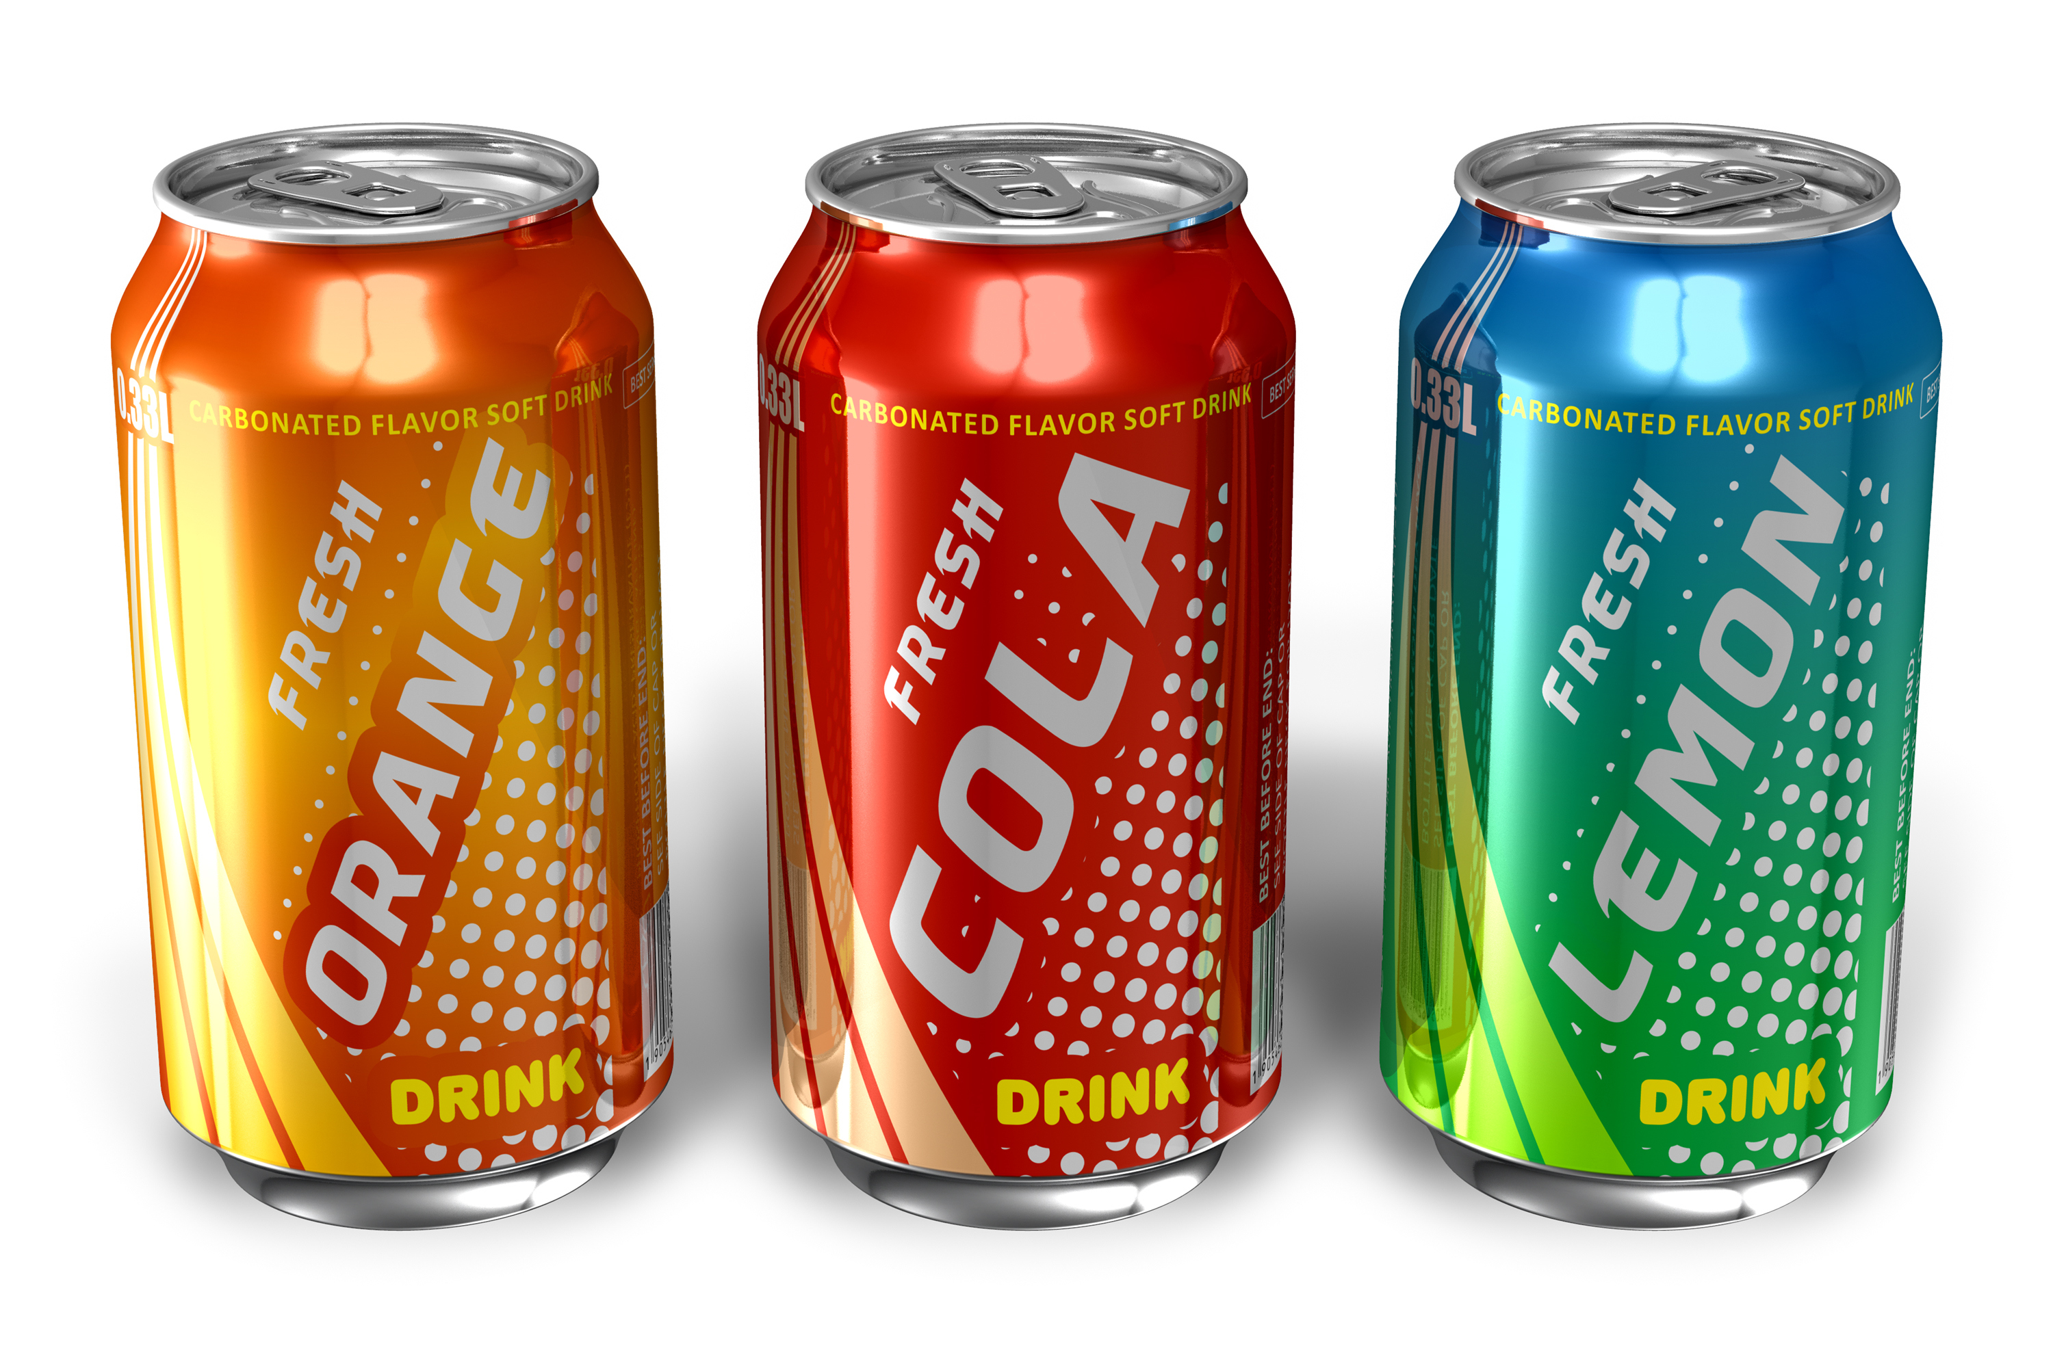
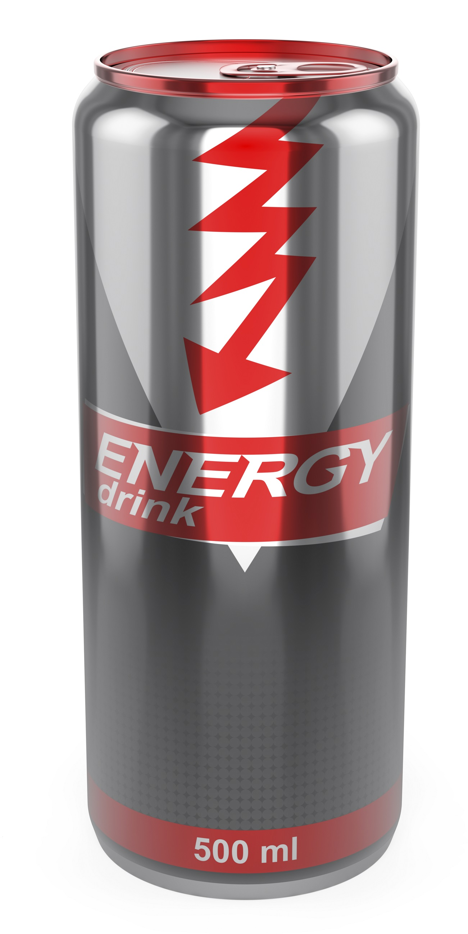
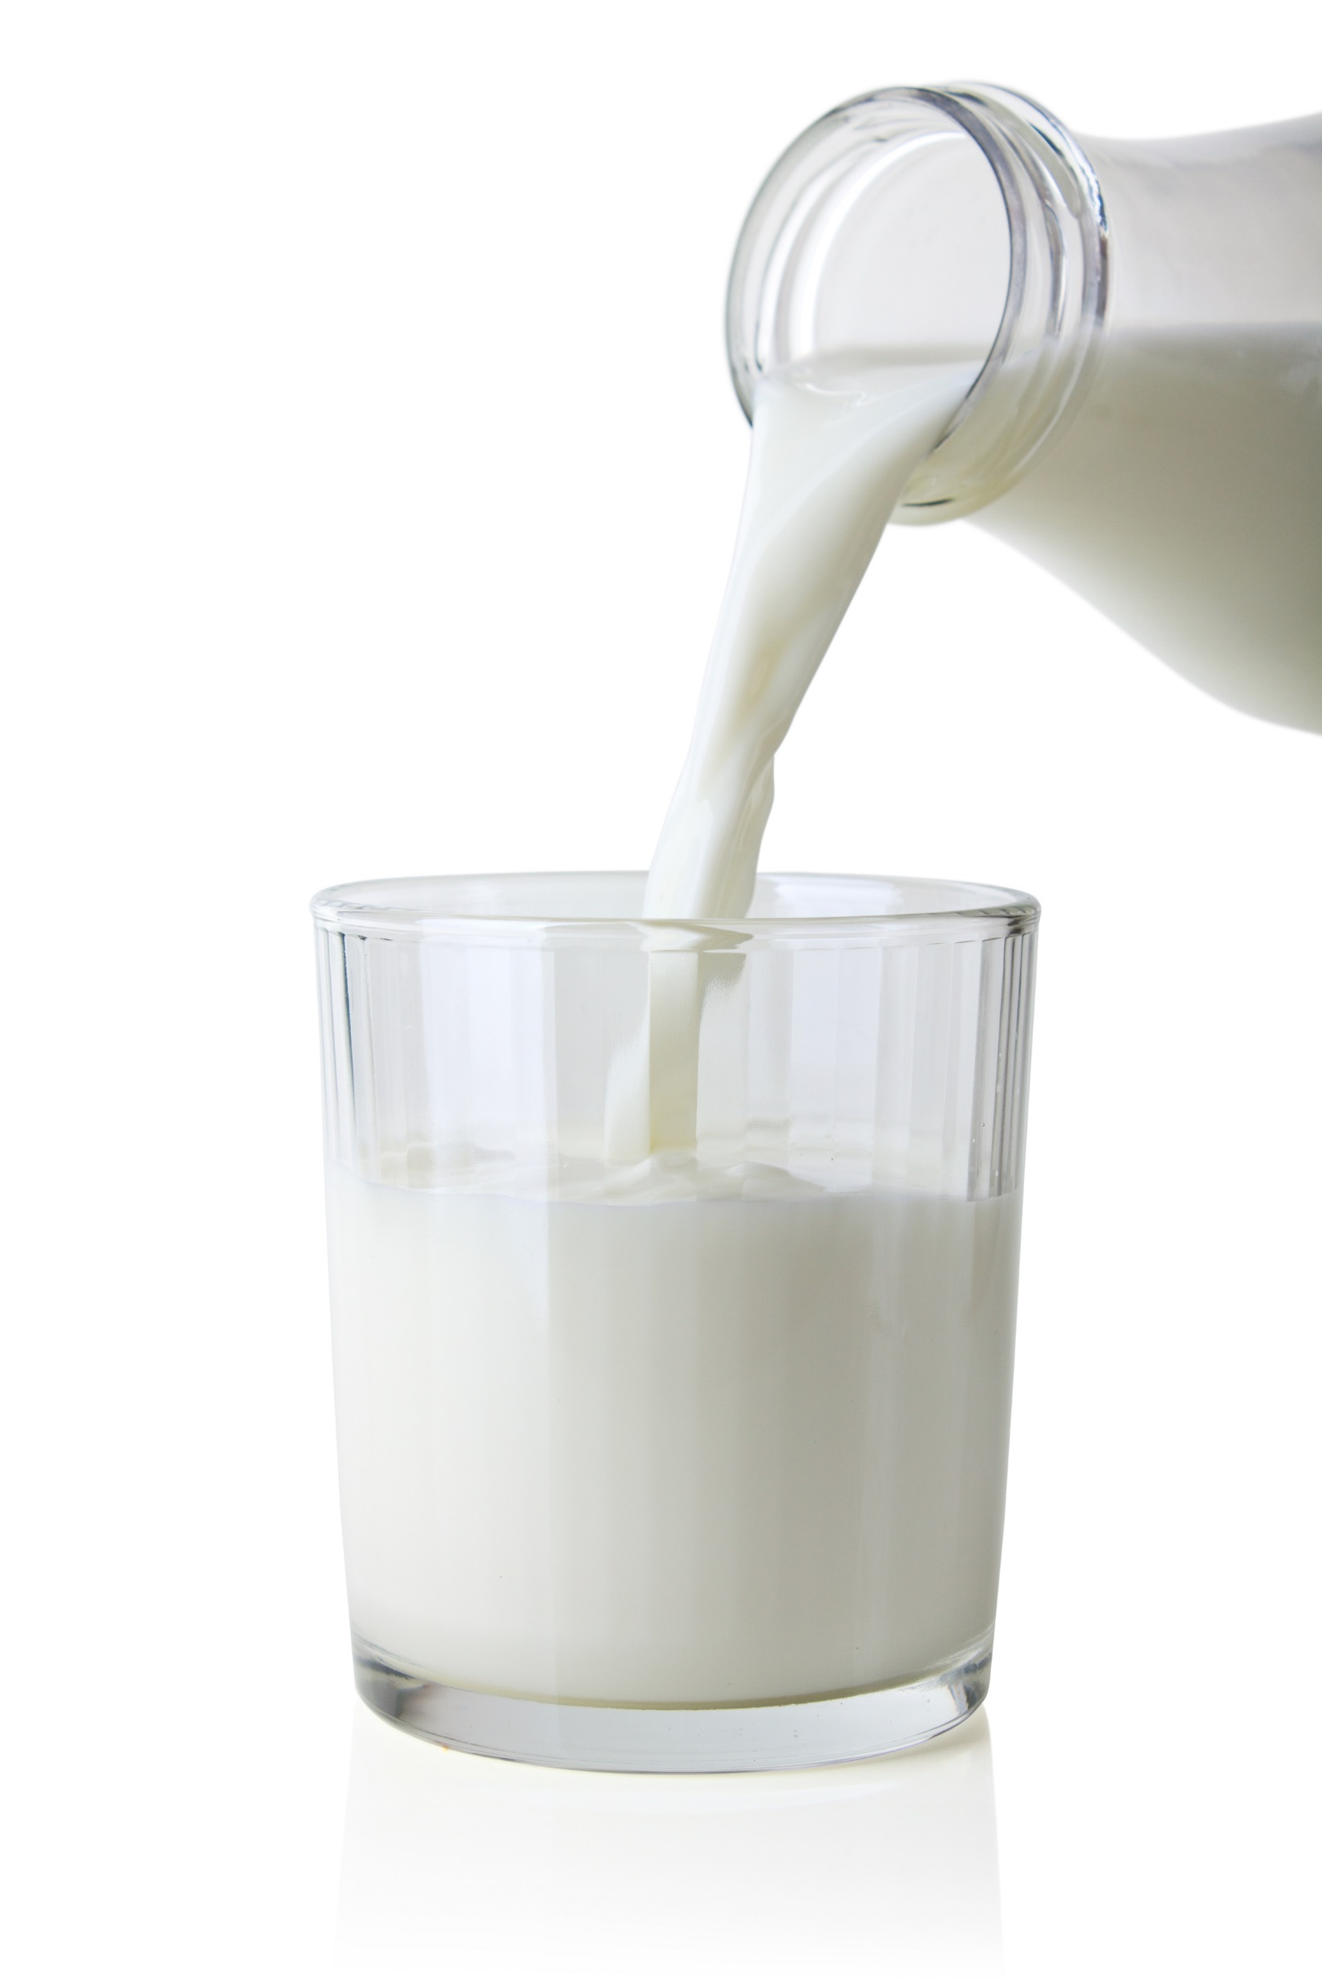
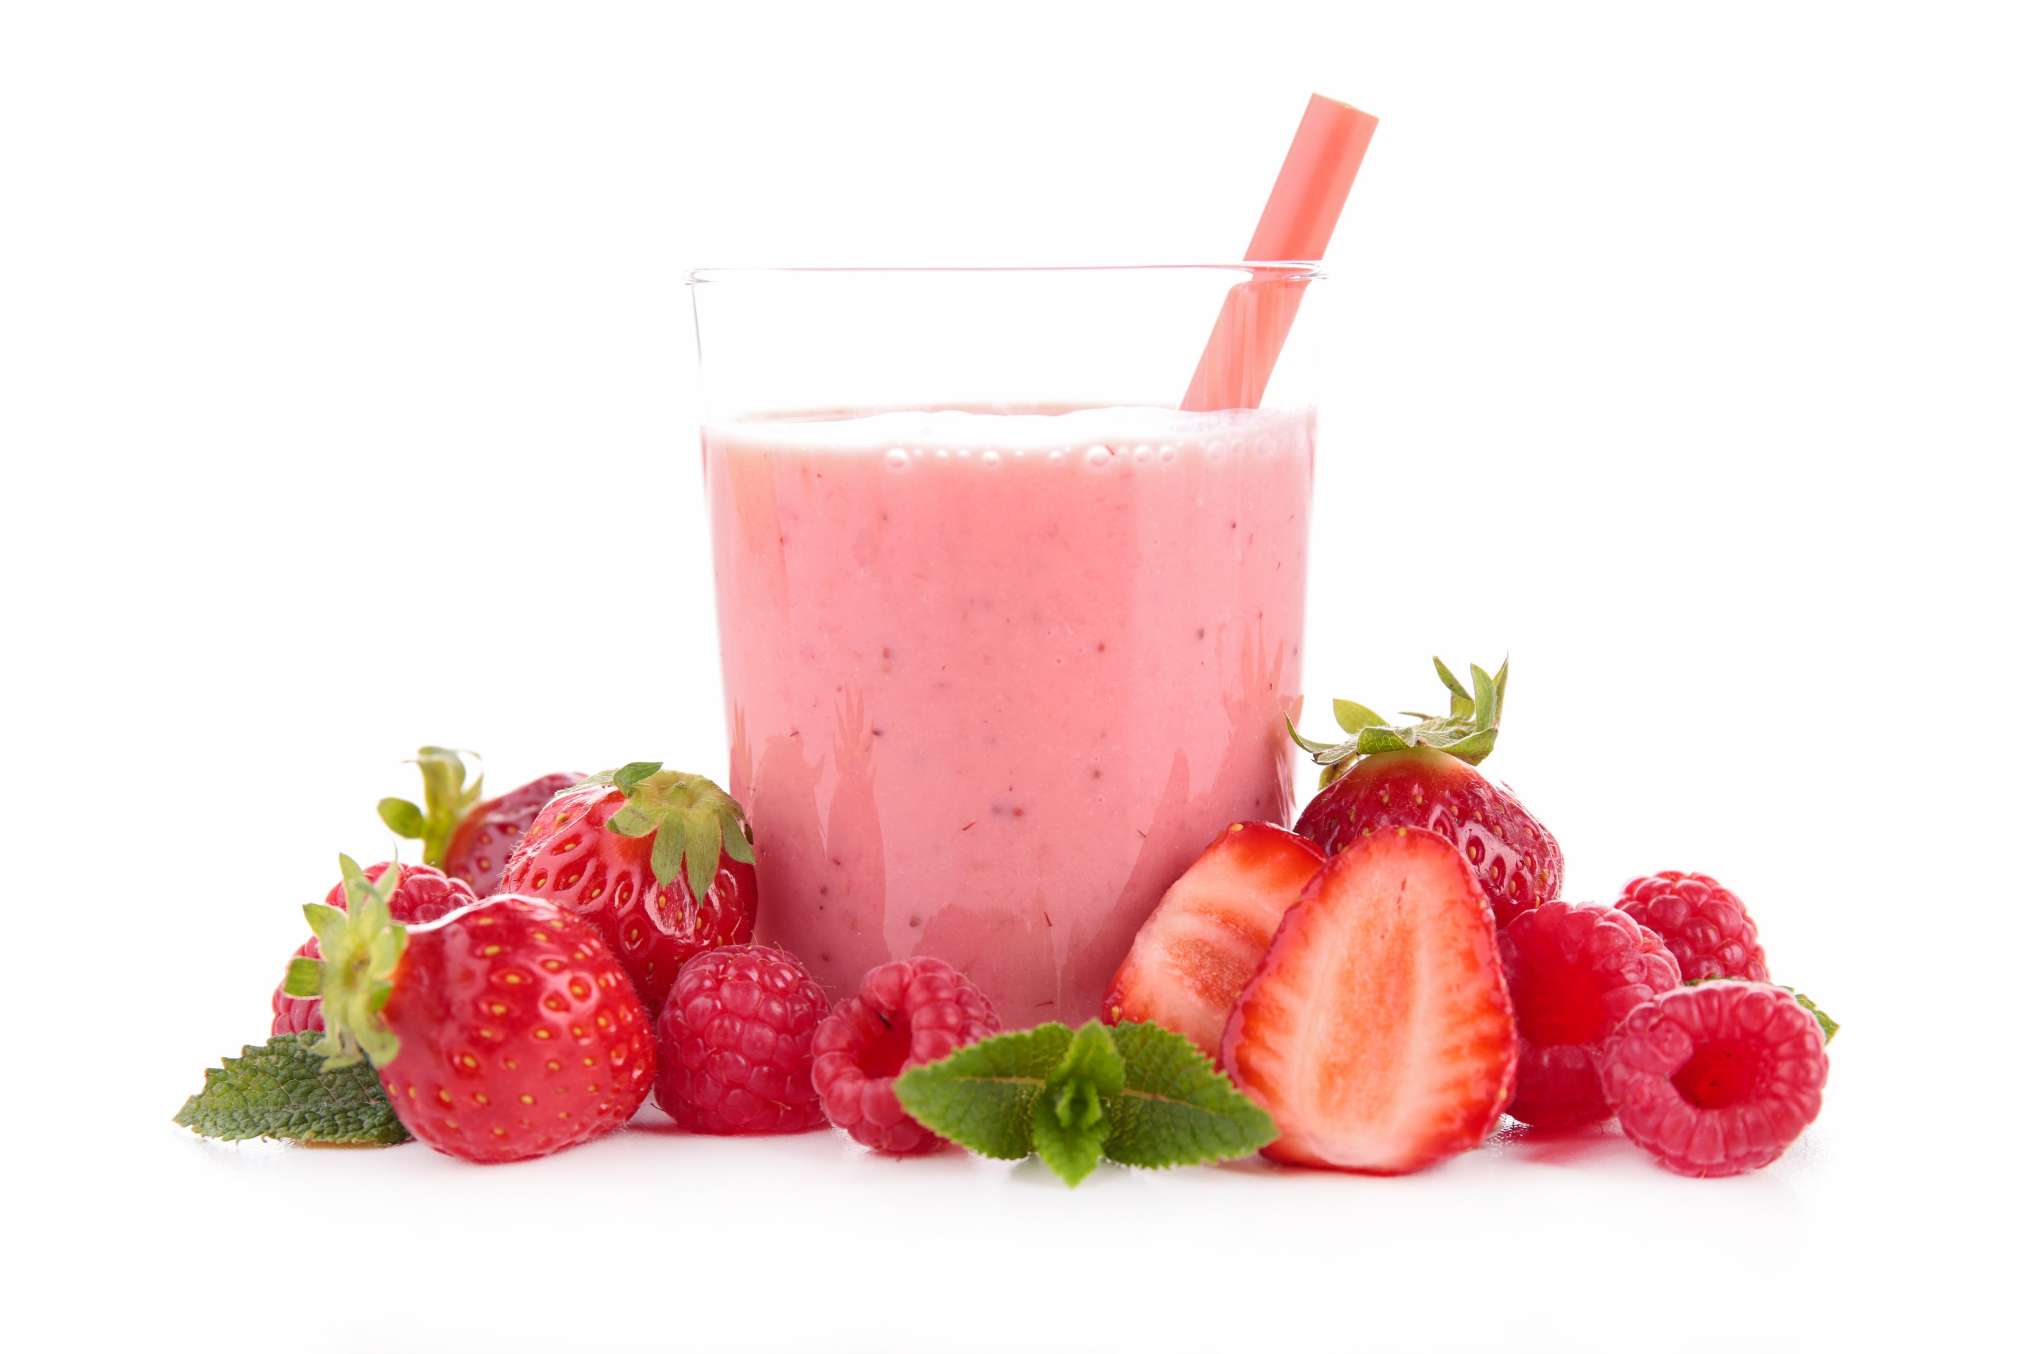
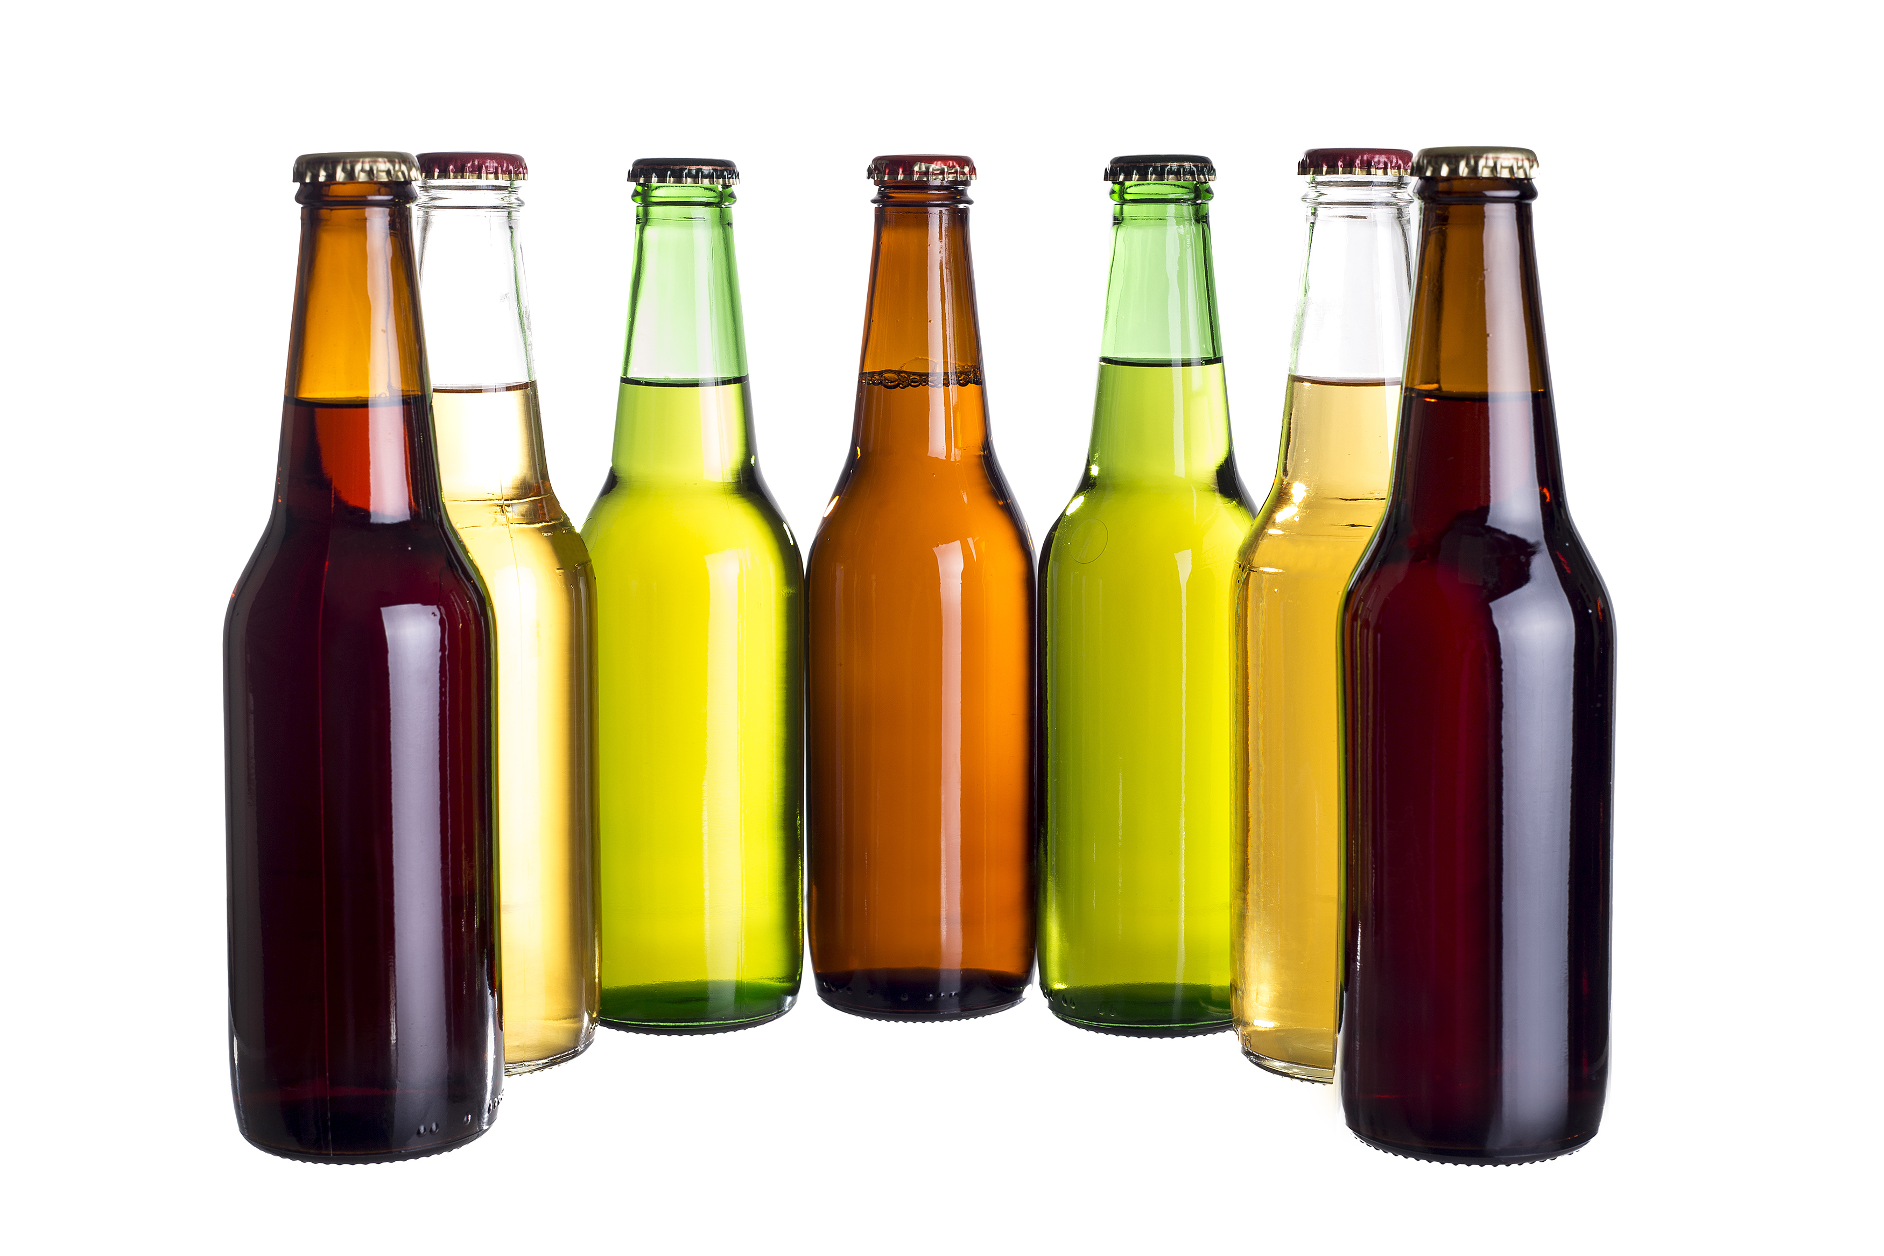
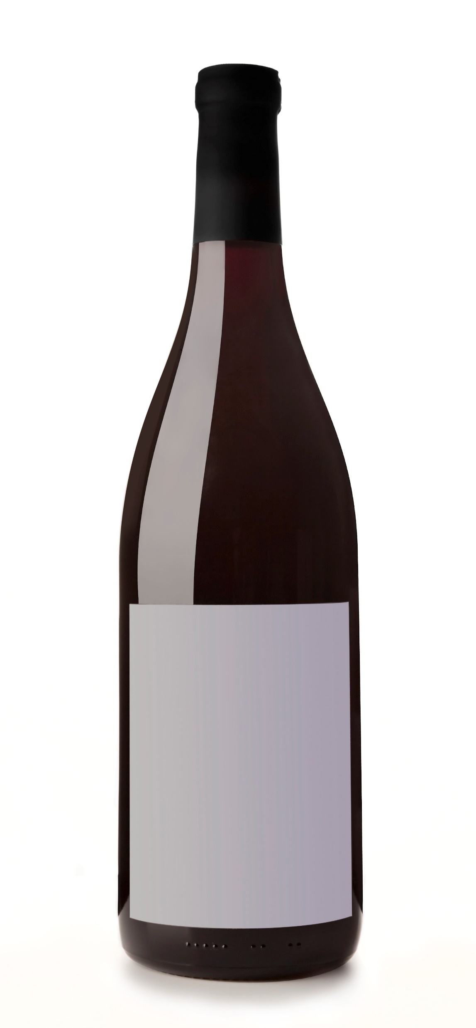
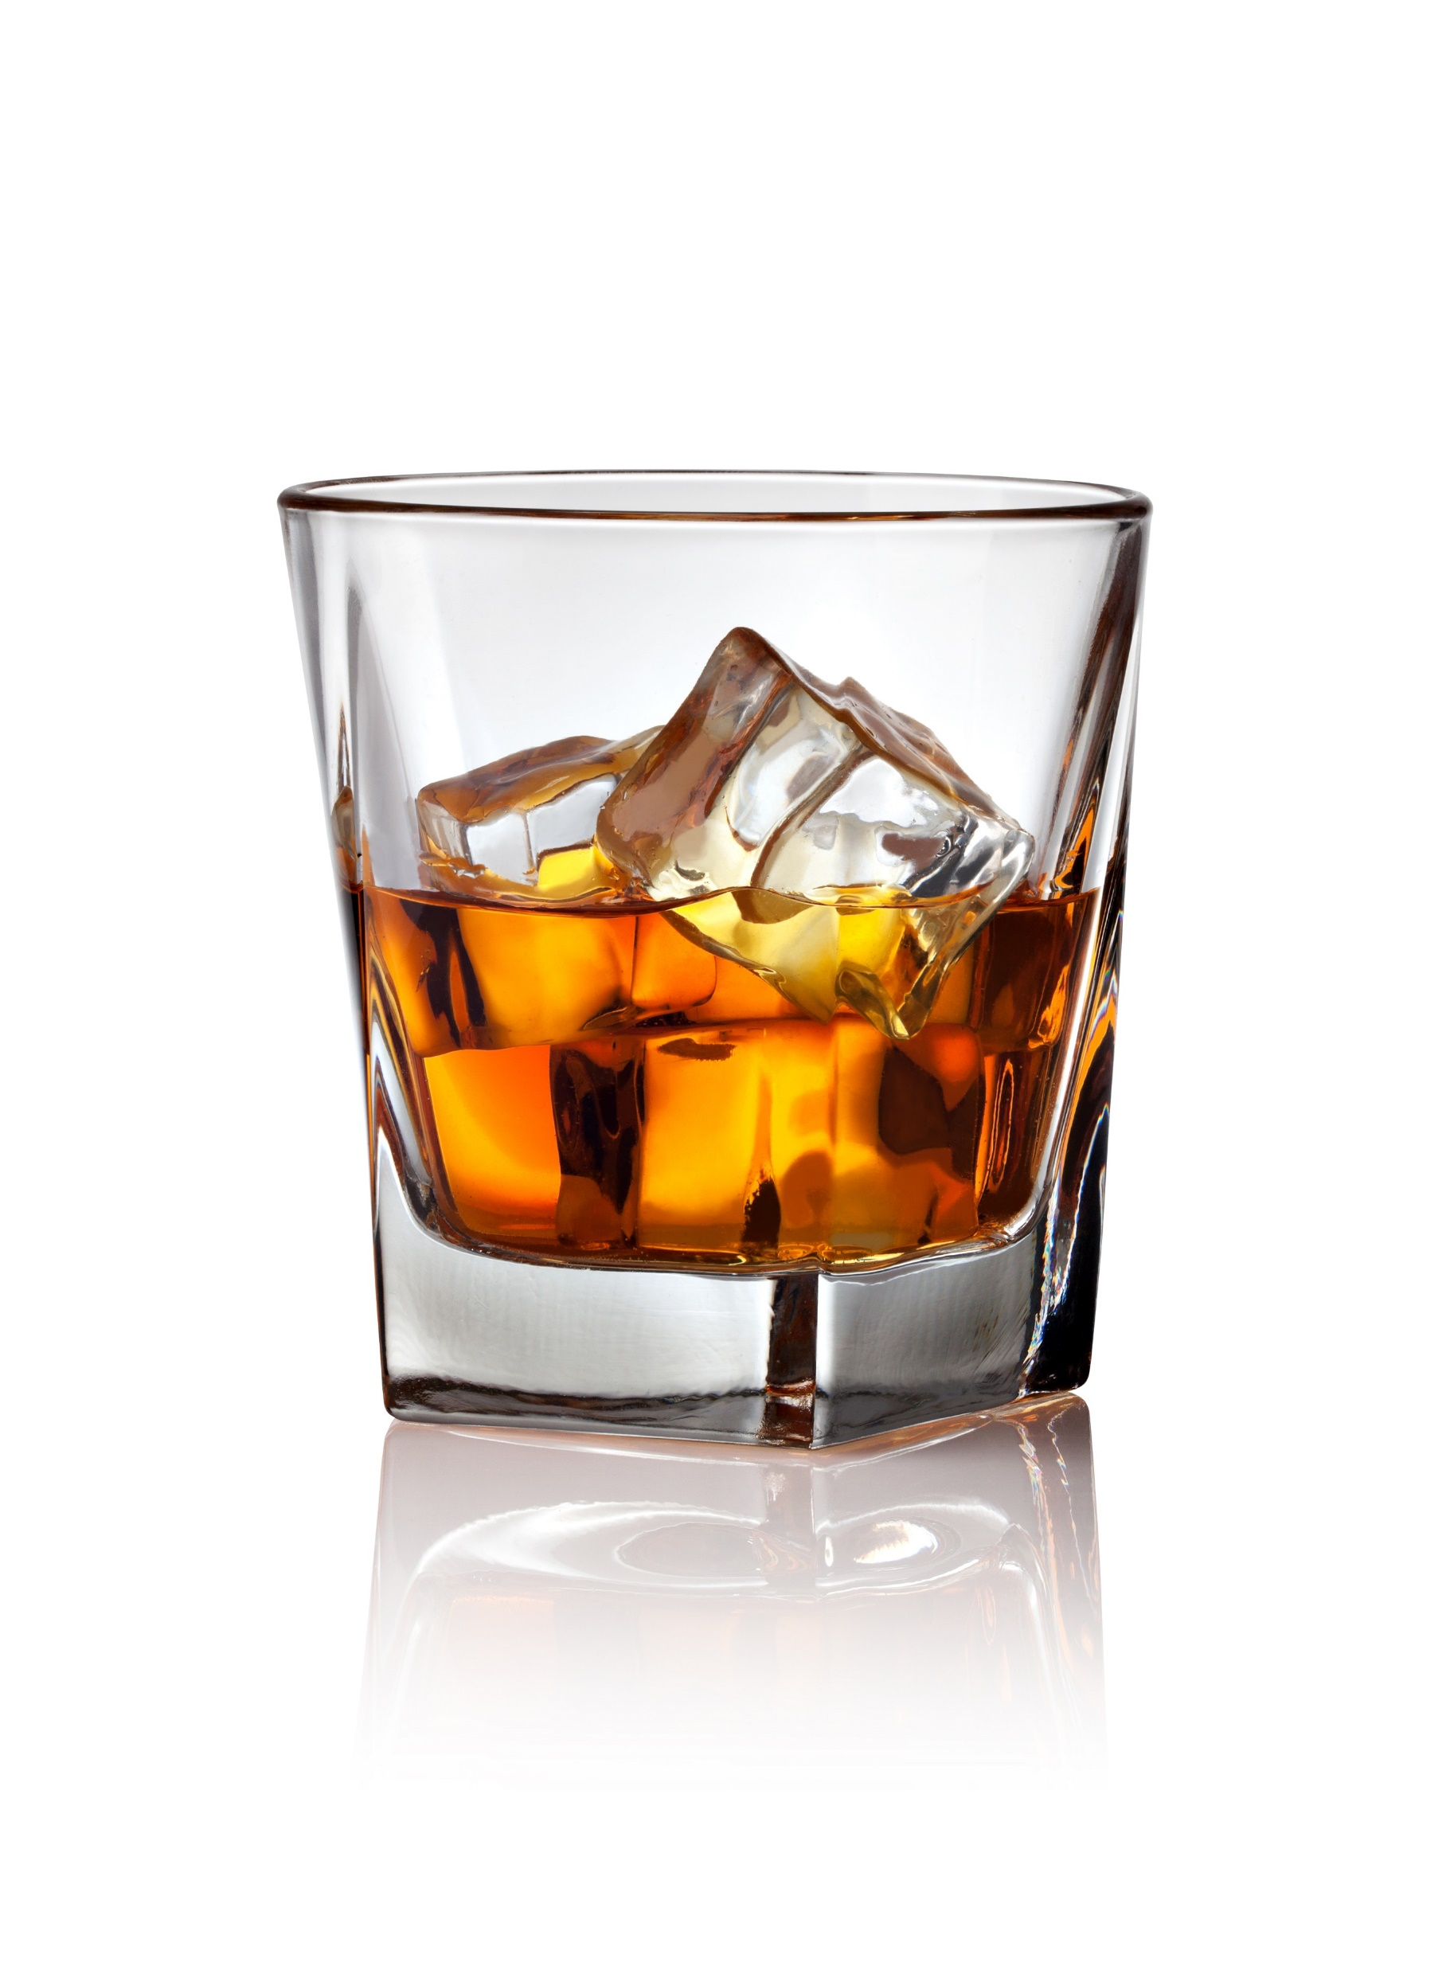
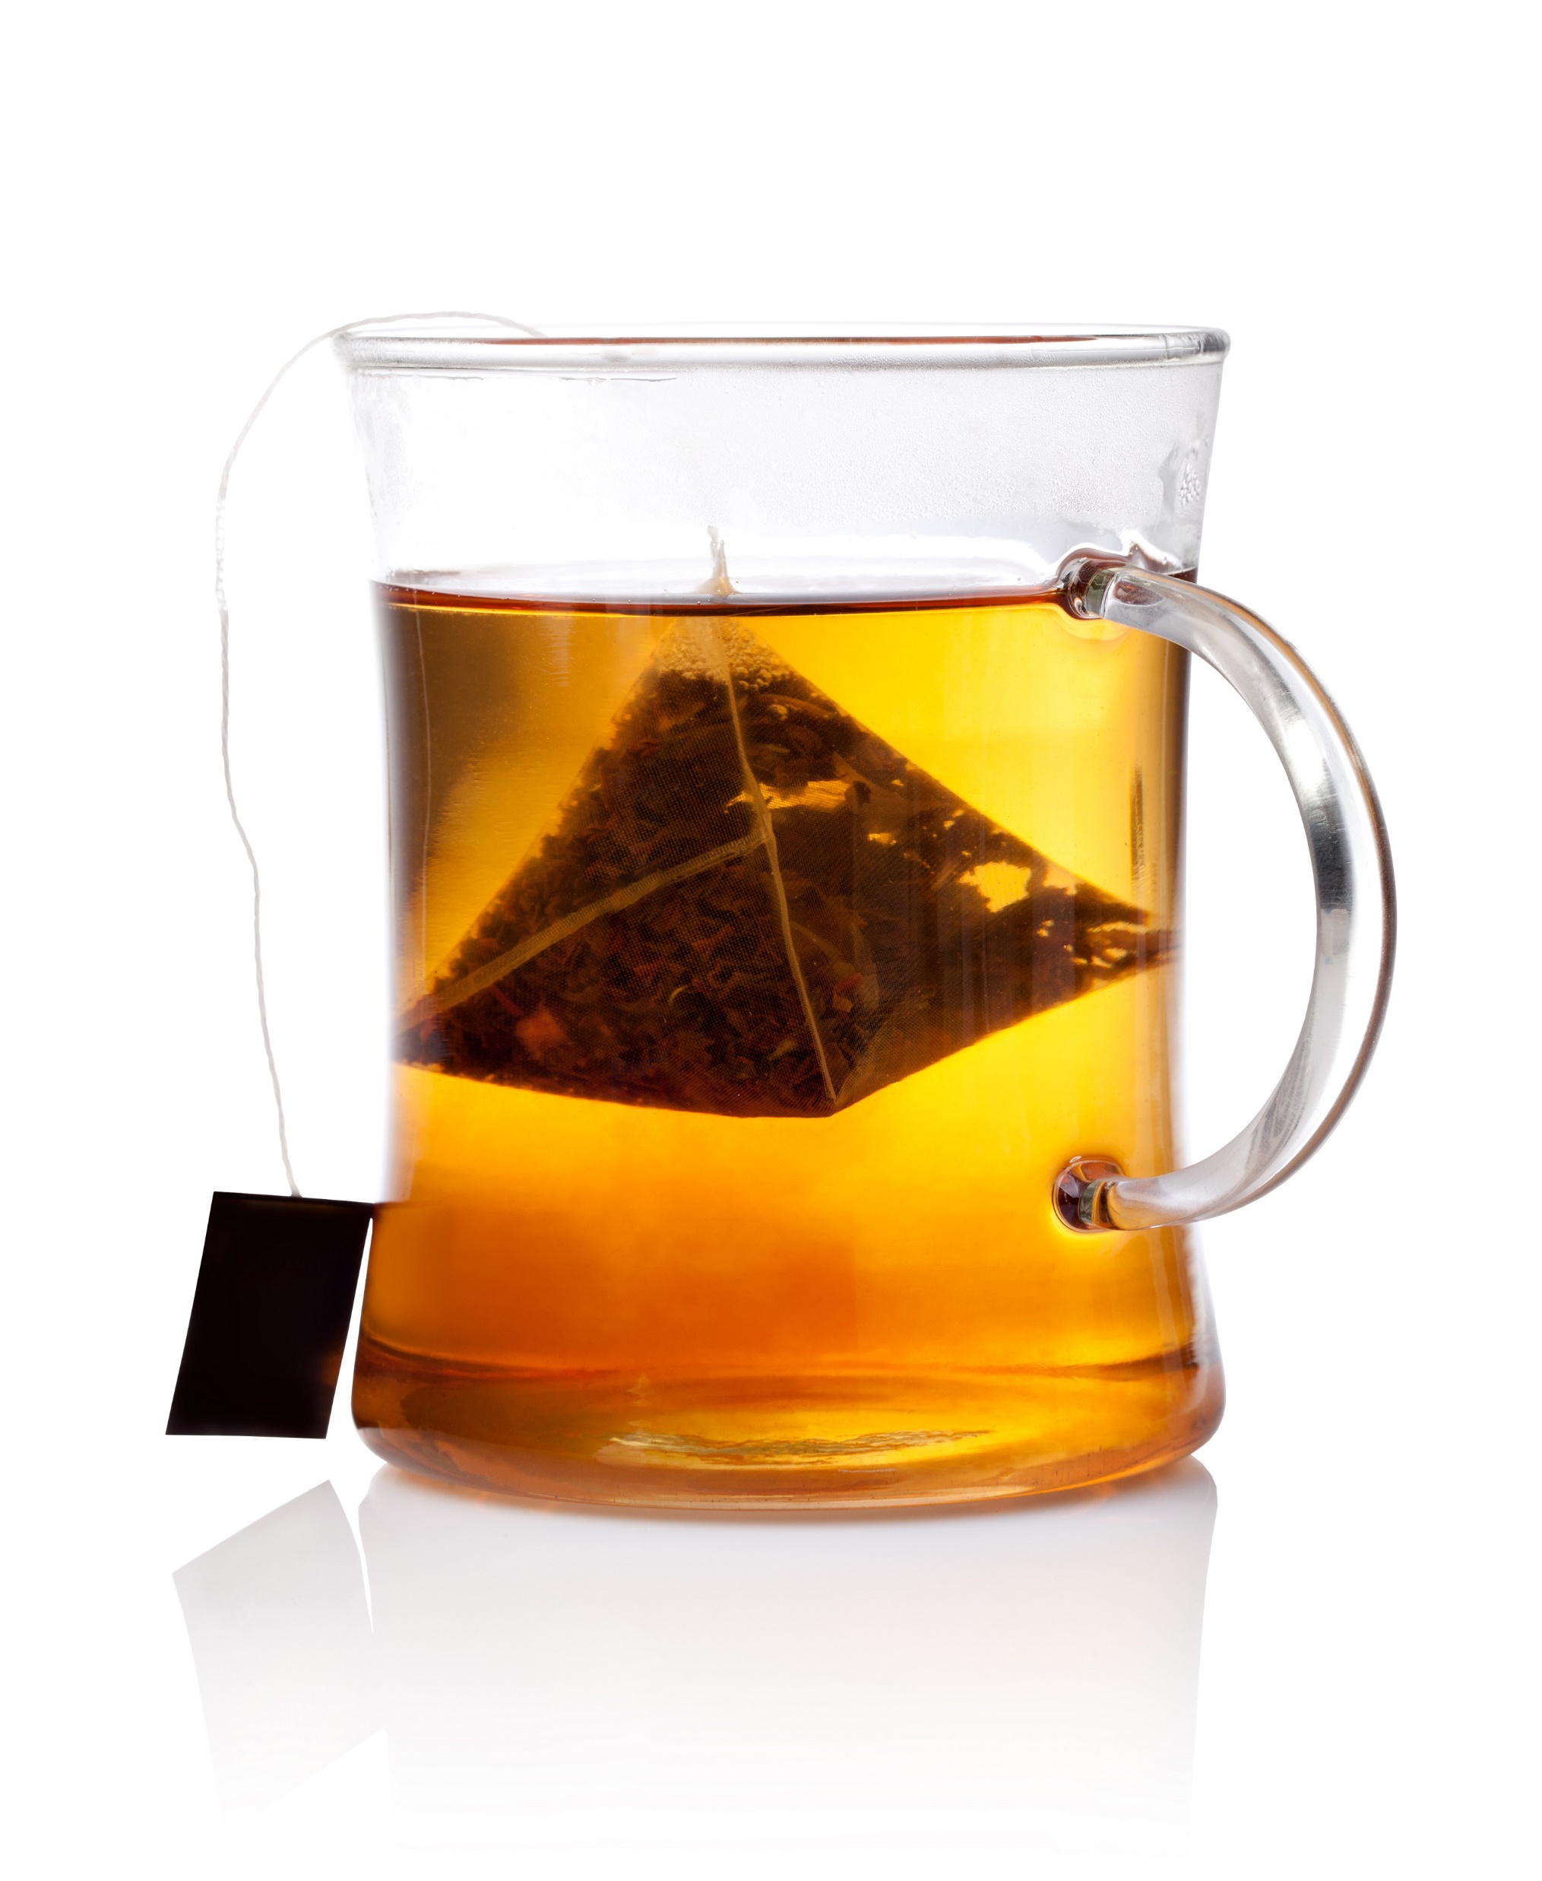

Question- What do you drink when you are thirsty?
Diet
o Fruit juice
Soft drink
Diet o Non-Diet
Milk
(include soy milk)
o Water
o Sport drink
Diet
o Alcohol
Notes:
Remember this question, what do you drink when you are thirsty? You can have more than one answer.

Slide 10
What do you drink when you are thirsty?
Notes:
Good job again, 92% of you choose water as the drink when you are thirsty. Other top choices were sports drinks, juice and non diet soft drinks.

Slide 11
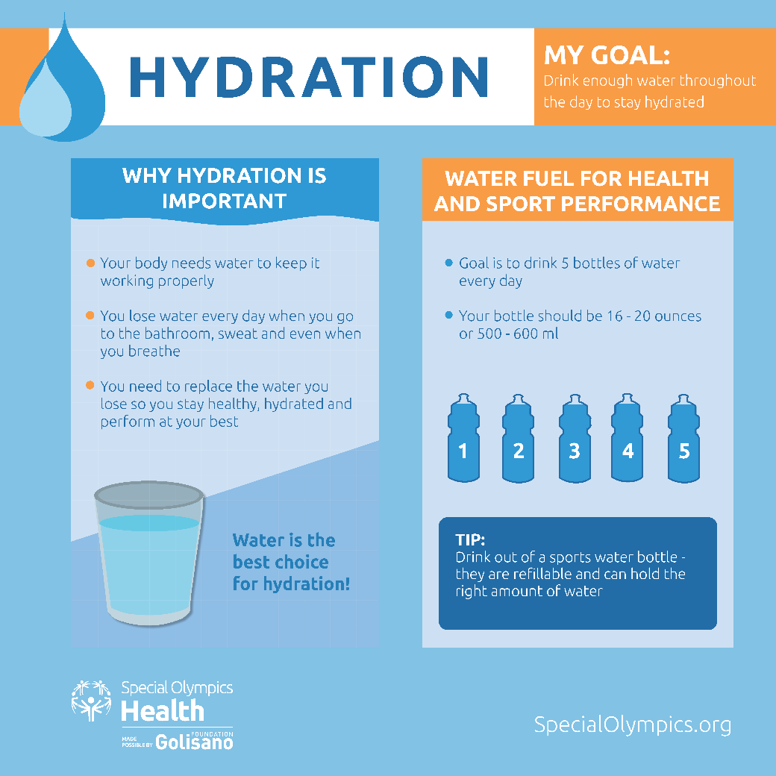
Water – Best Drink When You Are Thirsty
Get Your 5 a Day
Did you get your 5 yesterday?
Notes:
Water is the best drink when you are thirsty. Drink water before, during and after your workout or sport practice. How about a thumbs up for everyone who met the goal of 5 bottles of water yesterday?
Response: Based on the # of thumbs up—Great keep up the good job OR We need to plan to be sure everyone reaches the 5 a Day goal.

Slide 12
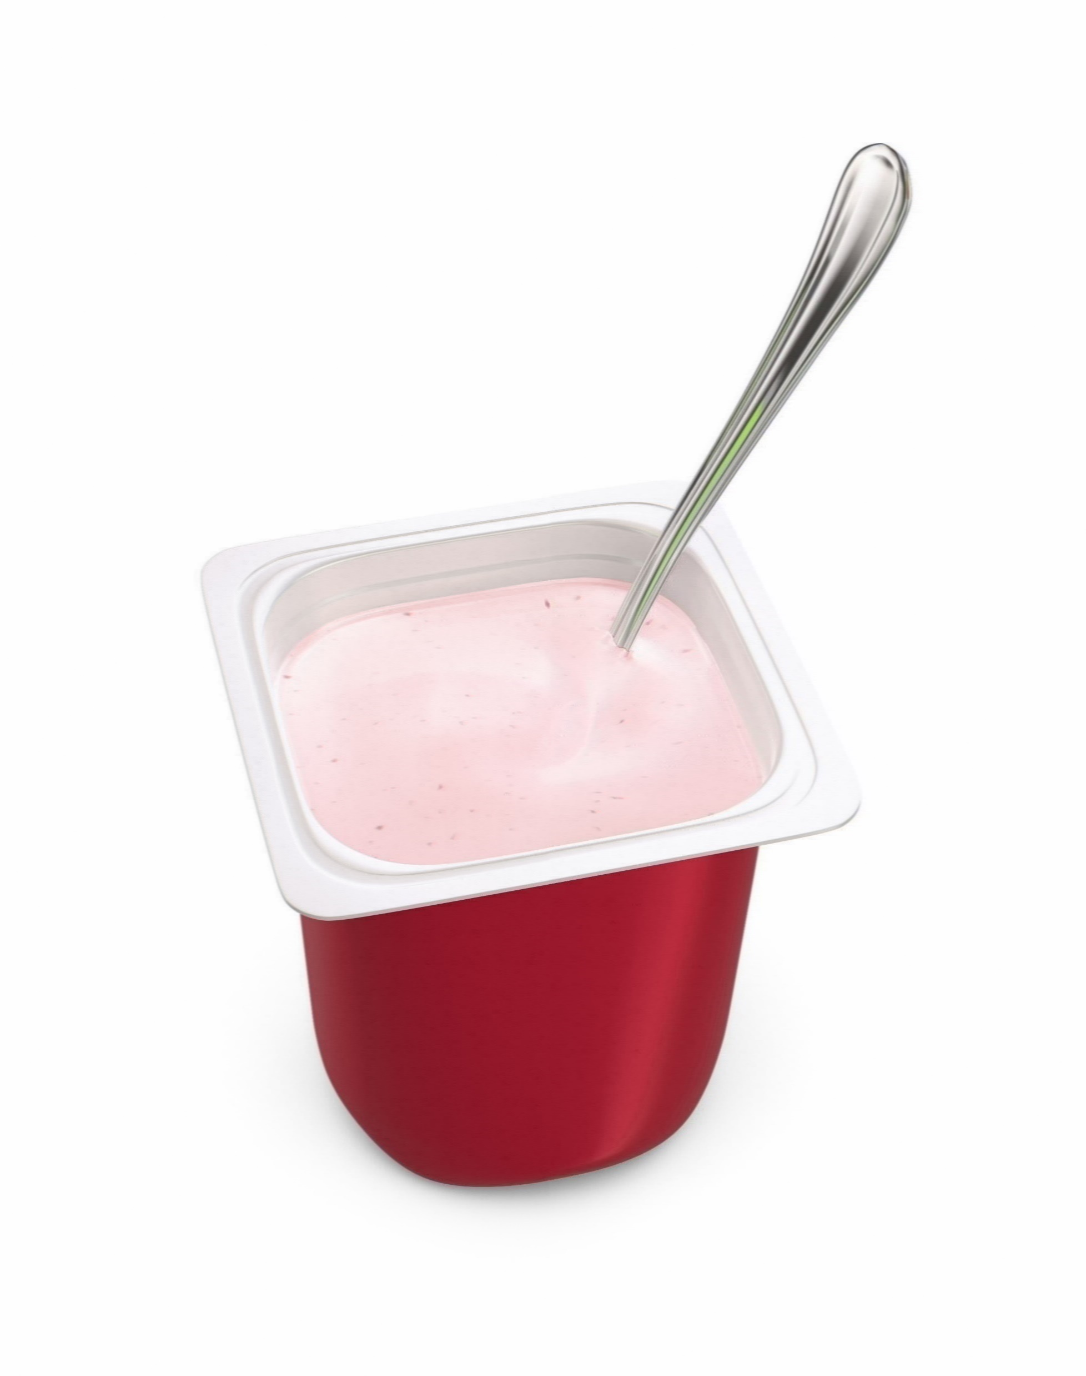

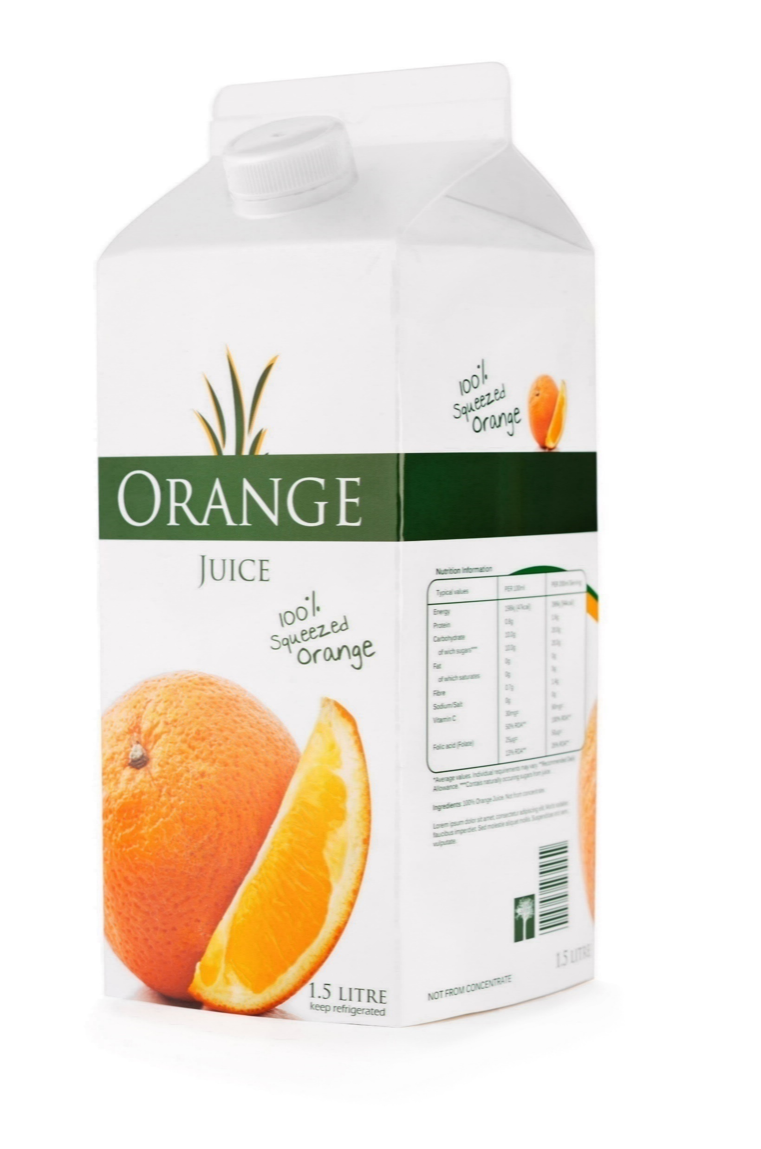
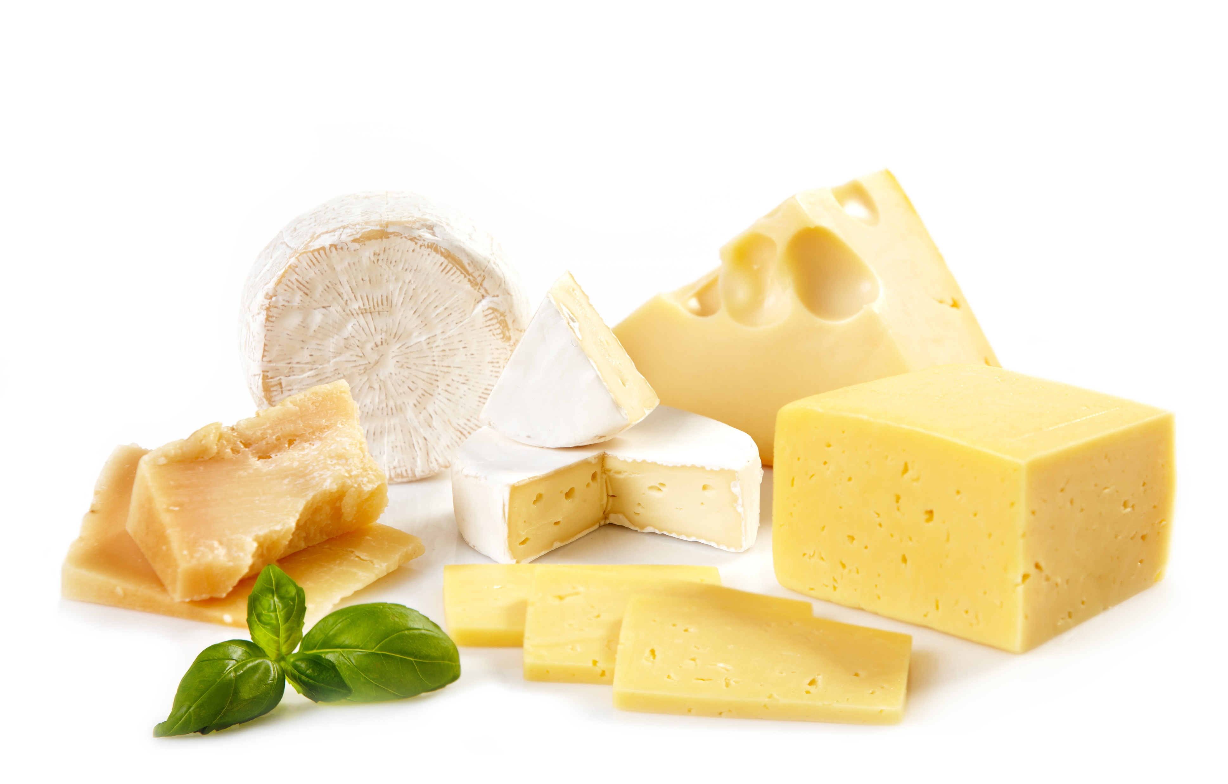
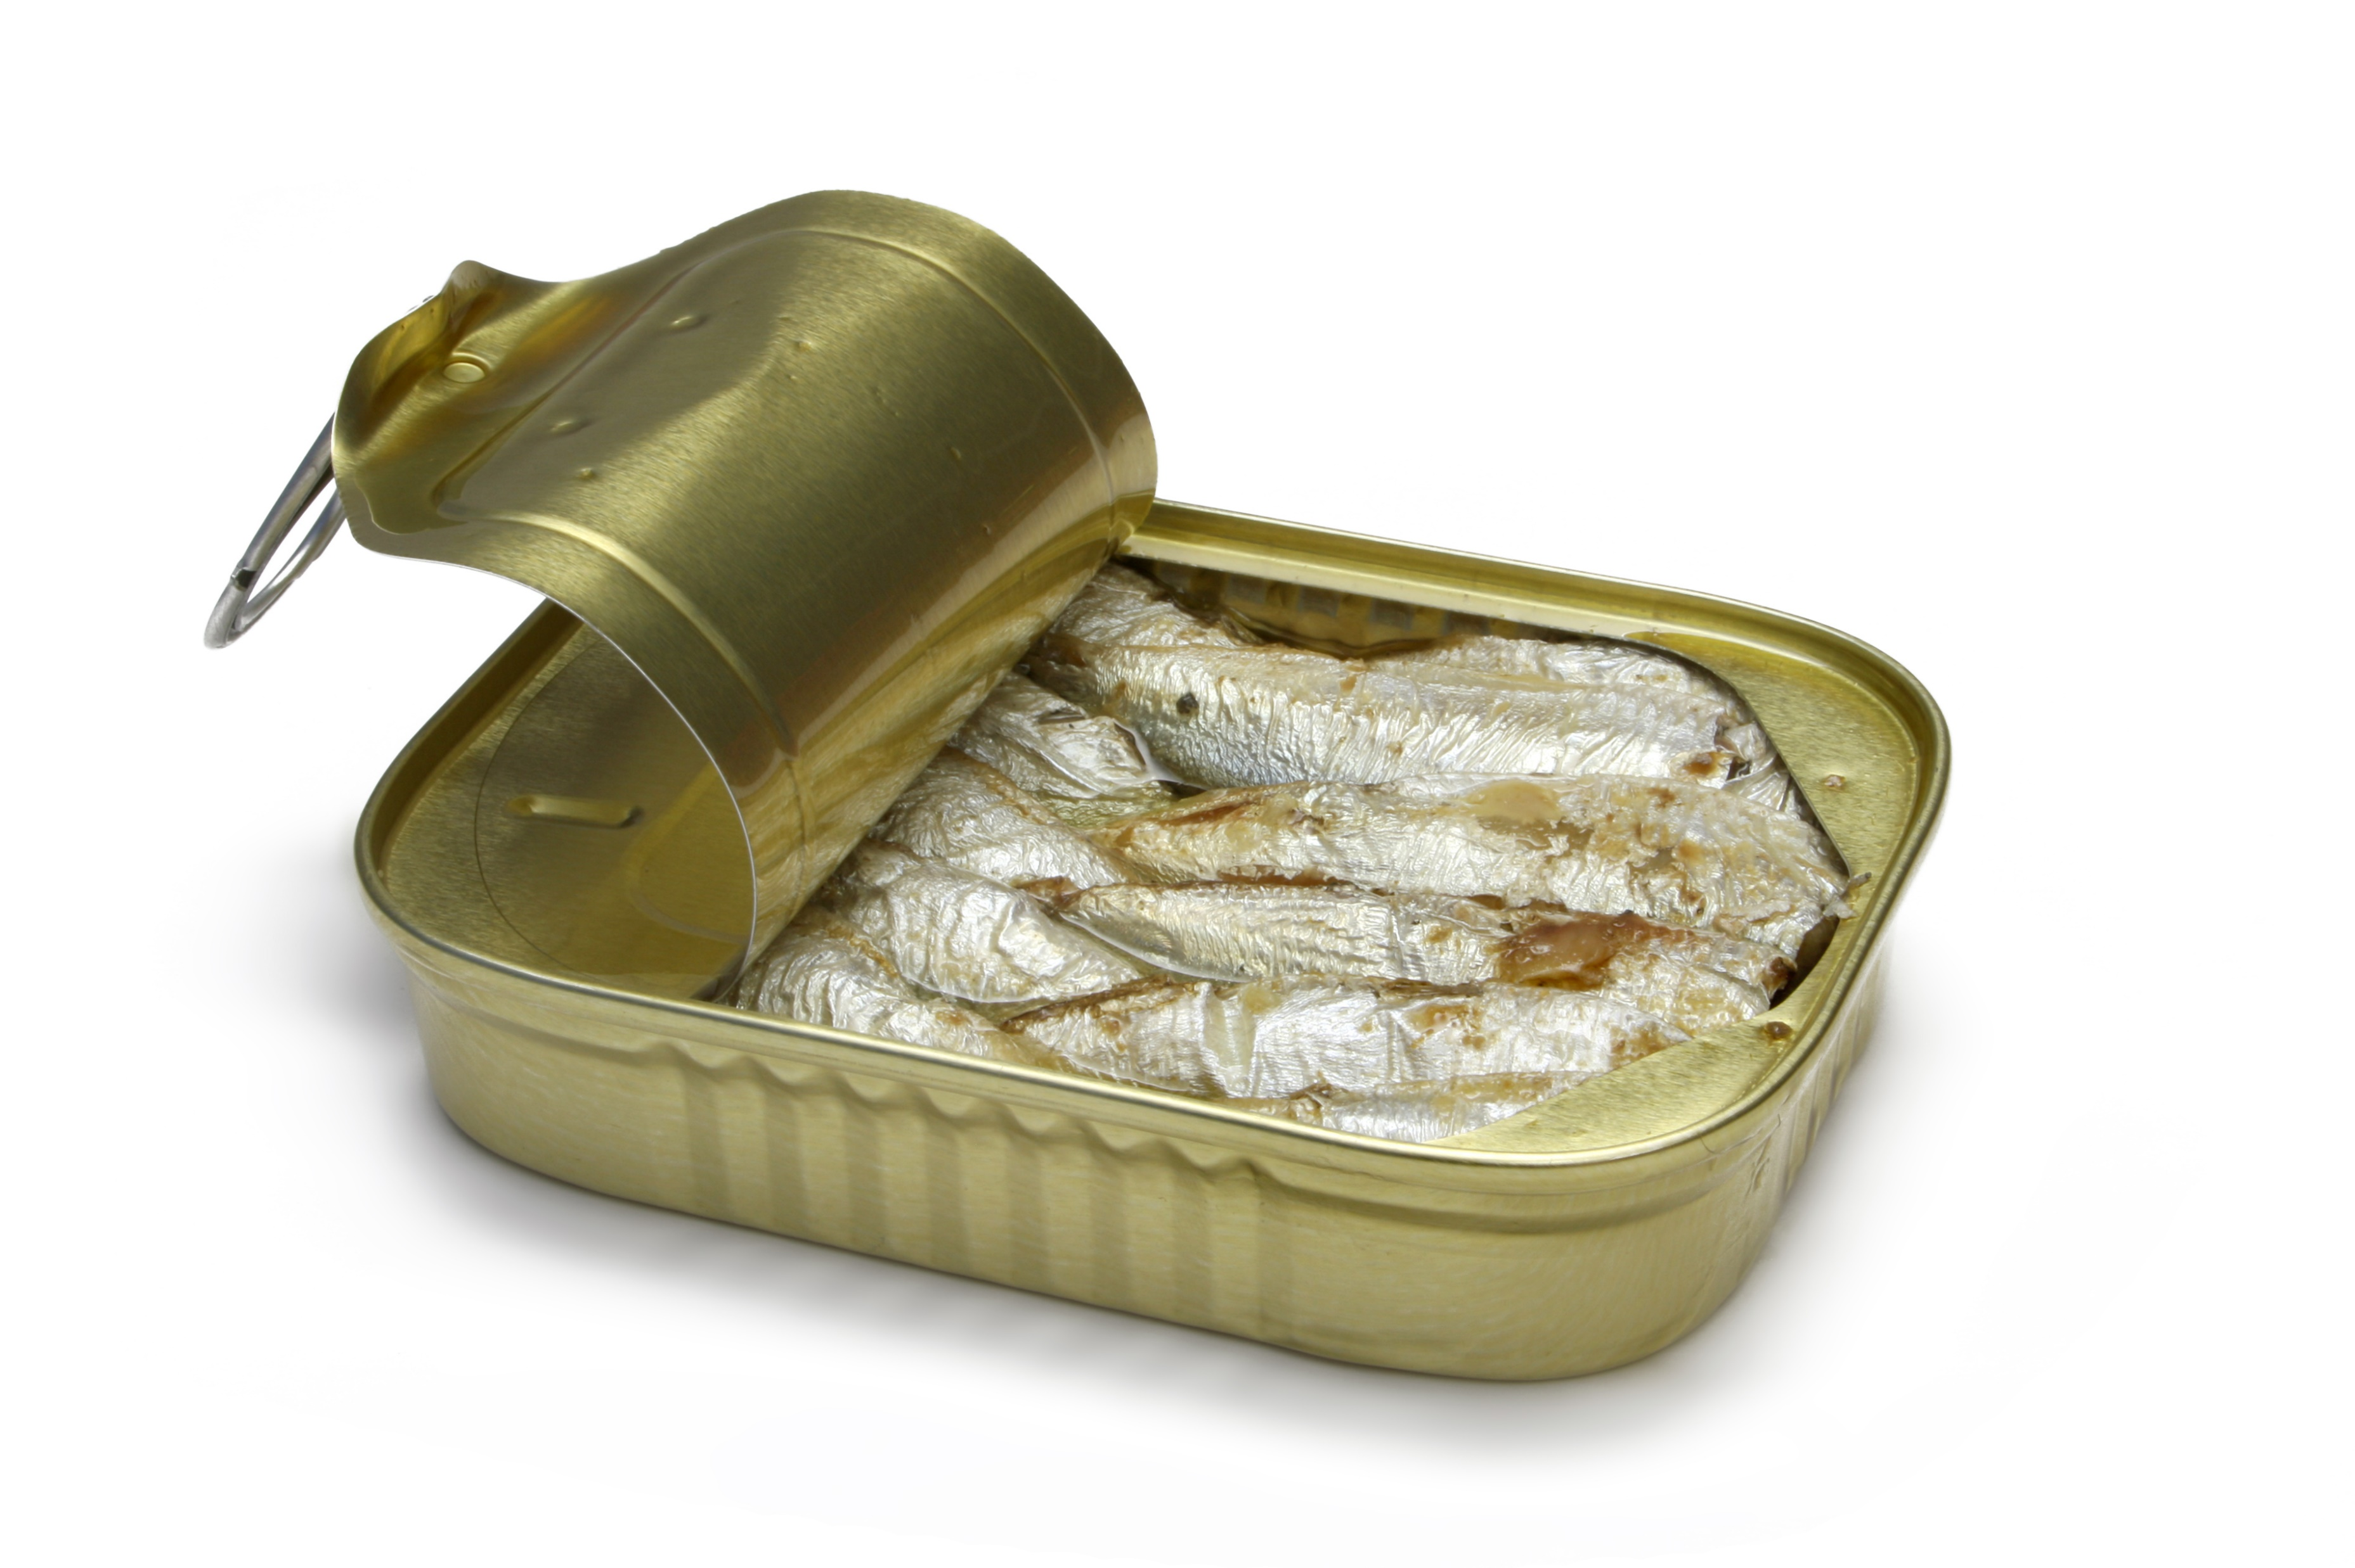
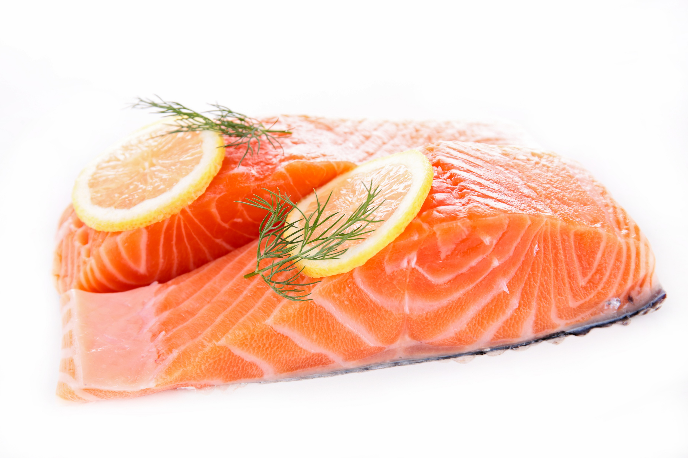
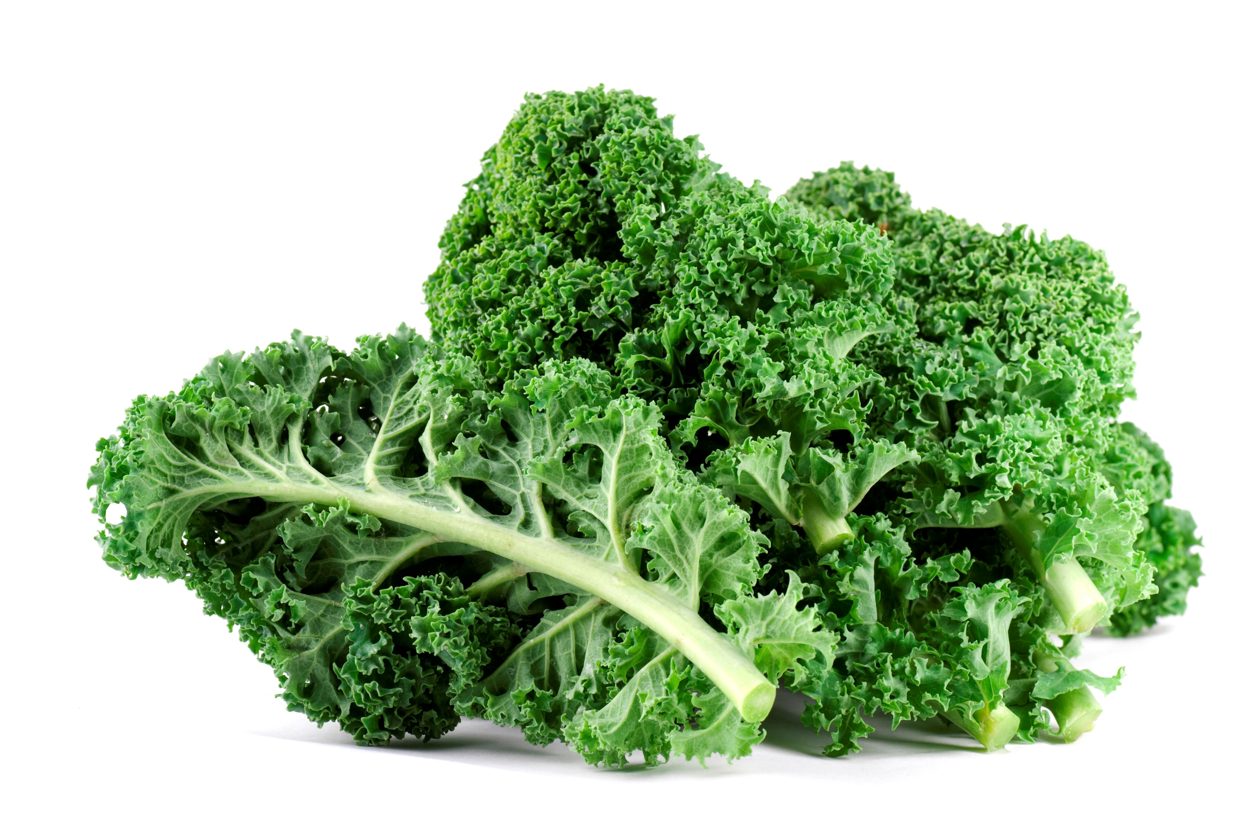
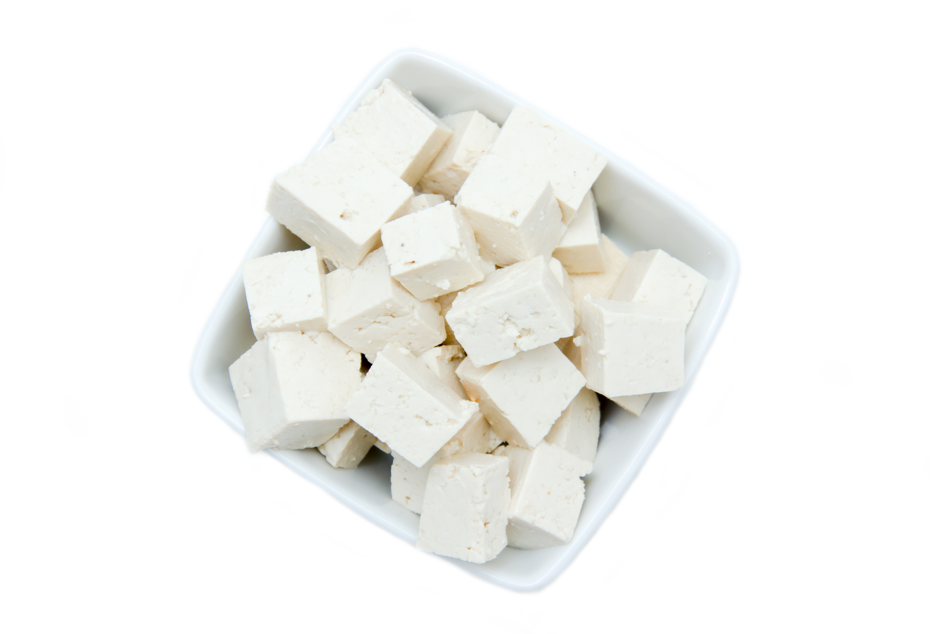
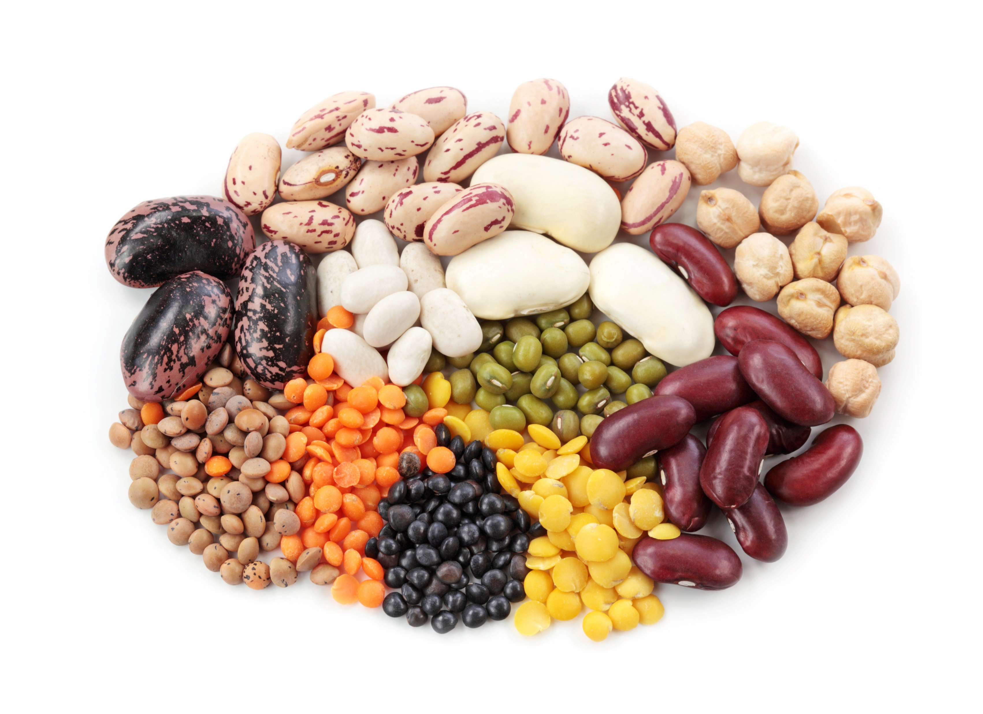
Do you drink or eat any of these foods (high in calcium)? Here are a few examples.
Yes
No
If yes, how often?
Less than 1 serving a day
1-2 servings a day
3-5 servings a day
More than 5 servings a day
Never
Calcium and Vitamin D Fortified Juice
Notes:
This question is about foods that are high in calcium and good for bone building. There are a few examples in the picture, I know you could name more.
Do you eat or drink any foods high in calcium? Check yes or no.
If you eat these foods, check the box which best describes the number of servings you have a day.

Slide 13
Foods High in Calcium—Bone Building Foods
Notes:
Good job again, almost 70% of you eat 1-2 servings a day, I know you can do better. Remember the My Plate recommendations? Your goal is to have 3 servings a day. Let’s talk about how to reach your goal.

Slide 14



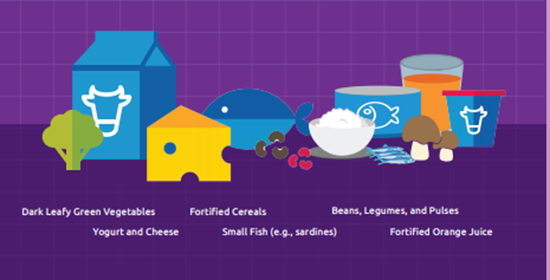


Choose drinks and foods that strengthen your bones
Notes:
There are so many foods that can help to build and strengthen your bones. You can choose from dairy, dark green leafy vegetables, small fish and foods that have been fortified with extra calcium and vitamin D. Can you name some of your favorite bone building foods?
(Depending on group size, this could be entered into the chat box, or ask athletes to raise their hand, unmute and then share with the group)

Slide 15
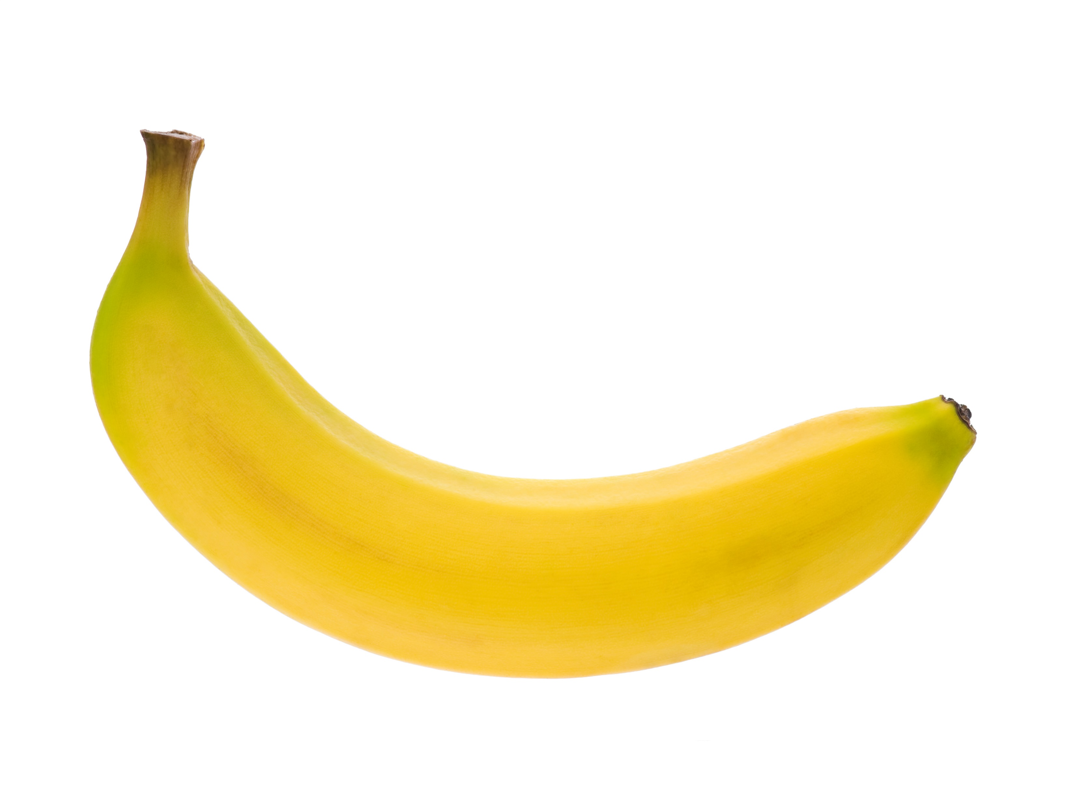
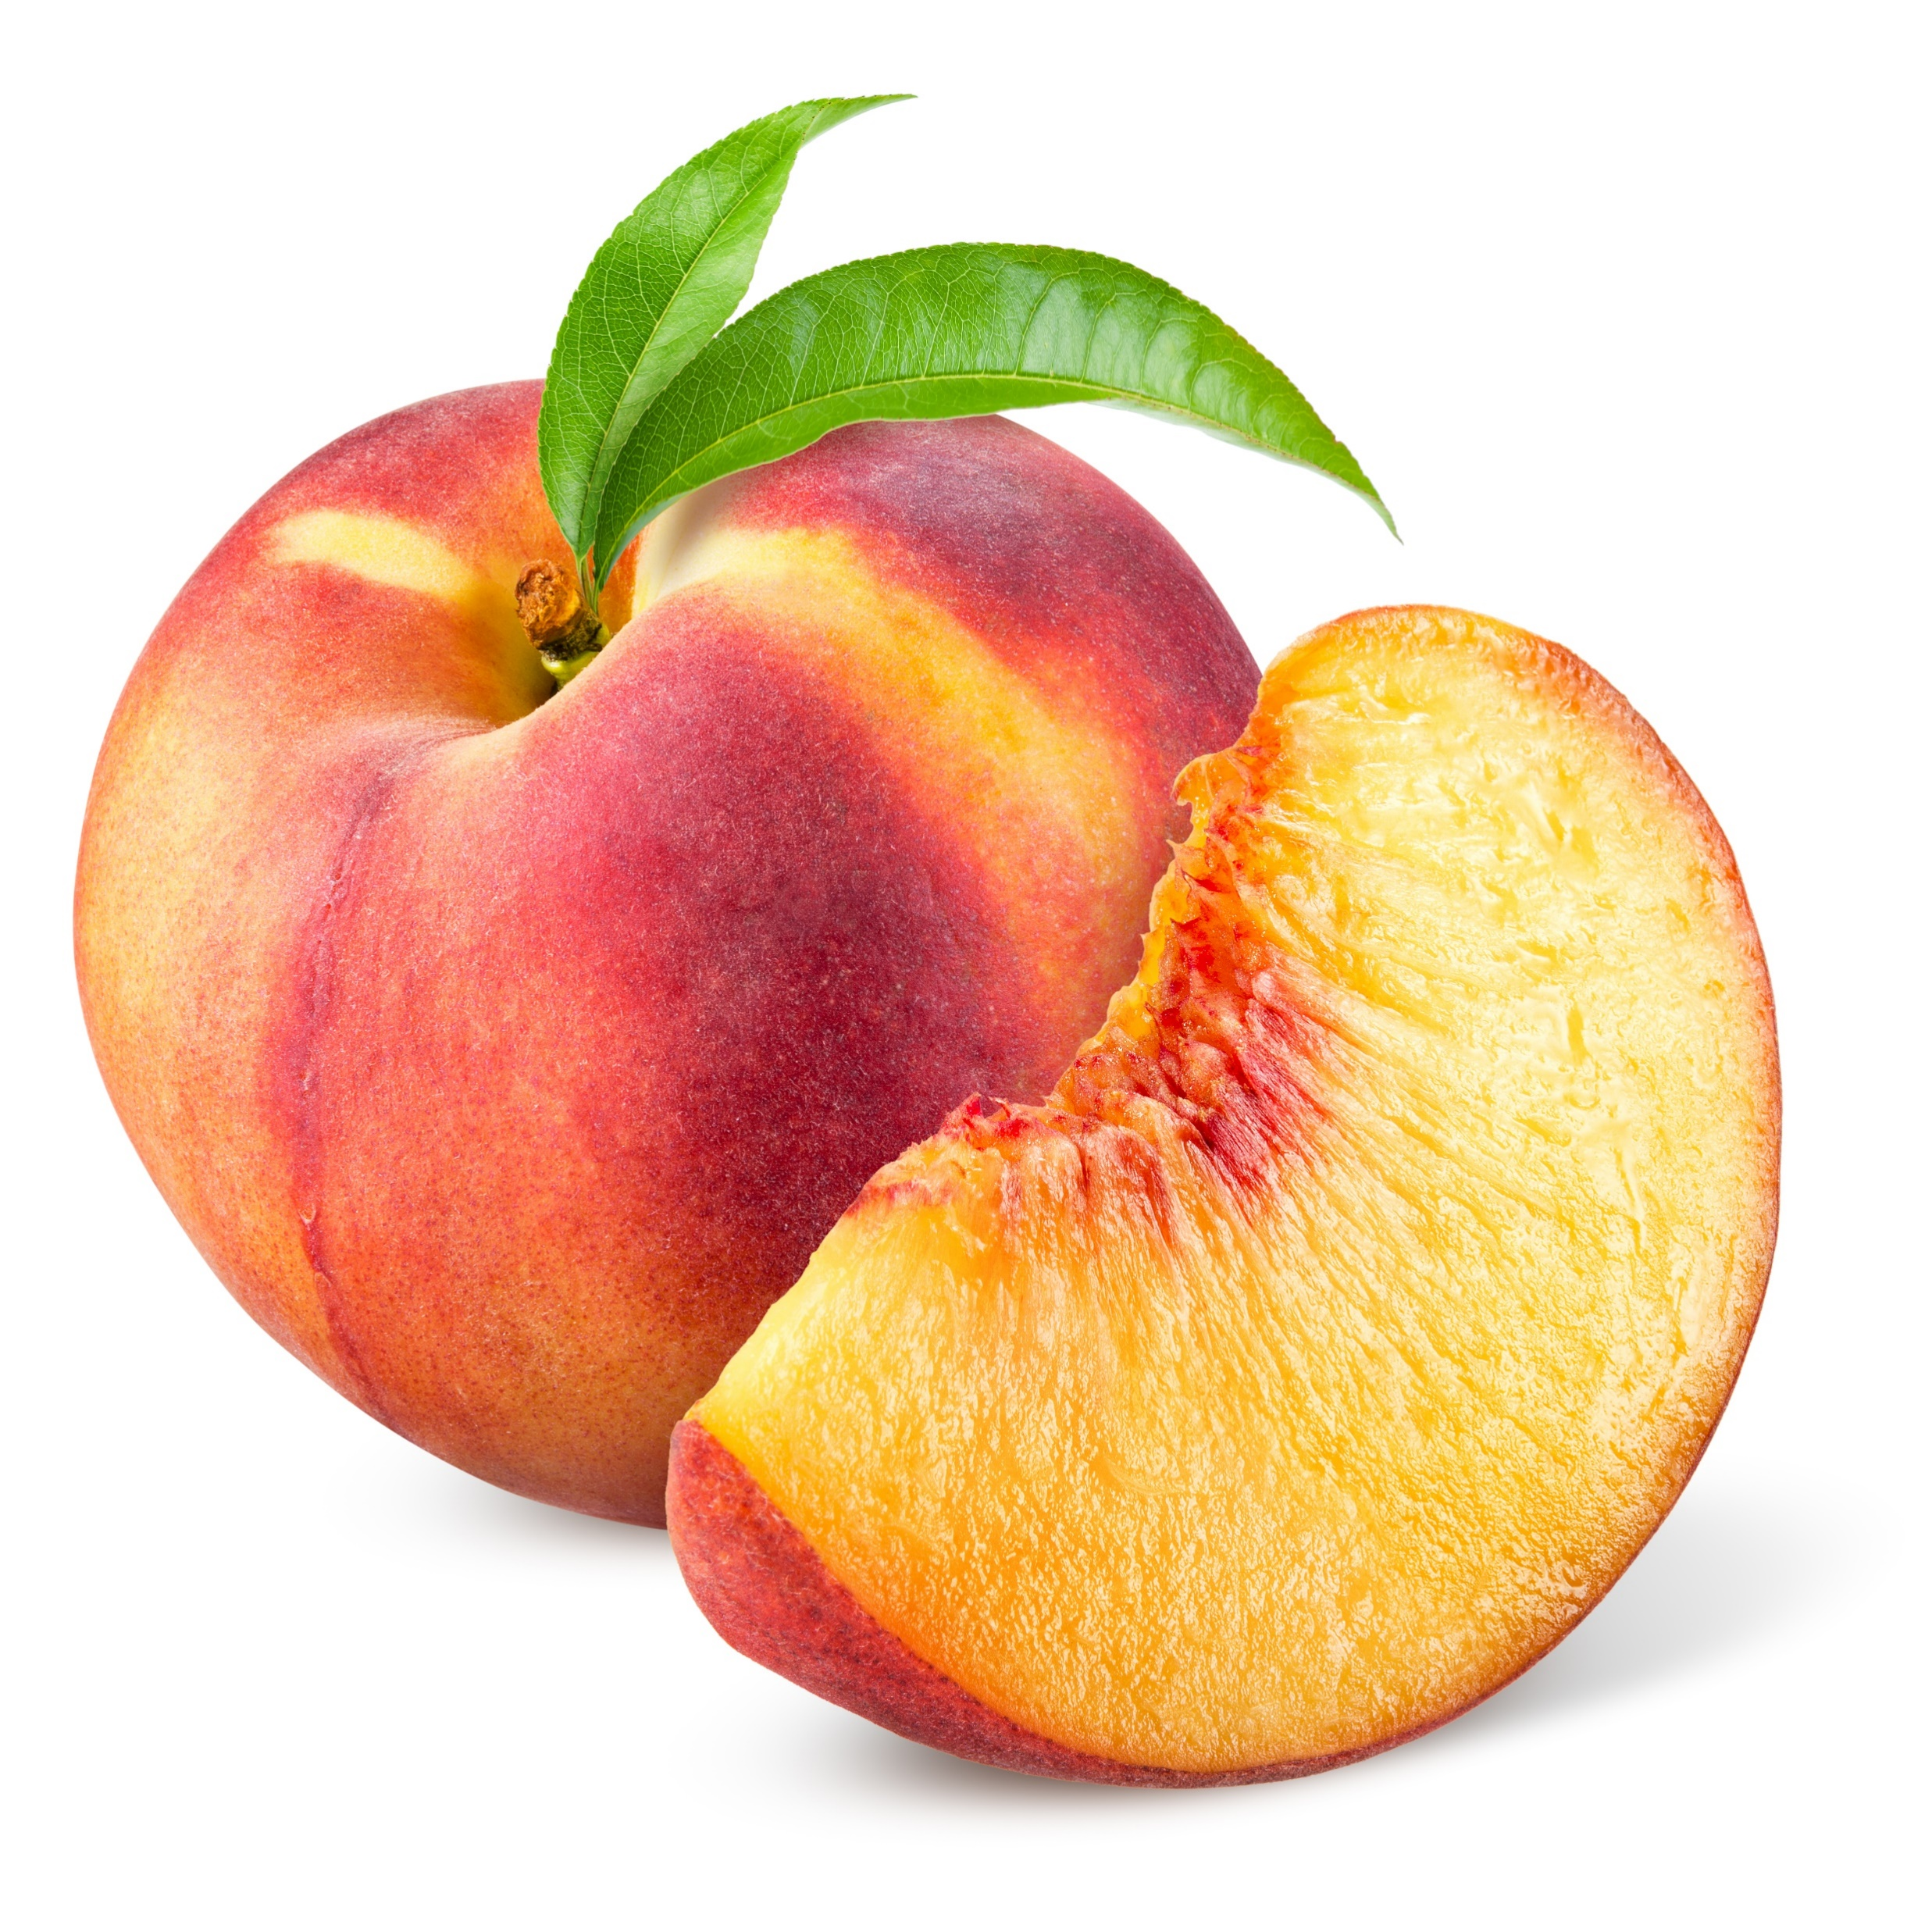
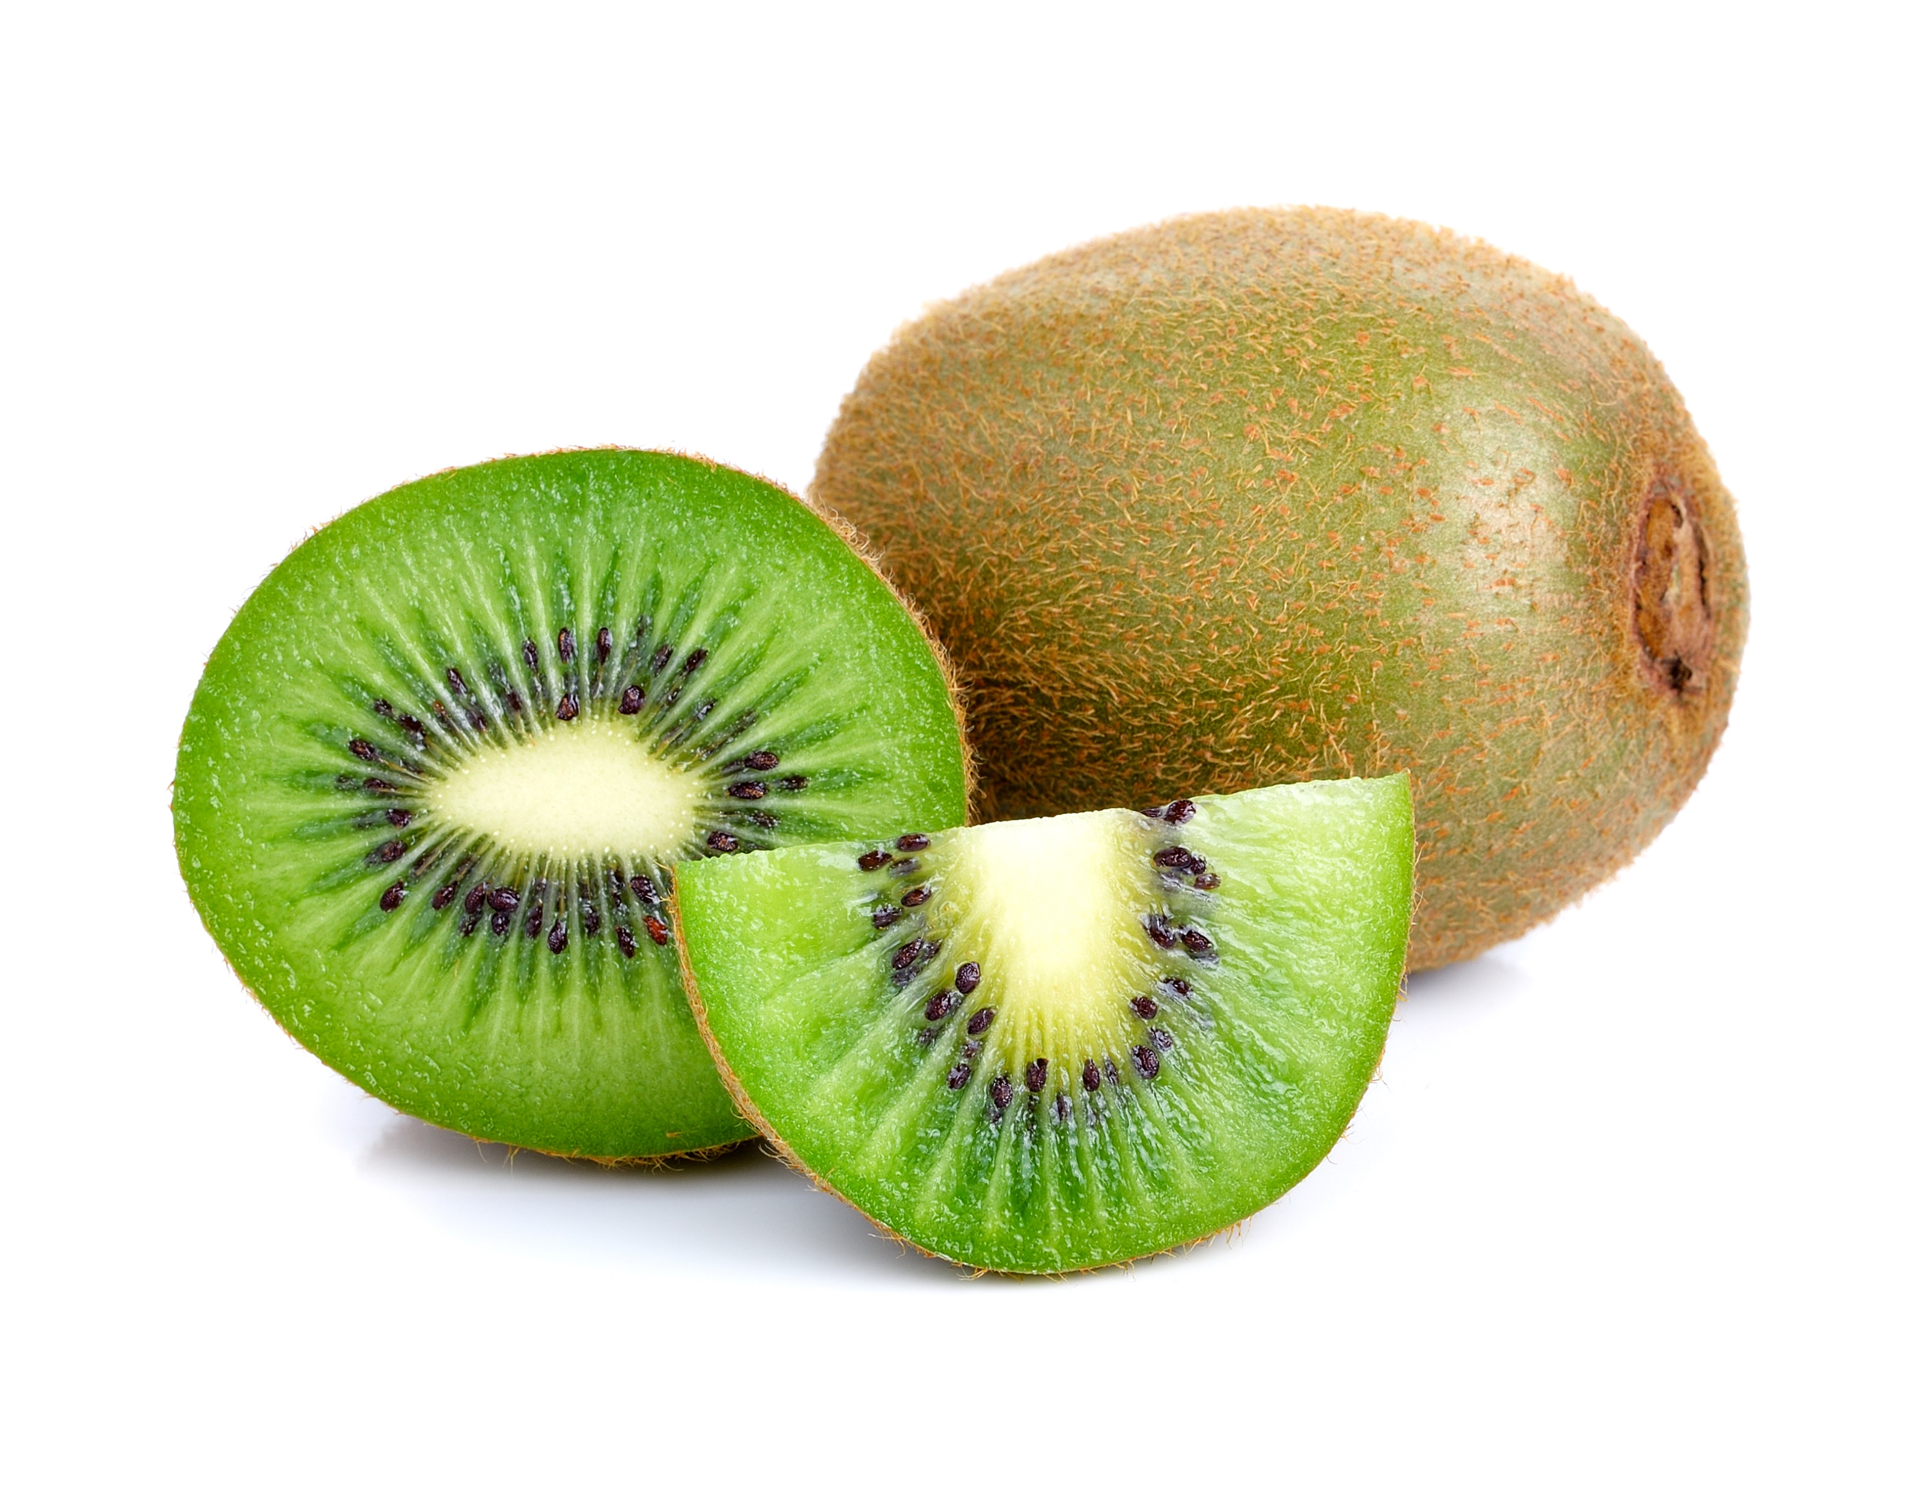
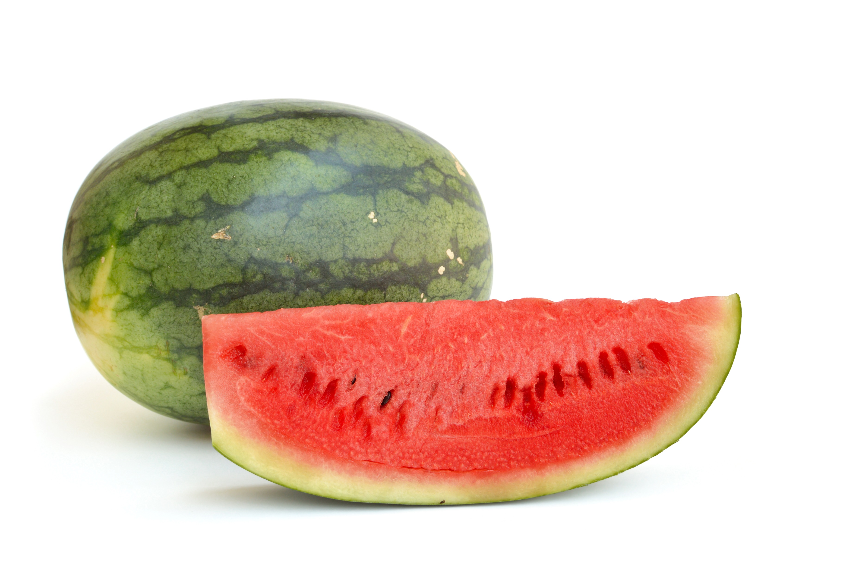
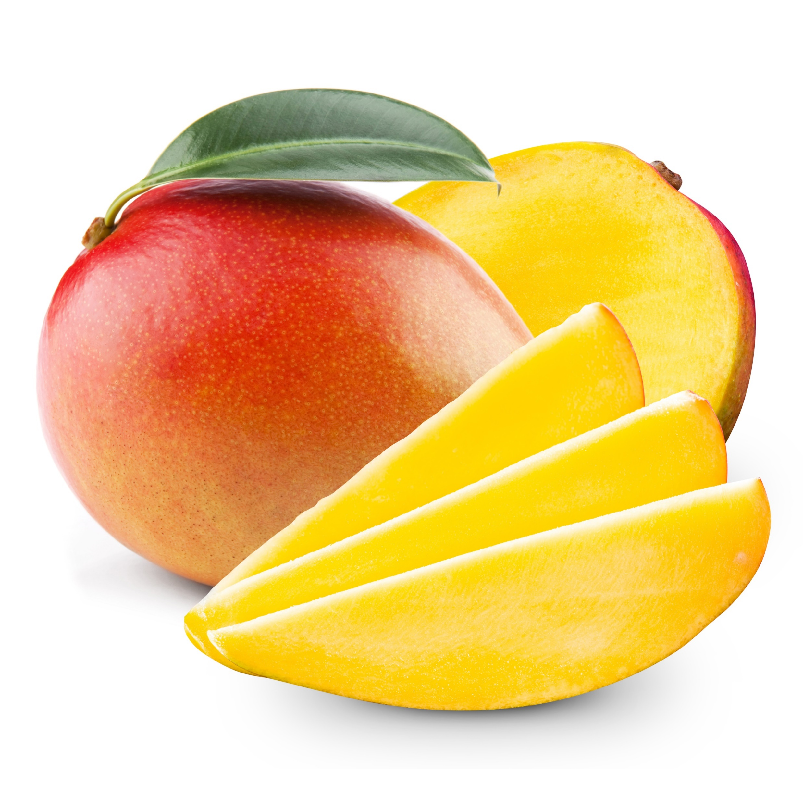

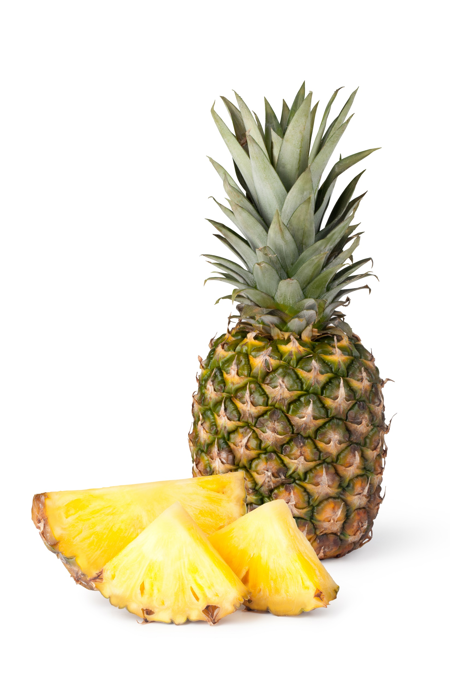
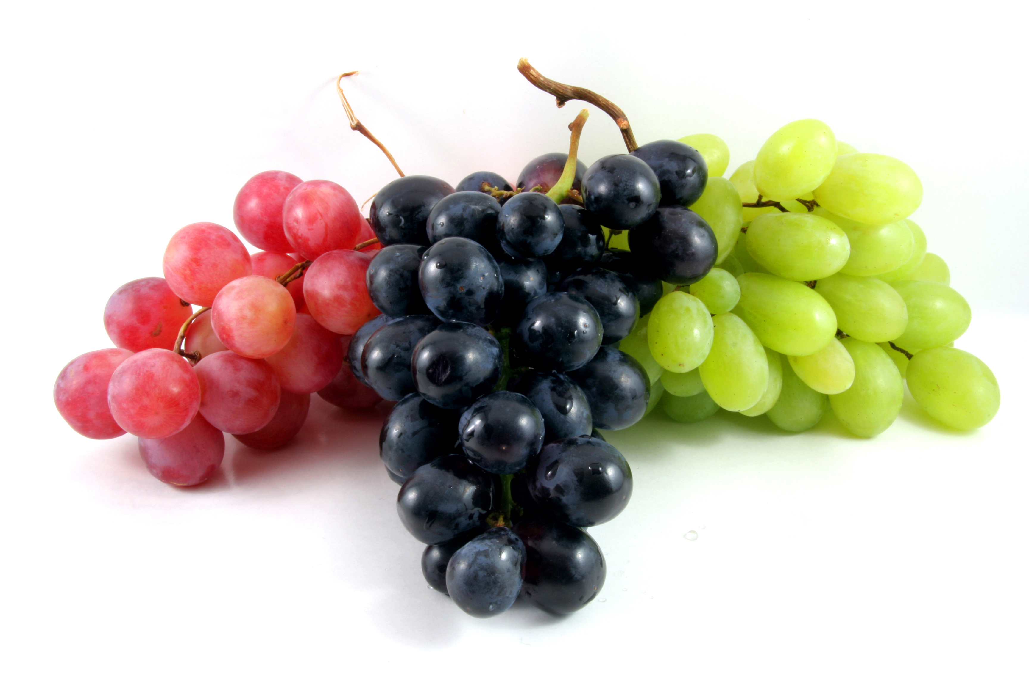
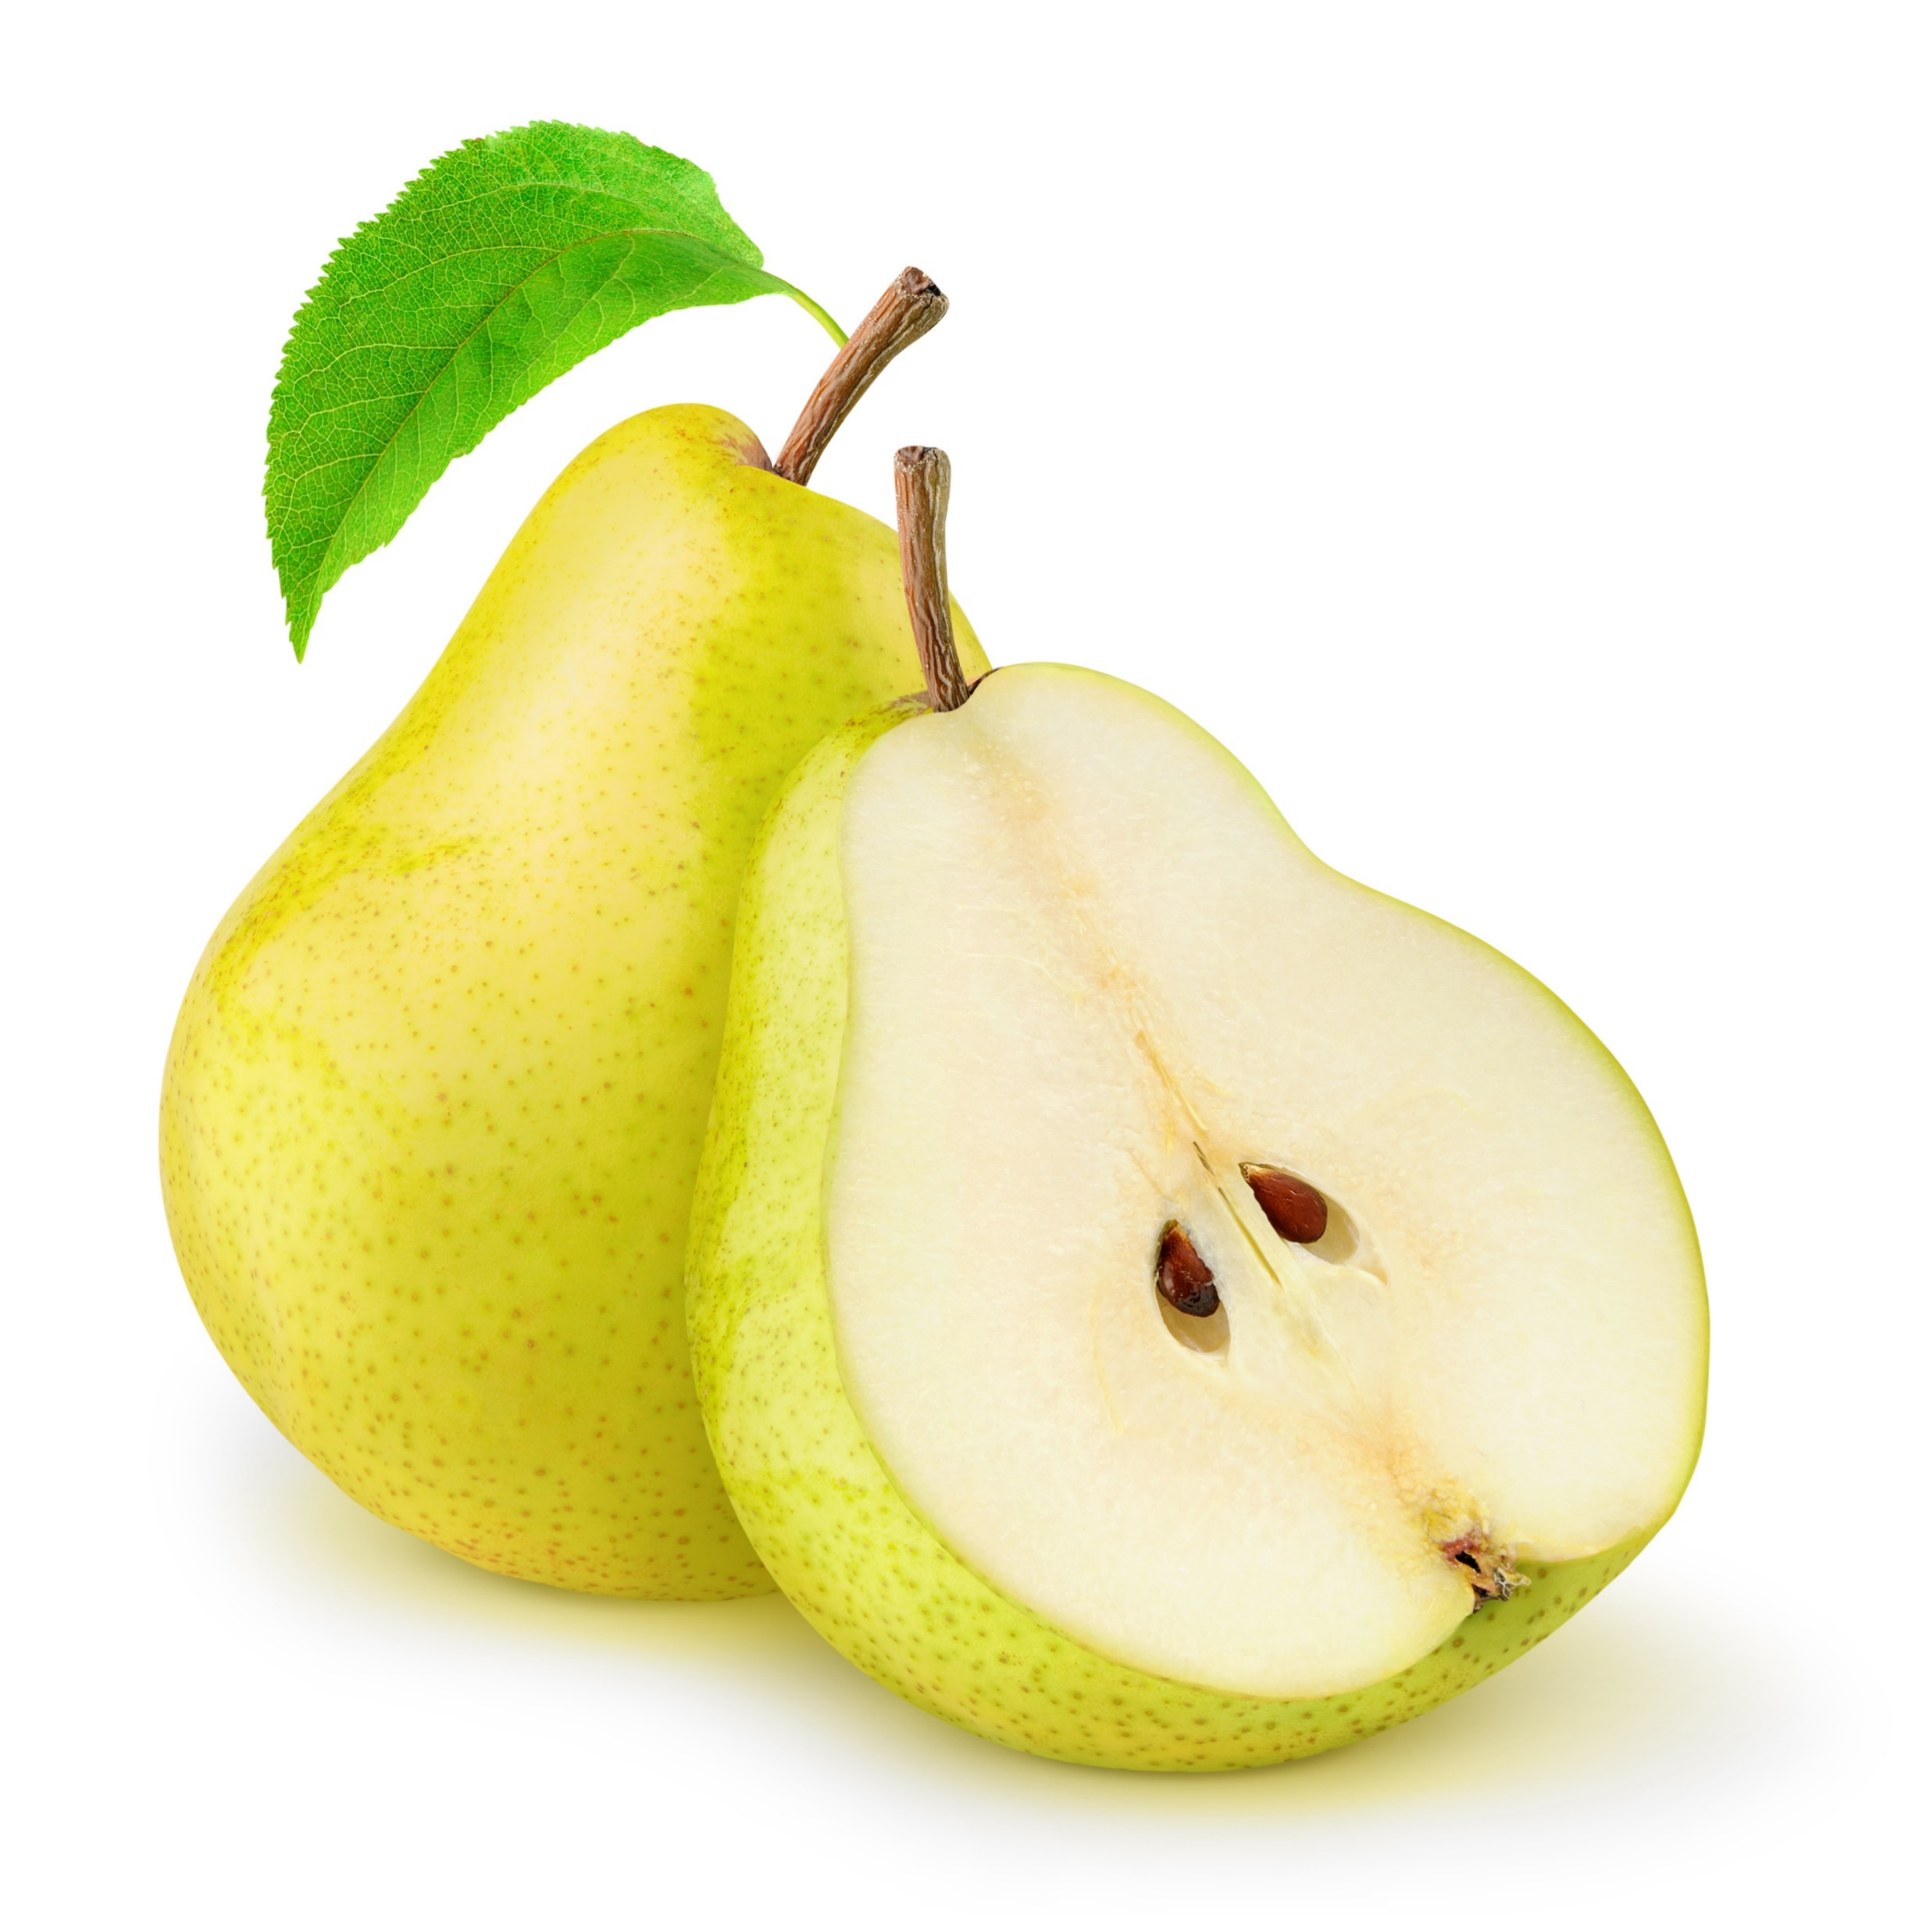
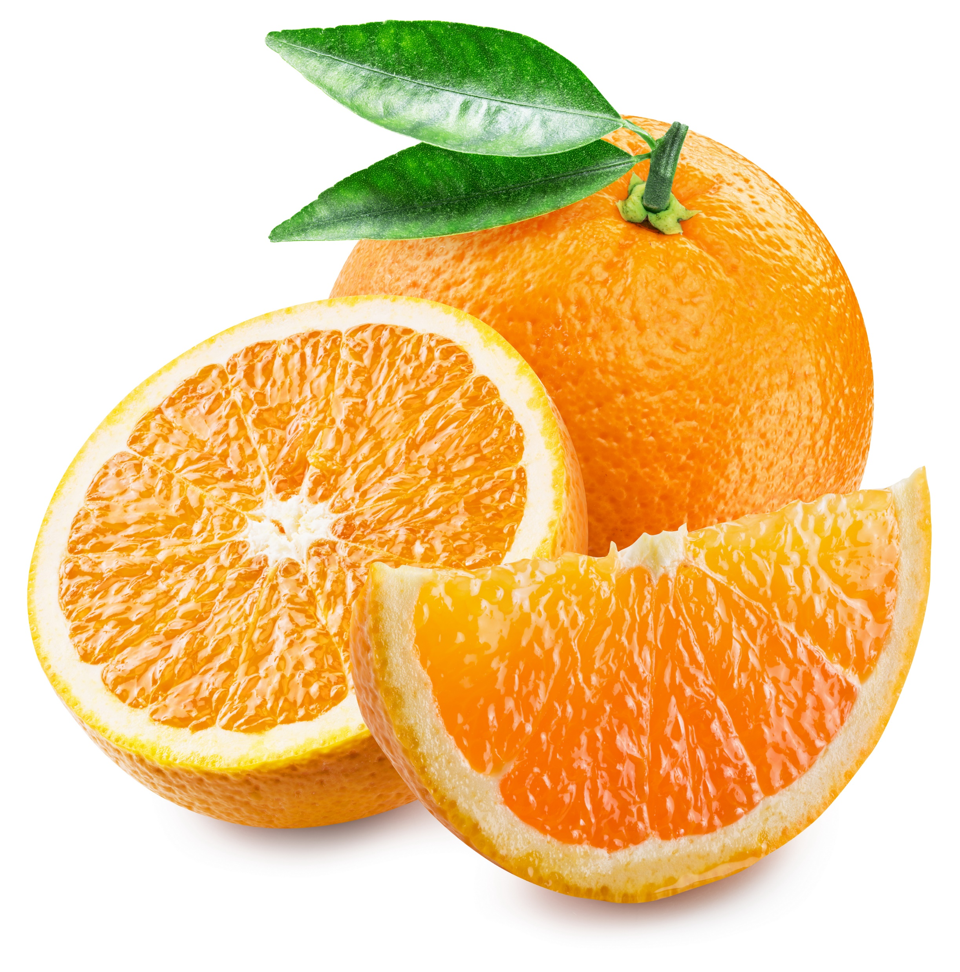
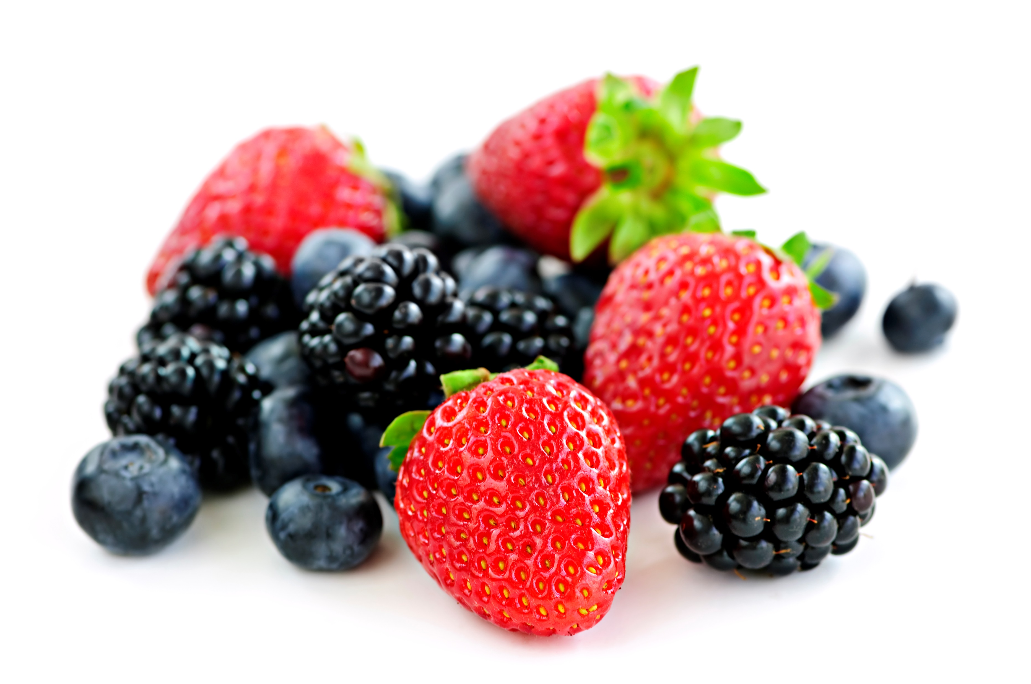
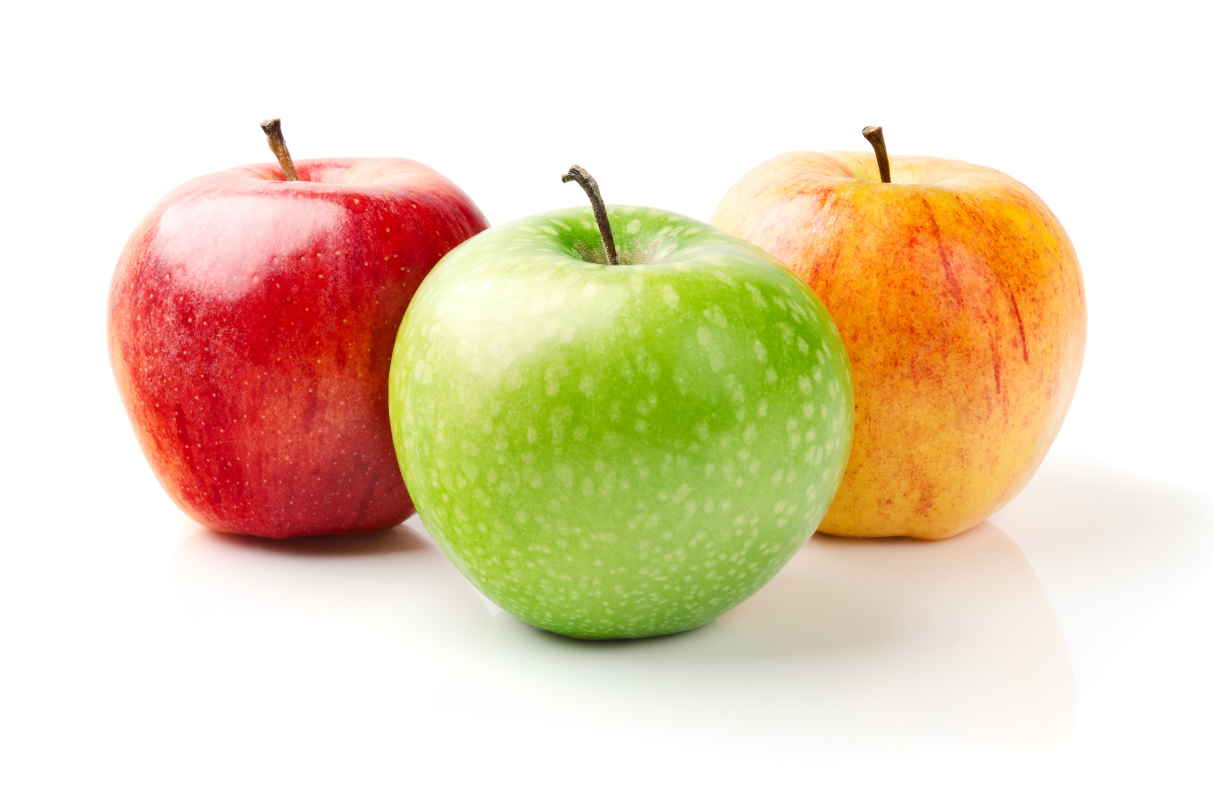
Do you eat fruits? Here are a few examples.
Yes
No
If yes, how often?
Less than 1 serving a day
1-2 servings a day
3-5 servings a day
More than 5 servings a day
Never
Notes:
This and the next one is about fruits and vegetables. Can you think about other fruits not in the examples? What is your favorite?

Slide 16
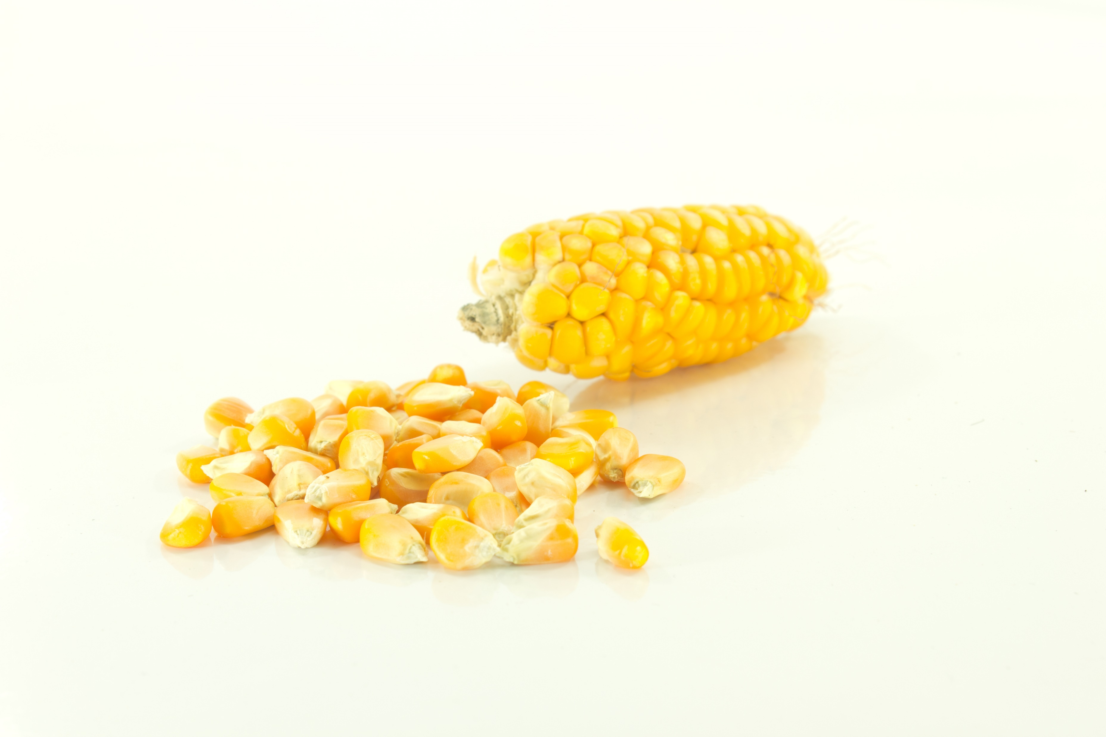
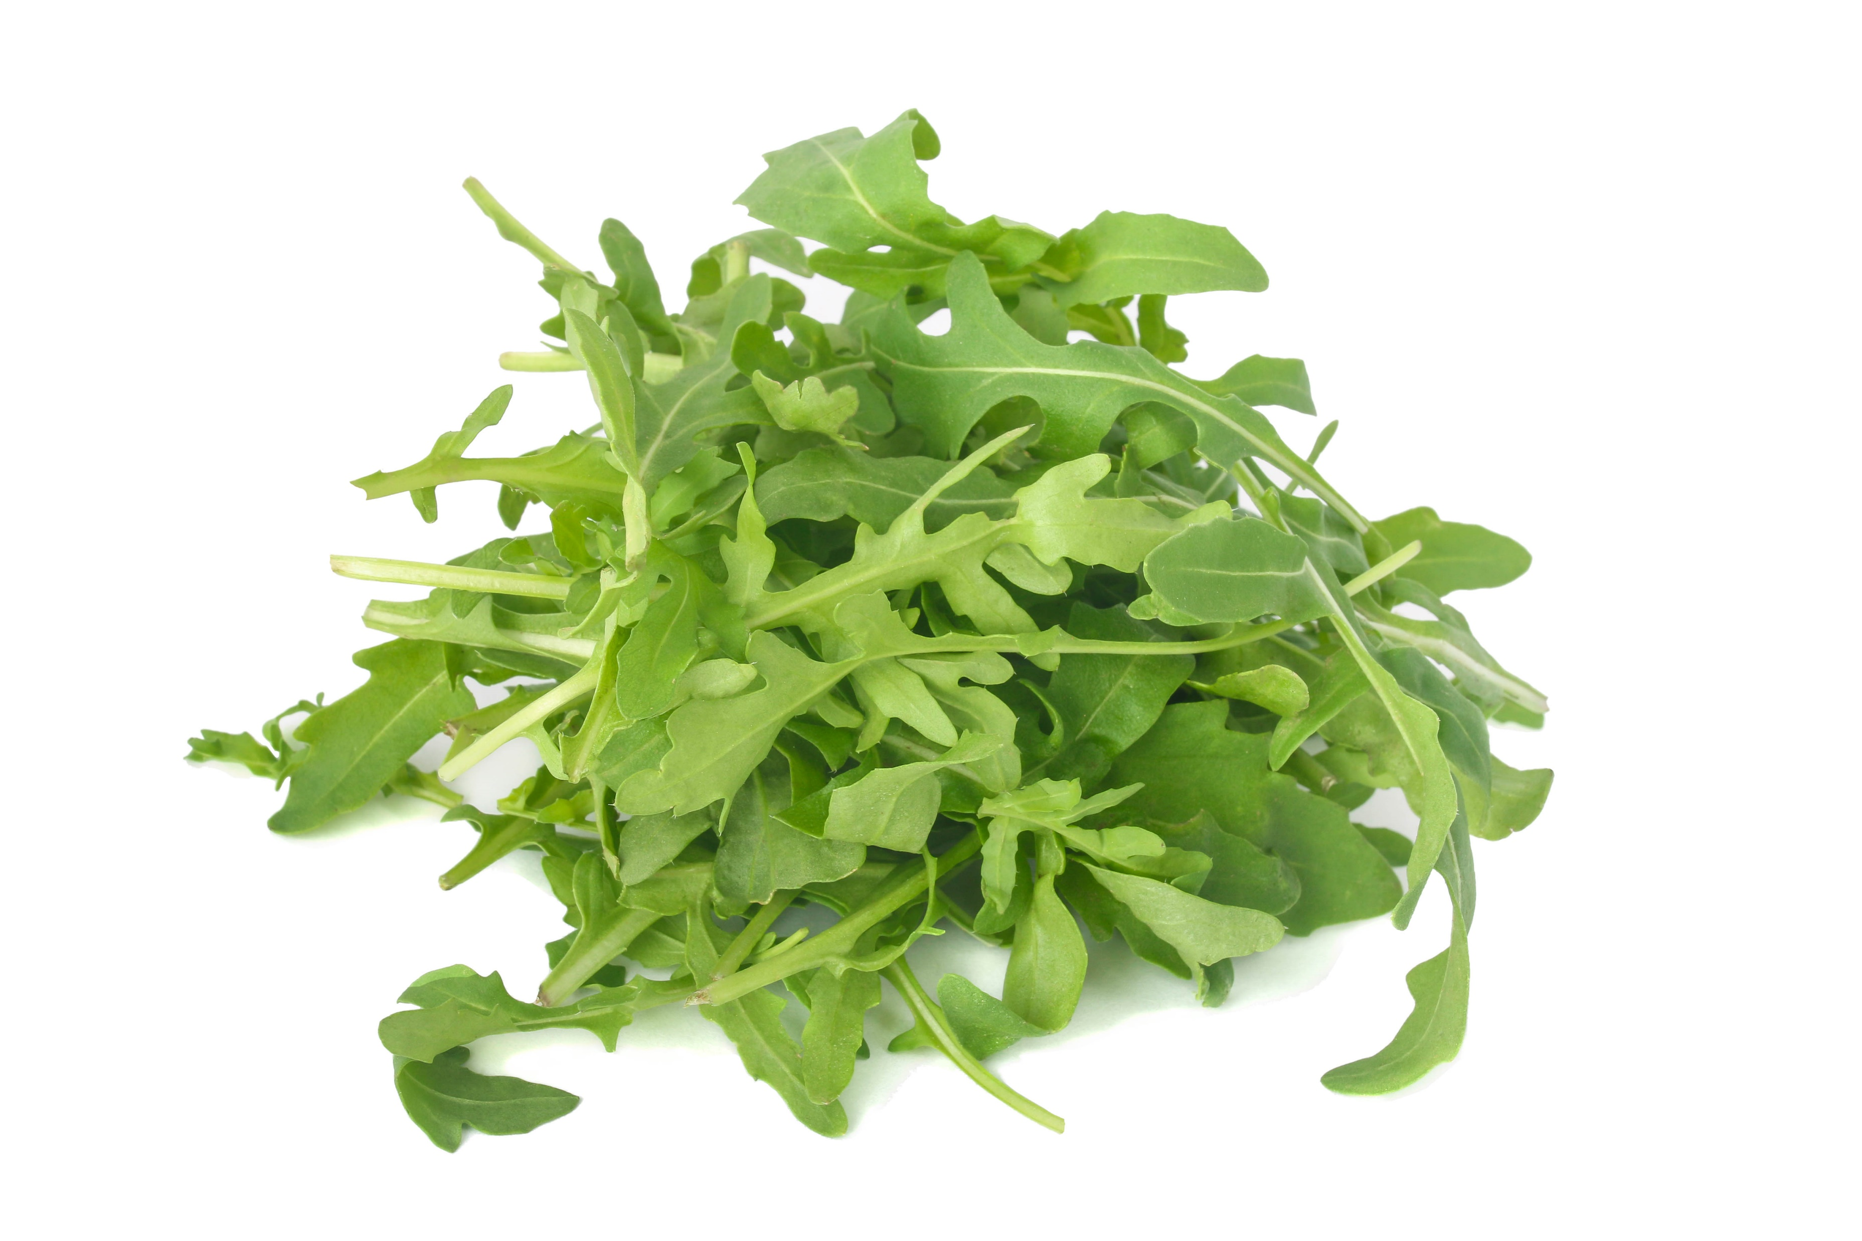
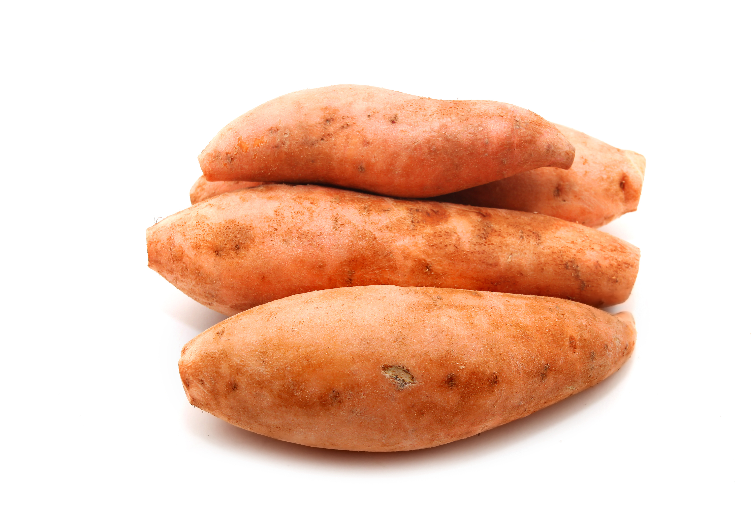
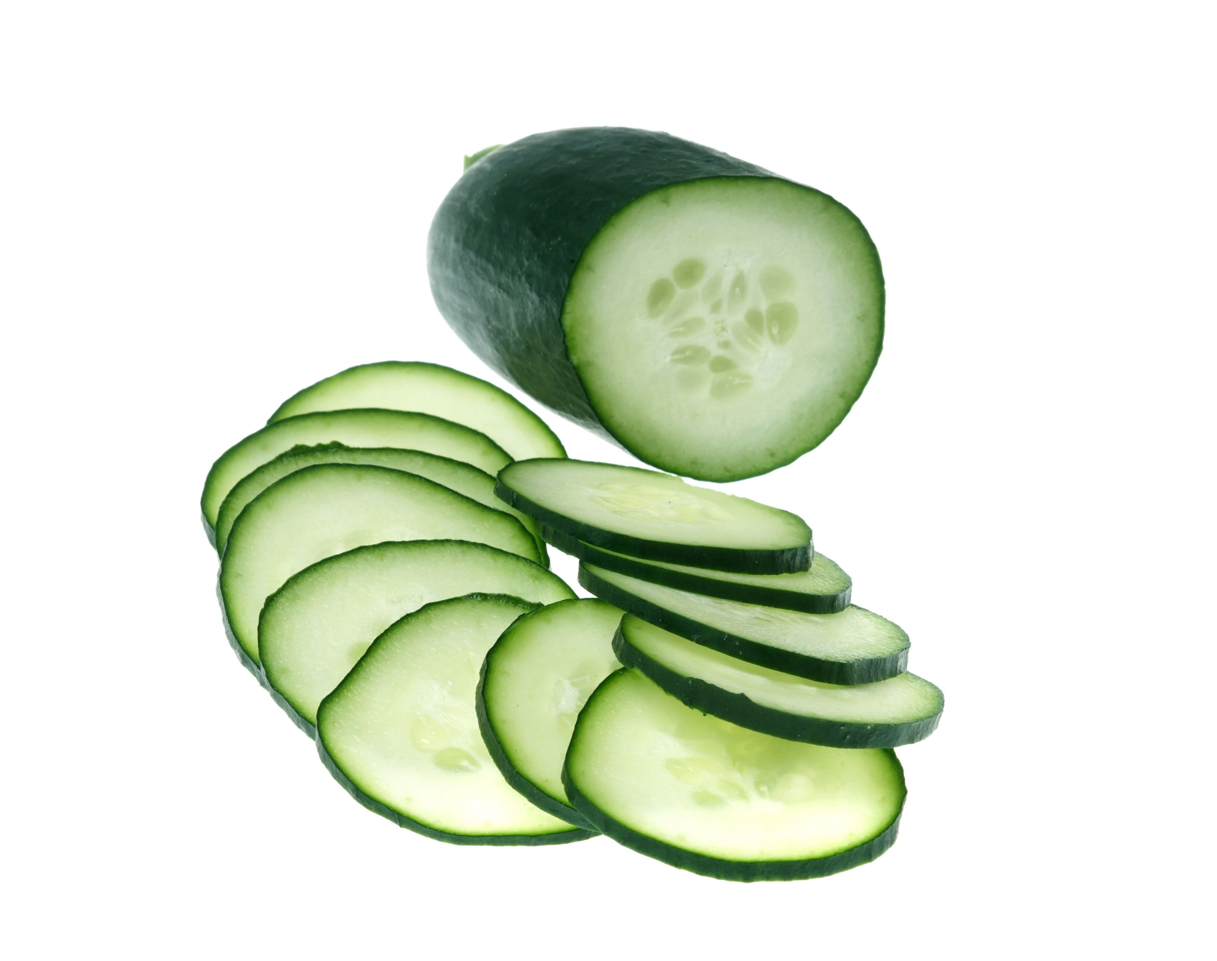
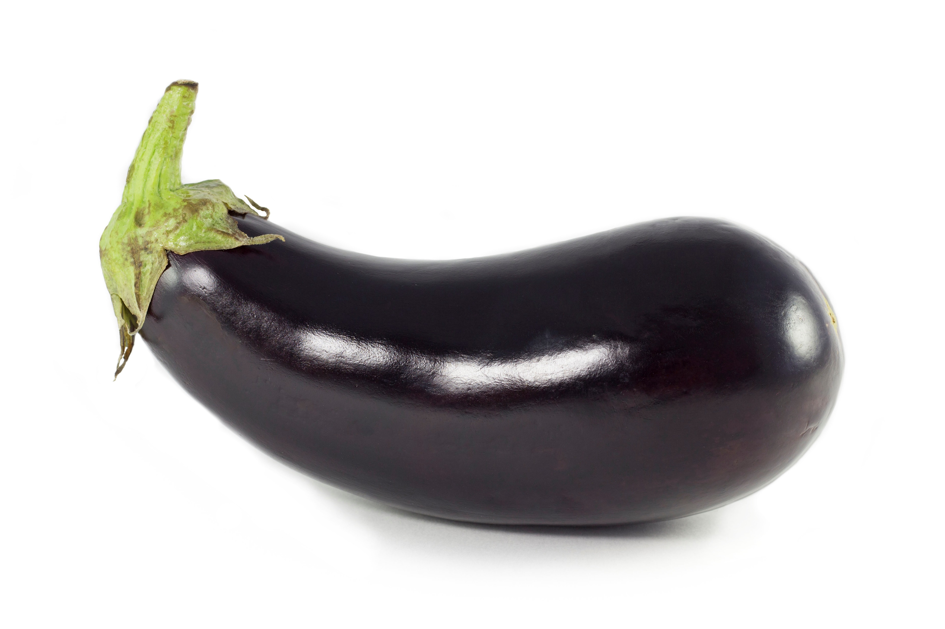
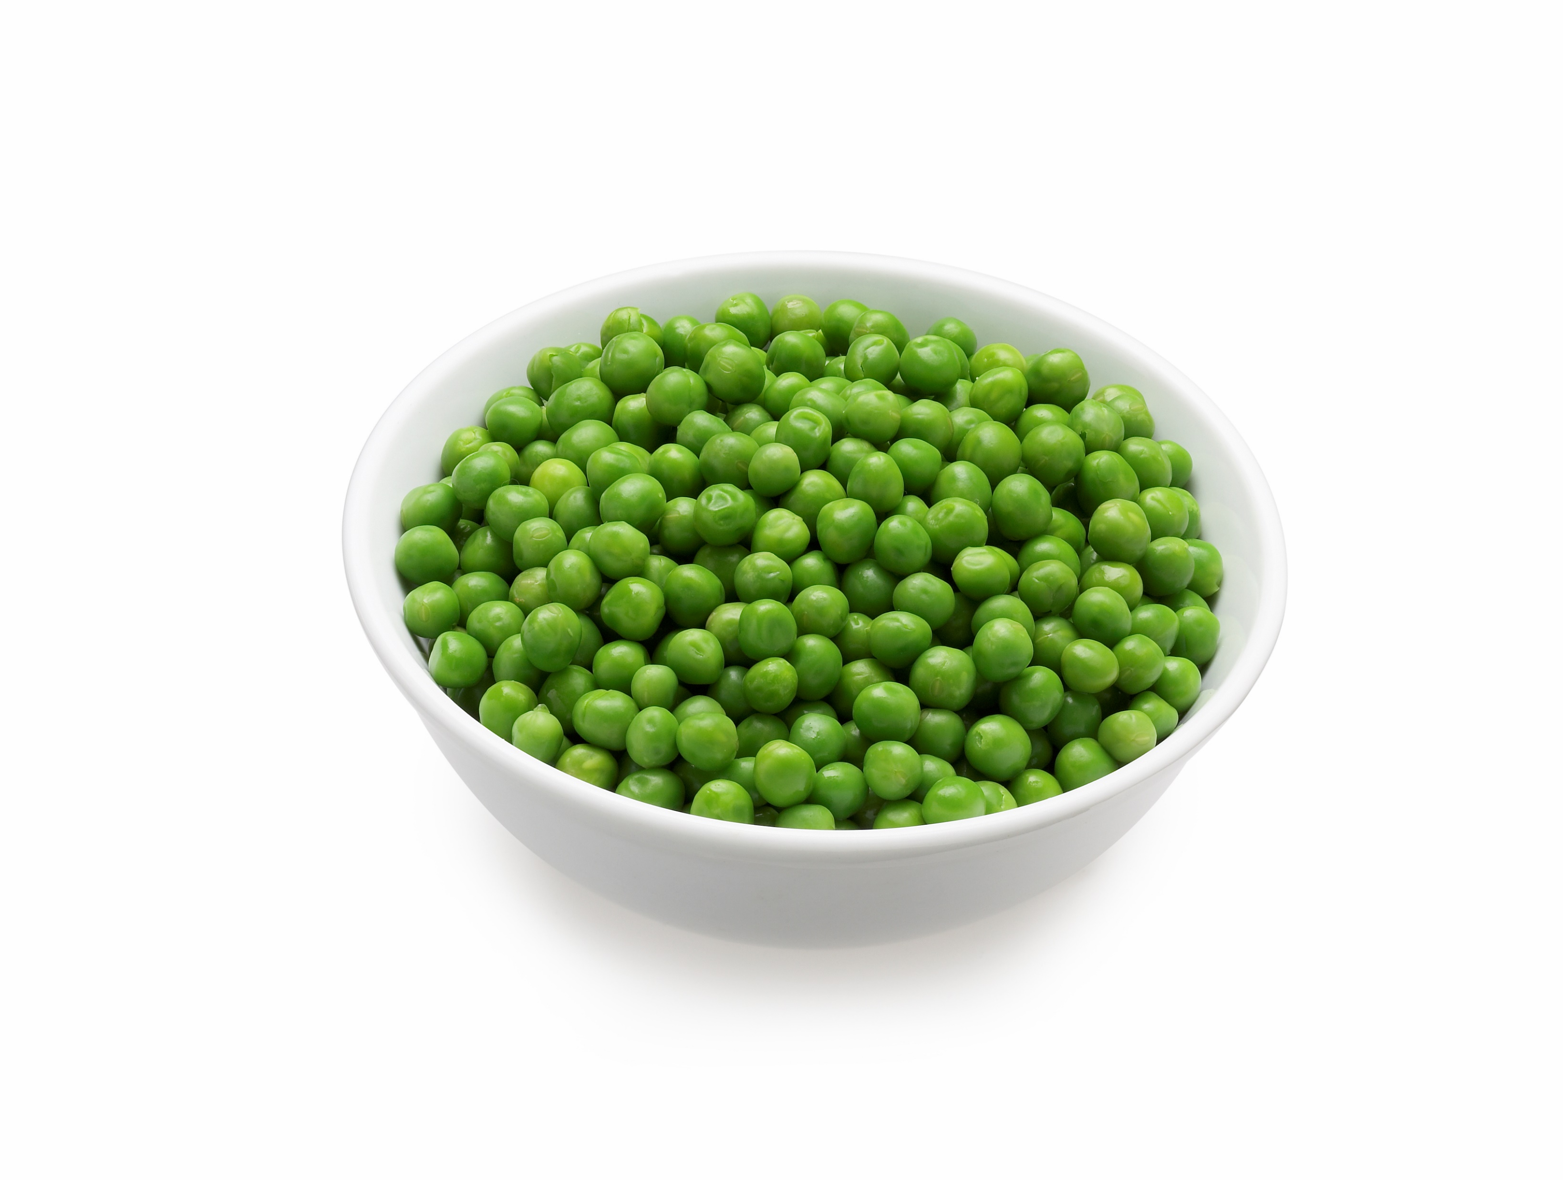
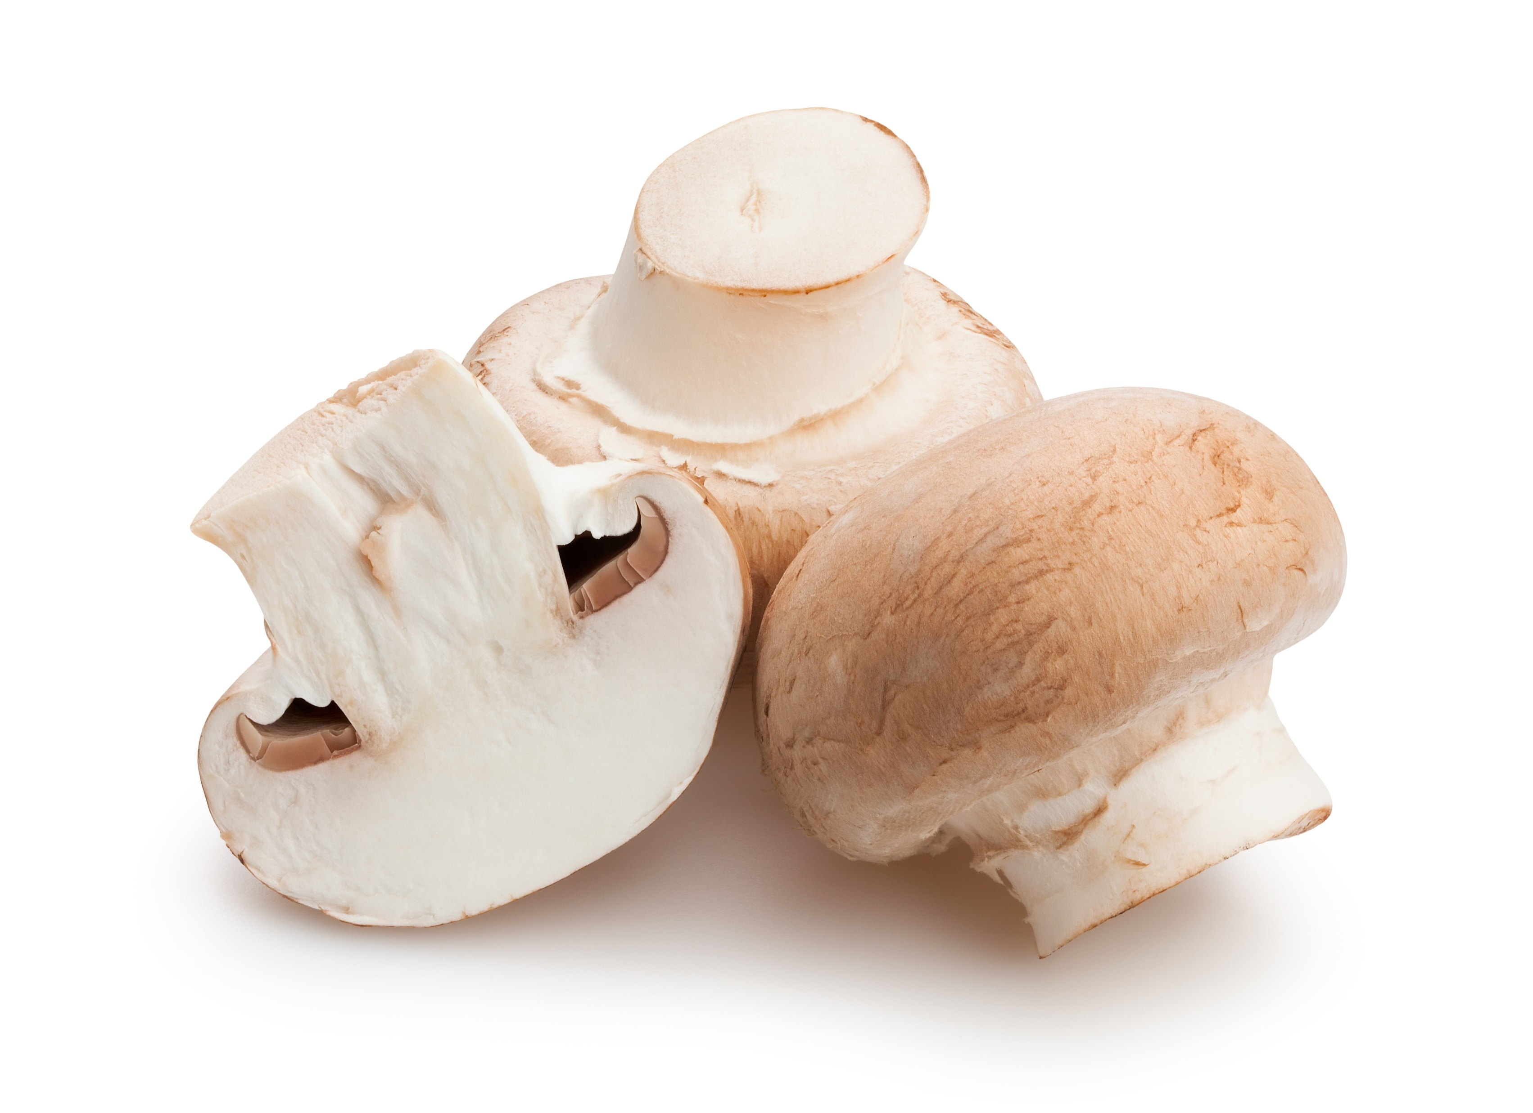
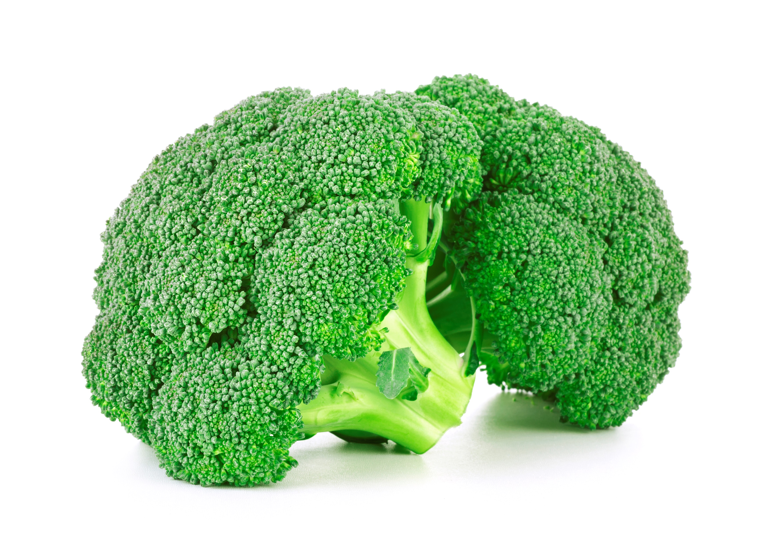
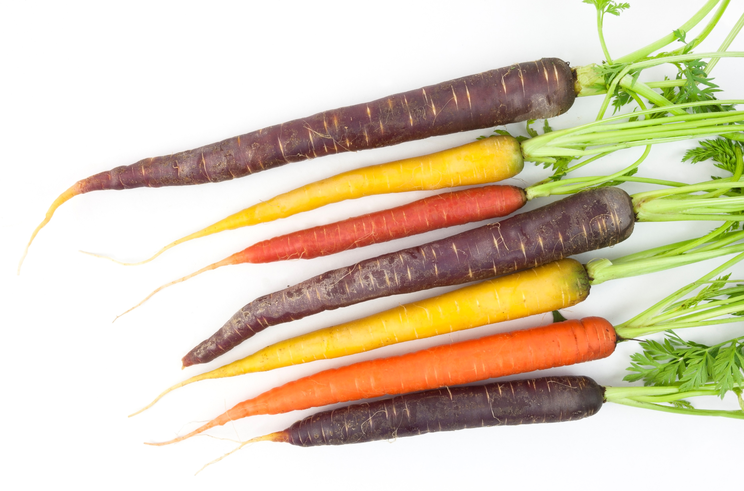
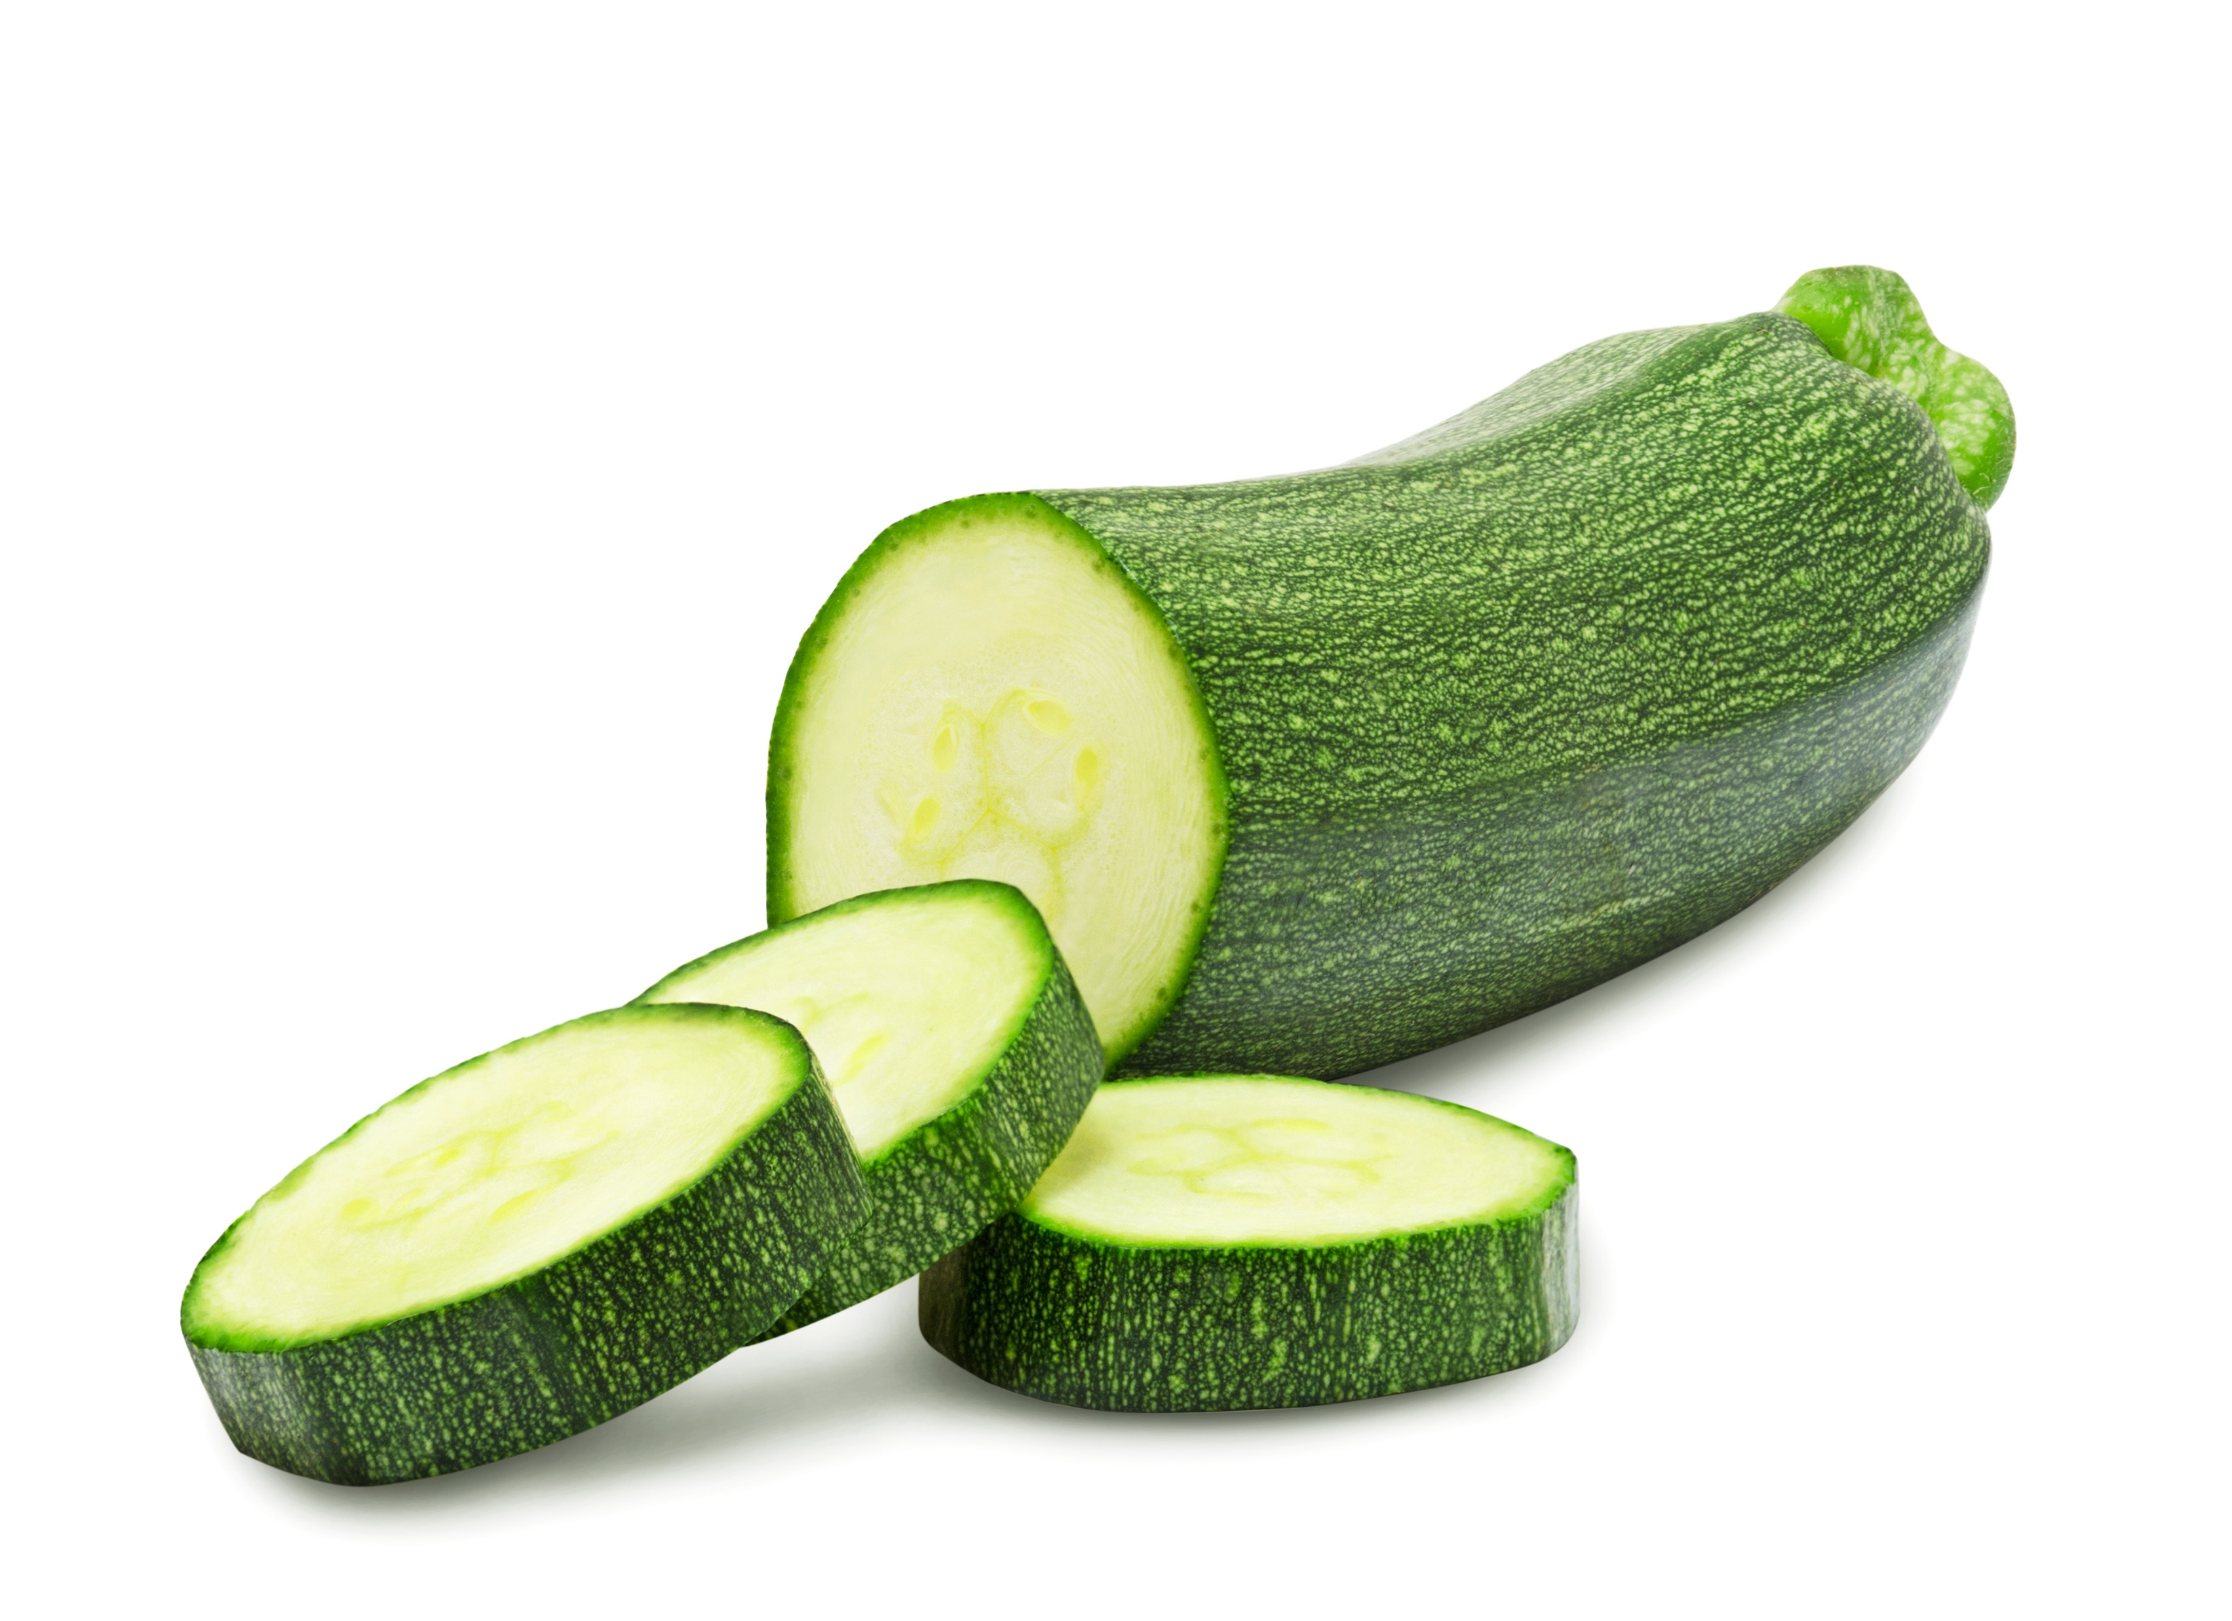
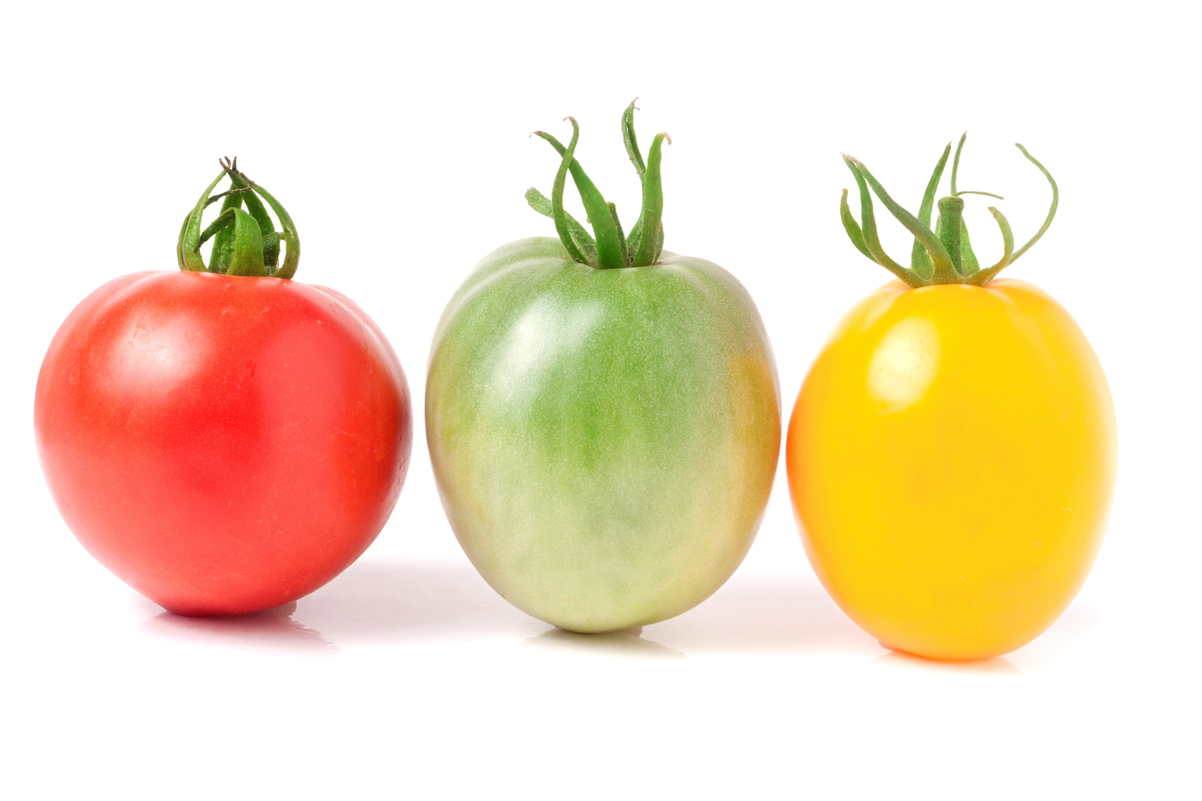

Do you eat vegetables? Here are a few examples.
Yes
No
If yes, how often?
Less than 1 serving a day
1-2 servings a day
3-5 servings a day
More than 5 servings a day
Never
Notes:
These are the vegetable pictures, how many other vegetables can you name? Do you have a favorite?

Slide 17
Fruits and Vegetables
Number of Servings a Day
Number of Servings a Day
Notes:
Good job, most of you had 1-2 servings a day of fruits and 1-2 a day of vegetables, you are close to your goal of 5 a day. Let’s talk about your goal and how to reach it.

Slide 18
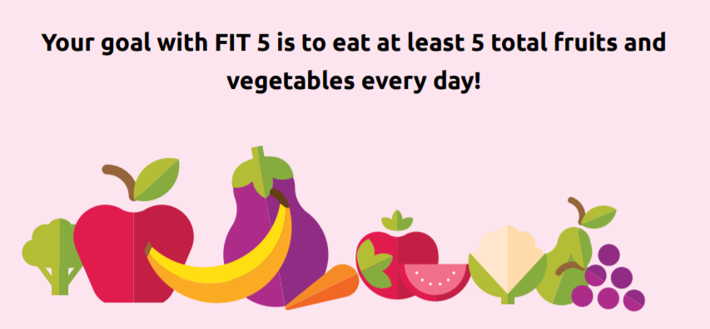
Name 3 fruits or vegetables you would like to try
Notes:
Did you meet the goal of 5 total fruits and vegetables each day? Remember at least one-half of your plate should be fruits and vegetables. Fresh, frozen, canned and dries all count.
Can you name 3 fruits or vegetables you would like to try? (Depending on group size, this could be entered into he chat box, or ask athletes to raise their hand, unmute and then share with the group)

Slide 19












Do you drink or eat any candy, cookies or snack foods? Here are some examples.
Yes
No
If yes, how often?
Daily
Weekly
Monthly
Never
Notes:
This question is about foods high in sugar, salt and or fat. There are a few examples in the picture but things like chips, cookies, candies would be examples.
We know that most of you eat some of these foods.

Slide 21
Notes:
Choose healthy snacks like unsalted nuts, fruit, or veggies. Here are a few ideas from Fit Five.

Slide 22







Do you drink sugar sweetened beverages?
Yes
No
If yes, How often?
Daily
Weekly
Monthly
Never
Diet
Diet
Notes:
This question is about sugar sweetened beverages. There are some examples in the picture.
Over ½ of the group drinks sugar sweetened beverages.

Slide 23
Notes:
Not too bag= just over ¼ of the group has a sugar sweetened beverage every day, most of you have a sugar sweetened beverage weekly, less monthly and a few never.
Daily 23.8 Weekly 47.6 Monthly 19 Never 9.5
What do we recommend?

Slide 24
Notes:
You should pick healthy beverage choices. Choose water, diet or low-calorie beverages instead of sugar-sweetened beverages. Add slices of lemon, lime, cucumber or your favorite fruit to make it more fun!
Think about the stop light Red, Yellow and Green- Red- stop for soda, energy drinks and sports drinks. Yellow- Drink low-fat milk and small amounts of 100% fruit juice at meals. Green for Go- water is the best choice.
Can you try this out and cut down or eliminate sugar sweetened beverages?

Slide 25

Do you smoke?
Yes- Vape
Yes- Tobacco
No
Does anyone around you smoke?
Yes
No
Notes:
This question is about smoking. We were interested to see if you smoked or chewed tobacco or vaped.
We also wanted to know if anyone around you smoked.

Slide 26
Congratulations
No one smokes
and
No one around you smokes!!
Notes:
Congratulations, you are a smoke free group---Stay that way

Slide 27



We choose Sports - Not Tobacco
Notes:
Note: Program should add photo on right and left of athletes engaged in sport to illustrate an active and healthy athlete.
You are a healthy athlete and want to achieve your personal best at your sport. Congratulations on avoiding tobacco. Because you avoid tobacco, you can perform better and run and walk faster and farther.
You can play your sport and be active longer.

Slide 28
Notes:
If you are around someone who smokes, these are a few ideas to help you avoid the smoke.
You can leave the room when someone is smoking or ask them not to smoke. Is someone you know trying to quit smoking? You can encourage them to quit and ask them if you can help them quit.
If someone wants to quite smoking, support from family and friends is important.
Discuss a few strategies on this slide.

Slide 29

When are the most important times to wash your hands? You can choose more than 1 answer.
After using the toilet
Before eating or touching food
After coming inside from a public place
After playing with animals
After coughing, sneezing, blowing your nose or mouth
After your sports practice
Notes:
This question is about important time to wash your hands.

Slide 30

Notes:
Good job on handwashing. Most of you made great choices. Don’t forget, it is important to wash your hands after playing with animals and after your sports practice.

Slide 31

Notes:
Let’s go over important steps in handwashing as illustrated on the picture.
Use soap and water, remember when to wash and wash for al least 20 seconds (about the same time as singing happy birthday).
Or insert the SOI handwashing video if you have internet access --https://www.specialolympics.org/videos/proper-hand-washing-techniques

Slide 32
Would you like to talk to a Health Promotion Clinical Director about any of the questions we asked or about your health?
Yes
No
Please tell us what you are interested in talking about
_________________________________________________
If you checked Yes, you will be contacted by Special Olympics to arrange a day and time.
Notes:
If you are interested in talking to a Health Promotion Clinical Director check yes. If you are not interested check no.
Please tell us what you are interested in talking about so we can arrange for the best person to talk to you.

Slide 33


Thank You For Your Participation
Notes:
Thank you very much for joining us today to talk and learn about Health Promotion. Have a great day.

