Slide 1

Social Media Toolkit for Health Promotion Instructions
Included in this slide deck is a series of key messages and engaging questions on the primary Health Promotion (HP) education topics. These take the HP education Posters and break them down into smaller messages. These resources can be used in a variety of ways, for example:
  Used collectively as a basis for a webinar led by a HP Clinical Director with athletes and/or with families/caregivers. The questions can be answered in chat or in a poll feature on the webinar platform.
  Share 1 message each day/week on your social media platform.
  Share 1 or 2 as “breaks” or “educational reminders/messaging” during virtual competitions or other virtual activities.
  For coaches to use with their athletes to prompt discussion.
  Combined and sent as a postcard mailing to participants.
However you chose to use them, we hope they are a helpful resource! Let us know how you are you using them healthpromotion@Specialolympics.org

Slide 2
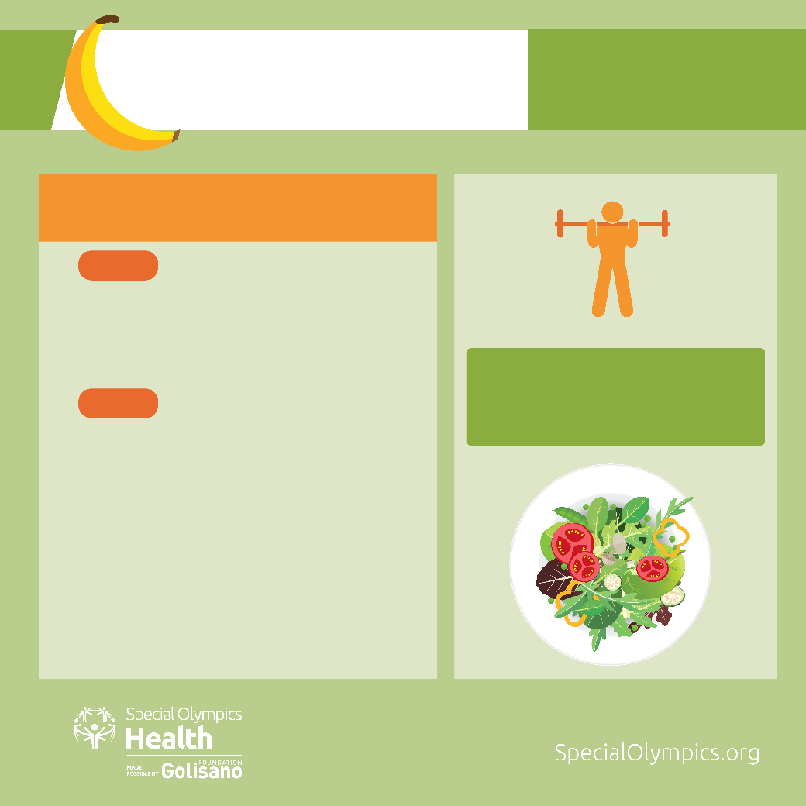
NUTRITION
MY GOAL:
Eat at least 5 fruits and
vegetables every day.
I CHOOSE TO EAT MORE
FRUITS AND VEGETABLES
WHY?
They give your body important vitamins,
minerals and energy needed for good health.
They provide energy for your sports performance.
TIP:
HOW?
Fresh, local and in season fruits and vegetables are the best
Eat a fruit a day with lunch.
Make half my plate fruits and vegetables every day. Have a salad for lunch.
When I want crunchy foods, I can eat apple slices, little carrots, celery sticks and snap peas.
Make a fruit smoothie with low fat milk or low-fat plain yogurt for dessert.

Slide 3
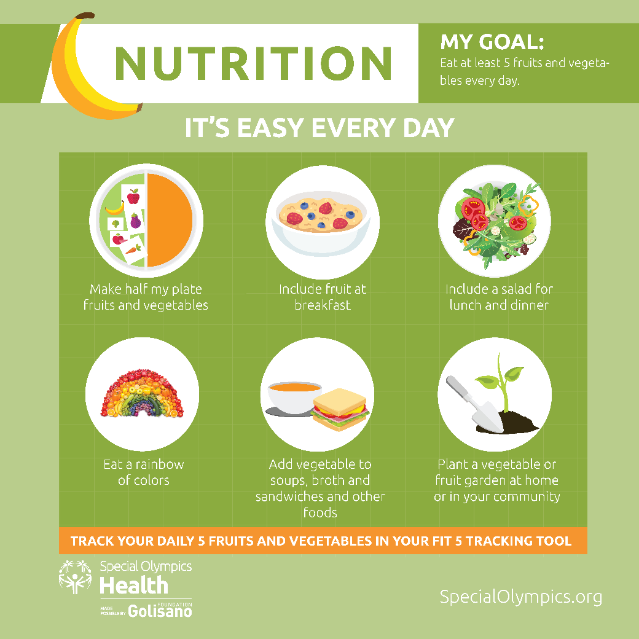
Win With 5 a Day
Grab and go ready to eat
  Keep a bowl of fruit on the table or counter.
  Keep cut-up fruits and vegetables in the refrigerator at eye level.
Eat the rainbow of colors-mix the red, green, orange and yellow foods.
Fruits dried, frozen, and canned (in water or 100% juice) as well as fresh, all count. Always have a choice on hand.
Include a fruit or vegetable at every meal and between meals.
Add vegetables to soups, stews, and sauces.
What is your favorite fruit or vegetable?

Slide 4
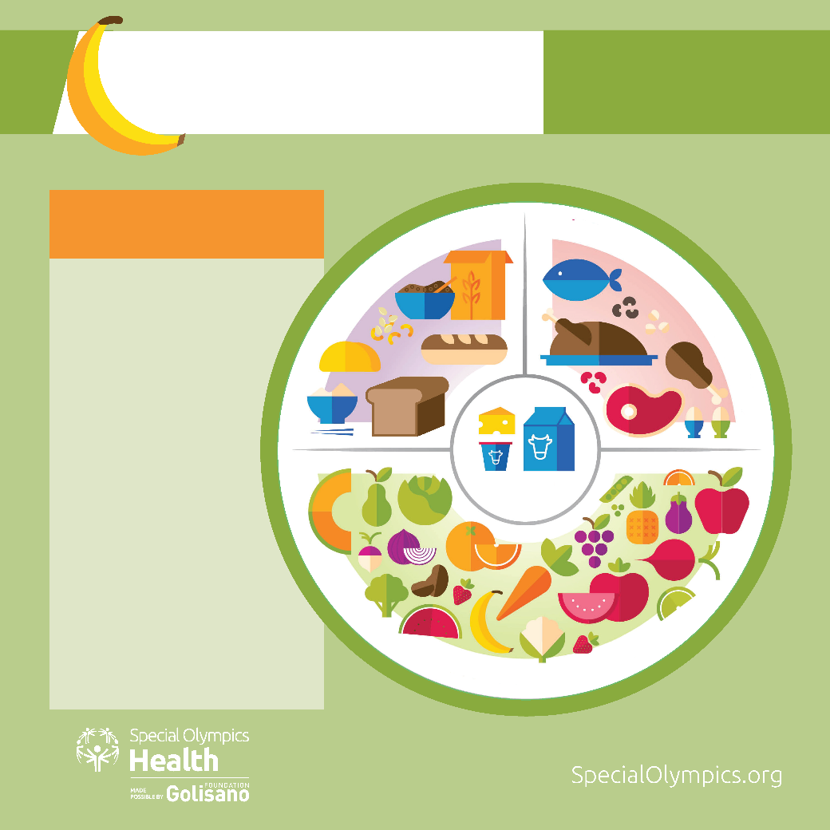
NUTRITION
MY GOAL:
Eat at least 5 fruits and
vegetables every day.
CREATING A HEALTHY PLATE
GRAINS
MEAT, FISH, EGGS, AND BEANS
You know fruits
and vegetables
are important
for your health,
but sometimes it
can be difficult to
know what other
foods you should
be eating.
This plate has all
the food groups,
with some
great choices in
each group!
FRUIT & VEGETABLES
DAIRY

Slide 5
Build a Healthy Plate
Make half your plate fruits and vegetables. Fresh, canned and frozen count. Add a fruit or vegetable to your breakfast choice. 4 points
At least half your grains should be whole grains. Try brown rice or whole wheat pasta. 4 points
Dairy foods include milk, fortified soy milk, cheese, yogurt. Look for low fat products. Try a smoothie for an in-between meal snack. 4 points
Meat, fish, eggs, beans, pulses, peas, legumes, nuts and seeds contribute protein, vitamins and minerals important for your health. Healthy choices include lean cuts of meat, like turkey and chicken, and dry beans and peas like lentils, black beans, chickpeas and tofu. 4 points
Score your plate. How many points do you get?

Slide 6
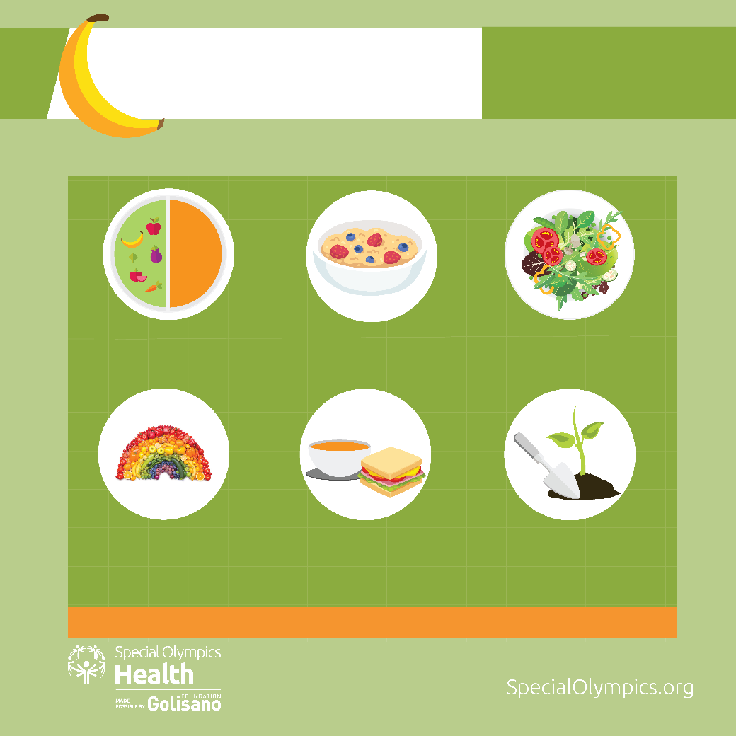
NUTRITION
MY GOAL:
Eat at least 5 fruits and
vegetables every day.
IT’S EASY EVERY DAY
Make half my plate
fruits and vegetables
Include fruit at
breakfast
Include a salad for
lunch and dinner
Eat a rainbow
of colors
Add vegetable to
soups, broth and
sandwiches and other
foods
Plant a vegetable or
fruit garden at home
or in your community
TRACK YOUR DAILY 5 FRUITS AND VEGETABLES IN THE FIT 5 TRACKING TOOL

Slide 7
It’s Easy to Eat Healthy Every Day
Healthy eating is important to your health and sports performance.
Talk to your coach about the changes you want to make.
Plan on how you will meet your goals for fruits and vegetables and water.
Don’t forget to use the Fit 5 Tracking Tool, you can follow your progress to meet your goals.
Share your success with your family, coach and team.
What are some of the changes you want to make?

Slide 8
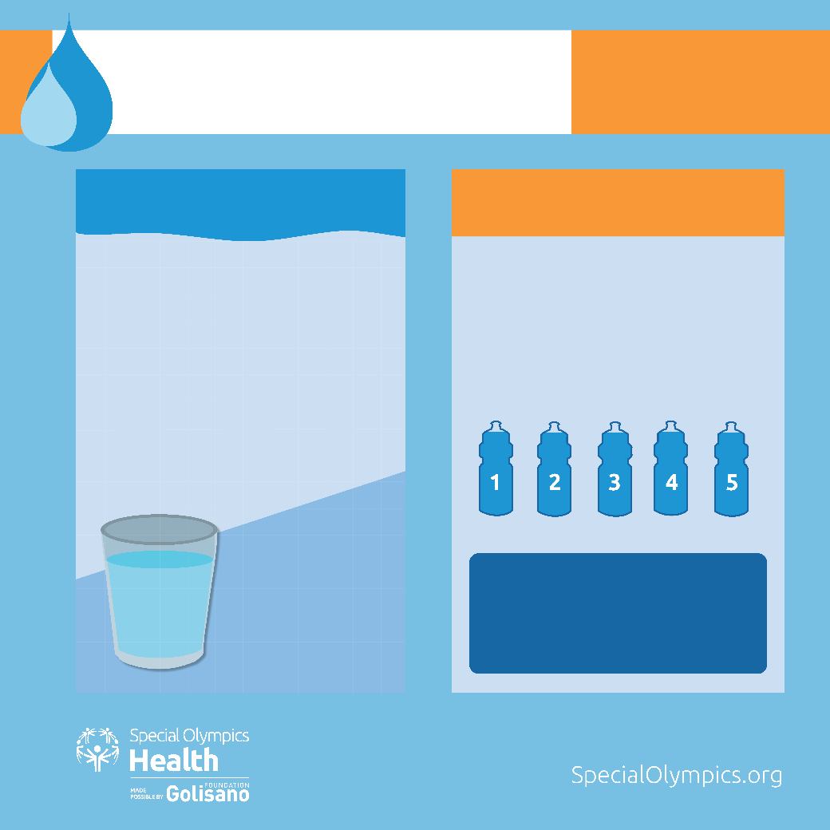
HYDRATION
MY GOAL:
Drink 5 bottles of water
every day
WHY HYDRATION IS
IMPORTANT
WATER FOR HEALTH AND SPORT PERFORMANCE
Your body needs water to keep it
working properly
You lose water every day when you go
to the bathroom, sweat and even when
you breathe
You need to replace the water you
lose so you stay healthy, hydrated and
perform at your best
Drink enough water throughout the
day to stay hydrated
Your bottle should be 16 - 20 ounces
or 500 - 600 ml
Water is
the best
choice for
hydration!
TIP:
Drink out of a sports water bottle -
they are refillable and can hold the
right amount of water

Slide 9
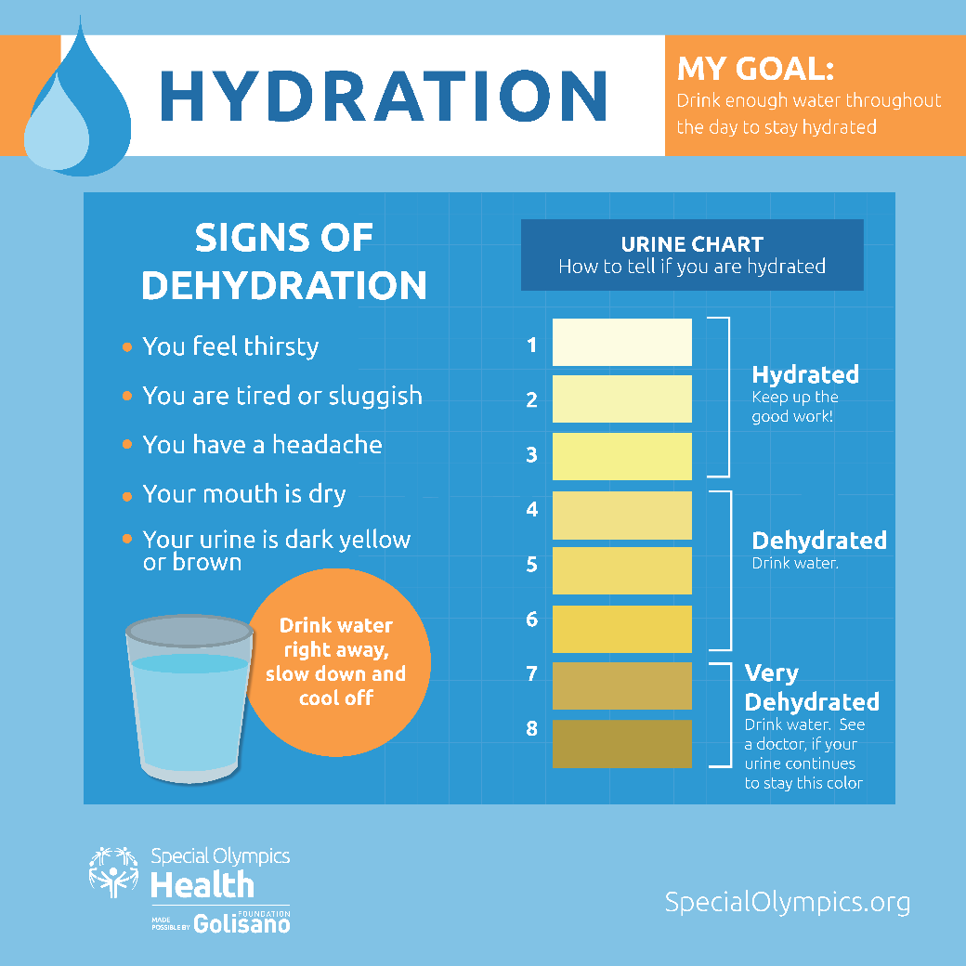
Water: Just Drink It!
Drink water before, during and after your workout or sport practice.
Fill a container with water and keep in the refrigerator. Add a few slices of fruit or cucumber or mint for a refreshing cool drink.
Make water your number one beverage to drink.
Drink water instead of sugar sweetened beverages.
How are you going to reach your 5 bottle a day water goal?

Slide 10
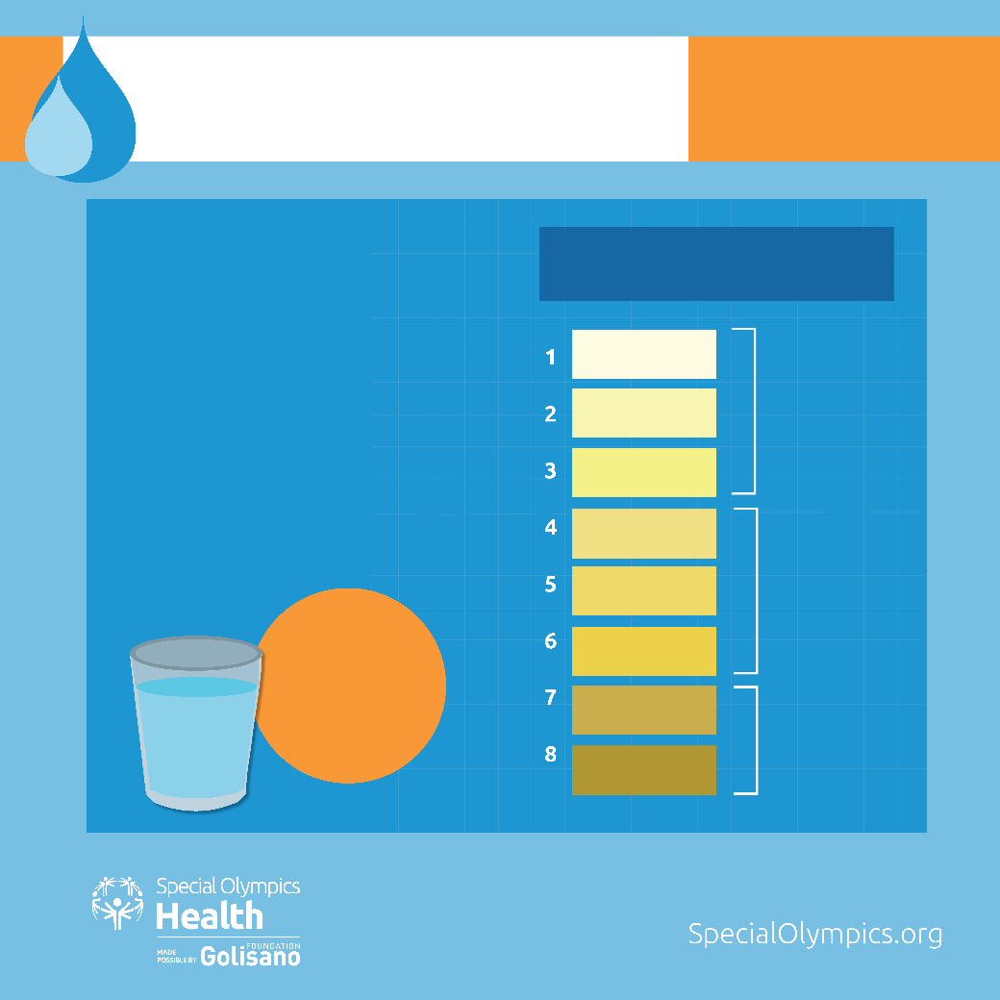
HYDRATION
MY GOAL:
Drink 5 bottles of water
every day
SIGNS OF
DEHYDRATION
URINE CHART
You feel thirsty
Hydrated
You are tired or sluggish
Keep up the good work!
You have a headache
Your mouth is dry
Your urine is dark yellow
or brown
Dehydrated
Drink water.
Drink water right away, slow down and cool off
Very Dehydrated
Drink water. See
a doctor, if your
urine continues
to stay this color.

Slide 11
Water to the Rescue—Prevent Dehydration
Watch for the signs of dehydration. Talk to your coach if you think you are dehydrated.
Don’t wait until you are thirsty for a drink, drink water before, during and after your workout or sport practice.
Did you know that dehydration of 1-2 % of your body weight can decrease your sport performance?
Drinking the right amount of water is important for your health and can help your sport performance.
How many bottles of water did you have today?

Slide 12


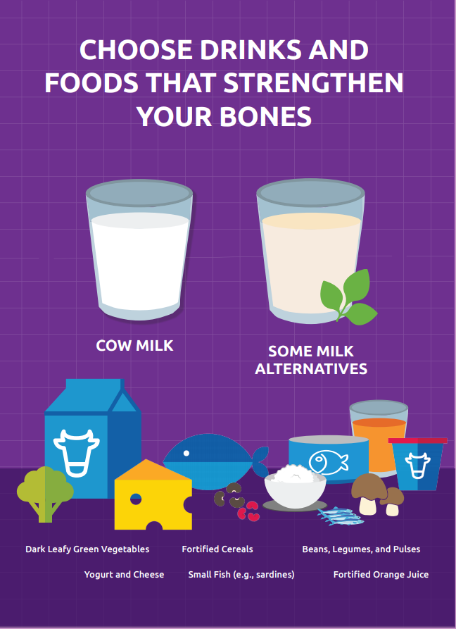
So many foods can help build healthy bones
Dairy foods like cheese, yogurt, kefir and milk.
Dark green vegetables like broccoli, brussels sprouts, dark green lettuce, collard greens, and kale.
Seafood like salmon, tuna, sardines, shrimp, herring and trout.
Add healthy seeds like sesame, sunflower, chia and quinoa to meals.
If you prefer non-dairy milk, read labels to choose the healthiest one. Each cup of the milk you choose should have at least:
8 grams of protein 300 mg of calcium
100 IU of Vitamin D No added sugar

Slide 13

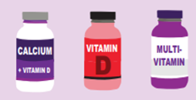
MAKE SURE YOU GET THE RIGHT VITAMINS AND MINERALS
Getting Vitamin D from the sun, some foods, and supplements helps keep your bones strong Talk with your doctor about a Vitamin D test and which vitamins you may need to take. Many people need to take a multi-vitamin pill, calcium pill, and a Vitamin D pill daily.

Slide 14
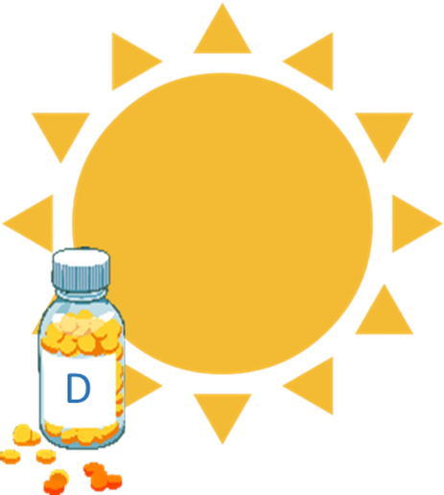
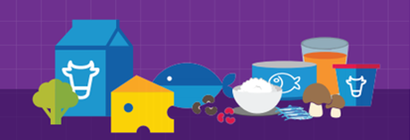
I choose to get enough Vitamin D every day.
WHY? Vitamin D, calcium rich foods and dark green veggies help keep your bones strong to prevent fractures. Vitamin D helps prevent muscle pain and weakness.
HOW? Get safe sun exposure every day, but don’t get sunburned. Choose foods with Vitamin D like milk, fish, fortified cereal, fortified yogurt, and sun exposed mushrooms. Ask your doctor about getting a Vitamin D test. Take a Vitamin D pill daily.
What are three ways you
can get Vitamin D?
1.__________________
2.__________________
3.__________________

Slide 15






What to avoid to protect your bones.
Too much salt causes calcium loss and bone breakdown. Eat fewer packaged foods, fast foods, and processed meats.
Avoid alcohol as it makes it hard for your body to absorb calcium.
Tobacco and nicotine increase the chance of bone fractures and slow healing of broken bones.
Replace sugary drinks with water, milk or orange juice with added calcium and vitamin D.
Limit time watching TV, working on a computer, and playing video games.

Slide 16









All exercise is good for your health. Weight bearing and resistance activities are the best for bone health
Which of these activities can help make your bones stronger?
Which ones will you do to enhance your sports performance?

Slide 17
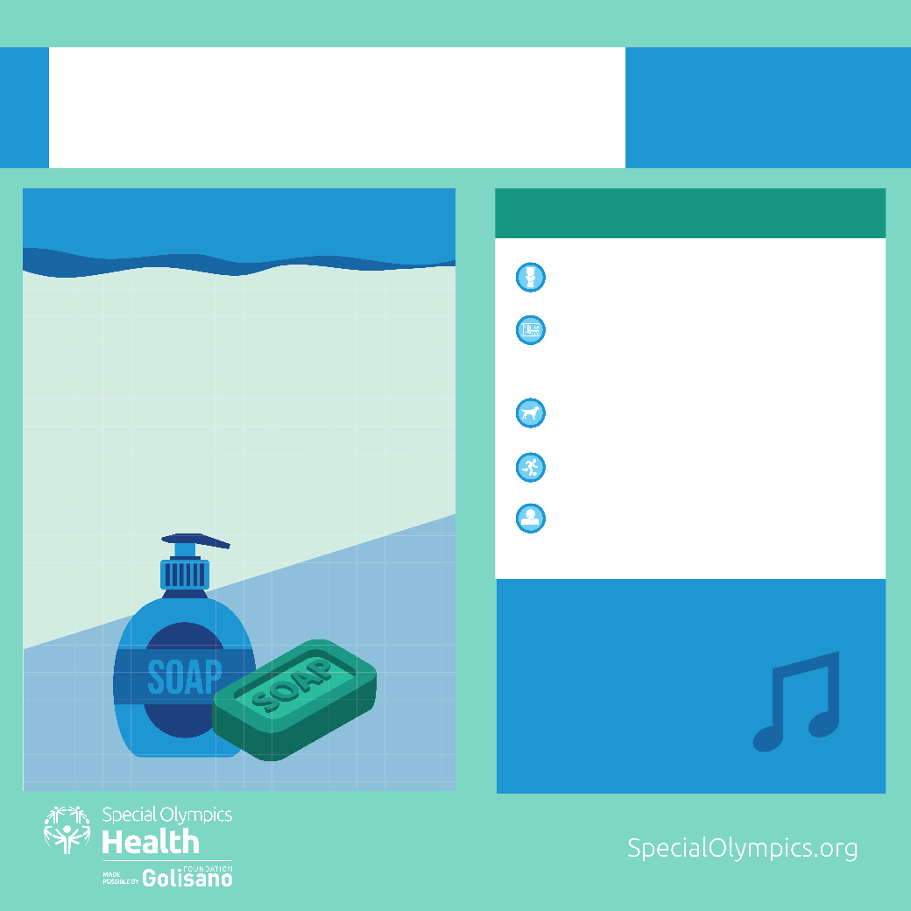
HANDWASHING
MY GOAL:
Have clean hands and
prevent spread of germs
HAND WASHING IS IMPORTANT BECAUSE…
WHEN TO WASH YOUR HANDS
After using the toilet
Before preparing, touching, or
eating food
After playing with animals
After your sports practice
After coughing, sneezing, or
blowing your nose or mouth
Regularly washing your hands with
soap and water can protect you
from illnesses caused by viruses and
bacteria
It is the best way to stop germs from
spreading
HOW DO I KNOW IF I WASHED MY
HANDS FOR 20 SECONDS?
Sing happy birthday to
yourself twice
OR
Sing the alphabet song
to yourself

Slide 18
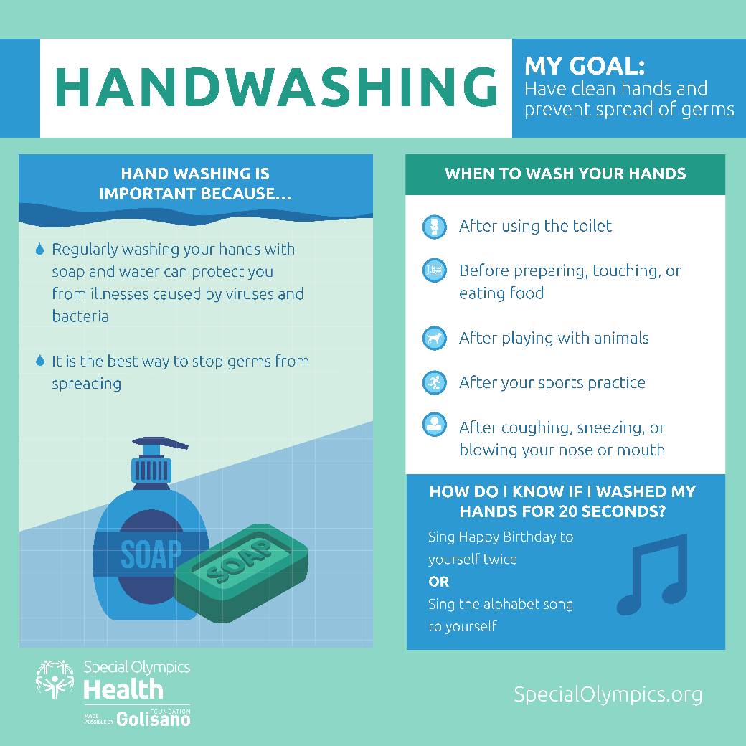
Handwashing - A Healthy Habit
Your hands carry germs you can’t see.
Wet, lather, scrub, rinse and dry.
Soap not available? Use an alcohol-based hand sanitizer that has at least 60% alcohol.
When was the last time you washed your hands today?

Slide 19
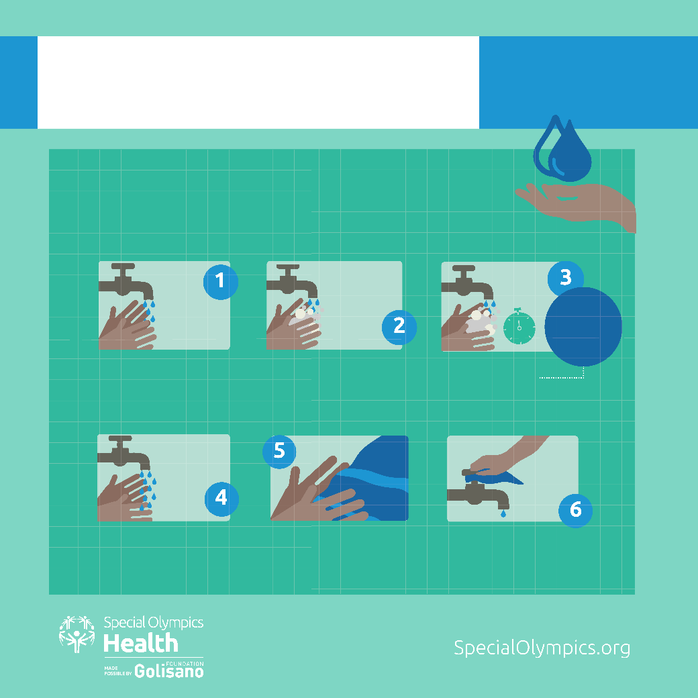
HANDWASHING
MY GOAL:
Have clean hands and
prevent spread of germs
6 EASY STEPS TO
CLEAN HANDS
Don’t forget to
scrub between
your fingers,
under your nails,
and the top of
your hands
WET YOUR HANDS
APPLY SOAP
WASH YOUR HANDS FOR 20 SECONDS
RINSE WELL
DRY YOUR HANDS
TURN OFF WATER WITH PAPER TOWEL

Slide 20
Handwashing- Good Health Is In Your Hands
Everything you touch has germs that stay on your hands.
Make clean hands a healthy habit everywhere you go so you don’t get sick.
Can you name the 6 steps for washing your hands?
Wash your hands now.

Slide 21

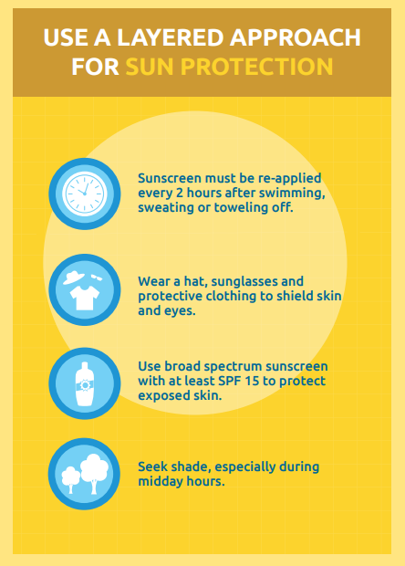




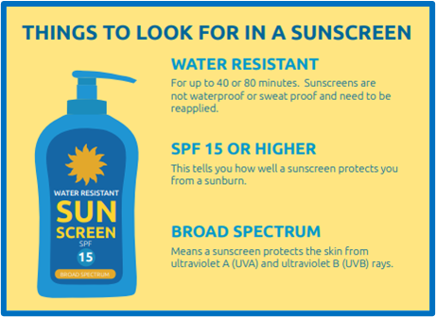

Slide 22
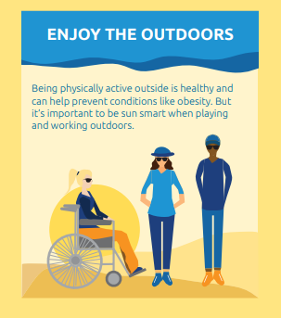
Our bodies can make Vitamin D from sunlight on our skin during the ‘summer’ months . Be careful not to burn in the sun. Be sure to cover up, find shade or use sunscreen before you turn red or get burnt.
Look on the bright side
sunlight makes Vitamin D

Slide 23
Enjoy the sun, but don’t get burned.
Avoid the sun during peak hours of 10 am – 2 pm.
Seek shade, wear UV protective sunglasses and a wide-brimmed hat.
Use plenty of sunscreen, with a SPF of 15-30 year-round. Apply it within 10-15 minutes after going outdoors, even on a cloudy day.
Reapply sunscreen every 2 hours and after swimming.
Use SPF lip balm. Use sunscreen on ears, neck and top of feet.
Remember to protect your scalp with a hat or sunscreen.
Even a single sunburn can increase a person's risk of skin cancer.
Why should you avoid getting sunburned?

Slide 24
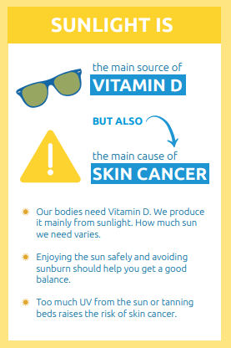
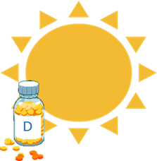

Many people have low levels of Vitamin D which can harm their health. Talk to your doctor about a Vitamin D test and the right Vitamin D pill dose based on your Vitamin D level.

Slide 25
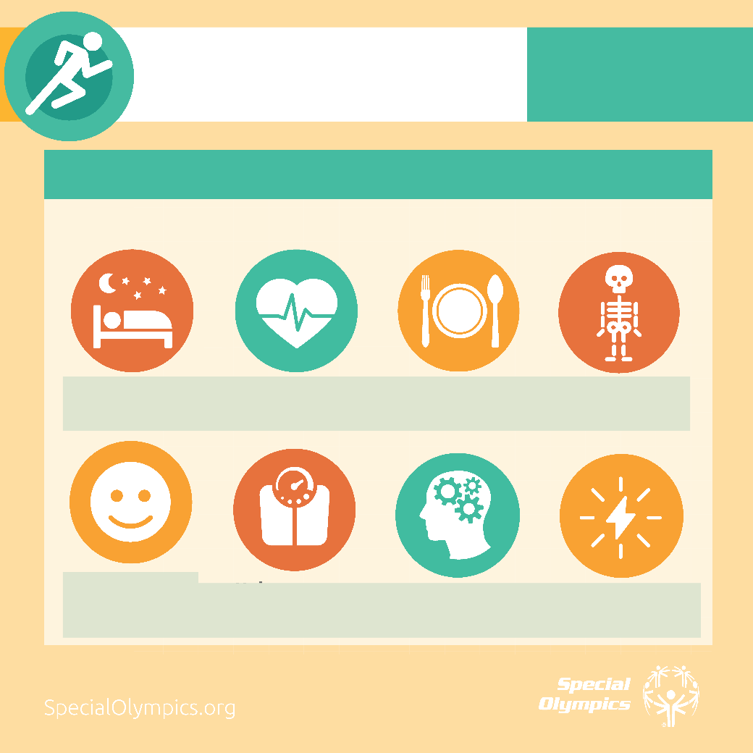
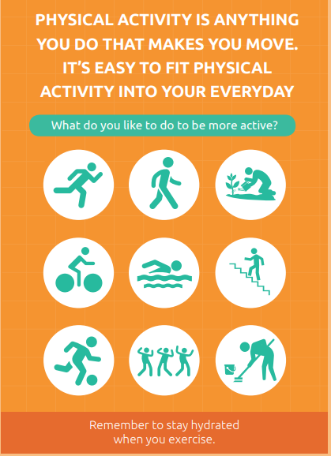
PHYSICAL ACTIVITY
MY GOAL:
Exercise or do physical activity
5 days a week
The best exercise to do is one you like and will keep doing!
What can do you do outside of your sports practice and competition?
Walk around the house while you're brushing your teeth.
Dance to the music whenever you can!
Take the stairs not the elevator.
Park on the outskirts of the parking
lot or garage.
Do an extra lap around the perimeter of the grocery store.
Clean your yard.
Walk your dog or walk with a friend.
Go on a long bike ride and find hills to ride up!
What can you add to your day to give you more steps or activity?
Notes:
Walk Around the House While You're Brushing Your Teeth. ...
Skip the Drive-Through And Go Inside. ...
Take the Stairs. ...
Climb the Escalator. ...
Use the Restroom on a Different Floor. ...
Park on the Outskirts of the Parking Lot or Garage ...
Do an Extra Lap Around the Perimeter of the Grocery Store.

Slide 26
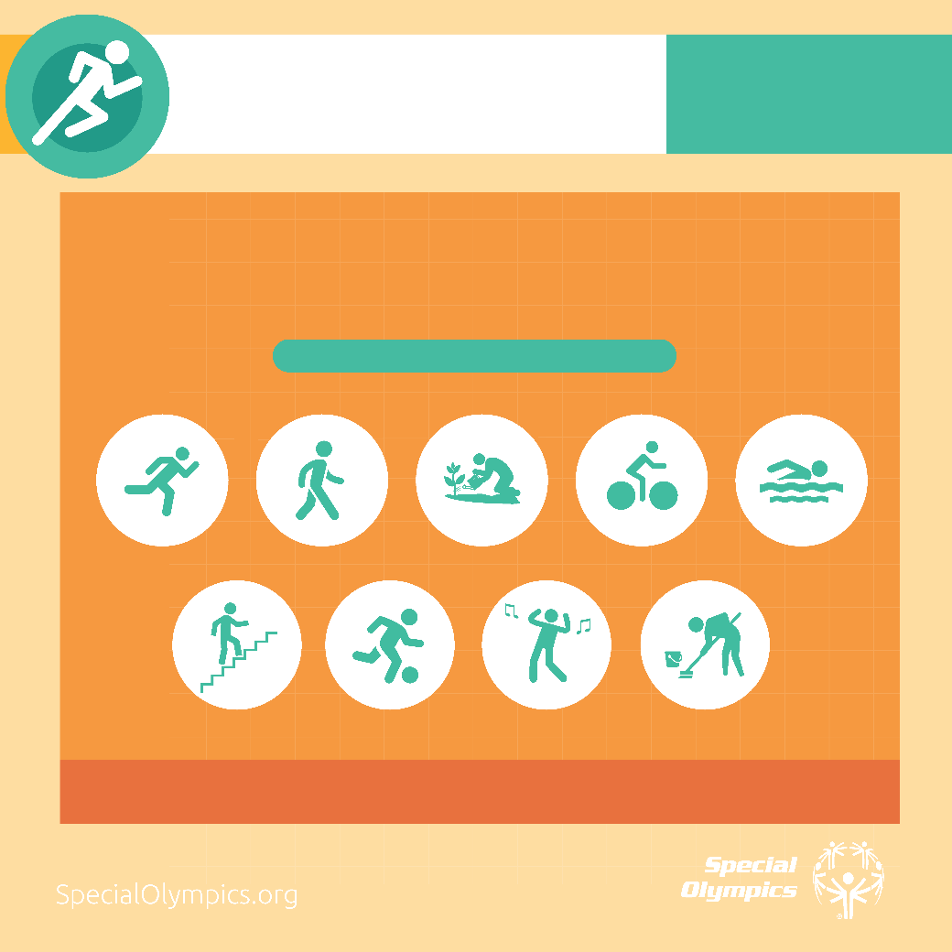
PHYSICAL ACTIVITY
MY GOAL:
Exercise or do physical activity
5 days a week
PHYSICAL ACTIVITY IS ANYTHING YOU DO THAT MAKES
YOU MOVE. IT’S EASY TO FIT PHYSICAL ACTIVITY INTO
YOUR EVERYDAY
What do you like to do to be more active?

Slide 27
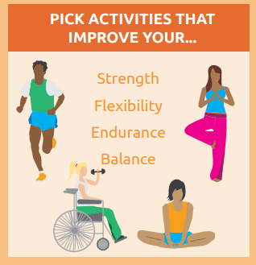
PHYSICAL ACTIVITY
MY GOAL:
Exercise or do physical activity
5 days a week
Become a better athlete by enjoying physical activity outside of your sports practice.
There are many ways to be physically active. Certain kinds of exercise can help you improve the skills needed for your sport.
What kinds of exercises will you do to improve
your athletic skills?

Slide 28
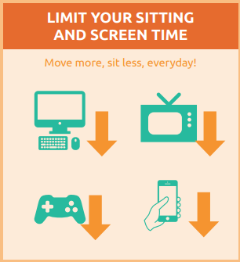

PHYSICAL ACTIVITY
MY GOAL:
Exercise or do physical activity
5 days a week
Screen time is a big hurdle to physical activity. Screen time
keeps us seated for long periods of time instead of being
active. This includes using a computer, tablet or
smartphone, watching TV and playing video games.

Slide 29
More activity and less screen time can help improve
your health and help you become a better athlete.
For 2 days, keep track of how much time you spend watching
TV, using your computer and using your smart phone.
If it's more than 2 hours a day, try to replace some of the time
with physical activity.
Reducing screen time can help you have:
  Better sleep
  A happier mood
  Stronger muscles and bones
  Have more energy
  More time to enjoy activities with family and friends.
What is your most important benefit you want to see when you cut down on
screen-time?

Slide 30
PHYSICAL ACTIVITY
MY GOAL:
Exercise or do physical activity
5 days a week
BEING MORE ACTIVE MAKES US HEALTHIER
Improves sleep
Lowers blood
pressures
Reduces
appetite
Strengthens
bones
Improves mood
Helps manage
weight
Boosts brain
power
Increases
energy

Slide 31
THE TOP HEALTH BENEFITS OF PHYSICAL ACTIVITY FOR ATHLETES
It strengthens your heart and your lungs.
It helps keep your arteries and veins smooth and clear.
It reduces your blood sugar levels, helps you control weight and reduces food cravings.
It strengthens your bones and muscles.
It helps prevent cancer.
It helps lower your blood pressure.
It improves energy levels and helps you feel more energetic.
It can enhance your emotional well-being; help you feel calmer and better able to enjoy the day.
Why do you want to become more active?

Slide 32
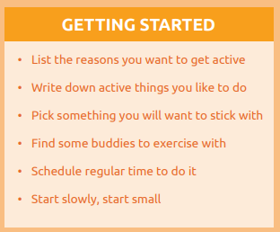
PHYSICAL ACTIVITY
MY GOAL:
Exercise or do physical activity 5 days a week
Who would you like to ask to exercise with?

