Slide 1
FUNfitness 2.0 Training Webinar
Kathleen Rodriguez, PT, DPT
Sr. Clinical Program Manager

Slide 2
Outline
Introduction
Healthy Athletes 2.0
HAS Form
Referral Guidelines
Clinical Director Training
Q&A
Please save questions until the end unless necessary for accessibility or related to a specific clinical aspect of the form that is being reviewed

Slide 3
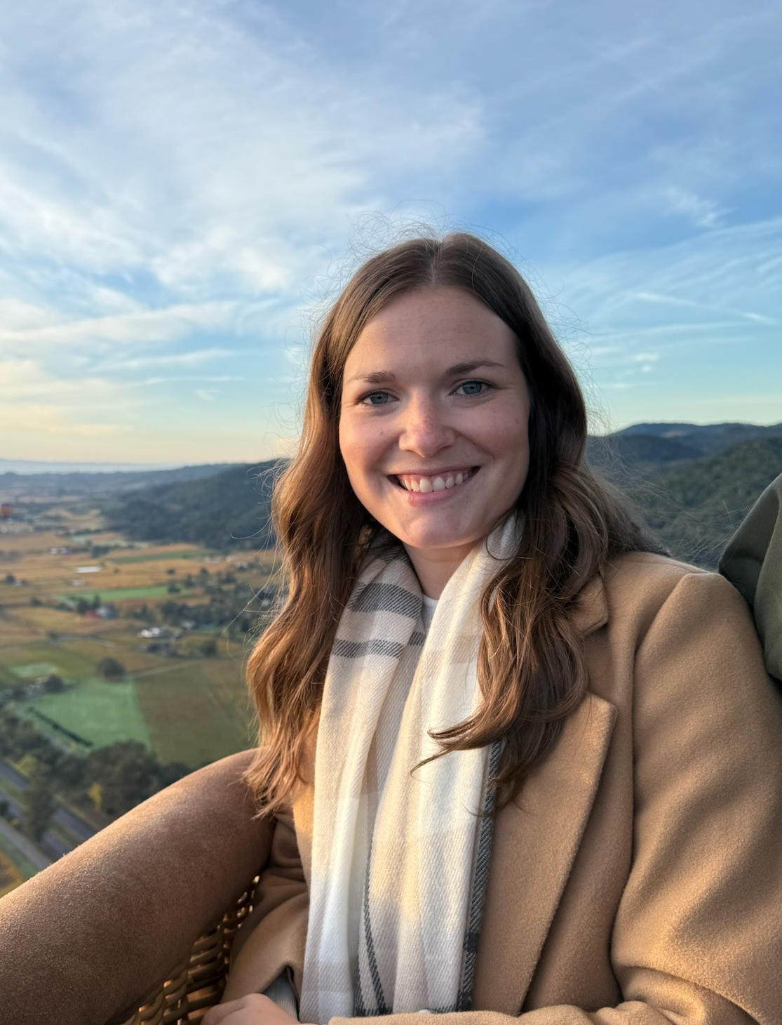
Introduction
Discipline Manager of FUNfitness and Fit Feet
Licensed Physiotherapist
Based just outside of
Louisville, KY, USA
(Eastern Standard Time zone)
Contact:
funfitness@specialolympics.org

Slide 4
Healthy Athletes 2.0

Slide 5
Healthy Athletes 2.0
Reviewed and updated content, HAS forms, and resources
Key FUNfintess 2.0 changes:
Updated tests and measures throughout the 4 main clinical stations
Streamlining of history questions
More robust referral guidelines
Access to HAS forms and resources
Sent directly to Programs hosting early events
Will be added to the resources page within the month
https://resources.specialolympics.org/health/funfitness

Slide 6
Clinical Director Training

Slide 7
Clinical Director Training
FUNfitness 2.0 CD Training Module is live on the LMS
ALL New CDs will be assigned this training automatically.
Current CDs previously trained on 1.0 will need to complete the discipline only 2.0 module before hosting FUNfitness 2.0 at an event
Note: All current CD’s have already been assigned the new modules on the LMS. It may appear that the course has already been completed, but it can be ‘restarted’ at any time.
For any LMS assistance, please contact elearning@specialolympics.org

Slide 8
HAS Form

Slide 9
HAS Form Introduction
General layout of information follows the current station set-up:
Station 1: Check In
Station 2: Flexibility
Station 3: Strength
Station 4: Balance
Station 5: Aerobic Fitness
Station 6: Check Out (includes Data Review & Education)
Registration information recorded during Check In
General form-filling information
Selection Fields
Circle = choose one answer only
Square = select any/all that apply
Consider “if yes/no” sub-questions

Slide 10
Station 1: Check In
Athlete demographic info
Consolidation of pre-station questions
Surveillance questions
Additional current care and access to fitness programming questions to support referral guidance

Slide 11
Station 2: Flexibility
Focus on functional tests and measures vs. goniometric measures
3 main areas tested: posterior chain, ankle, shoulder
Modified V Sit and Reach Test (New)
Weight Bearing Lunge Test (New)
Modified Apley Scratch Test (follow-up guidelines updated)
Addition of a pain question for each test

Slide 12
Station 3: Strength
Major change consolidating upper body and core testing
3 main areas tested: lower body, hand grip, core/upper body stability & control
10 Time Sit to Stand Test
Hand Grip Dynamometry (follow-up guidelines updated)
Isometric Push Up Test (New)
Alternative option: Seated Push-Up Test
Addition of a question to address the removal of the Thomas test from the flexibility station
Addition of a pain question for each test

Slide 13
Station 4: Balance
All the same tests and measures previously used with
Static & Dynamic Testing
Tandem Stance
Single Leg Stance Eyes Open & Eyes Closed
TUG Test
→ Alternative Option: Seated Functional Reach Test
Some updates to testing procedures and follow-up guidelines

Slide 14
Station 5: Aerobic Fitness
Updated HR/O2 monitoring procedures and follow-up guidelines
Pre-, Post-, and 1-minute-post measurement
Addition of physiologic response question
Updated non-ambulatory alternative test option
New alternative non-ambulatory test option =
6-Minute Push Test (wheelchair users only)

Slide 15
Station 6: Check Out
Form completion will take place during “Data Review” and “Education”
Indicate any additional resources provided (e.g., items typically given during education)
If appropriate, record referral recommendations + reasons when appropriate
Fill out the referral section horizontally:
Select provider type → Select urgency → Select/write reason for recommendation
Forms are then collected for Program storage for post-event data entry

Slide 16
Referral Guidelines

Slide 17
Referral Guidelines
Recommendations should be made by clinical volunteers based on the cumulative results of screening and history questions
Guidelines are available to support referral recommendations; however, clinical volunteers are encouraged to use overall clinical judgement

Slide 18
Q & A Email: funfitness@specialolympics.org

