Slide 1
FUNfitness 2.0 Training Webinar
Kathleen Rodriguez, PT, DPT
Sr. Clinical Program Manager

Slide 2
Outline
Introduction
Clinical Director Training
Healthy Athletes 2.0
HAS Form (including referral guidelines)
Q&A
Please save questions until the end unless related to accessibility concerns

Slide 3
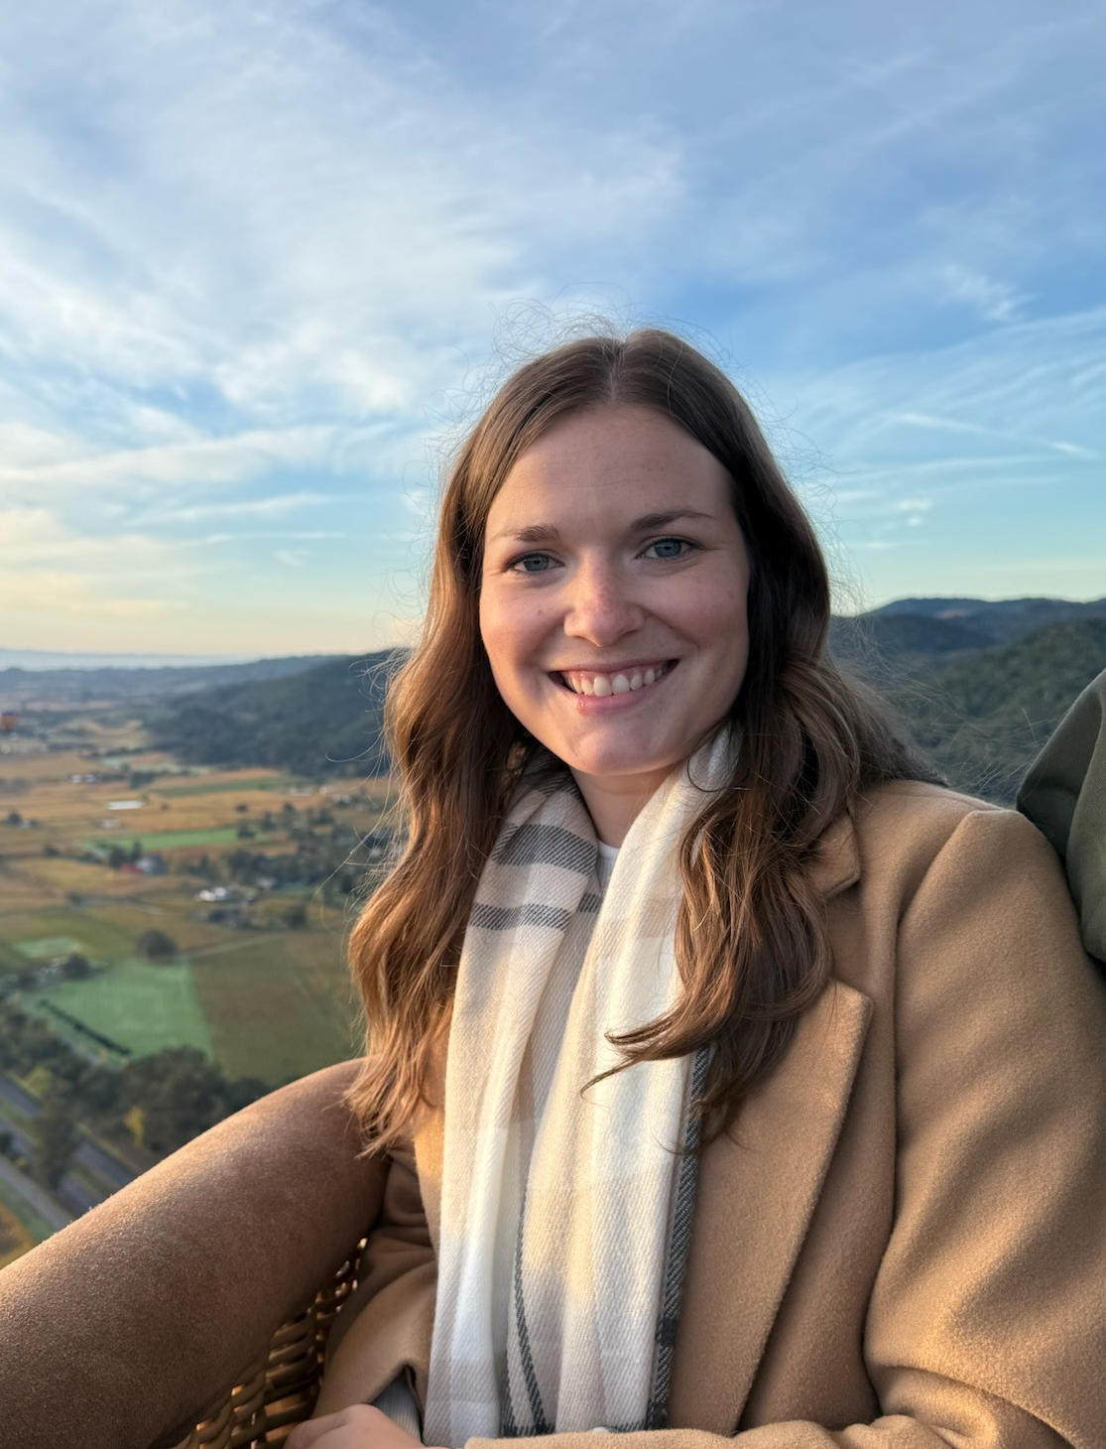
Introduction
Discipline Manager of FUNfitness and Fit Feet
Licensed Physiotherapist
Eastern time zone (US)
Contact:
funfitness@specialolympics.org

Slide 4
Clinical Director Training

Slide 5
Clinical Director Training
FUNfitness 2.0 CD Training Module is live on the LMS
ALL New CDs will be assigned this training automatically.
Current CDs previously trained on 1.0 will need to complete the discipline only 2.0 module before hosting FUNfitness 2.0 at an event
All current CDs have been assigned the new modules on the LMS. It may appear that the course has already been completed.
For any LMS assistance, please contact learning@specialolympics.help

Slide 6
Healthy Athletes 2.0

Slide 7
Healthy Athletes 2.0
Reviewed and updated content, HAS forms, and resources
Access to HAS forms and discipline-specific 2.0 resources available now
Forms: https://resources.specialolympics.org/health/healthy-athletes-system
Resources: https://resources.specialolympics.org/health/funfitness

Slide 8
HAS Form

Slide 9
FUNfitness 2.0 HAS form
Key FUNfintess 2.0 changes:
Updated tests and measures throughout the 4 main clinical stations
Streamlining of history questions
More robust referral guidelines

Slide 10
FUNfitness 2.0 HAS form
General layout of information follows the current station (re-listed below)
Station 1: Check In
Station 2: Flexibility
Station 3: Strength
Station 4: Balance
Station 5: Aerobic Fitness
Station 6: Check Out (includes Data Review & Education)

Slide 11
FUNfitness 2.0 HAS form
General form-filling information
Selection Fields
Circle = choose one answer only
Square = select any/all that apply
Consider “if yes/no” sub-questions
Tips for ensuring accurate post-event digitization​
Confirm all registration information is accurate and completed to the fullest ability
Confirm the form is completed in its entirety​

Slide 12
Accessibility During 2.0 Form Review
If you require closed captioning services during the form review portion of our webinar, please do the following:
Click the "More" button with three dots at the top of your Teams screen
Select "Language and Speech" drop down
Select "Show Live Captions"
To turn off, click the "X" in the caption text box

Slide 13
Station Overview

Slide 14
Station 1: Check In
Athlete demographic info/registration info can be confirmed here
Consolidation of pre-station questions
Surveillance questions
Additional current care and access to fitness programming questions to support referral guidance

Slide 15
Station 2: Flexibility
Focus on functional tests and measures vs. goniometric measures
3 main areas tested: posterior chain, ankle, shoulder
Modified V Sit and Reach Test (New)
Weight Bearing Lunge Test (New)
Modified Apley Scratch Test
Addition of a pain question for each test
Some follow-up guidelines have changed

Slide 16
Station 3: Strength
3 main areas tested: lower body, hand grip, core/upper body stability & control
10 Time Sit to Stand Test
Hand Grip Dynamometry (follow-up guidelines updated)
Isometric Push Up Test (New)
Alternative option: Seated Push-Up Test
Addition of a question to address the removal of the Thomas test from the flexibility station
Addition of a pain question for each test

Slide 17
Station 4: Balance
All the same tests and measures previously used
Static & Dynamic Testing
Tandem Stance
Single Leg Stance Eyes Open & Eyes Closed
TUG Test
→ Alternative Option: Seated Functional Reach Test
Some updates to testing procedures and follow-up guidelines

Slide 18
Station 5: Aerobic Fitness
Updated HR/O2 monitoring procedures and follow-up guidelines
Pre-, Post-, and 1-minute-post measurement
Addition of physiologic response question
Updated non-ambulatory alternative test option to the 6-Minute Push Test
Note: this alternative is still only for wheelchair users.

Slide 19
Station 6: Check Out
Form completion will take place during “Data Review” and “Education”
Indicate any additional resources provided (e.g., items typically given during education)
If appropriate, record referral recommendations + reasons when appropriate
Fill out the referral section horizontally:
Select provider type → Select urgency → Select/write reason for recommendation
Forms are then collected for Program storage for post-event data entry

Slide 20
Referral Guidelines

Slide 21
Referral Guidelines
Recommendations should be made by clinical volunteers based on the cumulative results of screening and history questions
Guidelines are available to support referral recommendations; however, clinical volunteers are encouraged to use overall clinical judgement

