Slide 1
Virtual Fit Feet

Slide 2
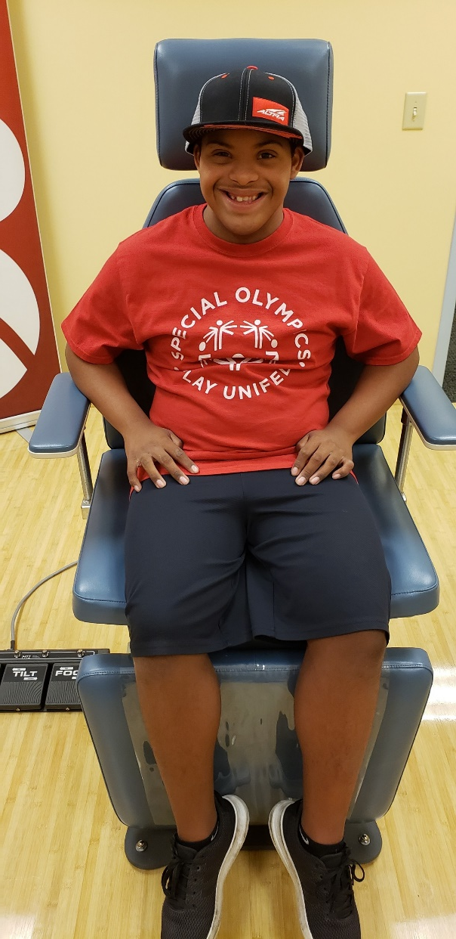
WELCOME!
Thank you for participating in our virtual Fit Feet event
Since we cannot check your feet in person, we want to check in with you online!
If you have been to Fit Feet before, most of this will be familiar
Any questions? Ready?… Let’s begin…..
Notes:
This slide is op for intro and why we doing this—like to ask if done Fit Feet before?—my blurb (and you can do this how you see fit) is hi (name of Athlete) I am Dr J from Fit Feet!----thanks so much for joining us today—we appreciate it- What we are doing is checking on Athletes to see if doing OK health wise---in this case, your feet, and also shoes and socks. Have you been through Fit Feet before?—if not explain what it is. Anyway, we cannot see you in person right now so we are doing this checkup online. Any questions before we start?

Slide 3
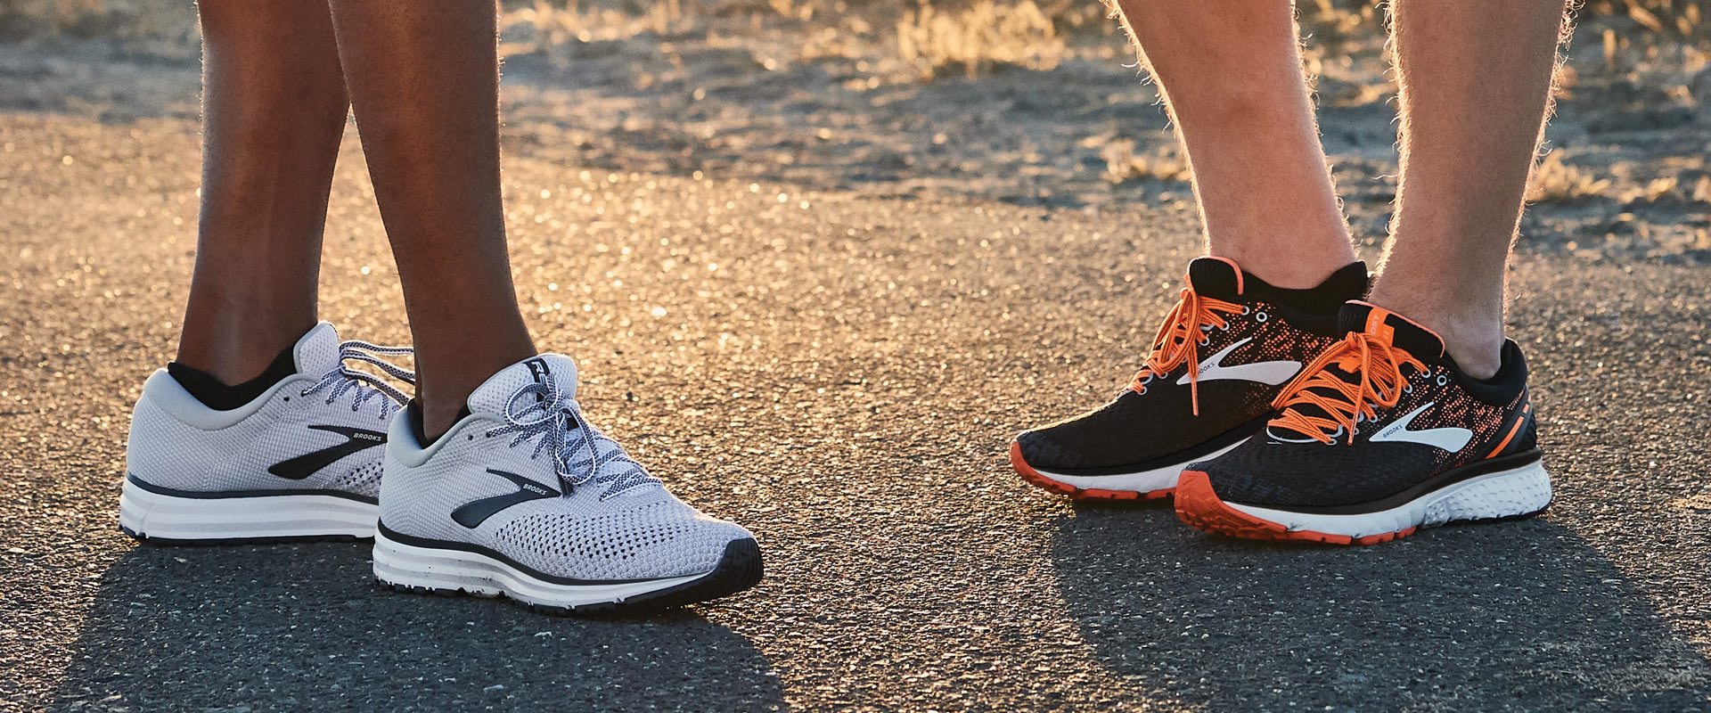
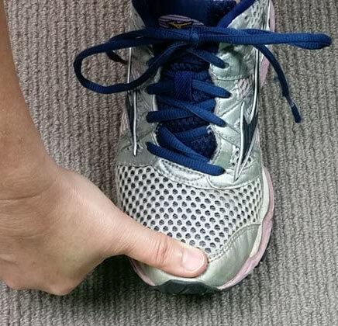
QUESTION 1: Do your shoes fit OK?
Yes
No
Don’t Know
Notes:
We are not going to be measuring feet with a Brannock device for self-evident reasons and some available foot measuring apps are time consuming and hard to use but if the CD wants to ask the Athlete to do a thumb test to check length, this may suffice to check for gross mismatch. The Athletes’ PPT to view has good picture of the Thumb test. It is also felt that obtaining the shoe size without measuring foot size is moot and not worth the time.
Given the difficulty of measuring either thumb test or paper Brannock, if Athlete says NO or Do not know then consider the measurement, same if shoes not comfortable as per Q4

Slide 4
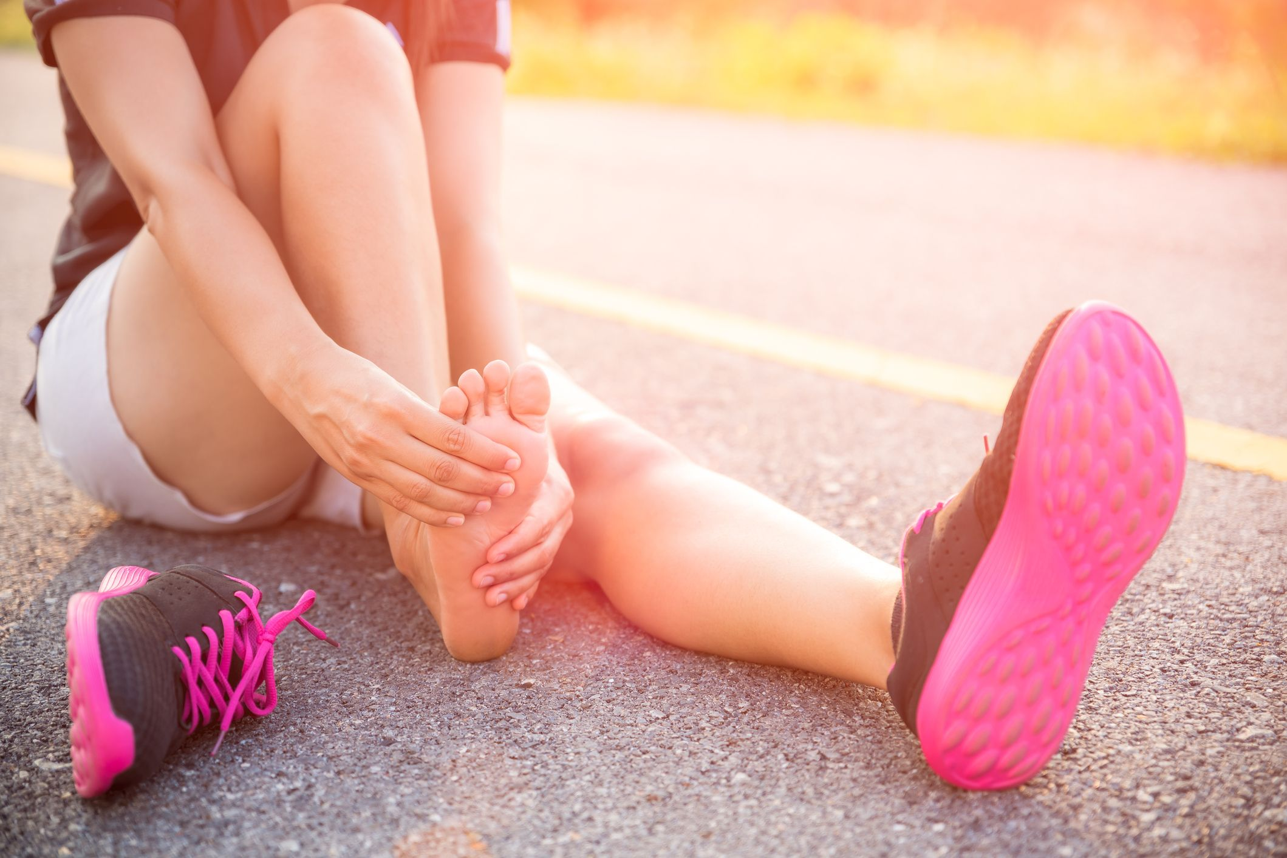
QUESTION 2: Are your shoes comfortable?
Yes
No
Don’t Know
Notes:
See Q5

Slide 5
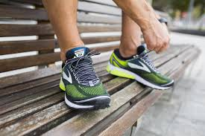
QUESTION 3: Are your shoes in good shape or worn out?
Good shape
Worn out
Don’t Know
Notes:
If Athlete says maybe or yes or don’t know this could be a quick look at the shoe for confirmation of poor condition.

Slide 6
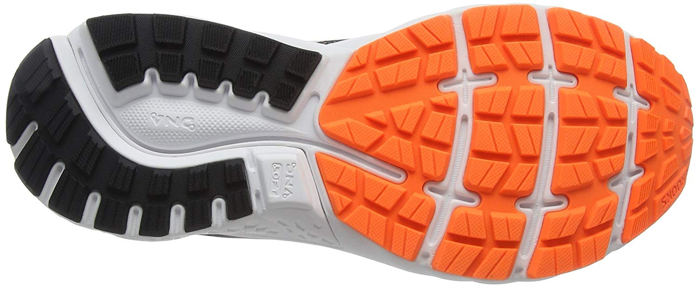
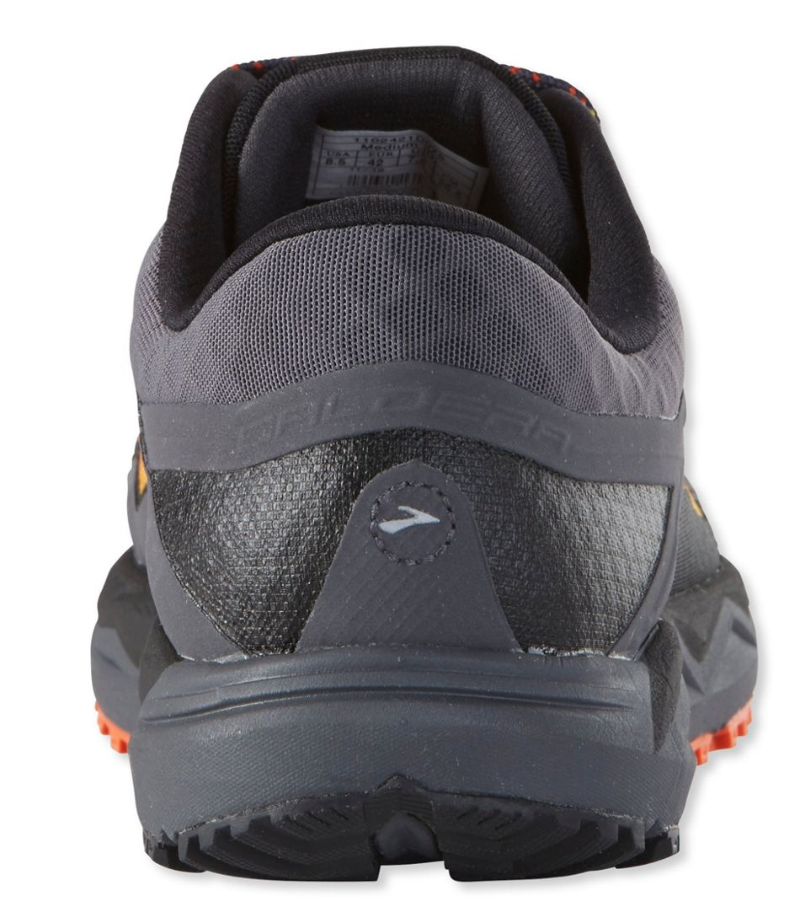
SHOES IN GOOD CONDITION
Notes:
Slides 10-13 can be shown to athlete for clarification

Slide 7
SHOES IN BAD SHAPE

Slide 8
SHOES IN BAD SHAPE

Slide 9
SHOES IN BAD SHAPE

Slide 10
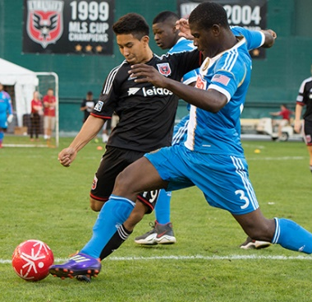
QUESTION 4: Are your shoes made for the sport you do? e.g. soccer cleats for soccer
Yes
No
Don’t Know
Notes:
this has not been part of Fit Feet previously but is an important addition—if they have shoes can maybe look and even have the athlete bend or twist the shoes

Slide 11
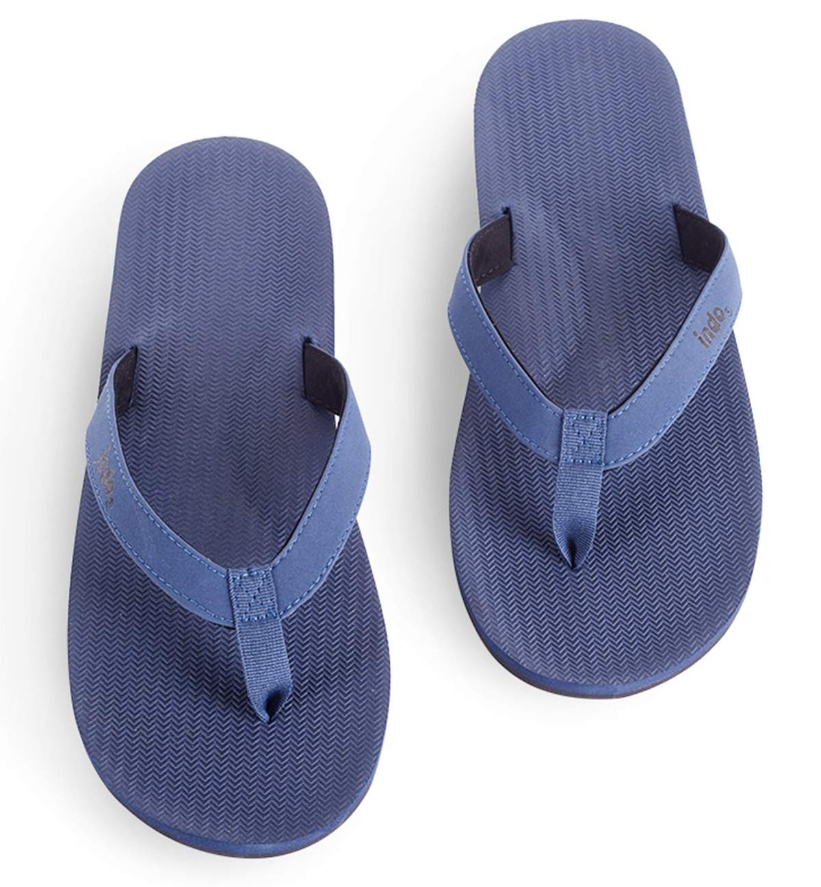
WRONG SHOES FOR SPORT
I Play Soccer!
Notes:
Can show to clarify wrong shoe for sport

Slide 12
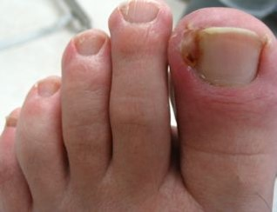
QUESTION 5: Do your nails hurt or do you have any problems with them?
Yes
No
Don’t Know
Notes:
Def try and take look see if reported probs

Slide 13
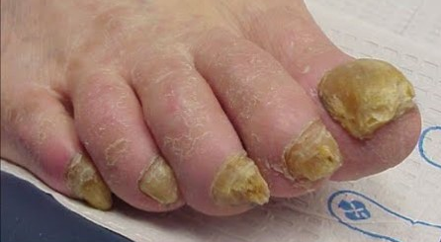
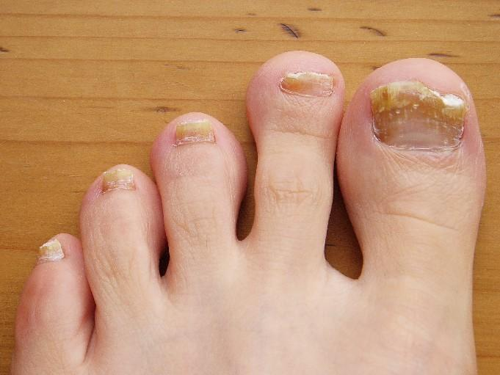
QUESTION 6: Do your nails look weird- yellow, black, thick, crumbly, coming off, etc. ?
Yes
No
Don’t Know
Notes:
Def try and take look see if reported probs

Slide 14
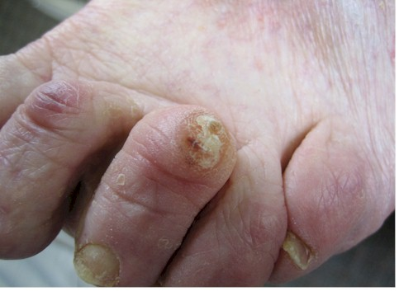
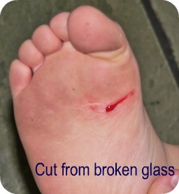
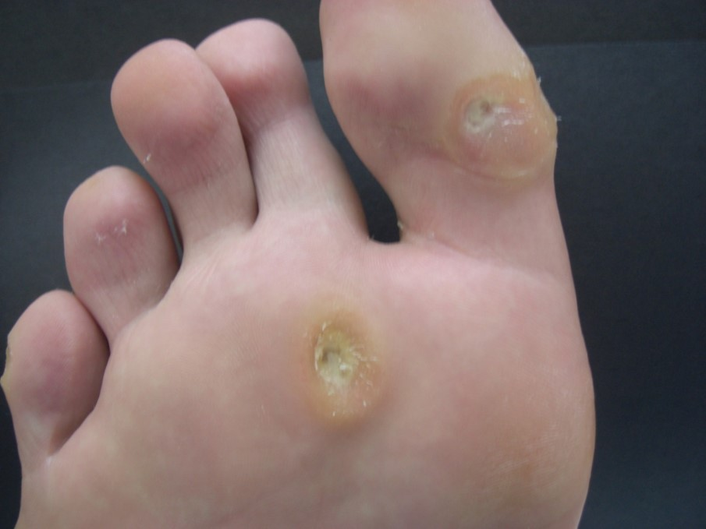
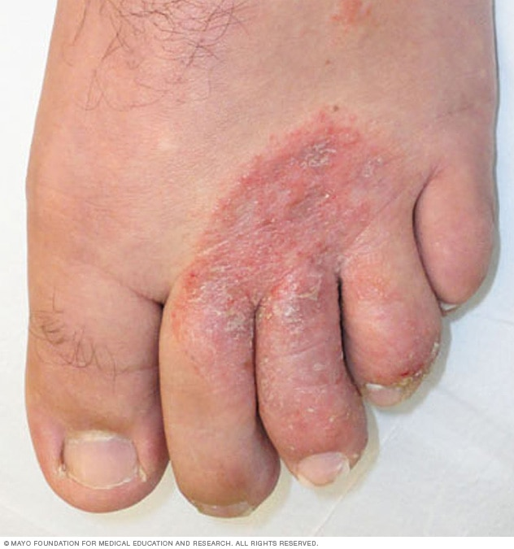
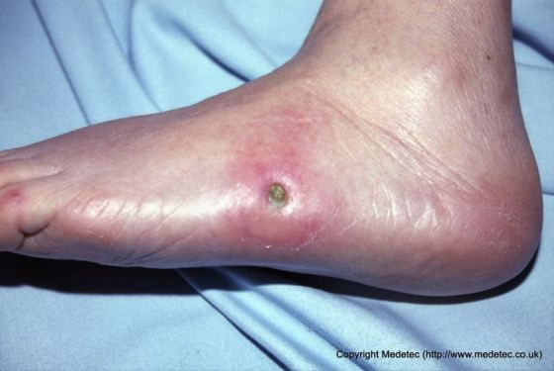
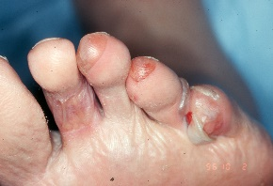
QUESTION 7: Do you have any skin problems like blisters, corns, calluses, sores, cuts, rashes etc. ?
Yes
No
Don’t Know
Notes:
Def try and take look see if reported probs this slide and 23 can be used to clarify

Slide 15
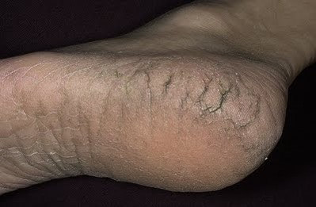
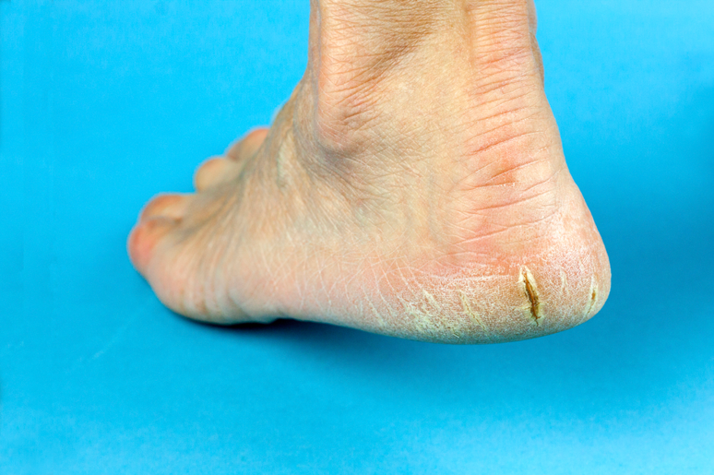
QUESTION 8: Are your feet real dry?
Yes
No
C. Don’t Know

Slide 16
QUESTION 9: Are your feet real sweaty or wet?
Yes
No
Don’t Know

Slide 17
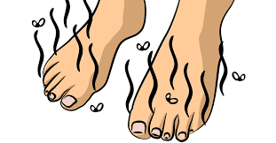
QUESTION 10: Are your feet real smelly?
Yes
No
Don’t Know

Slide 18
QUESTION 11: Any redness, scaling or itching between the toes?
Yes
No
Don’t Know

Slide 19
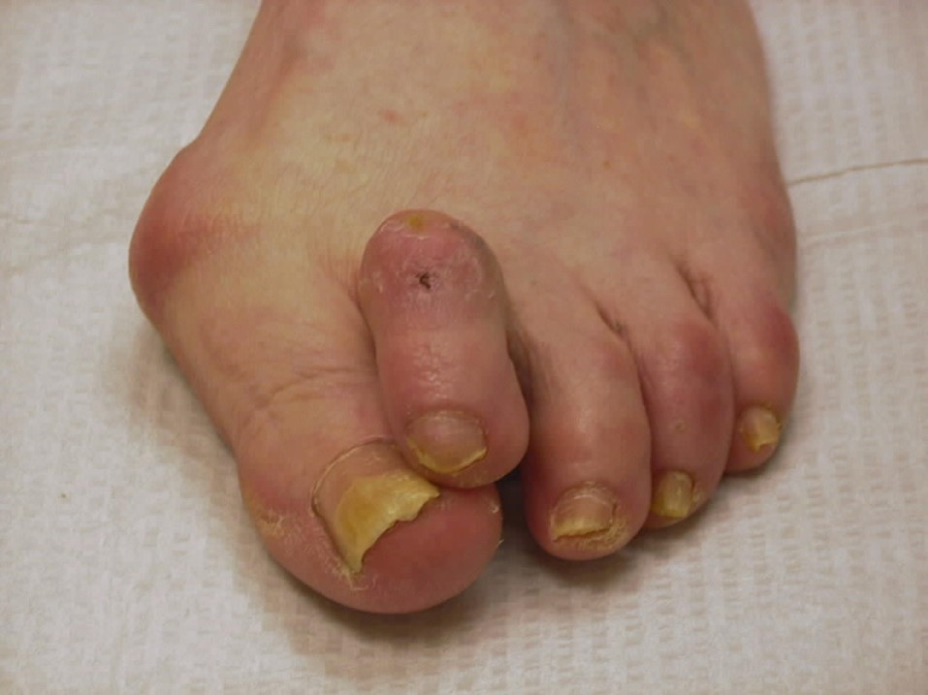
QUESTION 12: Do you have any sore bumps on your feet or toes?
Yes
No
Don’t Know

Slide 20
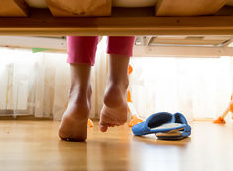
QUESTION 13: Do you feel any heel pain when you 1st get up or during activity?
Yes
No
Don’t Know

Slide 21
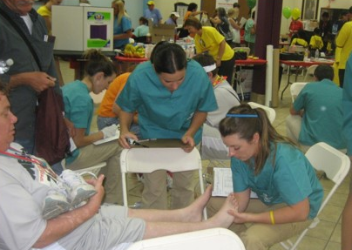
QUESTION 14: Do any of your joints hurt to move or feel stiff?
Yes
No
Don’t Know

Slide 22
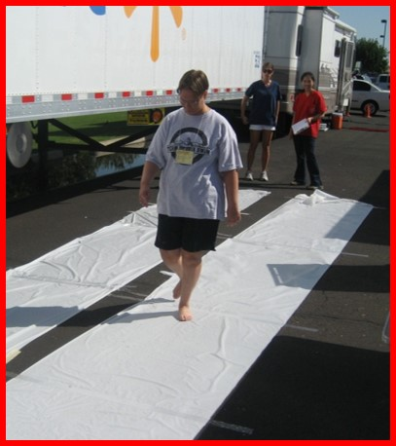
QUESTION 15: Do you limp?
YES
NO
Don’t Know

Slide 23
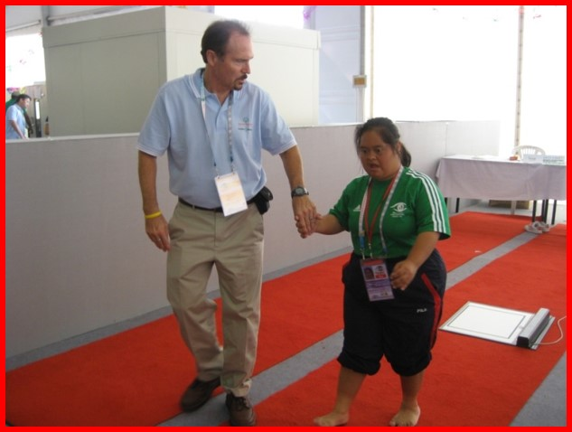
QUESTION 16: Is it painful to walk?
Yes
No
Don’t Know
Notes:
If tech feasible, can have athlete stand and check for structural deformities and simple gait changes

Slide 24
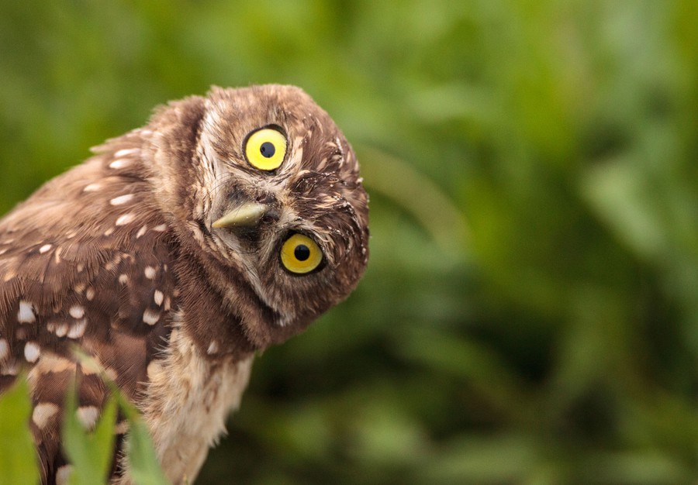
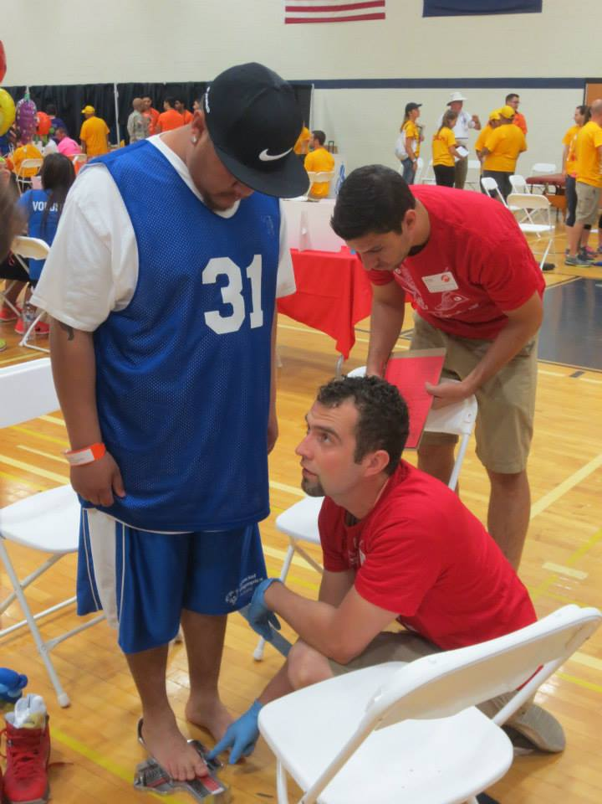
May we take a look?
If there are any issues the foot doctor would like to look at, please remove shoes and socks and stand up.

Slide 25
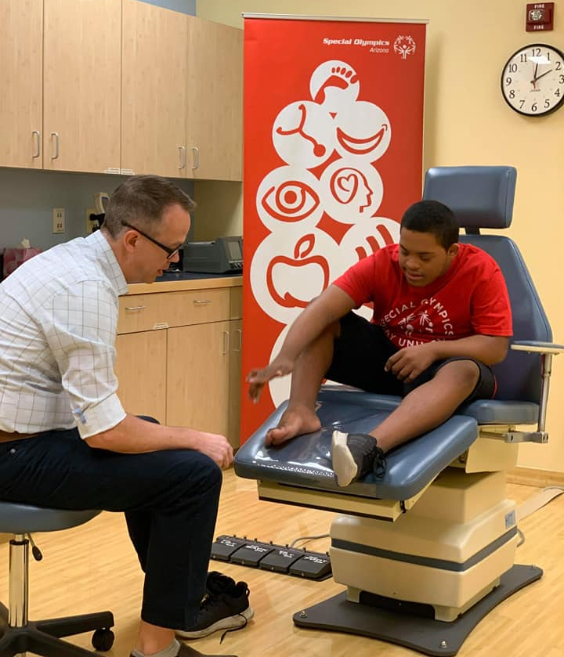
QUESTION 17: Do you have a local foot doctor?
Yes
No
Don’t Know
Notes:
If tech feasible, can have athlete stand and check for structural deformities and simple gait changes

Slide 26
WHAT NOW?
If you do not have a foot problem that needs attention, we will send you a report card that says, “YOU HAVE FIT FEET!” and we hope to see you at the next Fit Feet event. We may also send you a list of Foot Doctors that can help you if you develop a foot problem.
If you do have a foot problem that needs attention, we will note what this is on a report card we will send this to you along with a list of Foot Doctors that can help you. PLEASE make every effort to follow-up so your foot problem can be taken care of. We will be checking in with you to see how things are going.

Slide 27
THANK YOU SO MUCH!

