Slide 1
Fit Feet 2.0 Training Webinar
Kathleen Rodriguez, PT, DPT
Sr. Clinical Program Manager

Slide 2
Outline
Introduction
Healthy Athletes 2.0
HAS Form
Referral Guidelines
Clinical Director Training
Q&A
          Please save questions until the end unless necessary for accessibility or related to a specific clinical aspect of the form that is being reviewed

Slide 3
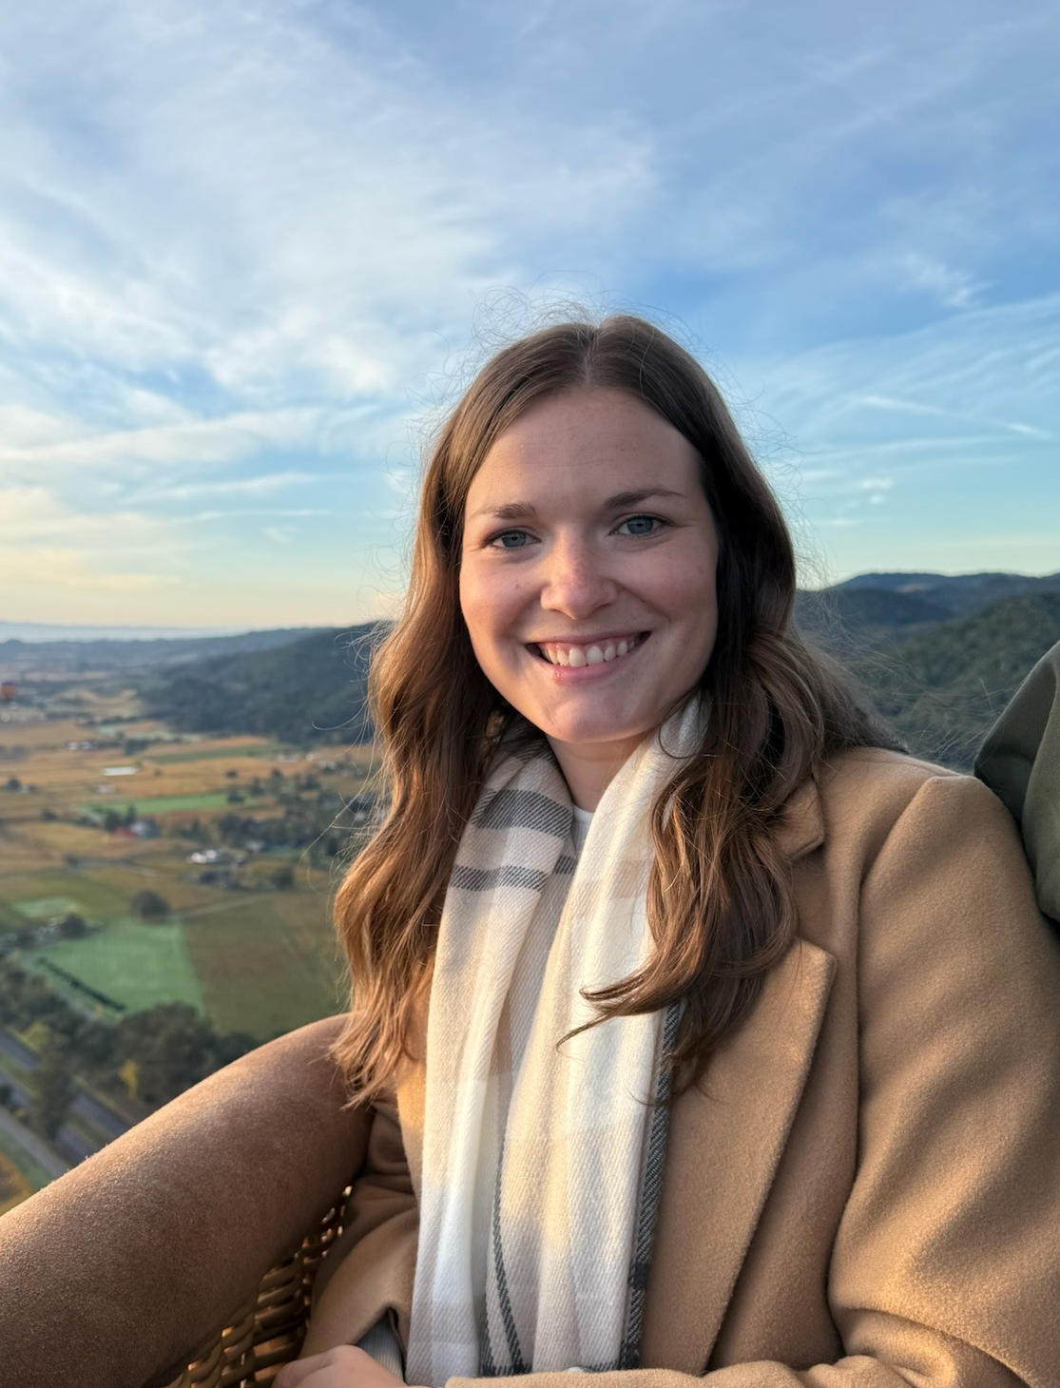
Introduction
Discipline Manager of FUNfitness and Fit Feet
Licensed Physiotherapist
Based just outside of
      Louisville, KY, USA
    (Eastern Standard Time zone)
Contact:
        fitfeet@specialolympics.org

Slide 4
Healthy Athletes 2.0

Slide 5
Healthy Athletes 2.0
Reviewed and updated content, HAS forms, and resources
Key Fit Feet 2.0 changes:
          Globally universal shoe size procedure changes
          Streamlining of history questions and station organization (including naming)
          Addition of a diabetic foot screen within the foot assessment
          More robust referral guidelines
Access to HAS forms and resources
          Sent directly to Programs hosting early events
          Will be added to the resources page within the month
          https://resources.specialolympics.org/health/fit-feet

Slide 6
Clinical Director Training

Slide 7
Clinical Director Training
Fit Feet 2.0 CD Training Module is live on the LMS
ALL New CDs will be assigned this training automatically.
Current CDs previously trained on 1.0 will need to complete the discipline only 2.0 module before hosting Fit Feet 2.0 at an event
          All current CD’s have already been assigned the new modules on the LMS. It may appear that the course has already been completed, but it can be ‘restarted’ at any time.
          For any LMS assistance, please contact elearning@specialolympics.org

Slide 8
HAS Form

Slide 9
HAS Form Introduction
General layout of information follows the current station set-up with slight naming changes:
          Station 1: Check In
          Station 2: Shoe/Sock Exam & Measurement
          Station 3: Foot Assessment
          Station 4: Biomechanics
          Station 5: Check Out (includes Data Review & Education)
Registration information recorded during Check In
General form-filling information
          Selection Fields
              Circle = choose one answer only
              Square = select any/all that apply
          Consider “if yes/no” sub-questions

Slide 10
Station Review

Slide 11
Station 1: Check In
Athlete demographic info
Updated history questions, including the addition of Surveillance questions
Additional current care question to support referral guidance

Slide 12
Station 2: Shoe/Sock Measurement & Exam
Updated measurement procedure to use tape measures vs Brannock devices
Standard measurement in centimeters
Conversion tables to convert to proper size
Added questions about proper fit to support data capture and post-event reporting

Slide 13
Station 3: Foot Assessment
Renamed but same general format/set up as “Skin, Nail, Toe, and Foot Exam”
Addition of pain questions during examinations and a Diabetic Foot Screen
Exam recording split into categories:
          Dermatological (skin and nail findings)
          Structural (bony changes)
          Diabetic Foot Screen Form
              History Q’s, Pulses, Palpation, Protective sensation

Slide 14
Station 4: Biomechanics
Condensed naming for efficiency
Measurement requirements consolidated to increase efficiency and reduce redundancy
Addition of pain questions during examinations
Exam recording split into categories:
          Static Exam
              Non-weight bearing (ROM)
              Weight Bearing (heel and arch positioning)
          Dynamic Exam
              Gait Analysis

Slide 15
Station 6: Check Out
Form completion will take place during “Data Review & Education”
Indicate any additional resources provided & referral recommendations
          Fill out the referral section horizontally:
              Select provider type → Select urgency → Select/write reason for recommendation
Forms are then collected for Program storage for post-event data entry

Slide 16
Referral Guidelines

Slide 17
Referral Guidelines
Recommendations should be made by clinical volunteers based on the cumulative results of screening and history questions
Guidelines are available to support referral recommendations; however, clinical volunteers are encouraged to use overall clinical judgement

Slide 18
Q & A
Email: fitfeet@specialolympics.org

