Slide 1
Fit Feet 2.0 Training Webinar
Kathleen Rodriguez, PT, DPT
Sr. Clinical Program Manager

Slide 2
Outline
Introduction
Clinical Director Training
Healthy Athletes 2.0
HAS Form (including referral guidelines)
Q&A
Please save questions until the end unless related to accessibility concerns

Slide 3
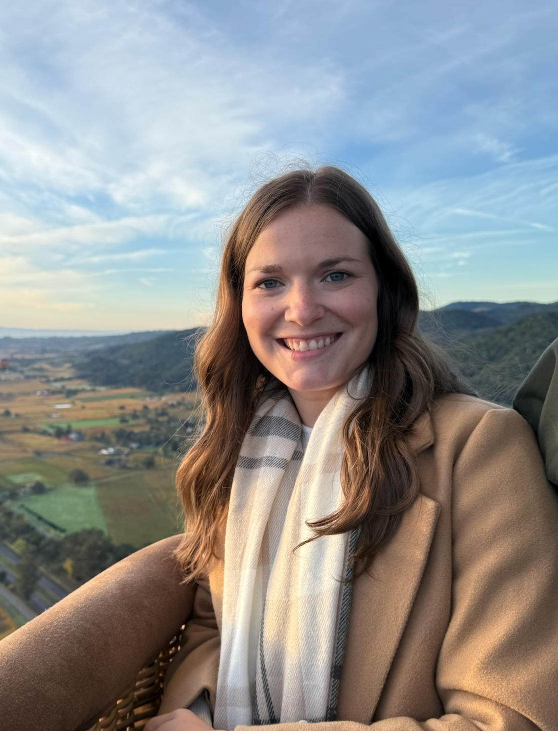
Introduction
Discipline Manager of FUNfitness and Fit Feet
Licensed Physiotherapist
Eastern time zone (US)
Contact:
fitfeet@specialolympics.org

Slide 4
Clinical Director Training

Slide 5
Clinical Director Training
Fit Feet 2.0 CD Training Module is live on the LMS
ALL New CDs will be assigned this training automatically.
Current CDs previously trained on 1.0 will need to complete the discipline only 2.0 module before hosting Fit Feet 2.0 at an event
All current CDs have been assigned the new modules on the LMS. It may appear that the course has already been completed.
For any LMS assistance, please contact learning@specialolympics.help

Slide 6
Healthy Athletes 2.0

Slide 7
Healthy Athletes 2.0
Reviewed and updated content, HAS forms, and resources
Access to HAS forms and discipline-specific resources available now
Forms: https://resources.specialolympics.org/health/healthy-athletes-system
Additional Resources: https://resources.specialolympics.org/health/fit-feet

Slide 8
HAS Form

Slide 9
Fit Feet 2.0 HAS Form
Key Fit Feet 2.0 changes:
Globally universal shoe size procedure changes
Streamlining of history questions and station organization (including naming)
Addition of a diabetic foot screen within the foot assessment
More robust referral guidelines

Slide 10
Fit Feet 2.0 HAS Form
General layout of information follows the current station set-up with slight naming changes
Stations names & order:
Station 1: Check In
Station 2: Shoe/Sock Exam & Measurement
Station 3: Foot Assessment
Station 4: Biomechanics
Station 5: Check Out
includes Data Review & Education

Slide 11
Fit Feet 2.0 HAS Form
General form-filling information
Selection Fields
Circle = choose one answer only
Square = select any/all that apply
Consider “if yes/no” sub-questions
Tips for ensuring accurate post-event digitization​
Confirm all registration information is accurate and completed to the fullest ability
Confirm the form is completed in its entirety​

Slide 12
Accessibility During 2.0 Form Review
If you require closed captioning services during the form review portion of our webinar, please do the following:
Click the "More" button with three dots at the top of your Teams screen
Select "Language and Speech" drop down
Select "Show Live Captions"
To turn off, click the "X" in the caption text box

Slide 13
Station Overview

Slide 14
Station 1: Check In
Athlete demographic info/registration info can be confirmed here
Updated history questions, including the addition of Surveillance questions
Additional current care question to support referral guidance

Slide 15
Station 2: Shoe/Sock Measurement & Exam
Updated measurement procedure to use tape measures vs Brannock devices
Standard measurement in centimeters
Conversion tables to convert to proper size
Added questions about proper fit to support data capture and post-event reporting

Slide 16
Station 3: Foot Assessment
Renamed but same general format/set up as “Skin, Nail, Toe, and Foot Exam”
Addition of pain questions during examinations and a Diabetic Foot Screen
Exam recording split into categories:
Dermatological (skin and nail findings)
Structural (bony changes)
Diabetic Foot Screen Form
Includes: History Q’s, Pulses, Palpation, Protective sensation

Slide 17
Station 4: Biomechanics
Condensed naming for efficiency
Measurement requirements consolidated to increase efficiency and reduce redundancy
Addition of pain questions during examinations
Exam recording split into categories:
Static Exam
Non-weight bearing (ROM)
Weight Bearing (heel and arch positioning)
Dynamic Exam
Gait Analysis

Slide 18
Station 6: Check Out
Form completion will take place during “Data Review & Education”
Indicate any additional resources provided & referral recommendations
Fill out the referral section horizontally:
Select provider type → Select urgency → Select/write reason for recommendation
Forms are then collected for Program storage for post-event data entry

Slide 19
Referral Guidelines

Slide 20
Referral Guidelines
Recommendations should be made by clinical volunteers based on the cumulative results of screening and history questions
Guidelines are available to support referral recommendations; however, clinical volunteers are encouraged to use overall clinical judgement

