Slide 1
Special Olympics:
Return to Activity
Implementation
June 2020
Notes:
This course is designed to cover the basic information about the coronavirus (COVID-19) including: what is the coronavirus, what are the symptoms, how does it spread, and how you can protect yourself.

Slide 2
Introduction

Slide 3
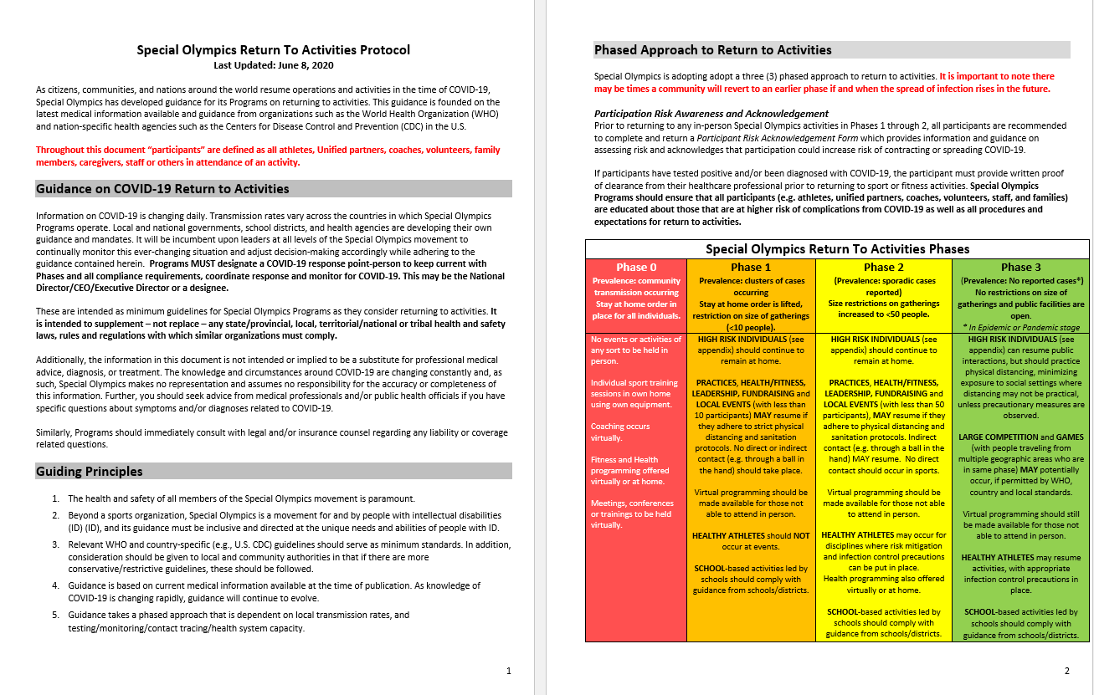
Introduction
Special Olympics Return to Activities Protocol (Click Here)
Notes:
As citizens, communities, and nations around the world resume operations and activities in the time of COVID-19, Special Olympics has developed guidance for its Programs on returning to activities. Please review this guidance before continuing with this course.
These are intended as minimum guidelines for Special Olympics Programs as they consider returning to activities. It is intended to supplement – not replace – any state/provincial, local, territorial/national or tribal health and safety laws, rules and regulations with which similar organizations must comply.

Slide 4
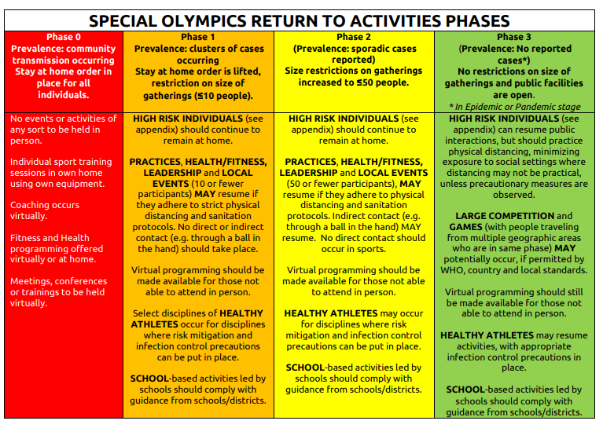
Notes:
Special Olympics is adopting adopt a three (3) phased approach to return to activities. It is important to note there may be times a community will revert to an earlier phase if and when the spread of infection rises in the future.

Slide 5
PHASE 0 – All Individuals Stay at Home
Share resources digitally and activate participants virtually (or via mailings).
Virtual participants with COVID-19 symptoms should refrain from participating in activities and consult with a healthcare professional for further evaluation.
Know how to communicate potential cases to the local health authorities for testing and to SOI.
Notes:
Let’s take some time to go over some of the details of each of the phases. During this phase activity should include:
PHASE 0 – All Individuals Stay at Home
Share resources digitally and activate participants virtually (or via mailings).
Virtual participants with COVID-19 symptoms should refrain from participating in activities and consult with a healthcare professional for further evaluation.
Know how to communicate potential cases to the local health authorities for testing and to SOI.

Slide 6
PHASE 1: Local gatherings restricted to <10 people, individuals at high risk should remain safe at home
Screening
Continue to offer virtual or at home training opportunities
Distancing guidelines
Groups should stay together and not change.
Standard infection prevention measures
No spectators
List of participants
Notes:
Phase 1: Local gatherings restricted to <10 people, individuals at high risk should remain safe at home
The activities for this stage should include:
On arrival, conduct screening for ALL PARTICIPANTS
Continue to virtual or at home training opportunities for participants unable to participate in person
Activities must comply with distancing guidelines at all times.
Groups should stay together and not change.
Program staff must provide reminders to participants on standard infection prevention measures (e.g. frequent handwashing, avoid touching face, cover mouth when sneezing/coughing, etc.) at the start and throughout event.
No spectators should be allowed to congregate on the sidelines of activities
Maintain a list of all participants with contact details.

Slide 7
PHASE 2: Local gatherings restricted to <50 people, individuals at high risk should remain safe at home
Screening
Distancing guidelines
Groups should stay together and not change.
Standard infection prevention measures
No spectators
Disinfect shared equipment
List of participants
Notes:
Phase 2: Local gatherings restricted to <50 people, individuals at high risk should remain safe at home
The activities for this stage should include:
On arrival, conduct screening for ALL PARTICIPANTS
Activities must comply with distancing guidelines at all times.
Groups should stay together and not change.
Program staff must provide reminders to participants on standard infection prevention measures (e.g. frequent handwashing, avoid touching face, cover mouth when sneezing/coughing, etc.) at the start and throughout event.
No spectators should be allowed to congregate on the sidelines of activities
Participants may share equipment when necessary. If shared equipment must be used, prepare a cleaning protocol and supplies to disinfect shared equipment between uses.
Maintain a list of all participants with contact details.

Slide 8
PHASE 3: No restrictions on size of gatherings and public facilities are open
Activity continues as normal
No onsite screening required
Proper hygiene practices are encouraged
Notes:
Phase 3: No restrictions on size of gatherings and public facilities are open
The activities for this stage should include:
Activity continues as normal, no onsite screening required
Proper hygiene practices are encouraged

Slide 9
Preparing the Venue

Slide 10
Preparing the Venue
Ensure that the venue is disinfected or sanitized
Post signage about PPE, hygiene, and physical distancing
Have hand sanitizer or handwashing facilities
Set-up single entry, with screening, and single exit areas
Notes:
Make sure that you arrive early to the venue to prepare the space. You will want to start by ensuring the venue is disinfected or sanitized, especially the bathrooms. Then you will want to put up signage that reinforces proper hygiene procedures, physical distancing, and wearing Personal Protective Equipment (or PPE). Additionally, you will want to make sure hand sanitizer and/or handwashing facilities are available. Lastly, you will want to Set-up single entry with screening and single exit areas.

Slide 11
Travel to Activity
Notes:
Remind participants that during transport to activities, it is recommended that participants should wear a mask if on public transport, such as a bus, trolley, subway or if carpooling which includes someone not living with them.
If Special Olympics is providing transportation, participants must wear facemasks during travel.

Slide 12
Traveling to the venue
Facemasks should be worn when a participant is:
Taking public transportation
Using Special Olympics provided transportation
Carpooling with someone not living with them
Notes:
Remind participants that during transport to activities, it is recommended that participants should wear a mask if on public transport, such as a bus, trolley, subway or if carpooling which includes someone not living with them.
If Special Olympics is providing transportation, participants must wear facemasks during travel.

Slide 13
Onsite Screening

Slide 14
Onsite Screening (required for Phases 1 & 2)
Step 1: Prepare your screening area
Create a single point of entry
Maintains physical distance (6ft/2m) during screening
Ensure you have the proper supplies
Notes:
Prior to entering an activity, practice, event, or gathering (in phases 1-2), for all participants.
It is important to take the necessary steps to create a safe onsite screening area. You will want to
-Create a single point of entry. One door or area of the space that allows participants to enter one at a time
-While maintain physical distancing of 6ft/2m during the entire process. It might be necessary for you to use tape, cones, or other markers to indicate what 6 feet or 2m looks like so participants know where to stand.
-You will want to make sure you have all of the necessary supplies for a proper screening including:
-thermometer (preferred non-touch thermal scanning thermometer if possible)
-gloves
-masks
-hand sanitizer
-disinfectant wipes
-pens
-Code of conduct forms for participants to sign

Slide 15
Onsite Screening (required for Phases 1 & 2)
Step 2: Screening Questions
In the last 14 days, have you had contact with someone who has been sick with COVID-19?
Have you had a fever in the last week?
Do you have a cough and/or difficulty breathing?
Do you have any other signs or symptoms of COVID-19?
Notes:
Once your participants start to arrive, you will start by asking them the required screening questions. It is suggested that you also use visuals for the questions as well.
The screening questions are:
In the last 14 days, have you had contact with someone who has been sick with COVID-19?
Have you had a fever in the last week (temperature of 100.4°F/37.8°C or higher)?
Do you have a cough and/or difficulty breathing?
Do you have any other signs or symptoms of COVID-19 (fatigue, muscle or body aches, headache, new loss of taste or smell, sore throat, congestion or runny nose, nausea or vomiting, diarrhea)?

Slide 16
Onsite Screening (required for Phases 1 & 2)
Step 3: Temperature Measurement
non-touch thermal scanning thermometer
Notes:
You then should conduct onsite measurement of temperature using thermometer (preferred non-touch thermal scanning thermometer if possible).
A Fever equals temperature of 100.4°F/37.8°C or higher.
If high, may re-test after 5 minutes to ensure temperature is accurate.

Slide 17
Onsite Screening (required for Phases 1 & 2)
Step 4: Record
If yes to any questions, participants MUST be isolated from the group, be sent home, and instructed to contact their healthcare provider
Participants who are found to have COVID-19 symptoms must wait 7 days after symptoms resolve to return to activity OR must provide written proof of physician clearance to Special Olympics to return earlier.
Participants who test positive for/have COVID-19 must provide written medical clearance before returning to sport and fitness activities.
Notes:
Record all names, results and contact information using the template provided and keep in case needed for contact tracing or reporting
If yes to any questions, participants MUST be isolated from the group, be sent home, and instructed to contact their healthcare provider
Participants who are found to have COVID-19 symptoms must wait 7 days after symptoms resolve to return to activity OR must provide written proof of physician clearance to Special Olympics to return earlier.
Participants who test positive for/have COVID-19 must provide written medical clearance before returning to sport and fitness activities.

Slide 18
Coaching Adjustments

Slide 19
Coaching Adjustments
Maintain physical distancing
Ensure no shared supplies
Wiping down all shared equipment frequently
Provide constant reminders about hygiene, standard infection prevention, physical distancing, and PPE
Avoid activities that require close contact
Ensure participants are wearing facemasks
Notes:
As a coach you have an important role in ensuring the safety of your participants. It’s necessary to adapt some of your coaching strategies to lead safe practices under these new guidelines.
During practice it will be important to maintain physical distancing of at least 6 feet or 2m between all participants. To do this, it might be helpful to place markers on the ground indicating what 6 feet is and having extra volunteers helping to remind participants during activities.
All participants should come to the activity with their own supplies, including a mask, water bottle, etc
In Phase 2 the use of shared equipment is allowed, but should be limited. When shared equipment is used it should be disinfected between uses.
Throughout the activity with verbal and visual signs you should remind participants about hygiene, standard infection prevention, physical distancing, and PPE
Avoid activities that require close contact like high fives, hugs, or team huddles
Wear facemasks throughout the activity, except during exercise, including upon arrival and departure

