Slide 1
Best Practice Resource Strategic Partnerships
SO Brazil

Slide 2
How to use this resource?
Partnership Model : Example on how to establish formal partnerships with local municipalities
Recruitments Strategy: Unified School Expansion, identify students with ID in the Public Education System

Slide 3
The Strategy….
SO Brazil´s main school recruiting strategy is through formal partnerships with the prefectures ¹ inside the 2 states. This strategy allows the Program to access a larger number or schools within these prefectures, and allows the Program to reach a greater number of students with intellectual disabilities who are in the public education system.
1 In Brazil, the prefecture (prefeitura or prefeituramunicipal in Portuguese) is the executive branch of the government of each Brazilian municipality.

Slide 4
Outreach Strategy
Step 1: Reach out to a prefecture (government body) by sending a project brief that explains the concept of Unified schools . (Document provided along with this ppt.). Prefectures are selected by SO Brazil based on the number of schools in the Prefecture’s geographic area (over 1000) and those it has established relationships with various due to previous collaborations. A couple of the Prefectures reached out to SO Brazil prior to the launch of the project.
Step 2: Once the prefecture demonstrated interest in the project, a physical meeting between SO Brazil and the prefecture was scheduled.
Talking points focused on: the formalization of the partnership (MOU), discussing the timeline and schedule of initial activities and trainings, and plan for implementation with the first-year set of schools.

Slide 5
Implementation Process:
Small prefectures (small number of PE teachers): A Train-the-Teacher workshop is offered to all PE teachers Schools are then selected based on the individual´s interest and capacity in leading/implementing the project.
Large prefectures (high number of PE teachers): The Secretariat of Education has sole discretion and choses pilot schools according to an evaluation that is conducted by the Secretariat.
Once the partnership is formalized by signing a partnership agreement (resource available with this ppt)., a schedule for trainings and other events (Unified Sports Festivals, Awareness Days, etc.) is defined, and implementation of the project can begin!
There are two ways the Program and the prefecture select schools for implementation:

Slide 6
Strategic Partnerships Outcomes
MUNICIPALITIES
Reach more schools¹
Increase the number of teammates
Increase the number of volunteers
More families involved
Increase Youth Activation
Sports facilities
Awareness
Inclusion
1 School Selection Criteria: 1)Number of students with ID in the school: 2) whether the school currently employs a PE teacher, and if yes, has the PE teacher previously participated in activities proposed by the secretary of education, 3) does the school count with a physical space for PE classes

Slide 7
Future Strategic Partnerships Looking Ahead….Reaching out to Universities.
UNIVERSITIES
Great potential of new trainers
Increase the number of volunteers
Increase the Youth Activation
Increase the number of teammates
Sports Equipment
Facilities
New teachers, coaches, directors...
Awareness
Inclusion Revolution

Slide 8
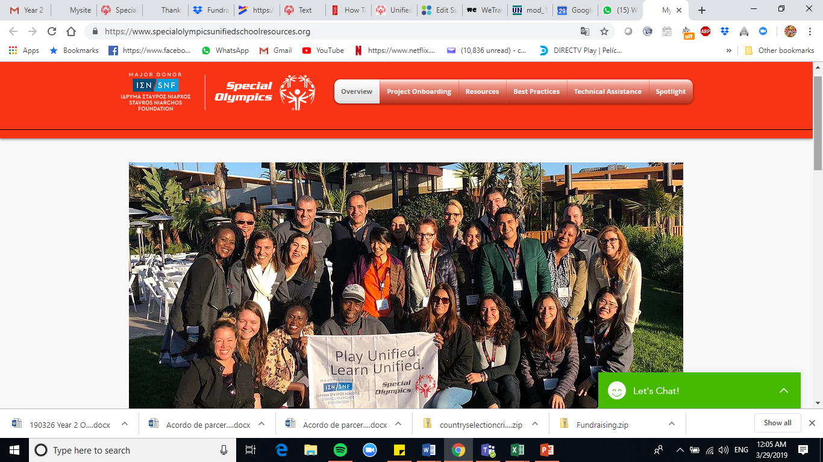
You can access this presentation and all supporting documents on this website
Click Here
https://www.specialolympicsunifiedschoolresources.org/

