Slide 1
Government Partnerships Best Practice Example: Special Olympics Kenya

Slide 2
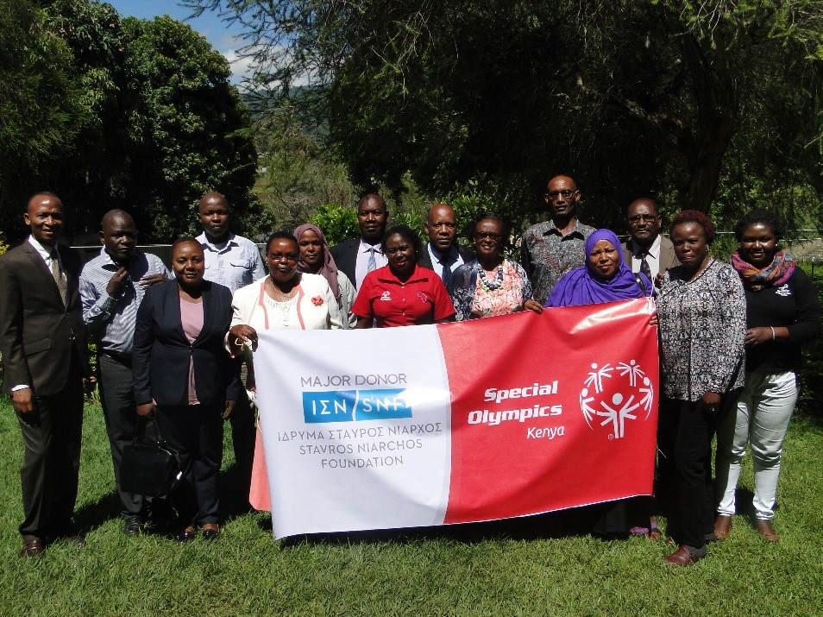
Government Partnerships established by SO Kenya:
1.Ministry of Education 2.Ministry of Health 3. Ministry of Sports 4. Ministry of Social Services
5. Ministry of Interior and Coordination of National Government

Slide 3
Strategy Best Practice Example: Special Olympics Kenya

Slide 4
Approaching Government Ministries.
When working with government….
Ensure compliance with specific ministries requirements e.g.SO Kenya ensures they file NGO annual returns every year and that we are compliant with all other government requirements.
Explore the provisions provided by government to support persons with intellectual disabilities, then utilize the human rights based approach to engage with them.
The biggest strategy to show the government what SO Kenya doing to support compliance with their mandate to Kenyan Citizens with intellectual disabilities.

Slide 5
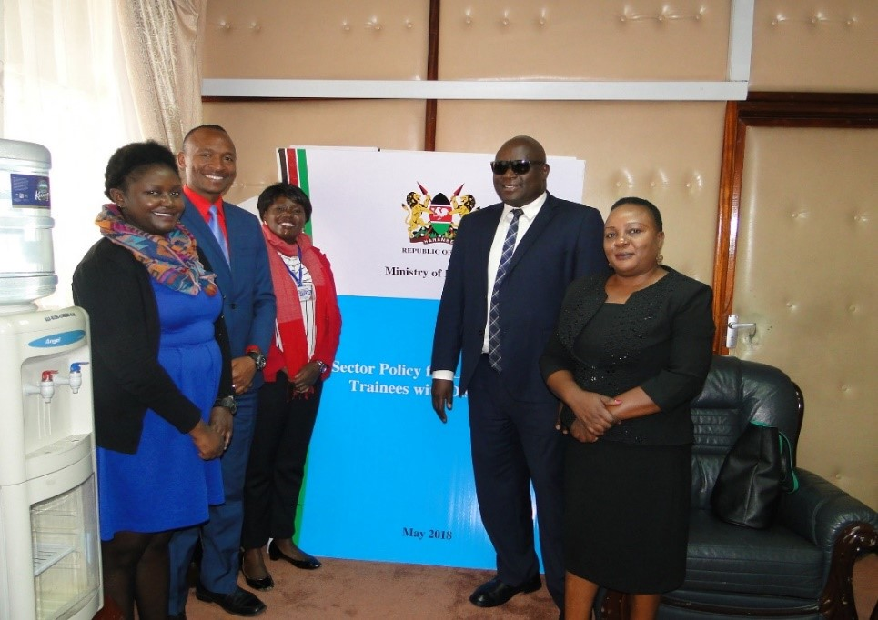
Ministry of Education
In 2007, SOI staff and then Program leaders presented to the Ministry of education, MOE. The staff highlighted the key areas SO Kenya engages in to support the government’s education goals.
In order to support Special Olympics Kenya, the minister appointed one of the senior staff in the ministry of education to sit in the Special Olympics Kenya Board.
As a result, there has always been a representative of MOE in the Special Olympics Kenya board, who acts as a Liaison between the two organizations.
The representative reports all SO Kenya school based activities to the minister and at the same time ensures that Special Olympics Kenya gets all the support they require from the MOE.
Special Olympics Kenya is now recognised as one of the key partners of ministry of education especially in promoting inclusion in schools and hence they are called to participate in the ministry’s as key stakeholders for example policy formulation etc.

Slide 6
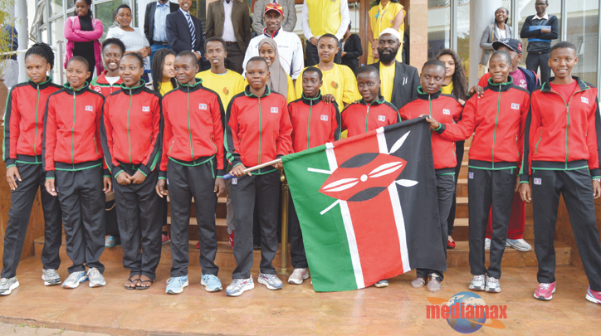
Ministry of Sports
Special Olympics Kenya registered as a member of the Kenya National Sports Council while at the same time writing letters to the ministry seeking supports and constantly seeking audience with successive ministers of sports.
A few years ago, the ministry of sports allocated liaison officers to different sports federations and since Special Olympics Kenya was already recognised by the ministry of sports they were allocated a Liaison officer who sits in the board of Special Olympics Kenya.
In 2013, a new sports bill was enacted a new Kenyan constitution was adopted. The act requires sports federations to be registered with the registrar of sports in order for them to get support from the ministry of sports, and Special Olympics Kenya has registered.
The new constitution devolved local sports development as a function of the county governments. To respond to this development, Special Olympics Kenya conducted a workshop for all the 47 ministers of sports in the counties and 26 of them responded.
Currently Special Olympics Kenya works with specific counties to support local sports training and competitions, while the ministry of sports in the national government supports world games teams and issues to do with policy in order to ensure inclusion of those with intellectual disabilities.

Slide 7
Ministry of Social Services
In 2003, the Disability law was enacted which provided for the establishment of National Council for Persons with Disabilities, housed in the Ministry of Social Services
For an organization/individual to benefit from the services offered by this council, they have to be registered with the council
Some of the athletes receive direct cash transfers, health services, school scholarship among other services from this council.
. Through the disability act, Special Olympics Kenya accesses the use of public facilities for free including, national and international stadiums, and is eligible to benefit from the National Fund for the Disabled.
.. Special Olympics Kenya has also registered as an organization that serves persons with intellectual disabilities and we also collaborate with the council and the family support network to ensure that our athletes are registered

Slide 8
Special Olympics Kenya runs its health programs in collaboration with the ministry of health.
Special Olympics works with specific governors who in turn authorise their ministers of health and county directors of health to support SO Kenya’s health programs.
On occasion the health departments have school based follow-up care and we collaborate with the specific schools and health departments to ensure that our athletes benefit.
Special Olympics Kenya also directly works with the Kenya Medical Training College both at the National headquarter and Specific campuses.
Ministry of Health

Slide 9
Results!
Best Practice: So Kenya

Slide 10
Ministry of Education
Partnership Results
1.Recruitment of new participants (coaches, athletes, families, unified partners)
Every year the ministry of education conducts registration for athletes, Partners, coaches and families, in the whole country. This has helped us map sub programs for effective monitoring.
This partnership has made possible registration of athletes, partners and Coaches and schools participating in the expanding Unified Schools project.
2. Coordination
-During the special Olympics games, the MOE provides teachers as coaches to ensure that the games are run in a successful way. The ministry of education also provides its sports facilities for weekly training and local competitions.

Slide 11
Ministry of Education
Partnership Results:
SNF PROJECT
-The MOE has designated a liaison officer to support and coordinate the SNF project.
- The partnership has made it possible to for SO Kenya to implement the project in a structured way as well as providing the ministry an opportunity to experience the impact of Special Olympics in supporting inclusive education.

Slide 12
Ministry of Education
Partnership Results: 3. Assessment The MOE through the Educational Assessment and Resource Centers (EARCS)conducted assessment for over 800 children with intellectual disabilities who were out of school in the UNICEF funded project. As a result, SO Kenya was able to enrol and retain more than 500 children with ID in schools. 4.Young Athlete Project. The YA program funded by Catholic Relief Services (CRS) partnership ensured that schools which supported the Early Childhood Development sites have inclusive education programs for the YA as well as guaranteeing school accessibility for the out of school YA.

Slide 13
Ministry of Health
Young Athletes Program During the Catholic Relief Services (CRS) funded project,35 healthcare workers were trained on disability to increase opportunities for YA to access health care The partnership made it possible for the YA and their caregivers to access the community health centres Community Health Volunteers were also provided by the ministry of health for health follow up care and to conduct home visits The Kenya Medical Training College provides medical students for the Health Athletes Screening.

Slide 14
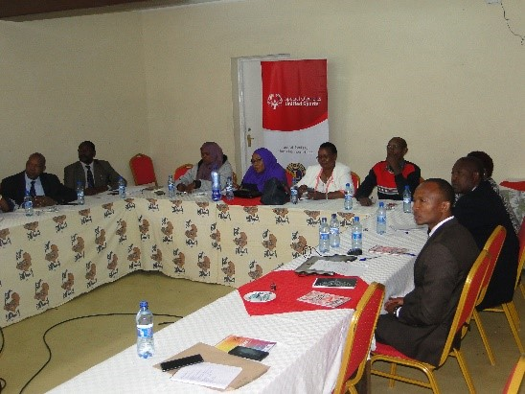
Ministry of Social Services
A total of 100 young athletes were issued with birth certificates making it easier for families to access quality health care A number of our athletes also benefit from direct cash transfer

Slide 15
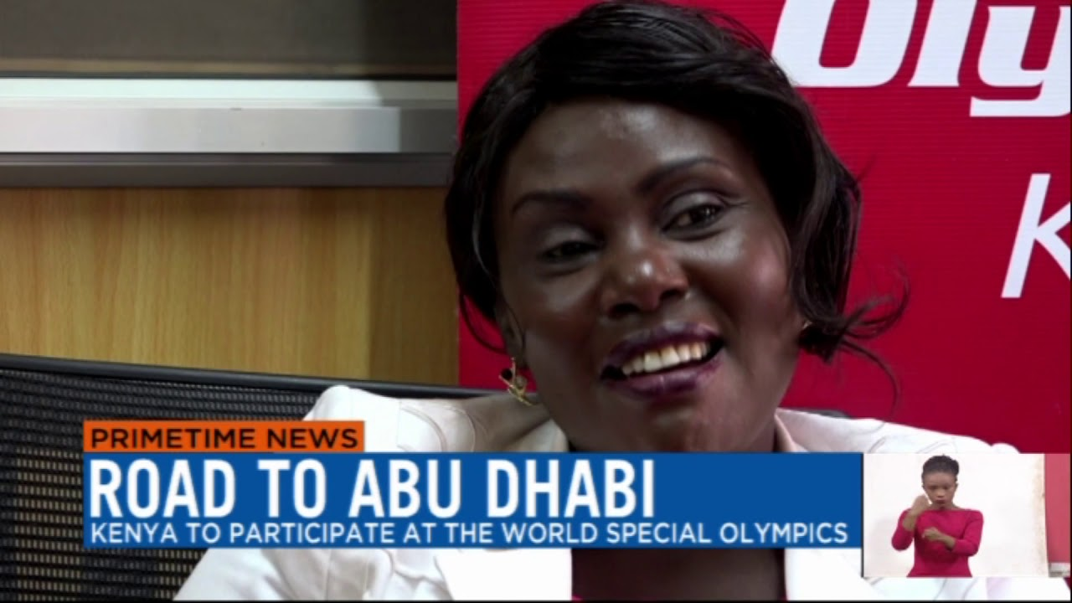
Ministry of Sports
Partnership with the Ministry of Sport has enabled the program to access sports facilities During the County games, various county governments offer funding for athletes The National Government supports the national teams representing Kenya in the world games by paying air tickets and providing allowances.

Slide 16
Ministry of Interior and Coordination of National Government
During the Chicago Unified Cup, the county government of Nairobi issued 12 athletes with national identification cards which is a prerequisite for getting a passport. Special Olympics Kenya has a formal partnership with the National Police Service to run the Law Enforcement Torch Run Program.

Slide 17
Liaison Officers
To ensure efficiency and effectiveness the Ministries of Sports and Education have nominated senior officers from the respective offices to sit in the SO Kenya board. This has really enhanced government relations!

