Slide 1
Unified Champion Schools
Special Olympics Global Youth & Education

Slide 2
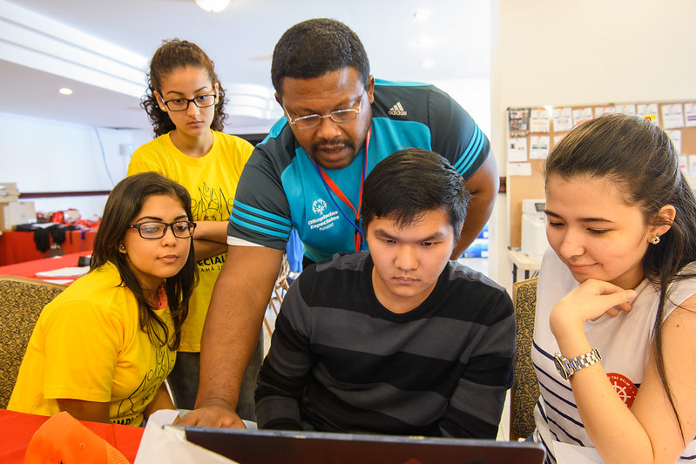
Welcome to the Unified Champion Schools Workshop!
Day 1

Slide 3
Welcome to the Unified Champion Schools Workshop!
Day 1

Slide 4
Objectives
General
Present the Unified Champion Schools model.
Specific
Raise awareness about the importance of promoting the social inclusion of persons with intellectual disabilities in schools.
Demonstrate the power of Unified Sports to promote inclusion.
Explain how Special Olympics is an international movement that advocates for the rights of persons with intellectual disabilities through sports, education, inclusive youth leadership, and community programming.

Slide 5
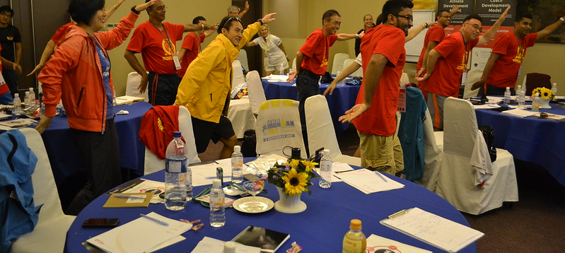
Ice-breaking activity

Slide 6
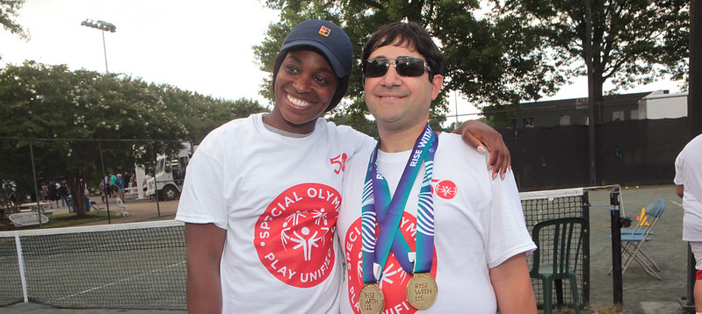
I. Special Olympics overview

Slide 7
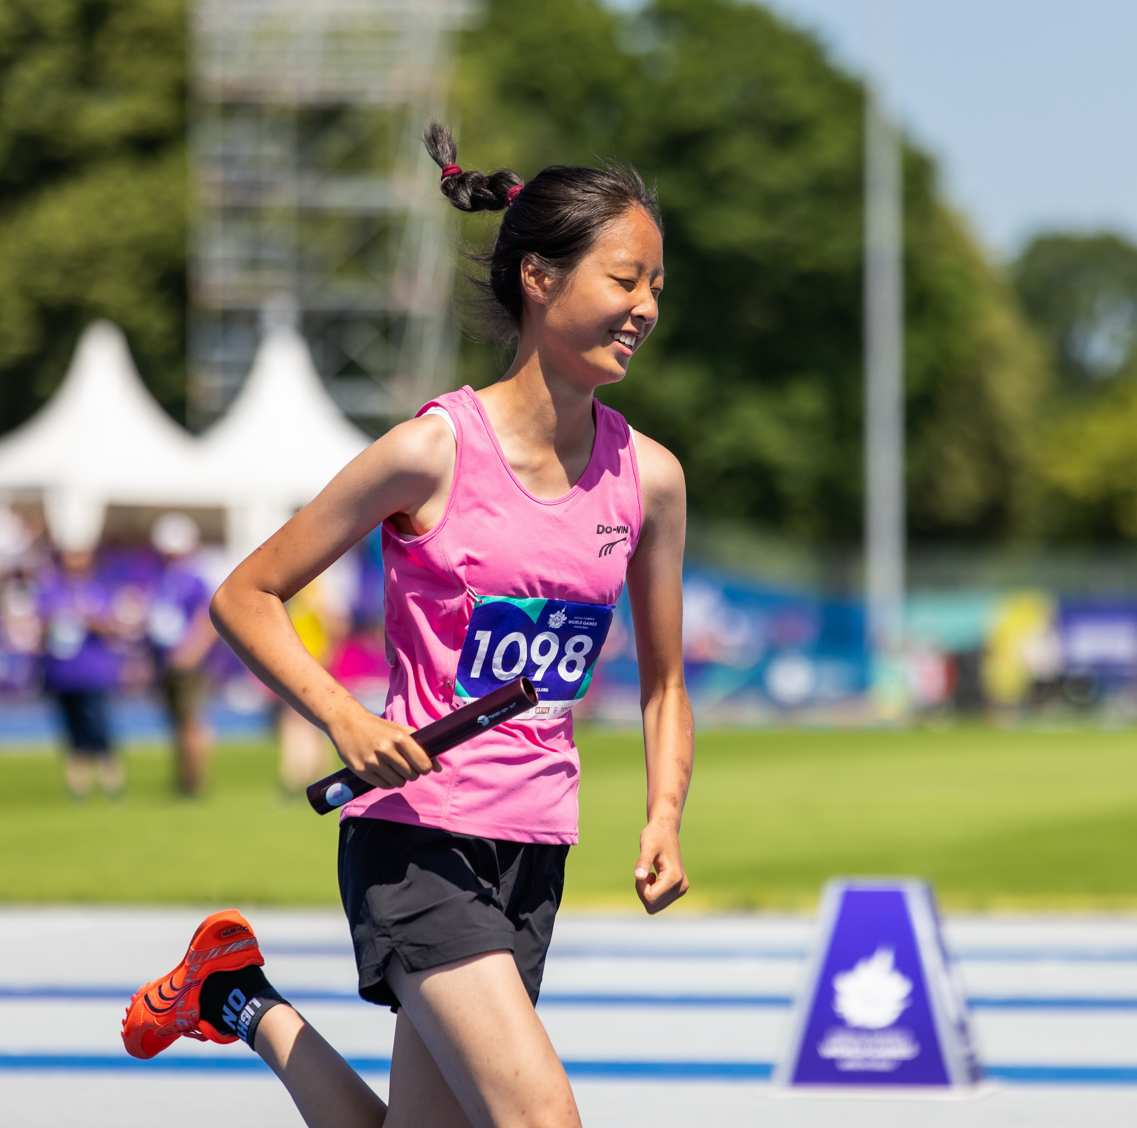
OUR
PURPOSE
Our Purpose
END DISCRIMINATION AGAINST PERSONS WITH INTELLECTUAL AND DEVELOPMENTAL DISABILITIES.
Special Olympics showcases the strengths of our athletes and delivers life-changing interventions that break down institutional, cultural, and personal stigmas.

Slide 8
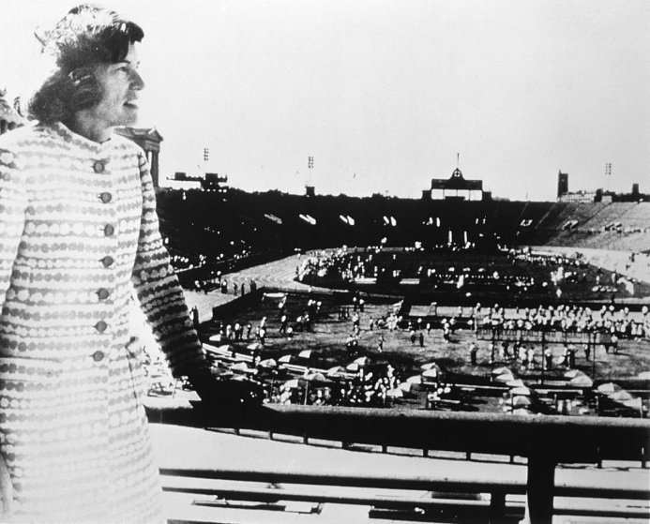
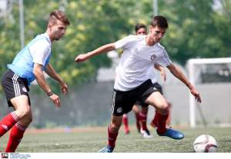
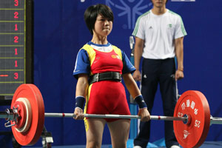
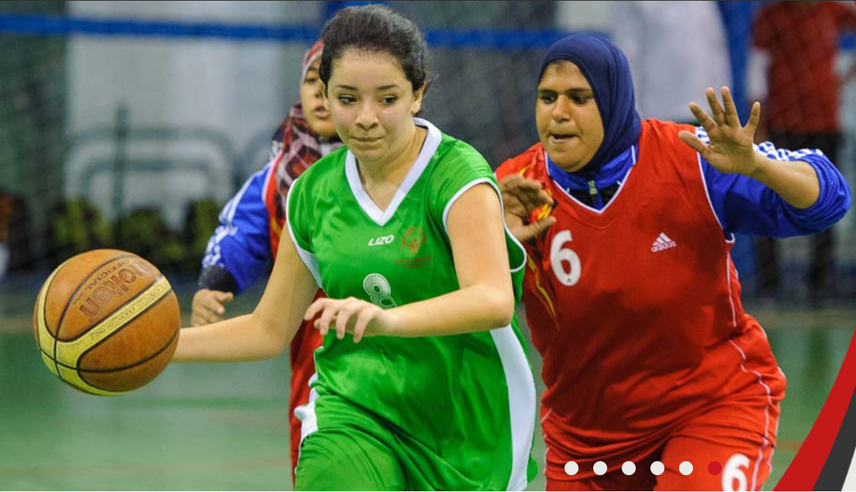
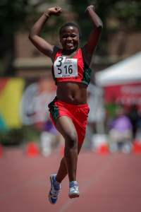
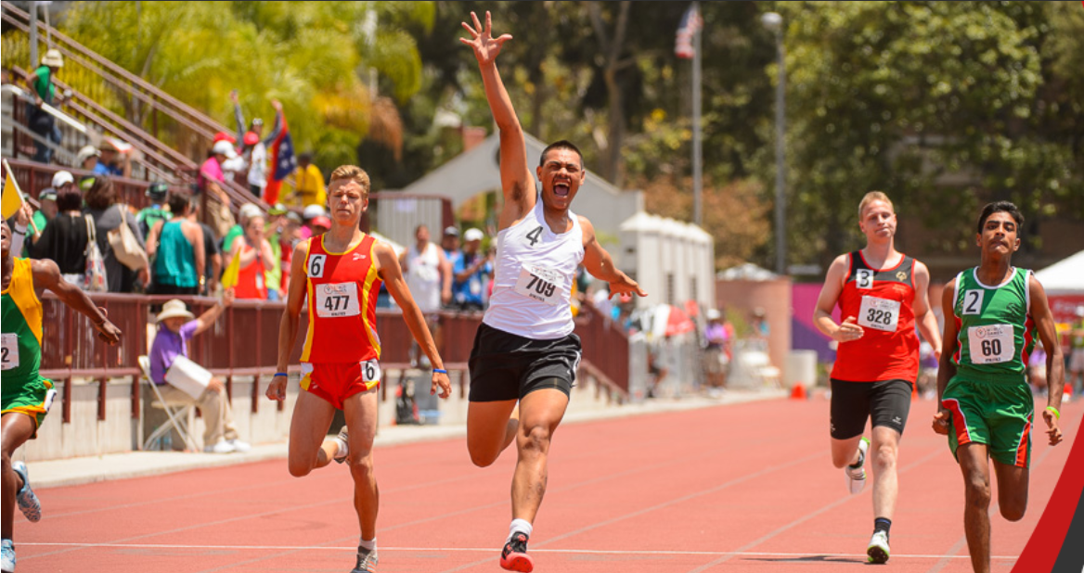
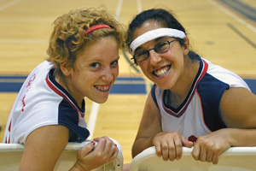
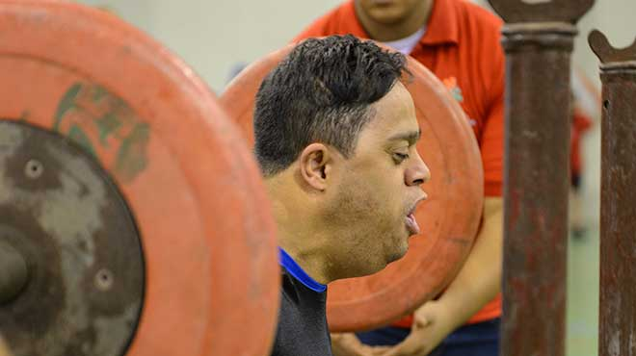
One Woman’s Dream turned into a global movement
Special Olympics was founded in 1968 by Eunice Kennedy Shriver

Slide 9
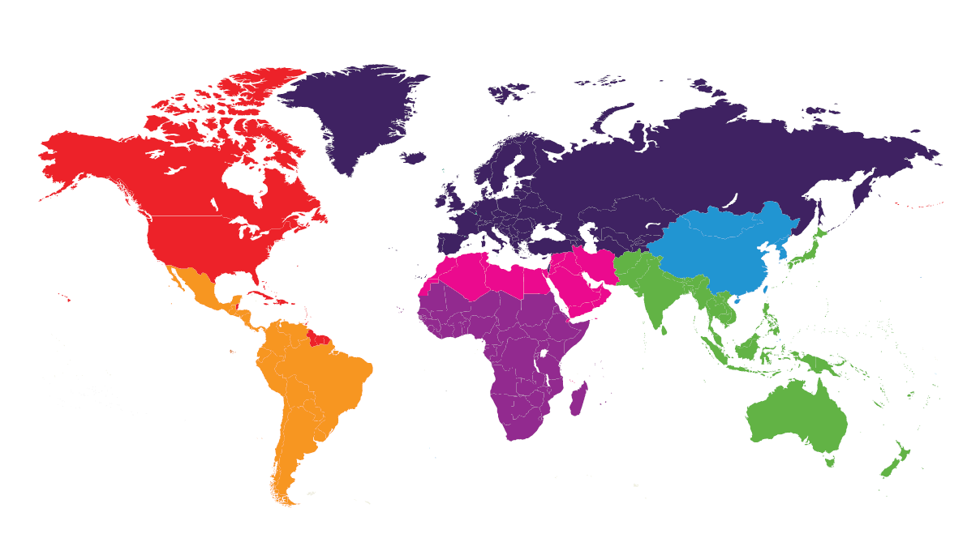




Around the world, Special Olympics creates change through
4 focus areas
Sport
Health
Inclusive Leadership Development
School and Youth Engagement
Annual Reach of Special Olympics
(as of 2021)
201
Countries
7
Global Regions
3,700,000+
Athletes
800,000+ Volunteers
80,000
Youth Leaders
33,000 Competitions
18,000
Health Screenings

Slide 10

Our ambition: An end to discrimination through a suite of intervention tools
End Discrimination Against People with Intellectual Disabilities
Transform every field, court, and pool to an inclusive gathering place for all abilities
Ensure that people of all ability levels are empowered, recognized for their strengths as leaders, and provided the training for life-long success in inclusion
Sport
Leadership Development
Ensure that people with intellectual disabilities – often the most marginalized in healthcare settings – receive equitable health treatment
Create and empower a global generation of young people with inclusive mindsets fueled by rich inclusive experiences
Health
School and Youth Engagement

Slide 11
Special Olympics [insert the name of your Program]
Include relevant information about your Program. For example, year of foundation, national reach, areas, schools where you work, photos, etc.

Slide 12
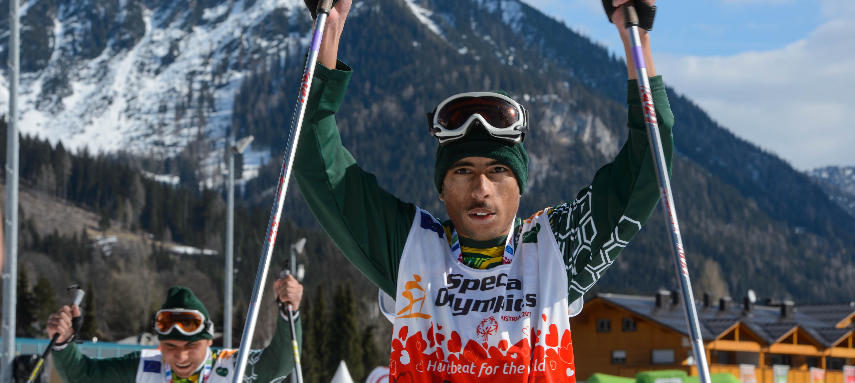
II. Intellectual Disabilities

Slide 13

Activity: Common Myths about Intellectual Disabilities
“Most people with intellectual disabilities have a severe intellectual disability.”
True or false?
False. This is a myth.
Fact: 85% of people with intellectual disabilities are only mildly impaired. Most have minor disabilities that don't get in the way of playing sports, being educated at inclusive schools, and being employed.
“People with intellectual disabilities typically receive substandard healthcare.”
True or false?
True. This is correct.
Fact: Persons with intellectual disabilities typically receive substandard healthcare or virtually no care at all. Our research has shown that people with intellectual disabilities die 16 years sooner than the general population.
Notes:
https://www.specialolympics.org/stories/athletes/common-myths-about-intellectual-disability#:~:text=Physical%20Abilities,Olympics%20athletes%20around%20the%20world!

Slide 14
Activity: Common Myths about Intellectual Disabilities
“People with intellectual disabilities cannot play sports.”
True or false?
False. This is a myth.
Fact: An intellectual disability does not impact your ability to play sports. In fact, there are more than 5 million Special Olympics athletes around the world!
“Including people with intellectual disabilities at school and the workplace can have negative effects.”
True or false?
False. This is a myth.
Fact: Special Olympics programs like Unified Schools and Unified Sports, where people with and without intellectual disabilities learn and play side by side, have shown that an inclusive environment can help break down barriers, promote understanding, and teach compassion.
Notes:
https://www.specialolympics.org/stories/athletes/common-myths-about-intellectual-disability#:~:text=Physical%20Abilities,Olympics%20athletes%20around%20the%20world!

Slide 15
Activity: Common Myths about Intellectual Disabilities
“People with intellectual disabilities cannot get married or have children.”
True or false?
False. This is a myth.
Fact: Special Olympics athletes, and other people with intellectual disabilities, have gone on to marry, have children (and grandchildren), and continue to defy expectations, debunk stereotypes, and contribute to society.
“Intellectual disability is a type of mental illness.”
True or false?
False. This is a myth.
Fact: Intellectual disabilities are not a type of mental illness like depression. There are no cures for intellectual disability. However, persons with intellectual disabilities can learn to do many things. They may need to take more time or learn differently than others.
Notes:
https://www.specialolympics.org/stories/athletes/common-myths-about-intellectual-disability#:~:text=Physical%20Abilities,Olympics%20athletes%20around%20the%20world!

Slide 16
Words matter
Instead of | Say
“The disabled” | Person with a disability
“Confined to a wheelchair” | Person who uses a wheelchair
“Autistic person” | Person with autism
“He is a Down” | He has Down Syndrome
“Normal” | Typical
“Mentally retarded” | Person with intellectual disabilities
Notes:
https://www.specialolympics.org/about/intellectual-disabilities/what-is-intellectual-disability

Slide 17
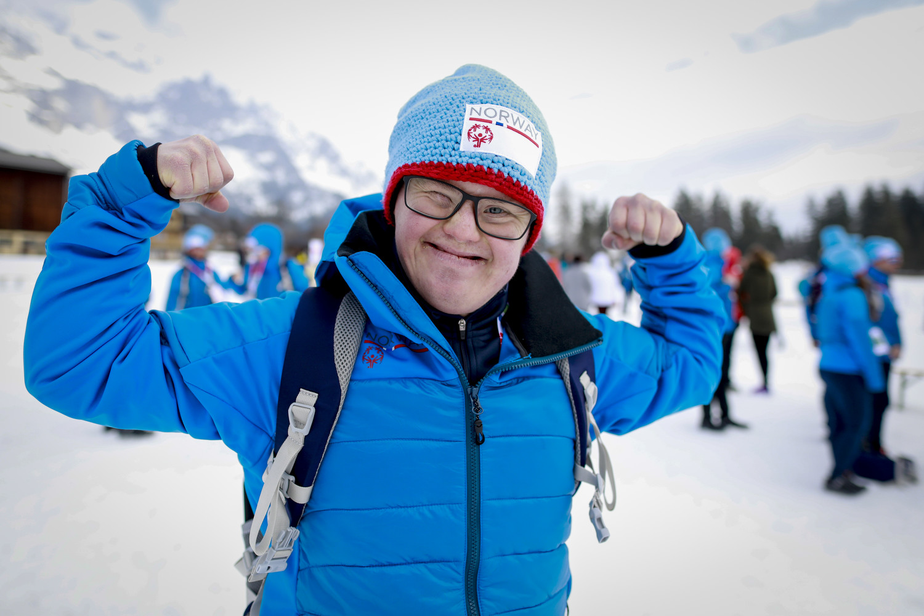
What is Intellectual Disability?
Children and adults with intellectual disabilities inspire us every day at Special Olympics events around the world. But what are intellectual disabilities?
Notes:
https://www.specialolympics.org/about/intellectual-disabilities/what-is-intellectual-disability

Slide 18
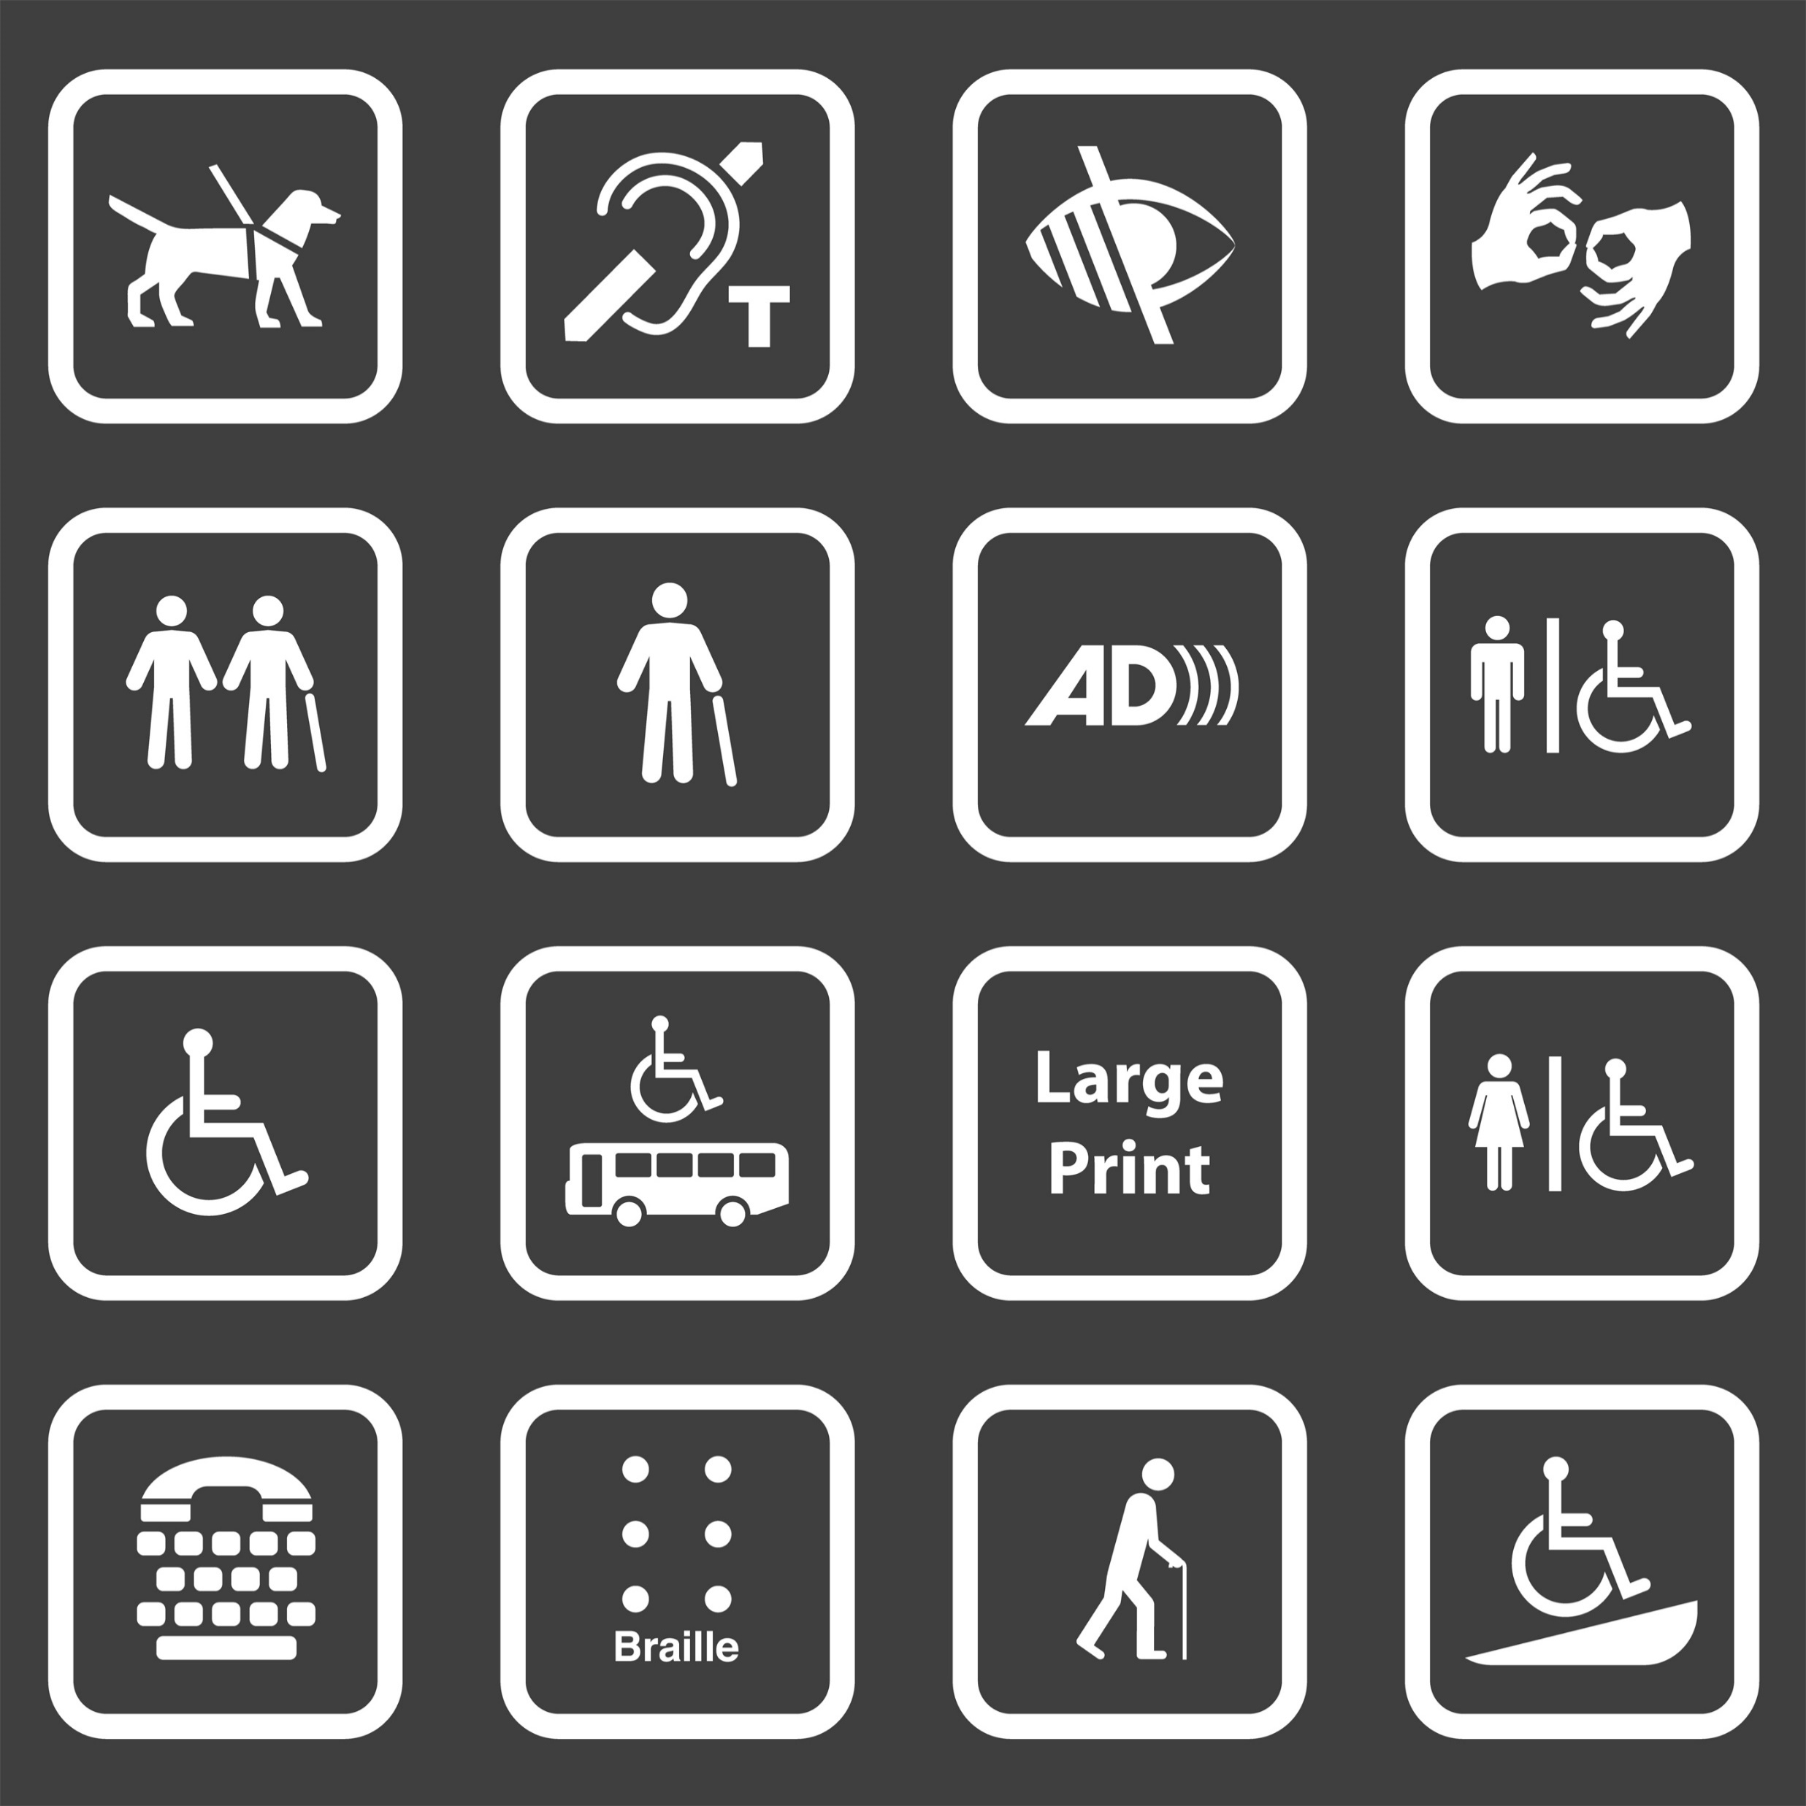
What is a Disability according to the Convention on the Rights of Persons with Disabilities?
Persons with disabilities include those who have long-term physical, mental, intellectual or sensory impairments which, in interaction with various barriers, may hinder their full and effective participation in society on an equal basis with others (Convention on the Rights of Persons with Disabilities, 2023).
This description of disability shifts the focus toward the social and environmental barriers that hinder an individual’s participation in society rather than on the individual’s impairments.
Notes:
This description of disability shifts the focus toward the social and environmental barriers that hinder an individual’s participation in society rather than on the individual’s impairments.
This approach to disability is called the “social model” of disability. The “social model” recognizes that the exclusion of a person with a disability from society is the result of a barrier or hindrance to the individual’s ability to participate fully, rather than the result of the individual’s inherent inability to participate.

Slide 19
What is Intellectual Disability?
There are many kinds of intellectual disabilities—and many causes. Intellectual disability is the most common developmental disability.
Intellectual disability (or ID) is a term used when a person has certain limitations in cognitive functioning and skills, including conceptual, social, and practical skills, such as language, social and self-care skills. These limitations can cause a person to develop and learn more slowly or differently than others. Intellectual disability can happen any time before a person turns 22 years old, even before birth. Intellectual disability is the most common developmental disability (Special Olympics International, 2023).

Slide 20
What are the most common causes?
Genetic conditions
Complications during pregnancy
Complications during birth
Diseases or toxic exposure

Slide 21
How common are Intellectual Disabilities?
Approximately 1 – 3 percent of the global population has an intellectual disability—as many as 200 million people.
Intellectual disability is significantly more common in low-income countries—16.41 in every 1,000 people.
The United Nations Development Program estimates that 80 percent of all people with disabilities live in low-income countries. While people with disabilities represent approximately one in 10 people worldwide, they are one in every five of the world’s poorest people.

Slide 22
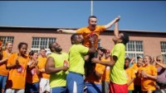
Challenge Expectations video

Slide 23

Coffee break

Slide 24
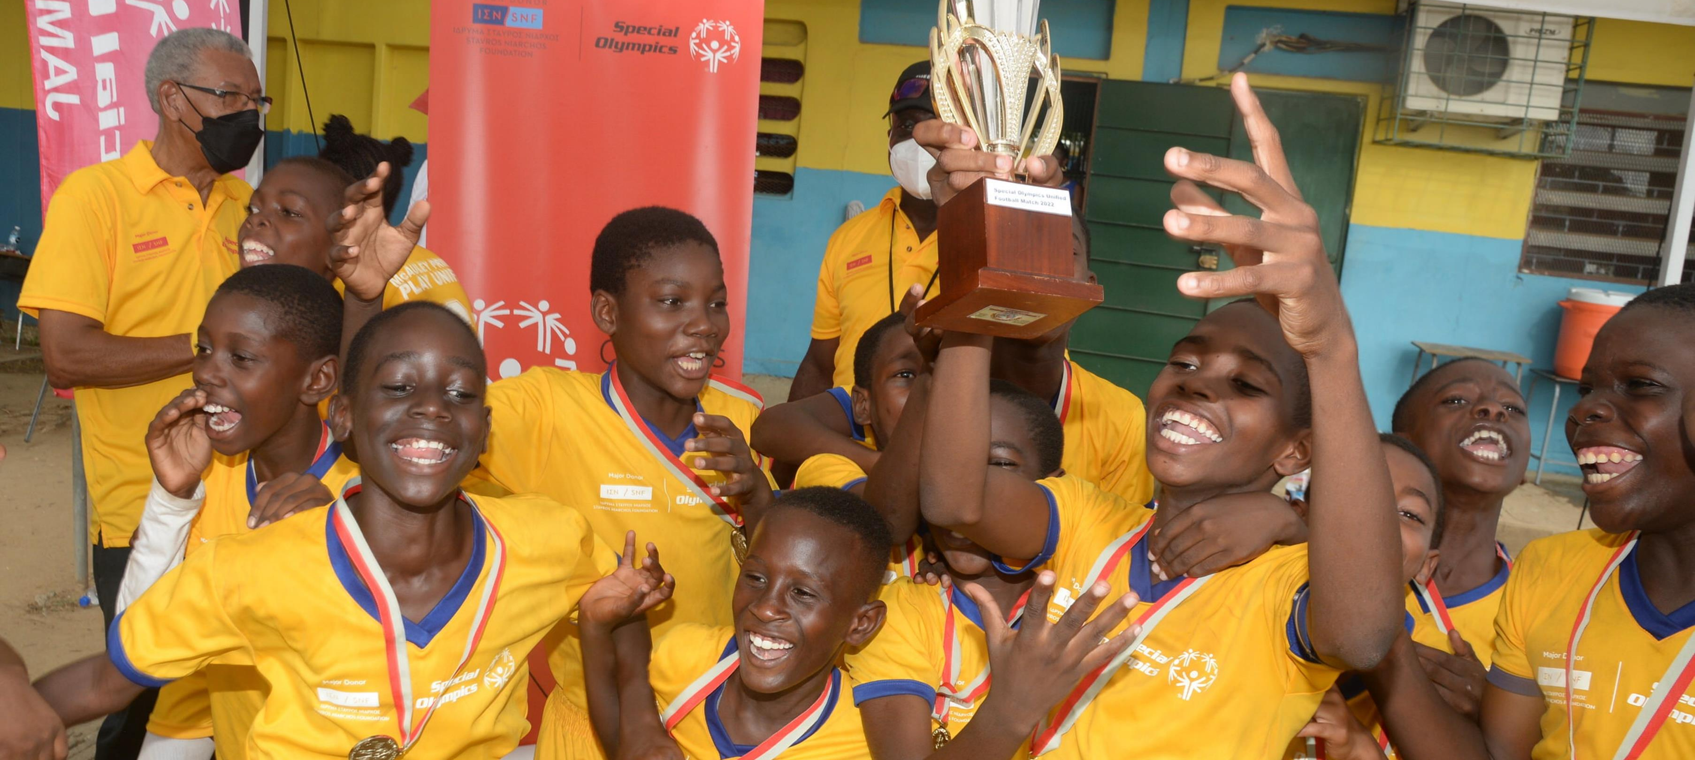
III. Unified Champion Schools ®

Slide 25
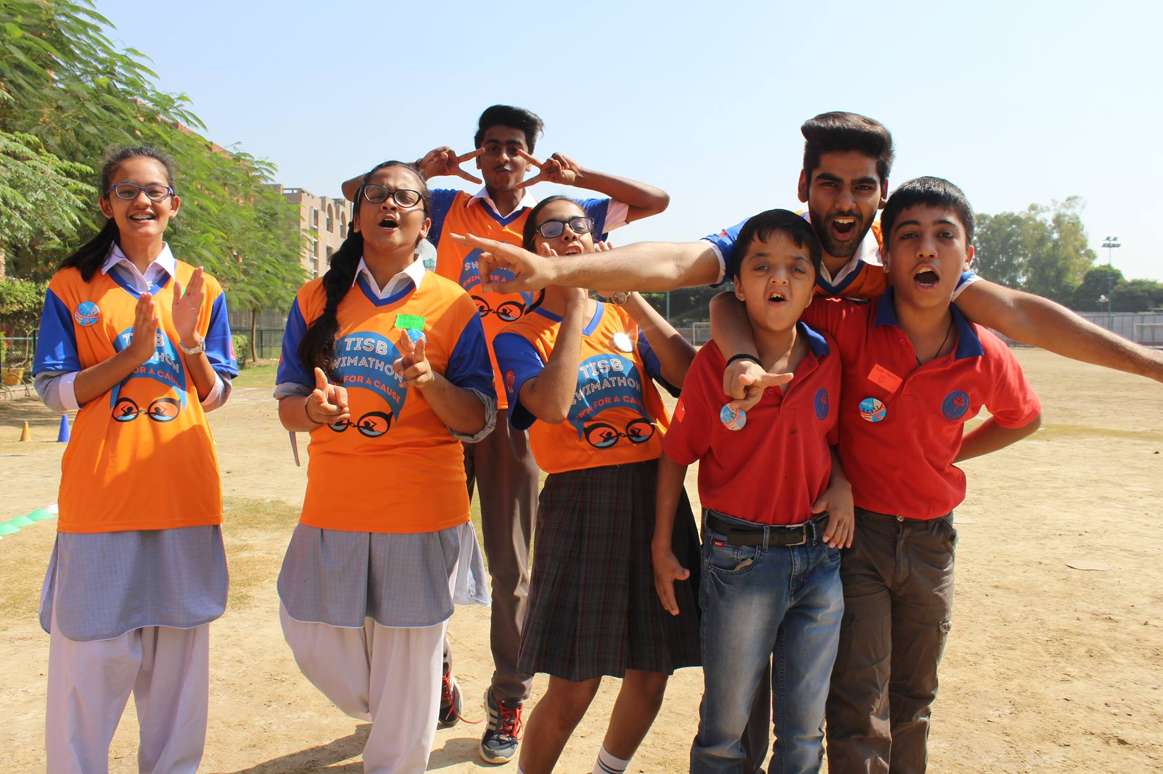
What is a Unified Champion School?
The Special Olympics Unified Champion Schools (SO UCS) ® program promotes social inclusion through intentionally planned and implemented activities affecting systems-wide change. With sports as the foundation, the three-component model offers a unique combination of effective activities that equip young people, both with and without intellectual disabilities, with tools and training to create sports, classroom, and school climates of acceptance.
Notes:
https://www.specialolympics.org/about/intellectual-disabilities/what-is-intellectual-disability

Slide 26




Special Olympics Unified Champion Schools
Using three components to drive inclusion
1
Unified Sports
Young people with and without ID join as teammates in sport and play
2
Inclusive Youth Leadership
Young people with and without ID join to lead advocacy and awareness efforts to increase inclusion.
3
Whole School Engagement
Awareness and education activities engage the student body in the message of inclusion.

Slide 27


Our Opportunity: A global youth movement with ‘hubs’ of thought leadership and program excellence
-- Illustrative --

Slide 28


Current global scope
148 | Countries with Unified Schools
22,000+ | Schools reach worldwide
Approx 1 million + young people participate in inclusive experiences through the UCS programming

Slide 29
National scope [Insert Programs information]
X | [Insert information about provinces in your country]
X | [Insert information about schools reached]
X | [Insert information about young people participating]

Slide 30
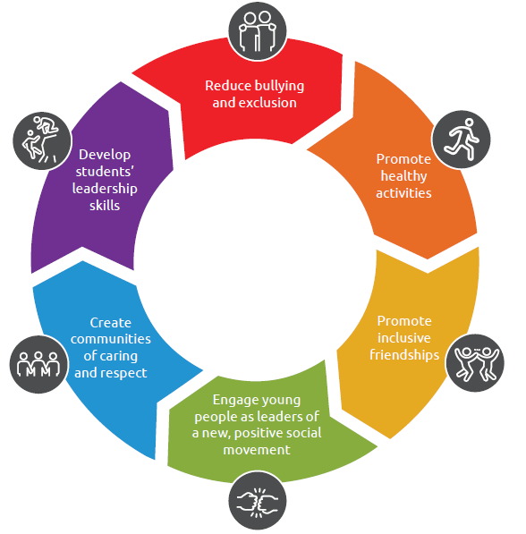
Our Impact
Special Olympics Unified Champion Schools
“Our view is simple, and our focus is clear: if we teach youth with and without intellectual disabilities to play together, they can learn, grow, and ultimately live together.”

Slide 31




The Impact of Special Olympics Unified Schools
Recent results from Special Olympics work with youth and schools
United States
84% of students report learning prosocial skills of compromise and sharing responsibility
88% of school staff feel that Special Olympics Unified Schools made a big impact in reducing bullying in their school
63% of staff feel that students are open to and accepting of differences and that the program has increased a sense of community in the school
84% of participating students regard program participation as a positive turning point in their lives
90% of students without ID reported their behavior changed due to Unified Schools.
80% of educators reported an improved sense of community.
80% of students without ID reported they can learn from people who are different from themselves.
95% of students without ID reported “much positive change" in their interactions with students with ID.
91% of educators reported changes in attitudes of students without ID towards students with ID.
100% of school administrators reported improved student confidence and leadership.
60% of educators reported a positive change in interactions between students with and without ID.
60% of students learned from people who are different from them.
70% of educators reported a more inclusive school climate.
India
Kenya
Mainland
China

Slide 32
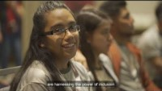
Unified Champion Schools video

Slide 33
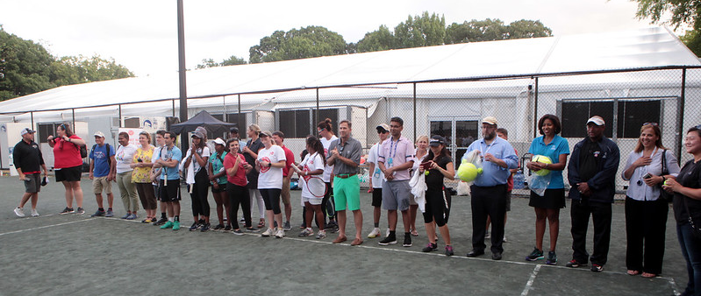
Activity: Unified Sports experience

Slide 34
Welcome to the Unified Champion Schools Workshop!
Day 2

Slide 35
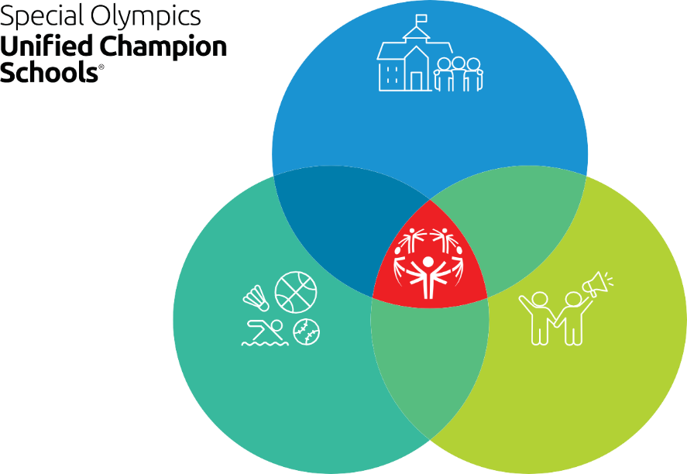
IV. UCS three components
WHOLE SCHOOL ENGAGEMENT
UNIFIED SPORTS
INCLUSIVE YOUTH LEADERSHIP

Slide 36
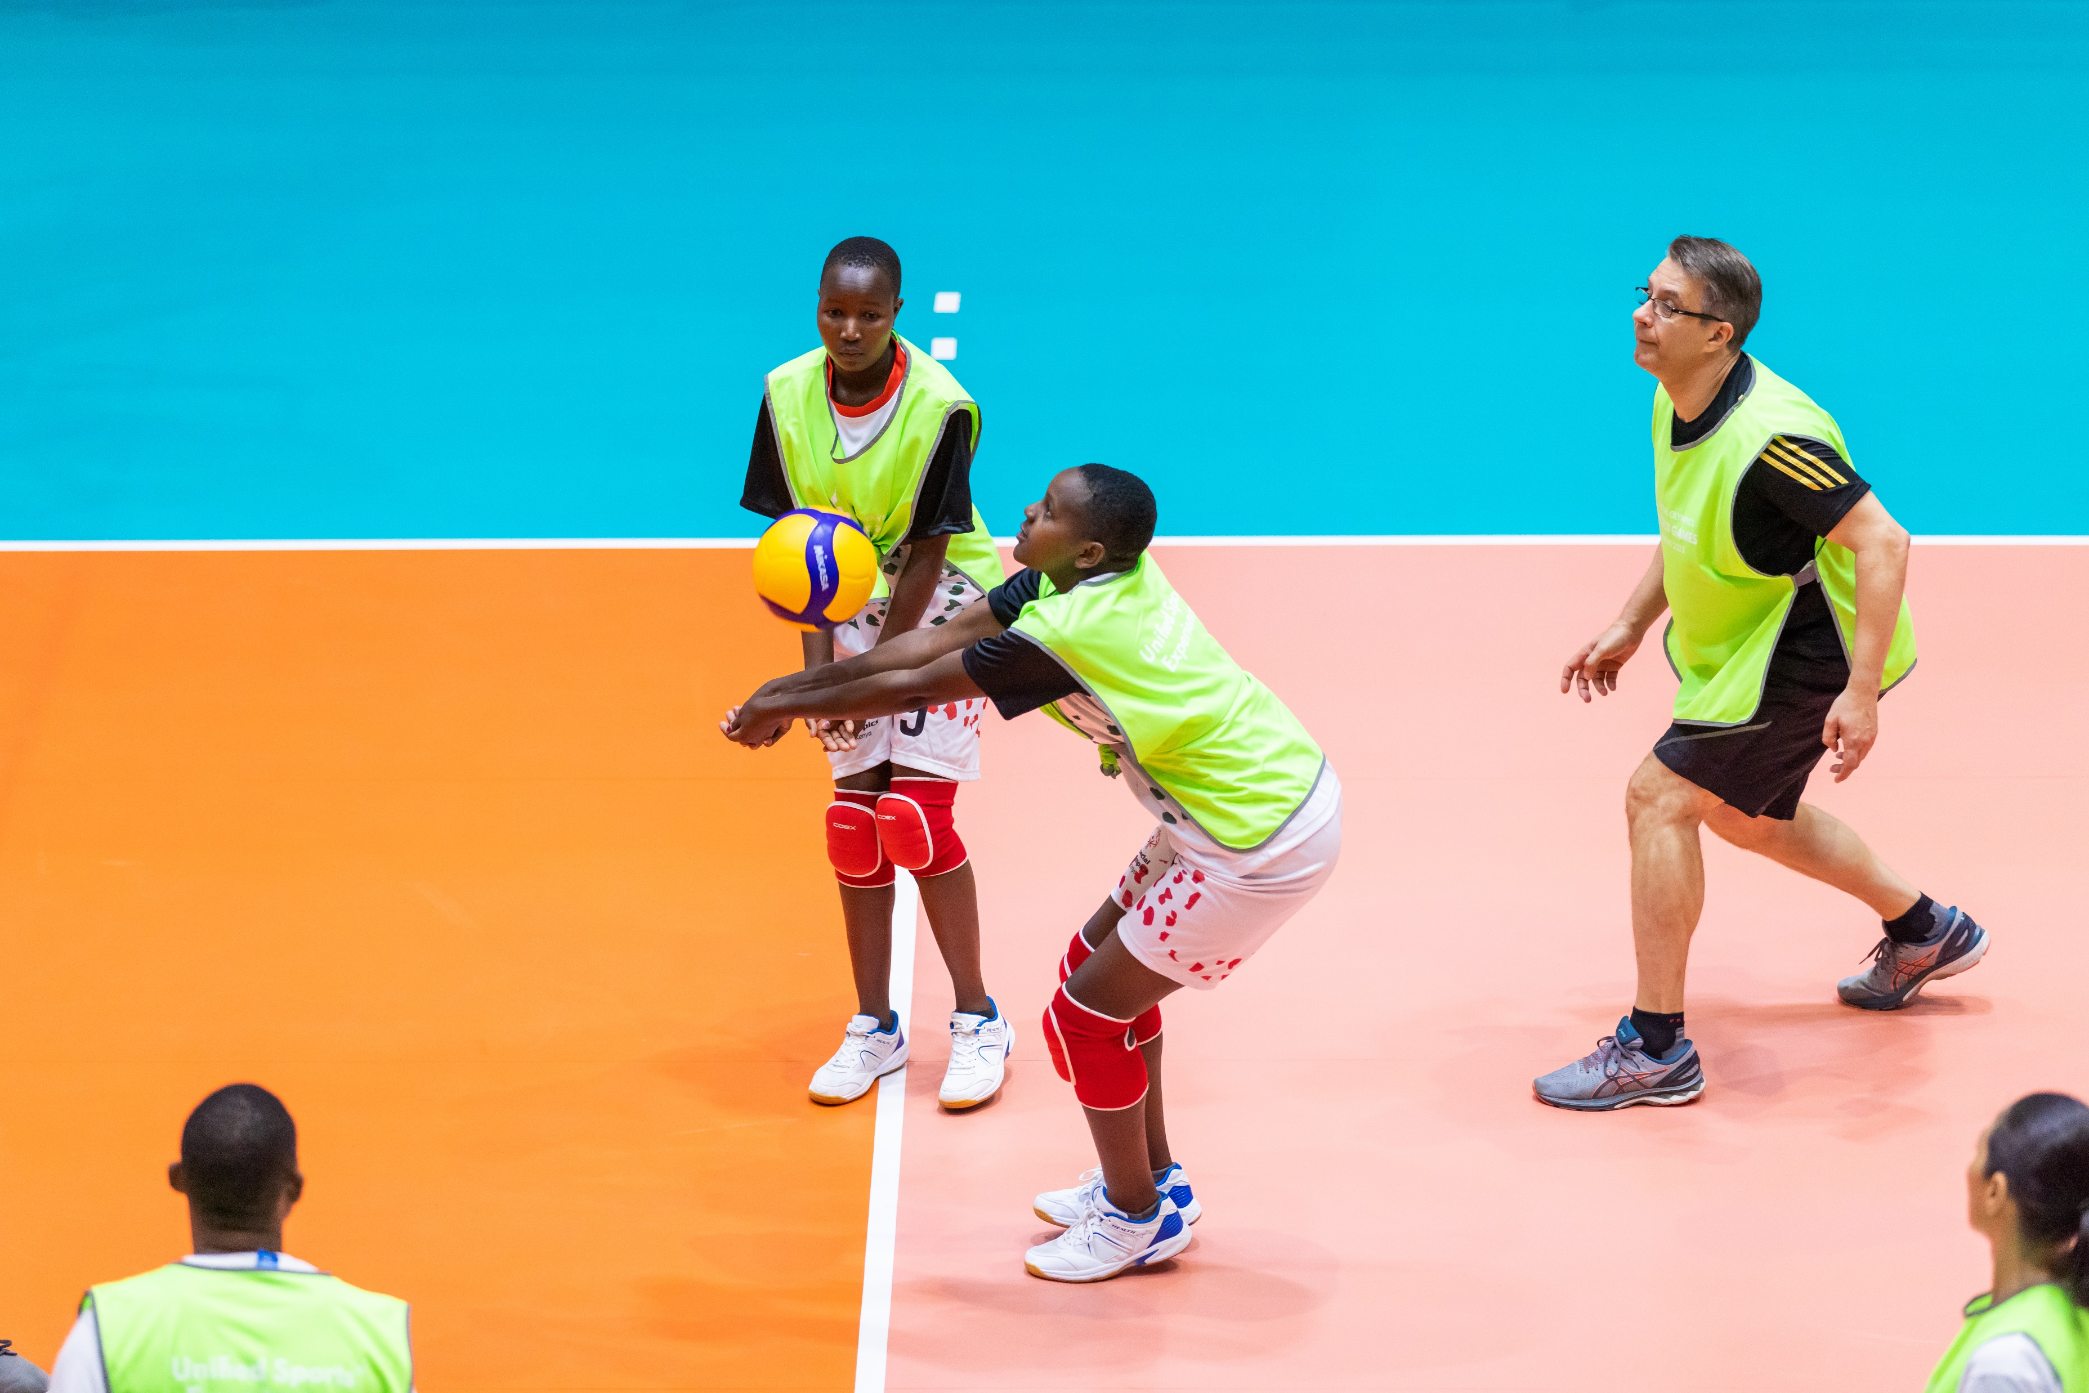
1. Unified Sports
Provide opportunities for students with and without intellectual disabilities to meaningfully participate in various fitness and sports activities alongside one another. A variety of options:
Unified Sports recreation activities
Unified Physical Education class
Unified Fitness Clubs
Intramural leagues
Interscholastic competitions
Young Athletes
MATP at schools

Slide 37
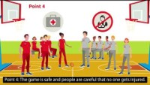
Unified Sports video

Slide 38
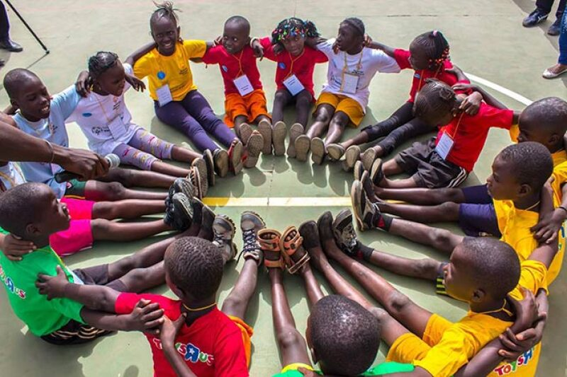
Example: Young Athletes in schools
Special Olympics Young Athletes is an early childhood program for children with and without intellectual disabilities, ages 2 to 7.
Young Athletes introduces basic sport skills, like running, kicking, and throwing.
Young Athletes offers families, teachers, caregivers, and community members the chance to share the joy of sports with all children.

Slide 39
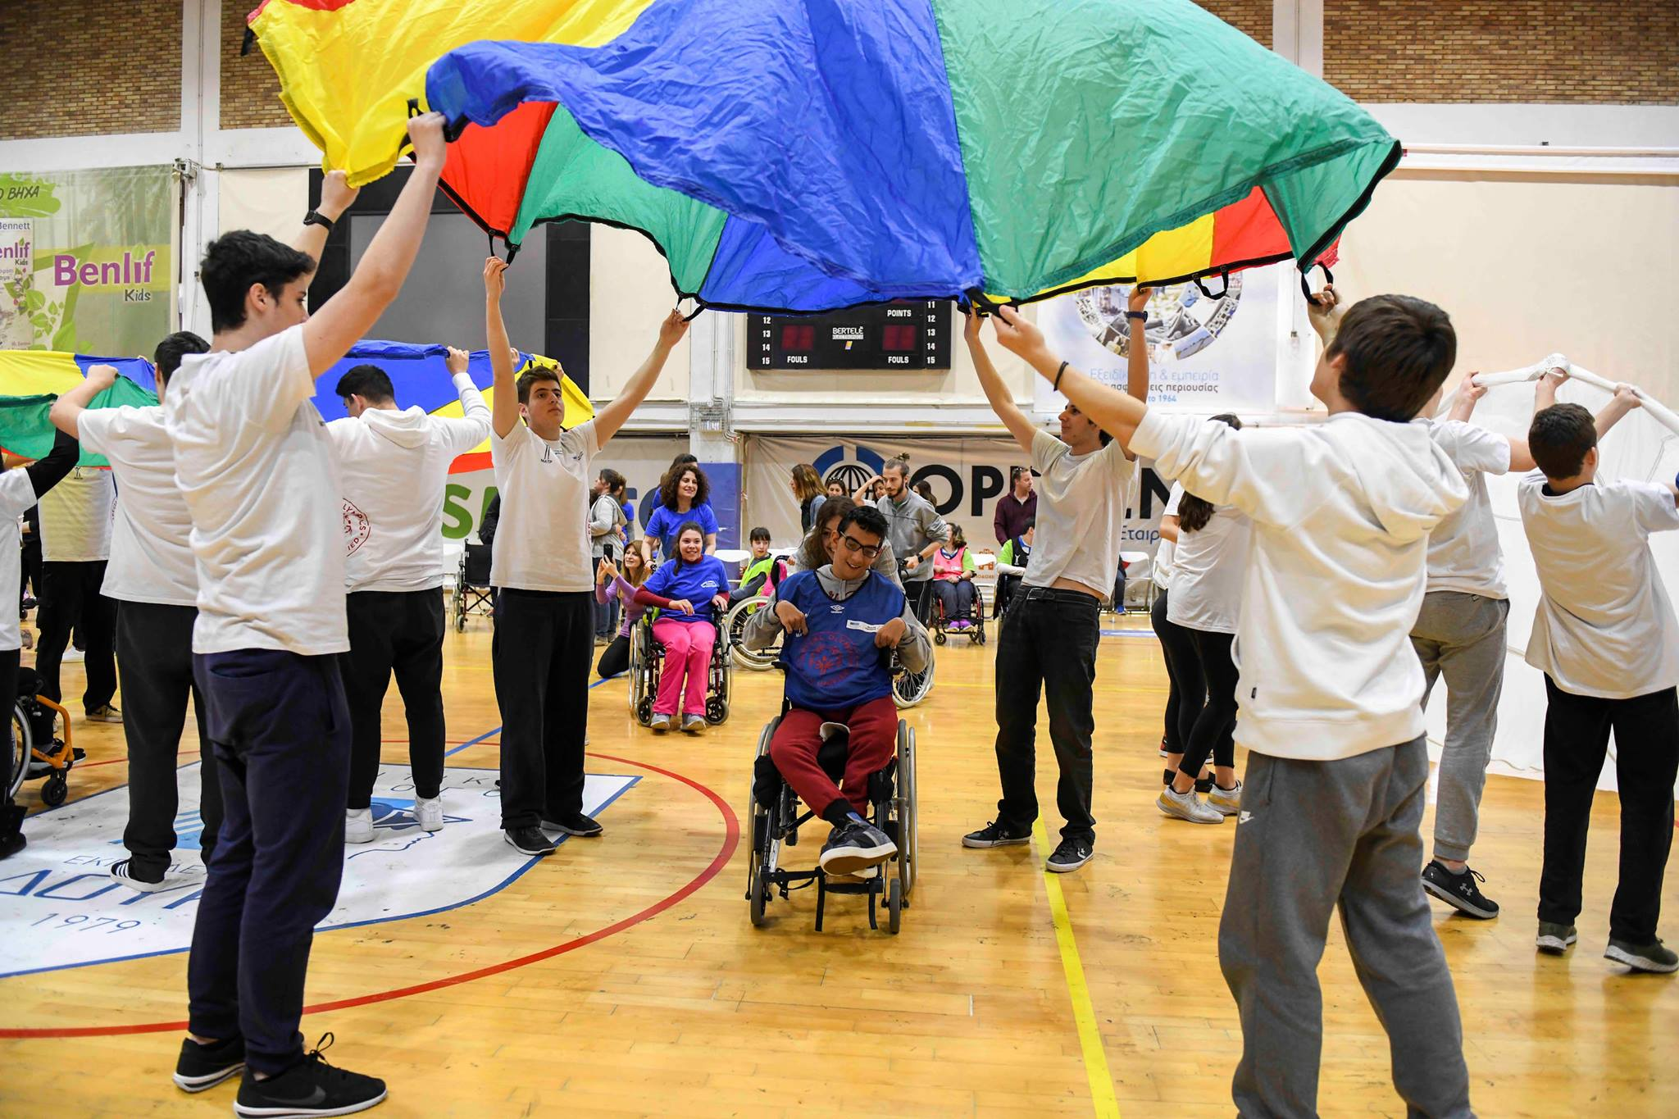
Example: Motor Activity Training Program (MATP) in schools
The MATP is a sport and play program for participants with severe and/or multiple disabilities of all ages.
MATP activities can be done at home, in schools, or in the community.
MATP activities provide a format for persons with and without disabilities to play together and learn about and understand each other.

Slide 40
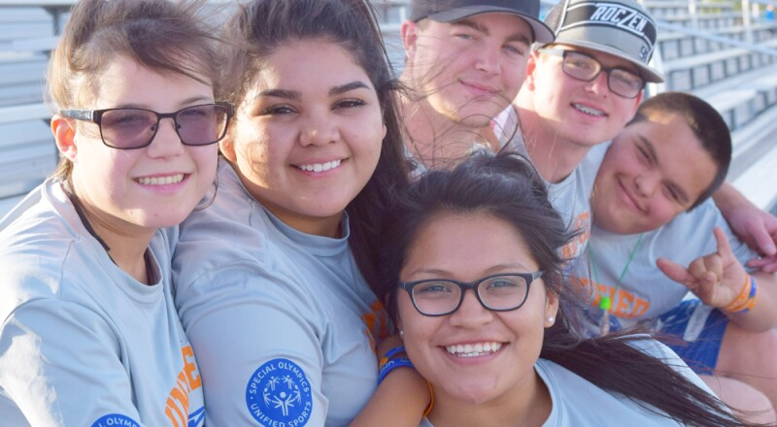
2. Inclusive Youth Leadership
Offers youth with and without ID opportunities to become agents of change within their schools and communities.
Some ideas on how to promote it at schools are:
Unified Clubs
Youth Leadership Experiences
Youth Activation Committees
Transforming existing school clubs into inclusive clubs

Slide 41
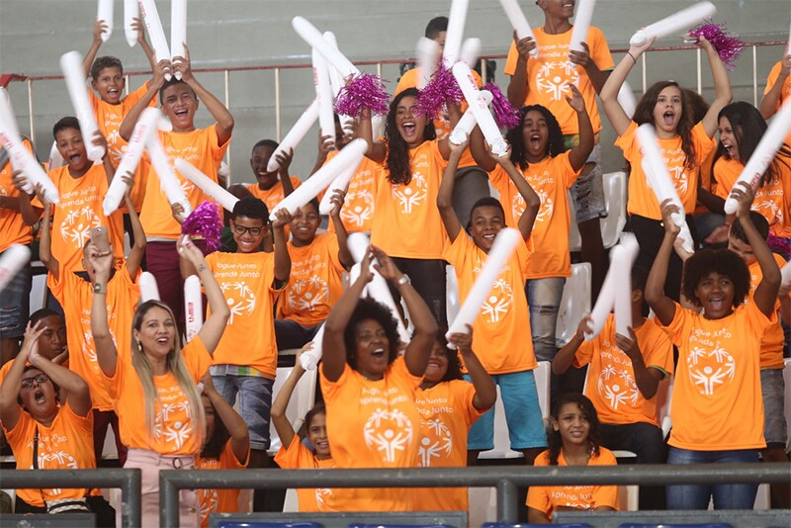
3. Whole School Engagement
Includes all school members, creating a community of acceptance and respect. For example:
Fans in the stands
Unified rallies
Spread the word Inclusion campaign
School assembly promoting unified messages to the entire school
Unified Young Readers school-wide book project

Slide 42
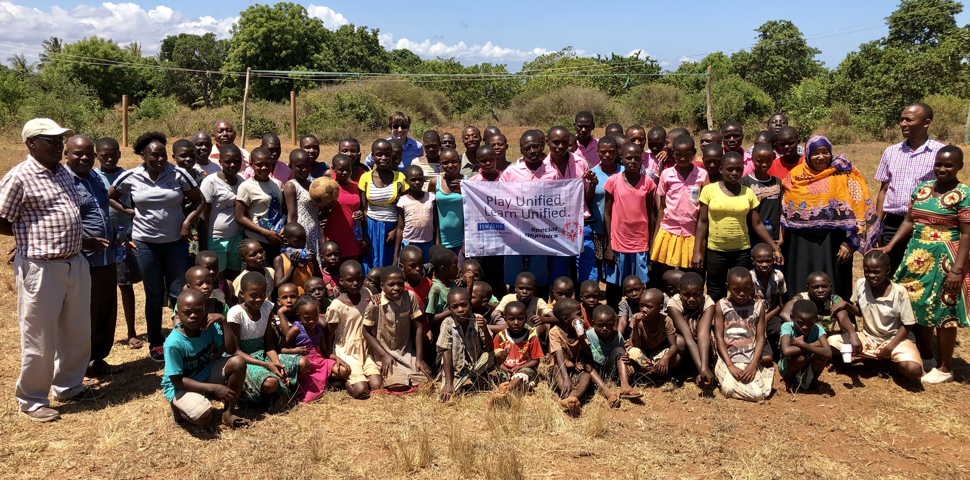
Activity: How to implement UCS in my school?

Slide 43
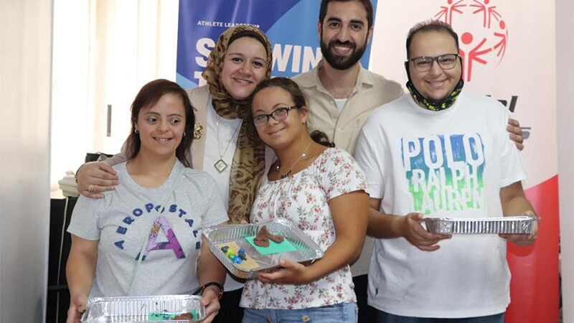
An idea: Establishing a Leadership Team
One step that could help to become a UCS is to bring together a team to lead the work.
The team will be responsible for establishing the vision and overarching goals for the school, coordinating early stages of implementation, and working with leaders of specific events.
The team will also monitor the strategy’s success with an eye toward continuous improvement.
Who should be on the Leadership Team?
The strongest teams include teachers from all grade levels, other school staff members, an administrator, parents, and students of different ages and abilities.

Slide 44
Coffee break

Slide 45
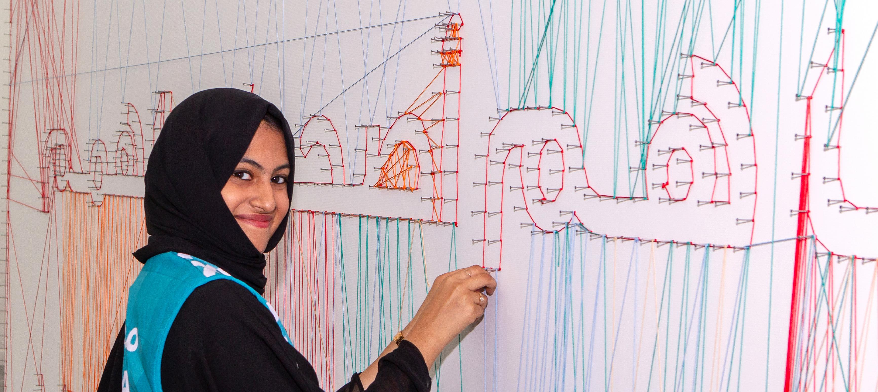
V. Inclusive Education

Slide 46
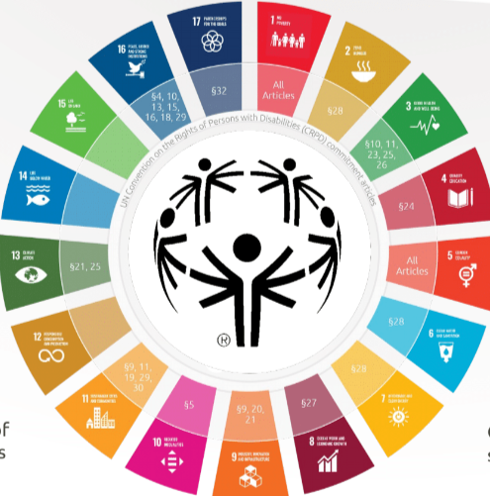
Our work in schools and the Sustainable Development Goals
Goal 4: Quality of Education
Contribution to SDG targets
4.2: ensure access to quality early childhood development
4.4: increase vocational skills of youth and adults
4.5: eliminate education disparities among vulnerable groups
4.A: upgrade or create accessible education facilities

Slide 47
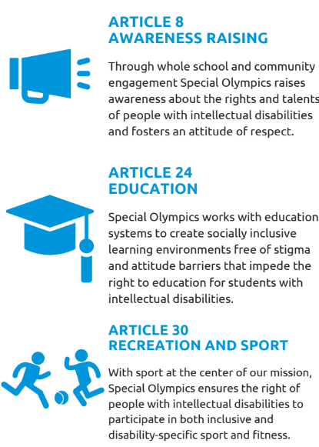
Our work in schools and the CRPD
With our work we also support the United Nations Convention on the Rights or Persons with Disabilities.
Our mission with Special Olympics Unified Champion Schools is simple. We believe if we teach children to play together, they can learn, grow, and ultimately thrive together. The success of Unified Champion Schools is an example of what we know to be true for transformative education efforts: powerful programming that elevates youth voice and celebrates inclusion can transform learning settings, which in turn accelerates the rate of change and impact in communities.
–Dr. Jackie Jodl

Slide 48
Inclusive Education in [name of your country]
[Include relevant information about your local context—for example, laws, policies, programs, etc.
Explain how UCS supports these national goals.
We invite you to explore this UNESCO link for more information about your country. Go to:
This theme in countries and find yours]
Notes:
https://www.specialolympics.org/about/intellectual-disabilities/what-is-intellectual-disability

Slide 49
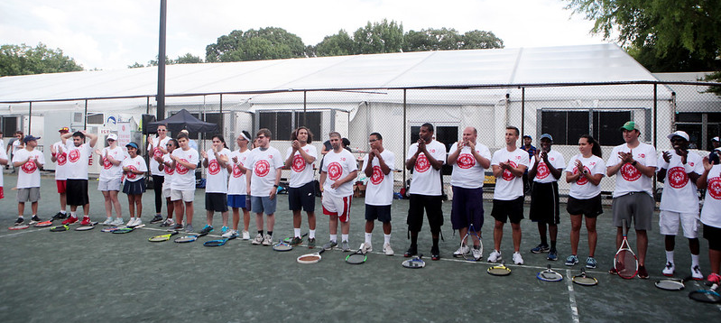
VI. Conclusion

Slide 50

Upgrade your world video

