Slide 1
Unified Champion Schools Educators Training
Special Olympics
Global Youth & Education

Slide 2
Agenda
GLOBAL
YOUTH &
EDUCATION
Why educators?
Educators Training Timeline:
Initial meeting with school leaders
Share materials before the training session
Plan the training session
Do the training session
Provide certificates and set actionable next steps
Follow up and offer continuous support
Resources
Video

Slide 3
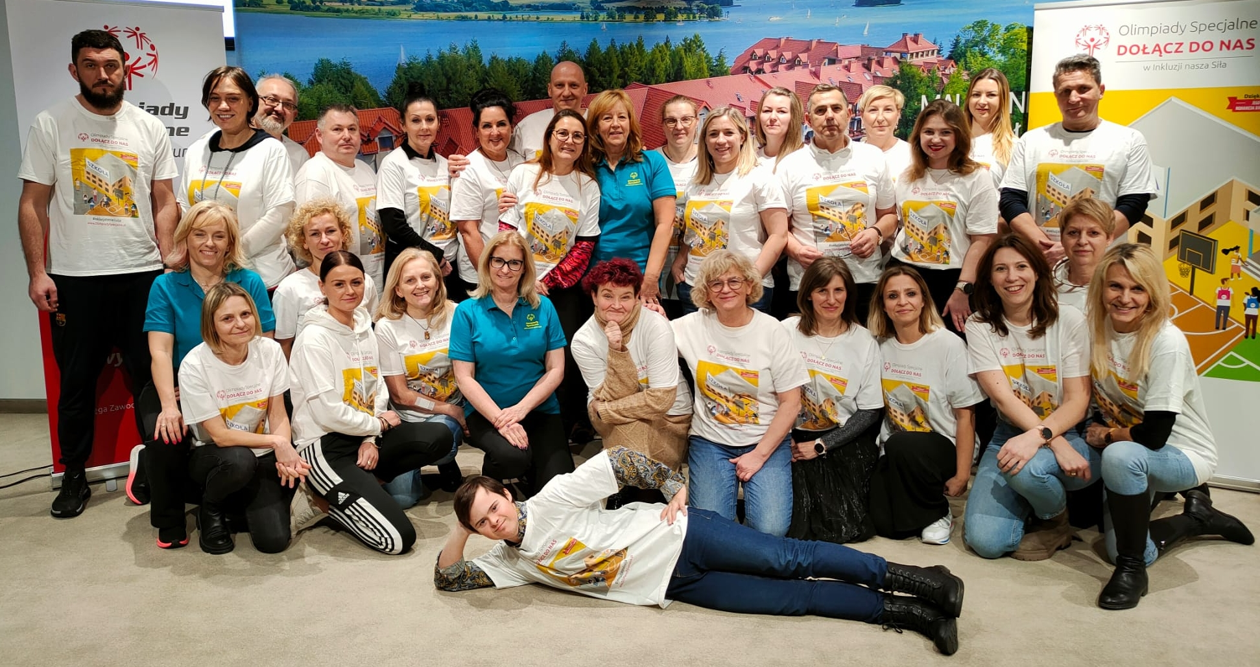
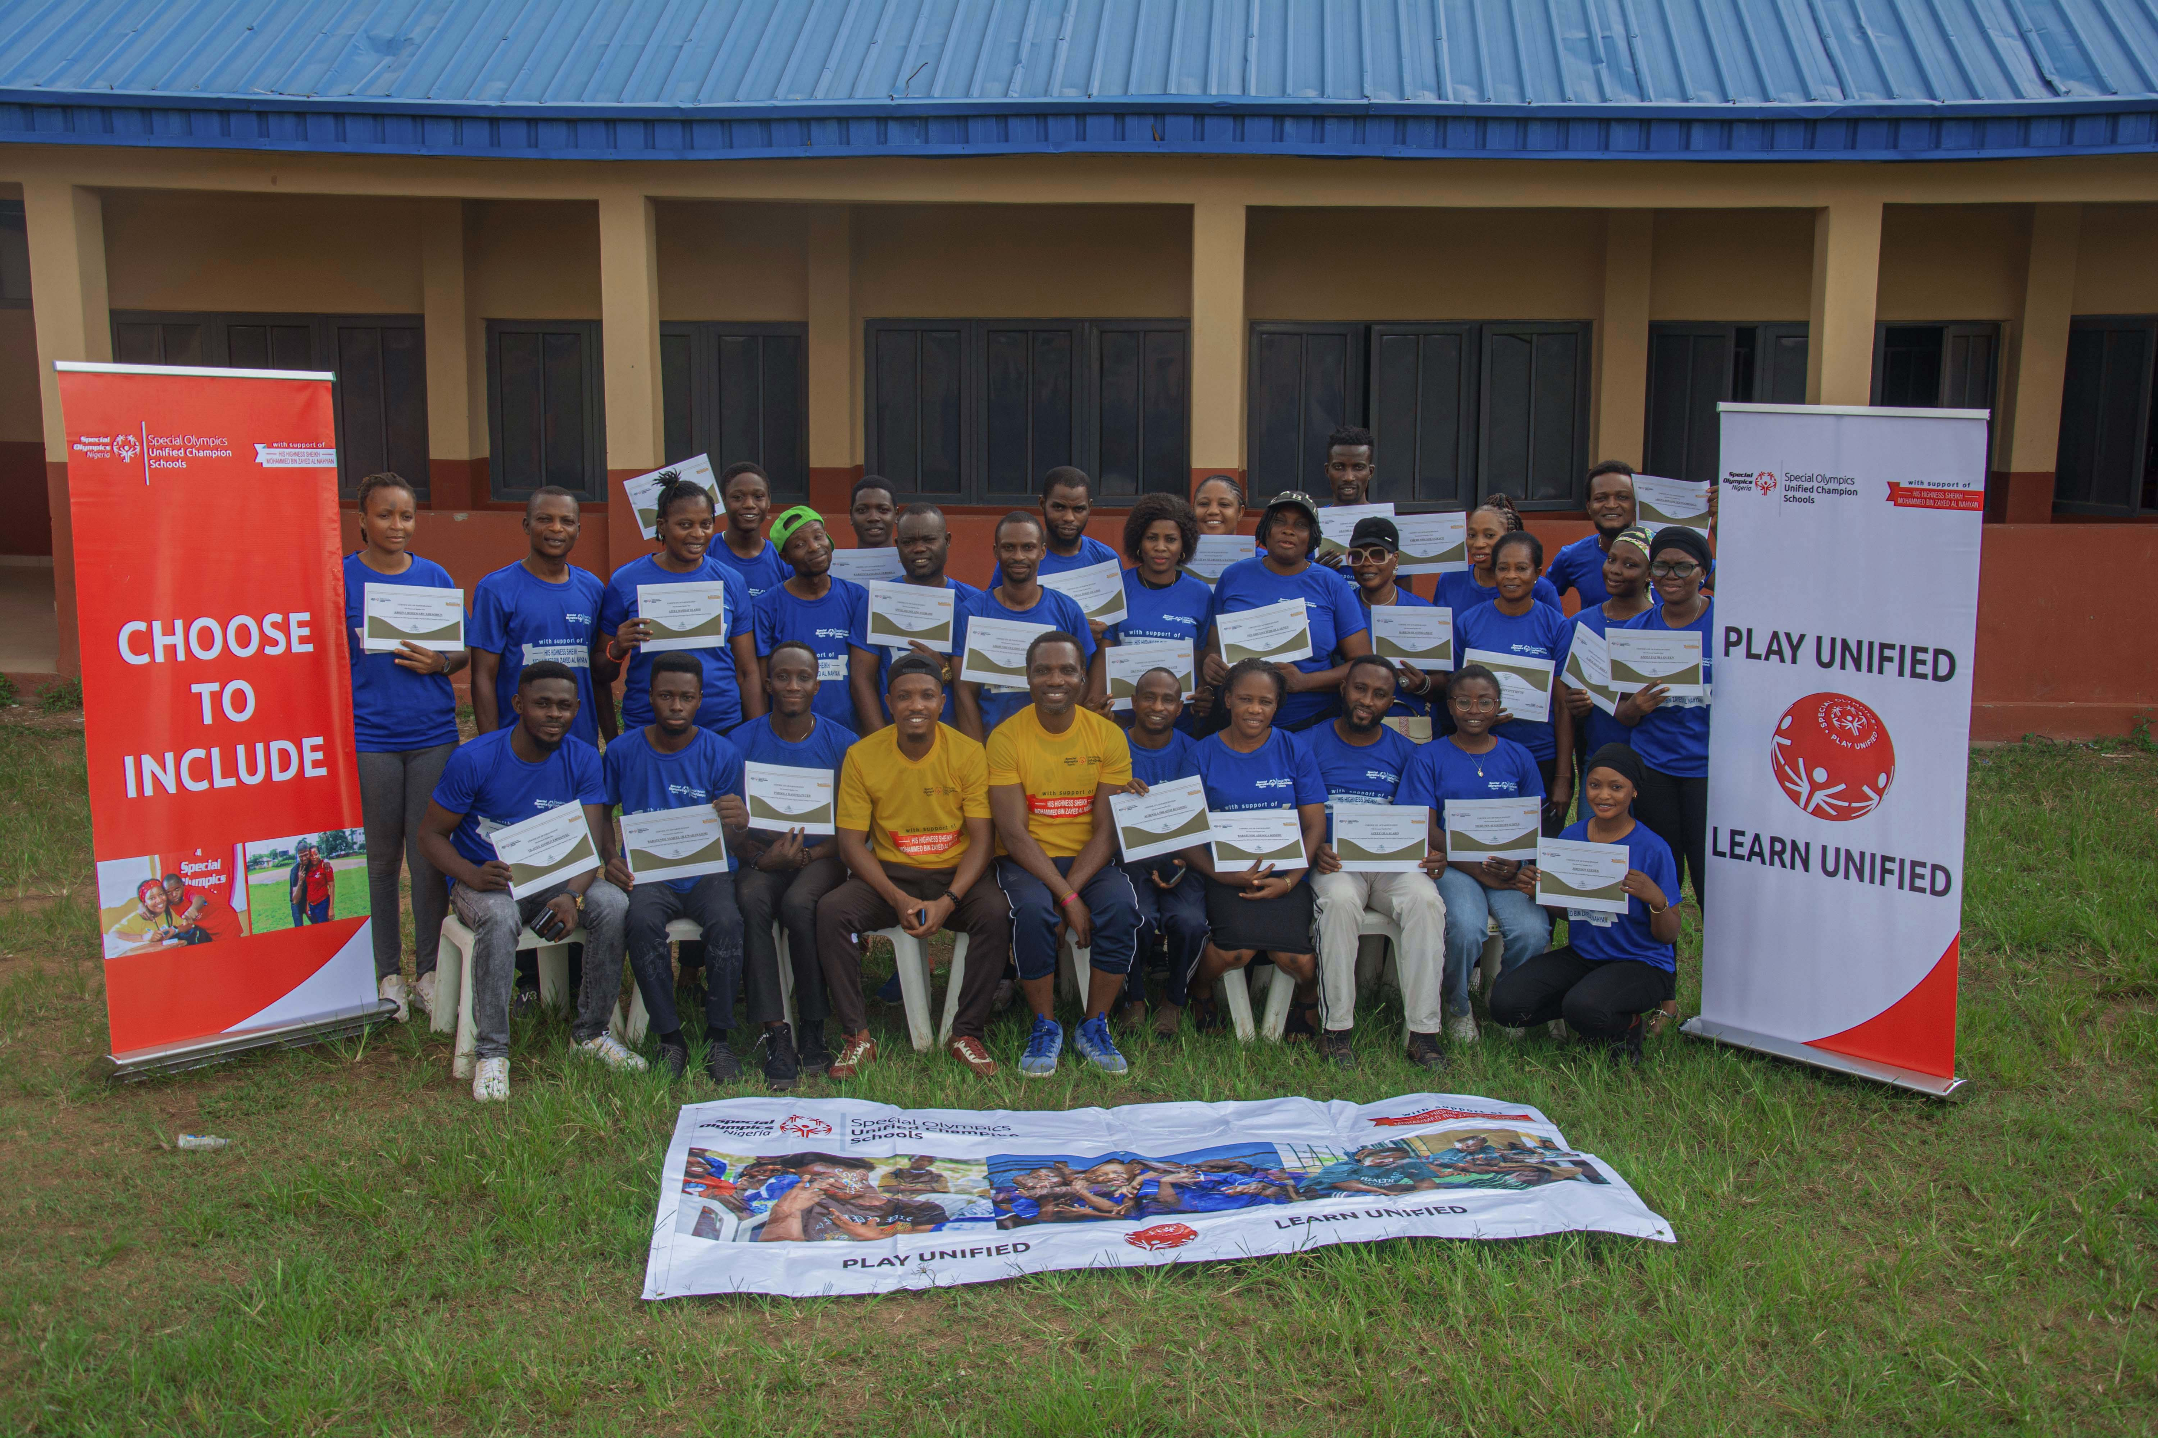
Why Educators?
GLOBAL
YOUTH &
EDUCATION

Slide 4
Educators Training
GLOBAL
YOUTH &
EDUCATION

Slide 5
1. Initial Meeting with School Leaders
In this first meeting with the school, show how Special Olympics programming can make their learning environment more inclusive and exciting. Also, clearly define the next steps for conducting training with the educators of that school.
GLOBAL
YOUTH &
EDUCATION
Tips and tricks:
Check out these infographics:
SO UCS Overview
The impact of Unified Schools around the world

Slide 6
2. Share materials before the training session
If the school agrees, share materials ahead of time to help educators feel prepared. Encourage them to deepen their understanding of Special Olympics through our online courses like:
Global Unified Schools Teacher Training
Unified Sports Coaching course
GLOBAL
YOUTH &
EDUCATION
Tips and tricks:
Check out the SO E-Learning platform

Slide 7
3. Plan the training session
Important aspects to consider
Time: When is the best time to do the training? How many hours will you have?
Audience: Who are the educators participating in the training?
Delivery method:
Will the training be virtual or in-person?
School level: Are you going to work with Pre-k, Primary, Secondary or University teachers?
Include athletes in your UCS Team.
Let them lead ☺
Be creative! Include games and experiential learning
GLOBAL
YOUTH &
EDUCATION

Slide 8
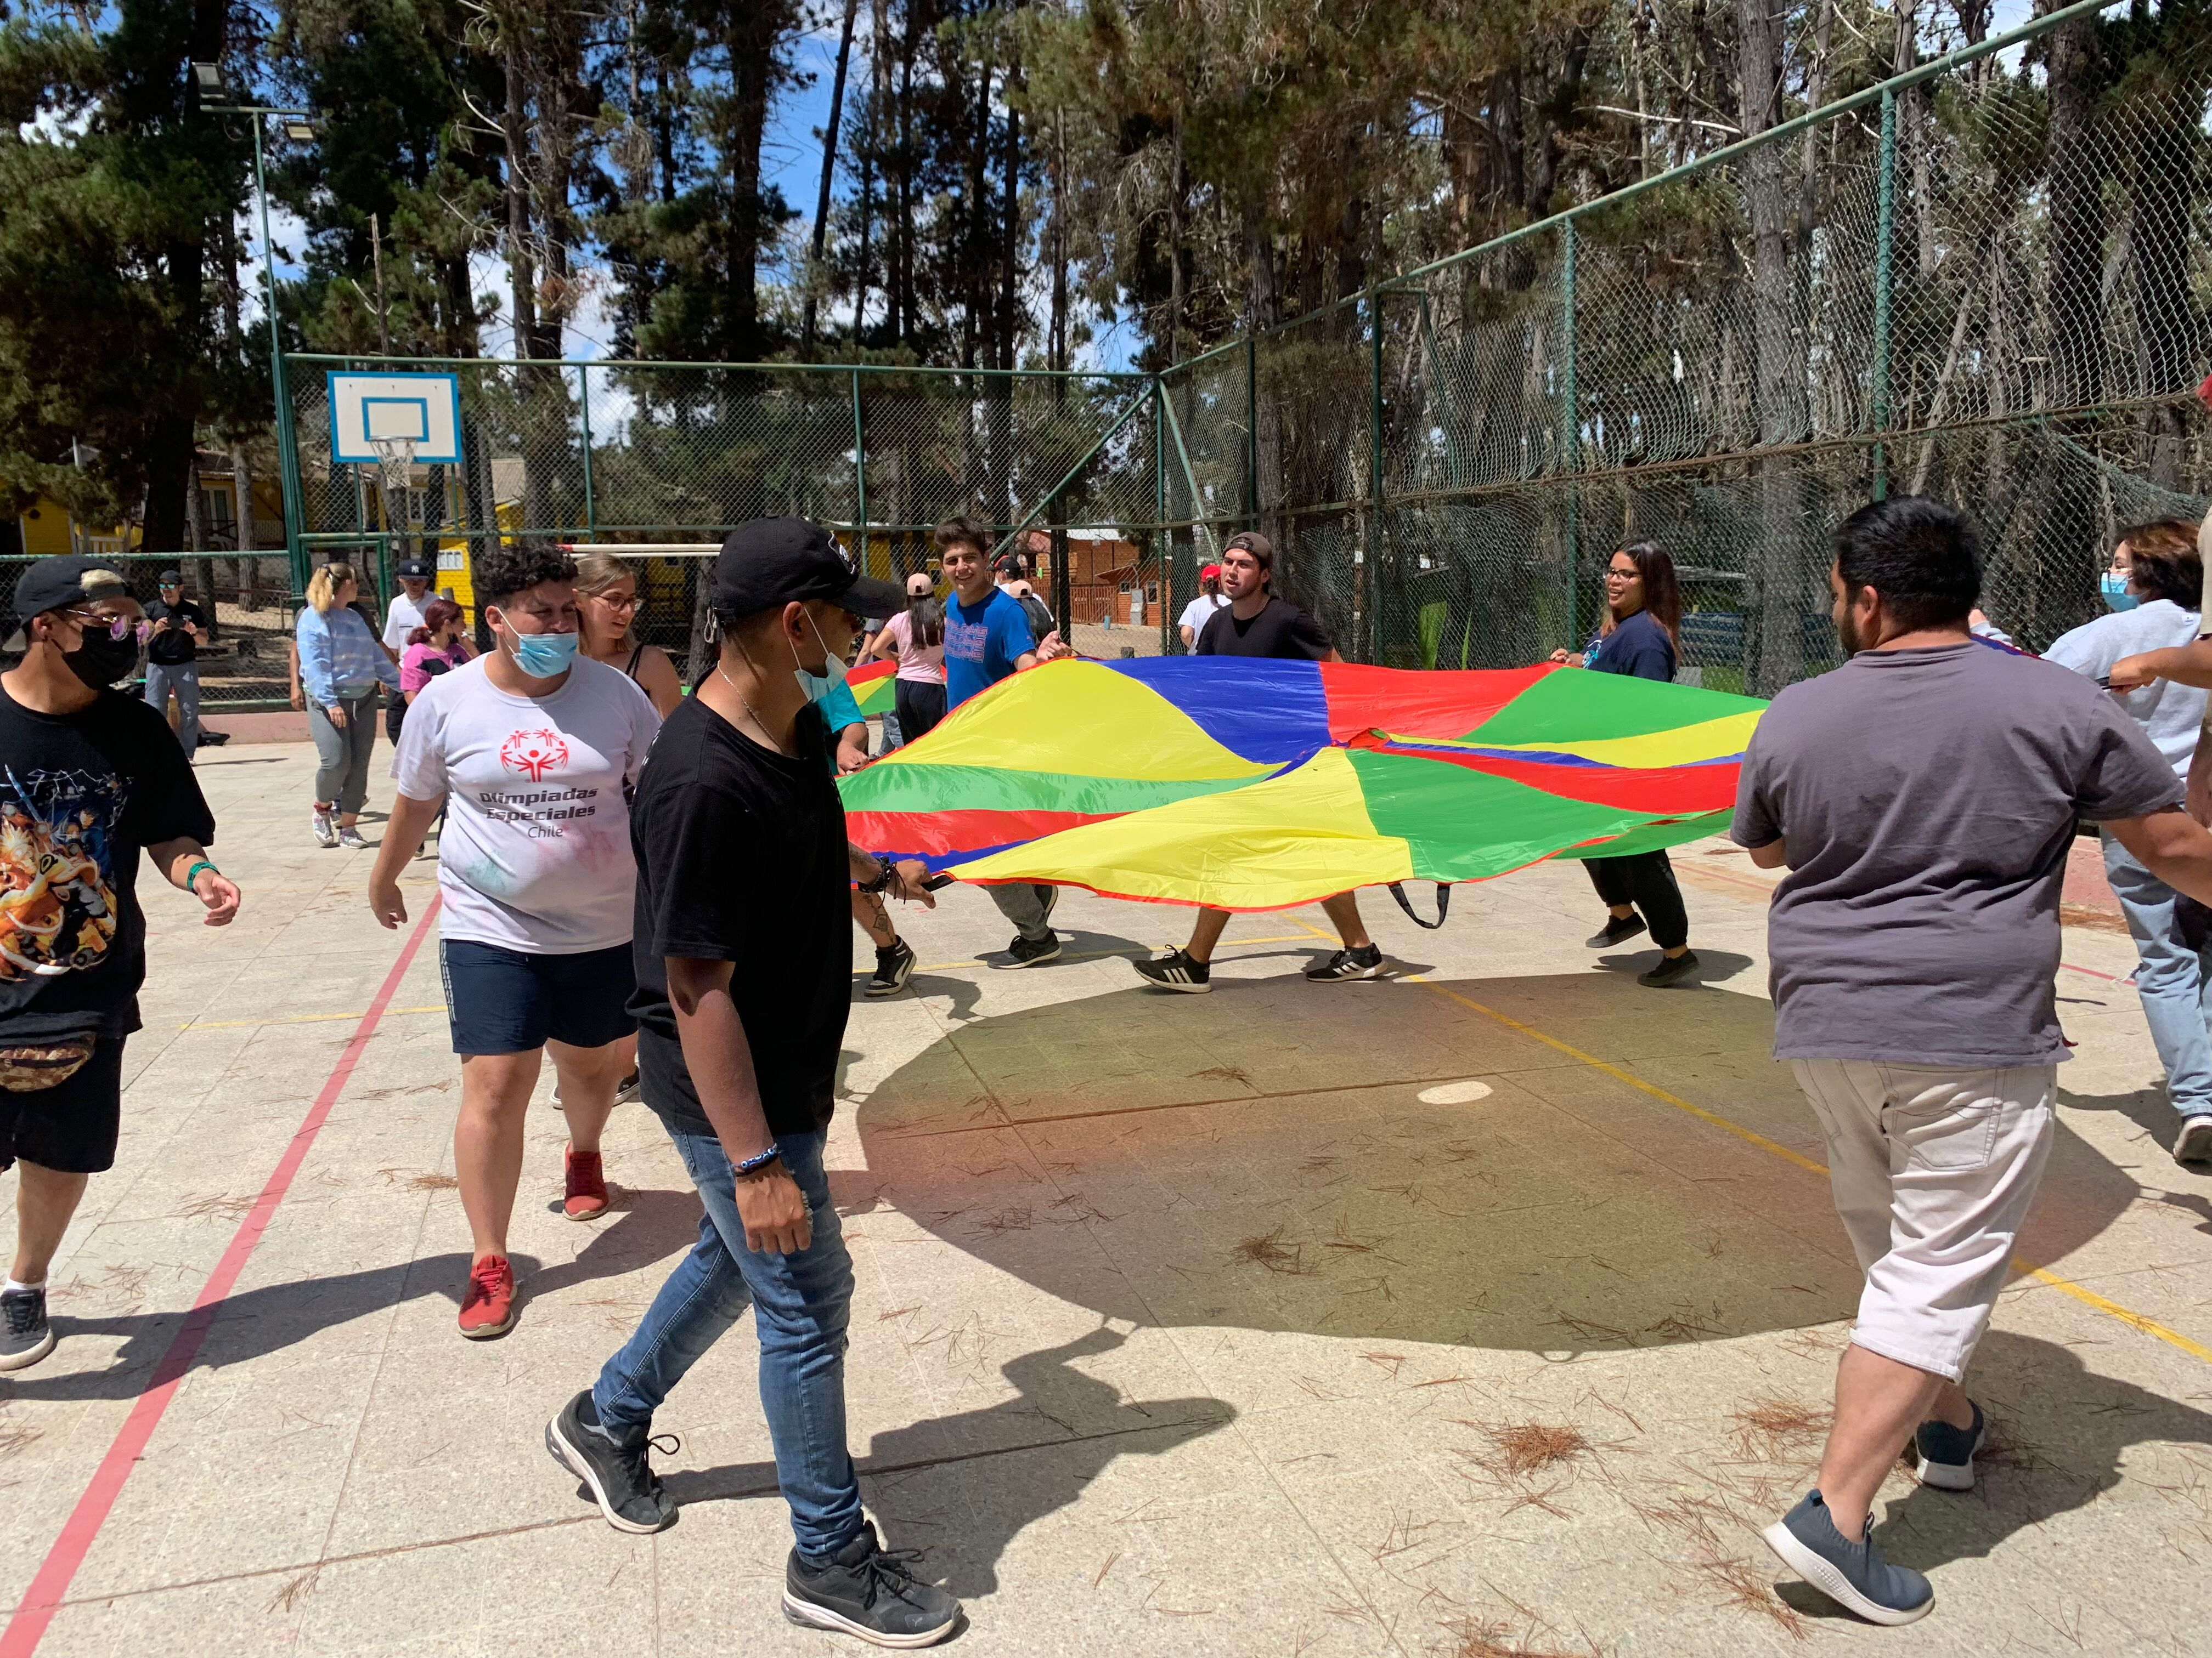
4. Do the training session
GLOBAL
YOUTH &
EDUCATION

Slide 9
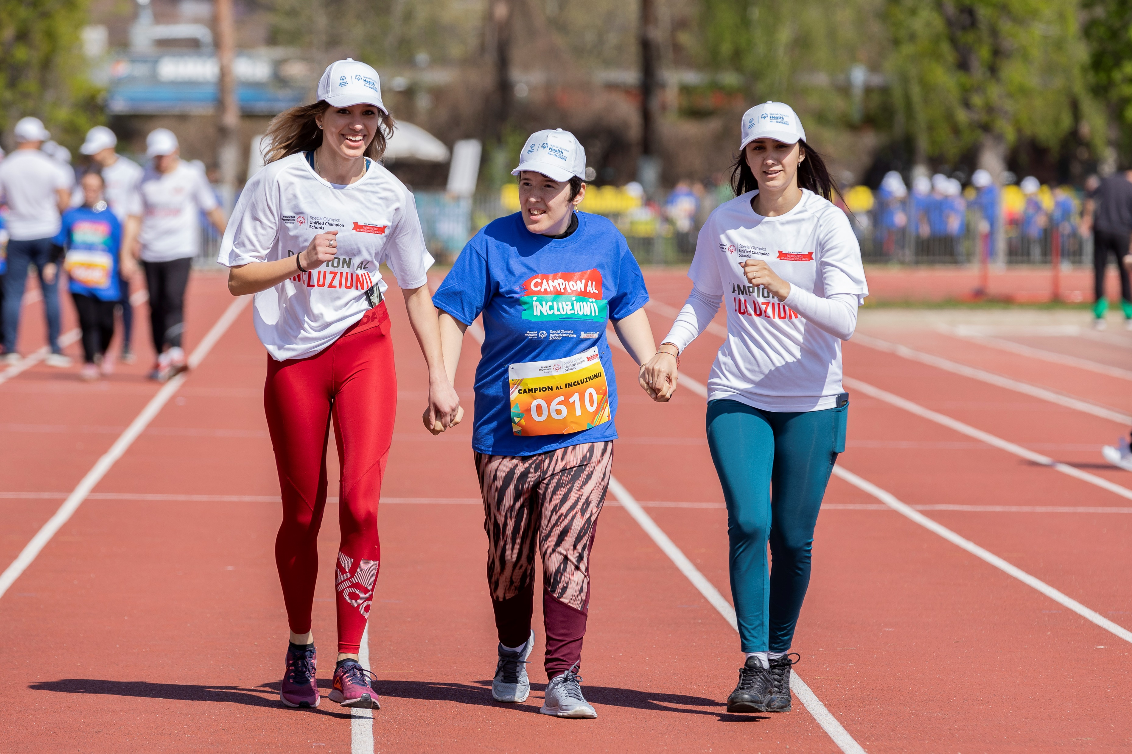
During the training: Introduce
When you meet in person, inspire educators by sharing the mission of Special Olympics. Highlight that we are the world’s largest Movement for inclusion, advocating for the rights of individuals with intellectual disabilities.
GLOBAL
YOUTH &
EDUCATION
Tips and tricks:
Explore the “How to present UCS programming to educators”, and this Workshop slide example

Slide 10
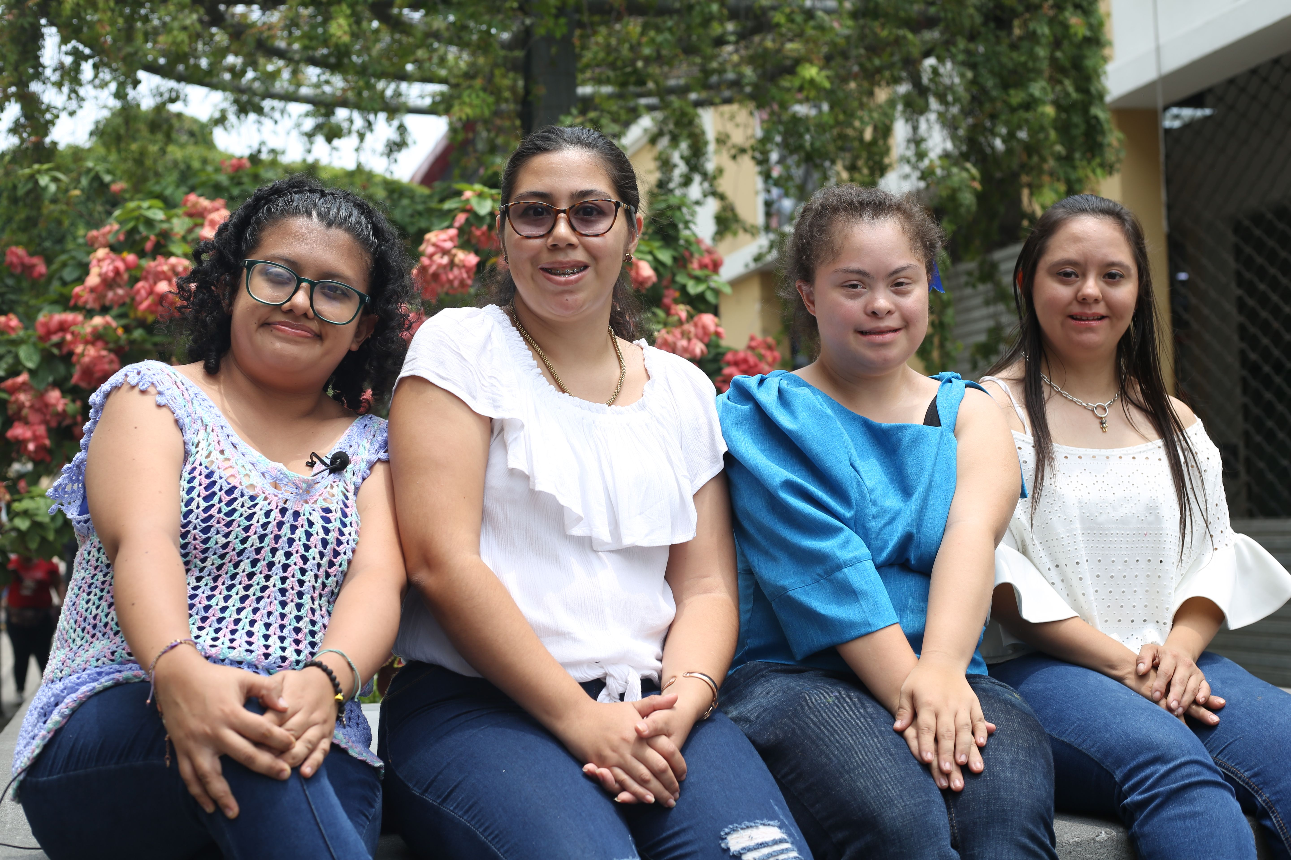
During the training: Raise awareness about ID
Through disability awareness the misconceptions surrounding people with ID can come to light. When these disappears the attitudes and behaviors become more positive and impactful.
GLOBAL
YOUTH &
EDUCATION
Tips and tricks:
Learn more about intellectual disabilities
Check out this activities to work with
groups

Slide 11
During the training: Present the UCS Model
Inspire educators with the UCS model, its three components (Unified Sports, Inclusive Youth Leadership and Whole School Engagement), and all the benefits for schools
GLOBAL
YOUTH &
EDUCATION
Tips and tricks:
Check out the following documents:
Social Emotional Learning and UCS
What is Unified Sports? video

Slide 12
During the training: Take one step forward
Highlight how UCS can support national goals, laws and policies related to inclusive education.
GLOBAL
YOUTH &
EDUCATION
Tips and tricks:
Check out this UNESCO website with information about inclusive education per country

Slide 13
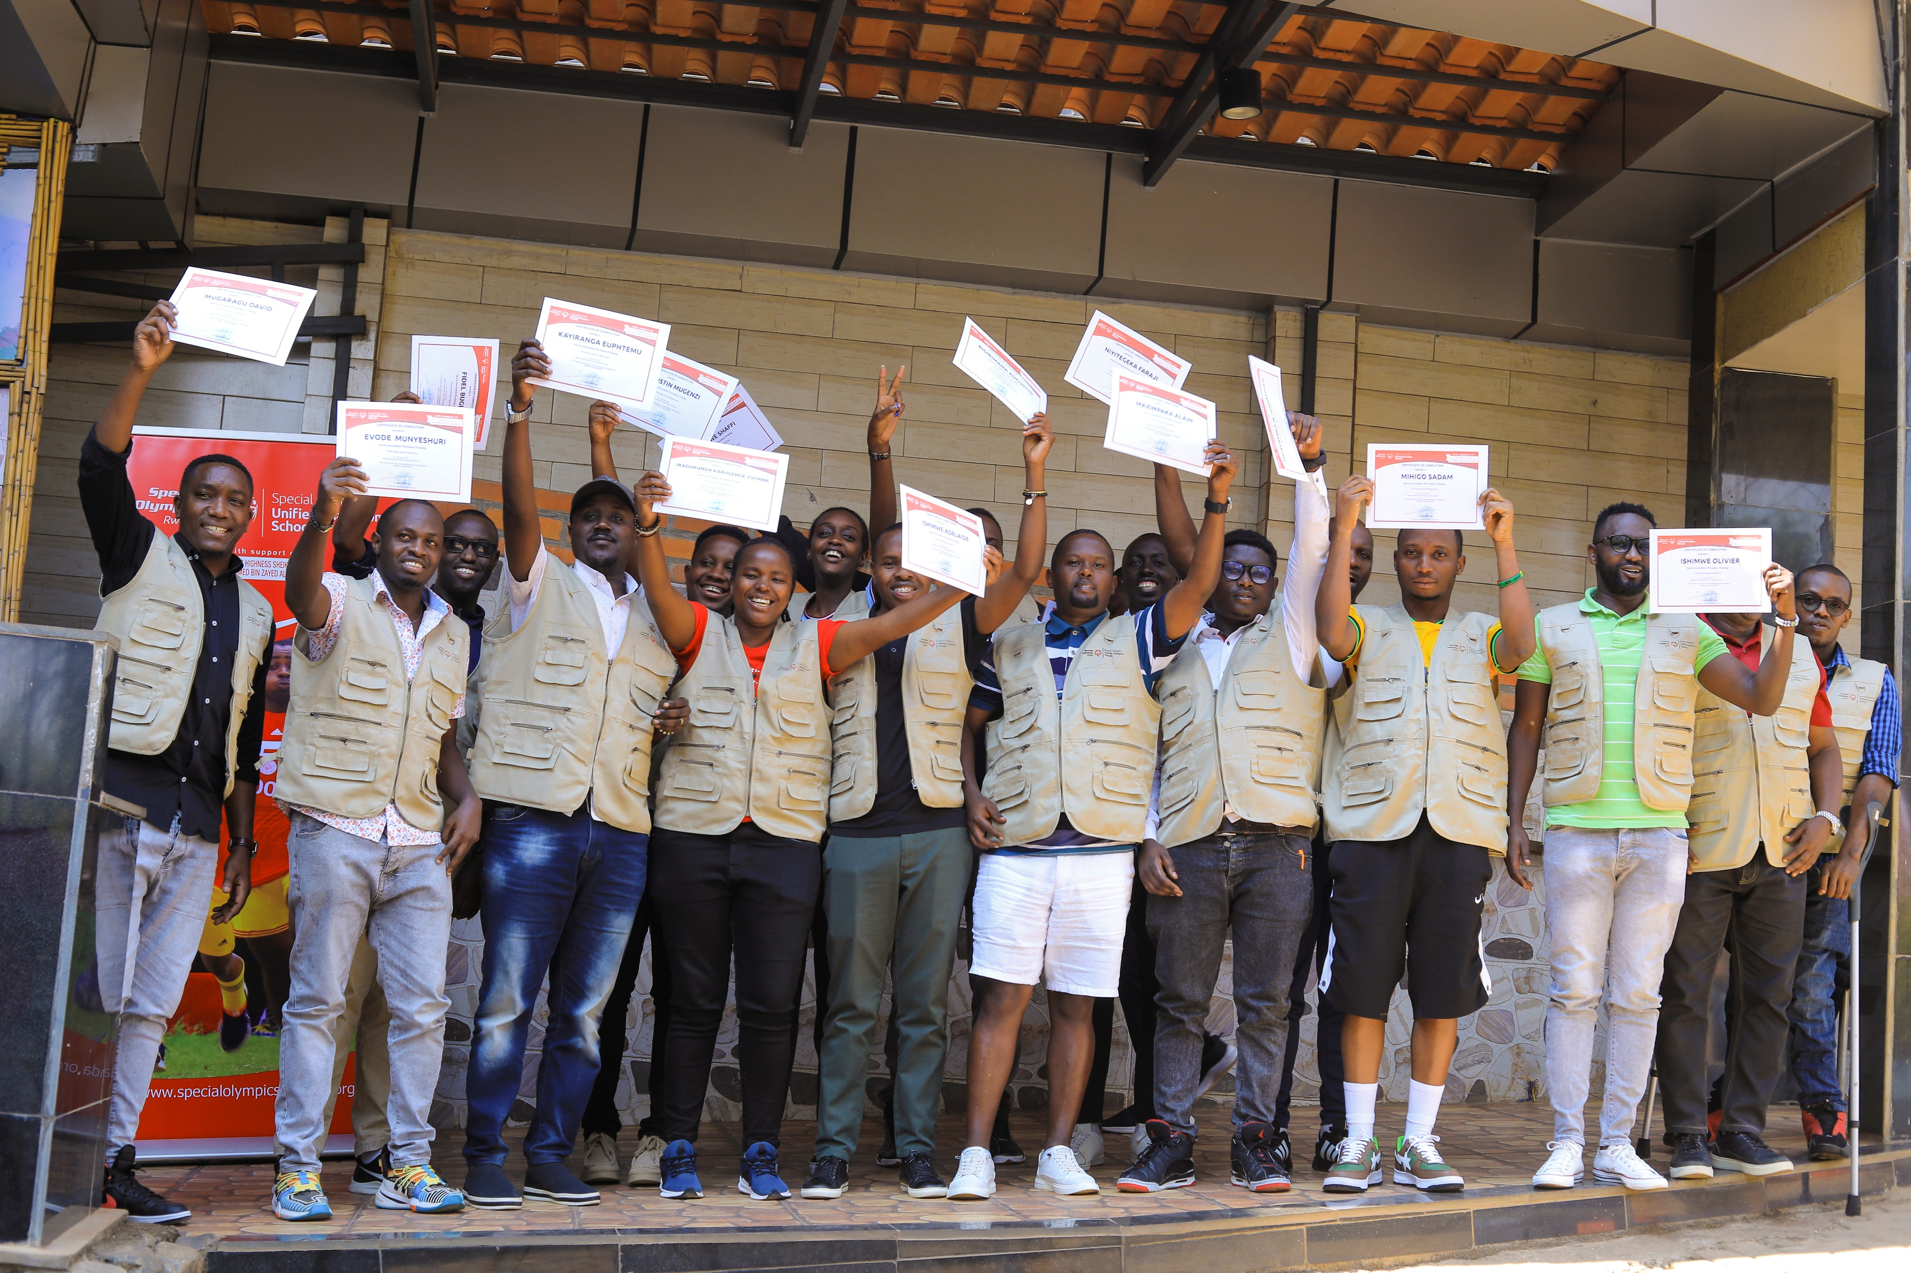
5. Closing the training
GLOBAL
YOUTH &
EDUCATION
If posible, provide certificates.
Set Actionable Next Steps

Slide 14
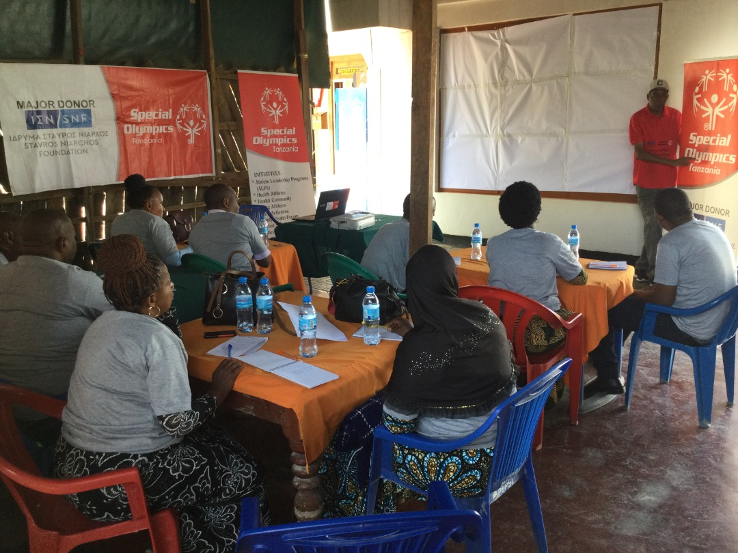
6. Follow up and offer continuous support
Design a plan to follow up with the schools and support the educators that will be leading the UCS model
GLOBAL
YOUTH &
EDUCATION
Tips and tricks:
You can create WhatsApp groups, send them emails, coordinate more school visits.
Find what is the best way for the school!

Slide 15
Resources
GLOBAL
YOUTH &
EDUCATION
How to present programming to educators
Activities to work with groups
UCS Run of Show template
UCS Workshop Checklist form
UCS Workshop Evaluation
UCS Workshop List of Participants

Slide 16
Resources
GLOBAL
YOUTH &
EDUCATION
Platform: UCS Online Program Network

Slide 17
V. Resources
GLOBAL
YOUTH &
EDUCATION

Slide 18
Thank you!

