Slide 1
Unified Champion Schools
Special Olympics Romania
Financial Management

Slide 2
Planning and budgeting
Plan activities according to project goals and budget constraints/ limitations
Create realistic budget and provide as many details as possible to planned expenses (quantities, estimated costs, timing of purchases)
Consider impact of financial fluctuations during the project lifetime (exchange rates, inflation, salary raises, market price increase)
Attach cash-flow forecast to the budget, and protect for delays in installment transfers due to reporting issues or unexpected causes

Slide 3
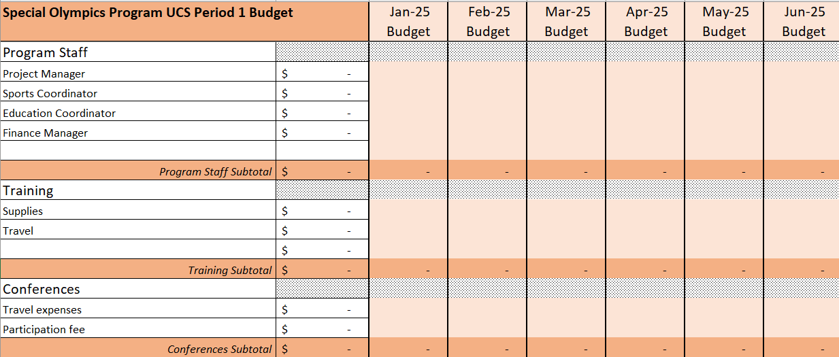
Project Budget

Slide 4
Purchasing
Designate project staff to coordinate purchases based on budget, activities and cash-flow plan. He/she should closely work with project and financial managers.
Make quarter plan of purchases
Establish criteria for selection of providers based on quality and price
Although we supplied equipment and supplies to schools from all-over the country we preferred to purchase them in Bucharest and then shipped to schools
Keep track of inventories and issue purchase orders to suppliers in accordance with planned activities
Try to stay within +/-10% variance of budget assigned for each expense category

Slide 5
Accounting
Keep monthly track of expenses.
Record them in both:
Regular organizational accounting system
Project financial reporting spreadsheet
Assign specific code to each expense for:
Project
Budget category

Slide 6
Reporting (1/4)
Given the 6 months reporting timeframe it is recommended to monthly up-date expenses and balances in the financial reporting file in order to have permanent accurate information about availability of resources

Slide 7
Reporting (2/4)
Create a simple tool to summarize financial progress
Unified Champion Schools
SO (program name)
Year | 2025 |  | 2026 |  | 2027 |  | Total
Semester | Jan-Jun | Jul-Dec | Jan-Jun | Jul-Dec | Jan-Jun | Jul-Dec
Revenue
Expenses
Balance
Remaining Amount (of full budget)
Last installment received | $0
Cash at the end of Jun 2025 | $0
Total spent from last installment | $0

Slide 8
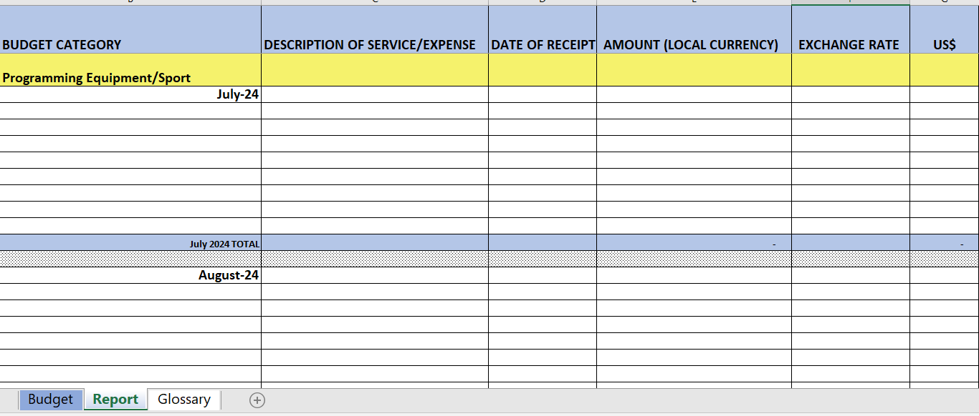
Reporting (3/4)

Slide 9
Reporting (4/4)
For US$ exchange rate use
https://www.oanda.com/currency-converter/en/
The reporting file is password protected for structural changes. Sometimes you may need more lines for a budget category in a specific month. In that case you ask SOI financial coordinator for insertion of more lines in that category in the respective month.

Slide 10
Cristian Ispas
National Director
Special Olympics Romania Foundation
c.ispas@specialolympics.ro
https://specialolympics.ro/programe/scoala-generatiei-unificate/

