Slide 1
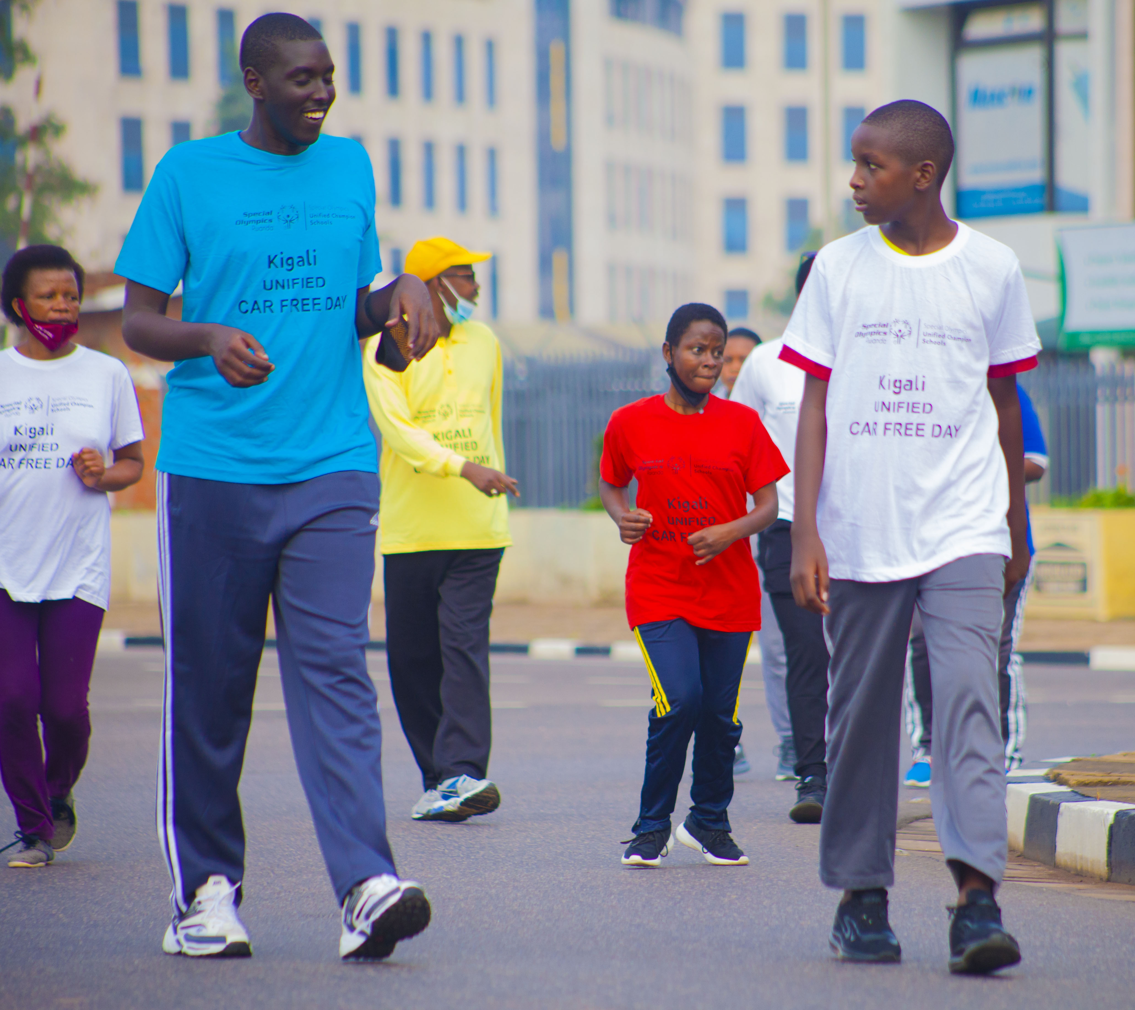
Breaking Barriers Through Unified Sports
(Unified Sports | Family Engagement | Community Inclusion)

Slide 2
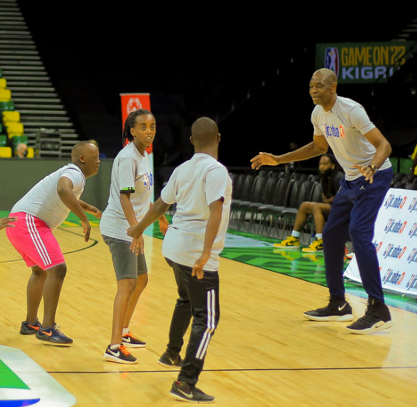
Introduction
"Special Olympics Rwanda (SOR) is committed to promoting inclusion and empowering individuals with intellectual disabilities through sports, education, and community engagement. One of our key initiatives is the Unified Champion Schools (UCS) program.“
UCS is a school-based program that fosters an inclusive environment where students with and without intellectual disabilities learn, play, and grow together. Through Unified Sports, inclusive youth leadership, and whole-school engagement, we create opportunities for meaningful interaction and long-term social change.

Slide 3
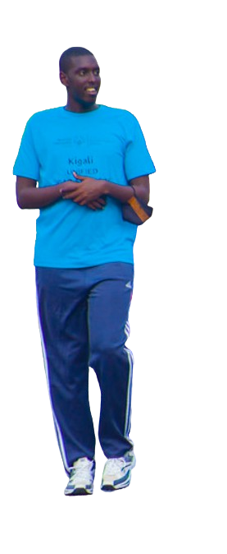
“ We will share the inspiring story of Gasana Kenny, a student with cerebral palsy at Tubiteho School, who, through Unified Sports, found a sense of belonging and became an advocate for inclusion alongside his mother, Gasana Louise, showcasing how UCS transforms lives and strengthens families, schools, and communities. "

Slide 4
Unified sport &School for People ID?
Why are school and sports important for people with ID?
The answer is simple:
Because they provide an opportunity to learn, socialize, and grow.
School helps children with ID develop cognitive and social skills, while sports offer them a chance to build confidence, improve their health, and interact with peers.
Unified Sports, in particular, is a powerful tool that brings together students with and without ID to train and play together. It fosters friendships, promotes inclusion, and helps break barriers that often isolate children with disabilities.

Slide 5
Family -The First Team in Inclusion
Quote from Gasana Louise (Kenny’s Mother): "Inclusion starts with us, the parents—it is our duty to ensure our children are seen, heard, and empowered."
Encouraging Social Inclusion
- Inclusion starts at home ,families model acceptance and belonging.
- Partnering with schools creates a supportive environment for children with ID.
Advocating for Equal Opportunities
- Families are powerful voices for inclusive education and sports.
- Their advocacy helps break barriers and change societal perceptions.
Providing Emotional & Moral Support
- Encouragement builds confidence and resilience in children with ID.
- A strong support system empowers them to engage, lead, and thrive.

Slide 6
From the Classroom to the Field
Kenny’s Unified Journey
"When I play, I feel like I belong. Sports gave me friends, confidence, and a voice. Inclusion isn’t just for school it’s for everywhere! Let’s open doors for everyone, because we all deserve a chance to shine." Gasana Kenny
- On the Court:
Kenny found joy and confidence playing Bocce and basketball, where every pass, cheer, and high-five strengthened his friendships and sense of belonging. Sports became his gateway to inclusion, proving that teamwork goes beyond the game.
- Beyond School:
Kenny made history as the first person with ID to join Rwanda’s Unified Car Free Day, proudly stepping onto the streets to play, engage, and inspire a more inclusive community.

Slide 7
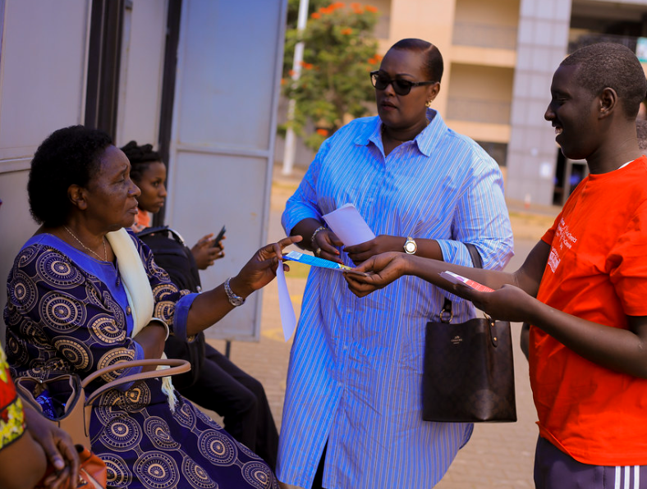
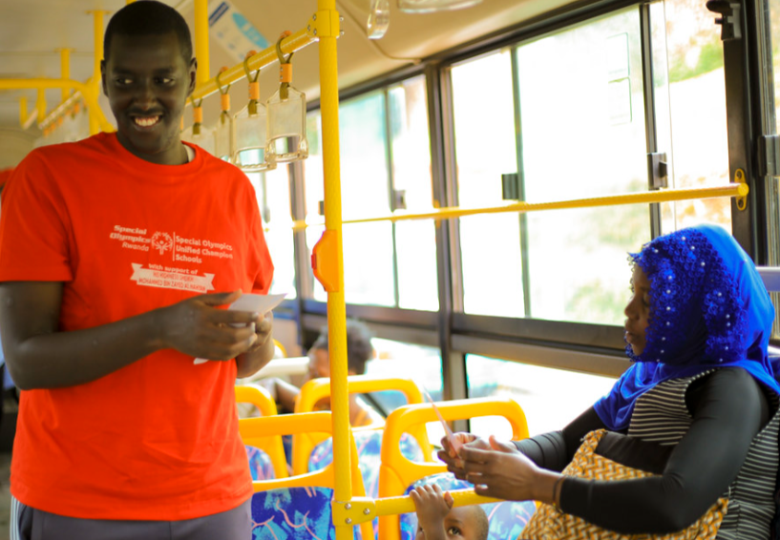
Parents and athletes as Powerful Advocates for Inclusion
🚍 Taking Inclusion to the Community
Kenny and his mother, Louise, stood proudly on downtown buses, sharing their message with confidence, disability is not inability! They encouraged passengers to embrace inclusion and support equal opportunities for people with ID in education, sports, and work.
🤝 Parents Leading the Way
By advocating together, parents can break barriers, change perceptions, and create a more inclusive society. When families speak up, communities listen!

Slide 8
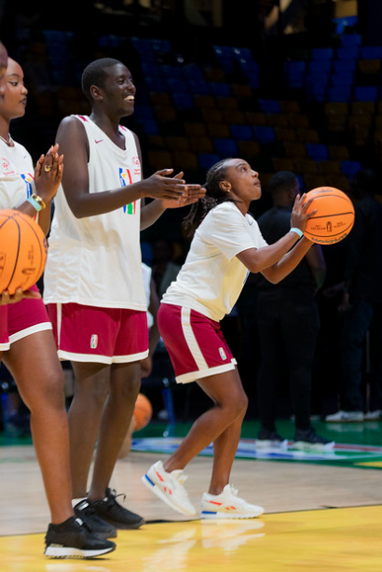
The Power of Transforming Schools Through UCS
🏫 A More Inclusive Tubiteho School
Through Unified Sports, Tubiteho School became a place where friendships flourished, barriers disappeared, and inclusion thrived. Students with and without ID bonded through play, learning from each other and building lifelong connections. Sports transformed perspectives, making acceptance a daily reality rather than an exception. Inspired by Kenny’s journey, more students with ID found the confidence to step onto the field, proving that when given the opportunity, everyone has the power to play, belong, and shine.
🚀 Expanding Inclusion.
Schools can train teachers, create more Unified Sports opportunities, and engage families to ensure every child, like Kenny, thrives in a truly inclusive environment!

Slide 9
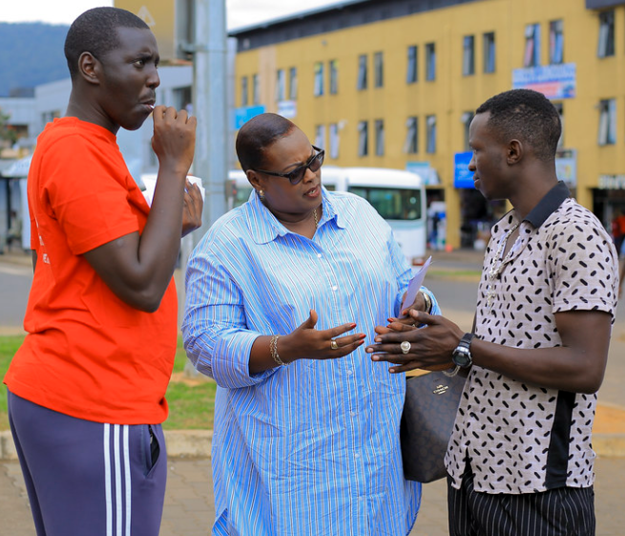
Testimonies from Kenny & His Mother
Gasana Kenny’s quote:
“Before, I watched others play. Now, I play too. I feel happy, I feel like I belong.”
Gasana Louise’s quote:
“I used to worry about my son’s future. Now, I see a world that welcomes him. Inclusion is possible.”

Slide 10
Inclusion Starts with Us
“Kenny’s journey shows that sports, family support, and advocacy can transform lives. When schools, families, and communities work together, inclusion becomes more than a goal it becomes a reality. Let’s continue to open doors, break barriers, and create a world where everyone belongs. Together, we make inclusion unstoppable!”

Slide 11
