Slide 1
MEDIA COMUNICATION
SPECIAL OLYMPICS SERBIA

Slide 2
TYPES OF MEDIA
Special Olympics Serbia works with 3 types of media in our Country:
National-has the most coverage (seen in the whole of the Country), the most difficult to get in touch with, but not necessarily the most efficient for the Project purpose
Regional-mostly covers Regional news, more reachable, better ,,partner” for the Project
Local- the best partner for the Project purpose ,easy reachable, suits the purpose

Slide 3
MEDIA
Special Olympics Serbia has a different approach when it comes to reaching out to the media, depending on their type:
National- send out prepared press release in advance, invitation to an event if applicable, send to the National TV outlet by mail with HI quality pictures and quotes. In best case scenario a hi quality video. There is no guarantee that any news or information will be published.
Regional-in very many cases they call us, as they picked up on our Project from the local TV-newspaper
Local-send out information about a Project/event taking place. In most cases they send out their reporter/tv crew and make their own report. Local news papers will always print the materials we send them. If we have a hi quality photo, that will be published as well.

Slide 4
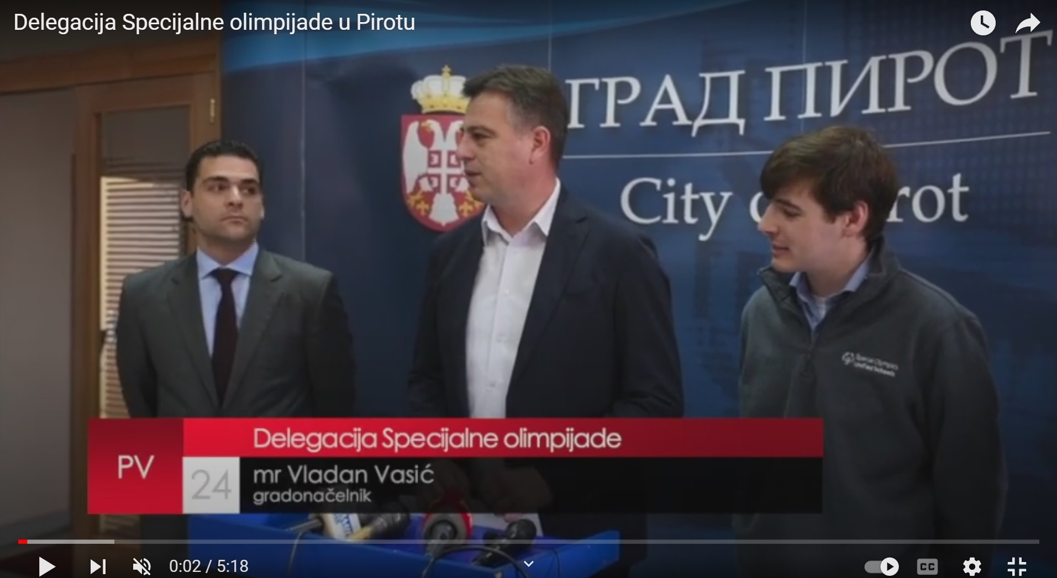
MEDIA
Pay attention if in the community that you implement your project, you have other forms of media:
School TV/Radio, newspaper- these can be very useful as this project is school based. Lots of parents read the school newspaper, as well as representatives of local government and ministry of education.
Community TV/radio/news paper

Slide 5
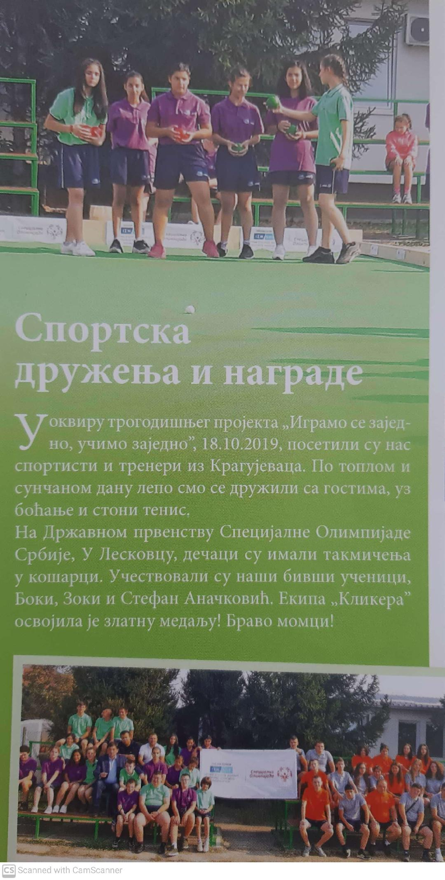
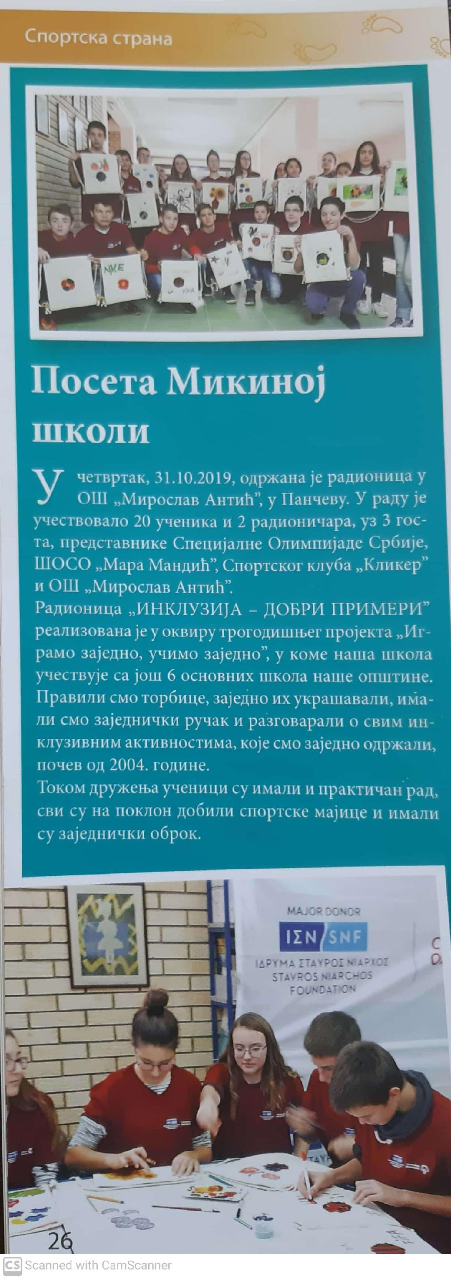
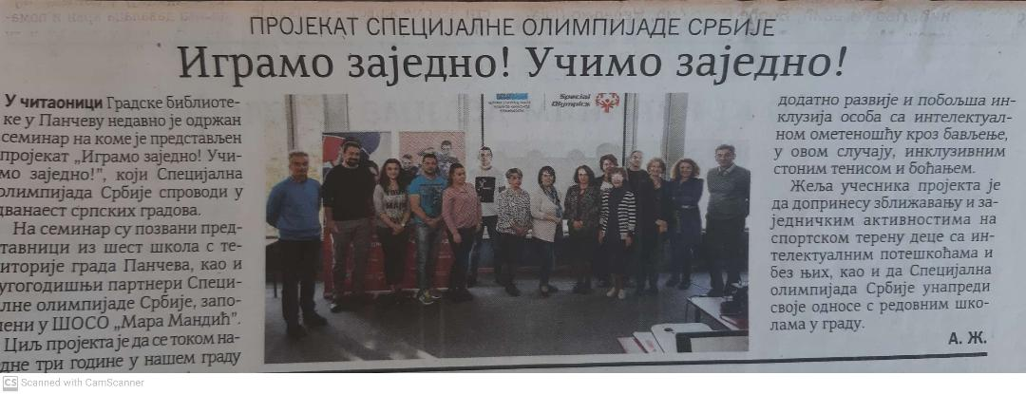
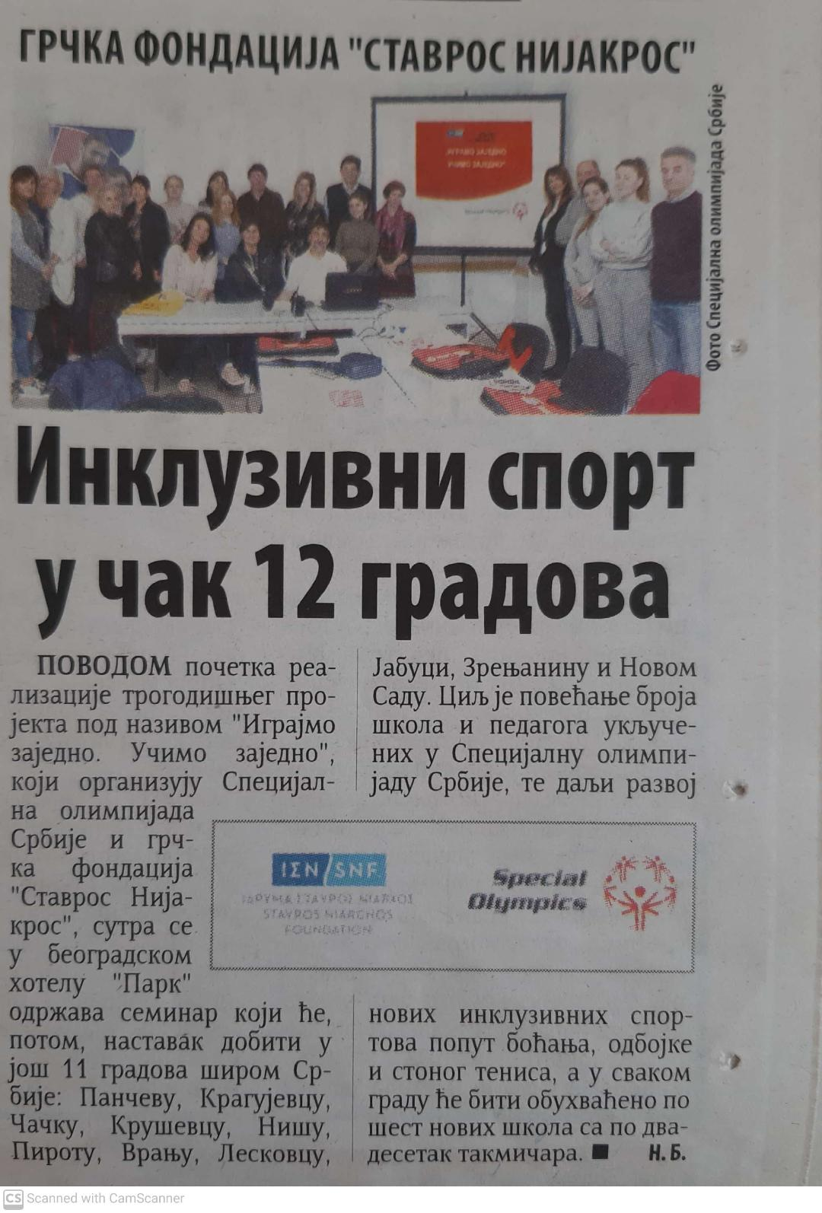
MEDIA

