Slide 1
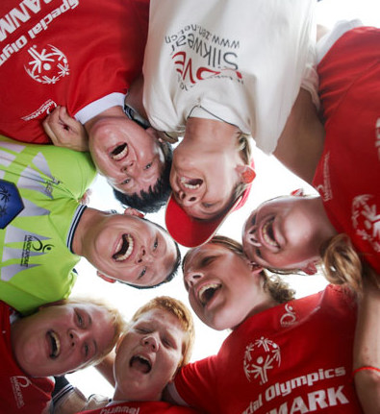
GII 101: The Basics
(for Educators/Youth)
JENNI NEWBURY Curriculum & Education Resource Manager, Special Olympics
September 2011

Slide 2
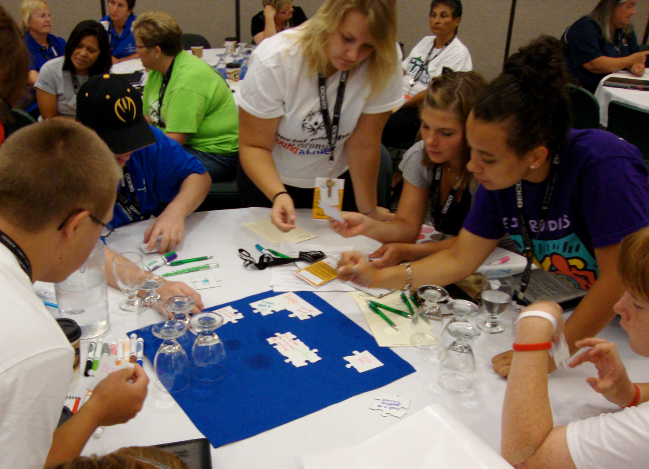
Content of Webinar
Intro to GII Lessons & Resources
Website
Talking About GII…
What We Are Up Against
Empowering Youth
Q & A
2

Slide 3
What do you know about Get Into It and Project UNIFY?
3

Slide 4
What age groups do you work with?
4

Slide 5
PROJECT UNIFY®
A strategy to activate youth, engage educators, and promote school communities of acceptance and inclusion where all young people are agents of change.
Utilizing the sports and education initiatives of Special Olympics, Project UNIFY®:
Fosters respect and dignity for people with intellectual disabilities
Changes actions and attitudes among their peers without intellectual disabilities.
CHARACTERISTICS
Unifying Sports Program
Youth Leadership
School/Community Collaborations
Creating/Sustaining Relationships
Communications
Professional Development
Continuous Improvement
5

Slide 6
Intro to Get Into It

Slide 7
Sponsors:
U.S. Department of Education
Mattel
Ray & Stephanie Lane
Endorsed by:
American Federation of Teachers (AFT)
American Association for Physical Activity and Recreation (AAPAR)
American School Counselor Association (ASCA)
Council of Exceptional Children
Community of Caring
Joseph P. Kennedy Jr. Foundation.
WHAT IS GET INTO IT?
An online resource for teachers to introduce acceptance
A resource downloaded by 40,000 teachers
A Whole school approach:
Teachers receive standards-aligned, inclusive lessons (launched to 3 million teachers and administrators)
Students with and without ID collaborate on projects and activities through service-learning and experiential-learning
Serves as complement to other school activities such as Spread the Word to End the Word Campaign®, Unified Sports® or Fans in the Stands
7

Slide 8
2010 RELAUNCH
The Get Into It interactive, age-appropriate service-learning lessons are designed to advance student’s civic knowledge and skill development, promote acceptance and understanding of people’s differences to motivate them to become advocates for and together with all people.
Our new, free K-12 Get Into It resources are available online: www.specialolympics.org/getintoit.
8

Slide 9
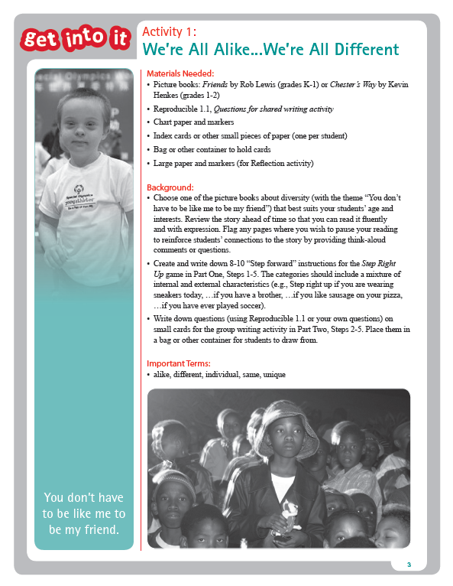
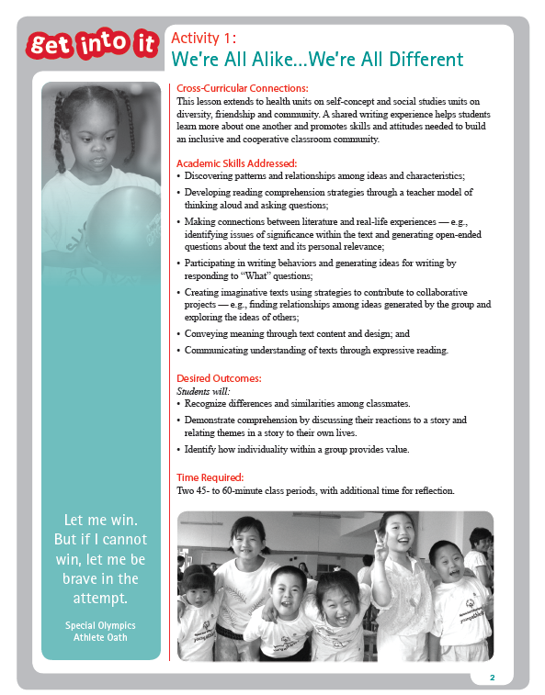
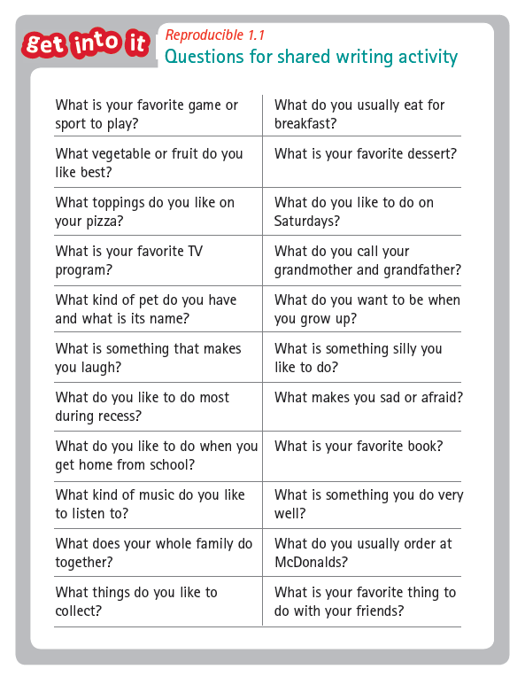
LESSON COMPONENTS
Academic Skills Addressed
Desired Outcomes
Time Required
Materials Needed/Background
Activity Steps & Suggestions
Reflection/Suggested Assessment
Cross-Curricular Extensions
Worksheets
9

Slide 10
ADDITIONAL ELEMENTS…
10

Slide 11
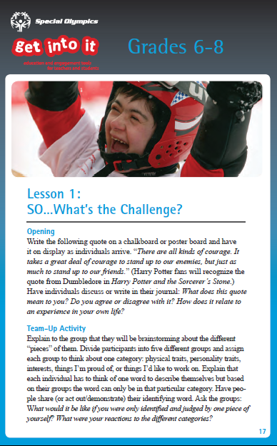
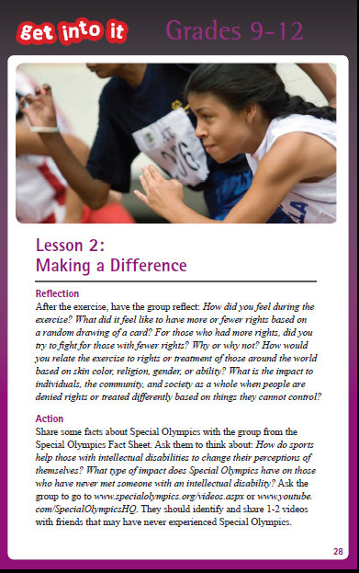
GII Active
Condensed version of K-12 GII Lessons based on more physical activity and discussions. Designed for less-structured environments (recess, after-school programs, sports teams)
11

Slide 12
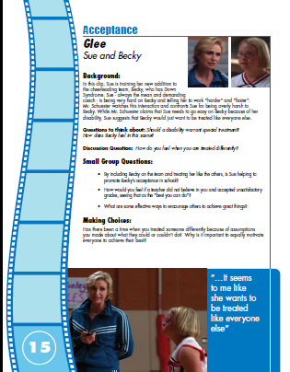
Movies that Move
Clips from films and TV shows based on themes of Different Abilities, Acceptance, Power of Words, and Youth Leadership with teacher’s guide
12

Slide 13
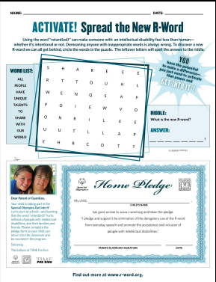
TFK Teacher’s Guide
Learning Magazine Activity Teaser
13

Slide 14
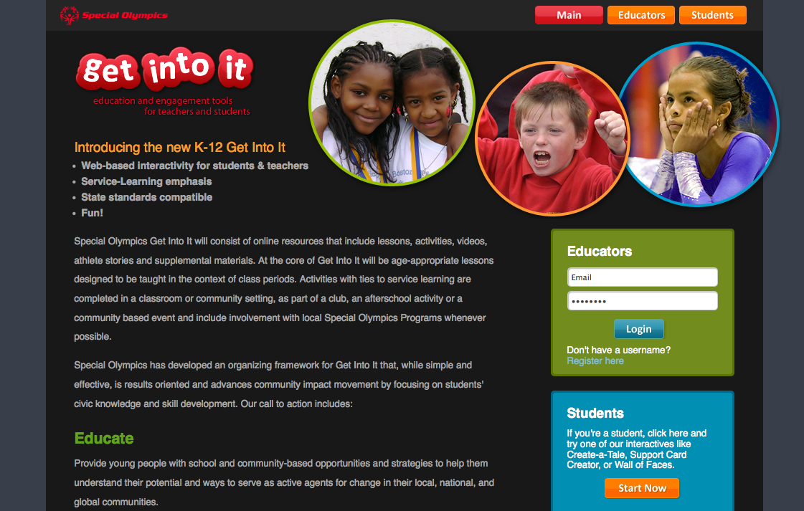
INSERT SCREEN SHOT
The Website
14

Slide 15
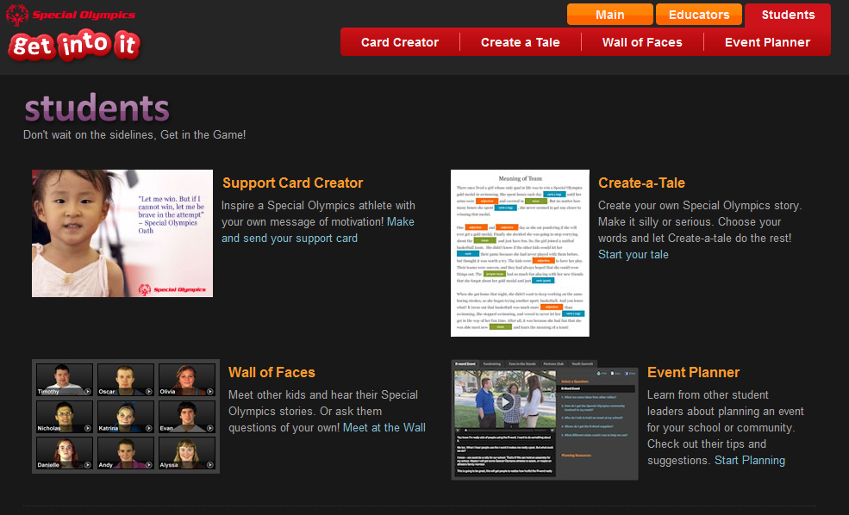
Student Activities
For all ages. Make a card. Make a story. Meet a friend. Make a difference.
15

Slide 16
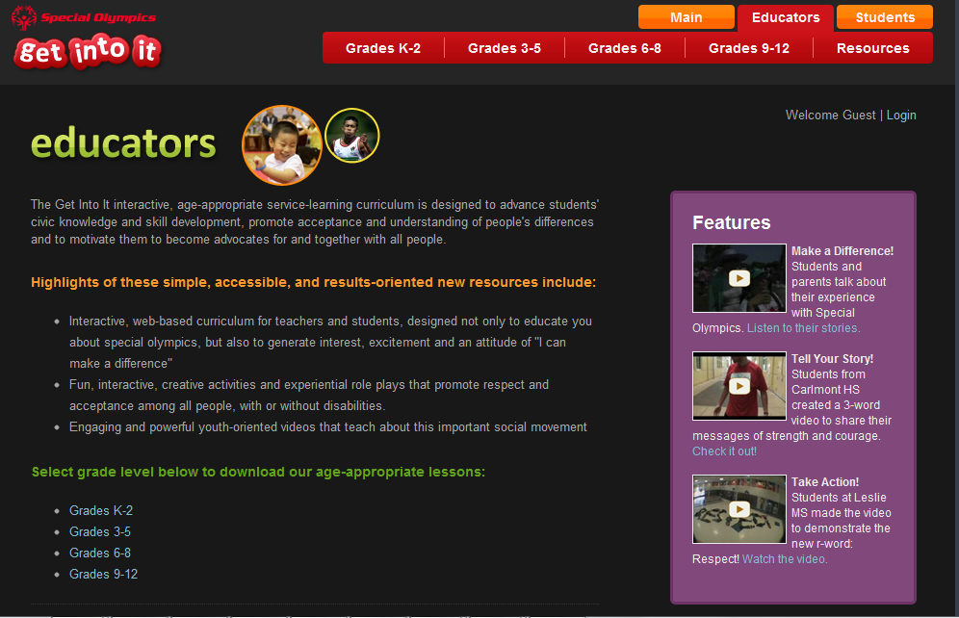
Educator Section
Create an account.
Download the lessons.
16

Slide 17
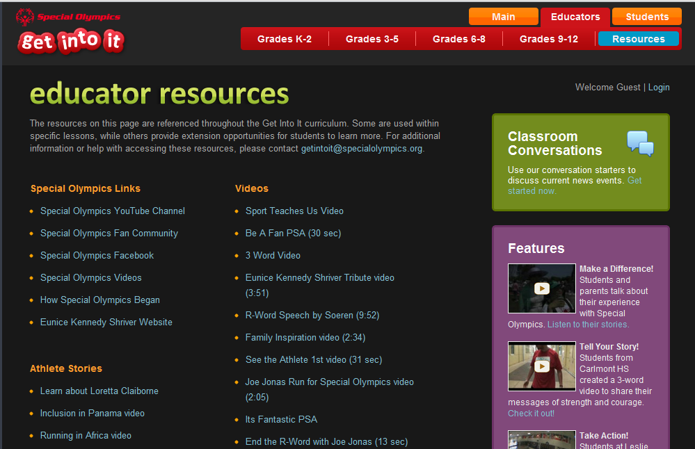
Resources Page
Links to all resources throughout the GII Lessons
17

Slide 18
Classroom Conversations
Builds on current events in our community. Can be used as a continuation or a great start to the conversation.
Access through Educator Resources Page
18

Slide 19
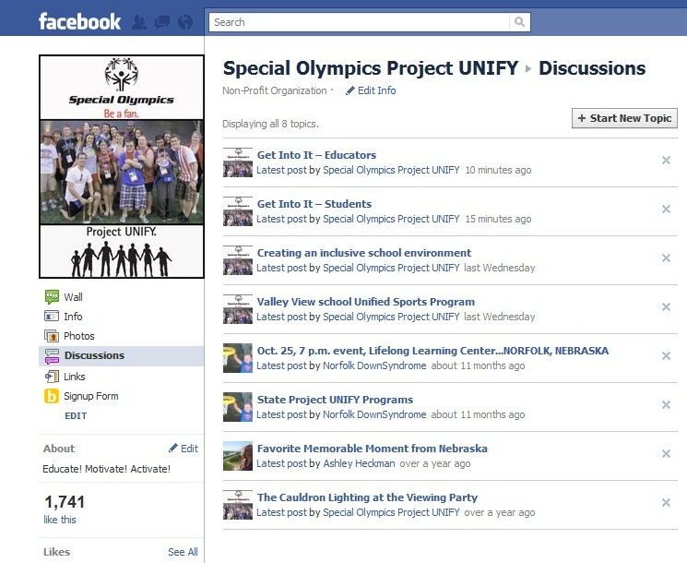
Facebook Discussions
For both Students & Educators. Share ideas. Share Perspectives. Share stories. Win Prizes.
www.facebook.com/projectunify
19

Slide 20
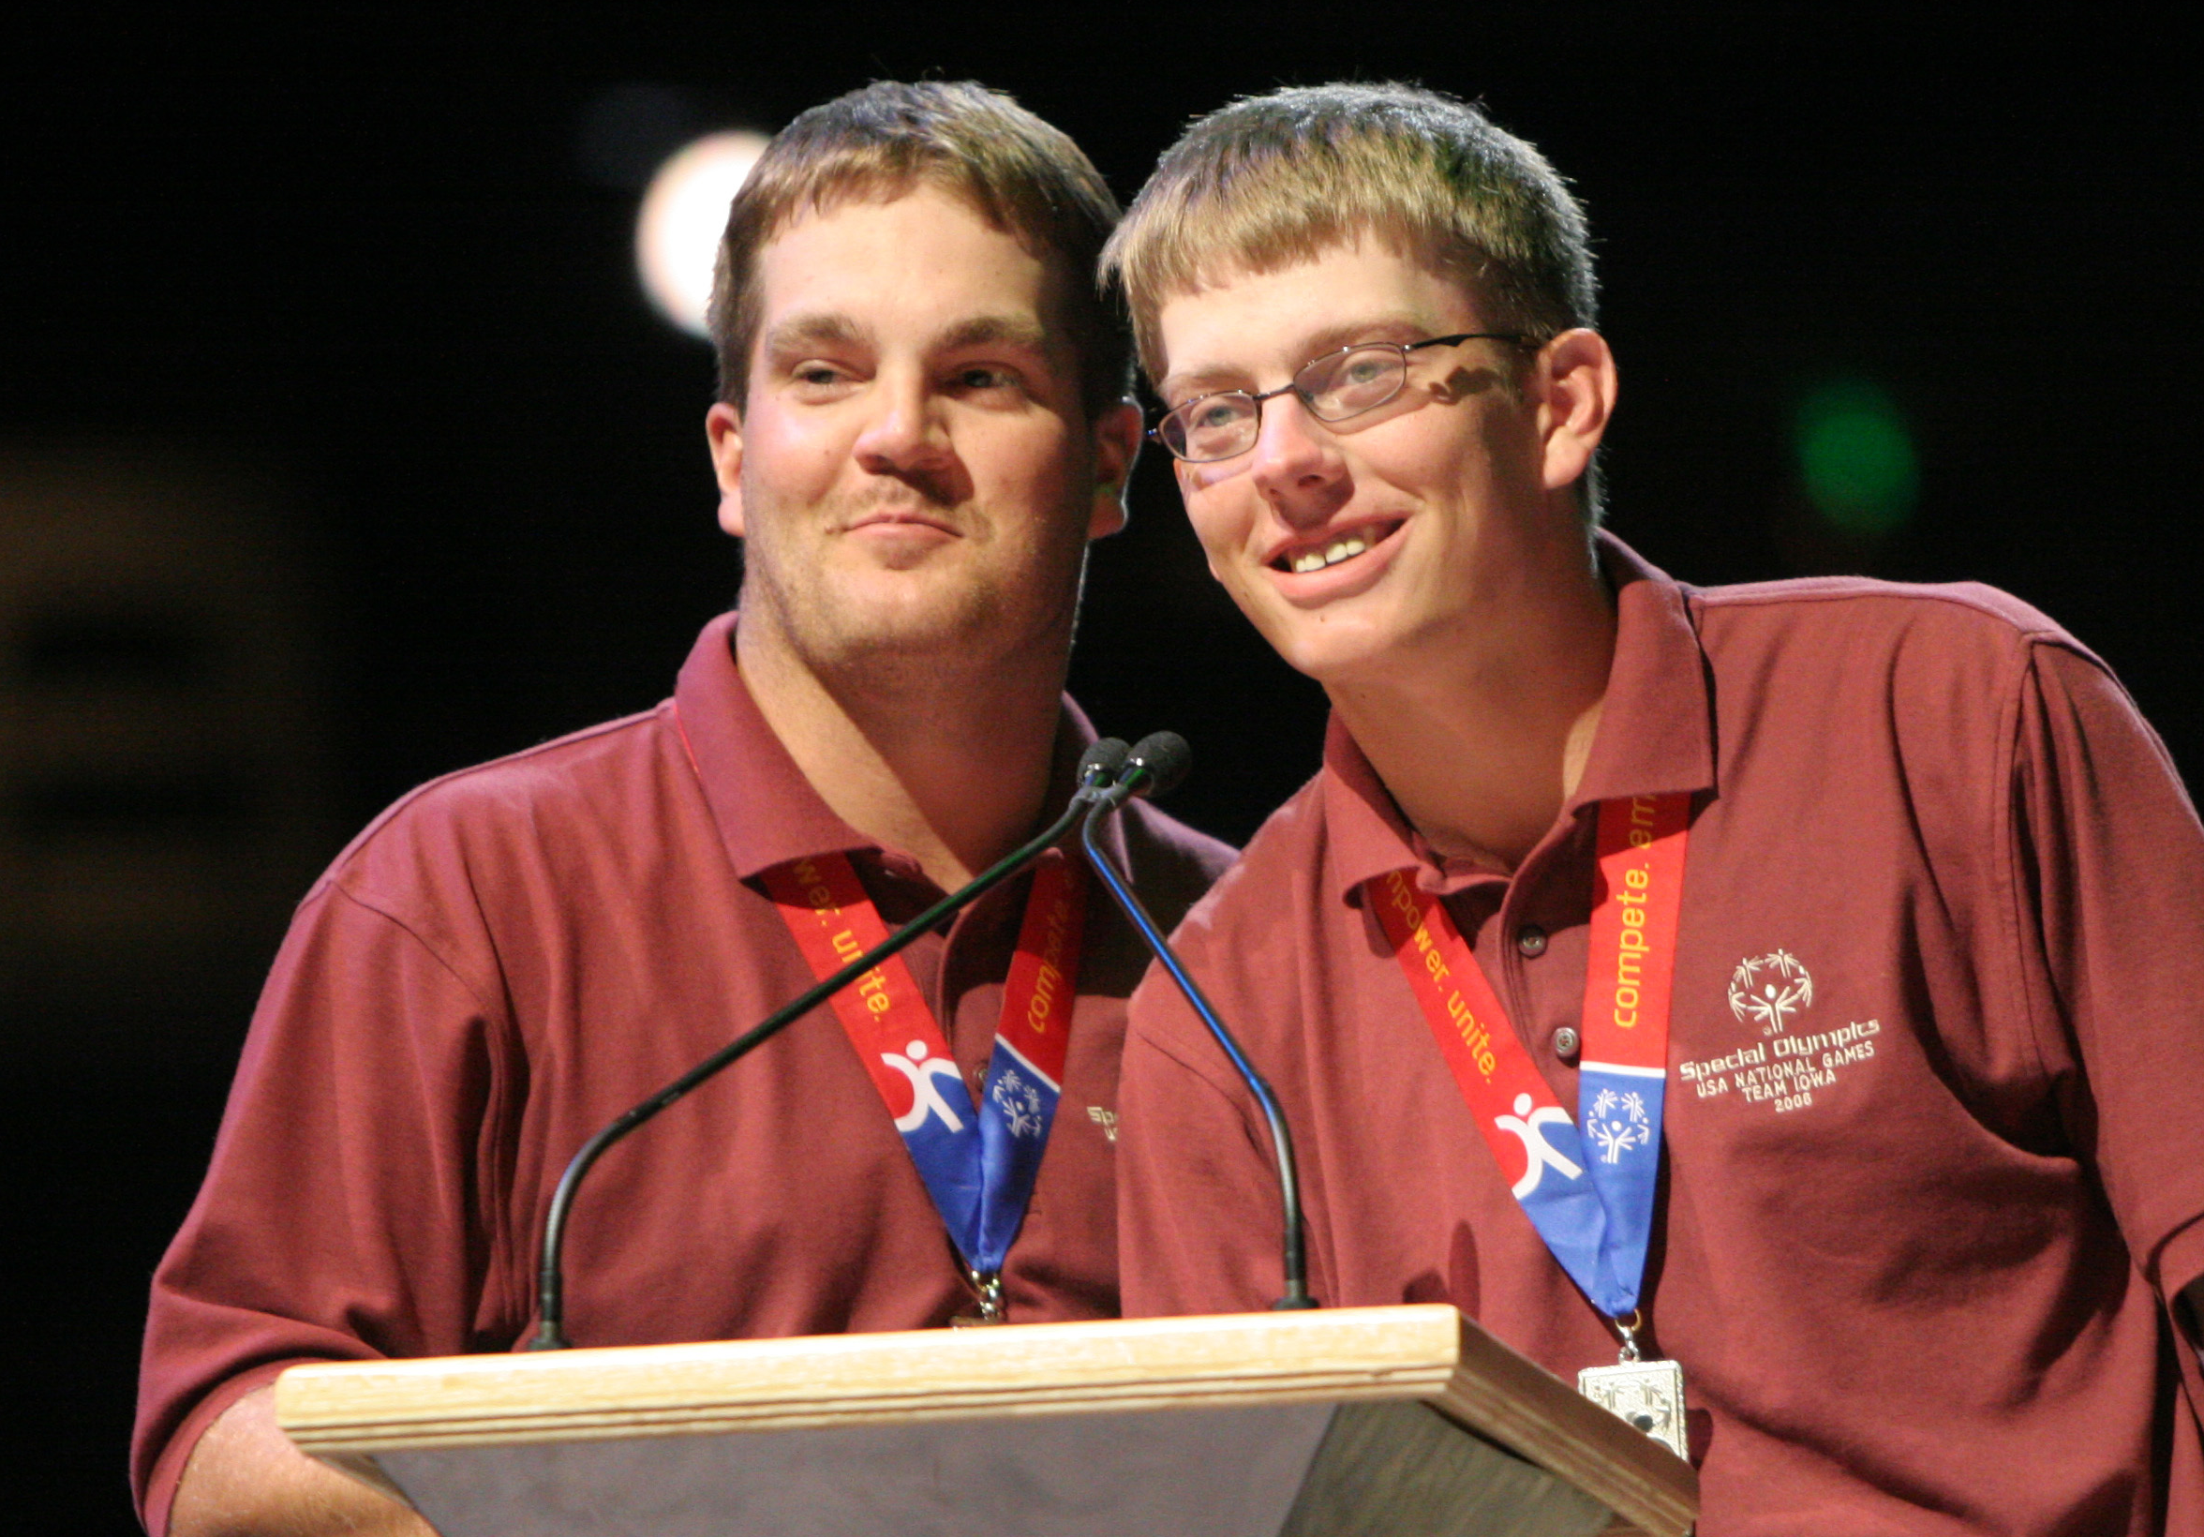
Talking about GII…
20

Slide 21
Which of these resources
would you use?
21

Slide 22
How do I share this with other educators?
Marketing PowerPoint
GII Brochure
One Page Flyer
Sample Letters to Teachers
Copies of Lessons
GII Playbook for Programs
& More…
http://resources.specialolympics.org/Sections/Get_Into_It.aspx
22

Slide 23
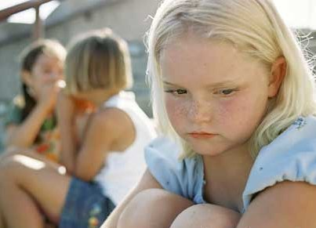
What We Are Up Against
Bullying and Safety Concerns
Isolation and Disengagement
Emotional Distress and Unhealthy Behavior

Slide 24
24 |
Issues: Bullying & safety concerns
For all students in school today feeling unsafe has a negative impact on learning:
28%
of students say they were bullied at school within the last 6 months.^{i}
35.5%
of students reported being in a physical fight within the previous year.^{ii}
For our population, bullying is the norm:
9%
of students with intellectual disabilities, are bullied or victimized once a week or more. ^{iii}
60%
of students with disabilities reported being bullied compared to 25 percent of the general student population. ^{iv}
2-3x
Only 10 studies have been conducted in the United States on bullying and developmental disabilities. All studies found that children with disabilities were two to three times more likely to be victims of bullying than their nondisabled peers. ^{v}

Slide 25
25 |
Issues: Isolation & Disengagement
All students who feel connected to their schools and engaged in their learning are more successful academically and have healthier behavior, yet:
40-60%
of students in high school are chronically disengaged from school. ^{vi}
only 55%
of high school students feel they are an important part of their school community. ^{vii}
For persons with intellectual disabilities:
only 10%
of youth say they have a classmate or friend with intellectual disabilities. Isolation for children with disabilities remains the norm. ^{viii}
Only 11-25%
of persons of employment age with intellectual disability have jobs as their transition from school to work leaves huge numbers lost and alone.
Notes:
Vi Klem, A. M., & Connell, J. P. (2004). Relationships matter: Linking teacher support to student engagement and
achievement. Journal of School Health, 74(7), 262–273.
Vii Yazzie-Mintz, E. (2007). Voices ofstudents on engagement: A report on the 2006 high school survey of student
engagement. Bloomington, IN: Center for Evaluation & Education Policy, Indiana University School of Education.
viii Siperstein, G. N., Parker, R.C., Norins Bardon, J., & Widaman, K. F. (2007). A National Study of Youth Attitudes toward
the Inclusion of Students with Intellectual Disabilities. Exceptional Children, 73, 435-455.

Slide 26
26 |
Issues: Emotional distress & Unhealthy behavior
All students must be healthy, safe and ready to succeed; yet, many are struggling:
only 34%
of students engage in enough regular physical activity, despite rising obesity.
15%
of high school students say they have seriously considered suicide within the last year.
11%
of high school students have made plans for suicide, and 7% have actually attempted to take their own lives. ^{ix}
44%
of children report stress-related sleeping difficulties. ^{x}

Slide 27
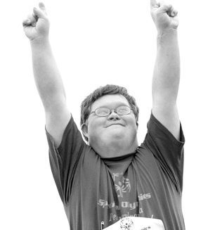
But by empowering our youth…
27

Slide 28
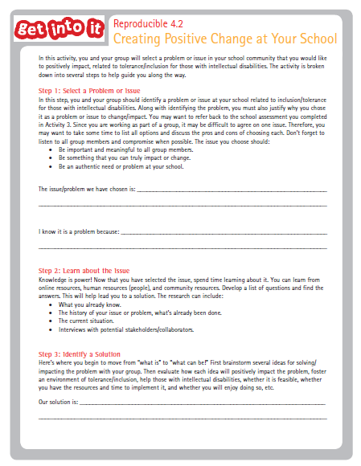
Service-Learning
Connects meaningful service opportunities with lessons and objectives students are working on in the classroom. Linked to significant change in student engagement and performance. Service-learning (and GII) put students in a position of leadership as change agents.
28

Slide 29
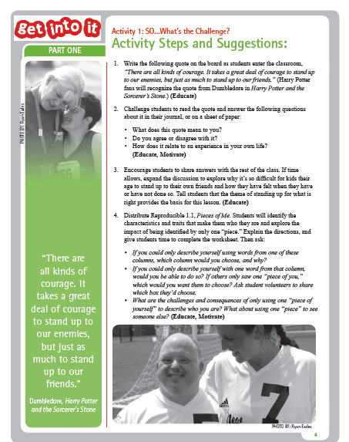
Anti-Bullying
GII lessons ask students to think critically about the way they treat others and the ability they have to make a difference. The lessons not only introduce students to others who are different than them but they help students to understand the value and abilities of all people.
29

Slide 30
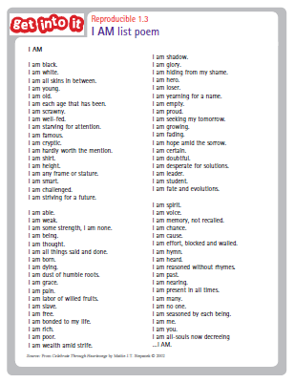
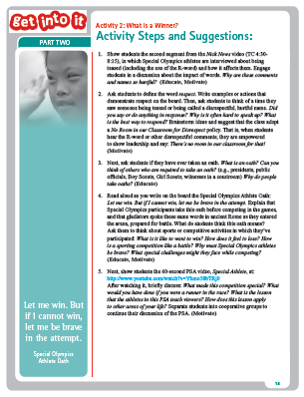
Character Education
Building students of character is becoming a larger goal of schools across the country. GII lessons provide opportunities for students of all ages to explore powerful character traits like perseverance, courage, respect and an understanding of human dignity.
30

Slide 31
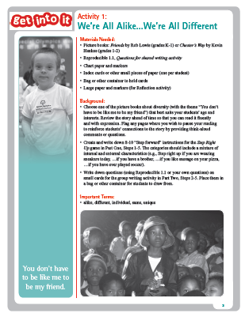
Talking About Inclusion
Are we taking an educational stance on inclusion? Not necessarily. But these lessons can help schools and districts who are by providing an opportunity for students to recognize the contributions of each of their peers. Are we taking a social stance on inclusion? Absolutely. And these lessons can help us achieve that goal.
31

Slide 32
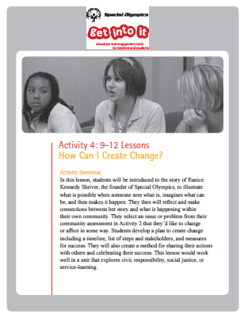
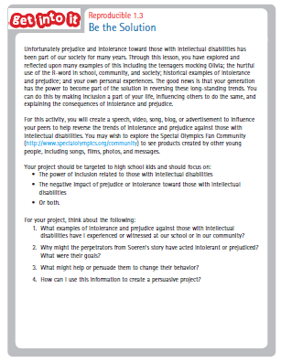
21st Century Skill Development
Beyond the core content of the academic subjects, students need to acquire key 21st Century Skills to succeed in this world. Skills like creativity, innovation, critical thinking, problem solving, and collaboration take students to the next level and are developed within the framework of GII.
32

Slide 33
Anti-Obesity
We are a sports organization. It is where we find our core, and where our lessons are inspired.
The GII lessons not only provide physical activities and simulations but the stories of our athletes encourage students to be active and take new risks in their own lives.
33

Slide 34
Which of these initiatives are most important at your school?
34

Slide 35
Questions/Comments?
JENNI NEWBURY Curriculum & Education Resource Manager, Special Olympics
(202) 824-0282
jnewbury@specialolympics.org
Get Into It educator and student portal:
www.specialolympics.org/getintoit

