Slide 1
From the Moment of Diagnosis
Birth - 3 Resources, Provider Connections, Healthy Start Toolkit

Slide 2
Agenda
Overview of Moment of Diagnosis
Recruitment tool + Provider involvement
SO Maryland example
Healthy Start example
Discussion
Notes:
Resources available for “moment of diagnosis”
How it can support growth of programming, work for a recruitment tool for SO and YA; how we can get providers involved
Going to share some brief, new resources; nothing too indepth

Slide 3
Why 0-3 if Young Athletes is 2-7?
General Rules
Age Requirements 2.01(b)(i) Young Athletes. The Young Athletes program introduces children from birth to seven to fundamental movement and sports skills in age and developmentally appropriate format. This program prepares children to enter Special Olympics sports training and competition when they reach the appropriate age and stage of development.
Family education
Virtual programming
Filling the gap between diagnosis and services starting
Connect with children & families as early as possible / before they can participate in-person
Notes:
Have spoken about these interchangeably– wanted to address the age range part up front
This also helps expand the conversation of ECD work beyond YA in-person programming, to all the other robust things we do as a team

Slide 4
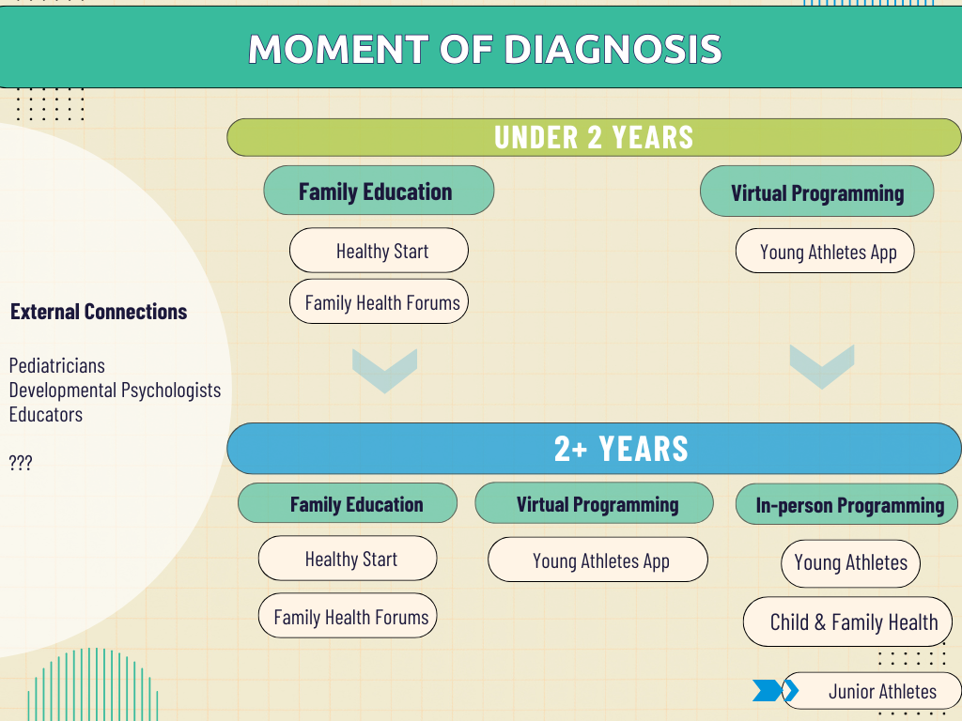
Notes:
Setting the stage for this language / ongoing support / being a resource for families at all points
Getting to the point of being a resource and reference for Providers working with young children; having access to the children with IDD who are receiving diagnoses
Mapping out what 0-3 IS/what approach should be. Acknowledge/articulate what 0-3 is... Provider education / support provided to families / etc.
Want to get to the point of laying the ground work next year to really get Program buy-in on the ‘moment of diagnosis’ / family education support for children under the age of 2/3.
Arrows show that all this programming FILTERS TO IN-PERSON PARTICIPATION

Slide 5
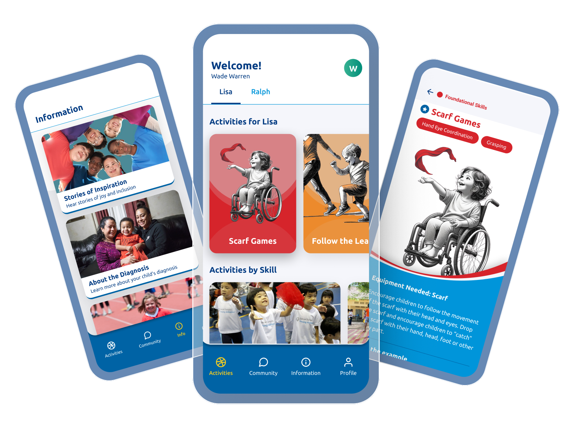
Virtual Programming
Notes:
Sort of the “new” section.. Introducing some resources, but just an extension of what is already happening

Slide 6
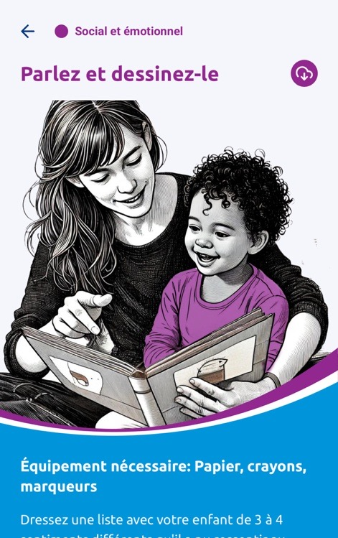
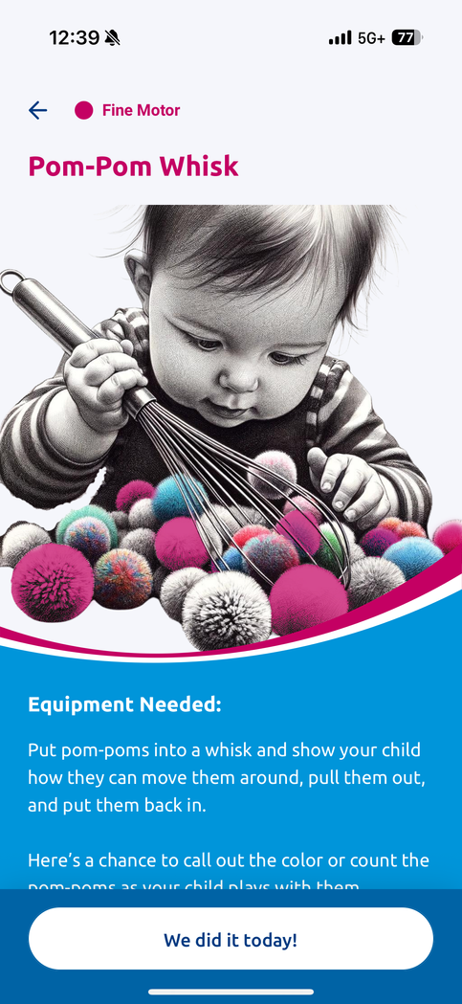

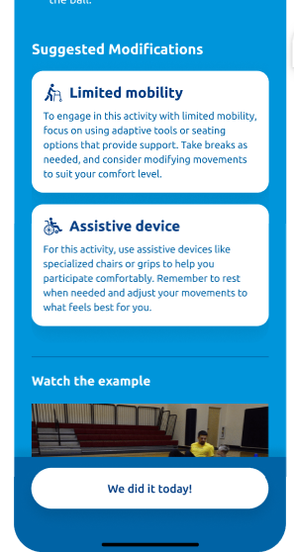

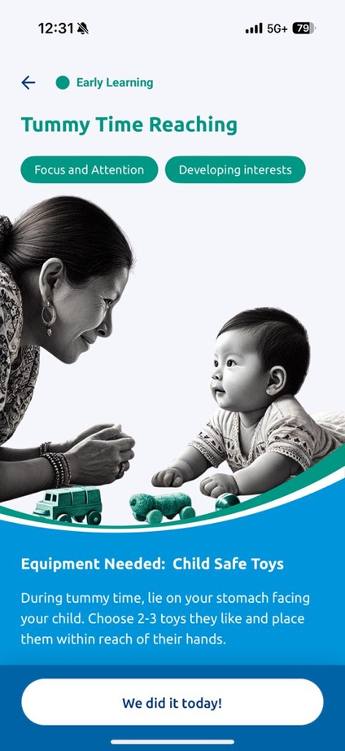
Young Athletes App
  Birth to 3
    Caregiver Interactions
    Routines
  More developmental domains
    Fine motor
    Language
    Cognitive (early learning)
    Social Emotional
  Inclusive Adaptations
  Information section (new videos)
Notes:
Inclusive adaptions- Ashlyn’s point about supporting/inclusive/bringing families in also supports that strong start space

Slide 7
Provider Log-in
Provider log-in can also support 0-3 implementation
Shared goals and common content
Families can share child profile with Provider

Slide 8
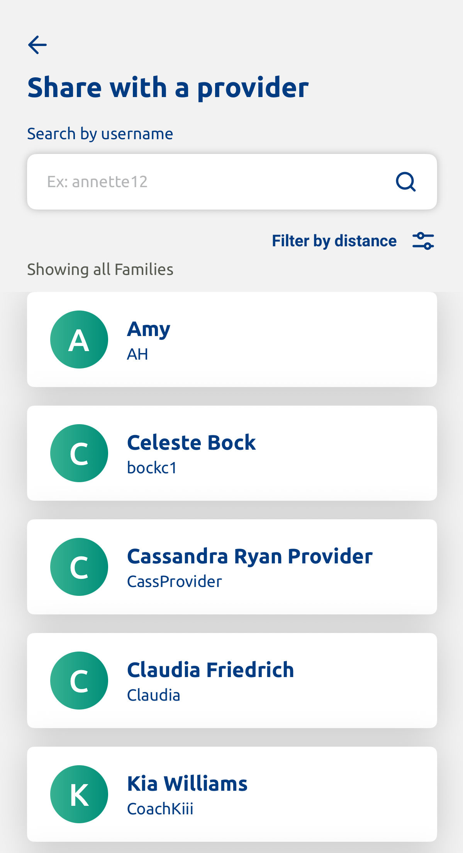
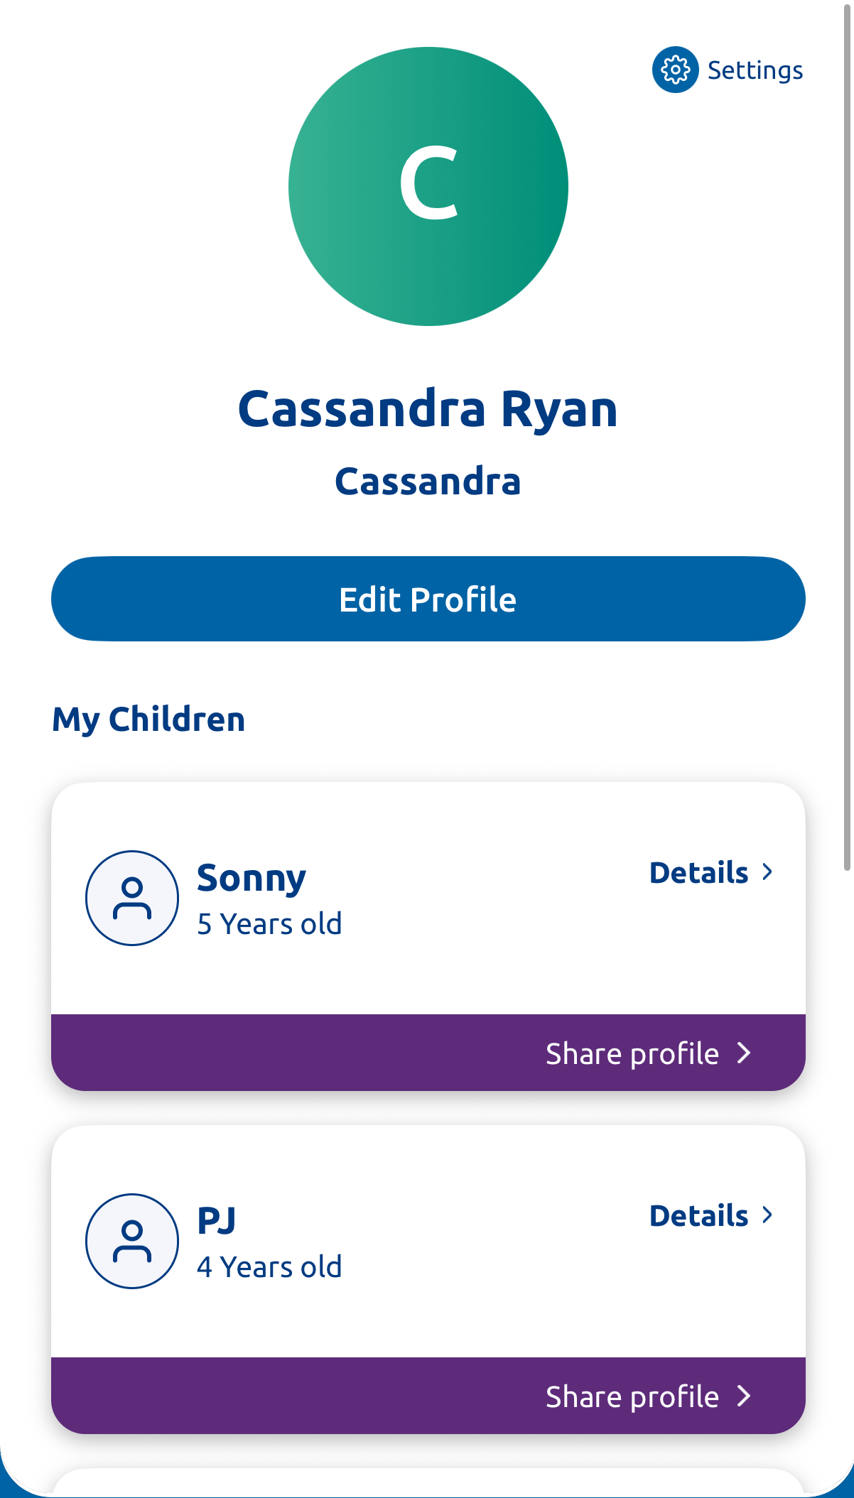
Family Steps

Slide 9
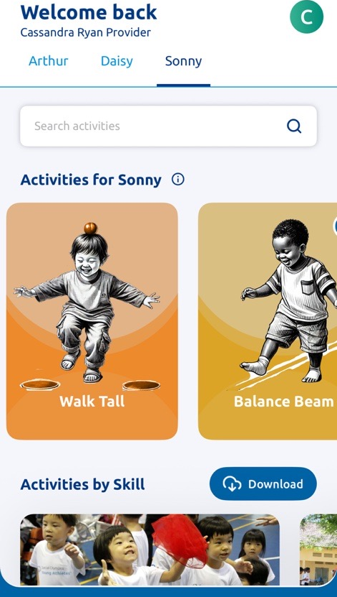
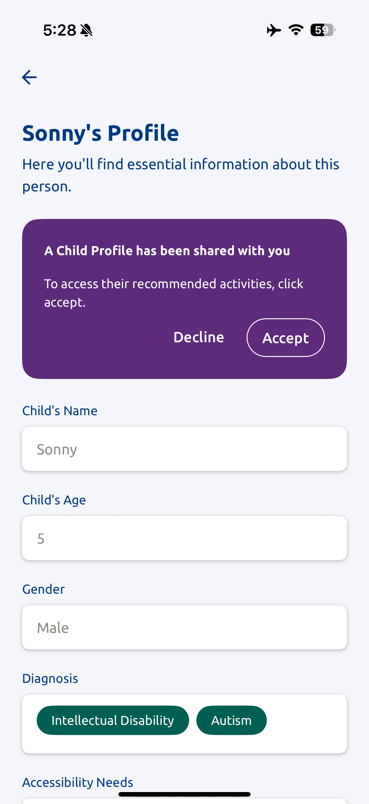
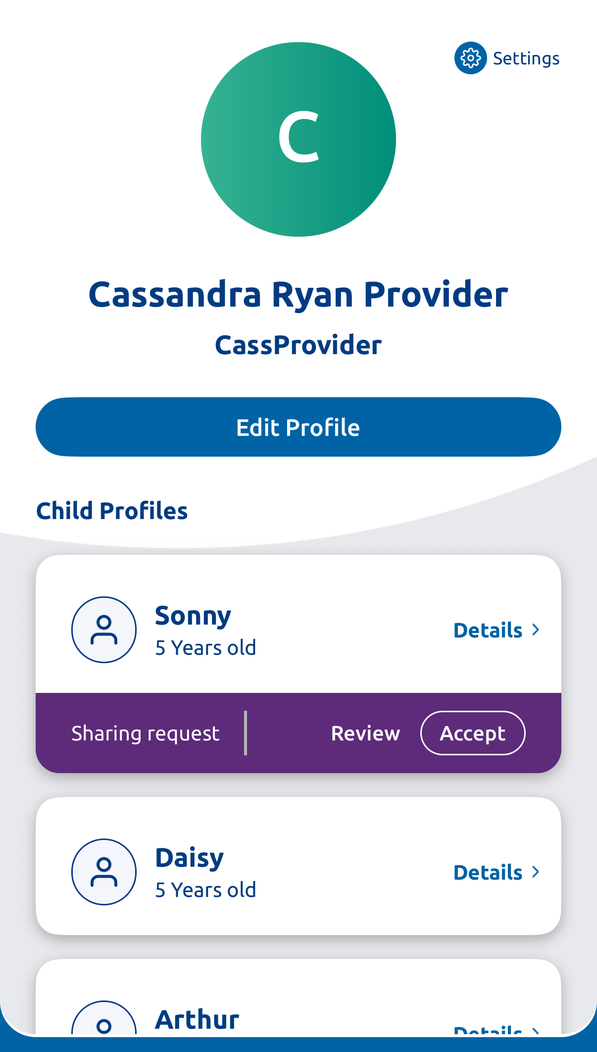
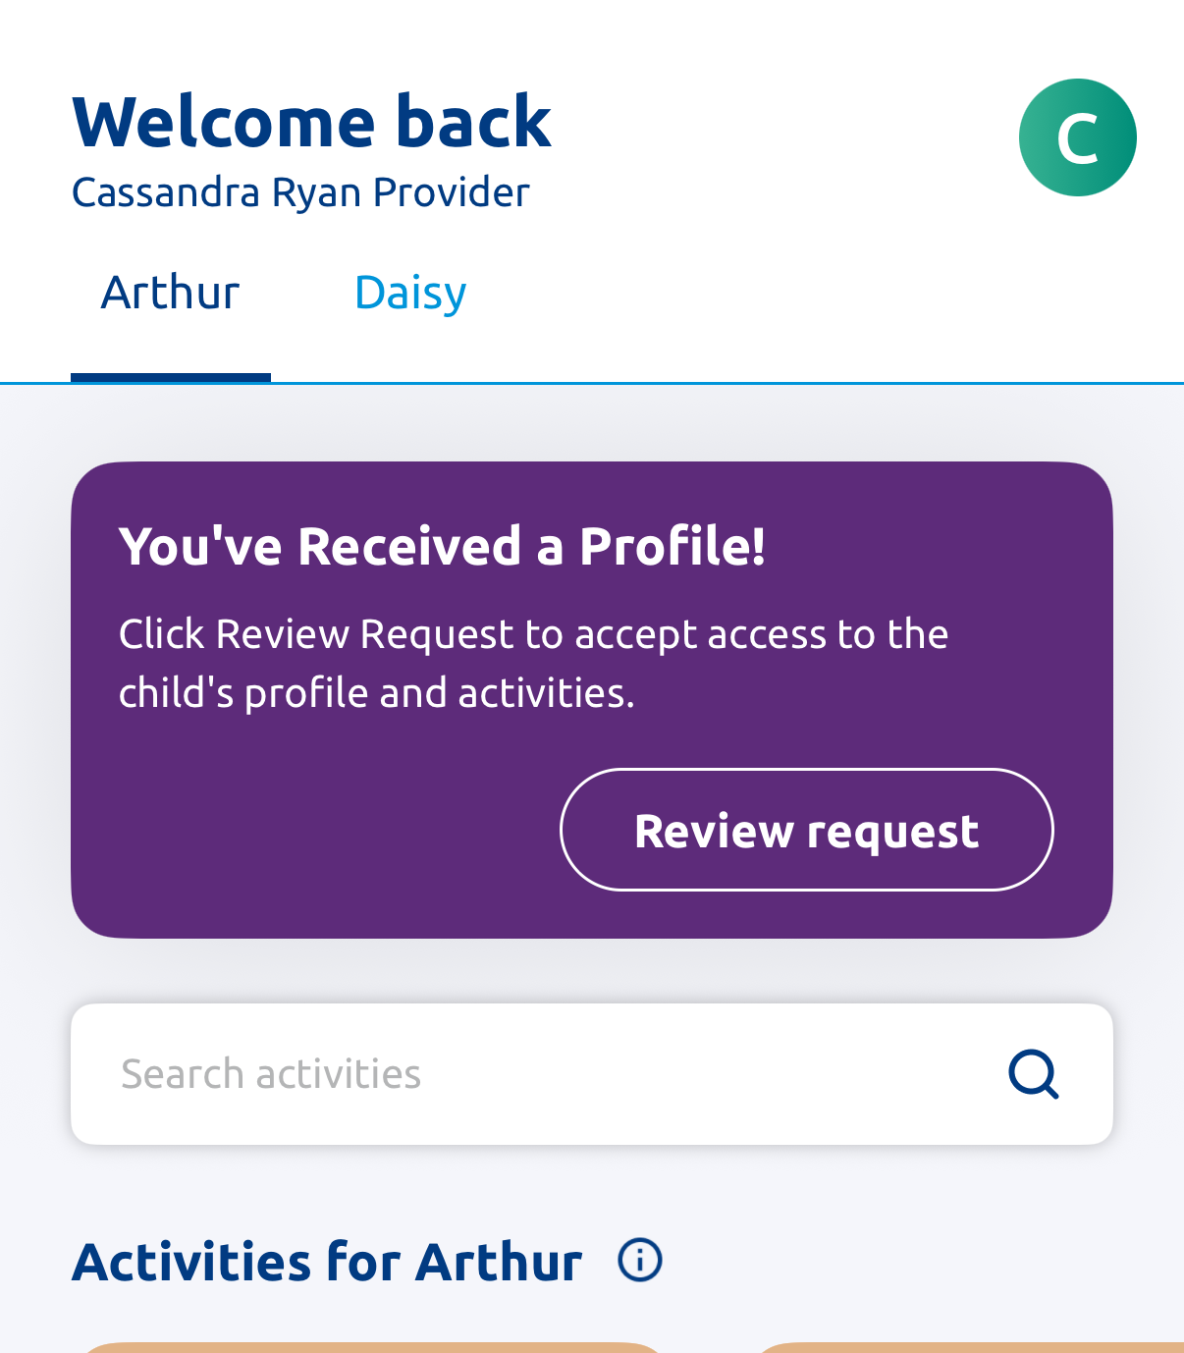
Provider View

Slide 10
Recruitment Opportunities
Outreach to families once children turn 2 (app data)
Pillar 3 collaboration (resources for healthcare providers/diagnostic psychologists)
Supports FHE goals—FHF topics focused on this early stage
Pediatric toolkit
Notes:
As we talked about this morning, really focusing on finding families as early as possible. Enhancing ECD programming, finding NEW families that are not already involved and may not be participating in-person.
Pull children into sport– Dimitri’s point
Framework perspective. Time of Diagnosis, might not be talking about existing YA participants. Not how does it support existing YA families—how do we reach new children who will become future YA.
Think about this work as recruitment tool... SO needs to be with the people providing diagnosis, health providers, etc. People who are connecting families to Special Olympics. Reframing what the tools do, and how we should get them to families.
One initial way we are trying this is by the creation of the Pediatric toolkit…

Slide 11



Slide 12



Slide 13

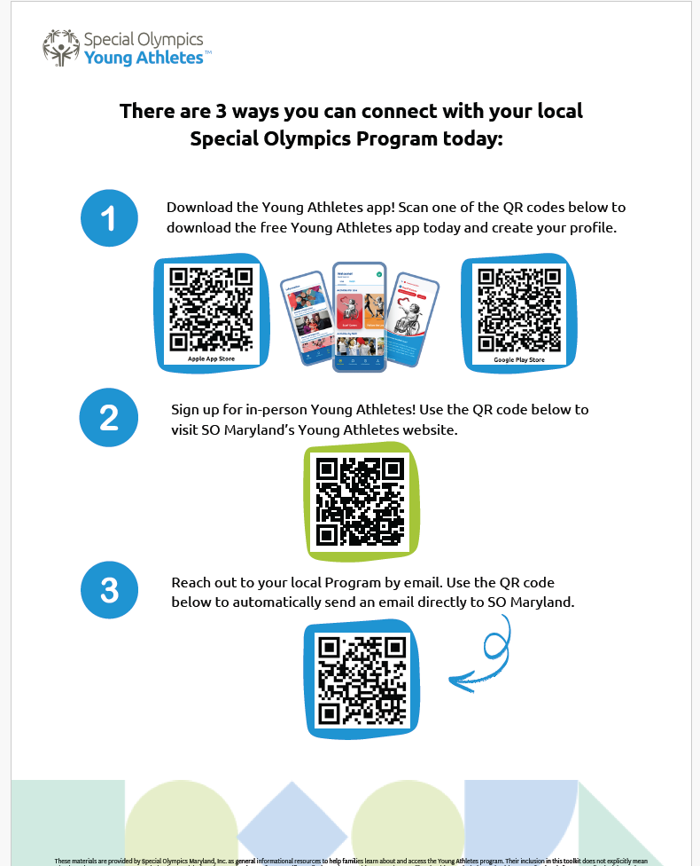

Slide 14
Program Example:
SO Maryland

Slide 15
SOMD Future Champions
WHY
Turning challenges into opportunity
Aligned with their state standards
Scalability
WHO
Partners
WHAT
Strategies for growth
Support for Families
Notes:
Country standards
SOA- have app as part of physical education in ECD
Ministries endorse that

Slide 16
Getting Creative with
Healthy Start
Notes:
The goal of this is to share resources that we have in different spaces, different ways,
Really setting the stage that we can support as early as possible.

Slide 18
Small Group Chat
What questions do you have about programming/resources in this space?
How do we get Program buy-in with this strategy?
Where do you see using these resources in your Region?
What opportunities are there in connecting with Providers at this development stage?
Notes:
Want to get to the point of laying the ground work next year to really get Program buy-in on the ‘moment of diagnosis’ / family education support for children under the age of 2/3.
where they see the connections and use from 0-3 being in their Region? What would be required? Obstacles? Questions, etc.?
Schools
Add young Athletes app
Challenge- language
Talking about ECD is hard part
Training our Health Messengers in the app; Training Health workers
Also have this app that parents can use
Virtual making the rounds
Resources to share out
Databases
What is the reach of families and YA
States/Countries; connecting to appropriate people
SOMD share best practices

Slide 19
Pillar 3 Connection
IHF course– what kind of information do we need to add to get buy-in across Programs?
Where else do we need to include this information to reach health care providers?

Slide 20
Questions?

