Slide 1






ECD
E-LEARNING
QUIZ TIME!

Slide 2



Question #1
How many ECD courses are there?
One
Nine
Fifteen
Five

Slide 3


Answer:
Nine*

Slide 4

Question #2
Name those courses!

Slide 5

ANSWERS
Young Athletes Onboarding
Introduction to Child & Family Health
Young Athletes Coaches Course
Young Athletes Smartsimple
Junior Athletes
Healthy Young Athletes
AIAN Course
UCS Elementary Implementation
Supporting Families Through the Intellectual & Developmental Disability Diagnosis

Slide 6
Coming Soon
Inclusive Adaptations

Slide 7
Question #3
Who should take the ECD courses?
Programming implementors & coaches
Regional ECD Leads
All the above
Program staff

Slide 8


Answer
All the Above
(+ more!)

Slide 9
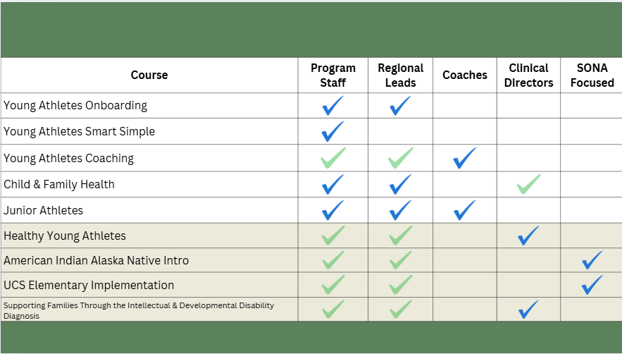

Slide 10
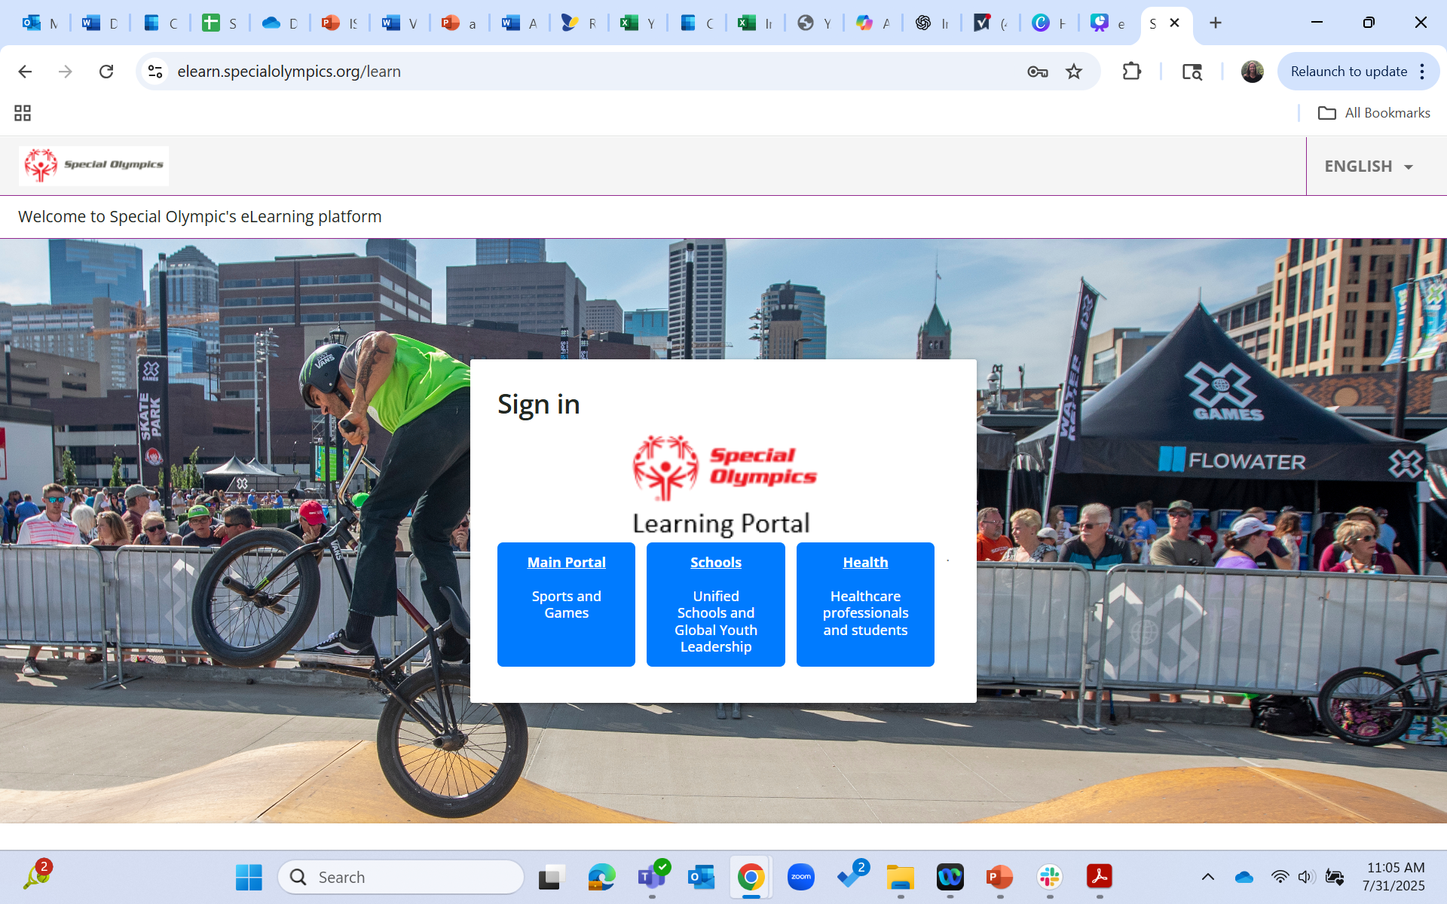
Question #4
Which portal has our ECD courses?

Slide 11
Answer

Slide 12
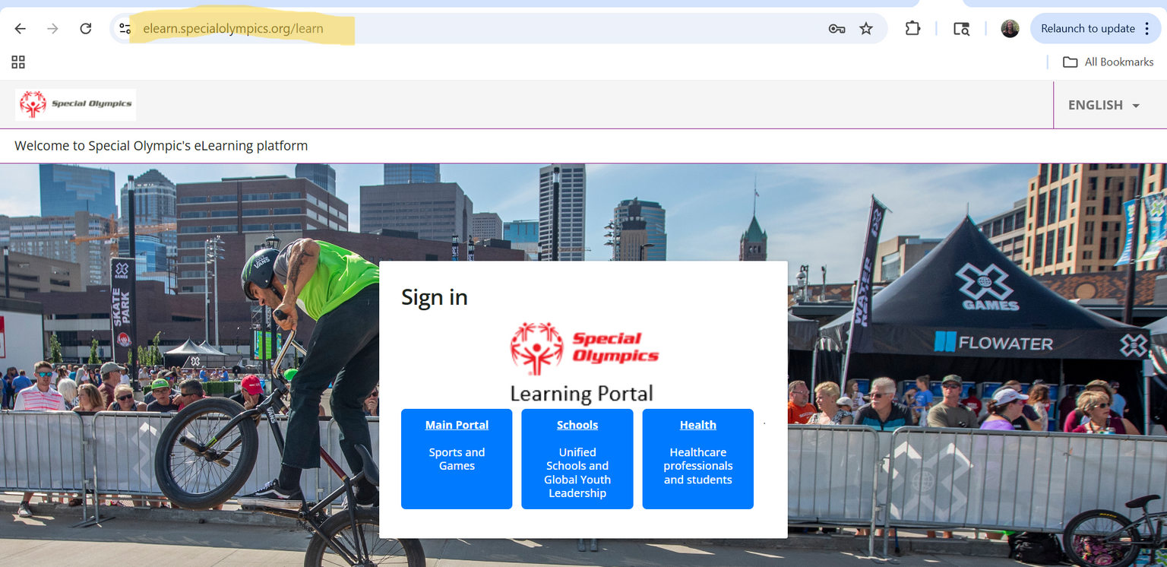
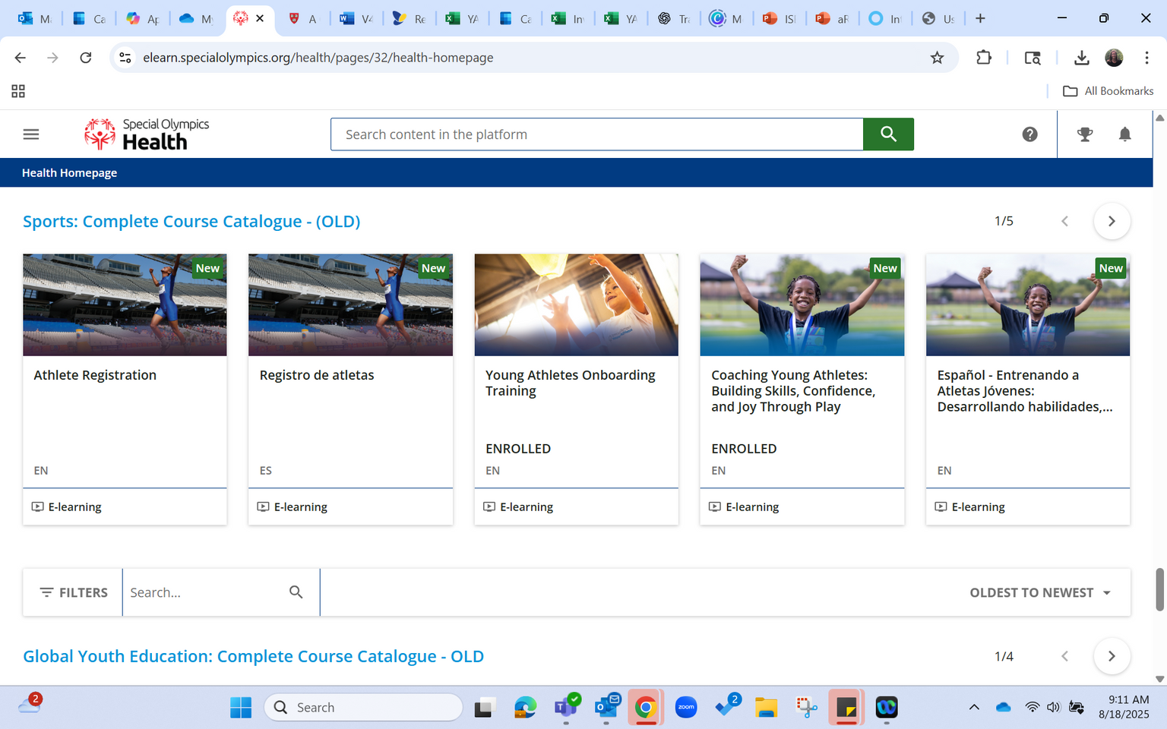

Special Olympics eLearning Portal
elearn.specialolympics.org

Slide 13

THANK YOU FOR PLAYING
...now let’s discuss!

Slide 14
  How can eLearning courses support overall training goals? (e.g. # of coaches trained)
  What role can you as ECD leads play in getting the courses to learners? Any successes to share?

Slide 15
Looking Ahead...
  Which courses need in-person guidance now?
    In 6 months?
  What is the average length needed for in-person training?
  Is anything missing? Gaps that still need to be filled?

