Slide 1

Engaging Partners

Slide 2

There are Many Types of Partners
Today We Will Review the Following
1. A Partner is Not Always a Donor
Partnerships extend beyond financial contributions. Many impactful collaborations are built on shared expertise, resources, or networks that advance our mission without direct funding.
2. Government Ministries Can Be Partners
Government agencies can play a key role by providing policy alignment, access to national programs, logistical support, and credibility that enhances the reach and sustainability of our initiatives.
3. Partners Can Provide Services That Are VIK (Value In-Kind)
Value In-Kind contributions—such as training for staff, event space, equipment, or specialized services, or even professional development—can be as valuable as cash donations, directly benefiting our participants and strengthening our programming.

Slide 3

Take the Pressure Off Partnerships
Not all partnership networking leads to long-lasting ongoing communication
A partner that engages with you on even a monthly basis is a STRONG partner
Conversations that lead to the biggest outcome can start simple!

Slide 4
Special Olympics Latin America:
Leveraging Government and National Organizations Country by Country to Grow ECD Programming

Slide 5
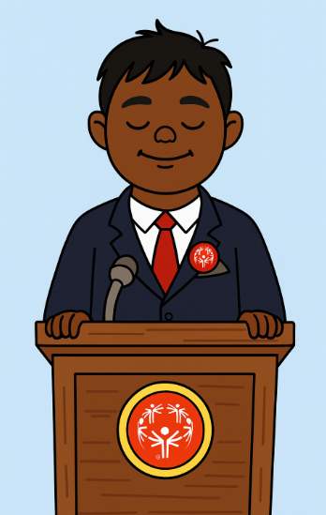
Coalition Engagement
ECD has been a huge focus of many governments around the world.
The Government Relations team is reaching out to get information on YOUR REGIONS ECD PROGRAMMING
Quick and clear communication is key!

Slide 6

Early Childhood Action Network (ECDAN)
Identifying Gaps in ECD & Disability

Slide 7

What Is ECDAN?
ECDAN is a “network of networks” established in 2016 by UNICEF and the World Bank, in collaboration with 86 global partners
ECDAN facilitates knowledge exchange, alignment, and advocacy across sectors, disciplines, and regions
ECDAN convenes and coordinates multiple regional and thematic coalitions and initiatives to foster collective impact.

Slide 8
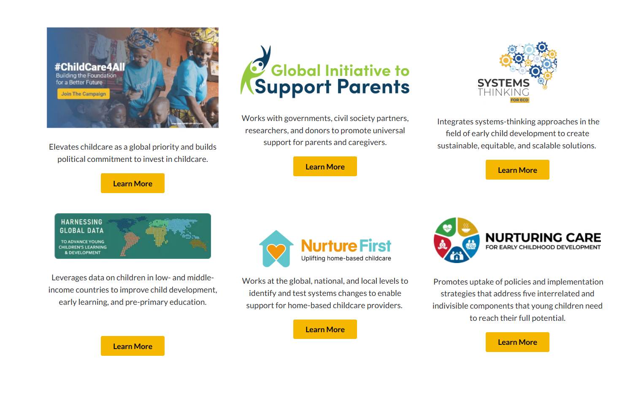
ECDAN Initiatives
*None of these initiatives focuses solely on disability, however it may be a theme within the initiative or have technical experts

Slide 9

Activity: Developing an ECDAN IDD Focused Initiative
Where are young children with IDD being left out or underserved in your region’s ECD systems?
What causes these gaps? (e.g., policy, stigma, lack of training, missing tools, poor cross-sector coordination)
Each participant writes one gap per sticky note, using one color

Slide 10

Activity: Developing an ECDAN IDD Focused Initiative
Group Gap Clustering
As a group, cluster similar gaps into categories
  Policy, Access, Measurement, Family Support, Transition, etc.
Solution Brainstorming
What’s one initiative or resource SO could lead under ECDAN to address this gap?
  Write solutions on a different color
Prioritization
Each participant uses 3–5 mini-stickies to vote on the most impactful/urgent ideas, if you would like to be an active member of the development and implementation of the initiative list your name on the sticky
  Top 3 ideas become the shortlist for ECDAN initiative proposals
  Our team will invite those interested to conversations as they apply

Slide 11
Selecting our Partners in the Initiative
Top 20 Potential Collaboration Partners
Africa Early Childhood Network (AfECN) – Regional leader with strong advocacy capacity across Africa.
Aga Khan Development Network (AKDN) – Extensive ECD programming in multiple countries.
American Academy of Pediatrics – Expertise in child health and developmental screening.
Arab Network for Early Childhood (ANECD) – Regional hub for the Middle East and North Africa.
Asia-Pacific Regional Network for Early Childhood (ARNEC) – Covers large and diverse APAC region.
Bernard van Leer Foundation – Major funder of innovative ECD programs worldwide.
Bill & Melinda Gates Foundation – Funding and research power, especially on health and education.
Brookings Institution – Global research leader on ECD policy and systems.
Caribbean Child Development Centre – Regional leader for ECD in the Caribbean.
Childhood Education International – Global reach with emphasis on inclusive education.
Children’s Investment Fund Foundation (CIFF) – High-capacity funder of child development initiatives.
Early Childhood Peace Consortium (ECPC) – Aligns with peace, inclusion, and social cohesion.
Harvard University Center on the Developing Child – Evidence-based program development and research.
International Rescue Committee (IRC) – Strong in humanitarian/ECD programming in crisis contexts.
LEGO Foundation – Play-based learning and inclusion for children with disabilities.
Open Society Foundations (OSF) – Advocacy and funding for equity and inclusion.
Partnership for Maternal, Newborn & Child Health (PMNCH) – Policy influence and global network.
Save the Children – Strong ECD footprint in both development and emergency settings.
UNICEF – Global leader in ECD programming, policy, and advocacy.
World Health Organization (WHO) – Standard setting and capacity building for child health and development.

Slide 12

ECD Networks by Region
Region | Network | Countries Included
Africa | AfECN | Pan-African (various countries)
MENA | ANECD | Multiple Arab countries (e.g., Lebanon, Egypt)
East Asia/Asia-Pacific | ARNEC | ~47 countries across East Asia, SE Asia, South Asia, and Pacific & Oceania
Europe & Central Asia | ISSA | Various European and Central Asian countries
Latin America | LatAm ECD Networks Cohort & Somos Crianza | Brazil, Colombia, Mexico, Peru, Chile, Guatemala, etc.
North America | Help Me Grow, CCCF, ECPN, CaribECD | US, Canada, and Caribbean

Slide 13
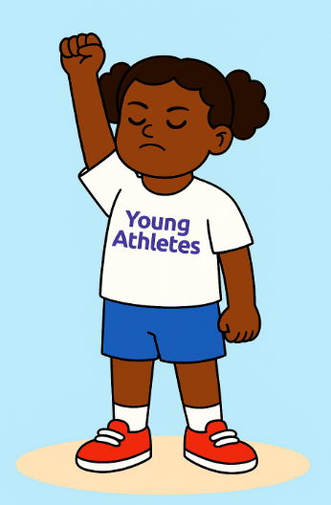
Partnership Activity: Be Brave in the Attempt
ECD Networks by region/country are places where potential partners can be found
Spend the next 15 minutes researching and locating ECD networks in your region and look for possible connections to our work and their stance on ECD and disability
Once you have reviewed the network identify an individual to connect with via email
Email the contact, the message can be simple, clear, and concise. The goal is to set up a time to discuss your shared passion for ECD and begin the first steps to securing a partner
Should there not be an ECD network, research partners that would be ideal to collaborate with in the coming year
Bonus points for those of you that reach out to 2+ individuals or making a LinkedIn connection

Slide 14

Consider This
Partnerships are not always professional organizations or governments
Influencers, celebrities, or people with large platforms can partner to share the message of Special Olympics ECD programming too!
Through out the week spend time searching and listing as many influencers, celebrities, characters, or highly influential people as possible that have an expressed interested in ECD, disability, education, sport, and/or health
Create a list with the names, reach (if known), potential ways to engage, and providing any other information that could support relationship building
Email your list to Ryland and he will do a deep dive into potential connections and potential ways to connect with these individuals

