Slide 1
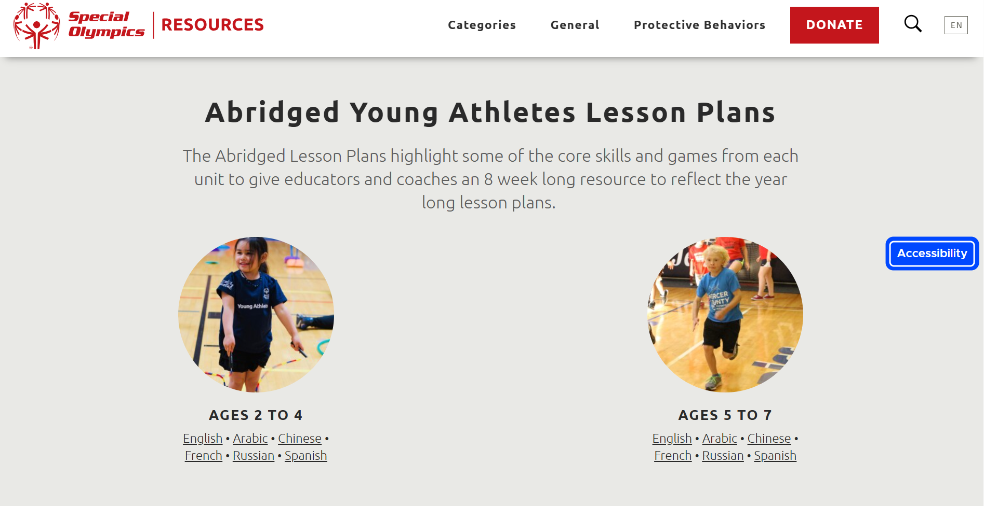
Abridged Lesson Plans

Slide 2
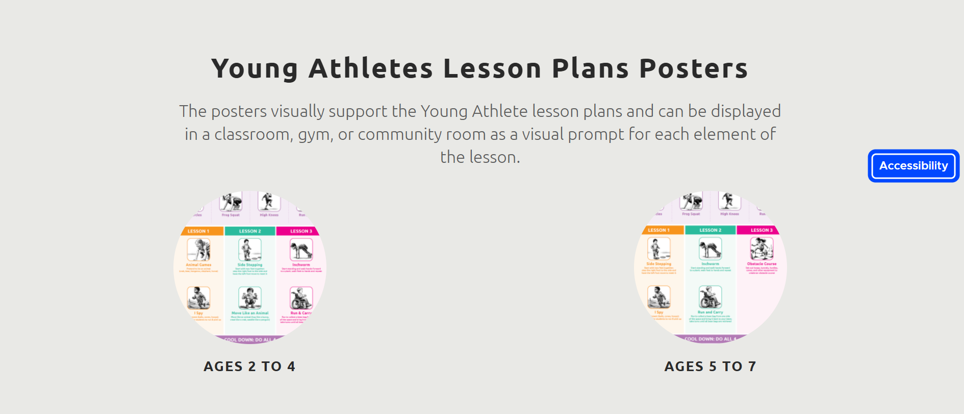
Lesson Plan Posters

Slide 3
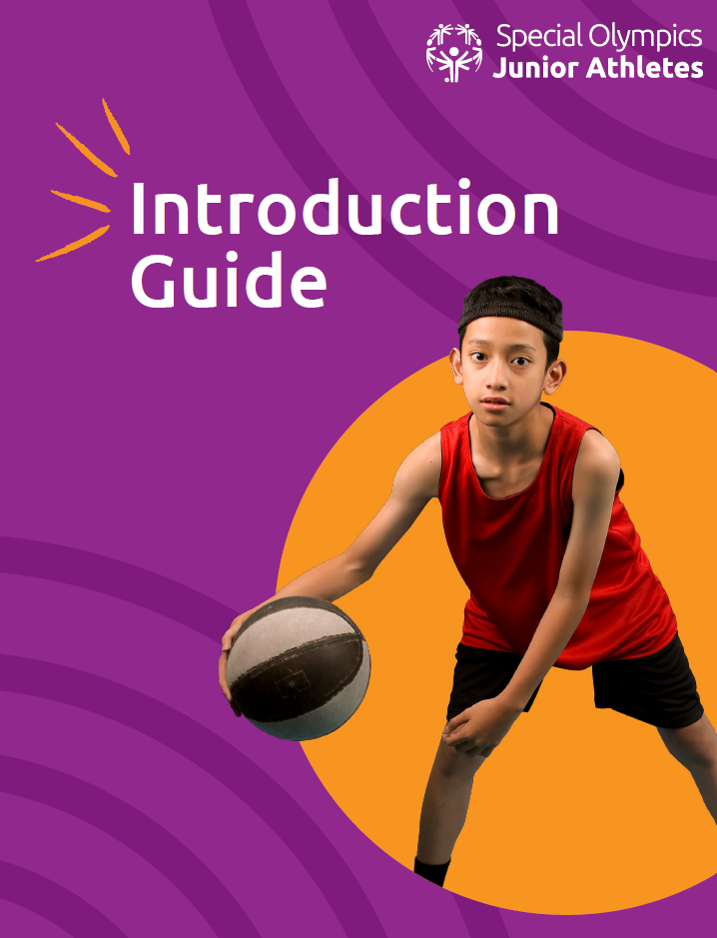
It’s Here! It’s Finally Here!
Junior Athletes

Slide 4
Junior Athletes Resources Include
The Introduction Guide
Units that focus on Pickleball (Raquet Sports), Athletics (Strength and Endurance), Football (Net/Wall Games) with many more sports and activities on their way!
The Junior Athletes Coaching Course on the eLearning platform

Slide 5
Program Implementation and Feedback Can Begin Now
We ask that you begin sharing these resources widely with Programs when you return home
Printed materials will be translated ongoing through the end of the year
The eLearning course is in English and Spanish with remaining languages ready by the end of the year
Please provide me with a running list of Programs that are implementing Junior Athletes and be open to having discussions throughout the year on feedback related to the program
This year we will collect any suggestions from the field that should be added or changes in the guidance, units before releasing one final version next summer

