Slide 1
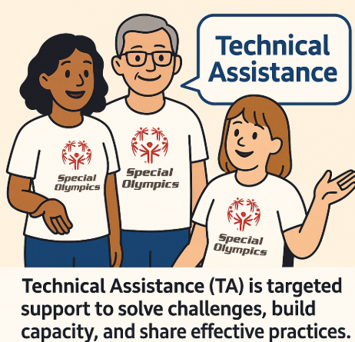
Defining Technical Assistance
Technical Assistance (TA) is targeted, practical support provided to individuals, teams, or organizations to help them:
Solve specific challenges
Build skills, capacity, and confidence
Implement best practices effectively
Achieve desired goals more efficiently
It can take many forms—such as coaching, training, resource sharing, problem-solving, or facilitation—and is often tailored to the recipient’s unique context, needs, and stage of development.
In your Early Childhood Development context, TA means hands-on guidance and knowledge-sharing that helps programs strengthen their work, align with strategies, and adopt proven approaches that improve outcomes for children and families.

Slide 2

Early Childhood Development Technical Assistance Plan
Activity-”Prompt and Pass”
Reflecting on Support-In the past year, what type of Early Childhood support or guidance was most helpful — and what was missing?
Your Wish List-If the Pillar 1 team could create one new training or resource just for you, what would you ask for?
Your Expertise in Action-What’s a topic or skill you feel confident sharing with other Programs? What would you love to lead or teach?
Looking Ahead-What’s one challenge you expect in the next year that technical assistance could help solve?

Slide 3
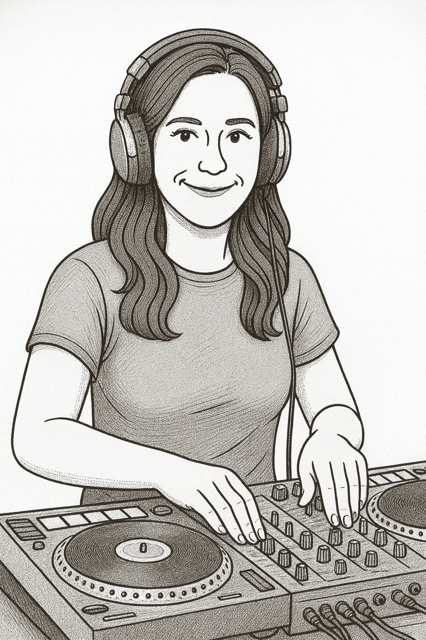

DJ Jazzy Jen Presents
The Special Olympics ECD Soundtrack

Slide 4
Regional ECD Technical Assistance Framework
Global ECD TA
Topic:
Global ECD TA
Topic:
ECD Learning Series #1
Topics:
Office Hours:
ECD Learning Series #2
Topics:
Office Hours:
Bi-monthly Meeting
Regional Lead:
Bi-monthly Meeting
Regional Lead:
Bi-monthly Meeting
Regional Lead:
Annual RHM & ECD In-Person Meeting
Bi-monthly Meeting
Regional Lead:
Bi-monthly Meeting
Regional Lead:
January
February
March
April
May
June
July
August
September
October
November
December
ECD Led TA
Topic Example: The YA App, Family Support, etc.
Region Specific Discussion
Webinar Topic #1:
Annual 1:1 Pillar 1 & ECD Regional Lead Meetings
ECD Led TA
Topic Example: The YA App, Family Support, etc.
Region Specific Discussion
Webinar Topic #2:
Leads in Each Area
Red=Pillar 1
Blue=Co-lead
Green=ECD Regional Lead
Region Led Program Meeting
Topic: All things ECD ☺ & Health
Date:

Slide 5
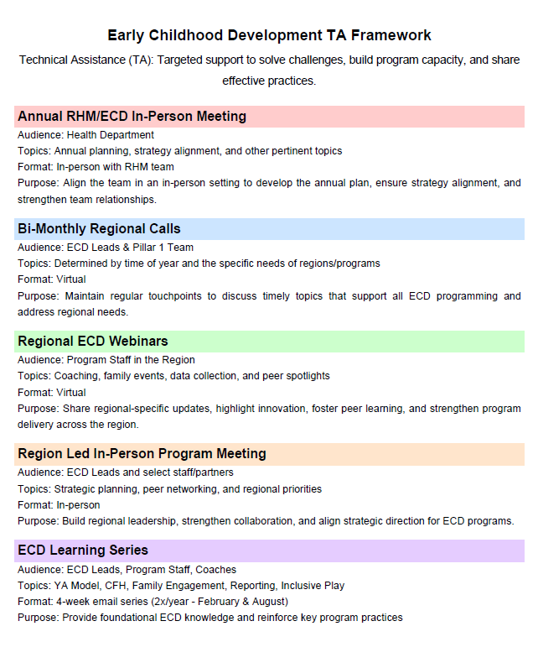

Slide 6

You are already doing this

Slide 7

Accountability to the Plan
Pillar 1 Team meets bi-weekly. We will have a standing agenda item related to the TA plan
Regional ECD team will integrate a standing agenda item to discuss TA on our bi-monthly call

Slide 8

Listen, Learn, Improve Loop
Listen
Purpose: Gather Insights, feedback, and experience from the field that ensure voices are heard
Method: Open-ended feedback forms after webinars or meetings
Office hours and open Q&A sessions
Learn
Purpose: Analyze and interpret the feedback
Method: Regional synthesis of feedback to understand localized patterns
Improve
Purpose: Apply the learnings to enhance strategies, materials, and TA offerings
Method: Adjust training materials or webinar topics based on feedback

Slide 9

Easy Ways to Collect Feedback
Plan Feedback Collection from Day One
Start with a loop, not a survey
Build in feedback after every TA interaction
e.g.:
  “How helpful was this?”
  “What else would you like next time?”
Use short polls in your presentations
Add 1-2 pulse check questions in regular communications
During Follow-up Calls with Programs start with “You Said, We Did” in response to the action items from previous discussions
This highlights the efforts we are all taking to make programming stronger through real time feedback

Slide 10

You are Already Doing Most of this Already!
This will be a Process Let’s Be Gentle With Ourselves
  The technical assistance plan has only added two components to what have already been doing and is formalizing communication between our team and you at the region level
  It should not be added work
  Each stage of this plan should be executed in the most simplistic way possible

Slide 11

Pillar 1 Site Visits
Our team finds incredible value of spending time on the ground learning about needs in the field
We are allocated around 2 visits a year for our full team
If you have an event, meeting, or simply programming that would be helpful for us to see in-person please provide the location, timeframe, and your needs to us in email
We know these visits take a lot time and effort to coordinate! We want to be of value to you, be honest with your needs, time, and availability

Slide 12

Technical Assistance Best Practices from SOEE
Work closely across departments (Health / Sports / Comms): We ensure everyone stays informed and updated so our work remains coordinated and consistent.
Stay on top of grant opportunities: We actively look for new grants and review them together (Ilse, Bjoern, and I) to decide how best to share them. Whenever possible, we combine HIG, HC, and FHF resources to support programs.
Share ideas as a team: Before advising programs, the three of us exchange suggestions to ensure our guidance is thoughtful and well-rounded.
Plan together weekly: Every Monday, we hold a short call to review the week ahead, set priorities, and confirm that everyone is aligned.
Connect with programs before they start: We meet with programs before grant implementation to understand their plans, answer questions, and offer guidance.
Follow up after implementation: Once a program has launched its grant, we reconnect to review progress, share feedback, and provide ongoing support.
Stay current with new resources: We keep up with the latest tools, materials, and resources, and share them with programs whenever they may be helpful.
Bring in extra expertise when needed: If a program could benefit from knowledge from other regions or headquarters, we connect them with those experts.
Regularly review the Master Budget: While we each track our own grants, we maintain a consolidated Master Budget so we have a complete, shared view of funding and notes.
Be flexible and open-minded: We recognize that each program is unique, so we adapt our guidance to help them make the best use of their grants.

Slide 13

Utilizing Teams to Communicate TA events, successes, challenges, and gathering support

Slide 14

Team to Support Technical Assistance from Pillar 1

Slide 15

Most Importantly You Can Rely on Each Other for Support Cross Collaboration
Spend the next 5 minutes thinking about topics YOU feel you can lead as an expert within our broader ECD work OR a way of implementing our ECD work you’d like to share with another region
Share your session with the group
Make a connection and determine if someone in the room can present their topic to your region

Slide 16

Building our 2026 TA Calendar
Team votes on Global ECD Webinar Topics
Team votes learning series topics
Each region shares estimated date and topic for region to Program webinar
Each region shares estimated date for in-person regional ECD meeting with bonus points for focused topics if known
Each region provides an invite list per topic-who besides ourselves and ECD Program contacts should attend these discussions?

