Slide 1

Special Olympics Health Pillar 1: Ongoing Prevention and Fitness
The mark “CDC” is owned by the US Dept. of Health and Human Services and is used with permission. Use of this logo is not an endorsement by HHS or CDC of any particular product, service, or enterprise.
Notes:
Lead: Alicia B

Slide 2
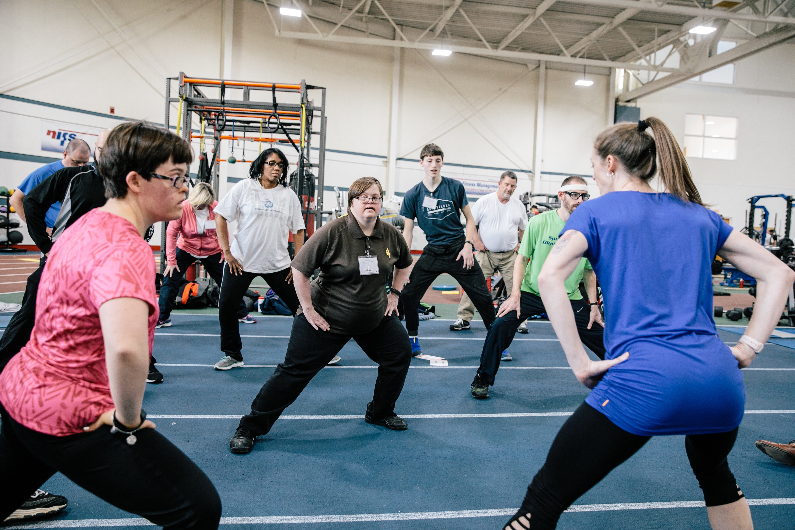
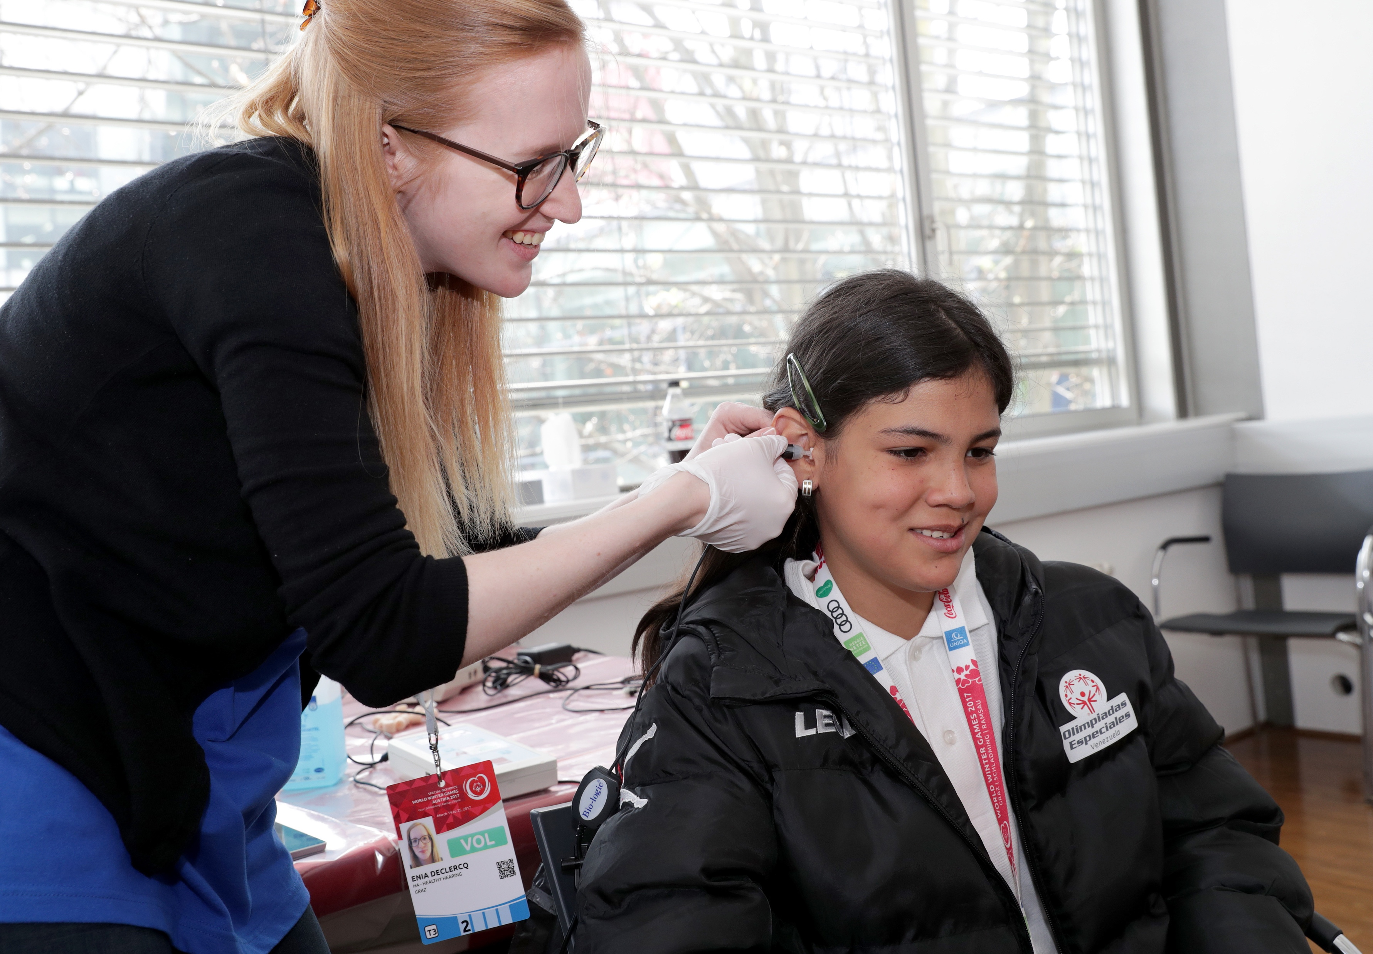
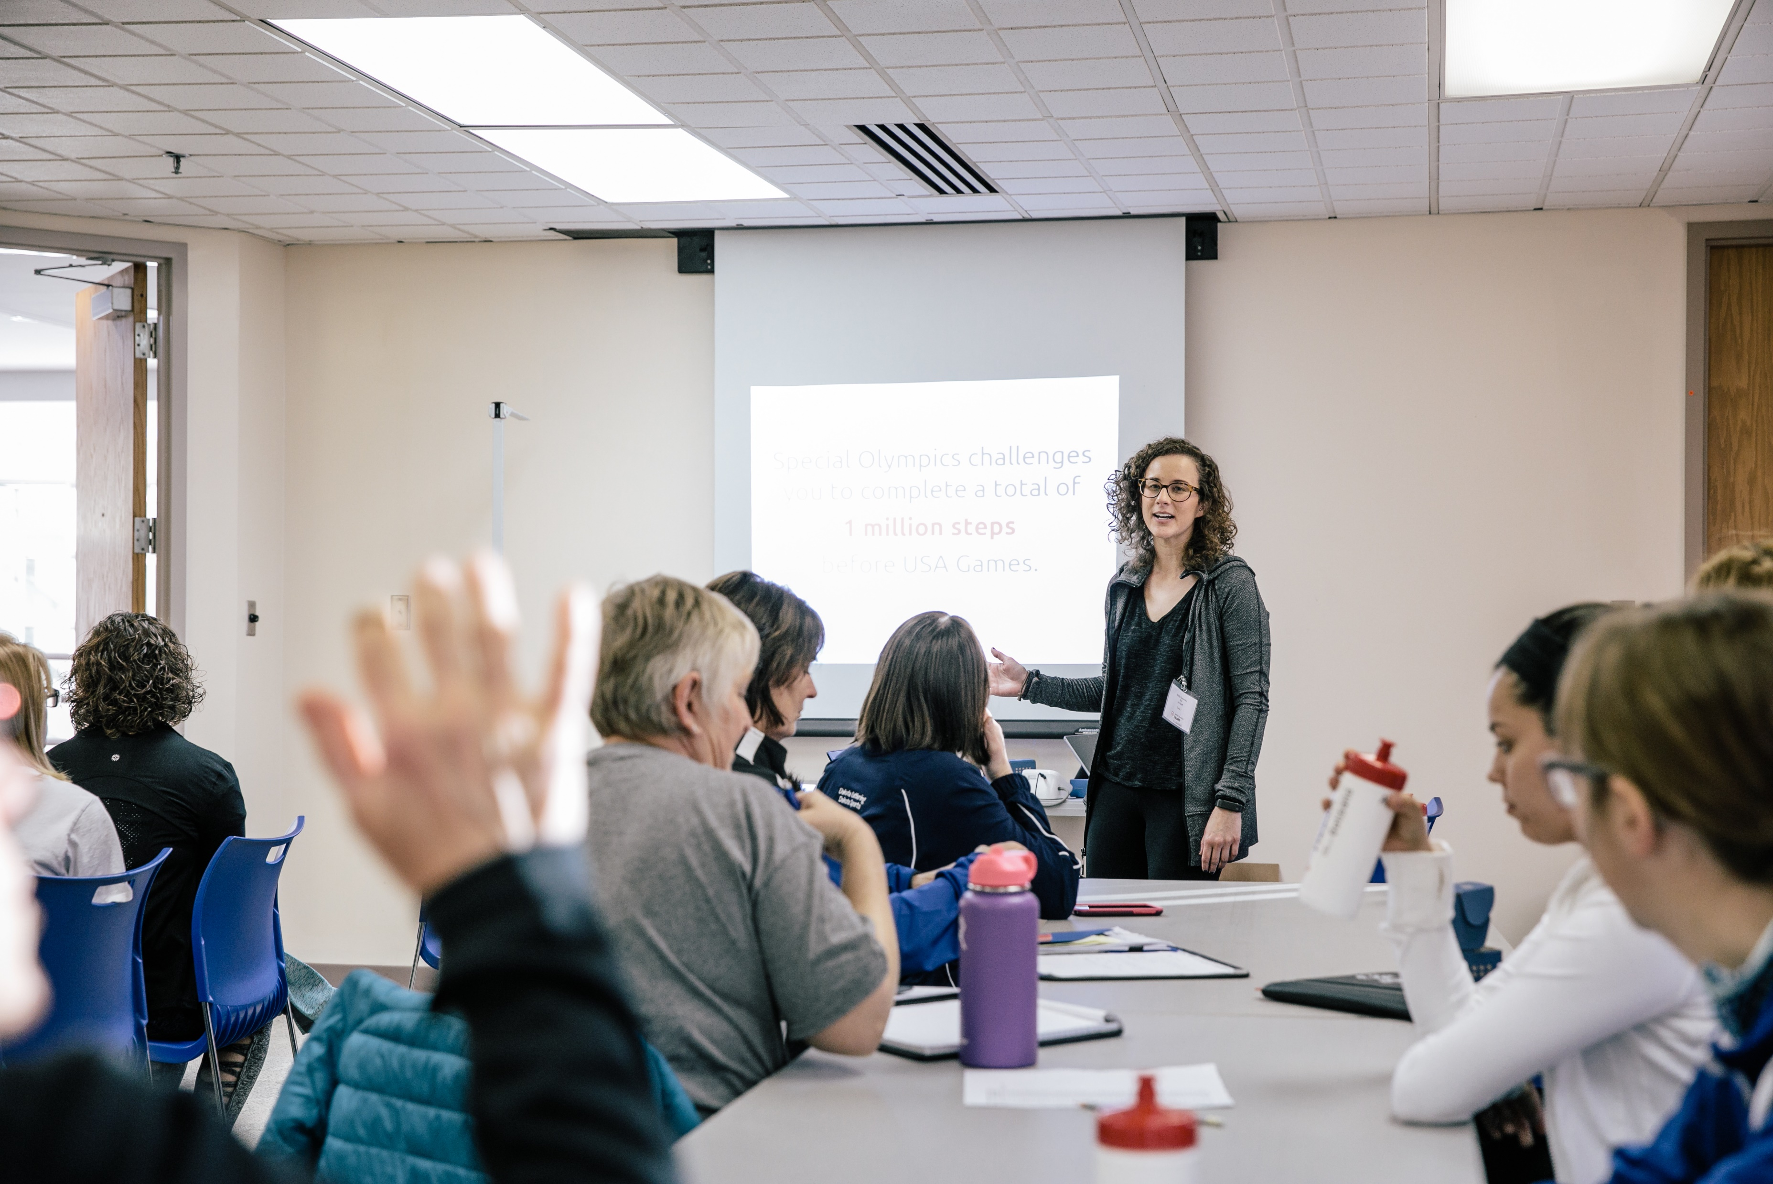
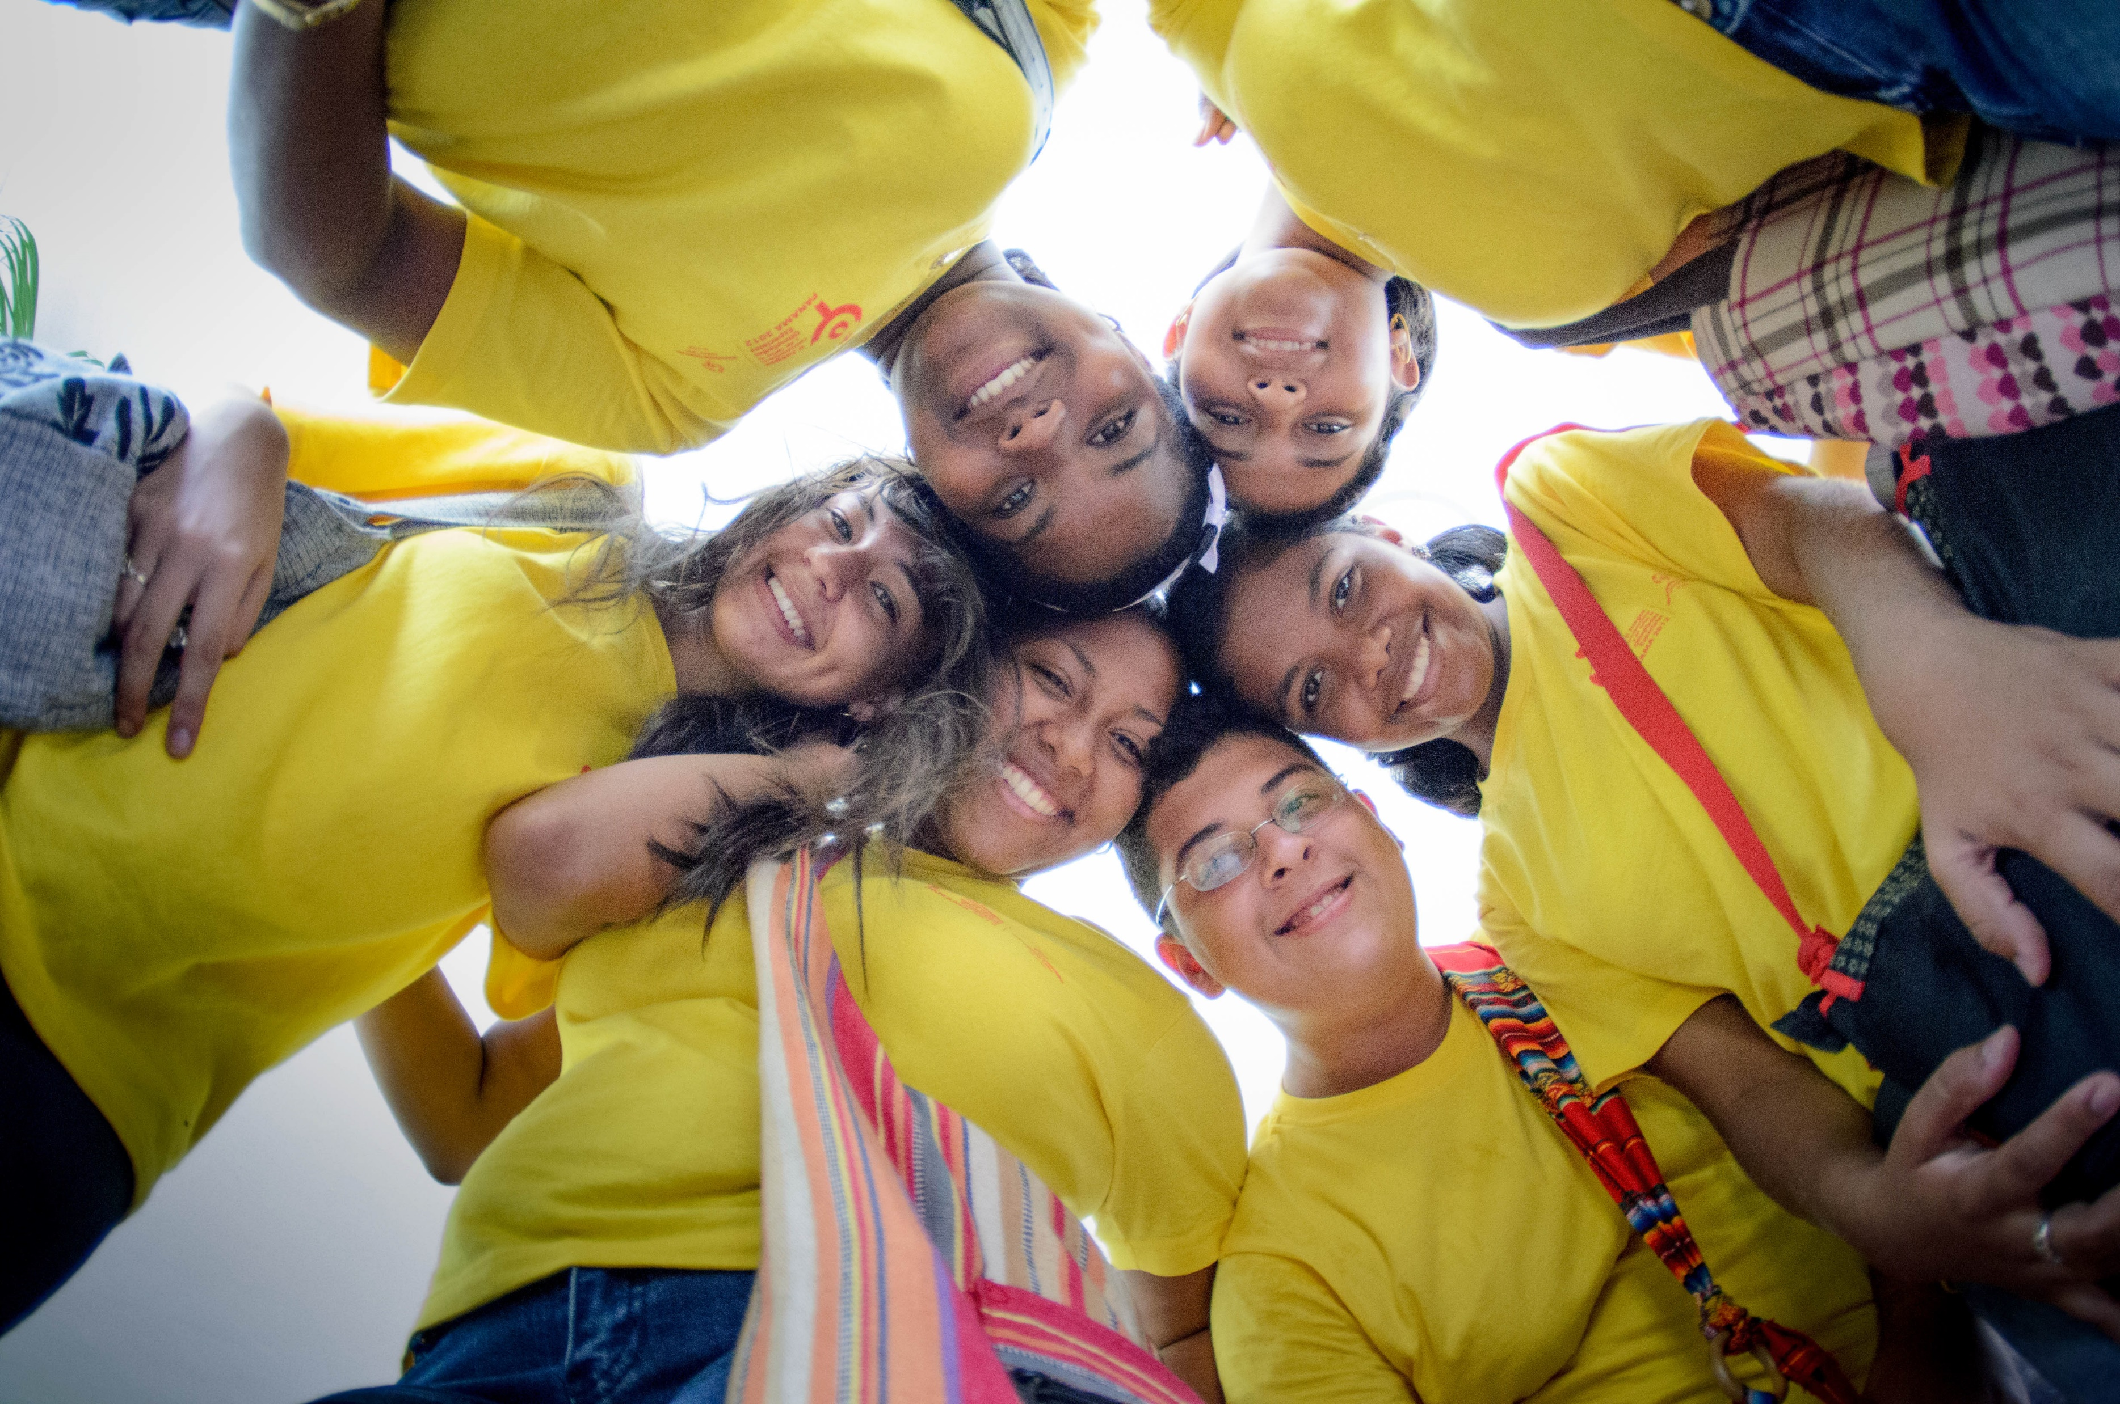
Health Structure
Pillar #1
Prevention
Pillar #2
Assessment
Healthy
Communities
Pillar #3
Training
Pillar #4
Health Systems
Notes:
Lead: Alicia B

Slide 3
Prevention Team
Rebecca Ralston
Sr Director, Early Childhood & Preventive Health
Jennifer Hansen
Senior Manager, Young Athletes
Ryland Towne
Specialist, Young Athletes
Cassandra Ryan
Manager, ECD Projects
Melissa Otterbein
Senior Manager, Fitness & Health Education
Gwendolyn Apgar
Manager, Fitness for Sports Performance
Jennifer Pittman
Manager, Family Health Education
Ashley Reid
Manager, Fitness in Schools
Leigha Cummings
Specialist, Fitness
ECD & Families Team
Fitness Team
Notes:
Lead: Alicia B

Slide 4

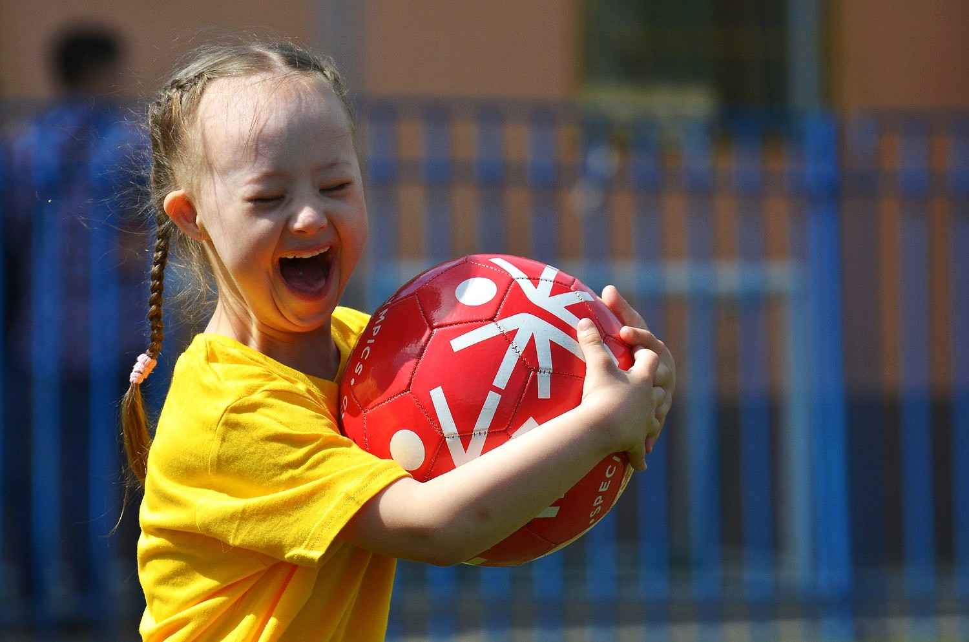
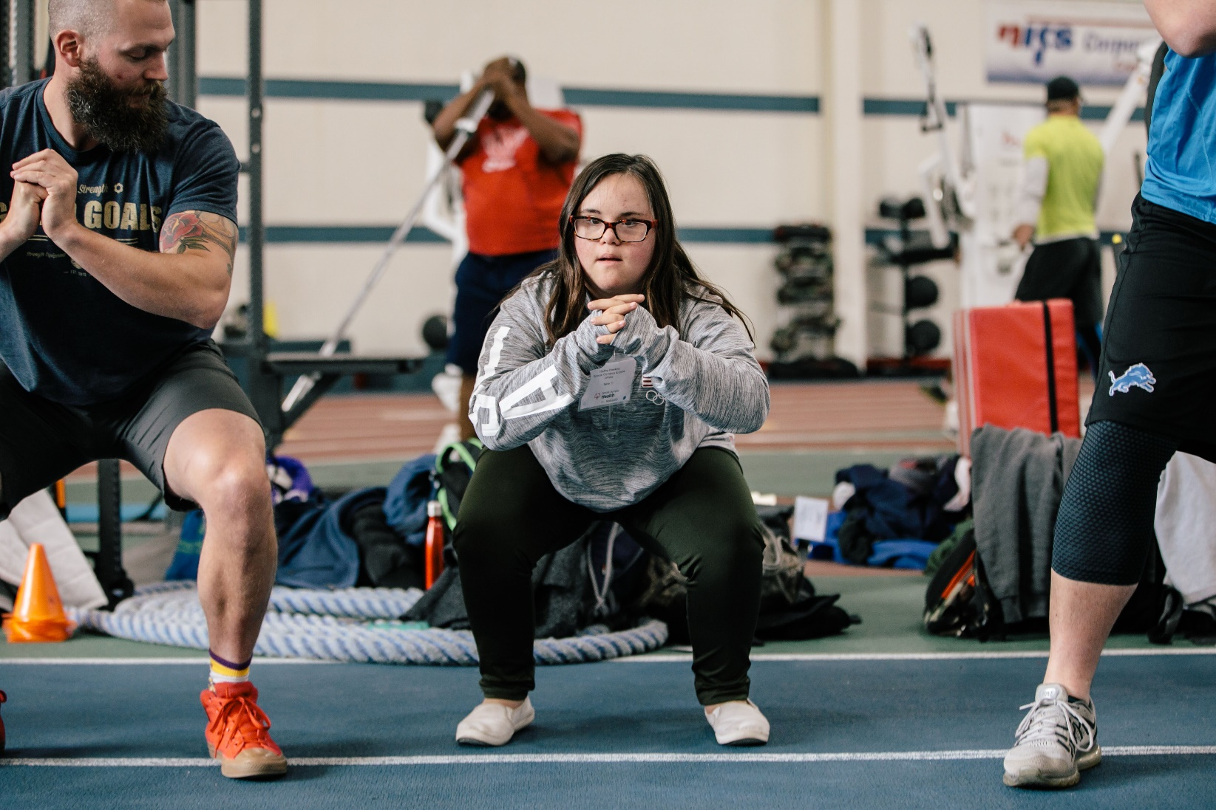
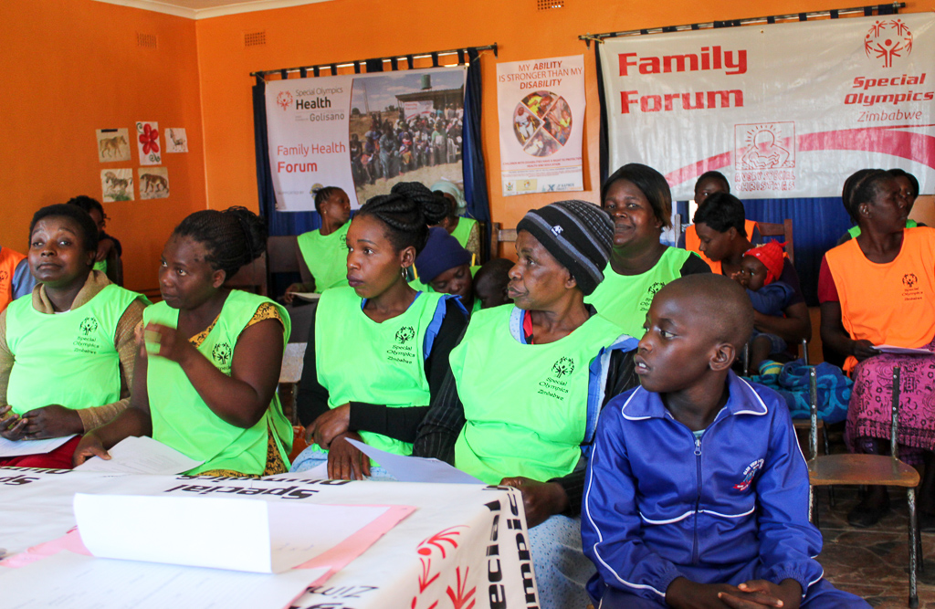
Pillar 1: Prevention
Strategic Priority
Expand ongoing physical activity, motor development, fitness, health and nutrition education, and wellness programming for Special Olympics athletes across the lifespan from early childhood to aging athletes
Notes:
Lead: Rebecca

Slide 5
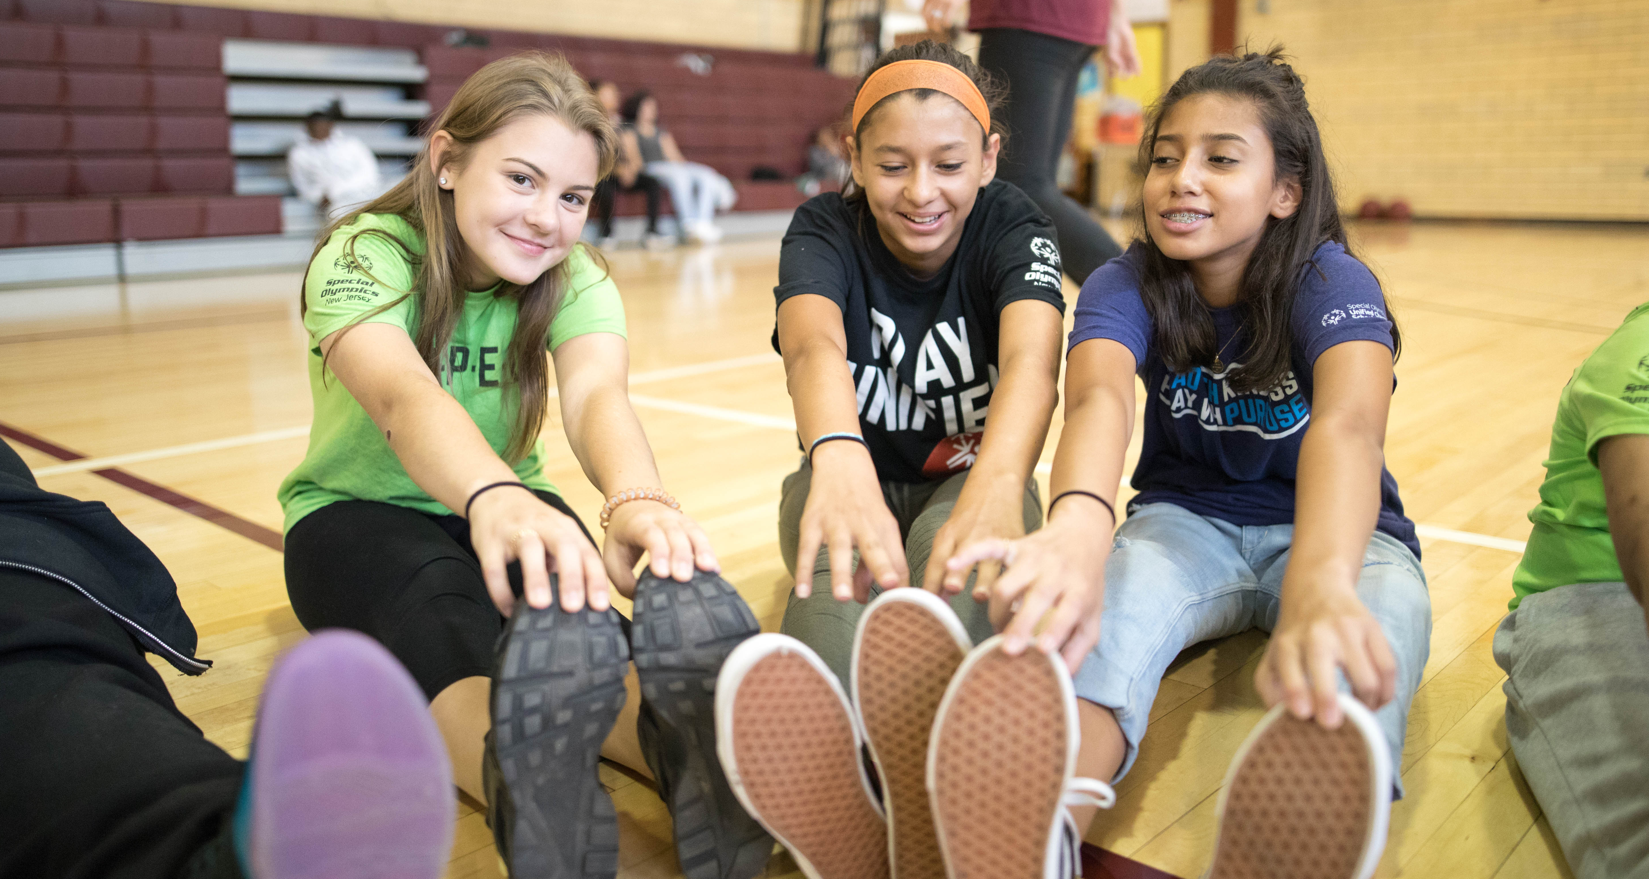


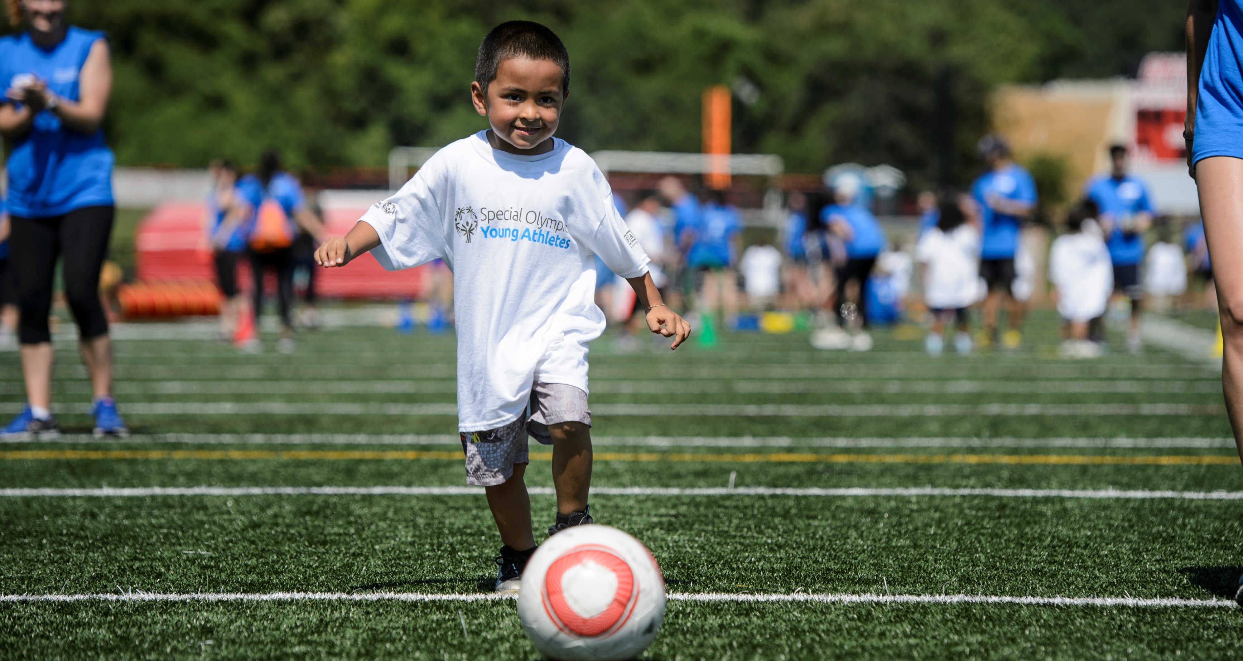

Pillar 1: Prevention
Strategic Goals
Early Childhood Development: Extend reach and scope of our early childhood program (Young Athletes) to improve developmental outcomes of children with ID, with a priority focus on using technology and accessing rural areas
Fitness & Health Education: Increase growth of global interventions in physical activity, nutrition, health promotion and social–emotional health to improve program quality and ensure adoption of healthy behaviors.
Family Health Education: Empower families and caregivers as advocates for people with ID ​through evidenced-based health education
Notes:
Lead: Rebecca

Slide 6
Pillar 1: Prevention
Sub-Strategy Priorities
Early Childhood Development | Fitness | Family Health Education
Enhance quality programming to impact new developmental outcomes (including SEL, problem solving and adaptive skills), support at home implementation, and increase participation. | Ongoing Programming: Provide high quality programming that supports Special Olympics athletes in achieving higher levels of fitness. | Expand virtual and in-person Family Health Forum programming to include new countries and community health-related prevention programming.
Young Athletes serves as a catalyst for establishing a lifelong pathway into Special Olympics movement by providing a seamless transition into sport through developmental sports. | Education: Educate Special Olympics leaders to promote adoption of healthy lifestyle behaviors among athletes. | Develop a family-centered, lifespan approach that activates families as advocates for people with ID and transitions from one-time participation to regular family engagement through in-person and at-home activities.
Empower families through digital and in-person programming that offers structured education, training and support to maximize potential child development. | Technology: Use technology to build awareness of fitness and health behaviors. | Health Education
Establish Young Athletes as an inclusive early childhood development program that benefits all children and offers significant value to communities and governments. | Advocacy: Increase accessible fitness opportunities for all individuals with intellectual disabilities. | Expand prevention programming to address the overarching health needs of Special Olympics by developing a comprehensive intervention strategy.
Health Education
Expand prevention programming to address the overarching health needs of Special Olympics by developing a comprehensive intervention strategy.
Notes:
Lead: Rebecca

Slide 7
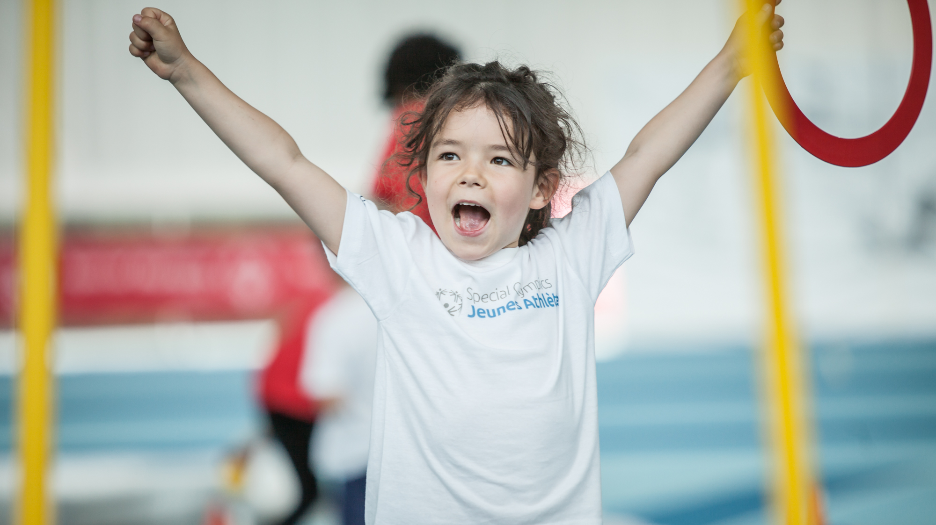
Early Childhood Development & Family Health Education

Slide 8
Pillar 1: Prevention
ECD & Families Programming
Quality Early Childhood Programming
Young Athletes (including implementation with partners – Head Start, American Indian & Alaska Native Head Start, and libraries)
Junior Athletes
Empowered & Educated Families
Healthy Start Parent Toolkit
Family Health Forums
Healthy Young Athletes Pediatric Screening
Young Athletes Mobile App
Child & Family Health Intervention
Notes:
Lead: Rebecca

Slide 9
Pillar 1: Prevention
ECD & Families Programming
Early Childhood and Families Programming
Young Athletes
New Parent Education
Family Health Education
Healthy Athletes Pediatric Screening
Child & Family Health Intervention
1st: children with & without IDD
2nd: teachers, coaches, implementers
Direct motor intervention for children with & without IDD
1st: parents & primary caregivers
2nd: health professionals
Education & support from time of diagnosis through Healthy Start & YA Mobile app
1st: Family members (incl. siblings)
2nd: health professionals
Family Health Forums and ongoing health educations for families of people with ID throughout the lifespan
1st: parents & primary caregivers
2nd: health professionals
Medical screening and follow up care specific to needs of children with IDD
1st: parents & primary caregivers/ children
2nd: health professionals
Combined programming including YA, parent and family education, and pediatric screenings
Notes:
Lead: Rebecca

Slide 10
Pillar 1: Prevention
ECD & Families Impact & Metrics
Impact of Young Athletes
Current Participation Metrics
After two months of participation in Young Athletes, children with ID experienced a seven-month gain in motor skills.
Children participating in Young Athletes saw significant increases in adaptive skills, including daily living, communication and social-emotional skills.
Parents and caregivers saw significant improvement in empowerment and efficacy through participation.
264,358 children with and without ID participated in Young Athletes globally in 2023, with 163,741 of the participants coming from 122 countries outside the United States
Strategic Plan Targets
650,000 children with and without intellectual disabilities (ID) participating in Young Athletes globally by 2030.
Notes:
Lead: Rebecca

Slide 11
Pillar 1: Prevention
ECD & Families Projects – 2024 Priorities
Launch full school year Young Athletes Curriculum to grow school-based programming
Continued expansion of Child & Family Health intervention model globally
Young Athletes Mobile App – Ongoing evaluation and continued technology development
Development of standardized FHF Curriculums and implementation of family health education model
Implementation of YA in tribal communities in the US through indigenized activities and expansion to indigenous communities globally
Notes:
Lead: Rebecca

Slide 12
Pillar 1: Prevention
ECD 2024+ Funding Needs
Funding Needs | Additional Background | Funding Needed | Fundraising Deadline
Young Athletes Mobile App (Organizational priority) | Phase 3 funding to complete V2 development and launch app globally. Ideally global funding/not-US specific. To be spent in 2024. | $800,000 (minimum required accounting for Bezos, CDC & Golisano funding) $1.3 Million (includes $$ towards endowment) | January 2025 Phase 3 scheduled to begin February/March 2024
Young Athletes Global Growth & Regional Support | Regional & Program funding to support global growth of YA, including MCH Intervention expansion. Global funding. | $500,000+ annually | Ongoing
Additional opportunities always available to support programming above and beyond current scope, including:
Young Athletes growth in the United States, including support of key partnership and programming areas:
Head Start
American Indian & Alaska Native (AIAN) Head Start
Community library integration
Parks & Recreation
Developmental Sports
Notes:
Lead: Rebecca

Slide 13
Pillar 1: Prevention
ECD Ongoing Funding Needs
To reach 650,000 Young Athletes by 2030, we need to add 400,000 Young Athletes over the next 7 years.
Given the rebuilding process and challenges reconnecting with former YA families and coaches, coupled with potential efficiencies in growth efforts using technology, we anticipate the following funding will be needed to reach 650,000 Young Athletes by 2030:
$10,000,000 over 7 years
Notes:
Lead: Rebecca

Slide 14

Fitness Programming

Slide 15
Pillar 1: Prevention
Fitness Programming
Fitness Models
Unified Fitness Clubs
Fit Families and Friends
Fitness for Sports Performance
Fitness Captains
Fitness Assessment
Technology and Resources
SO FitNow Mobile App
Fitness in Schools Online Educator Training
SOFIT
Fitness Challenges
Performance Stations
Coach Education
Fit 5 (adults)
Fitness for Youth and Schools
High 5 for Fitness
Unified Activity Plans
School of Strength
Online fitness provider trainings
Unified Fitness Kits and Cards
Notes:
Lead: Rebecca

Slide 16
Pillar 1: Prevention
Fitness Impact & Metrics
Impact of Fitness Programming
Current Participation Metrics
Special Olympics fitness programming improves health behaviors for participants:
37% increased their level of physical activity.
51% increased the number of fruits and veggies in their diets.
45% increased their water consumption.
Athletes most at risk for cardiovascular disease saw decreases in weight and high blood pressure.
451,957 athletes with ID participated in any fitness programming in 2021, with 312,346 athletes participating in ongoing fitness programming lasting 6+ weeks.
Strategic Plan Targets
700,000 athletes with ID participating in any fitness programming by 2026, and 550,000 athletes in ongoing programming of 6 weeks or longer.
Notes:
Lead: Rebecca

Slide 17
Pillar 1: Prevention
Fitness Projects – 2023 Priorities
Launch guidelines defining fitness programming criteria
Grow engagement and users on SO FitNow mobile app through new technology development
Expand Fitness Captains – a fitness-focused athlete leadership role on sports teams
Implement Fitness Through Sport strategy and toolkit to integrate health programming into sports
Pilot and launch curriculum to implement High 5 for Fitness in schools
Notes:
Lead: Rebecca

Slide 18
Pillar 1: Prevention
Funding Needs
Funding Needs | Additional Background | Funding Needed | Fundraising Deadline
SO FitNow Fitness Mobile App | Initial investment to reassess and rebuild fitness app for athlete usability, along with license fees, staff and technical support. | $200,000 | Ongoing
Fitness Global Growth & Regional Support | Regional & Program funding to support global growth of fitness programming and evaluations. Global funding. | $150,000+ annually | Ongoing
Fitness Wearables | Cash or product donation of wearable devices for athletes to track ongoing fitness and health activity through SO FitNow app. | Up to $1.2M or 15,000 wearable devices | Ongoing
Fitness Evaluation | Ongoing efforts to track effectiveness of interventions in impacting long term health outcomes | $100,000 annually | Ongoing
Additional opportunities always available to support programming above and beyond current scope, including:
Fitness growth in the United States: Program level support of Performance Stations, fitness challenges, ongoing programming implementation, etc.
Notes:
Lead: Rebecca

Slide 19
Pillar 1: Prevention
Fitness Ongoing Funding Needs
To reach 700,000 athletes with ID in fitness programming by 2026, we need to add 250,000 participants over the next 3 years. We anticipate the following funding will be needed to reach these targets:
$2.5M over 3 years
Notes:
Lead: Rebecca

Slide 20
Pillar 1: Prevention
Partner Visibility & Engagement Opportunities
Early Childhood & Families
Local Program recognition (t-shirt and banners at local events/programming)
Regional/global recognition (as relevant)
Volunteer activation (in-person event volunteers, YA backpack kit distribution)
Digital and physical assets (YA app, Healthy Start online toolkit, YA backpack kits, etc.)
Fitness
Local Program recognition (t-shirt and banners at local events/programming)
Regional/global recognition (as relevant)
Volunteer activation (in-person event volunteers)
Digital & physical assets (SO FitNow app, Unified Fitness Kits, etc.)
Notes:
Lead: Rebecca

