Slide 1

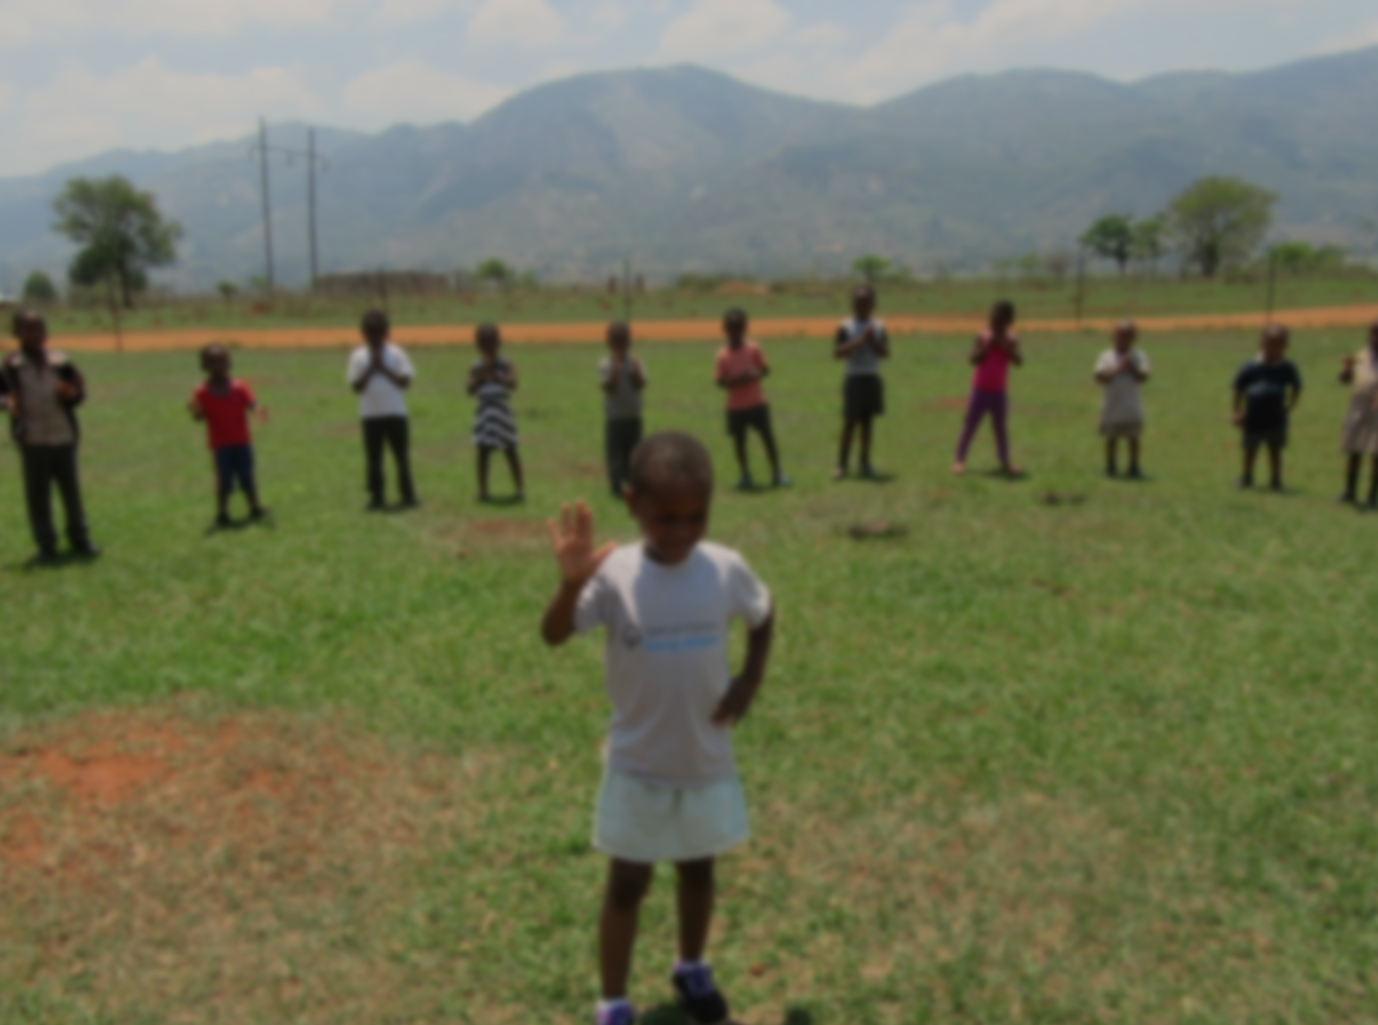
Young Athletes
Notes:
Facilitator Introductions
Allow all participants in the room to introduce themselves

Slide 2
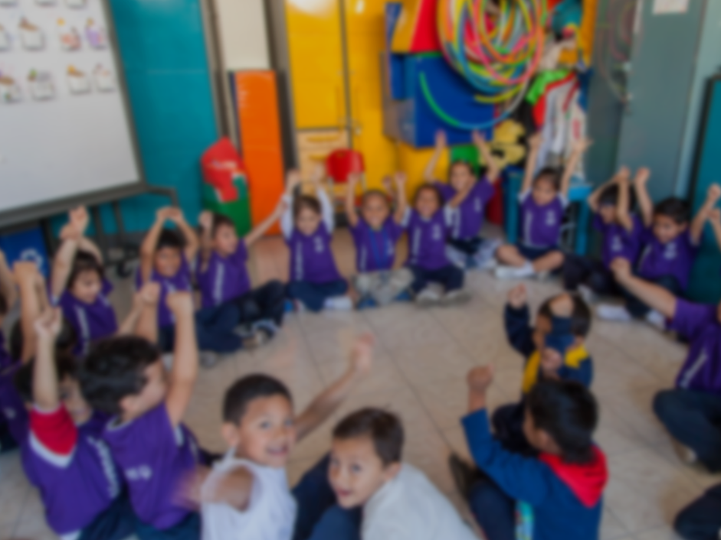

OVERVIEW
1
The Need
2
Young Athletes
3
The Impact
4
Young Athletes in (insert Program Name)
2
Notes:
Provide an overview of the four main sections of the training
The full training should take approximately 20-30 minutes to complete

Slide 3
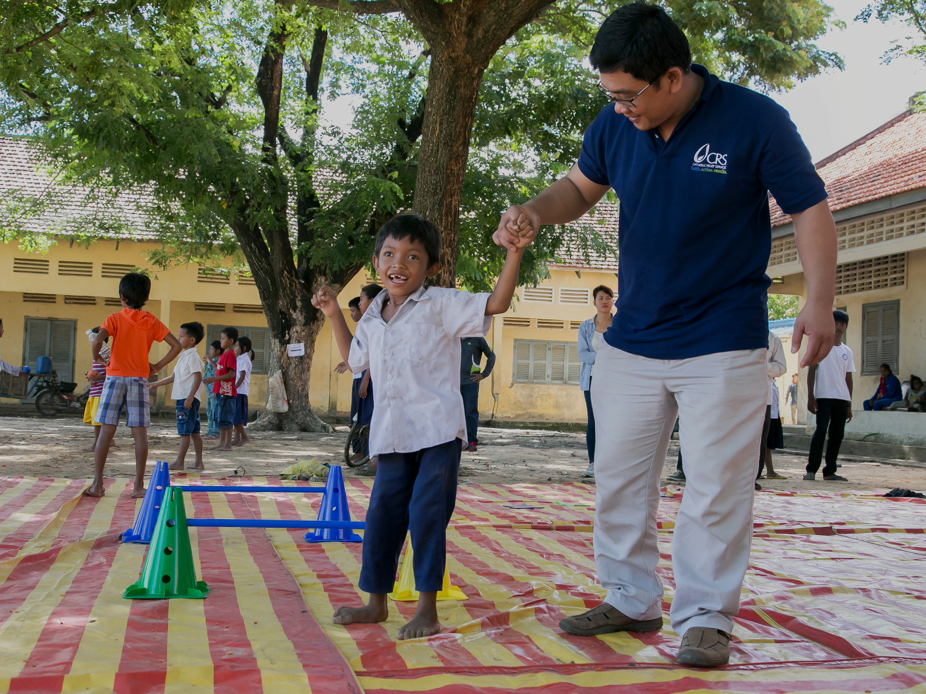
The
NEED
1
3
Notes:
Participating in Special Olympics has been shown to inspire joy, improve self-confidence, bolster family relationships and improve parents’ expectations of their children with intellectual disabilities (ID)
While this is crucial for people with ID of all ages, Special Olympics’ traditional sports program is only available to athletes ages eight and over
Children from impoverished areas who have an intellectual disability are destined to perpetuate the cycle of poverty if they are unable to access, and participate in, early childhood intervention programs like Young Athletes

Slide 4
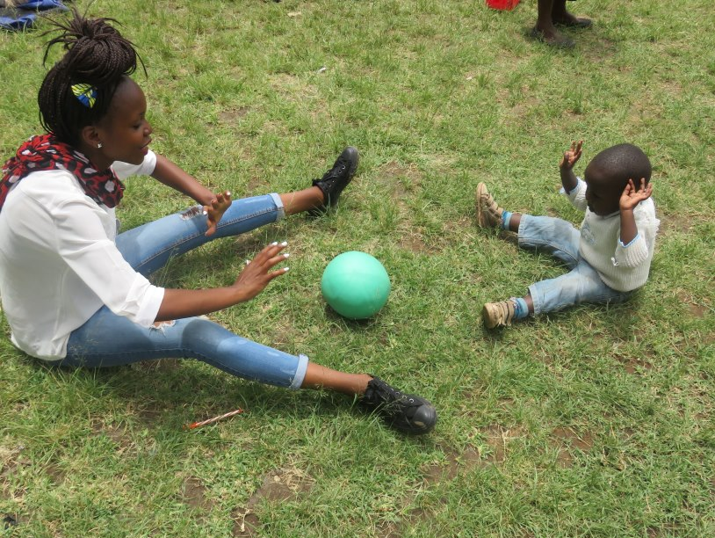
1
The Need
80%
of the children living with a disability globally live in a developing country
4

Slide 5
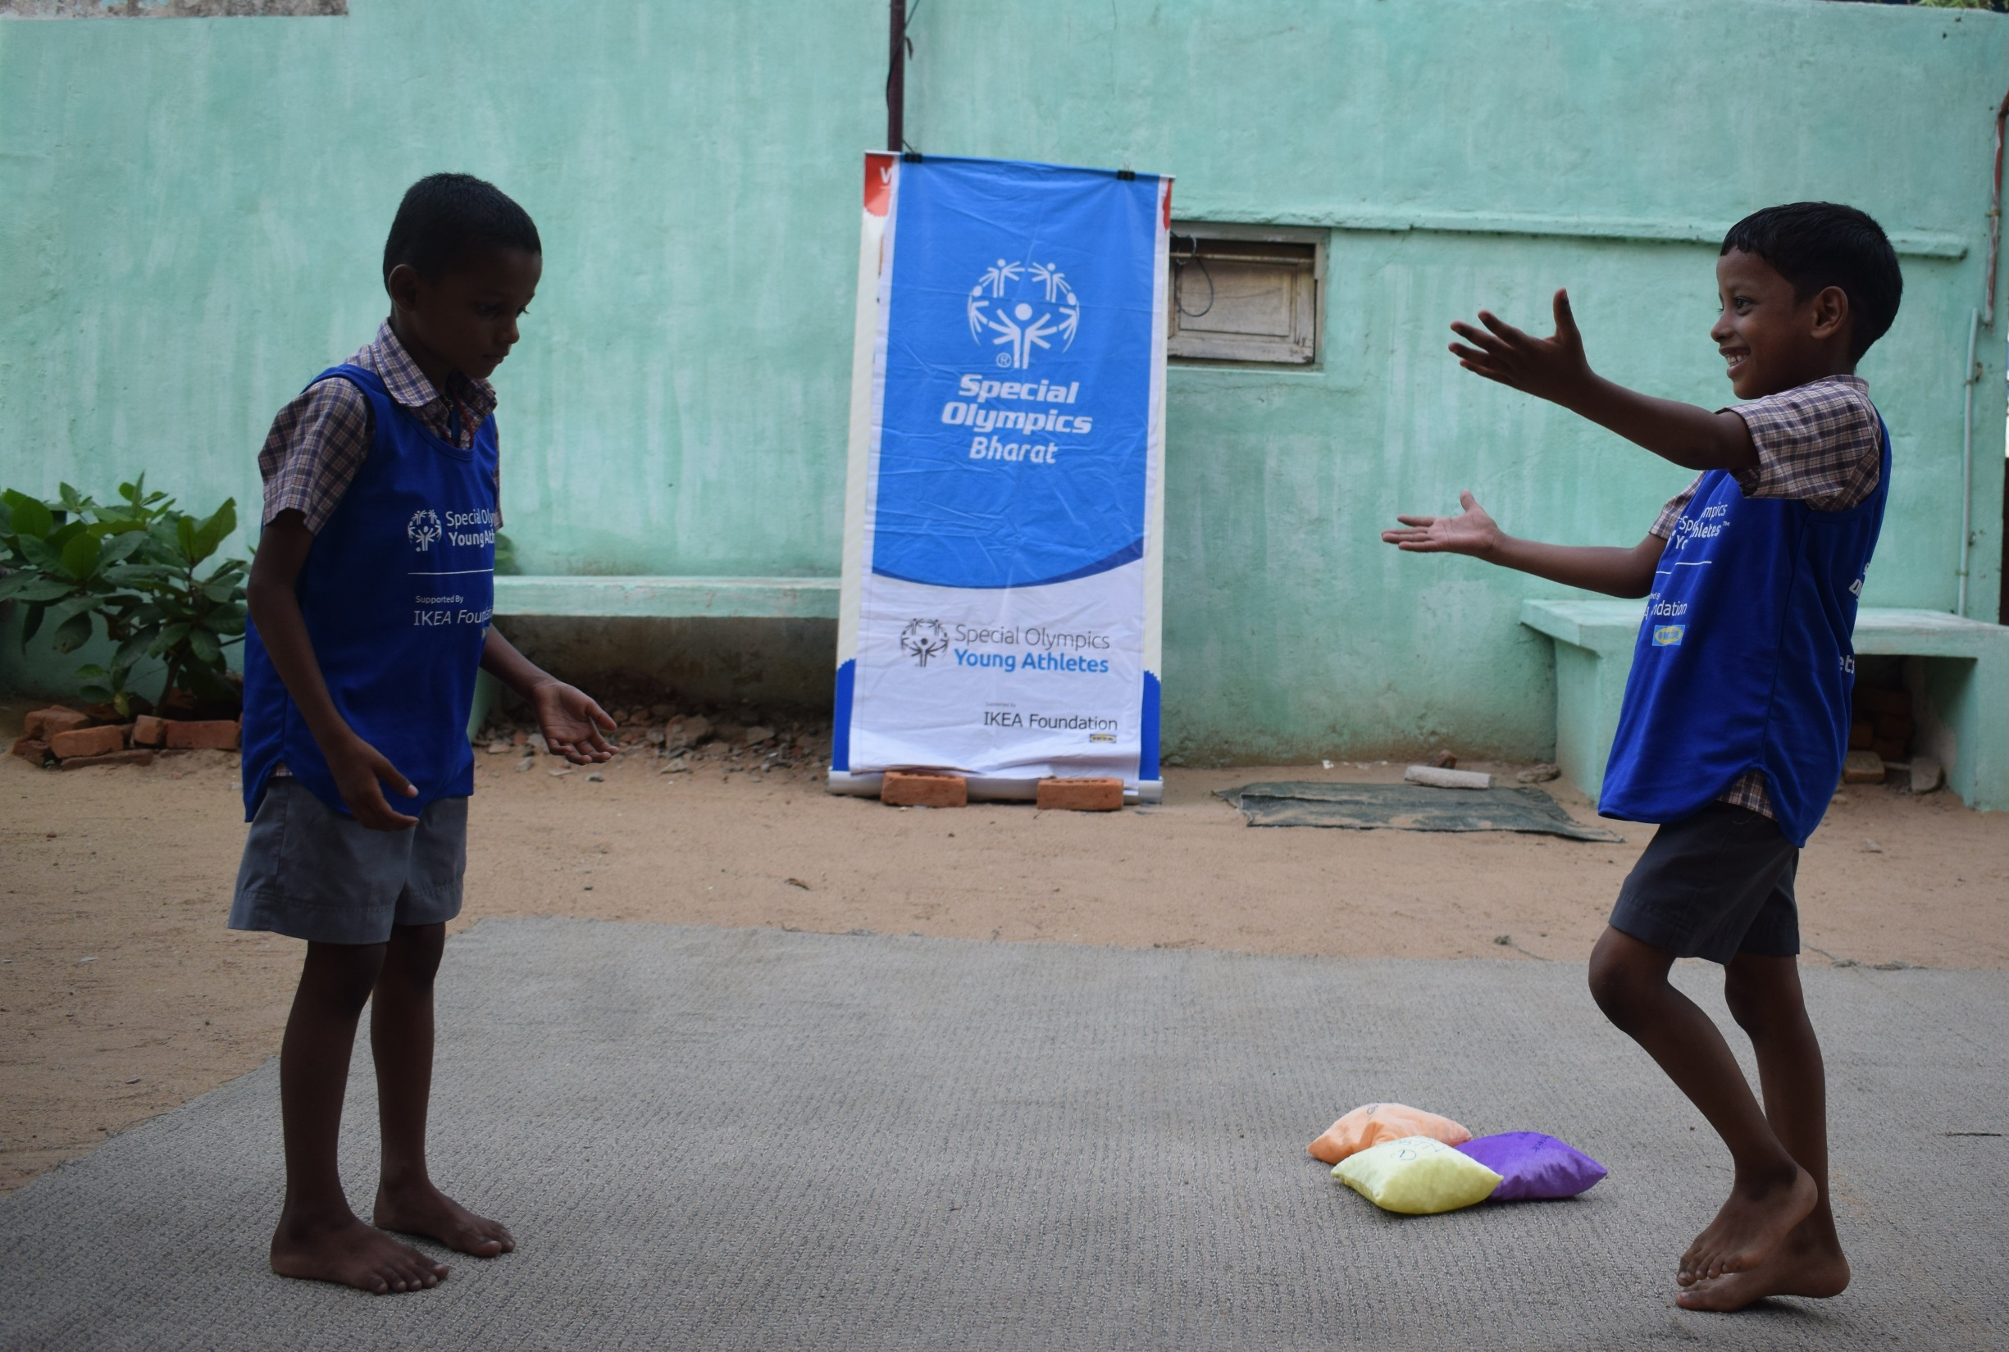
1
The Need
The vast majority of children with intellectual disabilities and their families have very limited or non-existent access to critical early childhood development programs
5

Slide 6
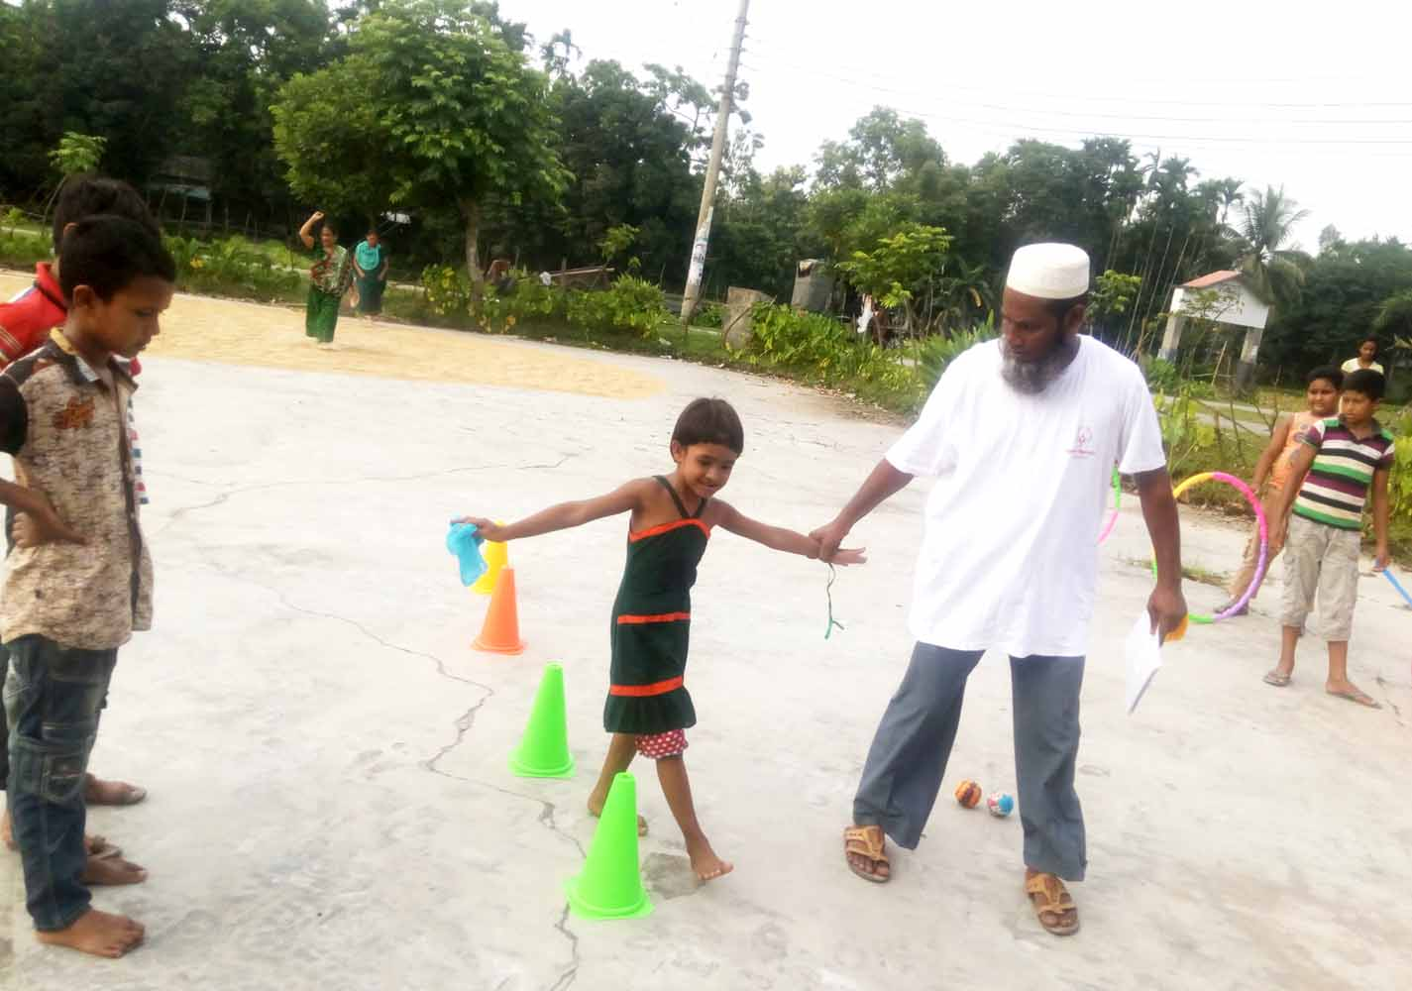
1
The Need
90%
of children with disabilities in developing countries are not in school
6

Slide 7
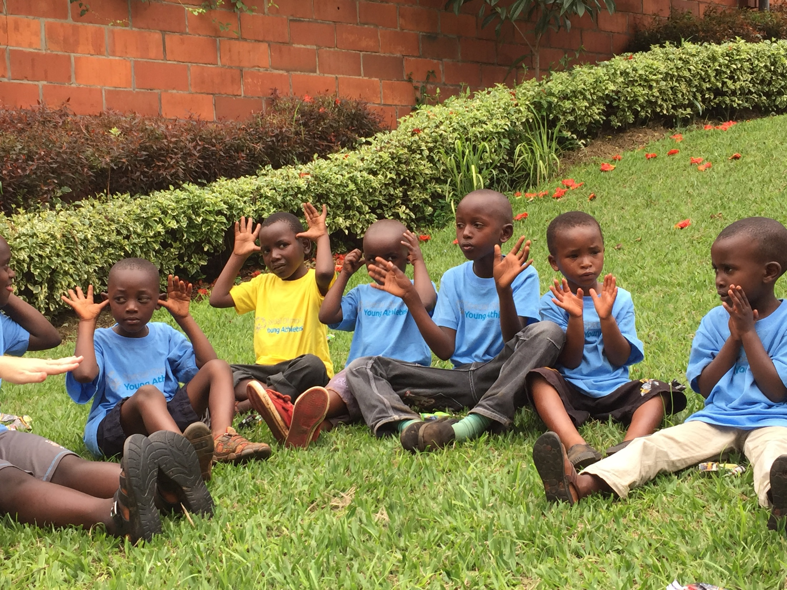
1
The Need
Throughout the world, public information and family education about intellectual disabilities is inadequate or simply non-existent
7

Slide 8
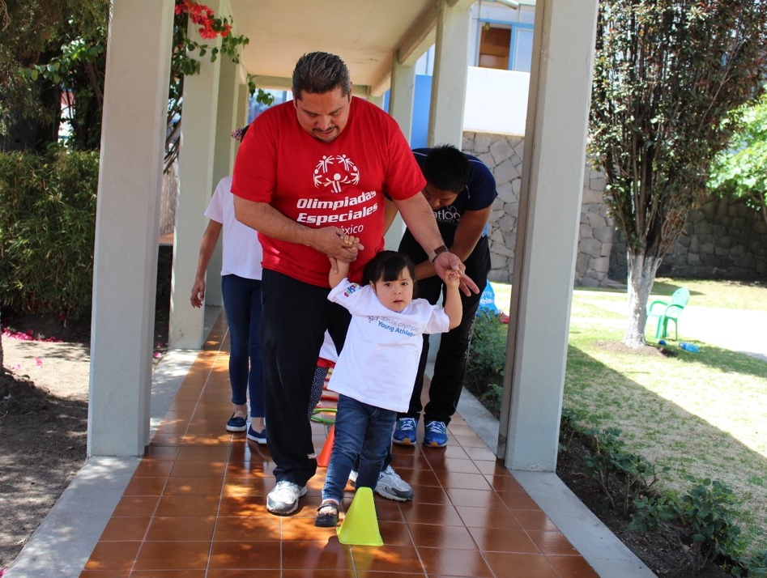
1
The Need
People with intellectual disabilities are less likely to receive basic health services such as eye exams and dental care, and have a higher obesity rate than the general population
8

Slide 9
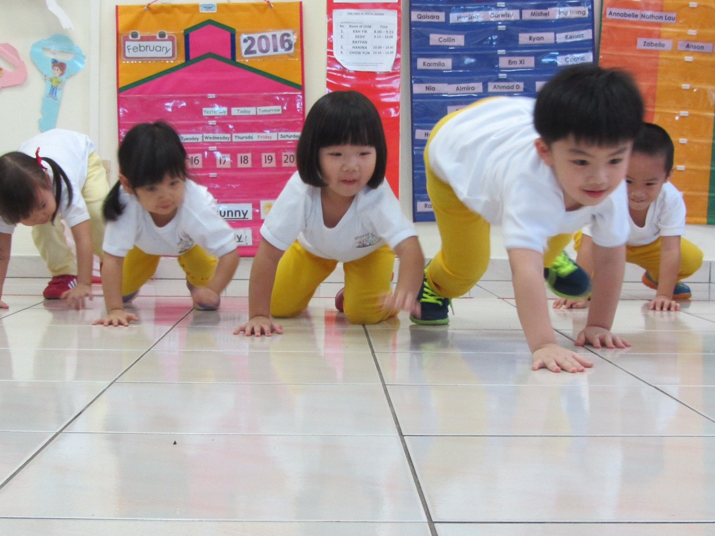
1
The Need
40%
People with intellectual disabilities have a
higher risk
of preventable secondary health conditions than the general population
9
Notes:
Most individuals with intellectual disabilities do not have access to medical care and do not see a doctor regularly

Slide 10
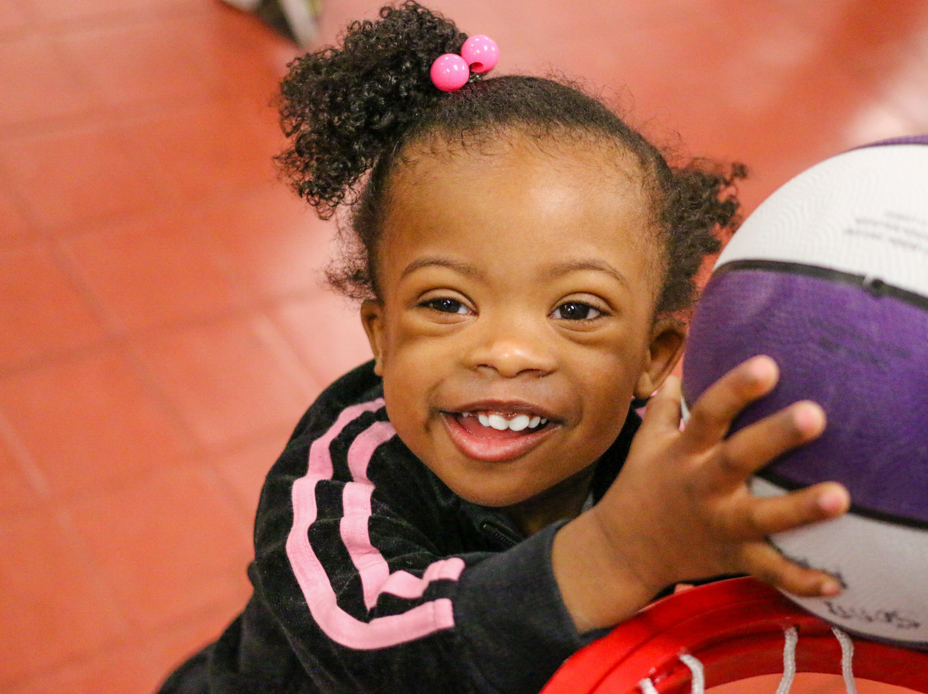
1
The Need
Societal views still do not recognize the full potential of children with intellectual disabilities
10
Notes:
Although society has come a long way with inclusion and respect, we still have a long way to go

Slide 11
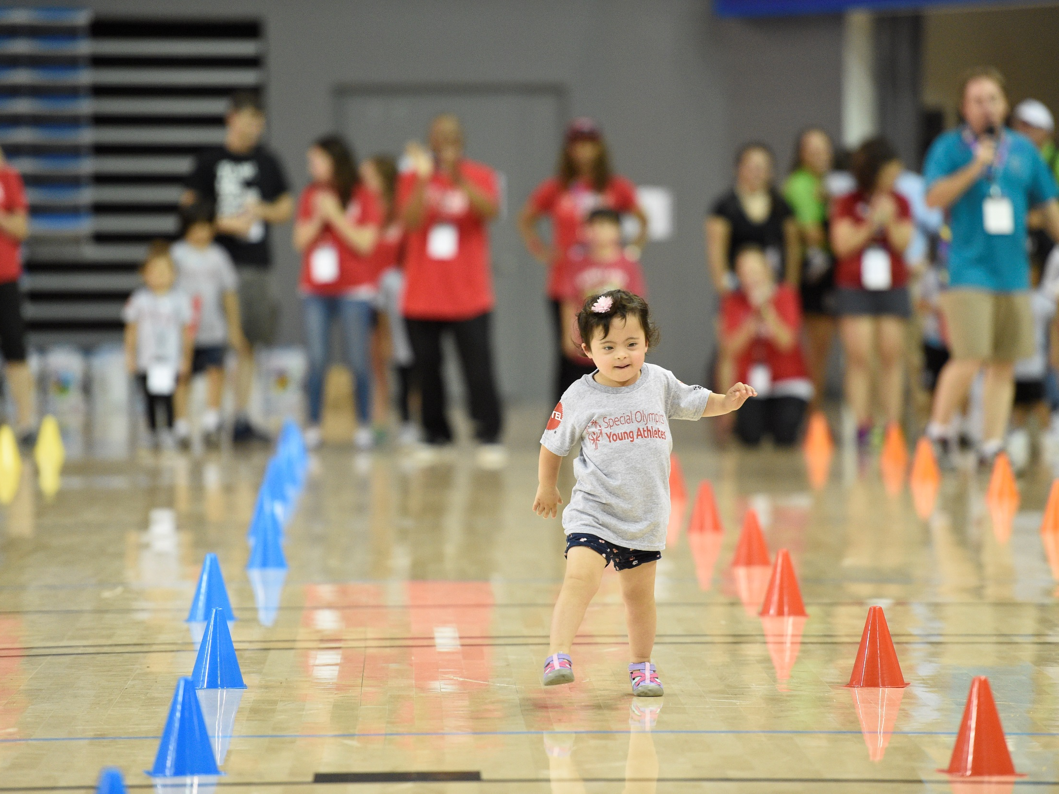
Special Olympics
YOUNG ATHLETES
2
11
Notes:
Special Olympics is working on tackling these needs through Young Athletes

Slide 12
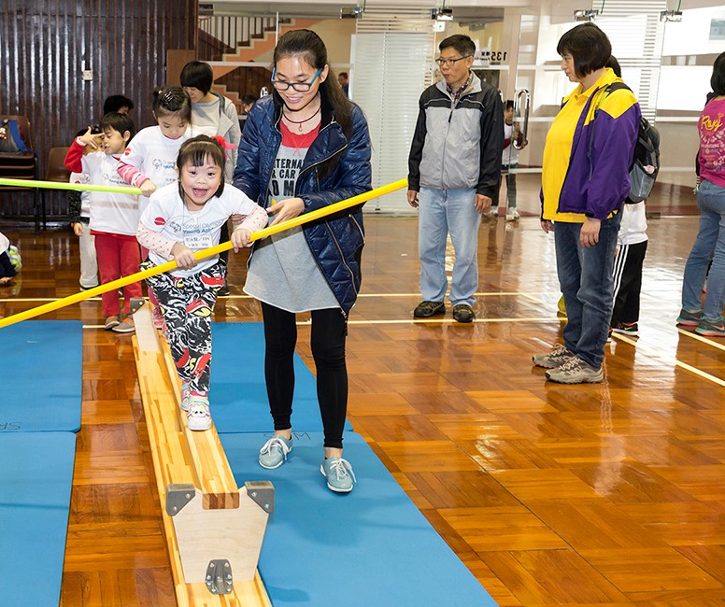

2
Young Athletes
Young Athletes
An inclusive sport and play program for children with and without intellectual disabilities (ID), ages 2 to 7 years old
Young Athletes develops critical cognitive, social and motor skills.
12

Slide 13
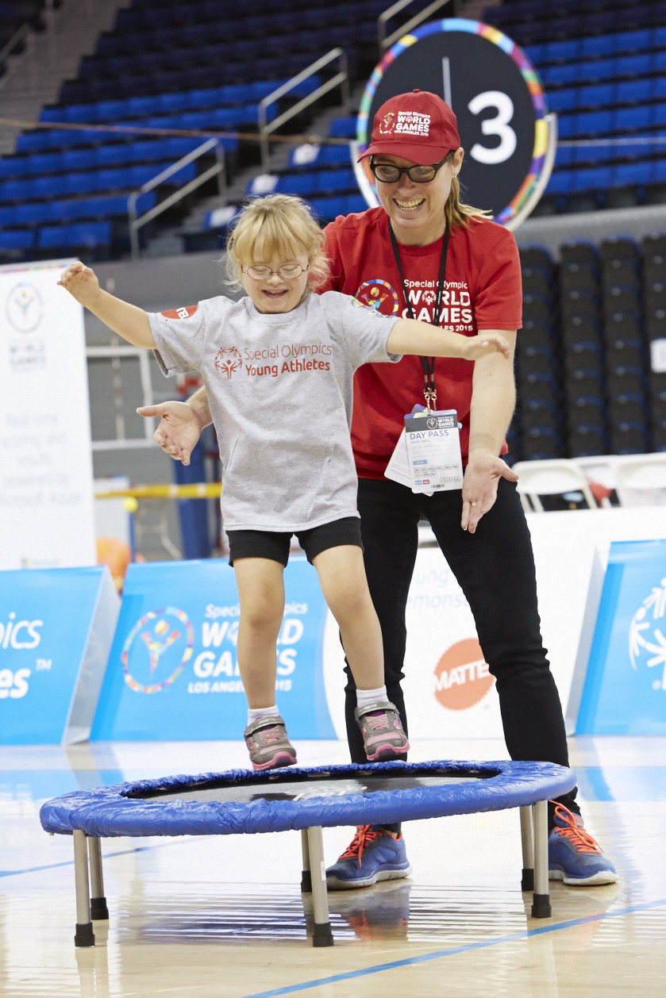
2
Young Athletes
The Goals
Support social inclusion and inclusive play
Encourage children with and without intellectual disabilities to learn & play together
Provide children with activities and games that meet their skill and ability level
Empower family members to see their child’s abilities and future potential
13

Slide 14
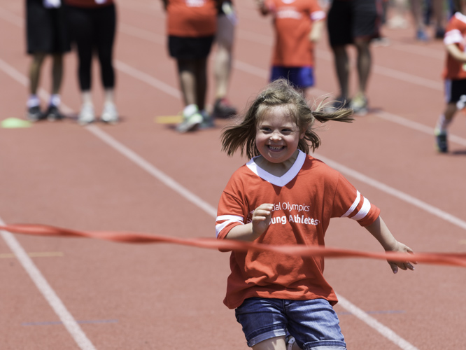
2
Young Athletes
Skill Development
Foundational Skills
Walking & Running
Balance & Jumping
Trapping & Catching
Throwing
Striking
Kicking
Advanced Sport Skills
14
Notes:
There are eight skill areas in Young Athletes that help children learn movements they will use in sports and daily life
Young Athletes consists of fun and engaging activities that align with the eight skill areas

Slide 15
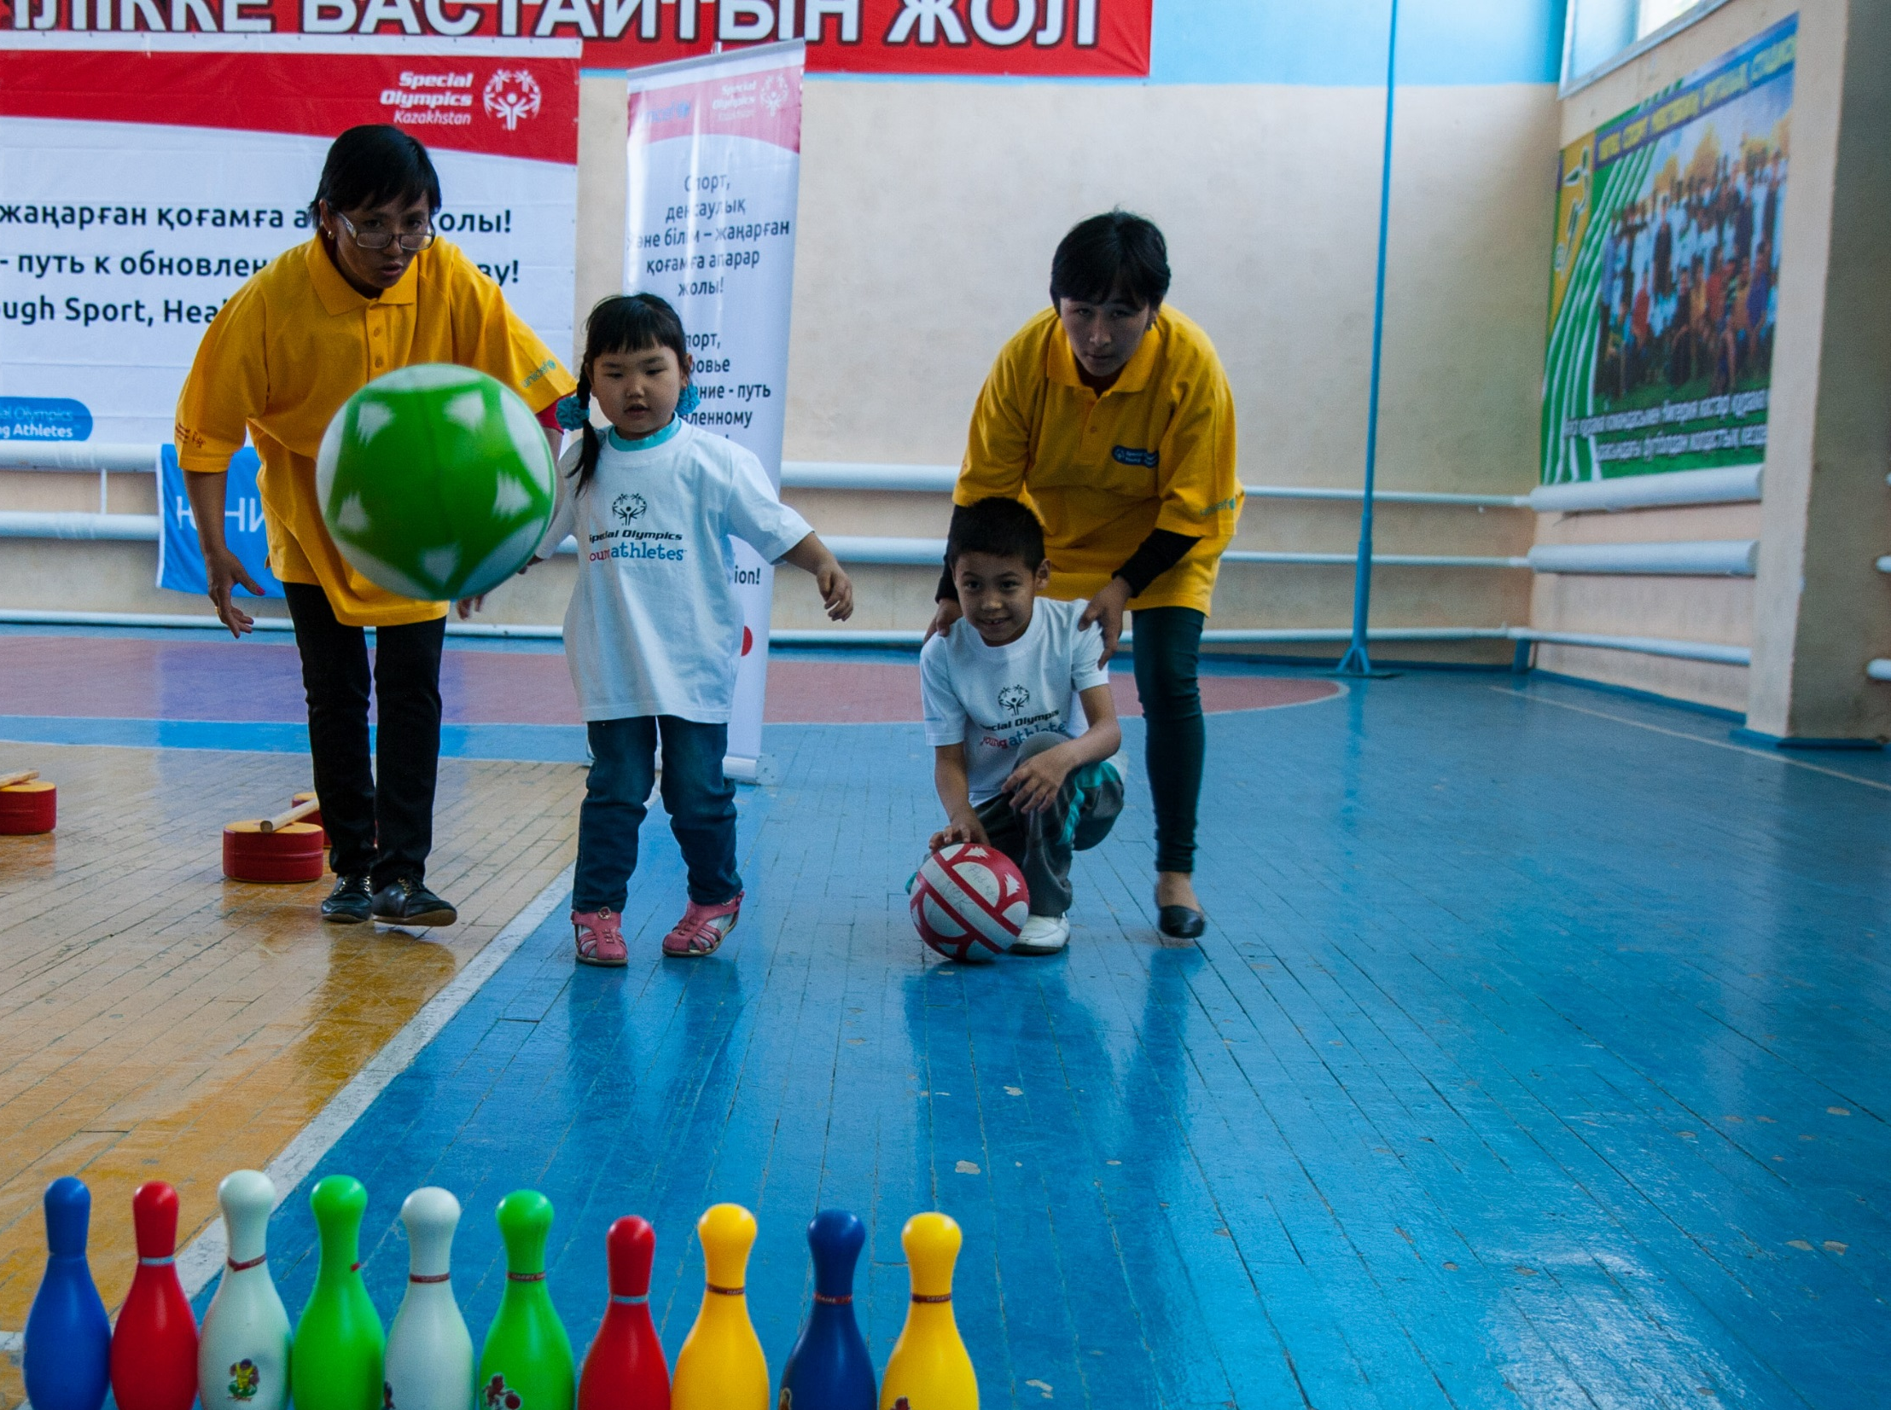



2
Young Athletes
Where it Happens
School
Community
Home
15
Notes:
Young Athletes can take place in the home, community or school—led by educators, parents, coaches or volunteers

Slide 16
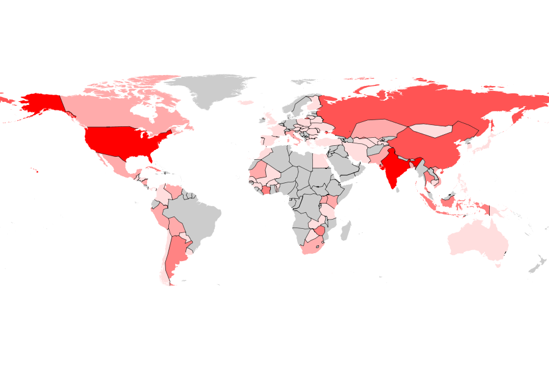
2
Young Athletes
163,159 Young Athletes worldwide in 2016
The Reach
66% of Special Olympics Programs conduct Young Athletes
16
Notes:
Young Athletes was started in 2005
Young Athletes is in all seven Special Olympics regions and 66% of SO Programs conduct YA

Slide 17
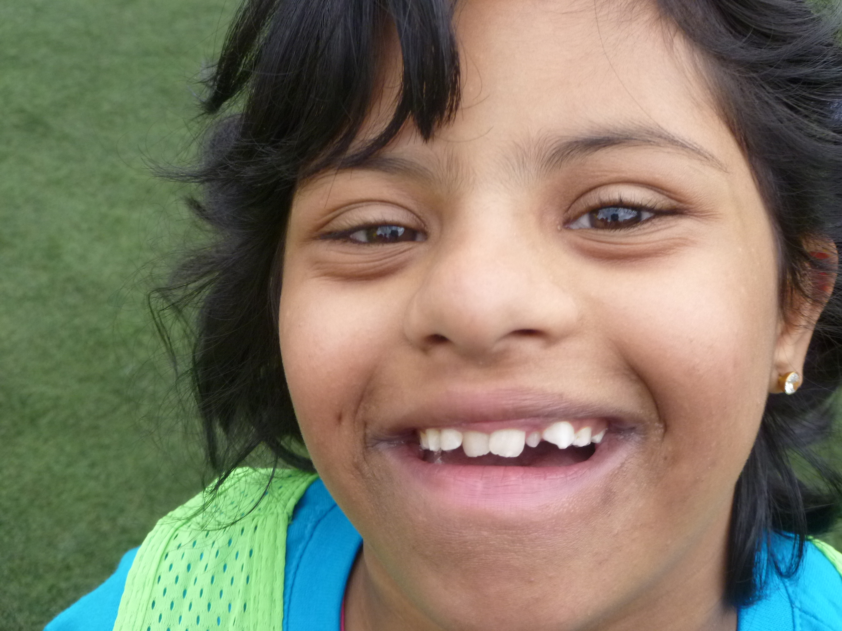
The
IMPACT
3
17
Notes:
Young Athletes benefits the child and the family, challenges expectations, forges relationships, fosters support networks, and builds crucial skills for young children

Slide 18
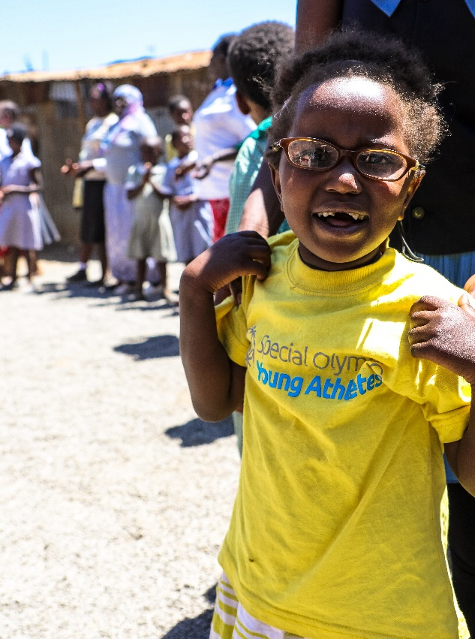
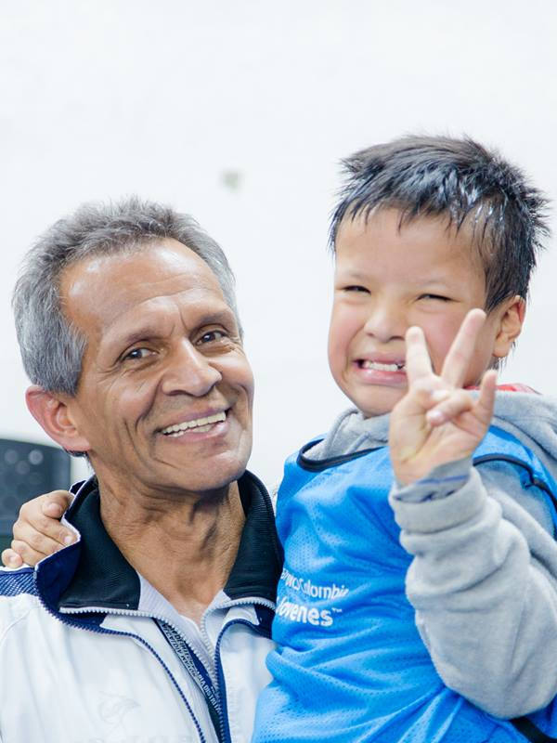
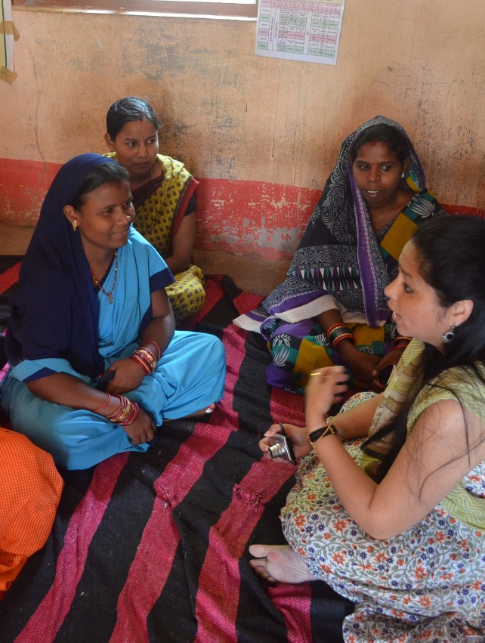
3
The Impact
The Child The Family The Community
Develops gross motor and social skills
Promotes positive family interactions
Breaks down stereotypes and promotes acceptance
18
Notes:
YA’s impact has a ripple effect that extends benefits beyond the participants in the program to the family and community
In this way, YA serves as a catalyst for change in the community and a mechanism to enhance social inclusion for people with ID

Slide 19
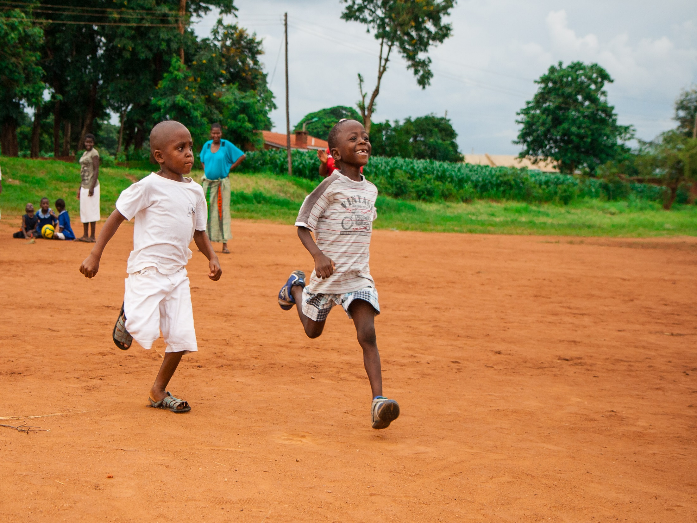
3
The Impact
Impact on Participants
After 2 months of participation in Young Athletes, children with ID experienced 7 month gain in motor skills*
At 5 and 10 month follow ups, children who participated in Young Athletes maintained a 4 month advantage in development
19
*Participation consisted of an 8-week structured curriculum
Notes:
Children with ID often experience challenges developing motor skills
Research conducted by Special Olympics has found that YA improves the motor skills of participants in both U.S. and international contexts
YA creates an environment where children with ID can play with their peers, perhaps for the first time, while developing motor and social skills

Slide 20
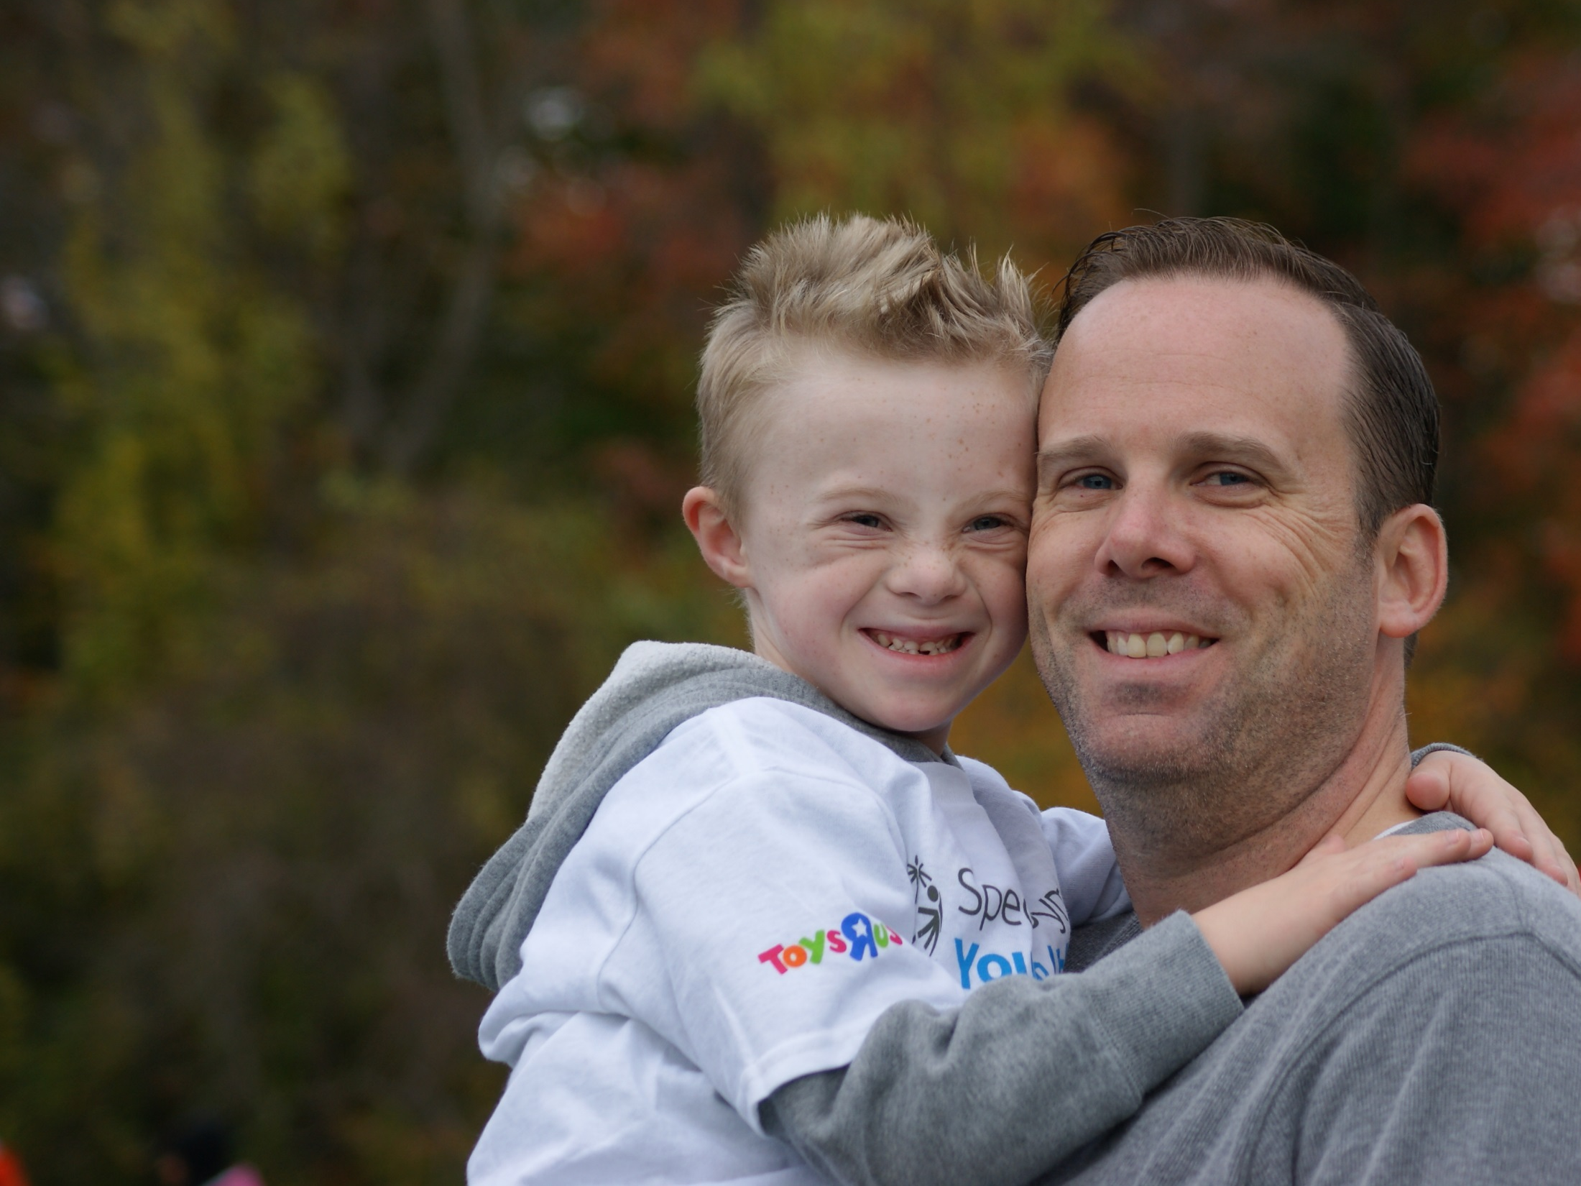
3
The Impact
Impact on Families
Provides a forum for educating families
Changes family perceptions on the value and worth of their child
Provides opportunities for families to come together to share challenges and rewards
20
Notes:
A 2014 study found that by demonstrating that children with ID can participate in, and benefit from, group activities, parents became more willing to bring their children into social settings
YA raises parents’ expectations of their child with ID

Slide 21
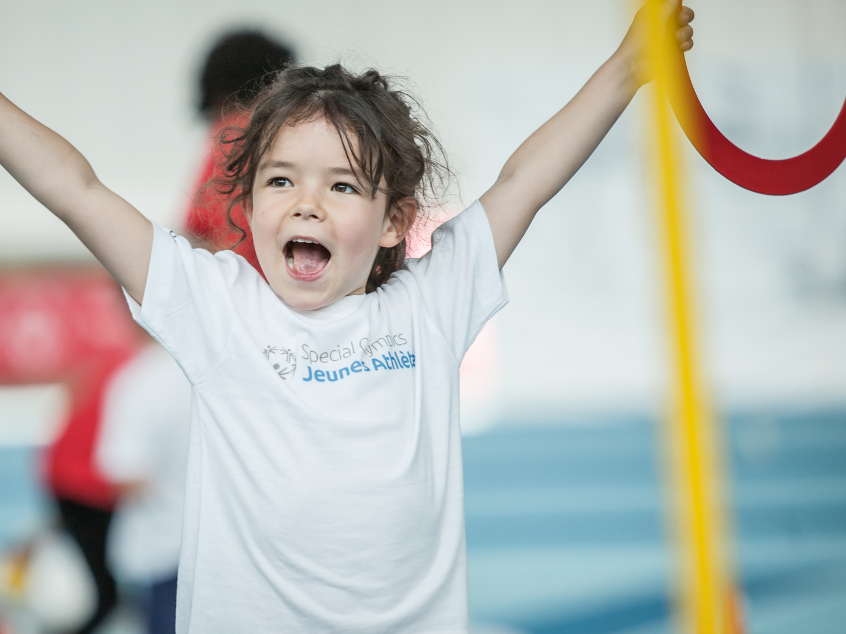
3
The Impact
Impact on Community
Changes perceptions and attitudes towards children and adults with intellectual disabilities
Creates environments that foster inclusion and respect
Provides opportunities for community members to learn about intellectual disabilities
21
Notes:
YA provides the community with an opportunity to learn about ID and to embrace members of the community with ID and their families

Slide 22
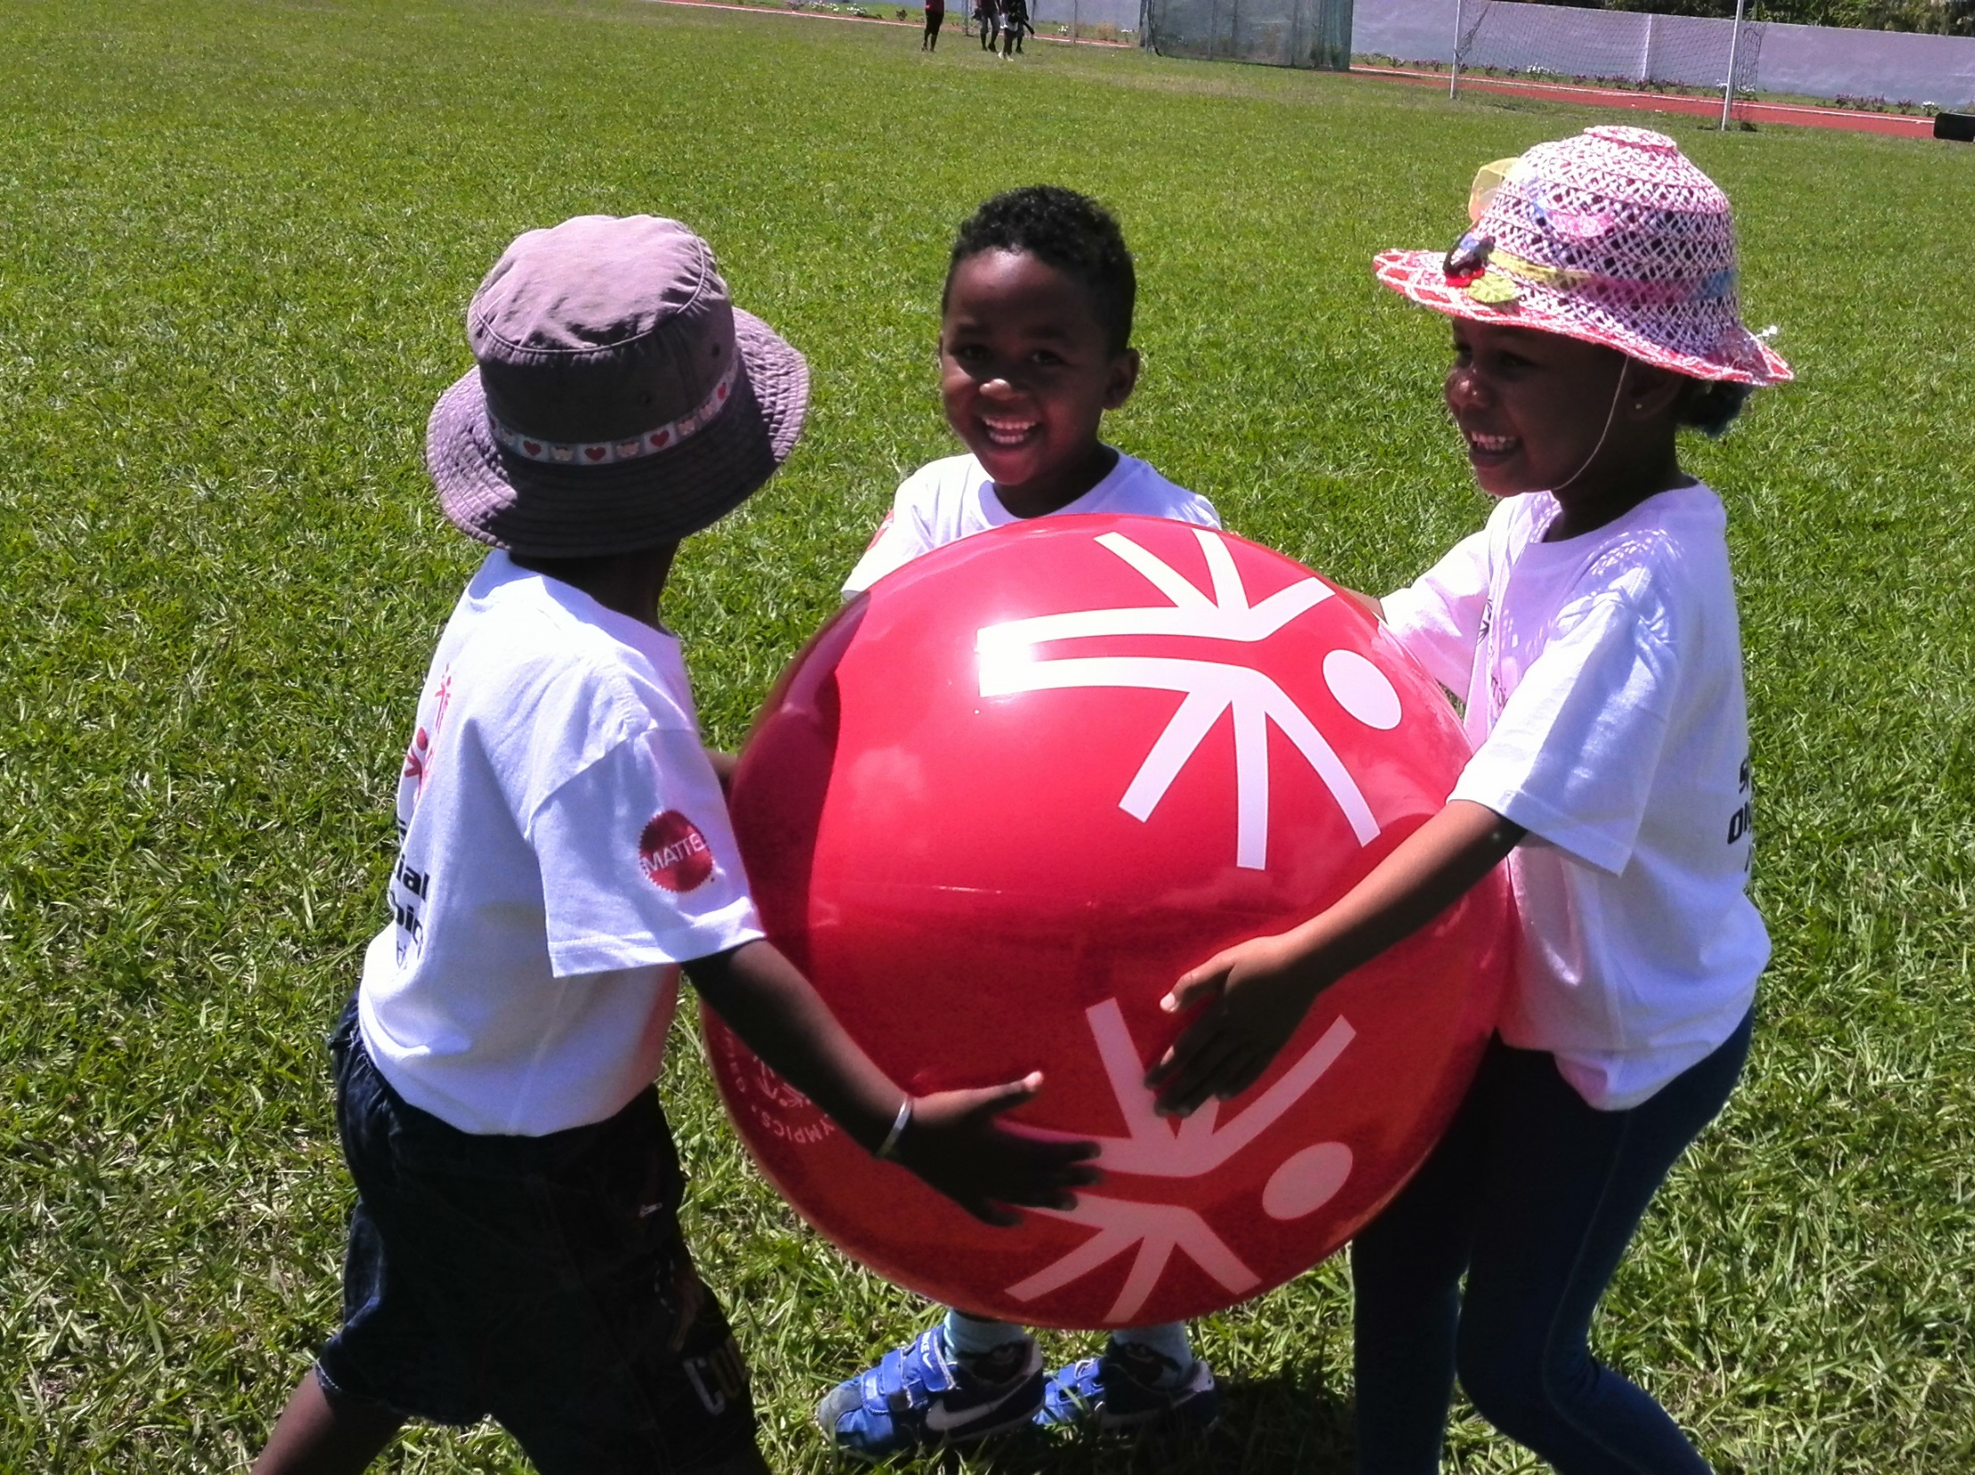
Additional Program Information Needed
Special Olympics
(Insert Program Name)
4
22

Slide 23
Additional Program Information Needed
4
Special Olympics (Program Name)
(insert Program-specific Young Athletes picture)
Young Athletes
Insert information on the current status of Young Athletes in your Program (number of registered Young Athletes, what areas you cover, etc.)
23
Notes:
Delete the “Program Name” text and replace it with the name of your Program or Region
Delete “insert Program-specific Young Athletes picture.” Insert a picture and place it over the white box
Delete the text in the text box and replace it with Young Athletes information for your Program (example: number of registered Young Athletes, number of trained coaches, etc.)

Slide 24
Additional Program Information Needed
4
Special Olympics (Program Name)
Our Impact
(insert Program-specific Young Athletes picture or video)
Insert Young Athletes impact story from your Program (example: a child who learned to walk through YA, etc.)
24
Notes:
Delete the “insert Program-specific Young Athletes picture or video.” Insert picture or video and place over white box. Delete “Program Name” and replace it with the name of your Program.
Insert a Young Athletes story or quote in the provided text box

Slide 25
Additional Program Information Needed
4
Special Olympics (Program Name)
Our Goals
(insert Program-specific Young Athletes picture)
Insert information on your Program goals for Young Athletes (growth metrics, programming goals, etc.)
25
Notes:
Delete the “insert Program-specific Young Athletes picture.” Insert picture and place over white box. Delete “Program Name” and replace it with the name of your Program.
Insert goals in the text box provided

Slide 26
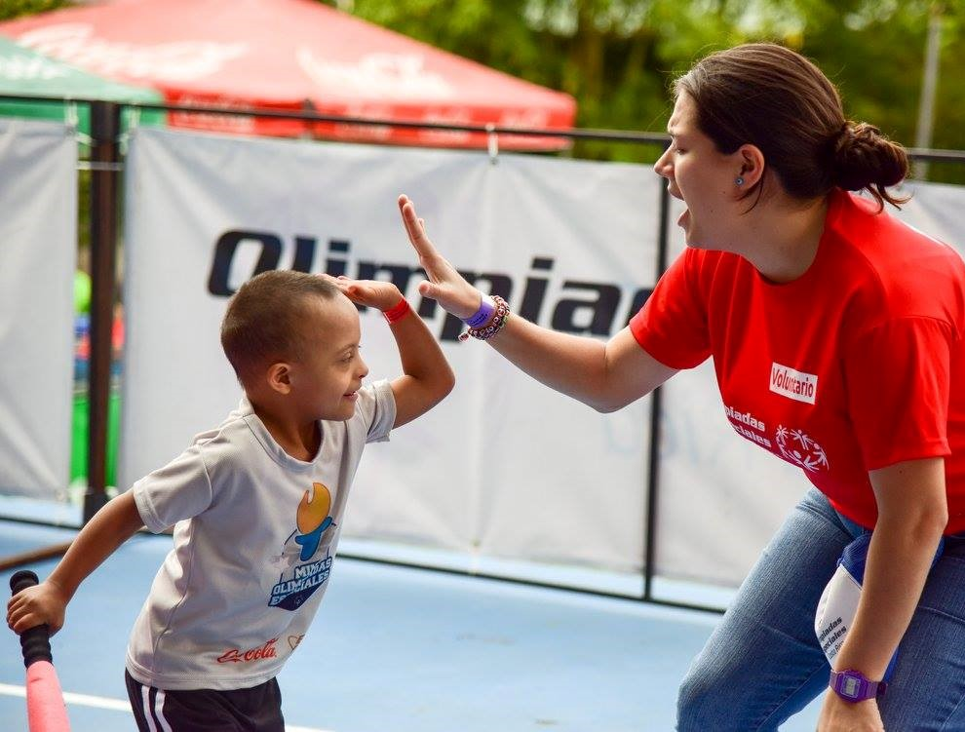
“My future dreams are for children to one day participate and be a Special Olympics athlete and star.”
Notes:
Use this slide to summarize the information shared and make an “ask” to the audience you are presenting to

