Slide 1
The Special Olympics powerpoint template
Some tips on creating your own template and great presentations.

Slide 2
Use large text to make a point.

Slide 4
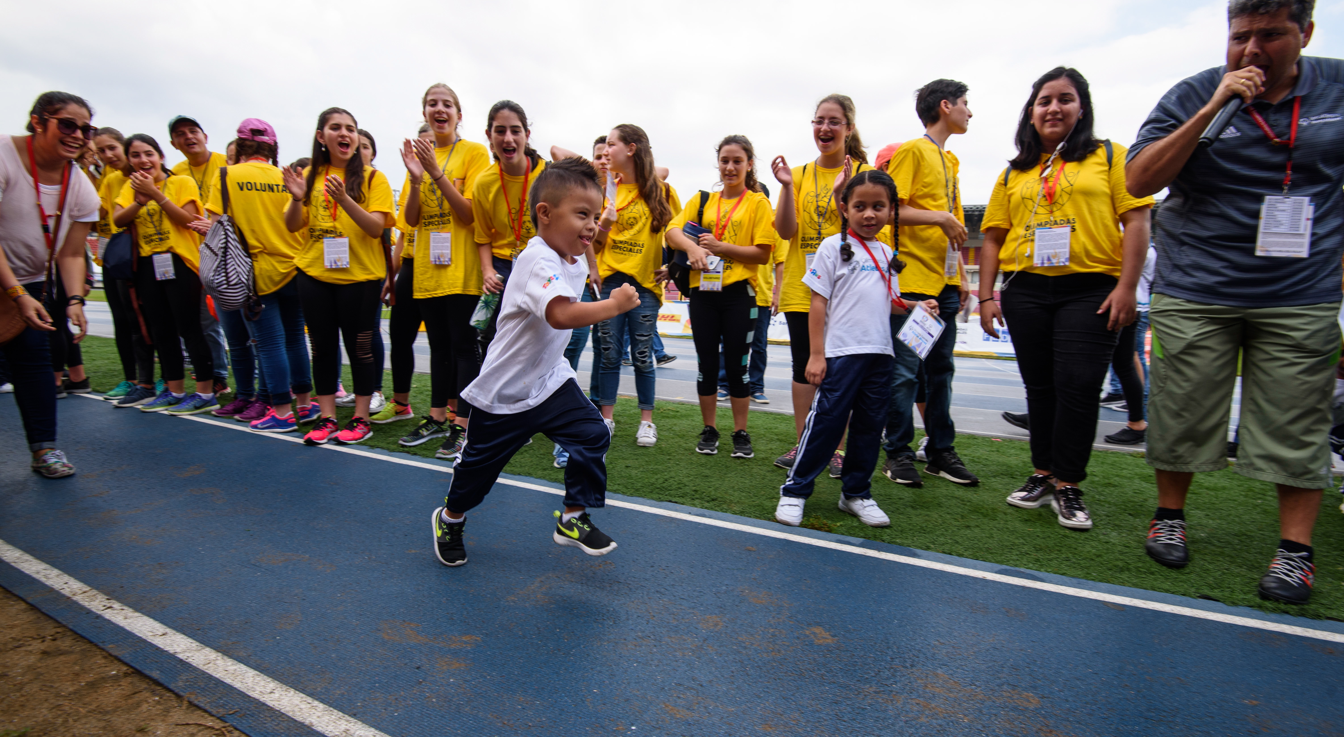
A picture paints a thousand words
Use the Picture and Caption format to create strong compelling slide like this. Don’t’t forget to caption where possible. For best effect crop the image to fill the placeholder.

Slide 5
Use chapter slides to punctuate the presentation

Slide 6
Slide Design Tips
SIMPLE
CLEAN
STRONG

Slide 7
Thank you.

