Slide 1
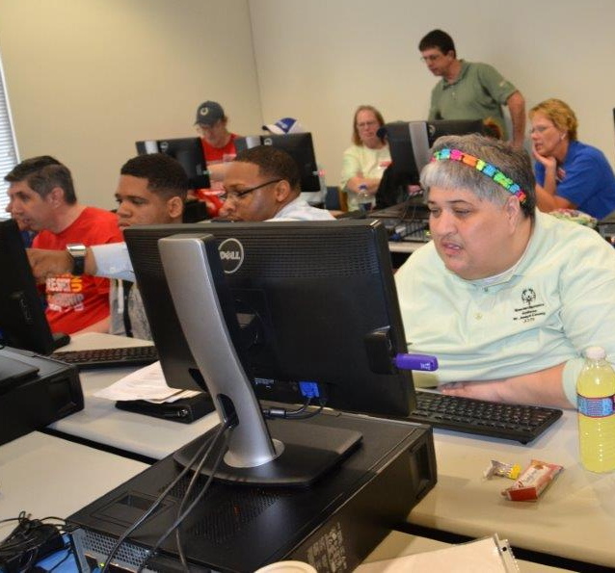
PowerPoint Athlete Leadership
Presenters:
1
2

Slide 2
Course Overview, Welcome & Introductions
Notes:
(5 minutes)
Welcome and Introduction to the Course
“Welcome to the PowerPoint Course!”
Pass out the one-pager which reflects the model of Athlete Leadership Training your Program is going to offer. Currently, there are two models – taking a series of courses based on interest with the ability to change areas of focus or focusing on one area and obtaining a major in it. Athlete Leadership University allows an athlete to choose a major and pursue courses in that major. (Remove the model that you will not be using. However, if you may be working toward a University Curriculum, feel free to keep it in.)
This course generally comes a little later in the Athlete Leadership Training Series (or University Curriculum model). The athlete is suggested to take this course sometime after he/she has completed the Introduction to Athlete Leadership Course and wants to convey their presentation in pictures.
“And now, let’s find out more about the instructors who will be facilitating this course.”
To set the tone, each of the instructors should introduce themselves first.
Give the attendees information about you, your sport and coaching background and your Special Olympics experience.
“My name is _________________ from ______________. I have worked in the mainstream as a _______________________________. My favorite sport is ____________. My co-facilitator is next.”
Once you are done introducing yourselves, comment on the expectation of the participants asking questions. “Please, if you don’t understand some of the areas or information we are covering, ASK QUESTIONS! Your questions and sharing of experiences will make the session more meaningful for you and others.”
“The handout you received at registration includes a list of people you can call to ask questions about Athlete Leadership. They are the Athlete Leadership Management Team in your Special Olympics _________________ (Program).” “Let’s see who is attending this class.”
Click to the next slide, “Introductions of the Class.”

Slide 3
Welcome, Course Overview and Agenda
Part 1: Overview and Introductions
Part 2: Mentor’s Role/Why Use PowerPoint
Part 3: Terminology
Part 4: Developing a Slide Show
Part 5: Presentations, Practicum and Course Feedback
Notes:
Welcome participants.
The training is designed primarily to teach you how to utilize computers. With this knowledge, you will learn to develop your own PowerPoint presentations.
There are many uses you to utilize PowerPoint such as a non-verbal Global Messenger, a different avenue for current Global Messengers to get their words across, during workshops, at Athlete Input Council Meetings, to Local Management Teams and many more.
This course is divided into 5 sections:
1. Overview and Introductions
2. Mentor’s Role/Why Use PowerPoint
3. Terminology
4. Developing a Slide Show,
5. Presentations.
We want you to ask questions during the course and work on your computer. Your mentor will help take notes, but you are expected to work on your computer.
Any questions about anything before we begin?

Slide 4
Introductions
Name
Local Program
What would you like to get from this training?
Notes:
Option #1 (for large group): Ask each participant to briefly introduce him/herself, giving name, Special Olympics Program, and what they want to get from this training. Place the items on a flipchart or board to remind them of the things the want to convey.
Option #2 (for small group): Pair participants at random, give them 5 minutes to interview each other and then have each member introduce the other to the group. Information could be; name, program, role in Special Olympics, family, what is the best thing about Special Olympics, etc.
Option #3 (for medium group): Form circle(s) of up to ten people. Give small ball to one person in each circle.
In Round One, person with ball says own name, locale, position, and hands ball to second person. That person says “Thank you (name of first person), and gives his/her own information. Repeat around group.
In Round Two, play quick game of catch across the circle, first calling the name of the person you are throwing to; person catching says “Thank you (name of thrower).
In Round Three, see if participants can give name of everyone else in their circle.
Trainer Notes: Change this slide if using option #2 or #3.

Slide 5
Mentors’ roleS and why use PowerPoint?
5 | Athlete Leadership - Power Point Course

Slide 6
Mentors’ Roles
Evaluate the athlete’s ability
“Best of your ability workshop”
Assess how much help your athlete will need
All information MUST come from the athlete, (borders, pictures, captions)
Notes:
Mentors: Lets review the Role of the Mentor in this PowerPoint Class:
Evaluate the ability of your athletes. The last thing that we want to achieve is frustration because they may not be as fast as other athletes, or that they do not understand what to do completely.
You have heard about the least restrictive environment; well, this is the Best of Your Ability Workshop! You must assess how much help each athlete is going to need today and on all the presentations that you work on together.
They will need more help today than they will on the next one and even less on the following one.
If an athlete seems to have a good understanding of what they are doing, let them go for it.
If an athlete does not have the physical ability, help them with the physical challenges. If they get tired easily, take over some of the topics.
2. However, the one aspect that cannot be done for the athlete is what pictures they want, the color of the borders, what they want to put into the captions, the title of each page. All that information must come from the athlete.

Slide 7
Mentors’ Roles (continued)
Athletes need to tell their own story and in their own way
Unless of course, they choose some really funky music or a really bad picture of you
Notes:
Here’s a great story from Special Olympics Hawaii that we’d like to share with you (substitute one of your own as soon as you can). We selected 6 athletes to be trained in Technology, one of whom is almost completely non-verbal. Why would we choose a non-verbal athlete when we knew that we would be traveling with this athlete to give presentations.
It is because he has a great story to tell, and we knew that PowerPoint was the best way for him to be able to tell his story. Jason was non-verbal with very poor muscle control throughout his body; therefore, working the mouse was not going to be easy. He struggled at first, and his mentor had to do most of the work for him. As we continued to work, we found that by holding the cord at the top of the mouse to control Jason’s little shakes, he was able to manipulate the mouse very well. He was now able to develop his whole presentation with very little assistance. When his parents took him to a computer store and had him work on many different styles of laptops, they found one that he was able to work the keypad right on the laptop pretty well. Now he was even more independent.
Unfortunately over the last year, Jason’s muscle control has deteriorated, and he can only work for short periods of time. We let him be as independent as he could be for as long as he could, then we stopped. If we are on a deadline, then his mentor will take over the control of the computer, but Jason can give the instructions on what he wants. He will say the color or shake his head yes or no to the animations, pictures, etc.
REMEMBER MENTORS: Best of THEIR Ability Workshop! Athletes need to tell their own stories in the manner in which they choose. Unless of course, they pick some really funky music or a really bad picture of you.

Slide 8
Why use PowerPoint?
Different way to give speeches, presentations, etc.
Opens the door for non-verbal athletes
Outlet within the Athlete Leadership program to explore
Visual Aid – pictures speak louder than words
Use of LCD
Notes:
Why Use PowerPoint?
Note that there are many different ways to give speeches, presentations, etc. PowerPoint is just another method of getting out information on the Special Olympics movement.
PowerPoint opens the door to athletes that cannot use their own voice to tell their story. Non-verbal athletes have a very powerful story that now can be told.
Athletes have a new outlet within Athlete Leadership to explore. Technology is fascinating for many of our athletes and many of them have a talent for it.
Media enhance a presentation; a visual aid in presentations can be very powerful. Pictures can speak a thousand words.

Slide 9
Multi-Media PowerPoint Training
Watch what we can DO!
Samples of what you can do (on USB Flash Drive):
Michelle Norton
Stacey 2
Tanner Willis
Notes:
Introduction to Media
Explain that the 3 PowerPoint Slide Shows which have been made by athletes, will be covered in this course.
Those items are: pictures, video, captions, templates, transitions and animation.
Note to Trainer:
Go through each PowerPoint and “call out” what they are seeing (pictures, video, captions, templates, transitions or animation).
Do Not Spend a lot of time – just enough time for “show and tell” and get them excited about what they will be able to do.
SHOW ONE SLIDE SHOW ONLY if you are worried about time. (The slide shows are of varying lengths.)

Slide 10
terminology
Notes:
The next area is called Terminology so that we can have the same understanding of a few technical words.

Slide 11
Terminology
Lots of Information …
This information will help you develop your own slide show this afternoon
We will practice as we go and have time available for individual training as you develop your presentation
Notes:
Explain to the participants that this is about all the information that you will be able to share with them without them being overwhelmed.
This information will help the participants develop their own slide show this afternoon.

Slide 12
Explanation of Terminology
Turn on your computer
Hardware is the actual machine on which you are working
Software is the CDs or USB Flash Drives that you may use
Keyboard is the place you will input your information (How many of you have ever practiced typing?)
Monitor is the place on your computer that you look at.
Mouse is the object that moves the arrow around on your monitor
Notes:
This will be a hands-on demonstration of the terminology that you will see in the slide show. You will learn a lot of information in a short amount of time today. Please do not be worried if you do not remember it all. The only way you will begin to remember is after today you will actually be doing the work on the computer. Relax and do not get frustrated. Hopefully, by the end of the day, it will all make sense. Now turn to your computer.
While you are explaining these items, show them to the participants.
Turn on your computer: there is a different button on each computer. You have to look to find it.
Software is on the CDs or USB Flash Drives that you may use.
Keyboard is the place you will input your information . How many of you have ever practiced typing?
Monitor is the place on your computer that you look at.
Mouse is the object that moves the arrow around on your monitor.
Again, you will learn a lot of information in a short amount of time today. Don’t be worried if you don’t remember it all. Your mentor will write some help notes in in the Participant Guide as you go thru the course. But the only way you will begin to remember is to actually practice what you learn on the computer. Tomorrow is not too early!
Trainer Note: Insure your computer is connected to the LCD projector. This is done so all participants can follow you at all times, the participants will need to follow you.

Slide 13
Getting Started
Put USB Flash Drive or CD into Port
Find Start or Windows Globe on Task Bar
Click on Globe: find and click on Computer
Find and double click on the drive that is located under Devices with Removable Storage. It maybe listed by the brand of the USB Flash Drive.
Double click on the folder called “Template”.
Notes:
Put a USB Flash Drive into a Port.
Find Start or Windows Globe on the Task Bar.
Click on Globe: find and click on Computer.
Find and double click on the drive that is located under Devices with Removable Storage. It maybe listed by the brand of the USB Flash Drive.
Double click on the folder called “Template”.

Slide 14
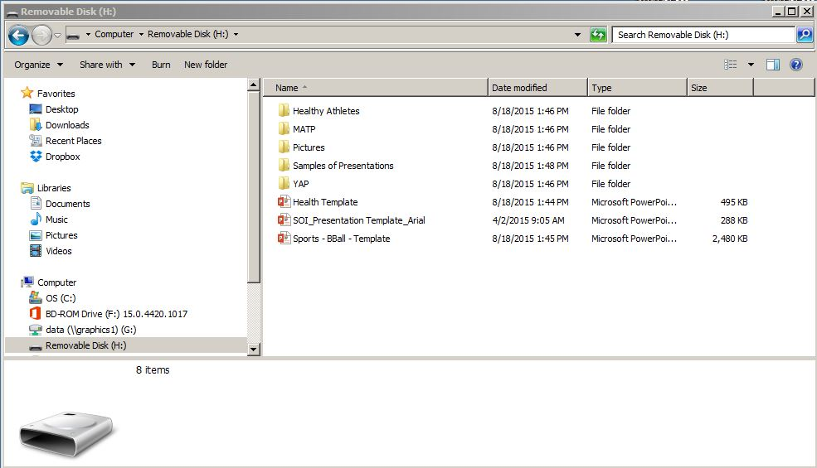
Opened Template
What you are looking at is called a pre-made template. Many of your Special Olympics presentations can be done using these templates.
Notes:
Double click on -- SOI Presentation Template Arial.
Go to page 5 in your Participant Guide.
This is a template branded and authorized by Special Olympics, Inc. and may not be altered in any fashion. The official font of SOI is Ubuntu. However not everyone in the world has Ubuntu downloaded on their computer so the font that in this training is Arial because it is considered a universal font.
Do not ever change the color, font or the design of the template for your use.
Notes to Trainer: Have mentor write on the notes section of page 5 to never change the SOI Presentation Template in any way, shape or form!

Slide 15
Slide Show Template
Notes:
This is what the template on your computer monitor should look like.
DO NOT EVER type on SOI Presentation Template_Arial.
Next we’re going to learn to save this template under another name, this is called “Save As”. This and more terminology will be on the next slide.
Click on “File” located in the upper left corner of your monitor. You will see this menu (might be another color) on the left side of your monitor.

Slide 16
More Terminology
Info: Protection, Inspect, Versions
New : Starts a new presentation
Open: Opens an existing presentation
Save: Saves the presentation you are working on.
Save As: Saves the presentation you are working on as a new name.
Print: Prints the open presentation
Share: Invite People, Email, Present Online, Publish Slides
Export: Create PDF/XPS Doc, Create Video, Package Presentation, Create Handouts, Change File Type
Close: Closes Presentation
Account: User Information
Options: General options for working with PowerPoint.
Notes:
Turn to page 7 in your Participant Guide.
Note to Trainer: Briefly go over each bolded term and give a brief explanation of each term. Explain that you will rarely use Account and Options.
Now we’re going to make you a copy of the PowerPoint Template that will enable you to make your very own PowerPoint Presentation.
Click on “Save As” …

Slide 17
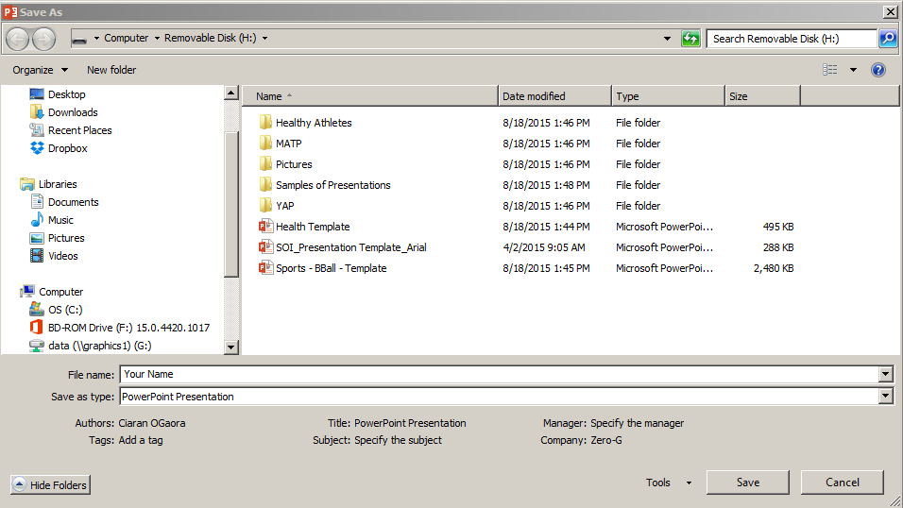
Save As
1
2
Save to the Letter that represent the USB Flash Drive. You may have to Browse.
Save template – Your Name
Notes:
Let’s do this together.
1 a. The page that comes up says “Save As” at the top.
b. Find the Template Folder “Under Current”.
c. Click Once.
a. You are going to “Rename” the file with your first and last name.
b. Type in your name on the highlighted blue space called “File Name” at the
bottom left of the page.

Slide 18
Top Tool Bar
Home – Basic design of Design, Font and shapes
Insert – Add Pictures, Clip art, and sounds
Design- Slide color and design
Transitions – Moving from Slide to Slide
Animations – Adds movement to word
Slide Show – Define and view presentation
Review – Spell Check / Add comments
View – Presentation view type
Notes:
Lets look at what guides everything in PowerPoint. It’s like our Road Map. It tells us what to do. Can everyone find the Tool Bar on their computer?
Take your cursor and move it over each of the sections of the tool bar.
Turn to page 9 in your Participant Guide and follow along with your cursor.
Start with Home – Home tells you the basic design, font and shape.
Insert – That means you can add things like pictures, clip art, and sounds.
Design – Lets you choose the slide color and design.
Transitions – Lets you choose how one slide moves to the next slide.
Animations – Movement can be added to words or other objects on the slide.
Slide Show – Lets you see what you’ve created.
Review – This lets you check your work for misspelled words and add comments.
View – You can decide how you want to view your Slide Show on the computer monitor.

Slide 19
Home
Clipboard:
Copy: Copy a highlighted object.
Cut: Cuts a highlighted object
Paste: Pasted the object that has been cut or copied
Slides:
New Slide: Inserts new slide
Layout: Slide Design of slide
Reset: Undo to default slide design
Section: Organize your slides into sections.
Notes:
Now we are going to dig into each of those headers or tabs on the Tool Bar. Start with the first tab Home.
Lets look at all the things that are under the home Tab.
Clipboard: Slides:
Copy New Slide
Cut Layout
Paste Reset
Section
Go to Page 10 in Participant Guide. Now let’s see what all those mean. Go to the 2nd slide on your monitor. Where it says “Main”, type your name. Now highlight your name. Take you cursor (mouse) and click on “Copy” in the home Tab. Copy means just that; you can copy it and put it somewhere else in your document. Now un-highlight your name and hit “enter” on the keyboard. Then click on “Paste”. Your name should appear 2 times. Now highlight the 2nd name; click Cut. Hit enter 2 times and click Paste. Your name should appear lower on the page.
Go to Page 11 in Participant Guide. Lets go to New Slide – Click on it. What happens? Add a “Blank” Slide, we will use it later. Now, Click on Layout – What happens? Now click on Reset, then Section. What Happens when you click on the different buttons?

Slide 20
Home - Font
Font:
Font Style: Change style of letters
Font Size: Change size of letters
Bold: Make letters bold
Italicize; Italicize the letters
Font color: Changes letter color
Notes:
Font means what the Print looks like. Is it dark? Is it Light? Does it have color?
Let’s look at all the things under Font.
Go to page 12 in your Participant Guide . Your mentor should write notes while you open the different categories with your cursor.
In order to make changes to words/numbers, you must first highlight the word/number to make a change.
Let’s look at several styles of fonts by clicking on the arrow . Some are fancy, some are straight. Highlight a word on the PowerPoint Template. To change the way it looks, click on the arrow next to the name of the Font (Arial). A list of Fonts will display. Click on the font you would like to change to (a slide bar will display on the right side, you can use this to display many more fonts).
Look at the number next to the font name. Hit the arrow with you cursor. Make the word you highlighted increase in size to 40, by clicking on the number 40 in the drop down menu.
Bold means you make it dark. Hit bold and see what it does to the word you typed.
Italicize – Change the word to Italics – Click on it with your cursor.
Let’s change the color of your word. Click on the word, 150, now go up and click on color and see all the colors you can make. Make your word RED.

Slide 21
Home - Paragraph
Paragraph:
Bullets: Adds numbers or Bullet style to a list
Align text Left: Move words to left of box
Align Text Center: Move words center of box
Align Text Right: Move words right of box
Justify Text: Moves words even across box
Text to Columns: Places a list to columns
Text Direction: Changes direction of words
Notes:
The next section under Home is Paragraph.
Mentors go to page 13 in the Participant Guide and write notes, if needed, in your athlete’s Guide.
Athletes, take your cursor and click with me as we go through each one.
The first is Bullets. You can do many types of bullets or numbers.
Align Left – Middle – Right aligns the words in the paragraph to the directions you click on.
Justify a paragraph will make the words look straight on the right and left sides.
Text to Columns will put a list into 2 (or more) columns.
Text Directions allows you to change the direction of the words.

Slide 22
Home - Drawing / Editing
Drawing:
Shapes: Add shapes and lines to presentation
Shape fill: Fills shape with color
Shape Outline: Outline shape with color
Shape Effects: Change design of shape
Editing:
Find: Locate words in presentation
Replace: Change words to different Font
Select: Selects areas for copy, changing or delete area
Notes:
Mentors turn to page 14 and 15 in the Participant Guide.
Trainer Notes:
Follow the format that has been used in previous pages.
Have the athletes put the cursor on each item … you demonstrate and let them also apply the task in the category to a letter, word or shape on the page as time permits.
You may only have time to demonstrate yourself if time is an issue.

Slide 23
Break
Please return in 10 minutes!
10
Notes:
It is about time that we take a break. You have been great with your attention and efforts.
See you in 10!

Slide 24
Insert
Tables:
Insert Excel tables/ Drawings
Illustrations:
Picture: Insert pictures from Computer, Web, Photo Album, Disk or USB Flash Drive
Shapes, SmartArt, Chart: Add Shapes, SmartArt and Chart to presentation
Notes:
Mentors turn to page 16 and 17 in the Participant Guide.
Trainer Notes:
Follow format that has been used in previous pages.
Have the athletes put cursor on each item …you demonstrate and let them also apply the task in the category to a letter, word or shape on the page as time permits.
You may only have time to demonstrate yourself if time is an issue.

Slide 25
Insert (cont.)
Links:
Hyperlink: Link to web page or picture
Action: Sets action when you mouse click or hover over
Text:
Text Box: Makes Box for words
Header & Footer: Slide number or date added to each page
WordArt: Makes decorative words
Date & Time: Adds Date and Time to Slide
Slide Number: Adds Slide Number to slide
Object: Adds Object to Slide
Notes:
Trainer Notes:
Follow the format that has been used in previous pages. Have the athlete put cursor on each item; you demonstrate and let them also apply the task in the category to a letter, word or shape on the page as time permits.
Have the athletes insert a text box and then change the font, color, text direction. They will have to click on the home tab to be able to do this.

Slide 26
Design
Slide Size/Format Background: Page size, Format Background
Themes: Set Background Design, Color, & Effects
Notes:
Mentors page 18 in Participant Guide.
Trainer Notes: This should be demonstrated and interactive.
To practice changing the design and color, we are going to open a new PowerPoint Template from your Template File folder.
Click Open
Click on Templates Folder and then
Double Click on Practice Design. You should see a Green PowerPoint Template.
Click on the Design Tab on the Top Tool Bar. You will see a section call “Themes” and “Variants”.
Let’s look at Variants 1st. With the cursor, hover over each of the different color combinations and see if you like one better.
If you decide you don’t like the design of the slide presentation, hover over the Themes and see if you find one you like better.
Give the athletes time to explore this. Remind them that they might have to move between the Design, Insert and Home Tabs.

Slide 27
Transitions
Transitions: How moving from slide to slide looks and sounds.
Style: Design type of transition to next slide
Sound: Design sound for slide transition
Speed: Set Speed of transition
Preview: View created slide transition
Notes:
Mentors go to page 19 in the Participant Guide and take notes on the transitions the athlete likes.
Trainer Notes: Demonstrate several transition styles and then how to add sound and set speed Give athletes and mentors at least 5 minutes to try different transitions.
Trainer Notes to Athletes:
Put a different transition on each slide.
Remember, you have to click on the slide that you want the transition to apply to.
Click on the Preview button to see and hear the effect.
Allow 5 minutes.

Slide 28
Animations
Animations: How a letter, word, or an object moves
Add Animation: Choose an animation effect to add to the selected objects.
Animation Pane: Displays animations and how they are activated.
Timing: Determine/adjust time for a animation.
Preview: View created slide animation
Notes:
Mentors go to page 20 in the Participant Guide and take notes on the animation the athlete likes.
Trainer Notes: Demonstrate several animations. Give athletes and mentors time to try this.
Trainer Notes to Athlete:
Put a different animation on each word.
Remember, you have to click on the slide and the text box that you want the animations to apply to.
Click on the Preview button to see the effect.
We have added words on slide 4 to make it faster to demonstrate animations.

Slide 29
Slide Show
Start Slide Show:
Beginning: Starts show at 1st slide
Current: Starts show from slide your viewing
Custom Slide Show: Show only the slides you choose.
Set Up Slide Show: Set up advances options.
Hide Slide: Hide Current Slide
Rehearse Timing: Practice slide show to see what works best.
Monitors: Set Monitor Resolution
Notes:
Mentors go to page 21 in the Participant Guide. Mentors write notes on things to remember.
Trainer Note: Demonstrate each of the buttons on the Tab.

Slide 30
Review - Proofing / Comments
Proofing:
Spelling: Spell check presentation
Research: Look up information
Thesaurus: Look up new words
Language: Translate text into a different language and proofing tools.
Comments: Add/Edit Comment to slide
Compare: Compares and combines other presentations into current presentation.
Notes:
Mentors go to page 22 in the Participant Guide.
Trainer Note:
Again demonstrate the buttons on the Review Tab.
Remember, proofing is one of the most important parts of a slide presentation (misspelled will be remembered).

Slide 31
View
Presentation Views:
Normal: Presentation Design View
Outline View: See the Outline of presentation
Slide Sorter: Arrange slide
Notes Page: Add Presentation Notes
Reading View: View Slide Show
Master Views: Views Slides in various ways.
Ruler/Gridlines: Use for Show design
Zoom: Enlarge view
Color/Grayscale: Change show color
Window: View and switch between multiple windows
Notes:
Mentors go to page 23 in the Participant Guide. Mentors remember to write notes about what you may need to remember.
Trainer Note: Demonstrate the different Views. This will be a personal preference for each of the athletes.
Have the athletes click on each of the Presentation Views.
Trainer Note to Athlete:
Ask athletes to return to the Notes Page and share this is the option they would use when making a presentation to a group or committee and they need to remember certain facts.
Trainer should continue by demonstrating views in Show, Zoom and Color at the top of the Tool Bar.

Slide 32
Break
Please return in 10 minutes!
10
Notes:
2nd break … take 10!

Slide 33
develop a slide show
Notes:
Now is the time you’ve all been waiting for.
We are going to let you make a Slide Presentation to share with the class.
It can be about any topic in Special Olympics.
It can be about a sport, why you like Special Olympics, your family’s involvement, the R word, Young athletes, Healthy Athletes, competition, Unified Sports –
you name it; you got it.

Slide 34
Developing Your Slide Show
Decide on a Topic to present
Write outline of presentation
Make slides with information (try to make at least 10 slides)
Insert Pictures & Shapes
Insert Design Themes and Background
Set Slide Transitions
Set Animations
Review / Check Spelling
View Show
Notes:
Mentors go to page 24 in the Participant Guide.
Here are the instructions for your slide show.
You may use any template you like. It’s all yours to make. You have to decide on everything. The only thing your mentor can do is help you find a button if you don’t remember where it was. You do everything else yourself including writing your outline for your presentation.
You may dictate your outline to your mentor to speed up the process.
Athletes and mentors, you will have 1 hour to complete this process.
Please do not spend a lot of time on 1 topic only or you will never finish your presentation.

Slide 35
presentationS, Practicum and Course Feedback
Notes:
We are on the home stretch!

Slide 36
Presentations
Who would like to present their PowerPoint first?
Notes:
We will have an hour for everyone to show their presentation.
Trainer Note: As trainers circulate around the room, be looking for the best presentations and hint to that team that they will be one of the first presenters or you can let them volunteer.

Slide 37
Practicum Requirements
Each athlete must make two NEW Special Olympics PowerPoint Presentations with a minimum of 20 slides each
Notes:
Athletes and Mentors, go to page 26 in the Participant Guide.
Review the practicum requirements, the form and timeline for completing the practicum.
Ensure athletes know to whom practicum materials are sent (email, Dropbox and mail address).

Slide 38
Back Home/Feedback
What will I do when I go back home?
What did I think about this course?
Notes:
I’d like to hear at least one thing you will do when you are back home as a result of what you learned in this course.
List your 4 things on the “Next Steps Back Home” form (Athletes and Mentors go to page 27 in the Participant Guide).
What did you like best about the PowerPoint Course? Ask several athletes and mentors.
Athletes and Mentors, go to page 28 in the Participant Guide. Please complete the Course Training Feedback Form NOW!
Collect the “Next Steps Back Home” and Course Training Feedback Forms.
If you run out of time, participants may return by email or mail to the Lead Instructor.

Slide 39
Show me the ATHLETE!
Notes:
Trainer Notes:
Ask group if they would please move to a designated location to take a group picture.
If you are going to give away anything, now would be the time i.e. Padfolia, Athlete Leadership t-shirt, etc.
Thank them for their efforts and tell them that you look forward to following their progress.

