Slide 1
Beyond the Vision
This is Athlete Leadership
Presenter:
Notes:
Note: Page 1 should be personalized by naming the presenter.

Slide 2
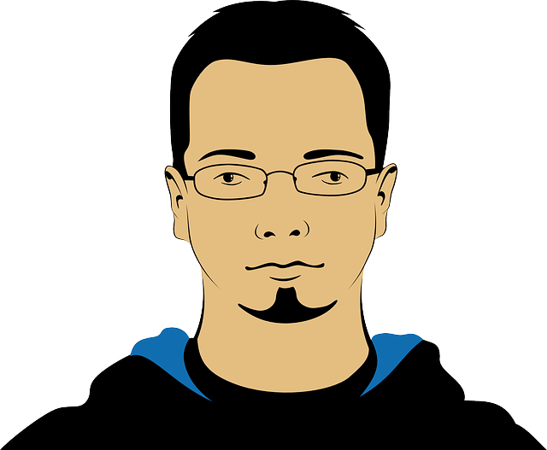
Welcome to Athlete Leadership
“If your actions inspire others to dream more, learn more, do more and become more, you are a leader.”
Presenter’s Name
Notes:
Note: Replace the picture on this page with a headshot of the Athlete Leader presenter and list his/her name underneath the picture.
Tell your story (2-3 minutes)
How long have you been in Special Olympics?
How has being an Athlete Leader changed your life?
I’m here today to make sure you know about Athlete Leadership, and see if you might be interested in doing more to help athletes become leaders in your Program. You may have heard it called ALPs before, now it’s called Athlete Leadership.

Slide 3
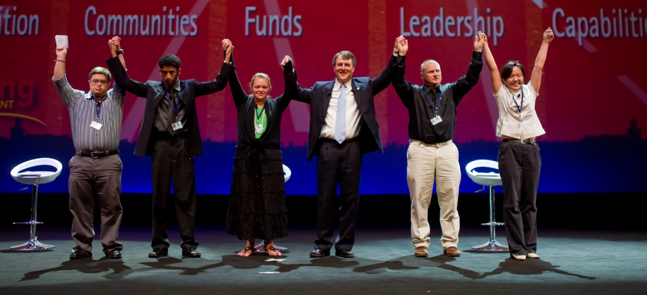
Athlete Leadership
Encouraging athletes to take meaningful positions of influence and leadership throughout the organization to help determine policy and set direction
Notes:
Making choices is usually something new to Special Olympics athletes. Even something as simple as choosing what sport to play is made for us.
Until Athlete Leadership, no one thought we could become a coach or committee member.
The key is our ideas can really help drive the direction of Special Olympics at all levels of the organization.
For example, a decision on whether to add a new sport should always include an athlete survey.
Adding or deleting events or activities should be decided after athlete input and advice on the subject.
Prior to Athlete Leadership there was only one ROLE for us in Special Olympics – as an ATHLETE.
Now that we have started Athlete Leadership, there are many roles for us throughout Special Olympics.

Slide 4
Beyond the Vision Video
Notes:
Note:
Work with your mentor to ensure the video as well as this PowerPoint is on your computer’s desktop.
Secondly, you must have:
a. Speakers plugged into the computer or
b. An audio patch which means your computer is plugged into the site’s sound system.

Slide 5
Roles for Athlete Leaders
Fundraisers | Volunteers | Athlete Leadership Course Instructors
Coaches | Games Management Team Members | Board or Committee Members
Global Messenger | Input Councils | Officials
Notes:
Here are some of the roles that athletes can fill for Special Olympics. You already may have athletes serving in some of these roles in your Special Olympics Program.
Each of us finds a role that best suits our abilities and interests. For example, I am involved in Athlete Leadership as ____________________________________________________
______________________________________________________________________________________________________________________________________________________________________________
(List all the roles you have experienced as an athlete leader.)
The important thing to remember is this … no one understands the importance of Special Olympics like athletes. When we’re given a chance, we’ll do our best to lead.

Slide 6
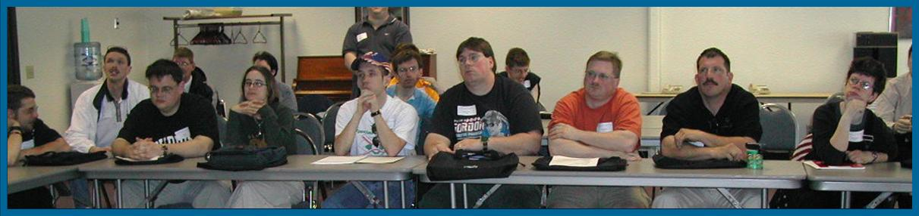
How Athlete Leadership Starts
Provide training for athletes, volunteers and parents for their new roles.
Providing training for coaches, volunteers & parents as they welcome athletes in their new roles.
Notes:
Training is important for both Athlete Leaders and volunteers, coaches and parents who will support our efforts.
Athletes need to learn how meetings work, how to speak in public, and how to coach; they need to know everything they can about Special Olympics.
Volunteers and coaches need to learn how to mentor athletes and how to serve as facilitators at meetings so that we feel welcome, safe and valued as a peer.
Program leaders, volunteers, and family members sometimes need to let their athletes voice their own opinions and help only when the athlete requests it.

Slide 7
Why is training for volunteers, parents, and coaches important?
Sometimes…
They don’t think we can do it
They need to learn to believe in our abilities
They need to remember that they are there to help us … and not do the work for us
Notes:
Why is training for volunteers, family members, and coaches important?
It is important for volunteers, parents or coaches to come to the training with us so that they can see what we can do because sometimes they don’t’ think we can do it.
(Give a personal story of when people did not think you could be in a leadership role.)
They also need to learn to believe in our abilities.
The hardest thing that they need to remember is that they are there to help us, not do the work for us.

Slide 8





How do athletes get training?
www.alpsu.com
Notes:
Special Olympics has created an Athlete Leadership Training Series for athletes that helps provide the knowledge and skills needed for us to handle most leadership roles. Knowledge is power.
Training can happen one class at a time, or can be organized into a University-type setting, where athletes have choices of classes.
All the training materials can be found at: website address .
Explain how athlete leadership and training is offered in your Program.
When we’re done, I’ll give you a flyer and sample materials about the courses in our Athlete Leadership Training Series.

Slide 9
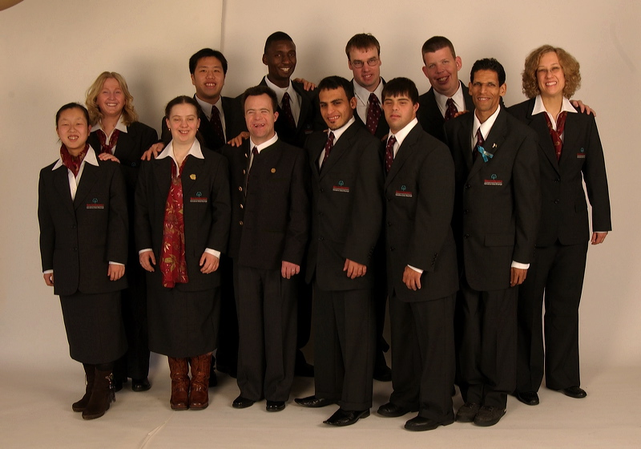
What does Athlete Leadership do for athletes?
Better Social Skills
Interacting with a variety of people
Respecting opinions of others
Advocating for other athletes
Listening
More Confidence
At work
At home
In the community
More Knowledge
About Special Olympics
Public speaking
Technology
Notes:
We love to see our ideas come to life.
When we’re part of the decision-making team both within Special Olympics and in our community we gain confidence and learn more.

Slide 10
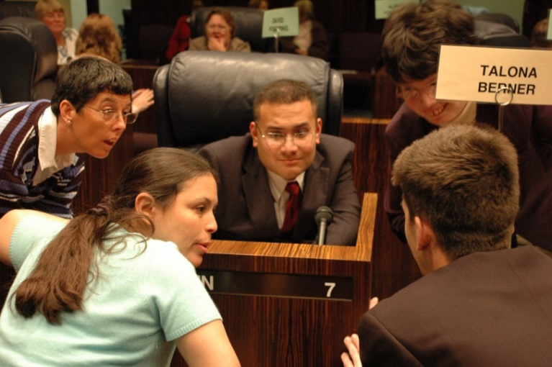
What can athletes do for Special Olympics?
Educate others
Change attitudes
Raise money
Recruit new athletes and volunteers
Mentor new athlete leaders
Help staff and volunteers
Notes:
Every athlete who joins Athlete Leadership becomes a spokesperson for Special Olympics - even if we don’t become a Global Messenger.
By being involved in helping run Special Olympics we change people’s attitudes about what a person with an intellectual disability can do. With us involved people are much more likely to donate or get involved as a volunteer.

Slide 11
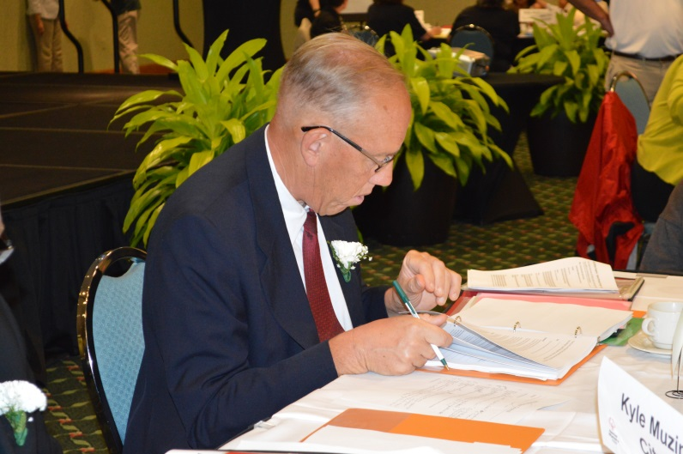
Key to Success
Respect athletes as partners in your Special Olympics experience.
Value athlete opinions and preferences.
Notes:
The best Athlete Leadership Programs have staff and volunteers who really believe in the potential of athletes. Every Athlete Leader has the best chance for success if they have a mentor who believes in them, and is willing to invest the time to help us be successful in whatever role we choose.

Slide 12
What does it take to start?
Commit today to making Athlete Leadership an important part of your Program
Use these materials to familiarize your staff, Board, and volunteers with Athlete Leadership
Offer Leadership training for interested Athletes … Knowledge is power!
Start listening to athletes – conduct an Input Council soon
Notes:
Hand out the folder with Athlete Leadership materials to everyone in the meeting.
If you are at a Regional/group meeting where there are more than 25 people, consider handing out the materials before the presentation. If you are meeting with the CEO and/or Board, hand out the materials now.
In the folder you will find an Athlete Leadership Fact Sheet, Training Series and University model. Also included is the Handbook for Athlete Leaders, which explains the many course offered. We wanted to show you that we have materials to support Athlete Leadership.
Today, we are asking you to commit to making Athlete Leadership an important part of your Program.
We want you to use these materials to familiarize your staff and volunteers with Athlete Leadership.
We want you to offer Leadership training for interested Athletes
Please start listening to athletes by using an Input Council.
Please start a state Athlete Input Council soon if you do not have one.
Holding an Athlete Input Council meeting is easy.
Just find a time ( after an event is a great way to start) and ask them to share their opinions.
What did you like about the event?
What could we do to make it better?
Take notes, ask your management team to consider their ideas, and see if there are ways to improve.
Are you ready to start or expand Athlete Leadership in your Program?
So, what are the next steps?

Slide 13
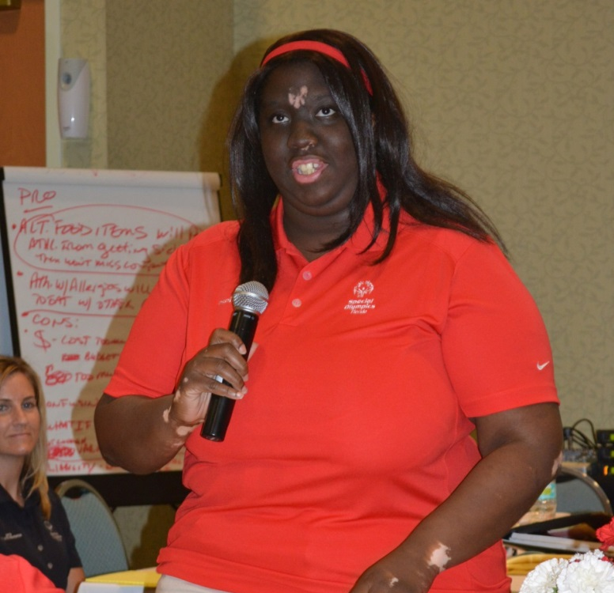
Ready; Set, Go!
As you make your next steps to start or expand Athlete Leadership … remember, we are here to help you!
Notes:
Remember, we are here to help you provide these opportunities to athletes who truly can be involved at every level of the program.
For a Regional Meeting or State/Provincial meeting, say : “We will be available to answer any questions after the presentation.”
If meeting with CEO and Board or Board member, say: “Do you have any questions?”
Note: Be sure you have a copy of the Frequently Asked Questions from the Beyond the Vision Presenter’s Guide with you.

Slide 14
Thank you for learning more about Athlete Leadership
Notes:
Thank you for having me here today to share my passion for Athlete Leadership and what we think it can do to improve the Special Olympics Movement as well as each of our Programs.
I am looking forward to talking with each of you soon.

