Slide 1
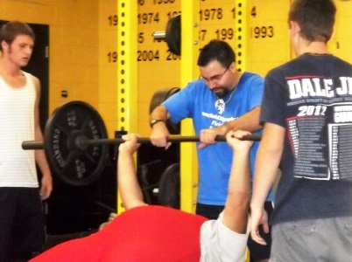
Athletes as Coaches
Athlete Leadership Sports
Presenters:
1
2
3
Notes:
(5 minutes)
Welcome and Introduction to the Course
“Welcome to the Athletes as Coaches Course!”
Pass out the one-pager which reflects the model of Athlete Leadership Training your Program is going to offer. Currently, there are two models – taking a series of courses based on interest with the ability to change areas of focus or focusing on one area and obtaining a major in it. Athlete Leadership University allows an athlete to choose a major and pursue courses in that major. (Remove the model that you will not be using. However, if you may be working toward a University Curriculum, feel free to keep it in.)
This is the first course in the Athlete Leadership Training Series (or University Curriculum model) focusing on Sports. The athlete is suggested to take this course after he/she has completed the Introduction to Athlete Leadership Course and wants to be a coach.”
“And now, let’s find out more about the instructors who will be facilitating this course.”
To set the tone, each of the instructors should introduce themselves first.
Give the attendees information about you, your sport and coaching background and your Special Olympics experience.
“My name is _________________ from ______________. I have coached in the mainstream and have now been coaching ___ years in Special Olympics. My favorite sport is ____________. My co-facilitator is next.”
Once you are done introducing yourselves, comment on the expectation of the participants asking questions. “Please, if you don’t understand some of the areas or information we are covering, ASK QUESTIONS! Your questions and sharing of experiences will make the session more meaningful for you and others.”
“The handout you received at registration includes a list of people you can call to ask questions of about Athlete Leadership. They are the Athlete Leadership Management Team in your Special Olympics _________________ (Program).” “Let’s see who is attending this class.”
Click to the next slide, “Introductions of the Class.”
1 | Athlete Leadership – Athletes as Coaches Course

Slide 2
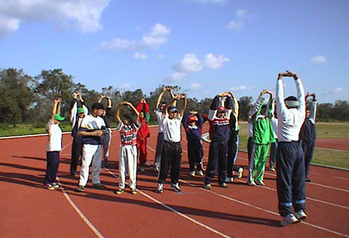
Introductions
Course warm-up
Facilitators and course attendees:
Self-introductions
Say name and where from
Share your favorite sport to play
Notes:
(10-15 minutes)
Introductions
After both instructors introduce themselves, the lead instructor will go around the room with each participant following his/her lead.
“Please say what your name is, where you are from and what your favorite sport is to play.”
If the group is large (more than 15 or 20), you will want to approach this differently. The goal is a brief introduction of name, where from and something about themselves that others do not know. It is a way to acknowledge and celebrate each individual’s unique gifts. You have many options for introductions. Other than what one thing others may not know about you, you may want to have them share what their favorite sport to play is, their favorite sport to watch or their favorite sports memory.
The instructor not involved in facilitating this process will take notes on each of the participants, where they are sitting and what they said.
At the end of each person’s offering, the lead instructor thanks them for sharing this information.
“Thank you all for sharing this information. During the course, you will see that we will utilize others’ skills as we learn about the sport role of coaching. Next are the course objectives and desired outcomes.”
Click to next slide, “Course Objectives and Desired Outcomes.”
2 | Athlete Leadership – Athletes as Coaches Course

Slide 3
Course Objectives & Desired Outcomes
Describe Athlete Leadership
Describe what it means to be a coach
Identify what a coach needs to know
Outline expectations for prospective coach & mentor
Explore jobs / levels of responsibility in coaching
Experience working with athletes
Plan next steps in training and certification
Notes:
(2 minutes)
Course Objectives and Desired Outcomes
These are meant to be a brief overview of what you will be covering within the course.
“Turn to page 3 in your Participant Guide:
“As you will see, we will first describe what Athlete Leadership is.
We will then explore what it means to be a coach and what you to know in order to coach.
Both the prospective coach (you) and the head coach or mentor have certain expectations of each other. We will identify what those are.
There are several jobs within the realm of coaching. Each is based on different levels of responsibility. You will have a chance to see what those jobs are and what responsibilities go along with them.
It is not enough to think about coaching, you need to experience what a coach needs to learn and does when working with athletes.
And lastly, you will have an opportunity to plan your next steps in training and certification for becoming a coach.”
“Throughout this course, we will check your understanding by using activities called Two-Minute Drills. These two-minute drills are also a good time to ask questions.
“Are you ready to begin?” … Pause for a response… “Let’s first look at what Athlete Leadership means.”
Click to the next slide, “Definition of Athlete Leadership.”
3 | Athlete Leadership – Athletes as Coaches Course

Slide 4
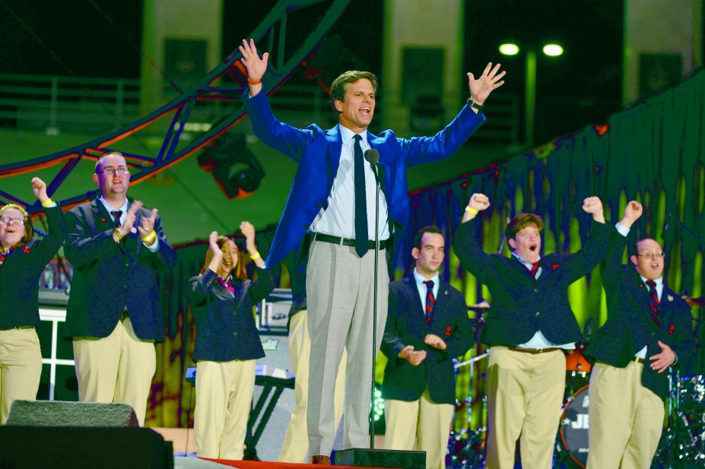
Definition of Athlete Leadership
Encouraging athletes to take
meaningful positions of influence and
leadership throughout the organization to
help determine policy and set direction
Notes:
(3 minutes)
Definition of Athlete leadership
“Take a look at the definition of Athlete Leadership. What does this statement mean to you?
What words jump out at you and what do they mean?”
Pause so that athletes can process the question and respond.
“This definition focuses on athletes being in meaningful, or useful, positions, not just present. The result is gaining opportunities to lead, impacting their own organization beyond being an athlete, helping determine policy and guiding the direction throughout Special Olympics.”
“The International Global Messengers and the United States Athlete Input Council are pictured together” Their impact crosses all borders.
“Let’s now take a deeper look into the definition.”
Click to next slide. “What Does This Mean?”
4 | Athlete Leadership – Athletes as Coaches Course

Slide 5
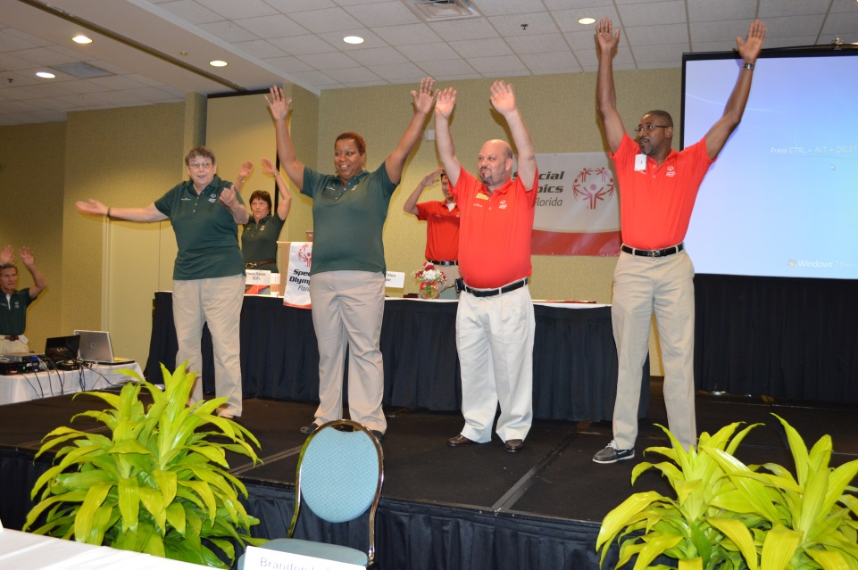
Key Concept of Athlete Leadership
Allowing athletes to choose HOW and in what ROLE they participate in Special Olympics
Notes:
(2 minutes)
Key concept of athlete leadership
Identify that there is a key concept of Athlete Leadership that is often overlooked.
Click to pull up the red banner point of emphasis.
“It’s really about Choice, and choice may be new to some athletes. Choice might be something as simple as choosing which sport you want to do, or it might be choosing to take on a new challenge like becoming a coach or committee member. The key is that athlete choice and interest should be driving the local, state, national and international strategic direction of our organization.”
“Example: A decision on whether to add a new sport should be made based on athlete interest in that sport. Additions or deletion of events or activities at Games should be decided based on athlete input and advice on the subject.”
“Prior to Athlete Leadership, there was really only one ROLE for athletes in Special Olympics – as an ATHLETE. Now that we have an Athlete Leadership opportunities at every level, there are many roles from which you can choose to participate in Special Olympics. We will discuss those roles a little later.”
“We are going to check your understanding with our first 2-minute drill. Since we are in sports, a 2-minute drill seems very appropriate.”
Click to the next slide, “Role Play Time.”
5 | Athlete Leadership – Athletes as Coaches Course

Slide 6
Role Play Time
2-minute drill:
Each prospective coach will brainstorm and list choices that you regularly make
Tell us what you choose to do every day
Clothes
Hair cut
How you treat others
To be in an Athlete Leadership role
What about your choice to be a coach?
Notes:
(4 minutes)
Role Play Time
Click - “Take the next 2 minutes and identify some of the choices that you make every day. Ready, go!”
Pick an athlete to help stand in front of class to give examples of choices they make everyday.
Click - “Who has at least 3 choices; who has at least 5 choices? Who has at least 10 choices? Who has more than that? Please stand up and read your choices.”
“Thank you. . .Does anyone have a choice that was not mentioned?”
“Let’s see what others identified as some of their choices.” Click the 4 listed.
Click - “Question: what about your choice to become a coach? Let’s see what it means to be a coach?
Click to the next slide, “Part 1: Explore What Coach Means.”
6 | Athlete Leadership – Athletes as Coaches Course

Slide 7
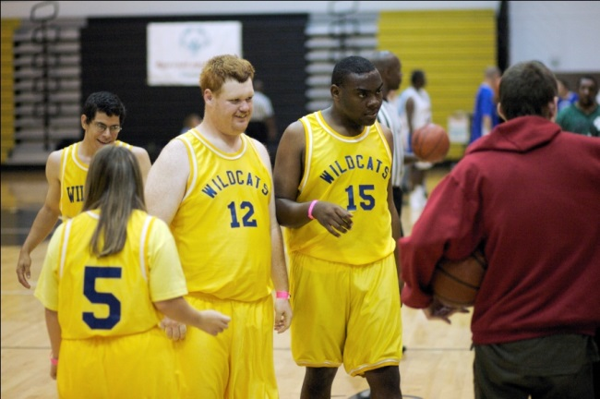
Part 1: Explore What “Coach” Means
Considerations
For the Prospective Coach
For the Head Coach/Designee
Notes:
(1 minute)
Part 1: Explore What “Coach” Means
“This section of the course covers the three area of coaching –
1) what it means to be a coach,
2) what a coach does, and
3) what a coach needs to learn.”
Click to the next slide, “Definition of Coach or Assistant Coach.”
7 | Athlete Leadership – Athletes as Coaches Course

Slide 8
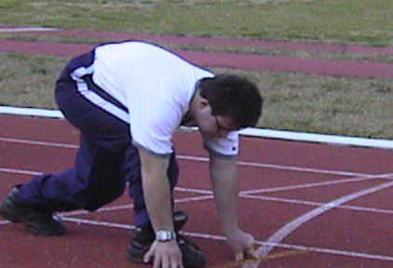
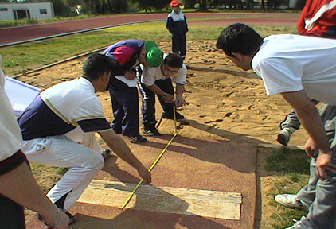
Definition of Coach or Assistant Coach
Assumes responsibility for athletes
Actively trains them
Coaches them during competition
Is certified or is working towards certification
May also be called a trainer
Athlete = prospective coach
Notes:
(1 minute)
Definition of Coach or Assistant Coach
“When we think of a coach or assistant coach, we are talking about a person who is responsible for athletes, actively trains athletes, and coaches athletes during competition. The coach is certified or working towards certification. In some cultures, the coach is called a trainer. “
“For our purposes during this course, athletes going through this training will be referred to as prospective coaches.”
“Now that we understand what a coach is, there are a few factors that the prospective coach needs to consider.”
Click to next slide, “Things to Consider by the Prospective Coach.”
8 | Athlete Leadership – Athletes as Coaches Course

Slide 9
Things to Consider by the Prospective Coach
Is coaching for me?
Self-Assessment
What do I need to know to be a coach or assistant coach?
What are the jobs and responsi-bilities of a coach?
What do I expect of the head coach and/or mentor?
What will the head coach/ mentor expect from me?
The prospective coach will consider the following:
Notes:
(1 minute)
Things to Consider by the Prospective Coach
“Listed are major items that you need to consider so that you will know if coaching is for you.”
“The bolded and colored words are what we are considering:
You will first discover if coaching is for you through a Self-Assessment. We’ll talk about the details of the Self-Assessment in a few minutes.
We will also cover what skills you have and what you need to know to become a coach.
In addition, we will identify the various jobs and responsibilities that you might like to do and
What expectations we have of one another.”
“First, we have a 2-minute drill to help you find out if coaching is for you.”
Click to the next slide, “2-minute drill, Is Coaching for Me.”
9 | Athlete Leadership – Athletes as Coaches Course

Slide 10
Is Coaching for Me?
2 minute drill:
Complete the Self-Assessment sheet
“Is coaching for me?”
Each one of the questions identifies areas important to coaching.
Place a mark “X” in each box that describes you or what you desire.
Describe why.
Notes:
(5 minutes)
2-minute Drill on “Is Coaching for Me?”
“Turn to page 4 and 5 in your Participant Guide.
You will work with your mentor to ensure that you know what each of these items means.
Each of these 13 items in the Self-Assessment relate to coaching.”
“Your mentor will not answer for you but can provide support toward your understanding of the words or concepts. Go ahead and discuss these with your mentor, but answer the questions yourself.”
“Take the next 5 minutes to complete the Self Assessment. Ready, Go!”
Pause…walk around; ask questions to see if they understand what they are supposed to do and are doing it.
“You may or may not have completed the entire assessment, which is okay.
What did you learn about yourself and about coaching from this exercise?”
Call on 2-3 different athletes to stand and speak for themselves. Reinforce their efforts and answers.
“There are additional things to consider as a prospective coach.”
Click for the next slide, “Additional Things to Consider as Prospective Coaches.”
10 | Athlete Leadership – Athletes as Coaches Course

Slide 11
Additional Things to Consider as a Prospective Coach
What do I need to know in order to coach?
What is the role of the coach?
What does this picture show about a coach?
Notes:
(2 minutes)
Additional things to consider AS A prospective coach
Start by having one of the instructors leading the brainstorming while the other records the answers on a flip chart. Or if an athlete would like to record on a flip chart, choose the athlete with the second instructor helping him/her as needed.
“Let’s brainstorm together and identify what you think you need to know in order to be a coach. As an athlete, you have been on the receiving side of coaching.
What do you think you need to know?
Does this picture give you some ideas on what some of those areas are?”
Pause and let the prospective coaches provide and record their answers on page 5 of their Participant Guide.
“If these are some of the things that a coach needs to know, what is the role of the coach?”
Click to the next slide, “Role of the Coach.”
11 | Athlete Leadership – Athletes as Coaches Course

Slide 12
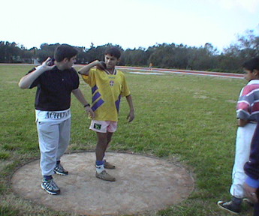
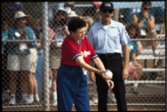
Role of the Coach
1
Offer Sports
2
Help athletes choose events
Train athletes
4
Assess skills
3
Notes:
(2 minutes)
Role of the coach
Now you start the section where you get specific about what they will do as a coach. Double check to see that everyone understands the words presented (assessment, selection, etc.).
You can also have existing coaches (best if they are former athletes that have become coaches) come to talk about the challenges involved with these tasks. You might even role-play assessing and then selecting athletes.
“The Program and/or coach decides on the sport…we hope that athletes have been involved so that they were able to give input in that choice.
Within the sport a coach should help athletes choose events. How do we know what event or events would best fit the abilities of an athlete? We know when we assess the athlete’s skills. In the pictures you see athletes performing, coaches watching and measurements taken.
Through the results gained from skills assessments, a coach can more effectively begin teaching and training the athlete because they can begin with what the athlete can do…not what they cannot do. Special Olympics is about ability, not disability.”
“What else does a coach need to know that is very important to any sport?”
Click to next slide, “Role of Coach: Know the Rules!”
12 | Athlete Leadership – Athletes as Coaches Course

Slide 13
Role of Coach: Know the Rules!
National Governing Body Sport-Specific Rules
Official Special Olympics Sports Rules
Notes:
(1 minute)
Role of Coach: Know the Rules!
“Knowing the rules and where to find them when you have a question is critical.
As an athlete, think about times when the rules are the most important thing to know; such as being on the line in the 200m or a foot fault in bowling. Rules govern the sport and how we compete.”
“As you see, there are two sets of rules: the National Governing Body Sport Rules and the Official Special Olympics Sports Rules. Special Olympics Rules add clarification or modification to the National Governing Body Rules.
One interesting point is, that when these two sets of rules disagree, which set of rules do we go by?”
Pause for the answers.
“Yes, it is the Special Olympics Rules.”
Click to the next slide, “As a Coach.”
13 | Athlete Leadership – Athletes as Coaches Course

Slide 14
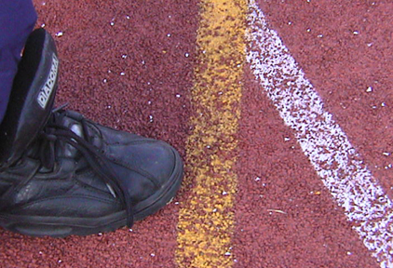
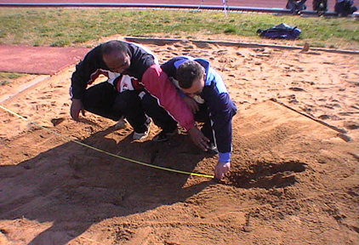
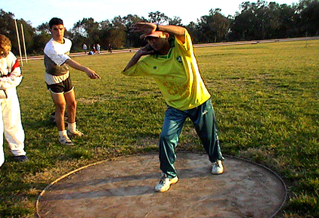
As a Coach
Know and understand the sport and its rules
Know how to teach and train athletes
Enable athletes to play according to the rules
Notes:
(1 minute)
As A Coach
“We need to know and understand the rules. Why? …
So that athletes can compete according to the rules, not be disqualified, and perform their personal bests.
“Take a look at the pictures. Do you see any rules violations or fouls?”
“They are measuring the heel print closest to the take-off board in the long jump. Legal
It appears that the toe is touching the line. Foul
The landing looks good in the long jump, but if the athlete falls back, it is measured with the break in the sand closest to the take-off board. True
The shot putter is taking his stance. Appears to being the proper position to put the shot legally.”
You might want to stage some obvious fouls or violations to see if they can pick them out.
“A coach needs to know the rules and how to effectively teach and train the athletes so that they can perform at their best and reach more closely to their capabilities.”
Click to the next slide, “As a Coach, You will…”
14 | Athlete Leadership – Athletes as Coaches Course

Slide 15
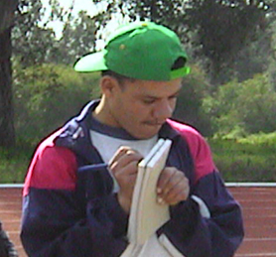
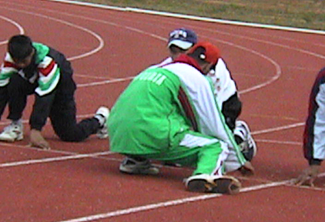
As a Coach, You Will . . .
Athletes
1. Plan for
2. Recruit
3. Train
4. Assess
Notes:
(1 minute)
As a Coach, You Will…
“Plan what?”
Pause for an answer… The season; practice; athlete programs, etc.
“Recruit who?”
Pause for an answer… Athletes; other coaches; helpers; mentors, etc.
“Train for what?”
Pause for an answer…Train to compete; to improve skills and performance; to get in shape, etc.
“Assess what and who?”
Pause for an answer… Ability; look at capabilities; of athletes…
“And WHY!?”
Pause for an answer… To assist athletes in reaching their capabilities…
“Who might help you?”
Pause for an answer…Other coaches; mentors; family members; teachers, etc.
“Let’s look at what coaches encourage.”
Click to next slide, “Coaches Encourage”
15 | Athlete Leadership – Athletes as Coaches Course

Slide 16
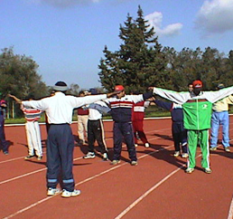
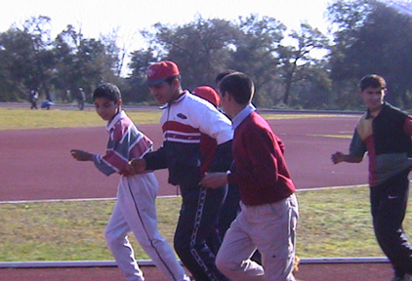
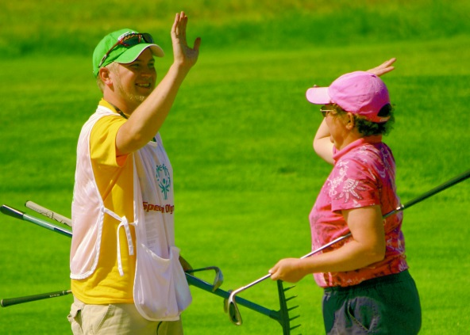
Coaches Encourage …
Physical fitness
Courage to try harder
Joy – having fun
Notes:
(1 minute)
Coaches Encourage
“As a coach, you should be a source of advice and comfort when your athletes need courage or to be reminded of the joy of sports.”
“You should also help with maintaining general physical fitness and healthy lifestyle choices including nutrition.”
“Let’s now take a look at the mentors, how helpful they can be and what role they play.”
Click to the next slide, “Mentors … Leadership Coaches.”
16 | Athlete Leadership – Athletes as Coaches Course

Slide 17
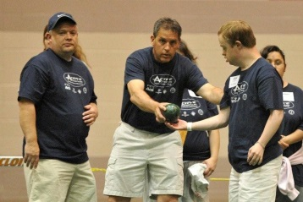
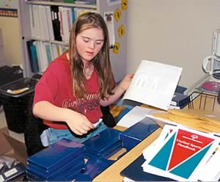
Mentors are Leadership Coaches
Commit to the athlete
Encourage and comfort
Remind; stay on task
Assist where needed
Listen; allow self-expression
Notes:
(1 minutes)
Mentors…Leadership Coaches
“Your mentor is a helper and a leadership coach. Here is an overview of what they can do:
Click before each bullet to pull up a picture –
He/she should also be a source of advice and comfort when you need courage or to be reminded of the joy of coaching.
In addition, the mentor can help you maintain your own physical fitness.
It is about listening to you and allowing you express what you think and need.
You need to talk to your mentor about how and when to help or offer advice.
Will you meet after each practice to talk about what worked well and what you’ll do next time?
Or do you have those talks just before each practice?”
“What follows is a list of responsibilities for the mentor.”
Click to the next slide, “Mentor’s Responsibilities.”
17 | Athlete Leadership – Athletes as Coaches Course

Slide 18
Mentor’s Responsibilities
Know the athlete; allow self-expression
Understand Special Olympics
Work with parents, guardians or group home to explain what Athlete Leadership is
Ensure meaningful positions of leadership
Help athletes stay on task
Help them understand minutes of meetings
Work in a one-on-one relationship with your athlete during each class and locally
Notes:
(2 minutes)
Mentor’s Responsibilities
“Turn to page 6 in your Participant Guide which identifies what a mentor can do.”
“Let’s take a look at what they can do to help and assist you.”
Pause and allow the participants to read these responsibilities.
“Which of these responsibilities are important to you, to prospective coaches and to your mentors.”
Pause; allow prospective coaches and mentors to think for a moment and then answer to each other. Do not be afraid of silence. Someone will be so uncomfortable with the silence that they will say something.
“There are other responsibilities that a mentor can fulfill.”
Click to the next slide, “Additional Mentor Responsibilities.”
18 | Athlete Leadership – Athletes as Coaches Course

Slide 19
Additional Responsibilities of the Mentor
Make sure you know about training opportunities
Provide ample opportunities for practical experience (managing group; problem solving)
Provide transportation if needed
Help athletes with medical or diet needs
Value your athlete’s opinions and preferences
Be an advocate for the athlete
Provide support as needed
Represent Special Olympics professionally
Notes:
(3 minutes)
Additional Responsibilities of the Mentor
“Here are more responsibilities that a mentor can fulfill. Prospective coaches, which of these do you need?”
“Prospective coaches and mentors, now work together and list what responsibilities the prospective coach needs and that the mentor can provide.”
Pause…allow the prospective coaches and mentors to work together on what can be provided.
“So athletes, how do your mentors fit into Athlete Leadership? What expectations do you have for one another?”
Click to the next slide, “Clear Expectations of Each Other.”
19 | Athlete Leadership – Athletes as Coaches Course

Slide 20
Clear Expectations of Each Other
Prospective coach of mentor
Assist in what is needed
Be involved during practices and competitions
Effectively communicate with one another – before, during and after practice
Provide sources of and support with ongoing education
Mentor of prospective coach
Get to and be on time to practices, meetings and competitions
Follow directions and be involved
Provide what needed to learn job
Uphold job responsibilities; be reliable and dependable
Communicate frequently
Be role model for sportsmanship and good conduct
Notes:
(4 minutes)
Clear Expectations of Each Other
“On page 7 of your Participant Guide is a listing of expectations of the prospective coach and of the mentor.”
Ask a prospective coach to read the first expectation, “Which prospective coach would like to read the first expectation of the mentor.”
After reading the line, ask what the phrase means. Anyone can answer; however, let the reader answer first.
Now ask a mentor to read the first expectation of the prospective coach.
Continue alternating between prospective coach and mentor down through each of the lists.
“Expectations go both ways. Each of you are working with each other.”
“So what about the Head Coach; what does the prospective coach need to consider about the Head Coach?”
Click to the next slide, “Things to Consider for Head Coach/Designee.”
20 | Athlete Leadership – Athletes as Coaches Course

Slide 21
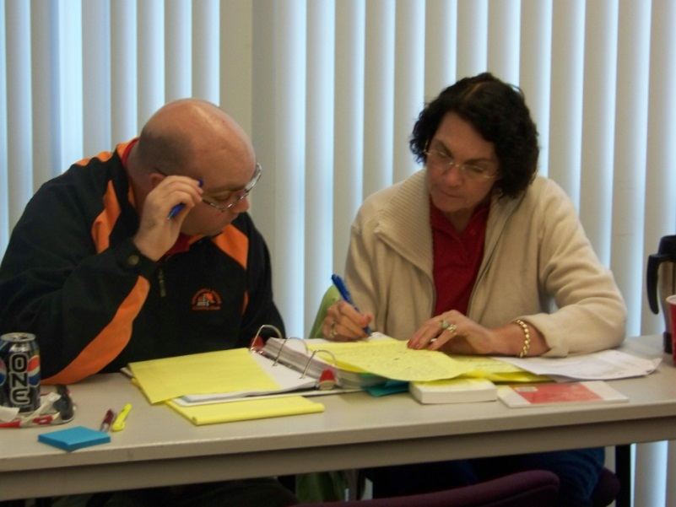
Things to Consider for Head Coach/Designee
How will you communicate with the prospective coach?
What kind of weekly feedback will be helpful to each of you?
Who should be included in feedback at end of the season?
Notes:
(3 minutes)
Things to Consider for Head Coach/Designee
“On page 8 in the Participant Guide, is a section on ‘Considerations for the Head Coach or Designee’.”
“The Head Coach or his/her Designee communicates with the staff and assigns staff to work with specific athletes … based on their ability and skill sets.
The important point here is to value communication and feedback and decide how you will communicate and what kind of weekly feedback will be helpful.
The Head Coach may designate an Assistant Coach to provide such communication because that individual may be a better communicator.
Communication takes place before practice, during practice and after practice so that the prospective coach can learn and be a contributing member of the team.
At the end of the season, each comes together to say what went well, what can be improved and what was learned.”
Summarize Part 1. “During Part 1: we identified what Athlete Leadership was, where Athletes As Coaches fit in the Training Series (or University Model), what it means to be a coach, what a coach needs to know and what expectations the prospective coach and mentor have for one another.
“Part 2: focuses on exploring coaching jobs and the levels of responsibility as well as keys to teaching and coaching the athlete.”
Click to the next slide, “Explore the Jobs and Levels of Responsibility.”
21 | Athlete Leadership – Athletes as Coaches Course

Slide 22
Part 2: Explore the Jobs & Levels of Responsibility
From Assistant Team Manager All the Way to Head Coach
To Teaching and Training the Athlete
Notes:
(1 minute)
Part 2: Explore the Jobs & Levels of Responsibility
“Turn to page 8 in the Participant Guide.
There is a continuum of choices and responsibilities within the area of coaching.
We will start with the position of Head Coach and proceed to the positions of Team Manager and Assistant Team Manager.
All positions can provide meaningful opportunities … and what they involve.”
“We will also learn about effective teaching and training tips in working with athletes and in helping them learn.”
Click to the next slide, “Level of Coaching Based on Responsibilities.”
22 | Athlete Leadership – Athletes as Coaches Course

Slide 23
Level of Coaching Based on Responsibilities
Head Coach
Coach
Assistant Coach
Training Assistant
Team Manager
Mentor
Athletes
Asst. Team Mgr.
Notes:
(1 minute)
Level of Coaching Based on Responsibilities
“This visual depicts the various leadership positions within coaching, the athletes being served and the mentor being in a helping or supportive position for the prospective coach … wherever he or she begins.”
“We will discover the responsibilities that go along with each of these positions.”
Click to the next slide, “Head Coach.”
23 | Athlete Leadership – Athletes as Coaches Course

Slide 24
Head Coach
Has charge of team in a particular sport for a season
Is knowledgeable - Special Olympics & sport-specific rules
Is certified in the sport
Develops phone/email communication
Decides disciplinary measures when necessary
Supervises all athletes and coaches
Is responsible for equipment, transport & lodging
Ensures Athlete Applications for Participation (medicals) & Volunteer Class A Forms are on file
Notes:
(2 minutes)
Head Coach
“On page 8-9 of the Participant Guide, is information regarding the Head Coach. As you take a look at the Head Coach and the major responsibilities, what do these responsibilities mean? What is the most important one?”
Pause as they read and see what a Head Coach does and is responsible.
Note: All athletes who become coaches (any form) must be registered and approved Class A volunteers and are subject to all the same screenings, training and standards as any other Class A volunteer.
“In essence, the Head Coach has entire responsibility for the team – for all of the athletes and the coaching staff. This is a big undertaking…the Head Coach needs a staff to effectively teach and train every athlete, to prepare them for and coach them during competition and to ensure that records, medicals, discipline, sportsmanship, equipment, and rules are covered.”
Click to the next slide, “Division of Labor.”
24 | Athlete Leadership – Athletes as Coaches Course

Slide 25
Division of Labor
Coach
Knowledgeable in SO & Sport Rules
Working toward certification
Some reading skills
Assigned practices
Supervises athletes
Arranges transportation
Assigned duties by Head Coach
Assistant Coach
Knowledgeable in SO & Sport Rules
Knowledgeable about Team Manager responsibilities
Preferred sport experience
Must be 16
Working toward certification
Assist coach with practice planning
Supervises athletes
Training Assistant
Does not have to be working toward certification
Helps with practice and duties as assigned by Head Coach or Assistant Coach
Assists Team Manager with duties (setting up equipment & venue; filing; assessments; scoring; safety checks, etc.)
Notes:
(2 minutes)
Division of Labor
“Go to page 9-10 of the Participant Guide. Each of these positions have decreasing responsibilities. While the Coach and Assistant Coach have or are working toward certification, the Training Assistant does not have to be, but should.”
“Take a few minutes, work with your mentor and read these positions and what they mean.”
Pause while the mentor and prospective coach compare all the positions.
“The last two positions are that of Team Manager and Assistant Team Manager.”
Click to the next slide, “Team Manager and Assistant Team Manager.”
25 | Athlete Leadership – Athletes as Coaches Course

Slide 26
Team Manager and Assistant Team Manager
Team Manager
Assistant Team Manager
Practice:
Competition:
Sets up; organizes; keeps safe; puts away
Venue:
Assists with set up and take down
Charts athlete performances
Assists athletes with uniforms
Equipment:
Duties match or are a good fit with individual’s skills
Manager assigns duties
Notes:
(4 minutes)
Team Manager and Assistant Team Manager
“These two positions focus on more of the operations side of coaching – equipment, setting up the venue, helping to record athlete performances and assisting athletes with uniforms when away at competitions.”
“As you have seen, there is quite a range of positions and the responsibilities that go along with them.”
“We will now compare these jobs and how you feel about them.”
Click to the next slide,”2-minute Drill – What Jobs Could You Begin Now?”
26 | Athlete Leadership – Athletes as Coaches Course

Slide 27
2-minute Drill – What jobs could you begin now?
Take 2 minutes and look back over the job descriptions
Where might you like to begin?
Head Coach
Coach
Assistant Coach
Training Assistant
Team Manager
Mentor
Athletes
Asst. Team Mgr.
Notes:
(3 minutes)
2-minute Drill – What jobs could you begin now”
“Since we have just covered the basic coach job descriptions, work with your mentor. Take the next 2 minutes to:
Review and compare what each does and
How you feel about doing those particular things.”
Pause; walk around the room; listen to their conversations so to each of these jobs and help were needed.
After two minutes, ask the group at large, “Prospective Coaches, did you find one or more jobs that you could do right now that you might like to try?
Pause; let them nod or answer then proceed.
“In order to decide where you might like to start, we will first review the major role of a coach and that is teaching and training the athlete.”
Click to the next slide, “Keys to Teaching and Training the Athlete.”
27 | Athlete Leadership – Athletes as Coaches Course

Slide 28
Keys to Teaching & Training the Athlete
Communication
Clear
Few words
Same words each time
Concepts made real
Action oriented
Notes:
(20 minutes)
Keys to Teaching and Training the athlete
Click to pull up “Communication.” “The first key is communication.”
“Turn to page 11 in the Participant Guide, since many athletes have a challenge with words, we need to consider what we say and how we say it so that athletes can understand what is expected of them as well as learn.”
Click to pull up clear. “The words need to have a clear meaning, not more than one meaning. In addition, you may need to “try” different words to find the ones athletes understand.”
Click to pull up few words. “We also need to use few words and more demonstration.”
Click to pull up same words each time. “Consistency in words with desired actions is key to an athlete’s understanding. Do not use different words to explain or direct the same action.”
Click on concepts concrete. “Making concepts concrete or real is the most challenging for athletes. Right and left are concepts. Instead of saying “go right,” say go toward your team’s bench.
Click on action oriented. “Words need to be tied to an action or a skill, so that when it is learned, it can be repeated. Instead of saying “good job”, say “good follow through.”
Click to the next slide, “Communication - continued.”
28 | Athlete Leadership – Athletes as Coaches Course

Slide 29
Keys to Teaching & Training the Athlete
Communication
How many instructions at once?
Do you talk too fast?
Do you sound angry?
What are your facial expressions?
Reward attitude & effort
Notes:
(10 minutes)
Keys to Teaching and Training the athlete
Click to pull up “Communication” again. “We also need to look at what we say and how we say it. Everything makes a difference – do we motivate our athletes or turn them off?”
Click on how many instructions should be given at once. “Because there is a processing challenge with some of our athletes, 1 or 2 part instructions is a guide … some athletes may be able to handle 3-4 part instructions. Determining what is appropriate to each individual is the key.”
Click on talk too fast. “If you talk too fast, the athlete cannot process the words fast enough to understand.”
Click on sound angry. If you sound angry, the athlete may not feel that you care and will not perform.”
Click on facial expressions. “Your words, gestures and actions must all convey the same thing … that you care about them and commit to helping them work toward improving and achieving what they are capable. Many athletes want to be challenged. They want to be treated like athletes.”
Click on last bullet, “Lastly, reward attitude and effort, not just outcome. Another athlete or team may just be better that day … create a series of goals that are attainable and specific as to what needs to be worked on next.”
“Let’s now look at using this knowledge in an athlete’s learning skills.”
Click to the next slide, “Skills Instruction.”
29 | Athlete Leadership – Athletes as Coaches Course

Slide 30
Skills Instruction and Levels of Assistance
Before teaching, assess what the athlete can do
Performing a Skill
What tasks make up a skill?
Tell them then:
Demon-strate and see
Provide some help
Provide a great deal of help
Skill is learned and perform-ed at basic level
When needed:
Break skill down
Work on parts (tasks)
Put parts together
Notes:
(5 minutes)
Skills instruction AND LEVELS OF ASSISTANCE
“In working with athletes, it is important to discover what athletes can do, not what they cannot do. In this way, we start out positively.” Point that out and re-emphasize it.
“We saw how important communication is – what we say, how we say it and how athletes respond.”
“You also need to know the skills of the sport and the parts or tasks that make up each skill.”
“Tell the athlete what skill to perform, immediately follow with a demonstration of the skill and then ask the athlete to perform it. The purpose is to see if the athlete can do it.
“If the athlete cannot perform the skill, the coach will partially assist the athlete by placing the body part into the correct position. If the athlete still cannot do it, the coach may need to physically take that part through the full range and then ask the athlete to perform it alone.”
“Whew…that was a lot! But it is something that we can do … Yes, it is 2-minute drill time.”
Click to the next slide, “2-minute Drill: Putting on a Jacket.”
30 | Athlete Leadership – Athletes as Coaches Course

Slide 31
Skills Instruction
2-minute drill:
Skill – Putting on a jacket
Work with your mentor for 2-minutes
Break this skill down (identify what a person must do to put on a jacket)
List those tasks
Teach another how to put on a jacket
(Use what was learned about effective communication/skills instruction to teach skill)
Notes:
(10 minutes)
2-minute Drill: Putting on a Jacket
“You and your mentor will utilize what you just learned. Break down the multi-part skill of putting on a jacket and make a list of those tasks.”
“How would you teach an athlete how to put on a jacket?”
“After 2-minutes, you will teach another athlete in a second group how to put on the jacket. Your mentor will jot down what you say, how you say it and what you do to assist that athlete putting on a jacket.”
Switch roles with that group so the other athlete has an opportunity to test his or her skills.
Ask the following questions:
“How did you do in teaching another athlete how to put on a jacket? What went well; what will you do differently next time? Even putting on a jacket has the potential of being complex.”
“We are getting close to applying these new skills in practice!” What are the essential elements of practice?”
Click to the next slide, “The Essential Elements of a Practice.”
31 | Athlete Leadership – Athletes as Coaches Course

Slide 32
Essential Elements of Practice
Overview of Testing the Role/Job of Coach in a Practical Session
Warm-up and Stretching
Skills Instruction
Competition Experience
Cool-down and Reward Efforts
Notes:
(1 minute)
Essential Elements of Practice
“Turn to page 12 in your Participant Guide. Next up is actually taking what we have learned and having an opportunity to test this role of coach in an actual practical moment.”
“We are done talking and will be more focused on doing.”
“There are 4 main elements of a practice:
Warm-up and Stretching
Skills Instruction
Competition Experience.
Cool-Down and Reward their efforts.”
“In Part 3, we will actually go through a short practice where each of you will be acting as an assistant coach.”
Click to next slide, “Part 3: Practical Experience – Testing the Role Sport Specifically.”
32 | Athlete Leadership – Athletes as Coaches Course

Slide 33
Part 3: Practical Experience
Testing the Role/Job of Coach in a Sport-Specific Way
Notes:
(1 minute)
Part 3: Practical Experience – Testing the Role Sport Specifically
“This session is learn by doing … all experiential. Put on your sneakers and let’s get after it! We will use the sport of track and field and the standing long jump as the event.”
Click on the next slide, to review the Practice format…”Training and Coaching in Practice.”
33 | Athlete Leadership – Athletes as Coaches Course

Slide 34
Training & Coaching in a Practice
Warm-up and Stretching
Movement and skills warmed up
Skills Instruction
Review previously learned skills
Assessments
Add new skill(s)
Competition Experience
Controlled game-like or event-like situations
Scrimmaging
Cool-down and Reward Efforts
Notes:
(2 minutes)
Training and Coaching in Practice
“What does a practice session look like?
How much should you plan for each part of it?”
“There are a few descriptors under each session so that you know what else we could include.”
Let them take their Participant Guide with them because everything they will be doing is in the Guide beginning on page 11.
Click on the next slide, “Practice or Training Session – Warm-Up and Stretching Exercises.”
34 | Athlete Leadership – Athletes as Coaches Course

Slide 35
Practice or Training Session
1. Warming up
Everyone should be active
Moving
Performing basic sport skills
Notes:
(5-10 minutes)
Practice or Training Session – Warming Up
“It is important to get moving and then work on sport-specific skills; this is both a skills warm-up and a body warm-up.”
“For track and field, if done in a hotel, warm-up by walking in place or in the area of the hotel that is far away from the rest of the hotel guests. Let’s follow Betsy, the leader today.”
“After 2 minutes of walking, we work on a sport-specific skills such as putting the shot or throwing the tennis ball (going through the arm motion without the equipment).
“What is the first thing after this warm-up section? Yes, Skills Instruction.”
Click to the next slide, “Skills Instruction.”
35 | Athlete Leadership – Athletes as Coaches Course

Slide 36
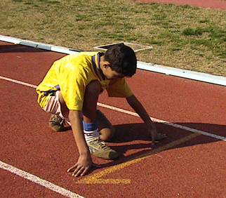
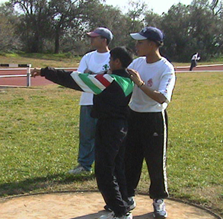
Practice or Training Session
2. Skills Instruction
Tell them – Demonstrate – Physically Assist
Remember, if after physically assisting and they still cannot do it, you may have to break the skill down into its parts
Notes:
(15 minutes)
Skills Instruction
“Turn to page 12 in the Participant Guide. When you are teaching a new skill, follow the 4 steps at the bottom of the slide, in that order.”
“Tell them –> Demonstrate –> Physically Assist”
“How do you “physically assist” and still teach instead of doing it for the athlete?” You may need to partially assist by ensuring they are in the right position as opposed to taking them through the full range of motion. Again, build upon what the athlete can already do.
Demonstrations are great here and great opportunities for replacing these shots!
“Our event is the standing long jump in athletics. First work with your mentor, analyze and list what must be done in order to perform this skill. Then practice teaching your mentor.”
“To increase the athlete’s ability to perform that skill, we will add a competition experience.
Click to the next slide, “Competition Experience.”
36 | Athlete Leadership – Athletes as Coaches Course

Slide 37
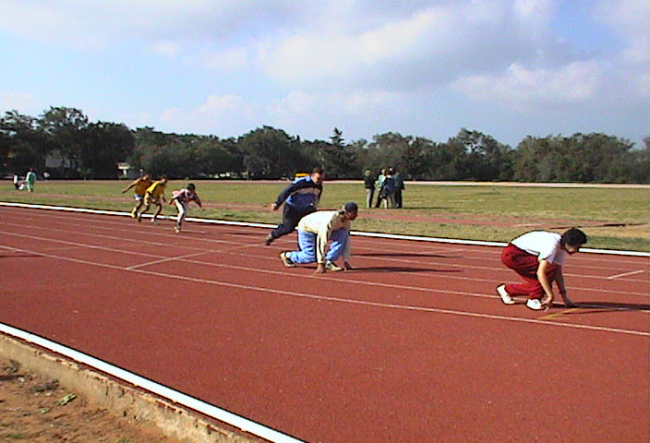
Practice or Training Session
3. Competition Experience
Enforce the rules all the time so that athletes can learn them…for example, measuring properly and staying between the lines
Notes:
(15-20 minutes)
Competition Experience
“Turn to page 13, an athlete must learn how to perform the skill in a competitive environment. We must use a games approach to our teaching so that the athlete can perform the skills in the sport. We must set up a competitive event so that we prepare the athlete for competition.”
“How can we simulate competition in a practice session? Pause for answers.
“We set up the venue as close as we can to what the athletes will be facing in competition. Each participant takes a turn, moves their feet in order to receives the ball…just like they do when they are conducting the real competition.”
“Why would you do that? Pause…so that the process is practiced, becomes familiar, and enables the athlete to do a personal best later.”
“Rules need to be enforced all of the time so that the athlete does not get to the competition and then fails to perform the standing long jump effectively because he/she did not know the rules, nor were the rules enforced.”
“In your group, practice getting into the right position, jumping from behind the line, landing and moving forward.”
Click to the next slide, “Cool-down and Team Talk.”
37 | Athlete Leadership – Athletes as Coaches Course

Slide 38
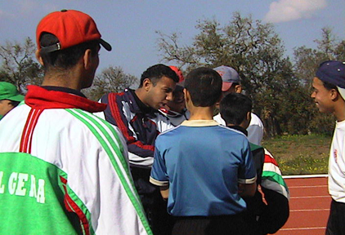
Practice or Training Session
4. Cool-down Activities
Team Talk
Notes:
(5-10 minutes)
Cool-down and Team Talk
“As athletes are cooling down, you have an opportunity to get to know them better and to find out what they are enjoying and what is frustrating for them. The talk part is essential if you are to keep them involved and get them ready for the next level of training and ALPs participation.
“This is a good place for an video or an actual of an athlete leading cool down or chatting with athletes after practice … The cool-down exercises focus on the large muscle groups like stretching the hamstrings while sitting.”
Take them through a few cool-down stretches.
Click - “Team talk focuses on rewarding their efforts and attitudes. We want to encourage all athletes to work hard and participate … no one should be standing around.”
“Time for a 2-minute drill!”
Click to the next slide, “2-minute Drill: Skills Instruction and Task Analysis.”
38 | Athlete Leadership – Athletes as Coaches Course

Slide 39
Skill Instruction – Task Analysis
2-minute drill:
Working as a team, the prospective coach breaks down one sport skill into smaller, attainable tasks that you could teach.
Mentor writes down tasks for prospective coach. Choose from the following:
Further expand the Standing Long Jump
Bocce Skills
Dribbling a Basketball
Notes:
(1 minutes)
2-minute Drill: Skills Instruction and Task Analysis
“In groups of 4, teams should decide on a sport, list the tasks to do a skill in that sport. Develop a list of things you need to teach and in what order you would teach them to athletes. The mentor writes down the prospective coach’s list.”
Click to the next slide, “Sport-specific Skills Instruction Activity.”
39 | Athlete Leadership – Athletes as Coaches Course

Slide 40
Sport-specific Skill Instruction Activity
Combine into groups of two: 1 prospective coach and 1 coach (mentor)
Teach standing long jump using the list you made with another group
Prospective coach must give the instructions; mentor may cue prospective coach but not help
Each group should teach one skill and perform one skill
Evaluate how skill is taught – give feedback
Notes:
(10 minutes)
Sport-specific Skill Instruction Activity
The parameters and description of what prospective coaches and their mentors will do is listed so that they can follow the process. Walk them through the steps.
“Now that you know what to do, we will create groups of two (prospective coach and mentor). Allow the prospective coaches to lead … break the skill down into its parts then teach them. Mentors can cue next steps but not take on the leadership role.”
“Each group should teach and perform then give feedback. Ready, go!”
After 10 minutes, call the groups together and ask the question,
“Assess the standing long jump; what makes up the jump?”
A volunteer will write the responses on a flip chart.
“Let’s check our work with the experts.”
Click to the next slide, “Assessment of Standing Long Jump.”
40 | Athlete Leadership – Athletes as Coaches Course

Slide 41
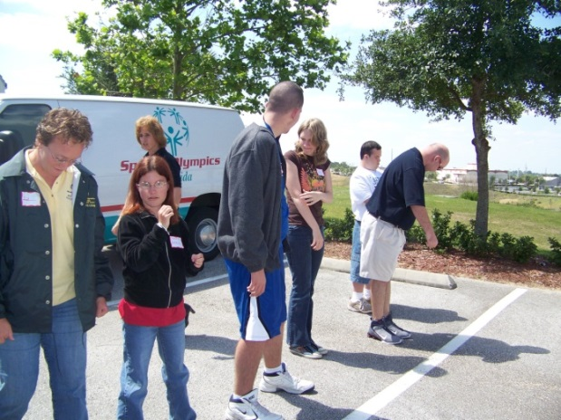
Assessment of Standing Long Jump
Assumes a ready-to-jump position
Demonstrates correct take off – effectively using arms and legs
Demonstrates proper landing
Jumps on command, under control
Can perform 2-leg take off
Walks out of pit/area properly
Likes jumping
Notes:
(2 minutes)
Assessment of Standing Long Jump
Point out what they identified that was correct. Often times, they will list even more areas. Praise their efforts and reinforce that by working together they were able to gain even more.
“That ends our practical session … you truly served as coaches today.”
“We will go back to our seats for Wrap-up and Planning.”
Click to the next slide, “Part 4: Wrap-up.”
41 | Athlete Leadership – Athletes as Coaches Course

Slide 42
Part 4: Wrap-Up
Debrief Course
Identify Lessons Learned
Next Steps
Training and Certification
Notes:
(1 minute)
Part 4: Wrap-up
“As you see, we will evaluate the course, note the lessons we learned, and plan the next steps including further training and certification for becoming a coach.”
Click to the next slide, “Where do I start?”
42 | Athlete Leadership – Athletes as Coaches Course

Slide 43
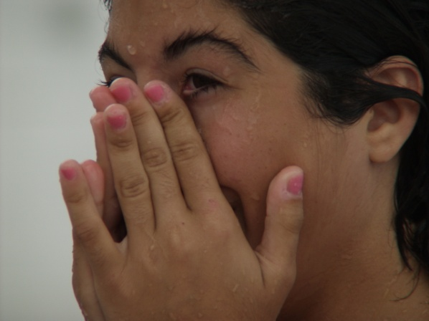
Where do I start?
Prepare a personal coaching plan with your Mentor
What is your next goal in Special Olympics?
What skills do you need to achieve your goal?
Who should you tell about your goals?
Notes:
(15 minutes)
Where do I start?”
Have a sheet pre-prepared for each participant if you like to help them answer these questions. Everyone should complete the form, athletes and mentors alike. Everyone should think about what they want to be doing five years from now and what skills they need to learn to be qualified to do that.
Everyone should tell their goals to someone who will support them and encourage them to achieve.
“Take a look at the questions on the PowerPoint. Take a few minutes to think about your next goal in Special Olympics.
1. On your sheet of paper, list what that goal is.
Pause for a minute.
2. Now list what you need to know or skills you need to have to achieve that goal.
Pause to give them time to work with their mentor and write.
3. Identify who you will tell about your goal(s). Briefly pause for their response.
Let’s take a look at the Athlete Leadership Coach Training and Certification Process, part of which you achieved today.
Click to the next slide, “Athlete Leadership Coach Training and Certification Process.”
43 | Athlete Leadership – Athletes as Coaches Course

Slide 44
Athlete Leadership Coach Training & Certification Process
Step 1: Complete Athlete as Coach Course with 10-hour Practicum observing coaches (Sport Assistant Diary)
Step 2: Complete Coaching Special Olympics Course with 10-hour Practicum assisting coach in training & competition (Sport Assistant Diary)
Step 3: Complete Skills Course with 10-hour Practicum working with athletes
Also complete General Orientation; Protective Behaviors; Concussion Training
Result = Certification Achieved
Notes:
(5 minutes)
ATHLETE LEADERSHIP Coach Training and Certification Process
“On page 13-14 of your Participant Guide is an overview of the Athlete Leadership Coach Training and Certification Process.
“In Step 1: You have completed the Athletes as Coaches Course. To complete this step, you will need to complete 10 hours observing a coach and keeping your Sport Assistant Diary that starts on page 15-16 noting lessons learned from the experiences.”
“In Step 2: You will complete the Coaching Special Olympics Athletes Course, either online or in person with a trainer. This will be followed by 10 hours of assisting the coach in training and competition. You will also write in your Sport Assistant Diary capturing what you learned.”
“Lastly, Step 3: You will complete an online or in person Sport-Specific Skills Course, 10 hours of working with athletes and complete the Practicum on page 17.”
“Within the first three steps, you and your mentor will also complete the General Orientation, Protective Behaviors and Concussion Training, if not already done so.”
“You will then have achieved becoming a certified Special Olympics coach.”
“How does that sound? … You should feel good about what you accomplished today… because you are well on your way to becoming a certified coach!”
Click to the next slide, “Course Evaluation.”
44 | Athlete Leadership – Athletes as Coaches Course

Slide 45
Course Evaluation
In your evaluation name three (3) things you have learned.
What will you do when you get home?
What part of the course did you like best?
What part of the course did you like least?
Each of you are encouraged to stand up and share one thing you learned today.
Are you ready to start?
Notes:
(15 minutes)
Course Evaluation
“On page 18 is the Course Evaluation. Please provide honest feedback. This will help us continue to improve the course and provide you with the best resources.”
Go over each of the questions as the participants provide feedback on a paper. When they finish, go around the room and encourage each prospective coach to stand up and share one thing they learned today.
When they finish, ask the question, “Are you ready to take the next step in becoming a coach?
Click to the next slide, “Tomorrow’s Coaches.”
45 | Athlete Leadership – Athletes as Coaches Course

Slide 46
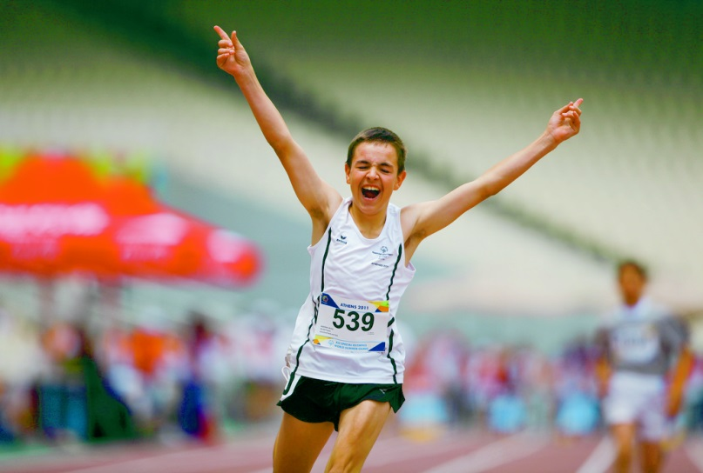
You Are Tomorrow’s Coaches
You are the reason why Special Olympics
will continue to grow and glow …
for both athletes and coaches …
because we will learn
from YOU!
THANK YOU!!
Notes:
(1 minute)
Tomorrow’s Coaches
Read or paraphrase this wonderful testament to each of these prospective coaches.
“It is you who are leading us into the future and growing the Movement. Thank you!”
Class dismissed …
46 | Athlete Leadership – Athletes as Coaches Course

