Slide 1
SPORT & COMPETITION
Presentation title to be placed here.

Slide 2

SPORT & COMPETITION
Presentation title to be placed here.

Slide 3
SPORT & COMPETITION
Presentation title to be placed here.

Slide 4
Standard text slide
A presentation few tips:
For most simple text slides, we should use a clean slide such as this.
This keeps the presentation feeling fresh and simple – clear communication.
Avoid putting too many points on the one slide.
Don’t forget that there are different slide layouts available within PowerPoint for chapter-heads, image slides etc.

Slide 5
Two column text or data slide

Slide 6
SPORT & COMPETITION
1
Chapter title to be placed here.

Slide 7
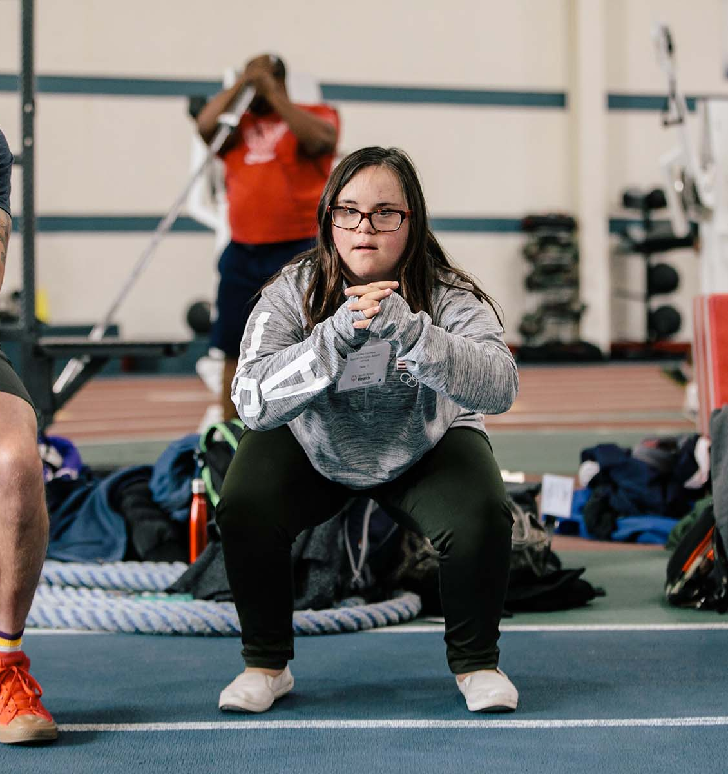
Sometimes a single bold statement is the most powerful.

Slide 8

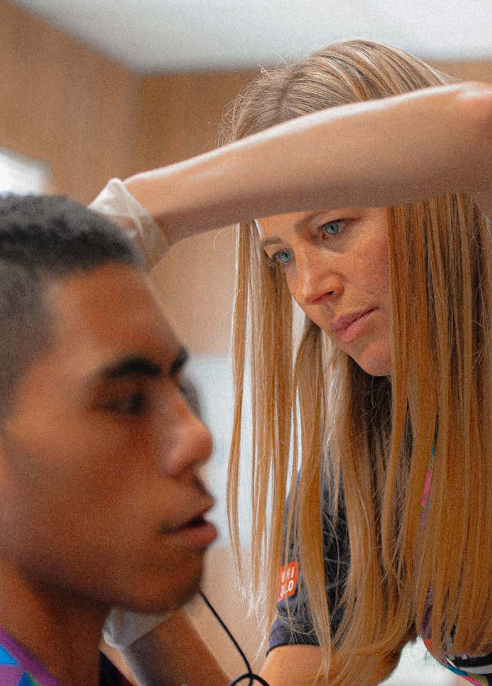

1
2
3
4
Sport
Leadership
Health
Education

Slide 9
A picture paints a thousand words
Don’t forget to caption where possible. For best effect crop the image to fill the placeholder.

Slide 11
Timeline slide

Slide 12
Data slide example
Title | Data 1 | Data 2 | Data 3 | Data 4 | Data 5
Row 1 | 00 | 00 | 00 | 00 | 00
Row 2 | 00 | 00 | 00 | 00 | 00
Row 3 | 00 | 00 | 00 | 00 | 00
Rew 4 | 00 | 00 | 00 | 00 | 00
Row 5 | 00 | 00 | 00 | 00 | 00
Row 6 | 00 | 00 | 00 | 00 | 00
Total | 00 | 00 | 00 | 00 | 00

Slide 13
Thank you.

