Slide 1
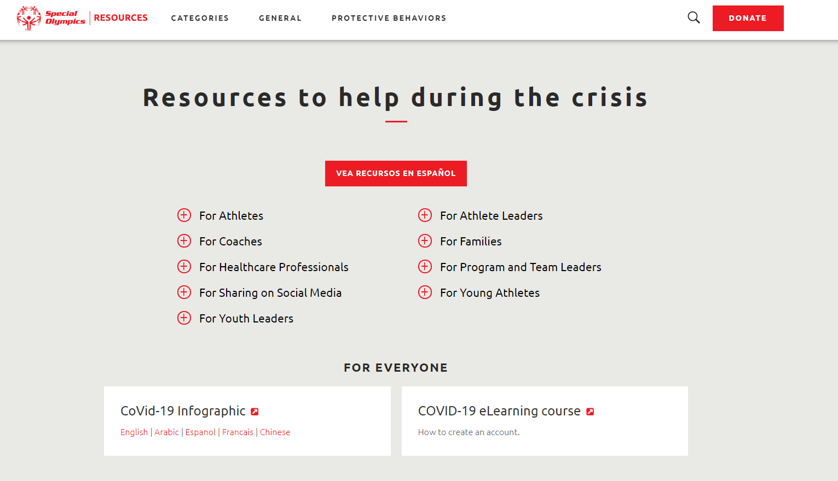
Resources
https://resources.specialolympics.org/resources-to-help-during-the-crisis

Slide 2
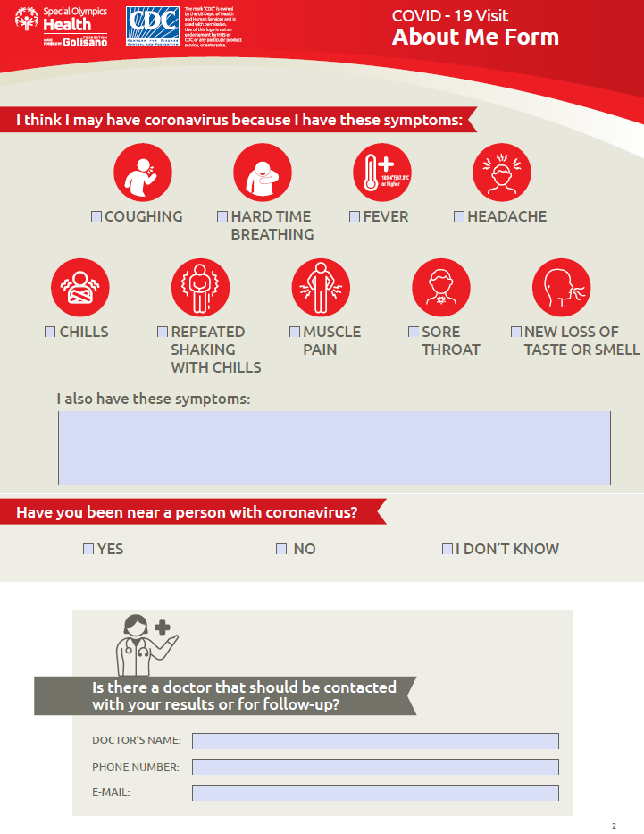

Slide 3
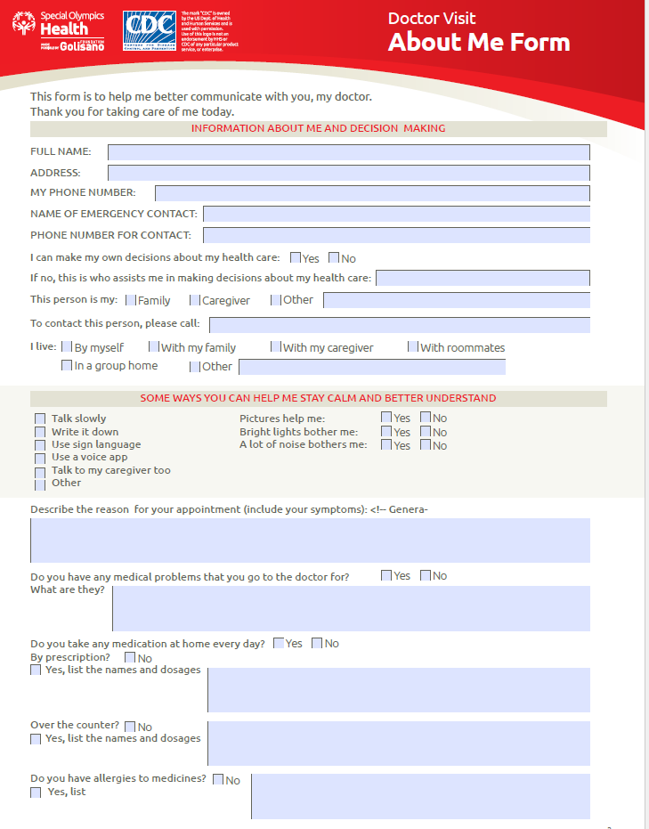
https://media.specialolympics.org/resources/covid-19/SOI-About-Me-Form-2.pdf?_ga=2.107800002.1766868561.1589218235-1140489679.1587742747

Slide 4
Update on the Online Learning Portal
5.12.20
Jamie Valis
Notes:
J/A

Slide 5
Learning Areas
Sport
Health
Protective Behaviors
Unified Champion Schools
Leadership Academy

Slide 6
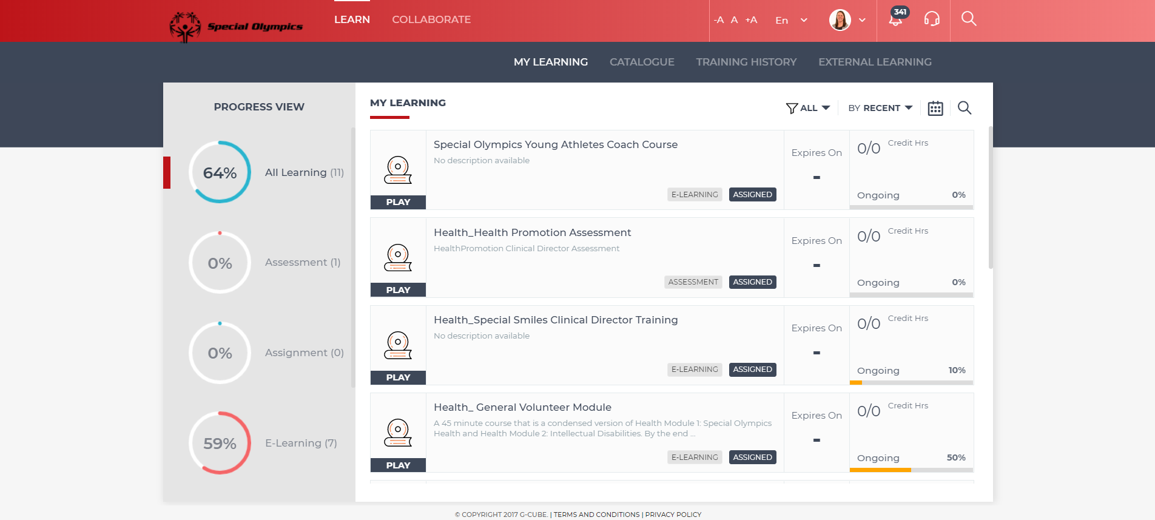
Course Updates

Slide 7
Healthy Athlete Discipline Modules
AVAILABLE NOW!
COMING SOON
IN DEVELOPMENT
Adjustment to blended learning protocols coming soon!

Slide 8
Additional Modules
General Courses
New Releases!
Coronavirus Outbreak: What You Need to Know
Fitness Modules
Inclusive Fitness
Sport Coach
Fitness Coach
Supporting Families in the ID Diagnosis
Special Olympics Health
Intellectual Disabilities
General Volunteer Module

Slide 9
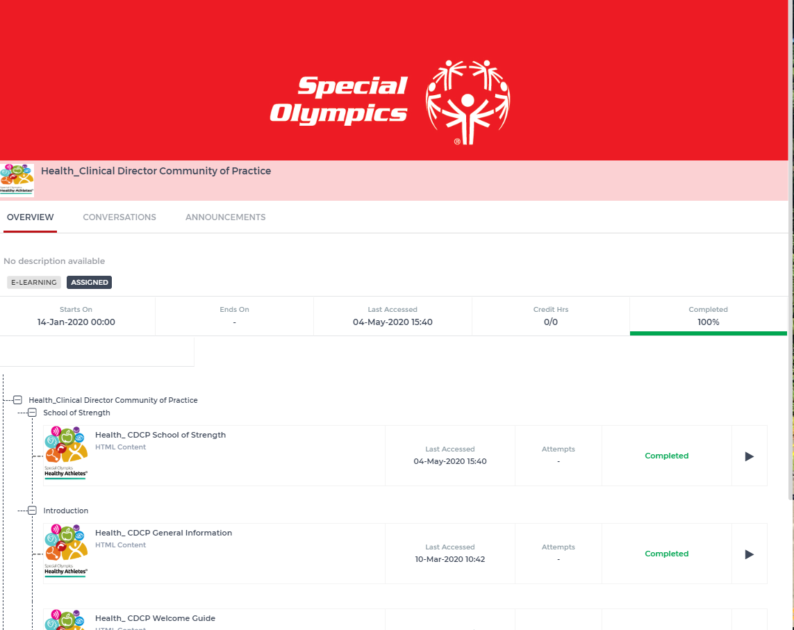
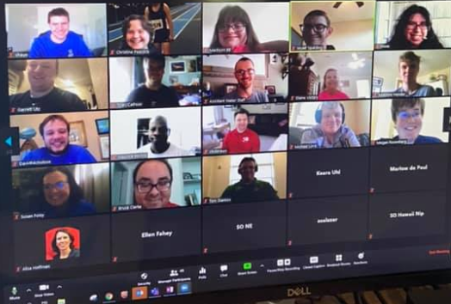
Additional Solutions
Clinical Director Community of Practice
4 week Virtual Health Messenger Training

Slide 10
How to Create an Account?

Slide 11
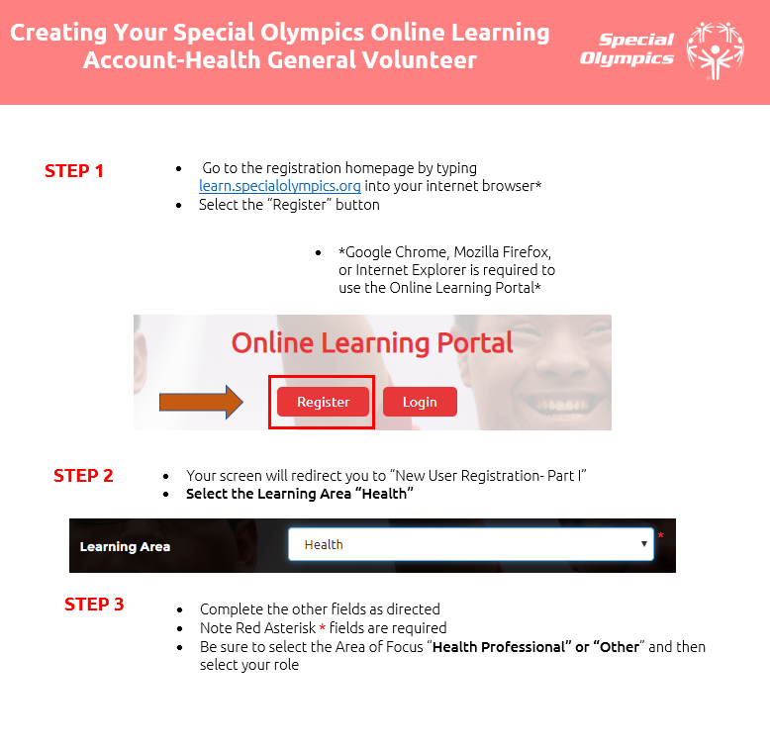
Help Guide
https://www.dropbox.com/s/fz4y4rqh41uarxr/Howto-CreateAnAccount_HEALTH_GeneralVolunteer_%20NEW.docx?dl=0
https://www.specialolympics.org/health-professional-training

Slide 12
Questions? Jamie: jvalis@specialolympics.org learn@specialolympics.org

