Slide 1
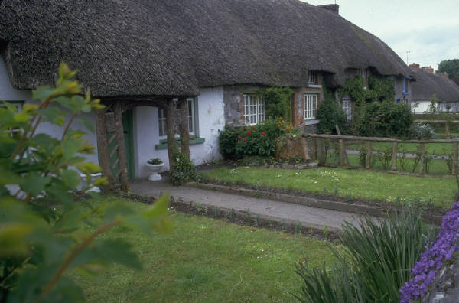
Welcome Back
Notes:
I am pleased to welcome everyone back to this fantastic meeting.
As you can see from the agenda, we have a half hour to talk about community building.
After this session you will be back to your core group until 12:30 when we will all be back together again.

Slide 2
Community Building Activity:
Talk with Your Neighbors
WHO has contacts in your community?
WHAT do you do to engage the community?
WHERE else would you like to reach out?
Notes:
We will begin this morning with a few questions to talk with your “neighbor” about.
Please take five minutes to talk with those sitting near you about these 3 questions.

Slide 3
What did you learn from each other?
About key community contacts
About outreach efforts
About community building
Notes:
It sounded like you had a lot to say in your groups.
Let’s hear a bit about what you learned from each other.

Slide 4

Building Communities:
A Global Strategy
Notes:
Thank you so much for participating in this community building exercise.
Before we move back into our separate tracks today I have some information about our global strategy of Building Communities

Slide 5
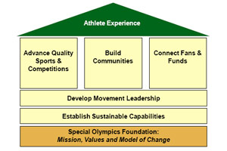
Strategic Plan 2010-2015
Notes:
Some of you may have been involved in the development of the Strategic Plan
This plan centers on the athlete experience and builds on SO mission and vision.
It also identifies 5 pillars for the Movement to focus on.
Family and YA programming are part of the Build Communities pillar

Slide 6

“The transformative power of Special Olympics comes when we build powerful communities of change…”
Notes:
Perhaps you can relate to this….
Just as we found in our exercise, not everyone thinks about community building the same way.
Yet, we know it is important for our athletes to be accepted and all of you are reaching out to tell others about SO

Slide 7
Initiatives
Grow and equip athletes in leadership positions
Activate youth at all levels of our Movement
Improve athlete health and well-being
Engage influential leaders and organizations
Create trained, empowered and involved families
Notes:
Specifically, there are 5 strategic plan areas identified in the Build Communities Pillar

Slide 8
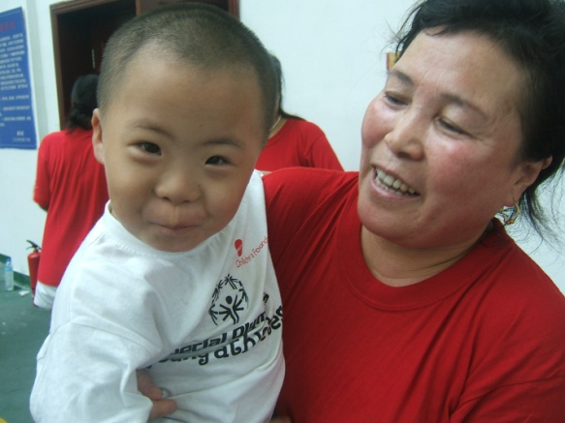
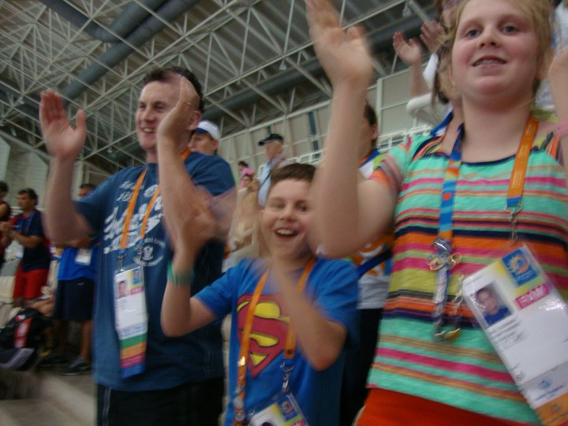
Families as Community Builders
Families are athletes first fans
Sharing stories of success makes an impact
Families can be passionate spokespersons and recruiters for Special Olympics
Notes:
So what do families have to do with community building?

Slide 9
Connections
Parents, siblings, grandparents and other family members have natural connections with neighbors, friends and acquaintances
Relationships with government leaders, advocacy groups, media and local celebrities take more effort to build
Social media connections are growing
Notes:
As you noted earlier, some connections are very natural for many of us
Yet, we know that having other connections takes a commitment to build relationshiops
Now we have online communities to build, as well

Slide 10
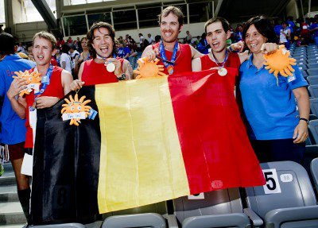
Notes:
The experience families have with Special Olympics truly is special.
You have each seen and heard many transformative stories or will if you are new to the movement.
Policy makers and community leaders also need to hear from families and athletes.
Families need to know how important their stories and voices are to community building.

Slide 11
Empowering Families to Do More
Family leadership training
Resources and support for expansion of the Young Athletes Program
Tools for Programs to engage families in diverse roles
New standards for family engagement
Notes:
There is much more families can do, too.
At the global level, we have a number of priorities to empower families to do more that were developed with Regions.
So my job is to help the Regions help you by developing training, resources, tools and standards.
SOEE is your key contact for direct support in developing your programs.

Slide 12
Notes:
And at the Program level as you think broadly about community building, think about families including athletes and youth
There are so many leadership opportunities that can be offered

Slide 13
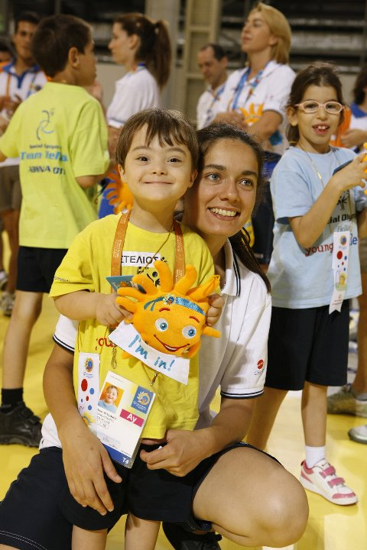
Global Goals
Every Program and every sub-Program will recruit and train a minimum of two family members as community builders.
Every Region will expand the reach of the Young Athletes by 100%.
Notes:
What you do in your Program is most important.
The strategic plan sets goals at all levels and these are the goals for family and young athletes.

Slide 14
Planning for Success Starts Here
Notes:
We know that planning your family and YA programs is key to achieving the global goals for Building Communities.
So I hope that this presentation has given you some perspective and the rest of the day will provide the practical help you need.
Thank you.

Slide 15
Barbara Warman, Director
Family and Young Athlete Programs
Special Olympics International
bwarman@specialolympics.org

