Slide 1


DATE
Special Olympics
INSERT TITLE
SUBTITLE
INSERT
PROGRAM
LOGO
INSERT
COMPANY
LOGO

Slide 4

DIVIDER SLIDE TITLE

Slide 5
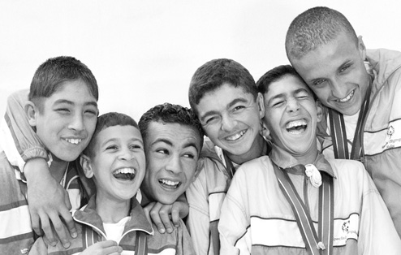
DIVIDER SLIDE TITLE

Slide 6
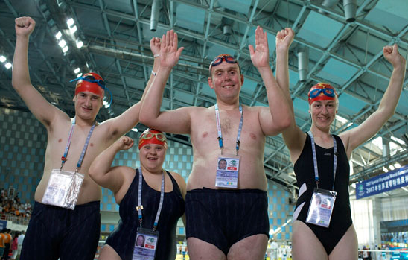
DIVIDER SLIDE TITLE

Slide 7

DIVIDER SLIDE TITLE

Slide 8
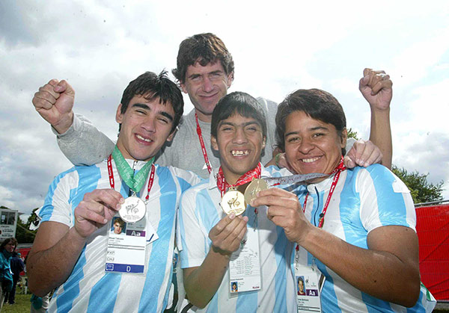
DIVIDER SLIDE TITLE

