Slide 1
A Very Special Christmas 25th Anniversary
November 19, 2012
Notes:
Susie to send info on Arvato
Susie to check with Kai re SO Germany
Susie to send info on Health Promotion project
Susie to make the changes discussed

Slide 2
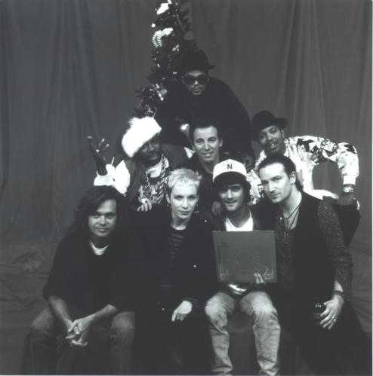
The Beginning
Started in 1987
Visionaries:
Jimmy and Vicky Iovine
Bobby Shriver
Herb Alpert and Jerry Moss (A&M)
Sargent Shriver and Eunice Kennedy Shriver
Unprecedented Support:
Top 15 artists of the time
Donated tracks, donated studio time, donated production fees and distribution
“The heaviest lineup of big-name rock talent since We Are The World” - New York Times, 1987

Slide 3
25 years of music
25 years later – the single most successful benefit recording series in music history!
9 albums, 3 compilations, 2 DVDs
More than 200 artists
$109 million in support for Special Olympics
Aretha Franklin Bruce Springsteen and the E Street Band Bryan Adams Carrie Underwood Colbie Caillat Dave Matthews Enrique Iglesias Eric Clapton Eurythmics Hootie & the Blowfish John Mellencamp Jon Bon Jovi Johnny Lang Jose Feliciano Mary J. Blige Miley Cyrus No Doubt Patti Smith Randy Travis Reba McEntire Run D.M.C. Sheryl Crow Stevie Nicks Stevie Wonder Sting The Pretenders The Pointer Sisters Tom Petty & The Heartbreakers Vanessa Williams Whitney Houston Wyclef Jean…and many more
Stevie Wonder
U2
Madonna

Slide 4
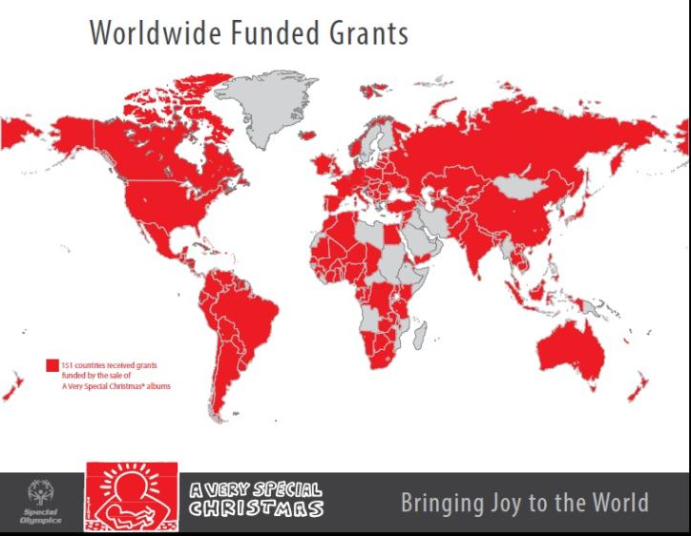
25 years of impact
A Very Special Christmas grants - providing opportunity and hope to people with intellectual disabilities in every corner of the world.
Enabled Special Olympics growth to more than 4 million athletes today
151 countries have benefitted from AVSC funding
Last year alone, $3.17M was distributed to 53 Programs in every region of the world

Slide 5
25th Anniversary Celebration
A Very Special Christmas is bringing joy to the world of Special Olympics through the transformative power of sport

Slide 6
Two new albums

Slide 7
Special Products
Walmart Deluxe Edition
CD plus 68-page magazine
Best Buy Deluxe
CD plus 5 bonus tracks
25th Anniversary Edition
First-Ever International Release
Album 1 plus Joy CD

Slide 8
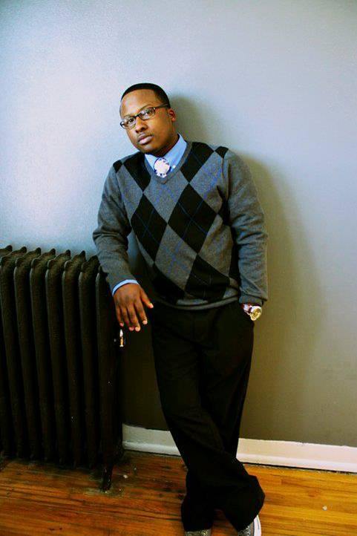
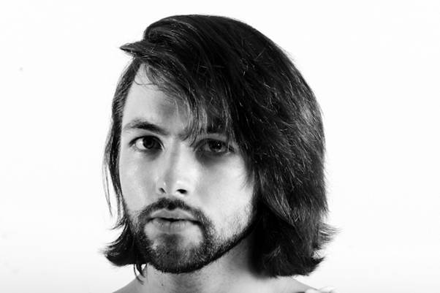
Corporate & Retail Partners
Coca-Cola Holiday Anthem Something in the Air featuring emerging artists Jono, Grayson Sanders and Lauriana Mae

Slide 9
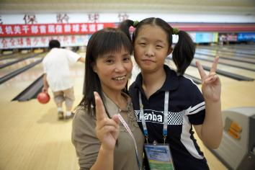
Non-traditional partners
BPAA (Bowling Proprietors Association of America)
Event activation and sales through 4,000+ bowling centers
Reaching 71 million people and 1.8 million league bowlers
Partnership with 85,000 Special Olympics Law Enforcement
Torch Run volunteers
Life Time Fitness
Sales and Event activation as part of Lifetime Fitness Commitment Day
Best Buy Mobile
Album sales and countertop displays in all stores
Disney Mobile Games
Joy to the World single by TRAIN to be the featured song of the week 11/26 on Disney Mobile Games Tap Tap Revenge

Slide 10
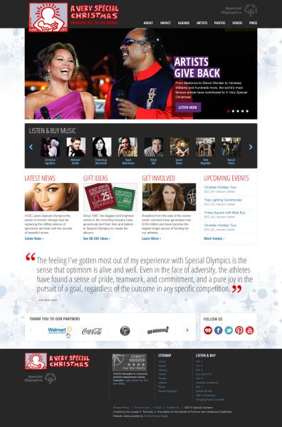
New Website
AVerySpecialChristmas.org
Created by Perfect Sense Digital featuring:
AVSC history and stories of impact
Artist pages and search optimization
Music samples from the entire catalog
Downloads and Press Room
www.averyspecialchristmas.org

Slide 11
Social Media and Ads
Digital and Print PSA Advertisements
New AVSC Facebook page and Twitter handle
@VerySpecialXmas
Dedicated social media partner to push out content and activate artists

Slide 12
Television Special
Television special on gmc tv celebrating the 25 year history of A Very Special Christmas…
Hosted by Vanessa Williams
Featuring new performances by Jordin Sparks, Train and Martina McBride
AVSC story told for the first time by Founders Jimmy Iovine, Vicki Iovine and Bobby Shriver
Special interviews with Stevie Wonder, Darius Rucker, Run DMC and Bono
Airing on December 8, 9, 14 and 17
at 9pm ET/PT
Only on gmc tv

Slide 13
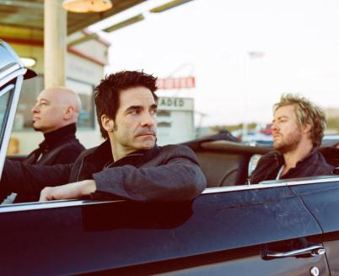
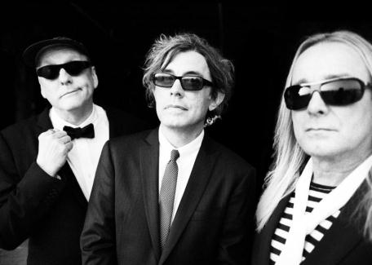
Music videos
Three new music videos set for November release by:
Train
Martina McBride
Cheap Trick

Slide 14
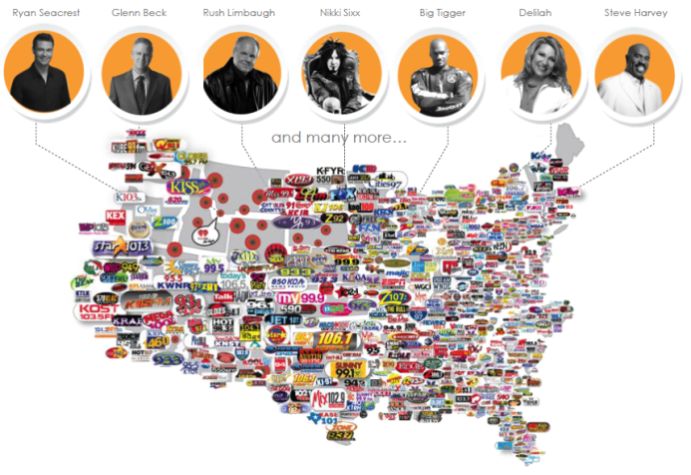
Radio
Radio partnership with ClearChannel Communities launching 11/26
iHeart A Very Special Christmas dedicated channel
Artist PSAs to run on up to 850 ClearChannel partner
stations and websites
Train and Jordin Sparks singles in
full rotation on ClearChannel AC
Radio specials to run on all formats
between Thanksgiving and Christmas
Partnership with Klove
On-air giveaways on country, top 40
and AC stations

Slide 15
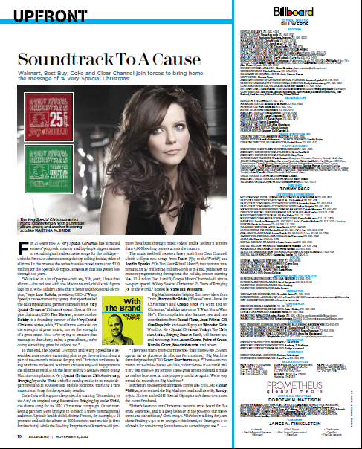
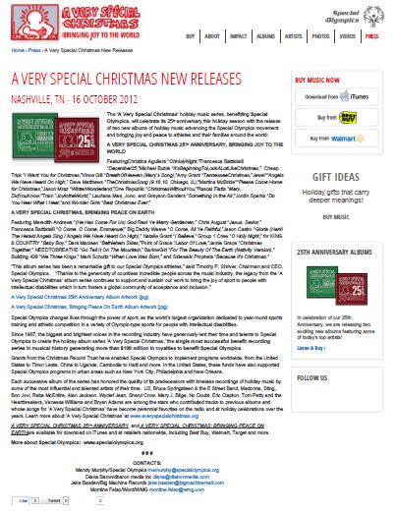
Press
11/3 Billboard Magazine Feature
AVSC and Partner Press Releases

Slide 16
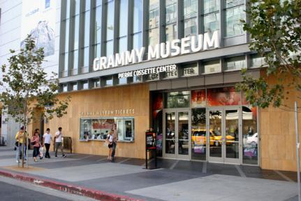
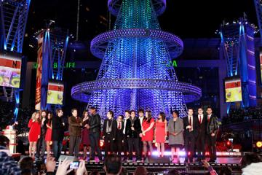
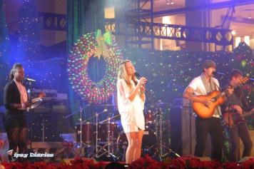
Special Events
Grammy Museum AVSC historical exhibit at LA Live
First-ever outdoor installation
Multi-media feature on first floor
Possible Artist appearance at LA Live
Tree Lighting ceremony

Slide 17
Get in the Spirit of the Season!
Partner | Activation Opportunities
25th Anniversary Albums | Purchase the albums at the “at cost” rate and re-sell them as fundraisers for your local Program Encourage your partners/supporters to purchase the albums as gifts for friends and employees (orders of 30 or more can receive reduced “at cost” rate through SOI) Help promote the release through social media and on your Program website
ClearChannel | Press Release pushed out to Radio Stations and SO Programs in each market Approach local Stations for Athlete/Local Program on-air promotion
BPAA | Partner with LETR for activation and fundraisers at Bowling Centers to benefit your Program
LifeTime Fitness | Approach local LifeTime Fitness clubs for possible tie-in or event with local Program Support Commitment Day Run on January 1, 2013
Retailers | Help be our eyes at local retailers – Best Buy, Best Buy Mobile, Target, Walmart – and let us know if you don’t see the product in store
GMC TV | Help promote the show starting on Monday, 3 December Conduct watch parties and encourage constituents to upload photos of their watch party to SOI facebook page
Giving Tuesday – Nov 27 | Participate in Giving Tuesday radio promotion by having a local Global Messenger appear on/call into radio stations promoting the Albums as a way of giving back

Slide 18
Questions and Suggestions
Download the Toolkit for more resources and information
Questions and Suggestions?

