Slide 1
Technology I
Notes:
1
Before class, load the “sam and brent” picture onto each “desktop” of the laptops.
This is the name of the course. Technology I. That basically means this is an introduction course to using a computer for specific purposes. We’re going to try to teach you what you need to know to get started with e-mail, the Internet and Web sites so you will be better Athlete Leaders.
If you don’t understand anything we say, please be sure to ASK QUESTIONS!!!
LDD

Slide 2
Technology I agenda
Become a better leader:
Why we use technology
E-mail
Web sites
Search engines
Notes:
2
Here’s our plan for the day. For the next few hours, we’re going to talk about what technology is and why it will help you be a better athlete leader. And we’ll introduce you to the tools on the computer that you will use most often: E-mail, Web sites and Search engines.
LDD

Slide 3
Technology I - goals
Improve your use of e-mail
Learn what the Internet is
Hang 10 on the WWW
Find information on SOIN site
Conduct research as a leader
Learn some new technologies
Notes:
3
What are our goals? ADD NEW STUFF
By the end of the class, you should:
Improve your use of email. (Have created and learned to use your own e-mail account)
Learn what the Internet is
Become familiar with “surfing” the World Wide Web
Explore and become familiar with Special Olympics Indiana’s Web site
Conduct research using SEARCH engines to help you with leadership activities
Learn some new technologies that athlete leaders can use
LDD

Slide 4
Technology I
Tools of the ‘trade’
E-mail
Web sites
Search engines
Notes:
4
Your computer is a very powerful tool. You can do lots of things with it – everything from playing music to writing stories to playing games. Today we’re going to talk about the computer as a way to communicate with others, especially with other people about Special Olympics.
The communication tools we’ll talk about are e-mail, the Internet, Web sites and Search engines. Each of those is a different thing and something you’ll use in a different way.
Quite simply, e-mail is electronic mail. It’s like a letter you write on paper with a pen and mail to a friend. But instead of a physical piece of paper, the computer gives you an electronic paper and you send your mail over the Internet.
What is the Internet? The Internet is the largest computer network in the world, which means it’s a bunch of computers around the world all hooked together electronically. Through the Internet, you can get e-mail, all sorts of information, games, online shopping, and more.
Part of the Internet is the World Wide Web, which is a huge collection of documents stored on computers around the world. A Web page is a document on the Web, and a Web site is a collection of Web pages maintained by a college, the government, an individual, or an organization such as Special Olympics.
A search engine is a super-fast private eye. It can look through all the documents on the WWW in a split second and give you answers lightning quick.
SHOW EXAMPLE of Indiana’s Web page. Have any of you seen this before??
LDD, BDD

Slide 5
Technology I
Tell us Your NAME
You’re an Athlete Leader. Why would you use:
E-mail?
Web sites?
Search engines?
Notes:
5
Let’s list some reasons why we’d use e-mail AS AN ATHLETE LEADER. (USE FLIPCHART.)
Why would we look at Web sites?
Why would Indiana have a Web site? Why would your county have one?
Why would we use Search engines?
LDD

Slide 6
Technology I
Communicate with other athletes
Communicate with others in SO
Communicate with our audiences
Make good use of our time
Get information
Social networking
Raise funds
Promote Global Messengers
Get new volunteers
Market your local SO program
Notes:
6
Let’s see – Did we list all these things?
We can communicate with most anyone in Special Olympics with e-mail: volunteers, management team members, other states, other nations. We can communicate with our various audiences: donors, groups who may want us to come speak with them.
We can get lots of information: What are other programs doing for fund raisers? What are the rules for basketball? What did your Athlete Input Council do during its last monthly meeting?
LDD

Slide 7
E-mail
You can exchange e-mail with people around the world!
Special Olympics Indiana state office
Athletes in your county program
County coordinator
Athletes around the state
Groups, such as Kiwanis or schools, about Special Olympics events
Notes:
7
Let’s talk about the different pieces of technology available to us in more detail, beginning with e-mail.
E-mail is a really convenient way for you to communicate with other people in Special Olympics: the state office, athletes in your county, your county coordinator, athletes around the state, and our donors and volunteers
LDD

Slide 8
E-mail
Advantages:
Speed
Cost
Convenience
Can do it anywhere
Record and history of communication
Coolness factor
Notes:
8
Why would we want to use e-mail?
One thing, it’s a lot faster. Have you ever heard of snail mail? That’s where you write or type a letter, put it in an envelope, try to find a stamp, then take it to the post office. Those are a lot of steps to do – a lot of time you have to invest. Plus then you have to wait for people to get the mail. I know sometimes it takes a letter several days to get to another state or a day or two just to get across town – and almost forever to get to Europe or Mexico! But with e-mail, your message can travel around the world in seconds! And just think about the environment – you’re not wasting lots of paper by sending e-mails!
It’s also pretty low-cost, too. Once you pay your service provider (like the cable company or phone company) for a connection to the Internet, there is no charge for sending and receiving e-mail. You don’t even have to pay extra if you send a really long message – or if the message goes all the way around the world! For a lot of people, e-mailing can mean spending less on long-distance telephone calls. The next time you’re about to pick up the telephone, consider sending an e-mail message instead.
E-mail is also really convenient. Do any of you like to stay up late? Sometimes you have something you want someone to know but it’s too late to call. With e-mail, you can send them anytime. And the person you send it to will be able to view it at his or her convenience.
Something else that is really good is that you have a record of what you told someone in an e-mail. If you write a letter or make a phone call, you may not remember if you gave all the information needed. Or if you find out someone else needs the information, you can just get it from an old e-mail and resend it.
And let’s face it, it’s just plain cool to send and get e-mail. LDD

Slide 9
E-mail
E-mail programs:
Microsoft Outlook (and Express)
Yahoo Mail (Brenda G&W, Paul)
AOL
MSN – Hotmail (Paul)
Windows Live Mail
Google mail or Gmail (Mark, Erica)
Notes:
9
An e-mail program lets you send, receive and manage your e-mail messages.
Some popular programs include these on the slide. Can any of you tell us what program you have?
We’re going to talk a lot about Google mail (or Gmail www.gmail.com) and show you some areas of interest.
(SHOW EXAMPLES) just high level; not detailed.
BDD

Slide 10
E-mail
Setting up Google Mail – Gmail
See #1 and #2
www.gmail.com
Click on “Create an account”
Fill in the information
Click on “I accept. Create my account”
Click on “Show me my account”
(CAPTCHA)
Notes:
10
Now we’re going to set you up with your own e-mail account. You already may have an account, but this one will be used for this class. Plus you may find you like it better than the one you have. And if you don’t already have an account, now you will!
In your handout marked “B”, under #1 you’ll see what we think is good about Google mail: You have lots of storage available for storing your messages. It has very good SPAM protection so you will get very little junk mail. It is supported by almost all the common Web browsers so you can read your mail from anywhere. Google search capabilities are built right in. It’s simple, efficient and fun! It automatically groups e-mail and its replies into a conversation, so you can easily follow the back and forth of an e-mail exchange.
Let’s go through the steps to set up your account (These are also listed in handout “B” #2):
Point your Web browser to: www.gmail.com.
Click on “Create an account.”
Fill in your name, your new username, your new password, and security question information.
Click on “Create my account.” You should get a message that your account was created.
Click on “Show me my account.” BDD
Complete Automated Public Turing test to tell Computers and Humans Apart

Slide 11
E-mail
Reading Gmail
See #3
www.gmail.com on Web browser
Sign in with USERNAME and PASSWORD
Read e-mail …
Read your email from Mike
Notes:
11
You can read your Gmail if you have a home computer. Or you can go to the library or anywhere else you can get computer access and read your own Google mail. It’s really easy:
In handout B, #3, you’ll see how to read your mail:
How to read Google e-mail in the future
Point your Web browser to: www.gmail.com.
Sign in to Gmail with your USERNAME and PASSWORD that you created above.
Click on a message header line to read that message.
Click on “Back to Inbox” to return to your inbox messages.
BDD

Slide 12
E-mail
Addressing an e-mail:
Parts of an e-mail address:
alpstechnology@gmail.com
chocolat@purdue.edu
chickswim77@yahoo.com
Check the address!
EXERCISES
Notes:
12
You can send a message to anyone around the world if you know the person’s e-mail address. It’s very much like your home address, where the postman knows your street and the number of your house or apartment. An e-mail address tells the location of your mailbox on the Internet.
An e-mail address consists of two parts separated by the @ symbol. An e-mail address cannot contain spaces.
The first part, such as alpstechnology, is the name of the person’s account. It can be a real name, a nickname; or maybe something else, like Mike & Jennifer use.
The second part of the address after the @ symbol is the domain name, which would be like your street and town on a regular address. It’s the location of your account on the Internet. Periods separate the various parts of the domain name. What would the domain name be in Mike’s address? What do you think his domain name means? The last part of the address is usually something like org, which often is some kind of nonprofit group like Special Olympics; edu, for education; com, which means commercial, or business; gov means government; and so on.
Let’s have everyone address an e-mail to Mike. OK. Helpers and athletes, please check to make sure it is correct. Did everyone get it correct? Did anyone put an “e” on chocolate? Do you know what would happen if you sent it with an “e”? Have you ever heard of a “bounced message”? That’s a message that returns to you because it cannot reach its destination – because the address is incorrect. Again, it’s just like you address an envelope; if you don’t have the right number or the right city, it won’t be delivered. Before sending a message, make sure you check the e-mail address for accuracy.
LDD

Slide 13
E-mail
Creating your contacts:
See #5 then #15 for more future contacts
ALPsTechnology@gmail.com (Mike)
chickswim77@yahoo.com (Jennifer)
“alpscoordinator”@abcmail.com
Your helper
EXERCISES
Notes:
13
It’s very important to keep track of all the e-mail addresses you have and keep them up-to-date. Your e-mail program will have a way for you to keep an address book, or contact list, right in your computer. It’s an excellent place to store information about the people with whom you interact frequently.
Let’s show you how you can add a person’s name and information about that person to your Gmail contacts. And then we’ll do one for me and Wes because you need that to complete your practical exercises. All of you athlete leaders, I’m sure, need to keep in contact with your ALPs coordinator, so let’s fill in information for that person.
Click on “Contacts” (this should show any existing contacts.)
Click on “+%” new contact icon. (this should bring up the fields to fill in with contact information.)
Fill in information. You may “More information” if you want to.
BDD

Slide 14
E-mail
Sending a good message:
See #7
Writing style and tone
Font, color
Subject lines
EXERCISES
Notes:
14
You can send a message to exchange ideas, to request information, to remind someone of a meeting – all sorts of things that you may need to do as an athlete leader.
Here are a few things that will make communicating by e-mail easier for you and whoever receives your e-mail (these are listed in handout B #7):
Make sure every message you send is clear. Make sure that you’re saying what you mean to say.
Try to keep your message as short as possible. You want to get to the point right away so you don’t waste a person’s time.
Make sure your spelling and grammar are correct.
Make sure your message won’t be misinterpreted. For example, the person you send it to may not realize what you write is meant to be sarcastic or a joke – and may not take it that way.
Always use upper and lower case letters when typing messages. A MESSAGE WRITTEN IN CAPITAL LETTERS IS ANNOYING AND HARD TO READ. THIS IS CALLED SHOUTING.
Using black type and an easy to read “font,” or type style makes it easier for whoever receives your message.
Pick out a subject line for the message that will let the reader know what the e-mail is about. You want to make sure the people you are e-mailing open your e-mail messages. So don’t make them guess about what the message is about. I’d recommend putting Special Olympics ALPs in the subject line along with whatever else the e-mail is about. That way the person you’re e-mailing will want to open it right away!
Let’s look at some of these areas in more depth (SHOW EXAMPLE):
This is where you put the address. If you want to copy someone else on a message, here’s where you do that. Maybe you want your county coordinator to know about a meeting and that you’re sending announcements to athletes. If you don’t want someone to know that you’re sending a copy of your e-mail to someone, you can send a “blind copy.” Only the person you send the “blind copy” to realizes that you’ve copied them in on an exchange of information.
This is where you put the subject of your e-mail
This is where you put your message. You can choose your type style here. And your type size here.
Athletes and Helpers: Let’s go to your screen and write an e-mail to the person to your right with a copy to Mike. Fill in the address and subject. Now you can go down and write a short message – you decide what you want to write. Now, change the type size and style to something you think is easy for someone to read. When you’re done, hit “send” and let’s see how many of you get through to Mike.
Let’s look at some of the e-mails and see if we think the type styles and sizes are good.
LDD

Slide 15
E-mail
Receiving a message:
Opening a message See #8
Opening an attachment (Be careful of viruses) See #16
EXAMPLES: Did you open my email w/attachment?
Notes:
15
You do not have to be at your computer to receive a message. Your service provider, like your telephone or cable company, keeps all your messages until you retrieve them.
When you open your e-mail, you will see an “in box,” which is like your mailbox at home. Instead of a bunch of envelopes and ads and magazines, you will see lots of separate lines (SHOW EXAMPLE), called headers. Until you read a message, its header is displayed in bold type. The line will tell you who it’s from, the subject, and when it came to your inbox. To display your mail in a window like this, just double click on the message header. To read the attachment, just click it. You may get a warning to be careful about opening attachments. Even if you don’t get a warning, be VERY careful about opening an attachment. PLEASE: Never open an attachment unless you know it came from a safe place – Special Olympics, a trusted friend, etc.
Some very important things for athlete leaders (these also are listed in handout B #8):
Check your messages regularly! Try to do it once a day if at all possible.
Reply to messages asap. You can reply to a message to answer a question, express an opinion, or supply the person with added information.
Be very careful about opening an attachment. Don’t open an attachment unless you know the sender – check to make sure it’s really the sender you know. Do you know why you need to be careful? Have you heard of a virus? Attachments can be a virus in disguise. You could easily open an attachment that could install a virus on your computer. All sorts of things could happen: There are bad and worse viruses. Bad viruses might just display irritating messages on your screen. The worst kind can destroy your computer. Viruses can spread to other computers through e-mail, so if you get a virus, you can accidentally send it to someone else. If you suspect you have a virus, it’s probably best not to send anyone e-mail until you confirm you’re virus-free. Everyone should have anti-virus software on your computer. Some information on anti-virus software is listed in handout B #16.
BDD

Slide 16
E-mail
Replying to a message:
Replying to a message
Forward a message
Attach a file to a message
EXERCISES
Reply to my class list “How’s class?”
Forward class list to Jenny
Attach your picture; send to Mike
Notes:
16
To reply to a message, click the Reply button (SHOW EXAMPLE). To send the response to the sender of the message and to all recipients of the message, click the Reply to All button. When you hit reply, the To and Subject edit boxes are already filled in. Also, the original message appears below the blinking insertion point. When you reply to a message, make sure you include part of the original message. This is called “quoting.” Quoting helps the reader identify which message you are replying to. To save the reader time, make sure you delete all parts of the original message that do not directly relate to your reply.
If you receive a message that you think might be of interest to someone else, like another member of your Input Council, you can easily forward the message. With the message still displayed, click the Forward button on the toolbar and it will display a message window like this. This time only the Subject edit box is filled in. Let’s try to forward a message: Type Mike’s e-mail into the To box and click the Send button.
You can also send files by e-mail, such as a Word document or picture. You should open your Inbox and click the New Mail Message button and type Mike’s address in the To box. In the Subject box, put Special Olympics Picture. Next, in the message area, type “Here is a picture from ALPs training for you.” Then click the Attach button. You’ll need to go to your “desktop” and find the “sam and brent” picture and click that to attach. Then hit “send.”
BDD

Slide 17
E-mail
E-mail storage:
Deleting/archiving messages
Organizing messages
Using folders/labels
See #4
EXAMPLES
Create folder/label called “ALPs”
Notes:
17
To delete a message, simply select it and click on the “delete” box. It will be moved to your trash barrel. Most of your e-mail should probably be archived so you can refer to it later. After you are done reading a message, select it and click on the “archive” box. It will be removed from your “INBOX” and be in your “All Mail” box.
After you have received lots of mail, you may find that you want to store your e-mail by project – such as Input Council, Coaching, Global Messenger, etc. To do that, you can create labels like these so you can categorize them and keep them organized. In G-mail, here’s how you would create a new label. Instructions are in handout B #4.
BDD

Slide 18
E-mail
Other E-mail tips:
Keyboard shortcuts: See #6
SPAM: See #9
Important addresses: See #15
EXAMPLES
Notes:
18
After using Gmail for awhile, you will want to save time by using some shortcuts. #6 shows you how to turn on keyboard shortcuts. <shift> + ?
One last word about e-mail. It’s really great to get an e-mail from a friend or from Special Olympics – it’s like getting a little treasure when you sit down at your computer. But after having an e-mail account for a while, you may start getting some downright irritating – and maybe even offensive – e-mail. It’s called junk mail or spam. It’s unsolicited e-mail – e-mail that you didn’t ask for. Spam is sent to multiple addresses at one time, usually by people who want to sell something or want something from you. Included in your handout B #9 are what we collected as our Top Ten list for spam and how to keep it from cluttering your inbox.
Also other Important addresses: See “Handbook for Athlete Leadership” that your have in your packet for the ALPs Management Team contact information. You may want to put them in your address book.
BDD

Slide 19
Break time
Notes:
19
Any questions??

Slide 20
World Wide Web
Learn the lingo:
Web site
Home page and links
Surf
Online
BE SAFE!
Notes:
20
Here’s what we’ll be doing for the rest of our class – talking about the Web. So let’s talk about some of the words we’ll be using.
A Web site is an area on the Web, like we saw with Special Olympics Indiana, that contains a collection of electronic documents, called Web pages. Just like a library is full of books, the Web is packed with Web sites. About any company or organization or person can have a Web site. As athlete leaders, you’ll probably spend a lot of your time looking at sites related to Special Olympics or organizations affiliated with Special Olympics.
The home page is the introductory page of a Web site (SHOW EXAMPLE of SOIN). When you type in the address of a site, the first page you go to is the home page. It’s similar to a table of contents but maybe has pictures and other graphics. It will tempt your interest with bits of information and give you links to the actual page that holds the information you want. (SHOW EXAMPLE OF CLICKING ON LINK.)
Moving from site to site or page to page is called surfing the Web. And to go surfing, you have to be connected to the Internet, which is called online. When you view a document on the Internet, that document is online.
IMPORTANT NOTE: As you search various Web sites, you must recognize something very important. I’ll call it PLAY IT SAFE! Web sites are constantly changing and evolving. A site you visited last month may no longer look the same or even exist. Since no one controls who is qualified to write a Web page, the content of the Internet is also uncensored. So please use common sense and an ounce of caution when looking at the sites. Just because it’s on a site, doesn’t make it true. And just because someone says who he or she is doesn’t always mean that person is telling the truth. LDD

Slide 21
World Wide Web
Addresses (URLs):
http://www.
soindiana
.org
EXERCISES See #10
Notes:
21
LDD: To surf the World Wide Web, you need to type in an address for each Web site you want to visit. Much like your e-mail address, a Web address is like a street address. Every page on the Web has a unique address called a URL, or Uniform Resource Locator.
The URL for the main page usually has three parts. You’ll see http://www. On most of your Internet explorer programs, you won’t even need to type this in. On some, you’ll need the www. part.
The second part of the address is the “domain name” – often the name of the organization that owns or maintains the site, such as SOIN.
The suffix shows what type of group owns the site and sometimes the country where the Web site is located, in this case an organization (www.specialolympics.ca).
BDD: Let’s try looking at some other Web pages. In your handout in Part #10 is a list of some Special Olympics sites that you may find useful. Let’s try to go to SOI. Now let’s do the Tippecanoe County. It was Jennifer who decided we needed a Web page and helped her mother put it together!
What if you type in a URL and it doesn’t take you where you want to go? First, make sure you have no typing errors or that no blank spaces sneaked in. Make sure your punctuation and numbers are in the right places. Be careful to exactly match the URL you are typing from. And beware of the period that follows a URL at the end of a sentence. That should not be typed as part of the address.
And expect some surprises! Sometimes when you start typing a URL, a completed URL – or a list of URLs – will pop up out of nowhere. That’s the browser’s AutoComplete feature. The browser has been keeping track of Web pages you’ve surfed recently. When you start typing, the browser checks your typing against its list of recently visited sites and tries to finish that URL for you. If it’s the one you want, just click on it. If not, just keep typing until another one pops up or you finish typing the URL you need, then hit “enter.”

Slide 22
World Wide Web
Speedier surfing:
Home page See #12
Favorite’s list See #13
Links (look for the HAND)
Button bar
EXERCISES
Notes:
22
Want to speed up your surfing? Your handout has some other ways besides the pop-ups we just discussed to make your surfing faster and easier. Look in part #12.One of these important ones is having a home page – the page that appears each time you start your Web browser. By selecting a Web page that you go to often as your home page, you can make your access to the Web and the sites you like much easier. Let’s practice doing this.
Go to the page you want as your new home page (you can choose one you know or one from the handout).
Click on “Tools” in the Menu bar, and then click on “Internet Options.”
Click on the “General” tab. In the “Home Page” section, click on the “Use Current” button.
Click on “OK.”
The favorite’s list can really speed up your Web navigation. (SHOW EXAMPLE)
Following links from one page to another also quickens your searching. A hyperlink – or link for short – is a connection from one Web page to another. When you see a link on a Web page, you can click on it with your mouse. Your browser reads the invisible URL hidden in the link and zooms you to that Web page.
Let’s go to mymms.com. Sometimes the link is underlined text or sometimes it’s colored text. Sometimes it’s even a picture or icon. So how do you tell when you’re looking at a link. Slide your cursor over the item slowly. If the item is a link, the cursor changes to a hand with a pointing finger.
You can also use buttons for shortcuts. Remember the browser’s Button bar? You can use the “Back” button to return to the Web page you just came from. You don’t have to remember a URL or even type it in. Your browser keeps track of where you’ve been and keeps copies of those pages. The “Forward” button returns you from wherever the “Back” button took you. The “Stop” button cancels the loading of a Web page, but it cannot unload the images that have already appeared on the screen. The “Refresh” button is a great one, especially if you like to look at pages that get changed often, such as a newspaper. You can keep that site open and then come back to it a few hours later and hit the “Refresh” key, and it will update it with all the new information. The “Home” button always takes you to your starting page, whatever you’ve selected as your home page. BDD

Slide 23
World Wide Web
Some good Web sites:
SOIN – let’s take a tour
Special Olympics sites See #10
Sites for athlete leaders See #11
EXERCISES
Notes:
23
One of the Web sites you’ll probably use often is Special Olympics Indiana. Let’s all go to that site, and go on a tour.
On handout B #10 are some other Web sites from other Special Olympics programs, including Special Olympics Inc. That’s a great page for athlete leaders to check periodically to find out what’s going (SHOW PAGE) on in Special Olympics around the world. It’s a good place to maybe discover some ideas that we may want to do in Indiana. Another interesting site is Special Olympics Canada (SHOW PAGE). Some of the other Special Olympics sites listed are those for the states where trainers have come from – Indiana, which is our home state; Wisconsin – some of you have met Jeanie Horvath at ALPs University in April; North Carolina, where Sherry Paul lives; and Virginia, where David Thomason is on the staff.
Besides those, we’ve just listed some sites as examples of what athlete leaders may be looking at, such as the healthy food issue. Perhaps when you were discussing this at Congress, you could have gone to some of these sites to get some information. Or Global Messengers sometimes would like to include a joke or two in their presentation – you can find those on the Web, too. Or maybe you’d like to join a Toastmaster’s group to hone your speaking skills. You can find that on the Web, too. You need sports equipment for your teams? – buy it on the Internet. You need hotel rooms at a cheap rate for your group? – get it on the Net.
That list is just a beginning. What you can do, though, is expand that list considerably.
BDD

Slide 24
Search Engines
Drivers, start your engines!
Google.com OR Bing.com
Searching for people or businesses (Switchboard.com)
See #11
Notes:
24
Then let’s start our engines! I’m a huge racing fan, so I try to get this expression in about every presentation I make. Just like a race car driver has an engine in his or her car, you have an engine – or two or three or more – in your computer. It’s called a search engine.
Think of a search engine as super-fast private eyes. You tell them what you’re looking for, and they work quickly to find it – often, in just seconds. As athlete leaders, you may need to find a variety of different information – maybe it’s a list of service organizations in your county for Global Messengers to speak with, rules of bocce ball, what the weather is going to be like for State Games in Terre Haute in June, suggestions for stretching exercises for different sports – the list could go on and on. Maybe it’s something as simple as the spelling of a word. These are the types of things that search engines do – find the answers to your questions or point you in the right direction.
A recent rating of search engines in PC Magazine finds that google.com is the best or second best in every search category. We’ve listed it in handout B #11 along with several others. You may want to try some of the others also and do your own comparison.
If you’re specifically looking for a person or telephone number or a specific kind of business in a town, one of the best search directories is Switchboard.com. You just type in the name, city, and state or as much as you know and it will find matches. You can also search by business category, such as sporting goods or restaurants. (SHOW Switchboard.com and search for chocolate places in Chicago.) LDD

Slide 25
Search Engines
Successful searching:
See #14
Be specific
Refine your search
Put phrases in quotations
Include several keywords
Play the field
Get help
Notes:
25
There are several tricks listed in handout B #14 that help you get better results when searching for information on the Internet.
Be specific. If you’re looking for tulips, don’t type “flowers” – type “tulips.” Being as specific as possible will help the search engine produce more focused results. Remember – even though Mike may tell you differently – computers aren’t human. They don’t know what you mean unless you tell them exactly.
Refine your search by using some symbols to narrow your search’s focus. Most search engines recognize math symbols like “+” and “-.” These let you add or subtract terms from your search. If you want to find out about Toby Maguire and his Spiderman role, type “Maguire + Spiderman.” If you’d type just Spiderman, you’d get all sorts of things, but adding Maguire will tell you about the person who plays Spiderman. In the same way, if you want information about saints, but not the New Orleans Saints, type saints –”New Orleans”. (notice, there’s no space between the hyphen and the quote.)
Put phrases in quotations if you’re looking for something very specific. Again, if you want to know about the latest Spiderman movie, don’t just type Spiderman movie, put “Spiderman 3” in quotations.
Try to narrow the focus as much as possible by using several words. Say you’re looking for information about ALPs. Don’t type just athlete leadership, or you may come up with something about college or pro athletes. Type in Special Olympics Athlete Leadership to make it more specific.
Don’t feel married to google or aol or whatever as your search engine. Each works differently, so the same keyword will not always produce the exact same results from one to the next. Explore and see which ones work best for you.
Get help from your search engine. Most feature a section called “Helpful Hints” or “Help” or “Advanced Search.” They’ll give you pointers about how to use that particular search engine. You’ll save a lot of time if you learn the basics of each search engine you try. LDD

Slide 26
Search Engines
Let me show you a sample!
What other movies and TV shows has the person who starred in “The Loretta Claiborne” movie been in?
Are you sure you know how to use google See #11 (30.)
Notes:
26
Since there is a little art to using Google, let me show you a sample.
#11 30. www.makeuseof.com/tag/are-you-sure-you-know-how-to-use-google
What questions do any of you have??
BDD

Slide 27
Search Engines
Let’s practice!
How many athletes attended the 2005 Special Olympics Global Athlete Congress in Panama?
Who is one of the 2007-09 Special Olympics International Global Messengers?
Who is president of Special Olympics Indiana and what is his e-mail address?
When is the basketball season in Southern California Special Olympics?
Notes:
27
We’ve given you Web sites; we’ve talked about search engines. Now let’s try and find some information on the Web.
Use a search engine or go to Web sites to answer one of these questions. Raise your hand when you have the information:
How many athletes attended the 2005 Special Olympics Global Athlete Congress in Panama (67 or 78)?
Who is one of the 2007-09 Special Olympics International Global Messengers?
Who is president of Special Olympics Indiana and what is his e-mail address?
When is the basketball season in Southern California Special Olympics (summer)?
What questions do any of you have??
LDD

Slide 28
End of day one
Notes:
28
Any question??

Slide 29
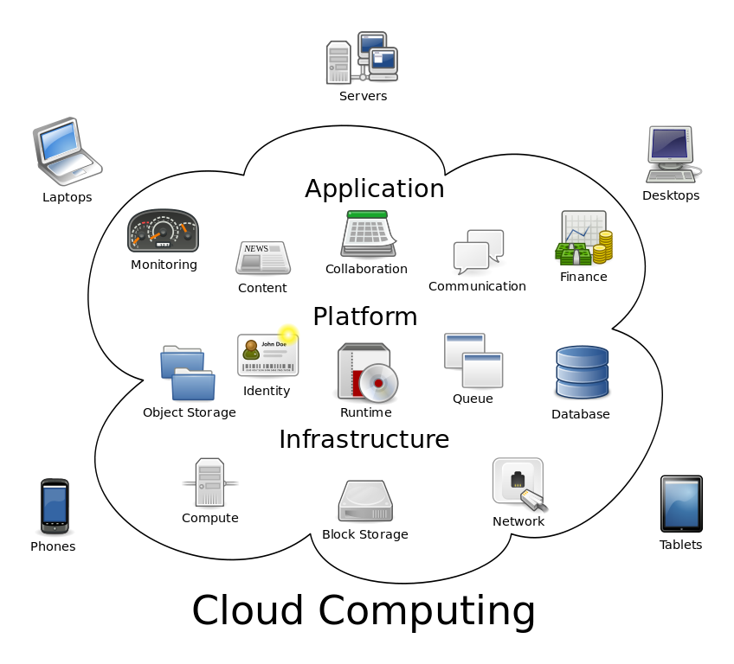
New technologies
Cloud computing
Notes:
29
Cloud computing is the use of computing resources (hardware and software) that are delivered as a service over a network (typically the Internet). The name comes from the use of a cloud-shaped symbol as an abstraction for the complex infrastructure it contains in system diagrams. Cloud computing entrusts remote services with a user's data, software and computation.
End users access cloud-based applications through a web browser or a light-weight desktop or mobile app while the business software and user's data are stored on servers at a remote location. Proponents claim that cloud computing allows companies to avoid upfront infrastructure costs, and focus on projects that differentiate their businesses instead of infrastructure.^{[1]} Proponents also claim that cloud computing allows enterprises to get their applications up and running faster, with improved manageability and less maintenance, and enables IT to more rapidly adjust resources to meet fluctuating and unpredictable business demand.

Slide 30
New technologies
Cloud computing examples:
Email
Facebook
Twitter
Websites
Smartphone apps
Notes:
30

Slide 31
Writing Articles
and
Taking Pictures
For
SOIN, Facebook or newspapers.
Notes:
Now we are going to talk about…
First who has a Facebook account?

Slide 32
Writing “Notes” or having a Page is a way of showing others what you like about Special Olympics or anything Consult the PIG (Program Info. Guide) page 45 before starting a Page
Notes:
https://www.facebook.com/notes/jennifer-mary-hoover/31-questions-to-get-to-know-each-other/10151152453563419
Creating a Facebook Page for your County would be a good way to share your ideas.
https://www.facebook.com/SOIN.Tippe
https://www.facebook.com/groups/ALPsofTippecanoe/

Slide 33
You can get to everything from your “About” page.

Slide 34
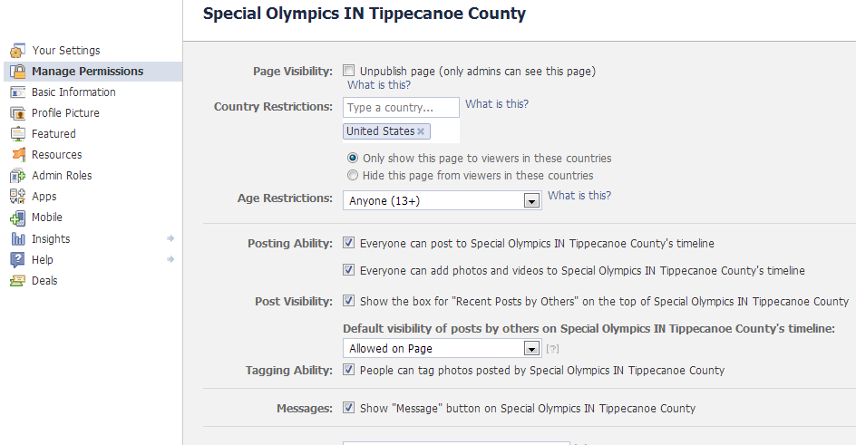
Notes:
If you set up a Page for your County you can do all kids of stuff by going to the Edit page. But you need at least two as administrators . I have four just in case they want to make changes too.

Slide 35
Photo’s
You as the Page Administrator you can add photo’s or videos
Just as you would on your page
Notes:
https://www.facebook.com/SOIN.Tippe/photos_stream

Slide 36
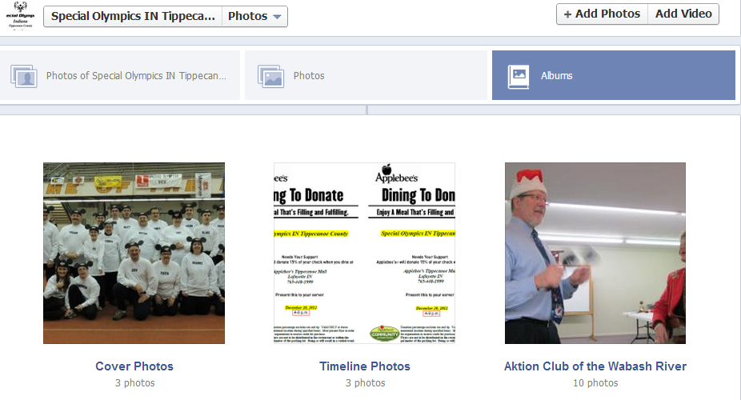

Slide 37
Blogging is great for sharing and telling the world about you and Special Olympics specialolympics-about.blogspot.com (made by Jennifer Hoover) soindianatippecanoe.wordpress.com (creating process by Peggy Hoover)
Notes:
http://jenlifeswim.blogspot.com/
blogger.com
http://soindianatippecanoe.wordpress.com/
http://www.bing.com/search?setmkt=en-US&q=blog

Slide 38
Bing Search Engine Sign up for FREE stuff
Go to bing.com
Click “Sign In”
Use Facebook or Microsoft to sign in
You can earn something like a $15 ProFlowers eGift Card by getting 400 points just by searching.
Notes:
Who uses Facebook or Microsoft- Hotmail
http://www.bing.com/rewards/dashboard
http://www.bing.com/rewards/tours
Keep bing up to start earning points.

Slide 39
Break time
Notes:
39
Any questions??

Slide 40
Too much email but still need it. Go to otherinbox.com/organizer and find out how. It work’s with…
See #21
Notes:
With Otherinbox I know all my important emails goes into the folder I need to check like my OIB -Finance-, or OIB -MOM- folder.

Slide 41
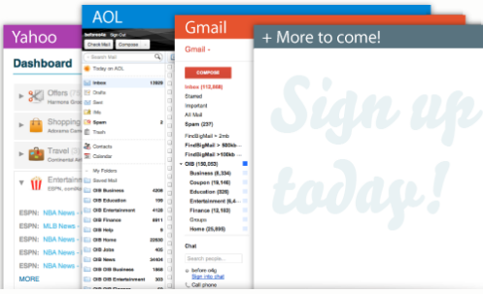

Slide 42
It will do the rest for you Just make new folders and put the senders email there Put OIB -Jennifer- and the folder will show on top. Put OIB Jennifer and will be in ABC order.
Notes:
http://www.otherinbox.com/support/welcome-to-organizer/
Yahoo need to have the OIB before the folder name.
If you have AOL or iCloud you will find that out for yourself.

Slide 43
Password Managers
One master password
One click login to most websites
Synchronize across browsers
Synchronize across devices
Automatic form filling
Secure your data
Store secure notes
See #19
Notes:
43
Here are some of the advantages of using a password manager. We will discuss a couple products.

Slide 44
Search “Password Safe” with Bing
Allows you to store all passwords in a single "safe" (password database)
All you need to remember is the master password (the master password, however, is not kept in the database in any form)
Download latest version now or later
Passwords are like P16<XK0OP: & created for you
Notes:
Who has there own computer today?
Who would like not to remember all there passwords?
Using Password Safe is safer and your email won’t get hacked into again.
http://passwordsafe.sourceforge.net/quickstart.shtml

Slide 45
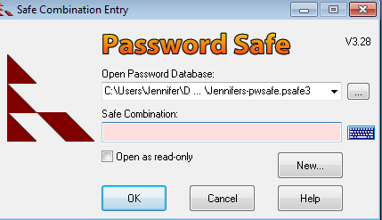
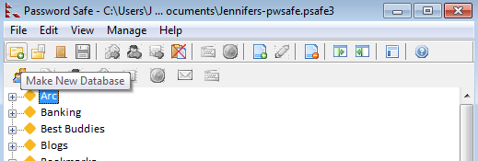
Notes:
Click on Make new database. You will need to name the file to save to your computer.

Slide 46
This is good for only “Chrome” browser
Go to passwordbox.com
Click Download
Create account with a password you will remember
When you log into your account it will remember and can log you in automatically
Notes:
https://chrome.google.com/webstore/detail/passwordboxcom/dljbcjbfojhlfhgenhepllagfecdpchb

Slide 47
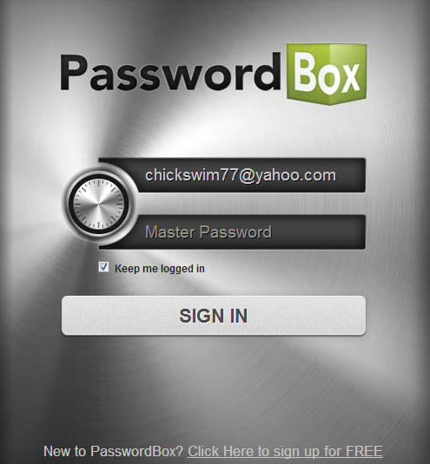

Slide 48
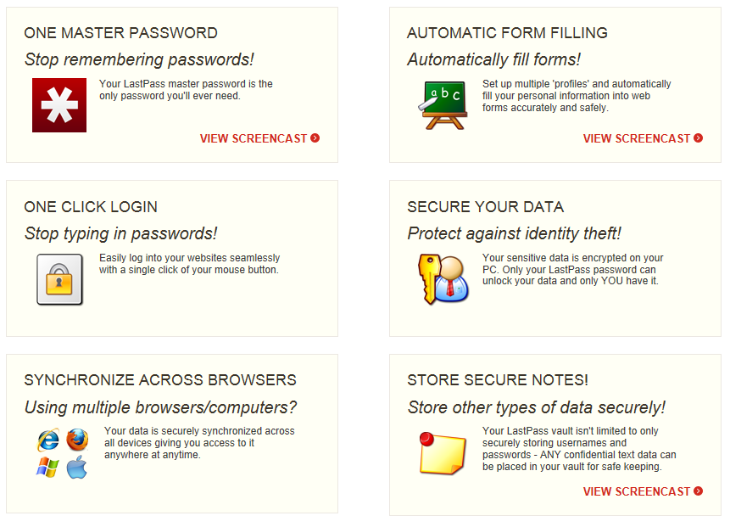
LastPass
Notes:
48

Slide 49
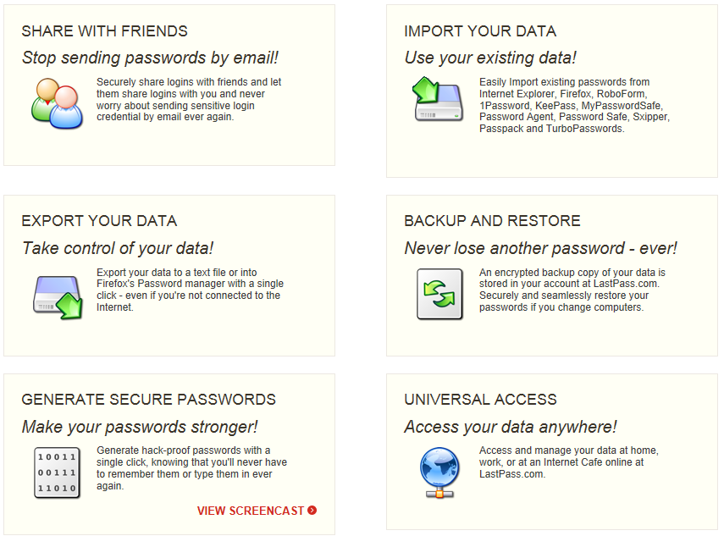
LastPass Premium $12/year
Notes:
49

Slide 50
Only an alternative to Microsoft Office
If you like simple older versions of Microsoft Office you can use this
Go to http://www.libreoffice.org/
Look around the site or just click download
You have to keep it up to date yourself
Notes:
But remember not many use this.
If you send a Libra Office document by email they won’t be able to open it in less they have it too.

Slide 51
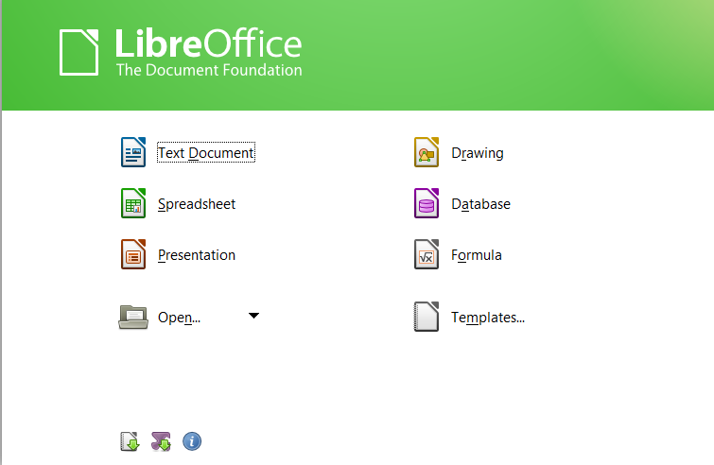

Slide 52
DropBox
Software/app to link all your computers together via a single folder.
Dropbox desktop application
Dropbox Website
Dropbox mobile website/app
www.dropbox.com/help
Notes:
52
The Dropbox Desktop Application is software that watches a folder on your desktop computer and syncs any changes to the web and to your other computers.
The Dropbox Website allows you to access your files on any computer from a web browser. You can also use the Dropbox website to share your files or folders with others.
The Dropbox mobile website and Dropbox for mobile devices allow you to connect to your Dropbox from your pocket, so you can take your files with you wherever you go.

Slide 53
DropBox Demo
Mike
Wes
Jennifer will send you a request to join
See more info See #20
Notes:
53
Talk about how we use DropBox.
Talk about getting free space.
In Handout B #20 are 3 references to more information when you get home.

Slide 54
If you have any questions Email: chickswim77@gmail.com facebook.com/jennifer.m.hoover jennifer.m.hoover@facebook.com Cell: (765) 714-3248

Slide 55
Technology I
How would you use technology?
Your Input Council wants to publicize a meeting
You are a Global Messenger and you want to give a speech to local civic groups to ask them to volunteer
Your county is having a fund-raiser
Remember: E-mail, Web pages and Google are your friends!
Notes:
55
We’ve learned about e-mail and many Web pages, especially the Special Olympics Indiana site. Now let’s brainstorm some on how you might use technology with some of the situations you have as an athlete leader.
Let’s hear your ideas on the first one: Your Input council wants to publicize a meeting. How can you use technology to help solve this problem? (IDEAS on FLIPCHART)
How about the second situation?
Let’s look at how you think technology can help you with fund-raising.
LDD

Slide 56
Handbook for Athlete Leadership
Practicum requirements
Goals
Notes:
Review the “Handbook for Athlete Leadership” and specific material regarding this course.
Review the course handout and practicum requirements.
I’d like to hear at least one thing you will do when you back home as a result of what you learned in this course.
I’ll give you a few minutes to write something down.
Get someone to record these.

Slide 57
Show me the ATHLETE!
Notes:
57
Make a sign like this for all your meetings.

Slide 58
End of day TWO
Notes:
58
Any question??

Slide 59
Technology I MORE
Improve your use of e-mail
Learn what the Internet is
Hang 10 on the WWW
Find information on SOIN site
Conduct research as a leader
Learn some new technologies
Notes:
59

Slide 60
E-mail
Getting friendly with your computer:
Important keys
Using the mouse
www.gmail.com
Notes:
60
Let’s go over some of the important keys on your computer. For some of you this may be a review, but others may be using a keyboard for the first time:
www.gmail.com then “Create a new account” for a sample to fill in.
Cursor (NOT really a key) Tab
Positioning keys – arrows Enter
Delete Backspace
@ Shift
Spacebar Caps Lock
Period
Now let’s try using the mouse:
Left button Right button
Double click Drag
Scroll wheel
BDD

Slide 61
Internet
Internet (international network) includes:
E-mail
News groups
World Wide Web
Notes:
61
Picture a huge road map! A really, really big map – like of the whole world! That will give you an idea of how the Internet – or international network – works. It all started in the 1960s when government organizations and universities created a network of computers that could communicate with each other. In the 1990s, it finally became available to the public.
What we know as the Internet is actually a huge web of large computer servers connected to smaller computers with cables, phone lines, satellites, and other devices. If you could see them on a map, it would look like a system of roads – or maybe Spiderman’s outfit.
Parts of the Internet most of us have heard about are e-mail, or maybe news groups, and the World Wide Web. We’ve already talked about e-mail. The other part of the Internet most athlete leaders will use is the World Wide Web.
When you go to a Web page by typing its address, your computer sends a request over your telephone or cable line. Your request travels through a maze of computers until it arrives at the one page you asked for. That computer then sends you the page back through the maze and into your computer. The page pops up full of life on your screen. You’d think this process would take days or weeks, but the beauty of the Internet is that you can see the site you asked for almost instantly.
LDD

Slide 62
World Wide Web
A tour of an Internet browser:
Title bar – www.soindiana.org
Button bar
Menu bar
Scroll bar
Address bar
Document area
Status bar
Notes:
62
The Title bar shows the title of the Web site you’re viewing and the browser name. The Minimize, Maximize, and Close buttons are located on the right side. Let’s try opening our browser and going to the Web site indicated. Now let’s make it smaller and then larger.
(SHOW ON OTHER SCREEEN) The Button bar or Navigation bar is a row of buttons that speeds up frequently used navigating or browsing commands, such as Back, Forward, and Stop.
The Menu bar displays menus of commands and options for browsing and navigating. Let’s move your cursor over each of these to look at what’s there.
The Address bar displays the address of the Web page you’re viewing. This is also the place to enter the address of any page you want to see.
The Scroll bar helps you move up or down if a Web page doesn’t fit in one screen. If the page is wide, you can also scroll from side to side. Try it!
Document area is where the Web pages show up.
The Status bar shows how much of the page is loaded . There also may be security messages that show up here.
BDD

Slide 63
World Wide Web
Web browsers:
Provided by your ISP
Internet Explorer
Netscape
Mozilla/Firefox
MSN Explorer
www.pcmag.com/article2/0,2817,2365692,00.asp
Notes:
63
Depending on what Internet Service Provider (or ISP) you have, logging on to your computer may start up what is called an Web browser automatically. Or you may have to log on and then click a browser icon separately (SHOW EXAMPLE). You may have a browser provided by your ISP, such as AOL Explorer. Or it may be part of your Microsoft Windows package that is on your computer. Internet Explorer is part of the Microsoft Windows package. Some of you may have browsers such as Netscape or Mozilla/Firefox.
LDD

Slide 64
Search Engines
Practice makes perfect!
From www.specialolympics.org, find Special Olympics Indiana
How would you purchase a medium white/navy baseball shirt from SOFL?
What event is held March 28, 2009 in Indiana?
How do you get to the Indiana state office?
Someone wants to volunteer. Where can you find the forms to give them?
Notes:
64
You all were great at that. Now let’s see how we can find the information we need to answer questions about Special Olympics Indiana:
Let’s go to Special Olympics Inc. and then find Indiana Special Olympics. [Find a location] When you saw that list of SO programs, did you realize you would see so many?
How would you purchase a medium white/navy baseball shirt from SOFL? [Off of www.SOFL.org, go to “Shop” then click on color and size, proceed to check out then view order. Make sure that you click “clear item” at the end or you may be ordering a shirt!]
What event is held March 28, 2009? [Events calendar –Men’s basketball tournament]
How do you get directions to the SOIN state office? [Contact us; download a map]
Where can you find the forms to fill out if you want to volunteer or need to give [click on Volunteer; then “individual volunteer interest form” to complete online]
LDD

Slide 65
Search Engines
Practice makes even more perfect!
Where can you learn about Global Messengers?
Who are the sponsors for SOIN?
When does SOIN hold training and competitions for bocce?
Notes:
65
Let’s try a few more:
Where can you learn about Global Messengers? [Google Special Olympics global messenger]
Who are the sponsors for SOIN [click on “Partner & Donor; current partners”]
How can you find out what months bocce holds training and competitions? [Sports; Bocce]
LDD

